Slide 1
FLP Impossibility
& Weakest Failure Detector
Consensus Protocols in Theory
Philip Daian - 10/25
slides influenced by Birman FA12 slides
Notes:
why we need it; replicating state to tolerate failure, show transitiions

Slide 2
Consensus!
Courtesy of
https://rethinkdb.com

Slide 3
Consensus Example
Clients
Storage
Leader

Slide 4
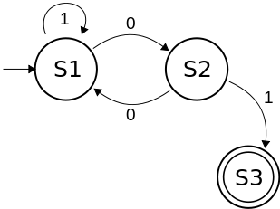
Consensus Example
100101 - S3
Clients
100101 - S3
Storage
100101 - S3
Replicated Leader
100101 - S3

Slide 5
Consensus Summary
Important problem! We’ve already talked quite a bit about forms of consensus
State machine replication -> consensus on state of machine
Leader election in leadered protocols -> consensus on leader
Paxos, CORFU -> essentially consensus protocols
Byzantine Generals -> consensus in malicious actor setting
Applications: “clock synchronization, PageRank, opinion formation, power smart grids, state estimation, control of UAVs, load balancing and so on” (Wiki)
Conditions: Termination, Validity, Integrity, Agreement
Conditions vary depending on problem model / definitions
Focus on consensus on a simple bit for simplicity; such protocols can extend

Slide 6
Impossibility of Distributed Consensus with One Faulty Process
1985
2001 Dijkstra prize; best paper in distributed systems
distributed systems,
e-voting,
oblivious transfer
distributed algorithms and impossibility results, formal modeling
algorithms, complexity,
theory

Slide 7
FLP : Primary Result
asynchronous deterministic distributed consensus impossible with even 1 crash failure
asynchronous deterministic guaranteed

Slide 8
Follow along!
http://the-paper-trail.org/blog/a-brief-tour-of-flp-impossibility/

Slide 9
Communication Model
message buffer
processes

Slide 10
send(p, m)
(p, m)
message buffer
processes

Slide 11
(p, m)
p
receive(p)
message buffer
∅
∅
processes

Slide 12
(p, m)
m
p
receive(p)
message buffer
reliable
processes

Slide 13
Step - Part 1 : event
(p, m)
m
p
receive(p)
message buffer
reliable
processes

Slide 14
Step - Part 2
# send(p, m)
p
finite # send(p, m)
message buffer
reliable
processes

Slide 15
Configuration
...
p
message buffer
reliable
processes

Slide 16
Schedule - σ
v1
p0
v2
p1
Event
(receipt of m by p)
Event
(receipt of m by p)
Event
(receipt of m by p)
v3
p2
v4
p3

Slide 17
Run
run
v1
p0
v2
p1
Event
(receipt of m by p)
Event
(receipt of m by p)
Event
(receipt of m by p)
v3
p2
v4
p3

Slide 18
0-Valent Configuration
Schedule - σ1
All
Processes
Decide
0
v1
p0
v2
Schedule - σ2
p1
v3
p2
Schedule - σ3
v4
p3

Slide 19
Initial configuration
Schedule - σ1
All
Processes
Decide
0
v1
p0
v2
Schedule - σ2
p1
v3
p2
Schedule - σ3
v4
p3

Slide 20
1-Valent Configuration
Schedule - σ1
All
Processes
Decide
1
v1
p0
v2
Schedule - σ2
p1
v3
p2
Schedule - σ3
v4
p3

Slide 21
Bivalent Configuration (Read: Undecided)
Schedule - σ1
Decide 0
v1
p0
Schedule - σ2
Decide 1
v2
p1
Schedule - σ3
Decide 0
v3
p2
v4
Schedule - σ4
p3

Slide 22
Now, we prove:
Any protocol in our model must have an infinitely long run (that never terminates)

Slide 23
Proof Outline
Start from the initial guaranteed bivalent configuration (Lemma 2)
Since the configuration is bivalent, there must be another bivalent configuration reachable from the configuration by applying e last (Lemma 3)
Since the configuration is bivalent… (Lemma 3)
Bivalent Initial Configuration
Lemma 2
Bivalent Configuration
Bivalent Configuration
Event
(Lemma 3)
Event
(Lemma 3)
Infinitely
Notes:
Say this up front, take us back to this after each step
Add bivalent / univalent slide by itself

Slide 24
Lemma 1; Housekeeping
Schedules are commutative

Slide 25
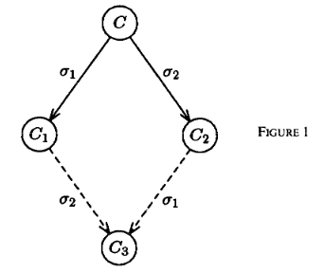
Proof! (Lemma 1) [from the paper]

Slide 26
Lemma 2
There is an initial bivalent configuration
(see: bivalent; read: undetermined / undecided)

Slide 27
Initial Configurations - neighbors
0-valent
1-valent
v1
v1’
p0
v2
v2
p1
v3
v3
p2
Notes:
Show all possible values of 3 processes
Karnaugh map?

Slide 28
Initial Configurations
0-valent
1-valent
v1
v1’
p0
v2
v2
p1
v3
v3
p2
Notes:
Show all possible values of 3 processes
Karnaugh map?

Slide 29
Initial Configurations
0-valent
1-valent
v1
v1’
p0
v2
v2
p1
v3
v3
p2
Notes:
Show all possible values of 3 processes
Karnaugh map?

Slide 30
Initial Configurations
0-valent
1-valent
v1
v1’
p0
v2
v2
p1
v3
v3
p2
bivalent OR both 0 OR both 1
Notes:
Show all possible values of 3 processes
Karnaugh map?

Slide 31
3 Processes - All Possible Inputs
0
1
1
0
0
1
1
0
p0
0
0
1
1
1
1
0
0
p1
0
0
0
0
1
1
1
1
p2

Slide 32
3 Processes - Neighbors differ by 1 Process Input
0
1
1
0
0
1
1
0
p0
0
0
1
1
1
1
0
0
p1
0
0
0
0
1
1
1
1
p2

Slide 33
We want to prove
There is an initial bivalent configuration
assume the opposite -
All initial configurations univalent
(see: bivalent; read: undetermined / undecided)

Slide 34
3 Processes - A Univalent-Only Scheme
1
0
1
0 1 0 1 0
0
1
1
0
0
1
1
0
p0
0
0
1
1
1
1
0
0
p1
0
0
0
0
1
1
1
1
p2

Slide 35
3 Processes - Another Univalent-Only Scheme
0
0
0
0 1 1 1 1
0
1
1
0
0
1
1
0
p0
0
0
1
1
1
1
0
0
p1
0
0
0
0
1
1
1
1
p2

Slide 36
So
Univalent only schemes don’t work
Must have initial bivalent configuration!

Slide 37
Reminder
Start from the initial guaranteed bivalent configuration (Lemma 2)
Since the configuration is bivalent, there must be another bivalent configuration reachable from the configuration by applying e last (Lemma 3)
Since the configuration is bivalent… (Lemma 3)
Bivalent Initial Configuration
Lemma 2
Bivalent Configuration
Bivalent Configuration
Event
(Lemma 3)
Event
(Lemma 3)
Infinitely
Notes:
Say this up front, take us back to this after each step
Add bivalent / univalent slide by itself

Slide 38
Lemma 3
If C is a bivalent configuration, and e is an event applicable to C, there is a
bivalent configuration reachable by applying e last
(this is the big one)

Slide 39
Lemma 3
2 Ingredients:
An event, e (fix any event)
D - all configurations right after e
Any
Configuration
New
Configuration
D
Receive e

Slide 40
Lemma 3
We will show:
D has a bivalent configuration
(through series of contradictions)

Slide 41
Lemma 3 - Contradiction 1
D has only 1-valent configurations
(E0 has seen e)
Initial C
Bivalent
E0
0 Valent
Receive e

Slide 42
Lemma 3 - Contradiction 1
D has only 1-valent configurations
(E0 has seen e)
Initial C
Bivalent
F0
1 Valent?
E0
0 Valent
Just received e
Other events
D

Slide 43
Lemma 3 - Contradiction 1
D has only 1-valent configurations
(E0 has seen e)
Initial C
Bivalent
F0
1 Valent?
E0
0 Valent
Just received e
Other events
D

Slide 44
Lemma 3 - Contradiction 1
D has only 1-valent configurations
(E0 has not seen e)
Initial C
Bivalent
E0
0 Valent
Events (no e)

Slide 45
Lemma 3 - Contradiction 1
D has only 1-valent configurations
(E0 has not seen e)
Initial C
Bivalent
E0
0 Valent
F0
1 Valent?
Events (no e)
e
D

Slide 46
Lemma 3 - Contradiction 1
D has only 1-valent configurations
(E0 has not seen e)
Initial C
Bivalent
E0
0 Valent
F0
1 Valent?
Events (no e)
e
D

Slide 47
Summary
Disproven:
D has only 1-valent configurations
D has only 0-valent configurations (same)
2 Possibilities:
D has only 1, 0 valent configurations (no bivalent) [next]
D has bivalent configurations

Slide 48
Lemma 3 - Contradiction 1
D has only 1, 0-valent configurations
D0
0 Valent
D
Initial C
Bivalent
Events (just got e)
D1
1 Valent
Events (just got e)

Slide 49
Lemma 3 - Contradiction 1
D has only 1, 0-valent configurations
(e’ and e have different destinations)
D0
0 Valent
D
Initial C
Bivalent
Events (just got e)
C0
1 Valent
D1
1 Valent
(just got e’)
(just became 1-valent)
(just got e)

Slide 50
Lemma 3 - Contradiction 1
D has only 1, 0-valent configurations
(e’ and e have different destinations)
D0
0 Valent
D
Initial C
Bivalent
Events (just got e)
e’
C0
1 Valent
D1
1 Valent
(just got e’)
(just became 1-valent)
(just got e)

Slide 51
Lemma 3 - Contradiction 1
D has only 1, 0-valent configurations
(e’ and e have different destinations)
D0
0 Valent
D
Initial C
Bivalent
Events (just got e)
e’
C0
1 Valent
D1
1 Valent
(just got e’)
(just became 1-valent)
(just got e)

Slide 52
Lemma 3 - Contradiction 1
D has only 1, 0-valent configurations
(e’ and e have same destination, p)
D
D0
0 Valent
Initial C
Bivalent
Events (just got e)
C0
1 Valent
D1
1 Valent
(just got e’)
(just became 1-valent)
(just got e)

Slide 53
Lemma 3 - Contradiction 1
D has only 1, 0-valent configurations
(e’ and e have same destination, p)
D
D0
0 Valent
E0
0 Valent
R - p “crashes”
Initial C
Bivalent
Events (just got e)
C0
1 Valent
D1
1 Valent
E1
1 Valent
(just got e’)
(just became 1-valent)
(just got e)
R - p “crashes”

Slide 54
Lemma 3 - Contradiction 1
D has only 1, 0-valent configurations
(e’ and e have same destination, p)
D
A
D0
0 Valent
E0
0 Valent
R - p “crashes”
R - p “crashes”
Initial C
Bivalent
Events (just got e)
C0
1 Valent
D1
1 Valent
E1
1 Valent
(just got e’)
(just became 1-valent)
(just got e)
R - p “crashes”

Slide 55
Lemma 3 - Contradiction 1
D has only 1, 0-valent configurations
(e’ and e have same destination, p)
D
Receive e
A
D0
0 Valent
E0
0 Valent
R - p “crashes”
R - p “crashes”
Receive e’, e
Initial C
Bivalent
Events (just got e)
C0
1 Valent
D1
1 Valent
E1
1 Valent
(just got e’)
(just became 1-valent)
(just got e)
R - p “crashes”

Slide 56
Lemma 3 - Contradiction 1
D has only 1, 0-valent configurations
(e’ and e have same destination, p)
D
Receive e
A
univalent
D0
0 Valent
E0
0 Valent
R - p “crashes”
Deciding R - p “crashes”
Receive e’, e
Initial C
Bivalent
Events (just got e)
C0
1 Valent
D1
1 Valent
E1
1 Valent
(just got e’)
(just became 1-valent)
(just got e)
R - p “crashes”

Slide 57
Summary
Disproven:
D has only 1-valent configurations
D has only 0-valent configurations (same)
D has only 1, 0 valent configurations (no bivalent)
1 Possibility:
D has bivalent configurations

Slide 58
The whole proof!
Start from the initial guaranteed bivalent configuration (Lemma 2)
Since the configuration is bivalent, there must be a bivalent configuration (in D) reachable from the configuration by applying e last (Lemma 3)
Since the configuration is bivalent… (Lemma 3)
Bivalent Initial Configuration
Lemma 2
Bivalent Configuration
Bivalent Configuration
Event
(Lemma 3)
Event
(Lemma 3)
Infinitely
Notes:
Say this up front, take us back to this after each step
Add bivalent / univalent slide by itself

Slide 59
Beyond FLP
Work has continued far beyond the FLP result:
Relaxing async model ; failure detectors
New models ; partially synchronous, sleepy, etc
Coming up next!
Reducing other problems to consensus
SMR, leader election, atomic broadcast, shared log, …
New forms of consensus in permissionless models!
Bitcoin, blockchains, ByzCoin, etc.

Slide 60
Consensus with Probability 1
I like 1! Cardinality 1
I like 1! Cardinality 1
I like 1! Cardinality 1
I like 0! Cardinality 1
I like 0! Cardinality 1
I like 1! Cardinality 1

Slide 61
Consensus with Probability 1
I like 0! Cardinality 3
I like 0! Cardinality 3
I like 1! Cardinality 1
I like 0! Cardinality 3
I like 0! Cardinality 3
I like 1! Cardinality 1

Slide 62
Consensus with Probability 1
I like 0! Cardinality 4
I like 0! Cardinality 4
I like 1! Cardinality 1
I like 0! Cardinality 4
I like 0! Cardinality 4
I like 1! Cardinality 1

Slide 63
Consensus with Probability 1
I like 0! Cardinality 5
I like 0! Cardinality 5
I like 0! Cardinality 5
I like 0! Cardinality 5
I like 0! Cardinality 5
I like 0! Cardinality 5

Slide 64
Consensus with Probability 1
I like 0! Cardinality 6
I like 0! Cardinality 6
I like 0! Cardinality 6
I like 0! Cardinality 6
I like 0! Cardinality 6
I like 0! Cardinality 6

Slide 65
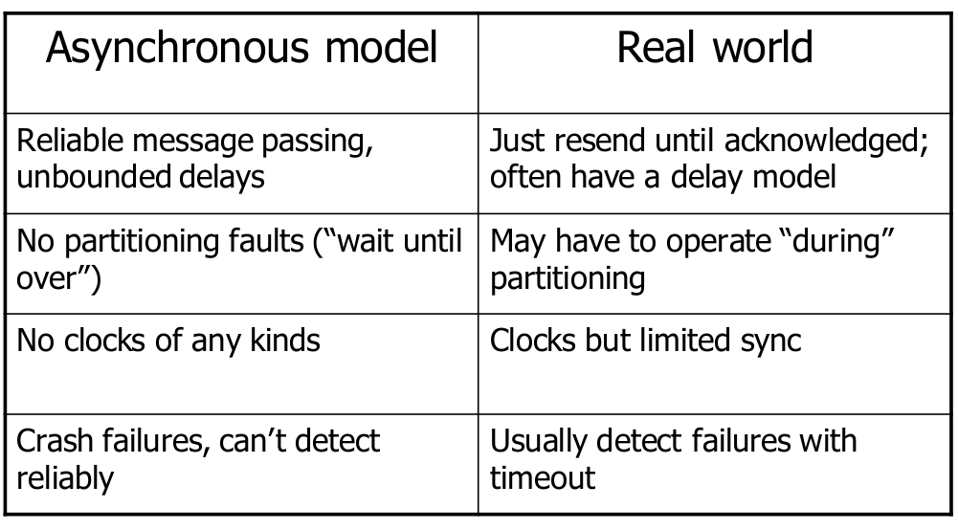
Wrap Up Discussion; FLP
Test your understanding: what is the difference between a univalent and bivalent state?
But what does “impossibility” mean in FLP?
How can we make sure our models are accurate for the desired setting?
What are the implications for protocols handling Byzantine faults?
Which one of these assumptions is easiest to relax in a datacenter?

Slide 66
Failure Detectors!
Motivation: OK, we know FLP impossibility asynchronously.
Can we create minimal weakening of model,
Achieve (asynchronous* deterministic) consensus?
YES: Failure Detectors

Slide 67
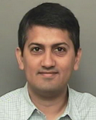
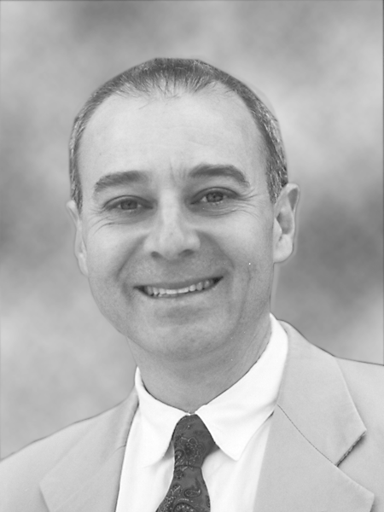
The Weakest Failure Detector for Solving Consensus
1996
Formalizes “failure detection service”; used by consensus as black box
Explores types, guarantees, constructions, proofs of failure detectors
Distributed and parallel computing, machine intelligence
Fault tolerance, synchronization, databases, theory
Reliable distributed computing, security, theory applications

Slide 68
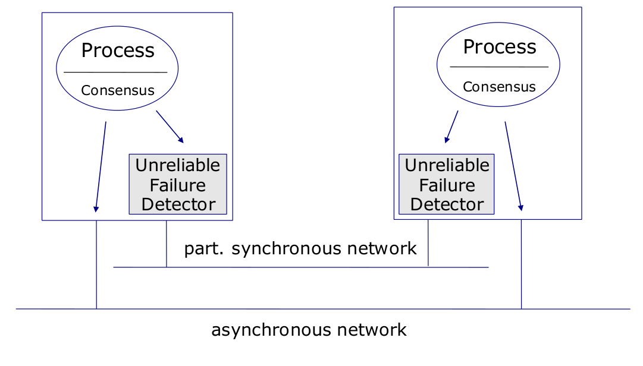
Motivation
Diagram from Ken Birman’s slides, ‘12FA

Slide 69
Background, Model, Assumptions
Same as last time!
Notes:
Partially synchronous distributed system
Discuss; implications of partial synchrony vs. asynchrony
Finite set of processes
Crash failure model
Message-based communication
Fully connected, reliable channels
Want to achieve failure detection

Slide 70
Failure Detection Guarantees
Want to achieve two properties:
Completeness: failed processes eventually suspected by correct processes
Accuracy: correct processes are never suspected by other correct processes
Can you think of a failure detector that is complete but not accurate and vice versa?
Incomplete or unreliable failure detectors provide some but not perfect satisfaction of above
Self test: How to implement perfect FD in synchronous model? Asynchronous model? What about the weakest imaginable FD?

Slide 71
Failure Detection Guarantee Variations
Strong completeness: Eventually every process that crashes permanently suspected by every
correct process
Weak completeness: Eventually every process that crashes permanently suspected by some
correct process
Strong accuracy: Correct processes never suspected
Weak accuracy: Some correct process never suspected
Eventual strong accuracy: There is a time after which strong accuracy holds
Eventual weak accuracy: There is a time after which weak accuracy holds
Accuracy
Completeness | Strong | Weak | Eventual Strong | Eventual Weak
Strong | Perfect (P) | Strong (S) | Eventually Perfect (♢P) | Eventually Strong (♢S)
Weak | Quasi-Perfect (Q) | Weak (W) | Eventually Quasi-Perfect (♢Q) | Eventually Weak (♢W)
Diagram adapted from Ken Birman’s slides, ‘12FA
Notes:
redraw

Slide 72
♢W for consensus!
coordinator
Propose
value
processes
Token - circulate around ring

Slide 73
♢W for consensus!
coordinator
Propose
value
processes - proposal
Token - circulated around ring
No change in failure detector

Slide 74
♢W for consensus!
coordinator
Decide
value
processes - proposal
Token - circulated around ring
Received by coordinator
No change in failure detector

Slide 75
♢W for consensus!
Decide
value
processes - proposal
Token - circulated around ring
Received by all processes
No change in failure detector

Slide 76
Real systems and failure detectors
Most common form of failure detection in real-systems timeout based; can you name a few?
Usually stronger than weakest failure detector
No violation of FLP; FLP applies to full system, incl. detectors
Real systems achieve consensus with high probability
FLP “doesn’t matter” (can be worked around) in practice

Slide 77
Wrap Up Discussion; Open Problems in Consensus
For crash fault tolerance, “trusted” setting
We have Paxos! We have RAFT! Can we get a simpler protocol?
Fail-stop model; we can achieve failure detection
In practice, is this a workable solution?
Byzantine faults!
PBFT protocol; so much easier than Paxos (look it up!)
“trustless” setting; lots of work to be done
What are the unique challenges?
Are there model relaxations possible other than computational bounding?
How to identify nodes?
Canetti et. al 2005 impossibility result

Slide 78
Takeaway!
Consensus is hard!
Subtleties in model of consensus strongly influence results
Make sure to choose model accurately matching reality
Minor differences in model -> major differences in results
The consensus ship is not yet sunk, much work to be done
Consensus is everywhere in distributed systems

