Slide 1
Distributed Consensus
Paxos
Ethan Cecchetti
October 18, 2016
CS6410
Some structure taken from Robert Burgess’s 2009 slides on this topic

Slide 2
State Machine Replication (SMR)
Server 1
Server 2
View a server as a state machine.
To replicate the server:
Replicate the initial state
Replicate each transition
S₀
S₀
S₀
a
Client
S₁
S₁
b
S₂
S₂

Slide 3
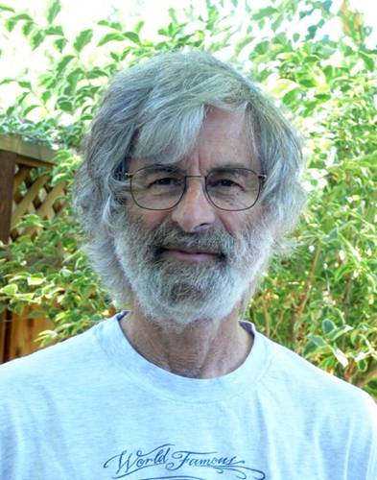
Paxos: Fault-Tolerant SMR
Devised by Leslie Lamport, originally in 1989
Written as “The Part-Time Parliament”
Abstract: Recent archaeological discoveries on the island of Paxos reveal that the parliament functioned despite the peripatetic propensity of its part-time legislators. The legislators maintained consistent copies of the parliamentary record, despite their frequent forays from the chamber and the forgetfulness of their messengers. The Paxon parliament’s protocol provides a new way of implementing the state-machine approach to the design of distributed systems.
Rejected as unimportant and too confusing

Slide 4
Paxos: The Lost Manuscript
Finally published in 1998 after it was put into use
Published as a “lost manuscript” with notes from Keith Marzullo
“This submission was recently discovered behind a filing cabinet in the TOCS editorial office. Despite its age, the editor-in-chief felt that it was worth publishing. Because the author is currently doing field work in the Greek isles and cannot be reached, I was asked to prepare it for publication.”
“Paxos Made Simple” simplified the explanation…a bit too much
Abstract: The Paxos algorithm, when presented in plain English, is very simple.

Slide 5
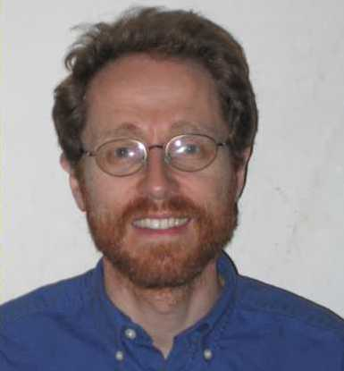
Paxos Made Moderately Complex
Robbert van Renesse and Deniz Altinbuken (Cornell University) ACM Computing Surveys, 2015
“The Part-Time Parliament” was too confusing
“Paxos Made Simple” was overly simplified
Better to make it moderately complex! Much easier to understand

Slide 6
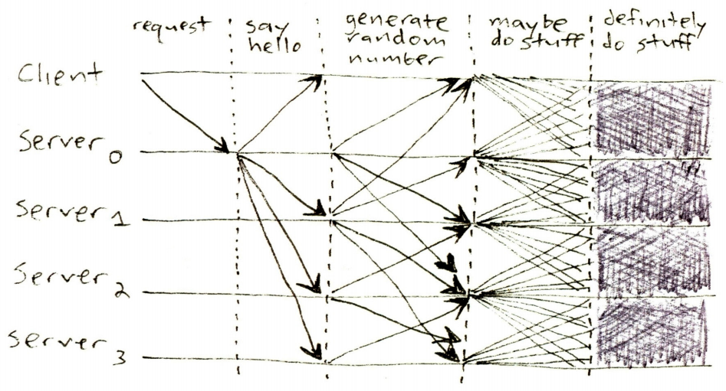
Paxos Structure
Figure from James Mickens. ;login: logout. The Saddest Moment. May 2013

Slide 7
Paxos Structure
Proposers
Acceptors
Learners

Slide 8
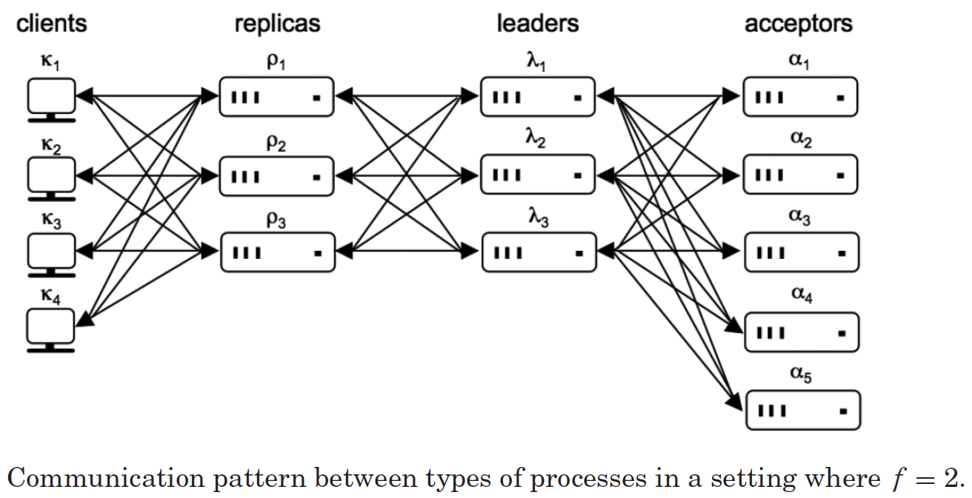
Moderate Complexity: Notation
Function as proposers and learners without persistent storage
Store data and propose to proposers
Figure from van Renesse and Altinbuken 2015

Slide 9
Single-Decree Synod
Proposer
b = 0
Acceptor_{i}
b' = 0
Decides on one command
System is divided into proposers and acceptors
The protocol executes in phases:
b = b + 1
Send (p1a,b)
if (b' < b)
b' = b
Send (p1b,b',c_{i})
Proposer proposes a ballot b
if (b' > b)
b = b'
abort
if majority
c = b-max(c_{i})
Send (p2a,b,c)
Acceptor_{i} responds with (b', c_{i})
If b' > b, update b and abort Else wait for majority of acceptors Request received c_{i} with highest ballot number
if (b' == b)
accept (b',c)
Send (p2b,b',c)
If b' has not changed, accept
A learner learns c if it receives the same (p2b, b',c) from a majority of acceptors

Slide 10
Optimizations: Distinguished Learner
Proposers
Acceptors
Distinguished Learner
Other Learners

Slide 11
Optimizations: Distinguished Proposer
Other Proposers
Distinguished Proposer
Acceptors
Learners

Slide 12
What can go wrong?
A bunch of preemption
If two proposers keep preempting each other, no decision will be made
Too many faults
Liveness requirements
majority of acceptors
one proposer
one learner
Correctness requires one learner

Slide 13
Deciding on Multiple Commands
Run Synod protocol for multiple slots
Slot 1
Sequential separate runs
Slow
Parallel separate runs
Broken (no ordering)
One run with multiple slots Multi-decree Synod!
Synod
c₁
Slot 2
Multi-decree Synod
Synod
c₂
Slot 3
Syond
c₃

Slide 14
Paxos with Multi-Decree Synod
Like single-decree Synod with one key difference: Every proposal contains a both a ballot and slot number
Each slot is decided independently
On preemption (if (b' > b) {b = b'; abort;}), proposer aborts active proposals for all slots

Slide 15
Moderate Complexity: Leaders
Leader functionality is split into pieces
Scouts – perform proposal function for a ballot number
While a scout is outstanding, do nothing
Commanders – perform commit requests
If a majority of acceptors accept, the commander reports a decision
Both can be preempted by a higher ballot number
Causes all commanders and scouts to shut down and spawn a new scout

Slide 16
Moderate Complexity: Optimizations
Distinguished Leader
Provides both distinguished proposer and distinguished learner
Garbage Collection
Each acceptor has to store every previous decision
Once f + 1 have all decisions up to slot s, no need to store s or earlier

Slide 17
Paxos Questions?

Slide 18
CORFU: A Distributed Shared Log
Mahesh Balakrishnan†, Dahlia Malkhi†, John Davis†, Vijayan Prabhakaran†, Michael Wei‡, and Ted Wobber†
†Microsoft Research, ‡University of California, San Diego
TOCS 2013
Distributed log designed for high throughput and strong consistency.
Breaks log across multiple servers
“Write once” semantics ensure serializability of writes

Slide 19
CORFU: Conflicts
What happens on concurrent writes?
The first write wins and the rest must retry
Retrying repeatedly is very slow.
Use sequencer to get write locations first

Slide 20
CORFU: Holes and fill
What if a writer fails between getting a location and writing?
Hole in the log!
Can block applications which require complete logs (e.g. SMR)
Provide a fill command to fill holes with junk
Anyone can call fill
If a writer was just slow, it will have to retry

Slide 21
CORFU: Replication
Shards can be replicated however we want
Chain replication is good for low replication factors (2-5)
On failure, replacement server can take writes immediately
Copying over the old log can happen in the background.

Slide 22
Thank You!

