Slide 1
Distributed Systems:
State Machine Replication and
Chain Replication
Hakim Weatherspoon
CS6410

Slide 2

Implementing Fault-Tolerant Services Using the State Machine Approach: A Tutorial
Fred Schneider

Slide 3
Why a Tutorial?
The “State Machine Approach” was introduced by Leslie Lamport in “Time, Clocks and Ordering of Events in Distributed Systems.”

Slide 4
Problem
Data storage needs to be able to tolerate faults!
How do we do this?
Replicate data in a smart and efficient way!!!

Slide 5
Outline
State machines
Faults
State Machine Replication
Failures Outside the state machines
Reconfiguring
Chain Replication

Slide 6
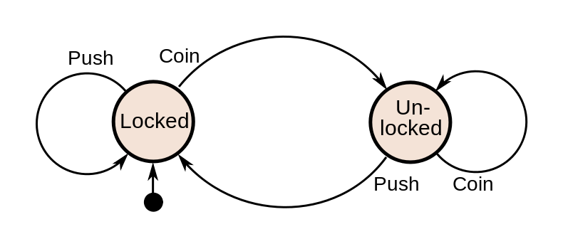
State Machines
State Variables
Deterministic Commands

Slide 7
Requests and Causality, Happens Before Tutorial
Process order consistent with potentially causality.
O1:
  Client A sends r, then r'.
  r is processed before r'.
O2:
  r from Client A causes Client B to send r'.
  r is processed before r'.

Slide 8
State Machine Coding
State Machines are procedures
Client calls procedure
Avoid loops.
More flexible structure.

Slide 9
Consensus
Termination
Validity
Integrity
Agreement
Ensures procedures are called in same order across all machines

Slide 10
Outline
State machines
Faults
State Machine Replication
Failures Outside the state machines
Reconfiguring
Chain Replication

Slide 11
Faults
Faulty: behavior no longer consistent with specification
Byzantine Faults:
  Malicious/arbitrary behavior by faulty components.
  Weakest possible failure assumption.
Fail-Stop Faults:
  Changes to fail state and stops.
Crash Faults:
  Not mentioned in tutorial.
  It is an omission failure, similar to fail-stop

Slide 12
Tolerating Faults
t fault tolerant
  ≤ t components become faulty
  Simply where the guarantees end.
Statistical Measures
  Mean time between failures
  Probability of failure over interval
  other

Slide 13
Outline
State machines
Faults
State Machine Replication
Failures Outside the state machines
Reconfiguring
Chain Replication

Slide 14
Fault Tolerant State Machines
Implement the state machine on multiple processors.
State Machine Replication
  Each starts in the same initial state
  Executes the same requests
  Requires consensus to execute in same order
  Deterministic, each will do the exact same thing
  Produce the same output.

Slide 15
t Fault-Tolerance
Replicas need to be coordinated
Replica coordination:
  Agreement:
    Every non-faulty replica receives every request.
  Order:
    Every non-faulty replica processes the requests in the same relative order.

Slide 16
t Fault-Tolerance
Byzantine Faults:
  How many replicas needed in general?
  Why?
Fail-Stop Faults:
  How many replicas needed in general?
  Why?

Slide 17
Outline
State machines
Faults
State Machine Replication
  Agreement
  Ordering
Failures Outside the state machines
Reconfiguring
Chain Replication

Slide 18
Agreement
“The transmitter” disseminates a value, then:
  IC1: All non-faulty processors agree on the same value
  IC2: If transmitter is non-faulty, agree on its value.
Client can
  be the transmitter
  send request to one replica, who is transmitter

Slide 19
Outline
State machines
Faults
State Machine Replication
  Agreement
  Ordering
Failures Outside the state machines
Reconfiguring
Chain Replication

Slide 20
Ordering
Unique identifier, uid on each request
Total ordering on uid.
Request, r is stable if
  Cannot receive request with uid(r') < uid(r)
Process a request once it is stable.
Logical clocks can be the basis for unique id.
Stability tests for logical clocks?
  Byzantine faults?

Slide 21
Ordering
Can use synchronized real-time clocks.
Max one request at every tick.
If clocks synchronized within δ,
  Message delay > δ
Stability tests?
Potential Problems?
  State Machine lag behind clients by Δ (test 1)
  Never passed on crash failures (test 2)

Slide 22
Ordering
Disadvantages?
  Stability test requires all nodes (clients / state machines) to communicate
    Logical clocks: communication required for requests to become stable
    Synchronized clocks: communication required to synchronize clocks

Slide 23
More Ordering...
Can the replicas generate uid's?
Of course!
Consensus is the key!
State machines propose candidate id's.
One of these selected, becomes unique id.

Slide 24
Constraints
UID1: cuid(sm_{i},r) <= uid(r).
UID2: If a request r' is seen by sm_{i} after r has been accepted by sm_{i}, then uid(r) < cuid(sm_{i},r').

Slide 25
How to generate uid's?
Requirements:
  UID1 and UID2 be satisfied
  r != r' uid(r) != uid(r')
  Every request seen is eventually accepted.
Define:
  SEEN(i) = largest cuid(sm_{i},r) assigned to any request so far seen at sm_{i}
  ACCEPT(i) = largest cuid(sm_{i},r) assigned to any request so far accepted by sm_{i}

Slide 26
Generating uid's....
cuid(sm_{i},r)=max(SEEN(i),ACCEPT(i)) + 1+i/N.
uid(r) = max(cuid(sm_{i},r))
Stability test?
Potential Problems?
  Could affect causality of requests
  Client does not communicate until request is accepted.
More or less communication needed?

Slide 27
Outline
State machines
Faults
State Machine Replication
Failures Outside the state machines
Reconfiguring
Chain Replication

Slide 28
Tolerating failures
Failed output device or voter:
  Replicate?
  Use physical properties to tolerate failures, like the flaps example in the paper.
  Add enough redundancy in fail-stop systems
Client Failure:
  Who cares?
  If sharing processor, use that SM

Slide 29
Outline
State machines
Faults
State Machine Replication
Failures Outside the state machines
Reconfiguring
Chain Replication

Slide 30
Reconfiguration
Would removing failed systems help us tolerate more faults?
Yes, it seems!
P(t) = total processor at time t
F(t) = Failed Processors at time t
Assume Combine function, P(t) – F(t) > Enuf
Enuf = P(t)/2 for byzantine failures
Enuf = 0 for fail-stop.

Slide 31
Reconfiguration
F1: If Byzantine failures, then faulty machines are removed from the system before combining function is violated.
F2: In any case, repaired processors are added before combining function is violated.
Might actually improve system performance.
Fewer messages, faster consensus.

Slide 32
Integrating repaired objects
Element must be non-faulty and must have the current state before it can proceed.
If it is a replica, and failure is fail-stop:
  Receive a checkpoint/state from another replica.
  Forward messages, until it gets the ordered messages from client.
Byzantine fault?

Slide 33
Discussion
Why does any of this matter?
What is the best case scenario in terms of replications for fault tolerance?
Is the state machine approach still feasible?
Are there any other ways to handle BFT?
Which was the most interesting?

Slide 34
Takeaways
The State Machine approach is flexible.
Replication with consensus, given deterministic machines, provides fault tolerance.
Depending on assumptions, may need more replications, may use different strategies.

Slide 35
Outline
State machines
Faults
State Machine Replication
Failures Outside the state machines
Reconfiguring
Chain Replication

Slide 36

Chain Replication For Supporting High Throughput and Availability
Robbert Van Renesse
Fred Schneider

Slide 37
Primary-Backup
Different from State Machine Replication?
Serial version of State Machine Replication
Only the primary does the processing
Updates sent to the backups.

Slide 38
Chain Replication Assumes:
No partition tolerance.
Chain replication: Consistency, availability.
A partitioned server == failed server.
High Throughput.
Fail-stop processors.
A universally accessible, failure resistant or replicated Master, which can detect failures.

Slide 39
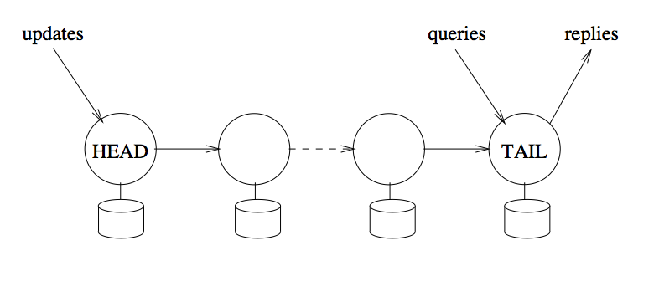
Serial State Machine Replication

Slide 40
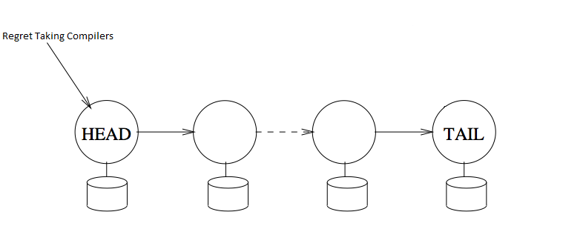
update

Slide 41
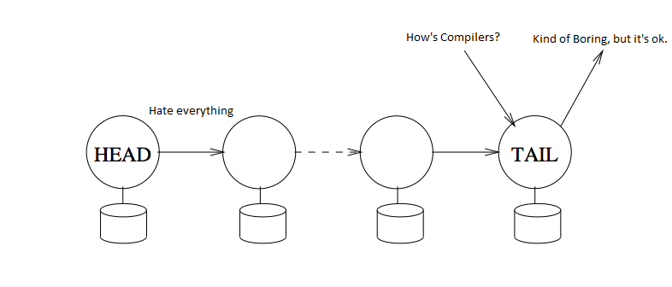
update

Slide 42
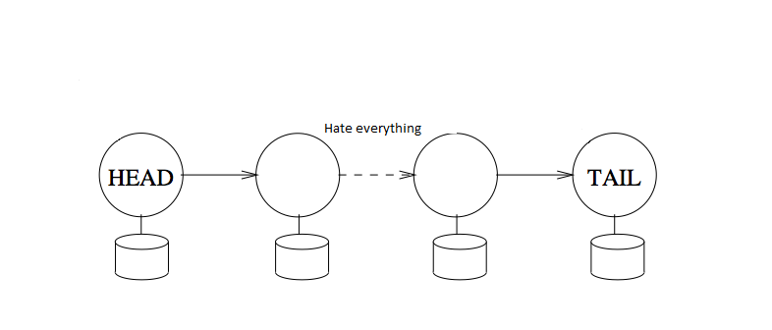
update

Slide 43
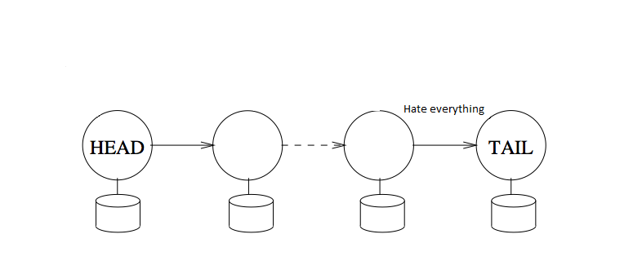
update

Slide 44
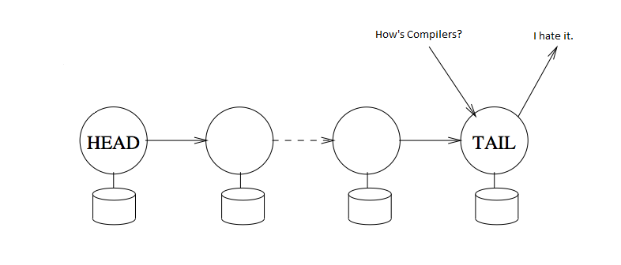
update
reply

Slide 45
Reads and Writes
Reads go to any non-faulty tail.
  Just tail, 1 server per chain
Writes propagate through all non-faulty servers.
  t-1 severs per chain

Slide 46
Master!!
Assumed to never fail or replicated w/ Paxos
Head fails?
Tail fails?
Other fails?

Slide 47
Sources
Fred Schneider photo: http://www.cs.cornell.edu/~caruana/web.pictures/pages/fred.schneider.sailing.c%26c.htm
Robert van Renesse photo: http://www.cs.cornell.edu/annual_report/00-01/bios.htm
Most Slides: Hari Shreedharan, http://www.cs.cornell.edu/Courses/CS6410/2009fa/lectures/23-replication.pdf
State Machine photo: http://upload.wikimedia.org/wikipedia/commons/9/9e/Turnstile_state_machine_colored.svg

Slide 48
Extras!!!

Slide 49
Storage Systems
Store objects.
Query existing objects.
Update existing objects.
Usually offers strong consistency guarantees.
Request processed based on some order.
Effect of updates reflected in subsequent queries.

Slide 50
Handling failures
Failures are detected by God/Master.
On detecting failure, Master:
  informs its predecessor or successor in the chain
  informs each node its new neighbors
Clients ask the master for information regarding the head and the tail.

Slide 51
Adding a new replica
Current tail, T notified it is no longer the tail.
State, Un-ACK-ed requests now transmitted to the new tail.
Master notified of the new tail.
Clients notified of new tail.

Slide 52
Unavailability
Head failure:
  Query processing uninterrupted,
  update processing unavailable till new head takes on responsibility.
Middle failure:
  Query processing uninterrupted,
  update processing might be delayed.
Tail failure:
  Query and update processing unavailable, until new tail takes over.

