Slide 1
Storage systems: File Systems
Hakim Weatherspoon
CS6410

Slide 2
Plan for today
Discuss Papers:
The Design and Implementation of a Log-Structured File System (LFS), Mendel Rosenblum and Ousterhout. SOSP, 1991.
Towards weakly consistent local storage systems (Yogurt), Ji-Yong Shin, Mahesh Balakrishnan, Tudor Marian, Jakub Szefer, Hakim Weatherspoon. SoCC 2016
Historical Context:
UNIX File System (UFS)
UNIX Berkeley Fast File System (FFS)

Slide 3
A Fast File System for UNIX Marshall K. McKusick, William N. Joy, Samuel J Leffler, and Robert S Fabry
Bob Fabry
Professor at Berkeley. Started CSRG (Computer Science Research Group) developed the Berkeley SW Dist (BSD)
Bill Joy
Key developer of BSD, sent 1BSD in 1977
Co-Founded Sun in 1982
Marshall (Kirk) McKusick (Cornell Alum)
Key developer of the BSD FFS (magic number based on his birthday, soft updates, snapshot and fsck. USENIX
Sam Leffler
Key developer of BSD, author of Design and Implementation
Notes:
“UNIX is basically a simple operating system, but you have to be a genius to understand the simplicity.” – Dennis Ritchie

Slide 4
Background: Unix Fast File Sys
Original UNIX File System (UFS)
Simple, elegant, but slow
20 KB/sec/arm; ~2% of 1982 disk bandwidth
Problems
blocks too small
consecutive blocks of files not close together
(random placement for mature file system)
i-nodes far from data
(all i-nodes at the beginning of the disk, all data afterward)
i-nodes of directory not close together
no read-ahead

Slide 5
Inodes and directories
Inode doesn't contain a file name
Directories map files to inodes
Multiple directory entries can point to same Inode
Low-level file system doesn't distinguish files and directories
Separate system calls for directory operations

Slide 6
File system on disk
freespace map
inodes and blocks in use
...
...
super block disk layout
inodes inode size < block size
data blocks

Slide 7
File representation
file size
link count
access times
...
data blocks
indirect block
double indirect
triple indirect
data
data
data
data
data
data
...
data
data
...
data
...
data
data
...
...
...
data
...

Slide 8
The Unix Berkeley Fast File System
Berkeley Unix (4.2BSD)
4kB and 8kB blocks
(why not larger?)
Large blocks and small fragments
Reduces seek times by better placement of file blocks
i-nodes correspond to files
Disk divided into cylinders
contains superblock, i-nodes, bitmap of free blocks, summary info
Inodes and data blocks grouped together
Fragmentation can still affect performance

Slide 9
FFS implementation
Most operations do multiple disk writes
File write: update block, inode modify time
Create: write freespace map, write inode, write directory entry
Write-back cache improves performance
Benefits due to high write locality
Disk writes must be a whole block
Syncer process flushes writes every 30s

Slide 10
FFS Goals
keep dir in cylinder group, spread out different dir’s
Allocate runs of blocks within a cylinder group, every once in a while switch to a new cylinder group (jump at 1MB).
layout policy: global and local
global policy allocates files & directories to cylinder groups. Picks “optimal” next block for block allocation.
local allocation routines handle specific block requests. Select from a sequence of alternative if need to.

Slide 11
FFS locality
don’t let disk fill up in any one area
paradox: for locality, spread unrelated things far apart
note: FFS got 175KB/sec because free list contained sequential blocks
(it did generate locality), but an old UFS had randomly ordered blocks and only got 30 KB/sec

Slide 12
FFS Results
20-40% of disk bandwidth for large reads/writes
10-20x original UNIX speeds
Size: 3800 lines of code vs. 2700 in old system
10% of total disk space unusable

Slide 13
FFS Enhancements
long file names (14 -> 255)
advisory file locks (shared or exclusive)
process id of holder stored with lock => can reclaim the lock if process is no longer around
symbolic links (contrast to hard links)
atomic rename capability
(the only atomic read-modify-write operation,
before this there was none)
Disk Quotas
Overallocation
More likely to get sequential blocks; use later if not

Slide 14
FFS crash recovery
Asynchronous writes are lost in a crash
Fsync system call flushes dirty data
Incomplete metadata operations can cause disk corruption (order is important)
FFS metadata writes are synchronous
Large potential decrease in performance
Some OSes cut corners

Slide 15
After the crash
Fsck file system consistency check
Reconstructs freespace maps
Checks inode link counts, file sizes
Very time consuming
Has to scan all directories and inodes

Slide 16
Perspective
Features
parameterize FS implementation for the HW in use
measurement-driven design decisions
locality “wins”
Flaws
measuremenets derived from a single installation.
ignored technology trends
Lessons
Do not ignore underlying HW characteristics
Contrasting research approach
Improve status quo vs design something new

Slide 17
The Design and Impl of a Log-structured File System Mendel Rosenblum and John K. Ousterhout
Mendel Rosenblum
Designed LFS, PhD from Berkeley
ACM Disseration Award Winner
Professor at Stanford, designed SimOS
Founder of VM Ware
John Ousterhout
Professor at Berkeley 1980-1994
Created Tcl scripting language and TK platform
Research group designed Sprite OS and LFS
Now professor at Stanford after 14 years in industry
Notes:
“UNIX is basically a simple operating system, but you have to be a genius to understand the simplicity.” – Dennis Ritchie

Slide 18
The Log-Structured File System
Technology Trends
I/O becoming more and more of a bottleneck
CPU speed increases faster than disk speed
Big Memories: Caching improves read performance
Most disk traffic are writes
Little improvement in write performance
Synchronous writes to metadata
Metadata access dominates for small files
e.g. Five seeks and I/Os to create a file
file i-node (create), file data, directory entry, file i-node (finalize), directory i-node (modification time).

Slide 19
LFS in a nutshell
Boost write throughput by writing all changes to disk contiguously
Disk as an array of blocks, append at end
Write data, indirect blocks, inodes together
No need for a free block map
Writes are written in segments
~1MB of continuous disk blocks
Accumulated in cache and flushed at once
Data layout on disk
“temporal locality” (good for writing)
rather than “logical locality” (good for reading).
Why is this a better?
Because caching helps reads but not writes!

Slide 20
Log operation
Kernel buffer cache
inode blocks
data blocks
active segment
Disk
log
log head
log tail

Slide 21
LFS design
Increases write throughput from 5-10% of disk to 70%
Removes synchronous writes
Reduces long seeks
Improves over FFS
"Not more complicated"
Outperforms FFS except for one case

Slide 22
LFS challenges
Log retrieval on cache misses
Locating inodes
What happens when end of disk is reached?

Slide 23
Locating inodes
Positions of data blocks and inodes change on each write
Write out inode, indirect blocks too!
Maintain an inode map
Compact enough to fit in main memory
Written to disk periodically at checkpoints
Checkpoints (map of inode map) have special location on disk
Used during crash recovery

Slide 24
Cleaning the log: “Achilles Heel”
Log is infinite, but disk is finite
Reuse the old parts of the log
Clean old segments to recover space
Writes to disk create holes
Segments ranked by "liveness", age
Segment cleaner "runs in background"
Group slowly-changing blocks together
Copy to new segment or "thread" into old

Slide 25
Cleaning policies
Simulations to determine best policy
Greedy: clean based on low utilization
Cost-benefit: use age (time of last write)
Measure write cost
Time disk is busy for each byte written
Write cost 1.0 = no cleaning
benefit cost
(free space generated)*(age of segment) cost
=

Slide 26
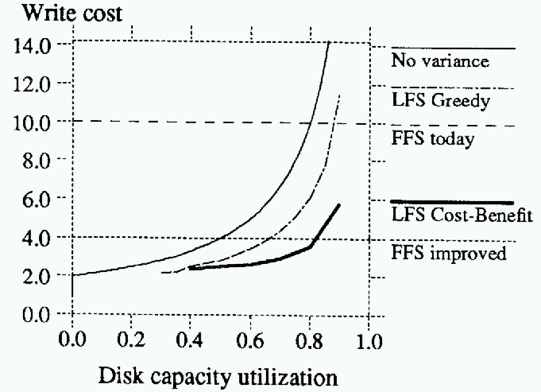
Greedy versus Cost-benefit

Slide 27
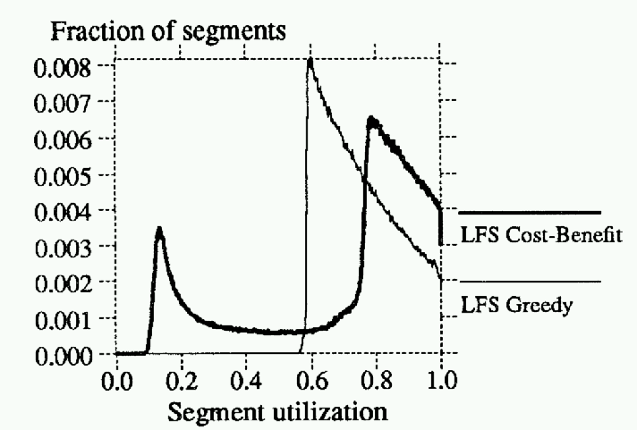
Cost-benefit segment utilization

Slide 28
LFS crash recovery
Log and checkpointing
Limited crash vulnerability
At checkpoint flush active segment, inode map
No fsck required

Slide 29
LFS performance
Cleaning behaviour better than simulated predictions
Performance compared to SunOS FFS
Create-read-delete 10000 1k files
Write 100-MB file sequentially, read back sequentially and randomly

Slide 30
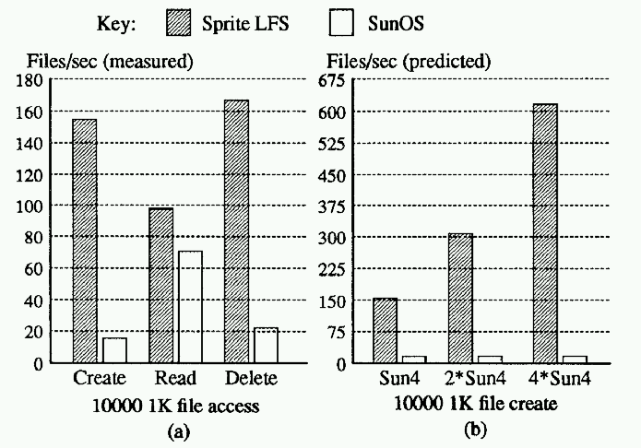
Small-file performance

Slide 31
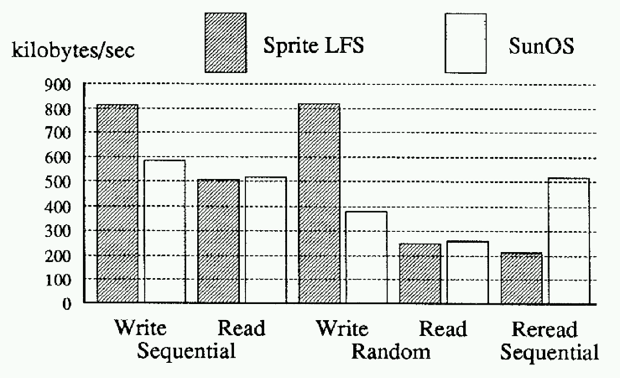
Large-file performance

Slide 32
Perspective
Features
CPU speed increasing faster than disk => I/O is bottleneck
Write FS to log and treat log as truth; use cache for speed
Problem
Find/create long runs of (contiguous) disk space to write log
Solution
clean live data from segments,
picking segments to clean based on a cost/benefit function
Flaws
Intra-file Fragmentation: LFS assumes entire files get written
If small files “get bigger”, how would LFS compare to UNIX?
Lesson
Assumptions about primary and secondary in a design
LFS made log the truth instead of just a recovery aid

Slide 33
Towards Weakly Consistent Local Storage Systems Ji Yong Shin, Mahesh Balakrishnan, Tudar Marian, Jakub Szefer, Hakim Weatherspoon
Ji Yong Shin
Student at Cornell, post-doc Yale
Mahesh Balakrishnan
Student at Cornell, Researcher at Microsoft
Professor at Yale
Tudor Marian
Student at Cornell, Researcher at Google
Jakub Szefer
Professor at Yale
Hakim Weatherspoon
Student at Berkeley, Professor at Cornell
Notes:
“UNIX is basically a simple operating system, but you have to be a genius to understand the simplicity.” – Dennis Ritchie

Slide 34
Motivation
Heterogeneity is storage is increasing
Magnetic disks (hard disk drives), NAND-flash solid state drives (SSD), DRAM, NVRAM, hybrid drives, Intel 3DXpoint, Phase Change Memory (PCM)
Exhibit different characteristics
Number of storage devices is increasing
And is log-structured / multi-versioned
Local storage system starts to look like a distributed storage system

Slide 35
Research Question
Can we make local storage system weakly consistent like a distributed storage system?
Weakly consistent means return stale (old versions) of data

Slide 36
StaleStores
Single-node storage system that maintains and servers multi-versions
Allows application to make performance consistency tradeoff
Higher performance and weak consistency for older version
Vs low performance and high consistency for latest version

Slide 37
StaleStores
Requirements:
Timestamped writes
Snapshot reads
Cost estimation
Version exploration

Slide 38
StaleStores
Requirements:
Timestamped writes
Snapshot reads
Cost estimation
Version exploration
API
Put
Get
GetCost
GetVersionedRange

Slide 39
Performance: Read Latency

Slide 40
Perspective
Log-structured is a simple but power abstraction
Performance is high since seeks are reduced
However, performance suffers if disk nearly full
Modern day resurrection of Log-Structrued
SSD and heterogeneity of storage
Future log-structured storage systems
Trade-off consistency for performance

Slide 41
Next Time
Read and write review:
Survey paper due next Friday
Check website for updated schedule

Slide 42
Next Time
Read and write review:
The Google file system, Sanjay Ghemawat, Howard Gobioff, Shun-Tak Leung. 19th ACM symposium on Operating systems principles (SOSP), October 2003, 29--43.
Spanner: Google's Globally Distributed Database, James C. Corbett, Jeffrey Dean, Michael Epstein, Andrew Fikes, Christopher Frost, J. J. Furman, Sanjay Ghemawat, Andrey Gubarev, Christopher Heiser, Peter Hochschild, Wilson Hsieh, Sebastian Kanthak, Eugene Kogan, Hongyi Li, Alexander Lloyd, Sergey Melnik, David Mwaura, David Nagle, Sean Quinlan, Rajesh Rao, Lindsay Rolig, Yasushi Saito, Michal Szymaniak, Christopher Taylor, Ruth Wang, and Dale Woodford. In Proceedings of the 10th USENIX conference on Operating Systems Design and Implementation (OSDI'12), October 2012, 251--264.

