Slide 1
Modern Systems: Security
Presented by Andrew Ferraiuolo
Cornell University CS 6510
9.20.2016

Slide 2
Two Secure Systems Approaches
Fabric (Myers)
Information flow
Nexus (Sirer & Schneider)
Credentials-based authentication
Hardware root-of-trust

Slide 3
Information Flow
Track and constrain the propagation of data throughout the system
Confidential
Trusted
Untrusted
Confidential
Public
Trusted

Slide 4
Information Flow Background
Lattice Model (Denning 1976)
Confidentiality and integrity are duals (Biba 1977)
Noninterference (Goguen 1982) – If an attacker can observe data in set L but not H, execution looks deterministic regardless of H.
secret
untrusted
public
trusted

Slide 5
Applications of Information Flow
Operating Systems
DStar, HiStar (Zeldovich 2008)
Digital logic
Gate-level information flow tracking – (Tiwari 2009)
Hardware architecture
Dynamic information flow tracking – (Suh 2003)
Type Systems
A lot of work (Survey: Sabelfield 2003)

Slide 6
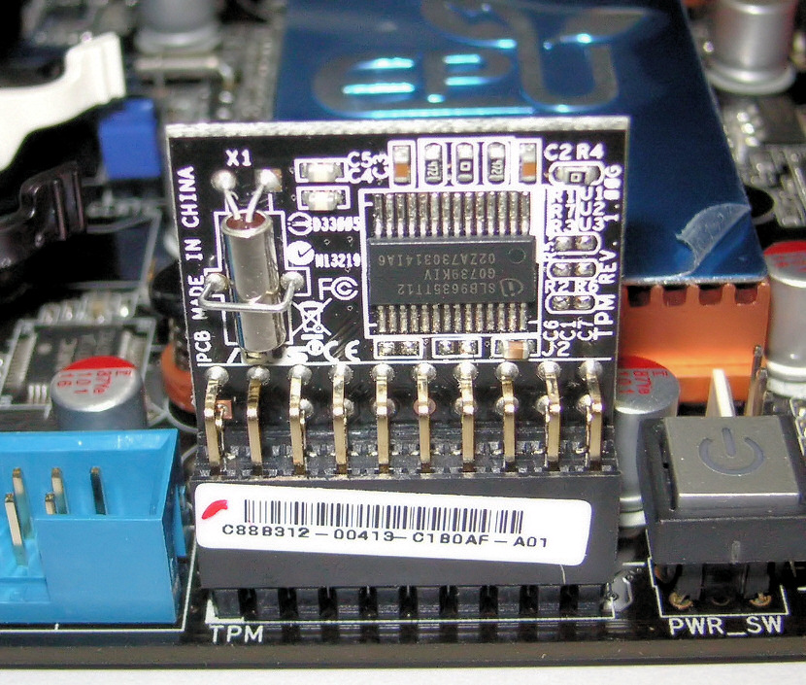
Hardware Authentication: TPM
Hardware support for providing remote attestation of software
Problems:
Cannot describe state-dependent trust
Compromises privacy
Provides purely axiomatic trust

Slide 7
Trust Bases
Axiomatic – A principal is assumed to be trusted
Trusted platform module
Synthetic – Transforms untrusted code into trustworthy code
Reference monitors, sandboxing
Analytic – Predicts whether certain program behaviors are possible
Proof-carrying code (Necula 1996), information flow!

Slide 8
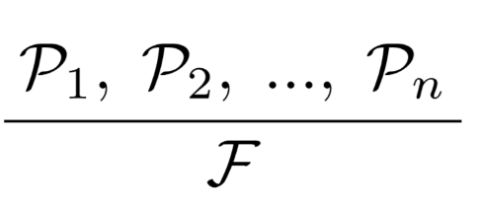
Credentials Based Authorization
Permit access when a principal satisfies some property (Appel 1999)
Goal Formula: conditions under which resource can be accessed
Credentials: a proof that satisfies a goal formula
Nexus adds features to support all three bases of trust.
Can Nexus be used to perform information flow analysis? Would you want it to?

Slide 9
Fabric
Goal: Secure distributed computation
Approach:
Secure language – information flow type system enforces noninterference
Decentralized security – multiple distrusting parties, no central authority

Slide 10
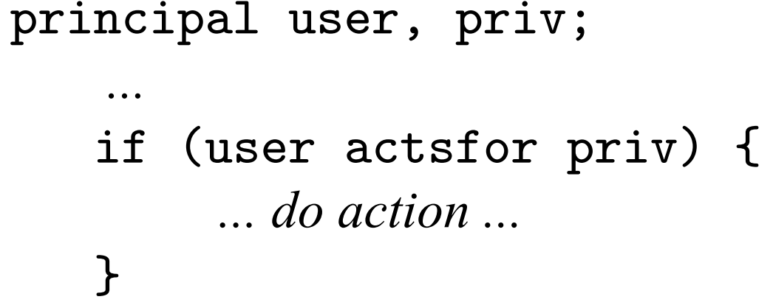
Principals
Represent entities (e.g., users, groups, nodes) and privileges.
Acts-for relation: supports delegation, can be used for access control

Slide 11
Labels
Express policies in the code
labels are associated with data
describe which principals can act on them and how
Policies are enforced mostly statically at compile-time
Some checks, e.g. for remote procedure calls are checked dynamically

Slide 12
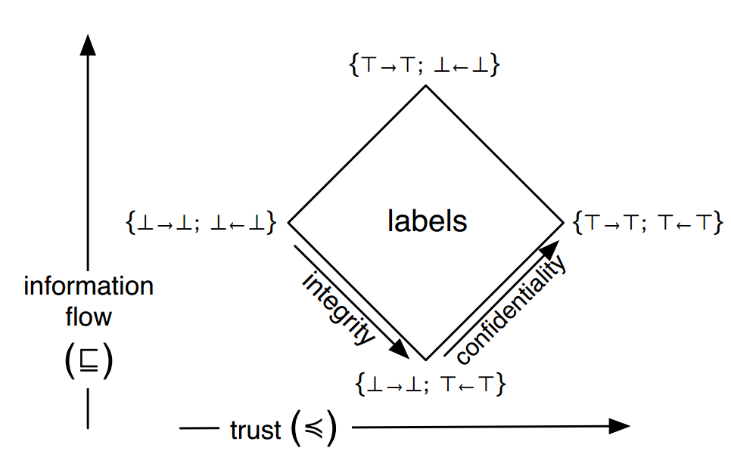
Labels
Decentralized label model (Myers 2000)
Written in terms of principals
Confidentiality { alice → bob}
Integrity { alice ← bob }
Flow ordering
permitted flow among labels
Trust ordering
restrictiveness of policy
(new in this paper)

Slide 13
Label Example

Slide 14
Remote Calls
Notes:
Since fabric is a distributed system, it supports remote procedure calls.
Procedure m1 makes a remote procedure call. First it looks up a worker node “w”. Then it does an access control check to see that w has the authority of bob. If it does it makes an RPC of method m2 on worker w.
Statically, the compiler checks that all the data sent to a worker is permitted to be read by that worker. Here data has a label that is allowed to be read by bob. Since it happens in a context where w actsfor bob, this is secure
The recipient of the remote call also needs to ensure that the data it receives is trustworthy. Since it has no knowledge of the caller at compile-time, the check is dynamic. At run-time the label to the write of m2 checks that the caller has the authority of Alice.

Slide 15
System Architecture
Fabric nodes take one of three forms
Storage nodes – persistent objects
Worker nodes – perform computation
Dissemination nodes – data replication
A single host can have multiple nodes

Slide 16
Evaluation: CMS
2X-4X slowdown compared to regular Java
Notes:
Evaluated the page load latency for CMS for three actions and 5 implementations of CMS
The bottom 2 implementations have an in-memory store. The best case is Java with an in-memory store. The Java implementation outperforms the other previous implementations, and so the FabIL implementation does as well
The FabIL/memory implementation has a 2X – 4X slowdown compared to the Java implementation.

Slide 17
Evaluation: OO7 Benchmark
The regular Java implementation is 10X faster
Notes:
The plain Java implementation runs about 10 times faster for the Hot implementatio

Slide 18
Nexus
Goal: Support authorization with all three trust bases.
Approach:
Nexus authorization logic (NAL) – describes principals and their beliefs
Reference monitor – general-purpose proof-checker enforces NAL
OS and hardware features for each basis of trust.

Slide 19
Nexus & Trust Bases
Axiomatic
trusted platform module – supports attested storage /w Merkle trees
Analytic
Introspection – exposes view of kernel state
e.g. process lookup tables, IPC ports, application state
Synthetic
Interpositioning – reference monitor can respond to untrusted I/O

Slide 20
Nexus Authorization Logic
NAL formulas have form “P says S” (see Schneider 2009)
Principal P believes S to be true
Predicates have application-defined meanings
Delegation
“A speaksfor B” means that if A says S then B says S.
Examples:
“Typechecker says isTypeSafe(PGM)”
“Server says NTP speaksfor Server on TimeNow”
Notes:
Delegation can be scoped using “on”

Slide 21
Caching and State
Decision cache - caches authorization decisions by the guard
Guard cache – caches partial proof-checking results.
State and Authorities – stateful predicates cannot be cached!
Authorities – listens on bound IPC, answers queries about stateful predicates.

Slide 22
Proof Evaluation Cost
Notes:
Execution time for checking proofs of increasing length.
Three rules: delegation (speaksfor), double negation, and disjunction elimination.
The solid line show the cost of proof-checking alone and the dashed line shows the total cost of execution time.

Slide 23
Interpositioning Overhead
Notes:
The authors say that introspection costs roughly as much as File I/O and is not on the critical path.
This figure shows the throughput of a UDP echo server for increasing levels of protection and for two different packet sizes.
The first two allow the driver to respond directly without interposition
In drv, the driver communicates through kernel IPC.
Kref and uref check compliance with a safety policy. Min and max show the performance with and without caching.

Slide 24
Comparison of Approaches
Information flow
Comprehensive/transitive
Noninterfere-ish (declassification)
Confidentiality/integrity, not availability
Policies
Written by app developer
Trust relationships
TCB: compiler(33k), crypto
Credentials based authentication
Constrains at resource interface
Policies
Written by OS writer
General propositional logic
TCB: OS(25k), theorem-prover, crypto
Notes:
The noninterfere-ish remark refers to the use of declassification and endorsement
Nexus TCB: 25k LOC
Fabric TCB:

Slide 25
Questions
Overall, which approach do you prefer?
Do you see any value in using both?
What is a reasonable (performance) cost for security in practice?
Is it 10%? 10X? 100X?
What do you think should be the root-of-trust?
The hardware? OS? Compiler? Theorem-provers?

Slide 26
Perspective
Noninterference is powerful, but too restrictive
Practical systems rely on declassification/endorsement.
No single answer. (Survey paper: Sabelfield 2009)
Need to address covert channels to be truly comprehensive.
Is formal verification the answer?
seL4

