Slide 1
Modern systems:
multicore issues
By Paul Grubbs
Portions of this talk were taken from Deniz Altinbuken’s talk on Disco in 2009: http://www.cs.cornell.edu/courses/cs6410/2009fa/lectures/09-multiprocessors.ppt
Notes:
Big thanks to Deniz, who wrote a pretty great presentation on Disco in 2009

Slide 2
What papers will we be discussing?
The Multikernel: A new OS architecture for scalable multicore systems. Andrew Baumann, Paul Barham, Pierre-Evariste Dagand, Tim Harrisy, Rebecca Isaacs, Simon Peter , Tim Roscoe, Adrian Schüpbach, and Akhilesh Singhania . Proceedings of the Twenty-Second ACM Symposium on Operating Systems Principles (Austin, Texas, United States), ACM, 2009.
Disco: Running Commodity Operating Systems on Scalable Multiprocessors, Edouard Bugnion, Scott Devine, and Mendel Rosenblum. 16th ACM symposium on Operating systems principles (SOSP), October 1997, pages 143--156.

Slide 3
High-level context
General-purpose operating systems must run efficiently on many different architectures.
Multiprocessing
Non-uniform memory access (NUMA)
(Cache coherence?)
Commodity, general-purpose OSs are not designed to do this
Rewriting them should be avoided
Exokernels (1995), SPIN (1996)
Notes:
What issues are these papers considering?
Commodity servers aren’t single-core systems, nor are they even multi-core systems running a bunch of the same cores. Systems might run on top of different machines with different CPUs and different ISAs.
Old memory models (a single CPU with a single cache hierarchy and a single main memory) are not valid - multiprocessors exhibit NUMA and OSs must account for this at the lowest levels
Cache coherence is taken care of by hardware, but the cost of these hardware protocols can be prohibitive for systems with many cores
Rewriting general-purpose OSs for specific architectures is error-prone and extremely expensive, and anyway pegs them to a particular architecture so they have to be changed again when the architecture changes
Talk about exokernels and SPIN in setting high-level context
Multikernel and Disco both crucially use multiprocessors, make this point

Slide 4
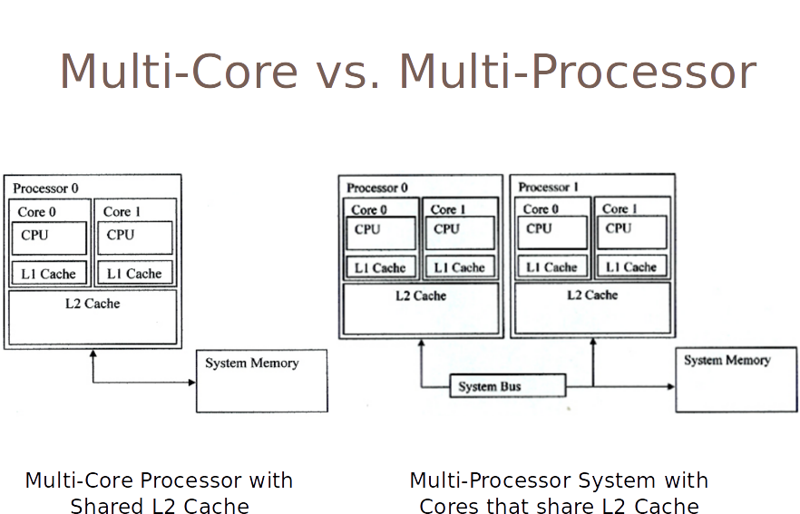
Notes:
Deniz’s slide

Slide 5
Notes:
All processors have access to all memory using load and store Access time depends on region of memory being accessed Different processors access different regions of memory at different speeds

Slide 6
Disco: Running Commodity Operating Systems on Scalable Multiprocessors
Edouard Bugnion, Scott Devine, and Mendel Rosenblum
What is the problem being considered?
Multiprocessing requires extensive OS rewrites
NUMA is hard, more rewrites
Notes:
Disco became the core of the first release of VMWare workstation
Talk about context again, specific to paper
Say CEO was fired (mendel rosenblum’s wife)
Maybe more specific background on Disco and virtual machine monitors
Running a traditional operating system on a machine that uses multiprocessing is complicated and requires lots of software changes. If the machine also has NUMA the problems get even worse because of coherence and locality issues in memory accesses

Slide 7
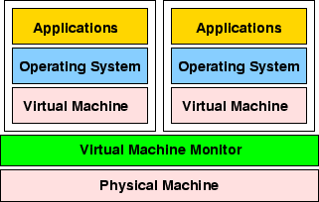
What is the authors’ solution to this problem?
A new twist on an old idea: virtual machine monitors (VMM).
Updated VMMs for the multiprocessing era
Notes:
The original virtual machine monitors were used on mainframes to allow multiple users to run different programs on one abstracted OS/hardware.
to create Disco, a layer of abstraction between commodity operating systems and the underlying multiprocessors

Slide 8
Disco vs. exokernels?
Exokernel leaves resource management to applications
Only multiplexes physical resources
Disco virtualizes them
Disco can run commodity OSs with little or no modification
More difficult to run commodity OSs on Exokernels
Notes:
Two different approaches to problem of OS abstraction not matching up with physical hardware

Slide 9
Disco vs. System/370?
Both are VM monitors
VM/370 maps virtual disks to physical disk partitions
Disco uses shared copy-on-write disks to decrease storage overhead
Disco supports ccNUMA multiprocessors
Heavily optimizes for NUMA and shared mem access

Slide 10
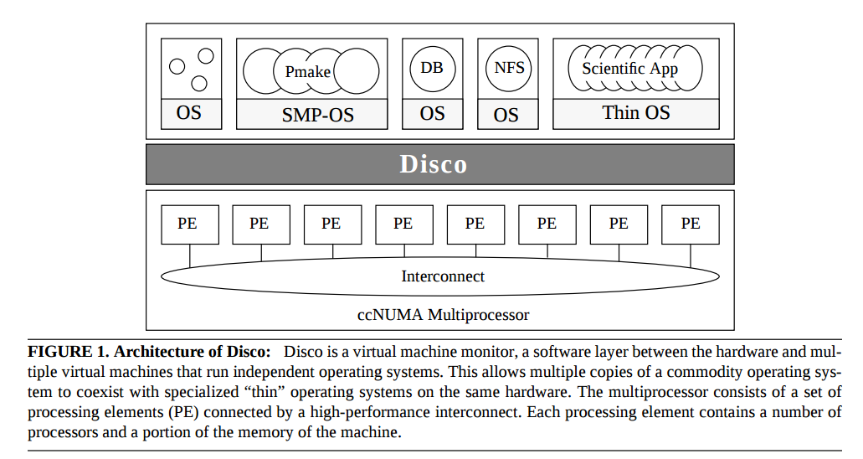
(picture taken from Disco paper)

Slide 11
Abstractions of hardware
Virtual CPU
Virtualized physical memory
Virtualized I/O devices

Slide 12
Virtual CPUs
No emulation of most instructions: code runs “raw” on hardware CPU
Exception: privileged calls (TLB, device access) must be emulated by Disco
Disco keeps process table for each vCPU for fast emulation
vCPU scheduler to allow time-sharing on physical CPUs
Compare to Xen paravirtualization?
Notes:
Compare to Xen’s paravirtualization approach: OS rewrite required but no trap/emulation of privileged instructions

Slide 13
Virtualized physical memory
Offers uniform memory abstraction to commodity OSs,
uses ccNUMA memory of multiprocessor
Dynamic page migration/replication
a small change to OS: Disco allocates shared memory
regions that multiple VMs can access
DB w/ shared buffer cache
Drawback: redundant OS/application code
Solution: Transparent sharing of redundant read-only pages like kernel code
Notes:
Maps virtual memory addresses to physical addresses
Disco keeps a software second-level TLB to reduce TLB misses (TLB must be flushed on VM switches, this is expensive)
Not strictly necessary to schedule pages, but is optimization for NUMA to increase locality
For applications that need more fine-grained control over memory, a small OS change lets Disco allocate shared memory that mutiple VMs can access
A database can have a buffer cache shared between several VMs doing query processing
Drawback: redundant OS/application code residing in memory of each VM

Slide 14
Virtualized I/O devices
No device virtualization really
Add special VMM-specific device drivers to kernel of OS
Pages handled using copy-on-write
Works well for read-only
Persistent disks only mounted on one VM
VMs read other disks using NFS
Notes:
Copy-on-write pages works well for read-only pages like kernel code, but persistent disks can only be mounted by one VM at a time. VMs read each others’ disks using NFS

Slide 16
How do they assess the quality of their solution?
FLASH didn’t exist yet so used an OS simulator
They weren’t able to simulate the machine particularly well
No benchmarks for long-running or complicated processes
Disco’s resource sharing policies were only superficially tested
They focused on four uses cases
Parallel compilation of GNU chess application
Verilog simulation of hardware
Raytracing
Sybase RDBMS
Notes:
https://en.wikipedia.org/wiki/SimOS
http://www.pdl.cmu.edu/DiskSim/
Weirdly, they targeted a machine that didn’t exist when the paper was published (FLASH) so they used an OS simulator for their experiments
they had to use a simplified model of a different kind of processor

Slide 17
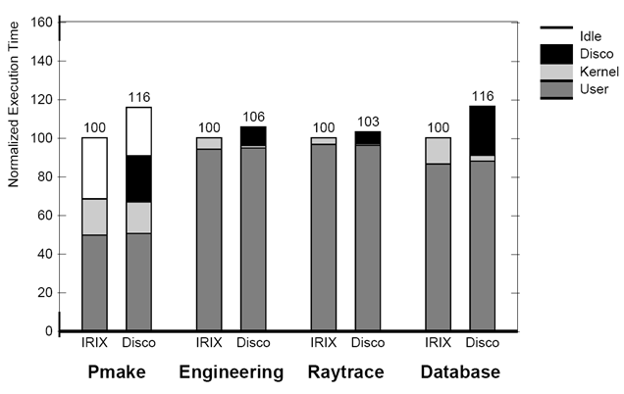

Slide 18
Thoughts/Questions?
Do you prefer Disco’s virtualization approach or hardware multiplexing, e.g. Exokernels? Which do you think is better?
Disco makes support for commodity OSs a first-class goal.
Is this desirable? Does it lead to suboptimal design decisions?
In OS research is it necessary to preserve backwards-compatibility?
Does not having a real machine to test on hurt the paper?
What did you really like about this paper?
What did you really not like about this paper?

Slide 19
The Multikernel: A new OS architecture for scalable multicore systems
Andrew Baumann, Paul Barham, Pierre-Evariste Dagand, Tim Harrisy, Rebecca Isaacs, Simon Peter , Tim Roscoe, Adrian Schüpbach, and Akhilesh Singhania
What is the problem being considered?
Diversity in systems, diversity in cores, diversity in multiprocessor architectures
What is the authors’ solution to this problem?
New OS structure: “multikernel”
How do they assess the quality of their solution?
Various benchmarks for cache coherence, RPC overhead
TLB shootdown case study
Notes:
Previous OS abstractions only had one unit of computation - the CPU. Systems have lots of heterogenous computation hardware: CPUs, GPUs, ASIC/FPGA, programmable NICs….
These different kinds of “processors” should be handled by the OS the same way that CPUs are
Interconnect topology is nearing a breaking point - using message-passing with a single shared interconnect causes serious congestion issues. Using hardware cache coherence to support a shared memory abstraction only exacerbates problems
A multikernel treats the physical system as an interconnected network of cores. OS functionality is implemented as a distributed system using message passing. Shared memory is supported using replication and two-phase commits

Slide 20
Three key ideas:
Make all inter-core communication explicit.
Make OS structure hardware-neutral.
View state as replicated instead of shared.

Slide 21
Make all inter-core communication explicit.
Inter-core communiation uses explicit messages
Avoids shared memory
Multiprocessors look more and more like networks
Using messages allows easy pipelining/batching
Makes interconnect use more efficient
Automated analysis/formal verification
Calculi for reasoning about concurrency

Slide 22
Make OS structure hardware-neutral.
Separate OS structure from physical instantiation: abstraction!
Only message transport and hardware interfaces are machine-specific
Minimizes code change to OS
Separate IPC protocols from hardware implementation
Performance/extensibility benefits

Slide 23
View state as replicated instead of shared.
Shared state is accessed as a local replica
Shared state consistency through messages
Consistency reqs tunable using diff protocols
Reduces interconnect traffic and synchronization overhead
Fault-tolerant to failures in CPUs

Slide 24
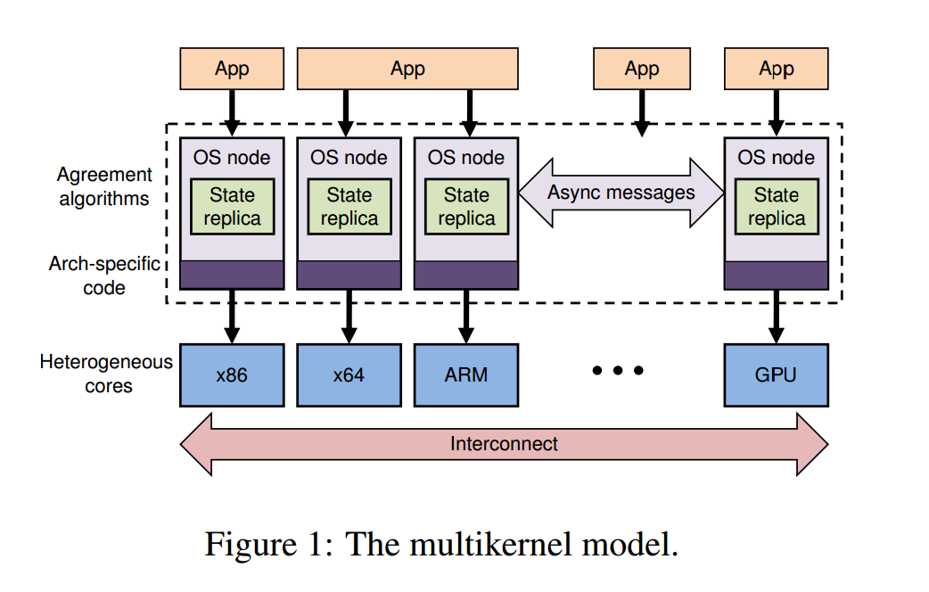
(Taken from the Multikernel paper)

Slide 25
Thoughts/questions?
Relying on distributed protocols for consistency of shared state
Good idea/bad idea? Why?
Multikernels do not target support for commodity OS
Good idea/bad idea? Why?
Is their “system-as-network” model accurate? Should the interconnect be treated like other communication channels?
What did you really like about this paper?
What did you really not like about this paper?

Slide 26
What connects these two papers?
Multiprocessing! NUMA!

