Slide 1
Microkernels: mach and L4
Hakim Weatherspoon
CS6410

Slide 2
Introduction to Kernels
Different Types of Kernel Designs
Monolithic kernel
Microkernel
Hybrid Kernel
Exokernel
Virtual Machines?

Slide 3
Monolithic Kernels
All OS services operate in kernel space
Good performance
Disadvantages
Dependencies between system component
Complex & huge (millions(!) of lines of code)
Larger size makes it hard to maintain
E.g. Multics, Unix, BSD, Linux

Slide 4
Microkernels
Minimalist approach
IPC, virtual memory, thread scheduling
Put the rest into user space
Device drivers, networking, file system, user interface
More stable with less services in kernel space
Disadvantages
Lots of system calls and context switches
E.g. Mach, L4, AmigaOS, Minix, K42

Slide 5
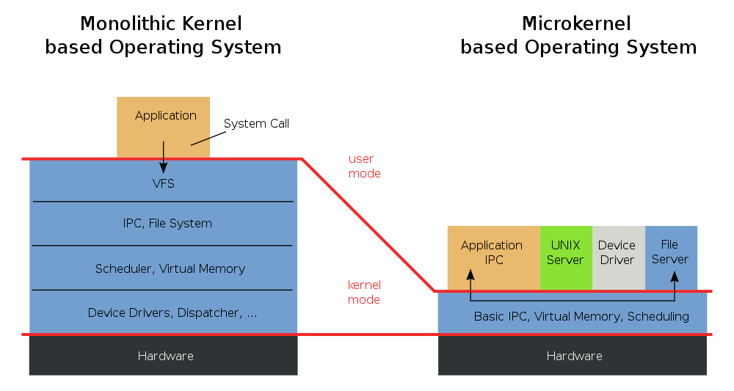
Monolithic Kernels VS Microkernels

Slide 6
Hybrid Kernels
Combine the best of both worlds
Speed and simple design of a monolithic kernel
Modularity and stability of a microkernel
Still similar to a monolithic kernel
Disadvantages still apply here
E.g. Windows NT, NetWare, BeOS

Slide 7
Exokernels
Follows end-to-end principle
Extremely minimal
Fewest hardware abstractions as possible
Just allocates physical resources to apps
Disadvantages
More work for application developers
E.g. Nemesis, ExOS
This Thursday!

Slide 8
The Microkernel Debate
How big should it be?
Big debate during the 1980’s

Slide 9
Summary: Kernels
Monolithic kernels
Advantages: performance
Disadvantages: difficult to debug and maintain
Microkernels
Advantages: more reliable and secure
Disadvantages: more overhead
Hybrid Kernels
Advantages: benefits of monolithic and microkernels
Disadvantages: same as monolithic kernels
Exokernels
Advantages: minimal and simple
Disadvantages: more work for application developers

Slide 10
1st Generation Microkernels

Slide 11
Mach: A New Kernel Foundation For UNIX Development
USENIX Summer Conference 1986
Mike Accetta, Robert Baron, William Bolosky, David Golub, Richard Rashid, Avadis Tevanian, and Michael Young
Richard Rashid
Lead developer of Mach
Microsoft Research
William Bolosky
Microsoft Research
Avadis Tevanian
Primary figure in development of Mac OS X
Apple Computer (former VP and CTO)

Slide 12
Mach
1st generation microkernel
Based on Accent
Memory object
Mange system services like network paging and file system
Memory via communication

Slide 13
Mach Abstractions
Task
Basic unit of resource allocation
Virtual address space, communication capabilities
Thread
Basic unit of computation
Port
Communication channel for IPC
Message
May contain port capabilities, pointers
Memory Object

Slide 14
External Memory Management
No kernel-based file system
Kernel is just a cache manager
Memory object
AKA “paging object”
Pager
Task that implements memory object

Slide 15
Lots of Flexibility
E.g. consistent network shared memory
Each client maps X with shared pager
Use primitives to tell kernel cache what to do
Locking
Flushing

Slide 16
Problems of External Memory Management
External data manager failure looks like communication failure
E.g. need timeouts
Opportunities for data manager to deadlock on itself

Slide 17
Performance
Does not prohibit caching
Reduce number of copies of data occupying memory
Copy-to-use, copy-to-kernel
More memory for caching
“compiling a small program cached in memory…is twice as fast”
I/O operations reduced by a factor of 10
Context switch overhead?

Slide 18
2nd Generation Microkernels

Slide 19
The Performance of Micro-Kernel-Based Systems
SOSP 1997
Herman Hartig, Michael Hohmuth, Jochen Liedtke, Sebastian Schonberg, Jean Wolter
Herman Hartig
Prof at TU Dresden
Jochen Liedtke
Worked on microkernels Eumel, L3
Is the “L” in L3 and L4

Slide 20
The Performance of Micro-Kernel-Based Systems
Evaluates the L4 microkernel
Ports Linux to run on top of L4
Suggests improvements

Slide 21
L4
2nd generation microkernel
Similar to Mach
Started from scratch, rather than monolithic
Even more minimal
Uses user-level pages
Tasks, threads, IPC

Slide 22
L4Linux
Linux source has two cleanly separated parts
Architecture dependent
Architecture independent
In L4Linux
Architecture dependent code is modified for L4
Architecture independent part is unchanged
L4 not specifically modified to support Linux

Slide 23
L4Linux
Linux kernel as L4 user service
Runs as an L4 thread in a single L4 address space
Creates L4 threads for its user processes
Maps parts of its address space to user process threads (using L4 primitives)
Acts as pager thread for its user threads
Has its own logical page table
Multiplexes its own single thread (to avoid having to change Linux source code)

Slide 24
L4Linux – System Calls
The statically linked and shared C libraries are modified
Systems calls in the lib call the Linux kernel using IPC
For unmodified native Linux applications, there is a “trampoline”
The application traps
Control bounces to a user-level exception handler
The handler calls the modified shared library
Binary compatible

Slide 25
A Note on TLBs
A Translation Look-aside Buffer (TLB) caches page table lookups
On context switch, TLB needs to be flushed
A tagged TLB tags each entry with an address space label, avoiding flushes
A Pentium CPU can emulate a tagged TLB for small address spaces

Slide 26
Performance - Benchmarks
Compared the following systems
Native Linux
L4Linux
MkLinux (in-kernel)
Linux ported to run inside the Mach microkernel
MkLinux (user)
Linux ported to run as a user process on top of the Mach microkernel

Slide 27
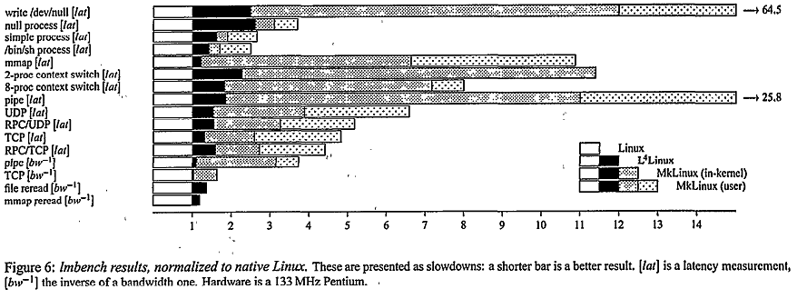
Performance - Microbenchmarks

Slide 28
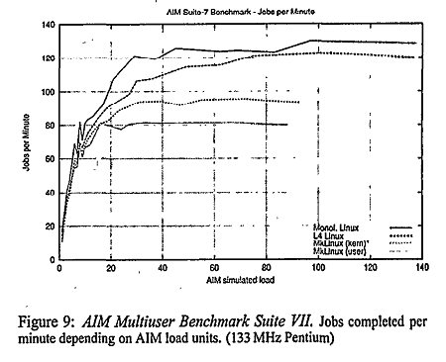
Performance - Macrobenchmarks

Slide 29
Performance - Analysis
L4Linux is 5% - 10% slower than native Linux for macrobenchmarks
User mode MkLinux is 49% slower (averaged over all loads)
In-kernel MkLinux is 29% slower (averaged over all loads)
Co-location of kernel is not enough for good performance

Slide 30
L4 is Proof of Concept
Pipes can be made faster using L4 primitives
Linux kernel was essentially unmodified
Could be optimized for microkernel
More options for extensibility

Slide 31
Perspective
Microkernels have attractive properties
Extensibility benefits
Minimal/simple
Microkernels can have comparable performance

Slide 32
Next Time
Continue working on project proposals
Talk to me
Read and write a review:
Exokernel: an operating system architecture for application-level resource management, Dawson R. Engler, M. Frans Kaashoek, and James O'Toole, Jr. 15th ACM symposium on Operating systems principles (SOSP), December 1995, pages 251–266.
Unikernels: library operating systems for the cloud, Anil Madhavapeddy, Richard Mortier, Charalampos Rotsos, David Scott, Balraj Singh, Thomas Gazagnaire, Steven Smith, Steven Hand, Jon Crowcroft. 18th ACM International Conference on Architectural support for programming languages and operating systems (ASPLOS), March 2014, pages 461--472.

