Slide 1
Classic Systems: Unix and THE
Hakim Weatherspoon
CS6410

Slide 2
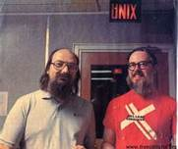
The UNIX Time-Sharing System Dennis Ritchie and Ken Thompson
Background of authors at Bell Labs
Both won Turing Awards in 1983
Dennis Ritchie
Key developer of The C Programming Lanuage, Unix, and Multics
Ken Thompson
Key developer of the B programming lanuage, Unix, Multics, and Plan 9
Also QED, ed, UTF-8

Slide 3
The UNIX Time-Sharing System Dennis Ritchie and Ken Thompson

Slide 4
The UNIX Time-Sharing System Dennis Ritchie and Ken Thompson

Slide 5
The UNIX Time-Sharing System Dennis Ritchie and Ken Thompson
Classic system and paper
described almost entirely in 10 pages
Key idea
elegant combination: a few concepts that fit together well
Instead of a perfect specialized API for each kind of device or abstraction, the API is deliberately small

Slide 6
System features
Time-sharing system
Hierarchical file system
Device-independent I/O
Shell-based, tty user interface
Filter-based, record-less processing paradigm
Major early innovations: “fork” system call for process creation, file I/O via a single subsystem, pipes, I/O redirection to support chains

Slide 7
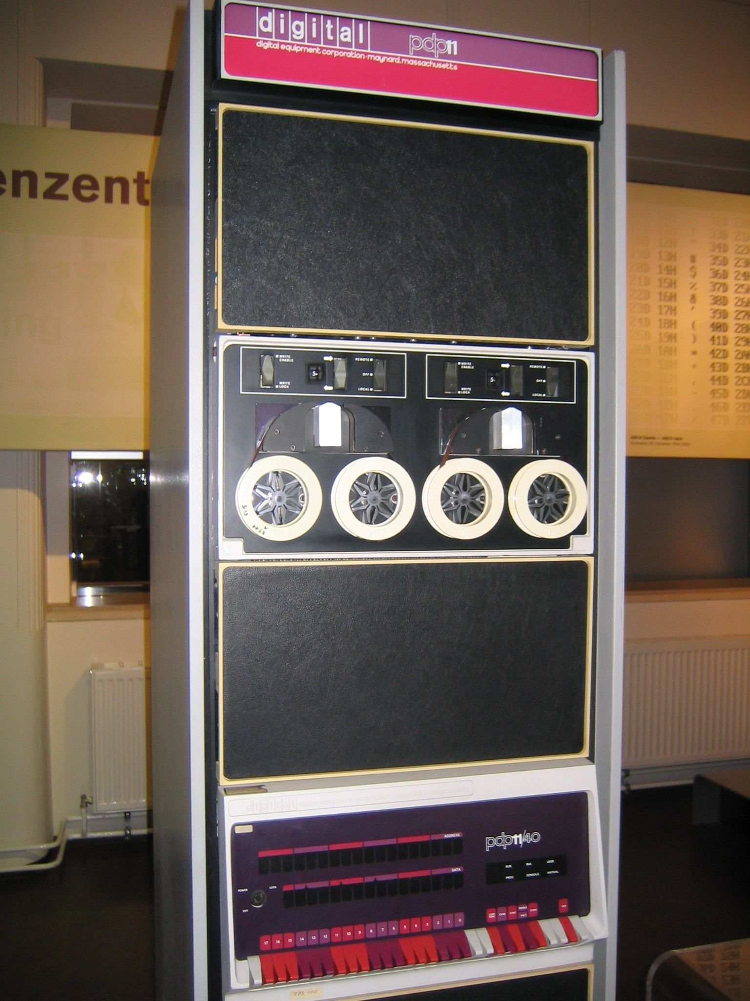
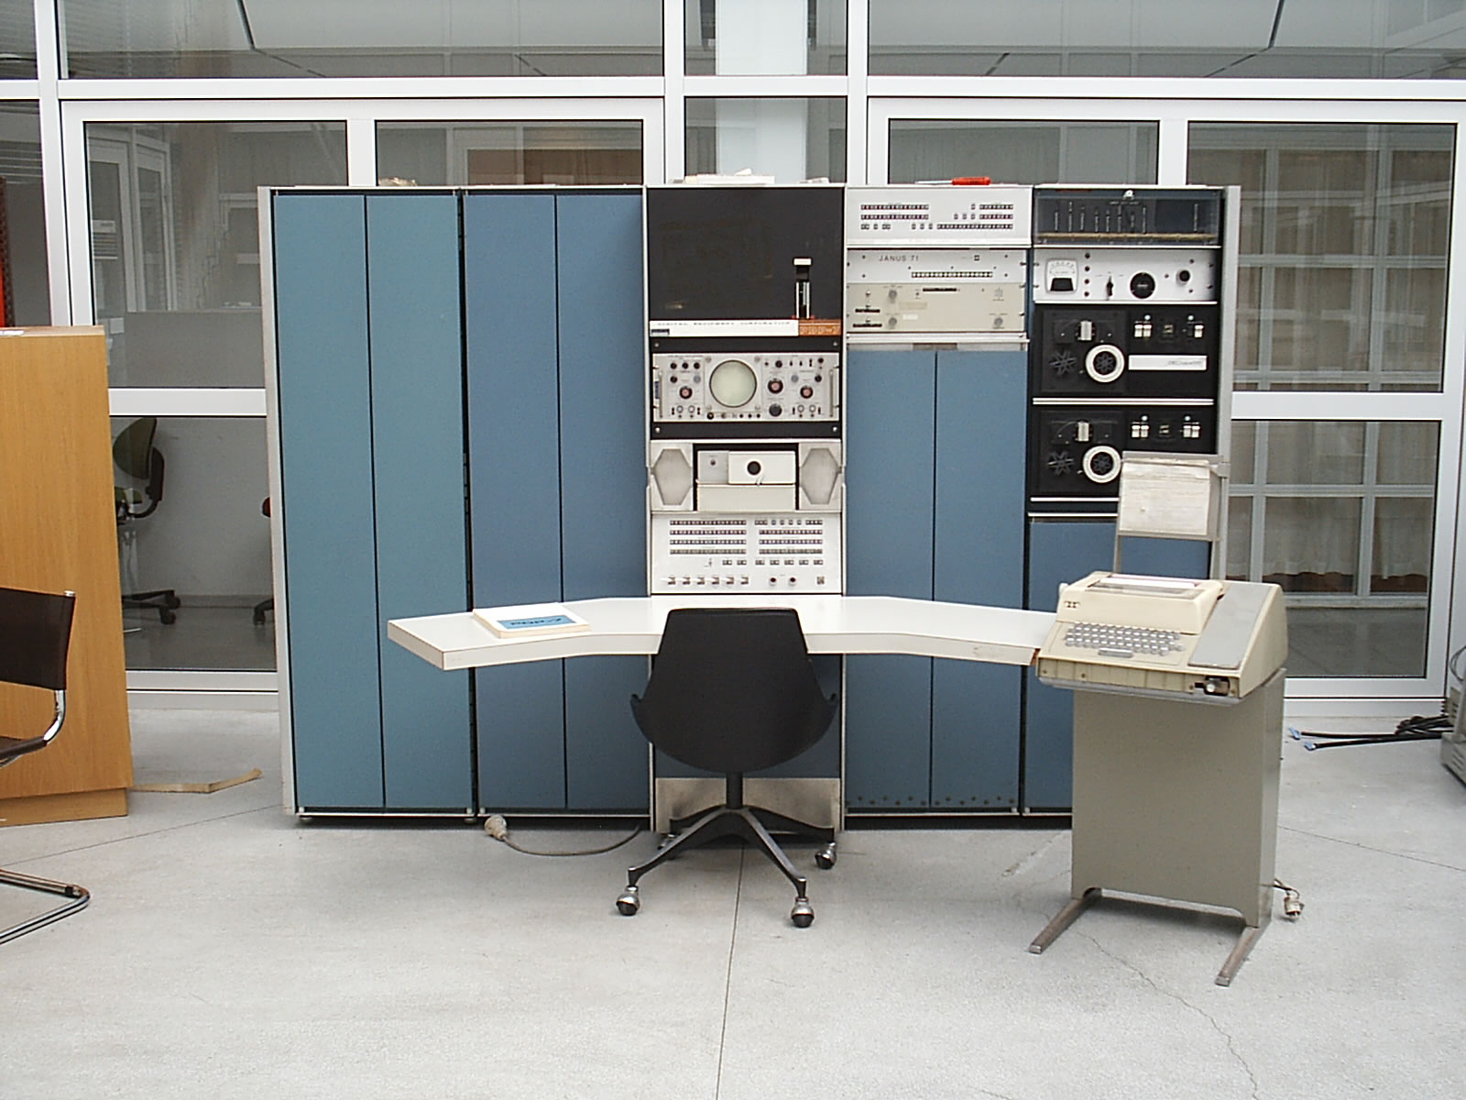
Version 3 Unix
1969: Version 1 ran PDP-7
1971: Version 3 Ran on PDP-11’s
Costing as little as $40k!
< 50 KB
2 man-years
to write
Written in C
PDP-7
PDP-11

Slide 8
File System
Ordinary files (uninterpreted)
Directories (protected ordinary files)
Special files (I/O)

Slide 9
Uniform I/O Model
open, close, read, write, seek
Uniform calls eliminates differences between devices
Two categories of files: character (or byte) stream and block I/O, typically 512 bytes per block
other system calls
close, status, chmod, mkdir, ln
One way to “talk to the device” more directly
ioctl, a grab-bag of special functionality
lowest level data type is raw bytes, not “records”

Slide 10
Directories
root directory
path names
rooted tree
current working directory
back link to parent
multiple links to ordinary files

Slide 11
Special Files
Uniform I/O model
Each device associated with at least one file
But read or write of file results in activation of device
Advantage: Uniform naming and protection model
File and device I/O are as similar as possible
File and device names have the same syntax and meaning, can pass as arguments to programs
Same protection mechanism as regular files

Slide 12
Removable File System
Tree-structured
Mount’ed on an ordinary file
Mount replaces a leaf of the hierarchy tree (the ordinary file) by a whole new subtree (the hierarchy stored on the removable volume)
After mount, virtually no distinction between files on permanent media or removable media

Slide 13
Protection
User-world, RWX bits
set-user-id bit
super user is just special user id

Slide 14
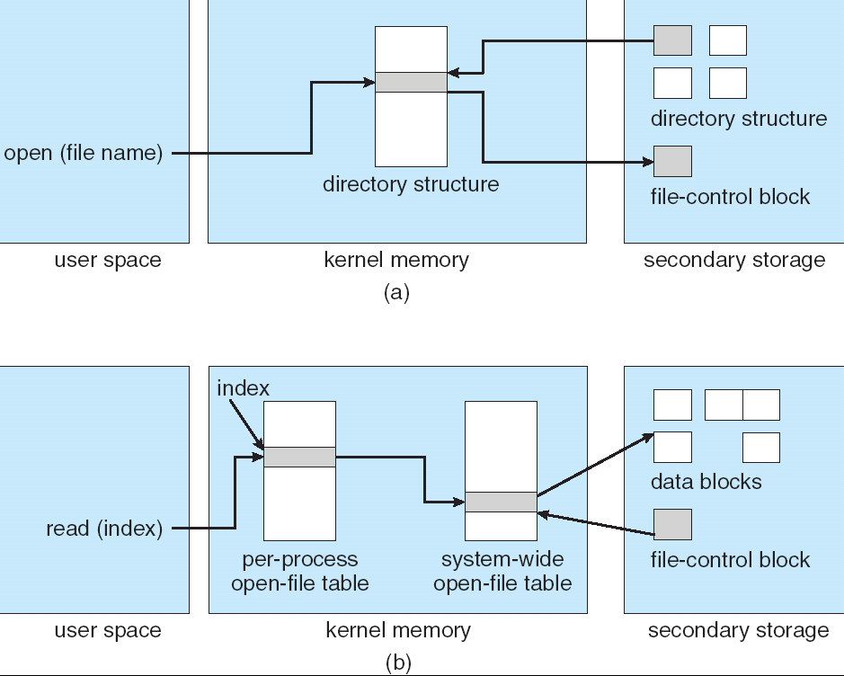
File System Implementation
System table of i-numbers (i-list)
i-nodes
path names (directory is just a special file!)
mount table
buffered data
write-behind

Slide 15
I-node Table
short, unique name that points at file info.
allows simple & efficient fsck
cannot handle accounting issues
Inode
File name
Inode#

Slide 16
Many devices fit the block model
Disks
Drums
Tape drives
USB storage
Early version of the ethernet interface was presented as a kind of block device (seek disabled)
But many devices used IOCTL operations heavily

Slide 17
Processes and images
text, data & stack segments
process swapping
pid = fork()
pipes
exec(file, arg1, ..., argn)
pid = wait()
exit(status)

Slide 18
Easy to create pipelines
A “pipe” is a process-to-process data stream, could be implemented via bounded buffers, TCP, etc
One process can write on a connection that another reads, allowing chains of commands
% cat *.txt | grep foo | wc
In combination with an easily programmable shell scripting model, very powerful!

Slide 19
The Shell
cmd arg1 ... argn
stdio & I/O redirection
filters & pipes
multi-tasking from a single shell
shell is just a program
Trivial to implement in shell
Redirection, background processes, cmd files, etc

Slide 20
Traps
Hardware interrupts
Software signals
Trap to system routine

Slide 21
Perspective
Not designed to meet predefined objective
Goal: create a comfortable environment to explore machine and operating system
Other goals
Programmer convenience
Elegance of design
Self-maintaining

Slide 22
Perspective
But had many problems too. Here are a few:
Weak, rather permissive security model
File names too short and file system damaged on crash
Didn’t plan for threads and never supported them well
“Select” system call and handling of “signals” was ugly and out of character w.r.t. other features
Hard to add dynamic libraries (poor handling of processes with lots of “segments”)
Shared memory and mapped files fit model poorly
...in effect, the initial simplicity was at least partly because of some serious limitations!

Slide 23
Even so, Unix has staying power!
Today’s Linux systems are far more comprehensive yet the core simplicity of Unix API remains a very powerful force
Struggle to keep things simple has helped keep O/S developers from making the system specialized in every way, hard to understand
Even with modern extensions, Unix has a simplicity that contrasts with Windows .NET API... Win32 is really designed as an internal layer that libraries invoke, but that normal users never encounter.

Slide 24
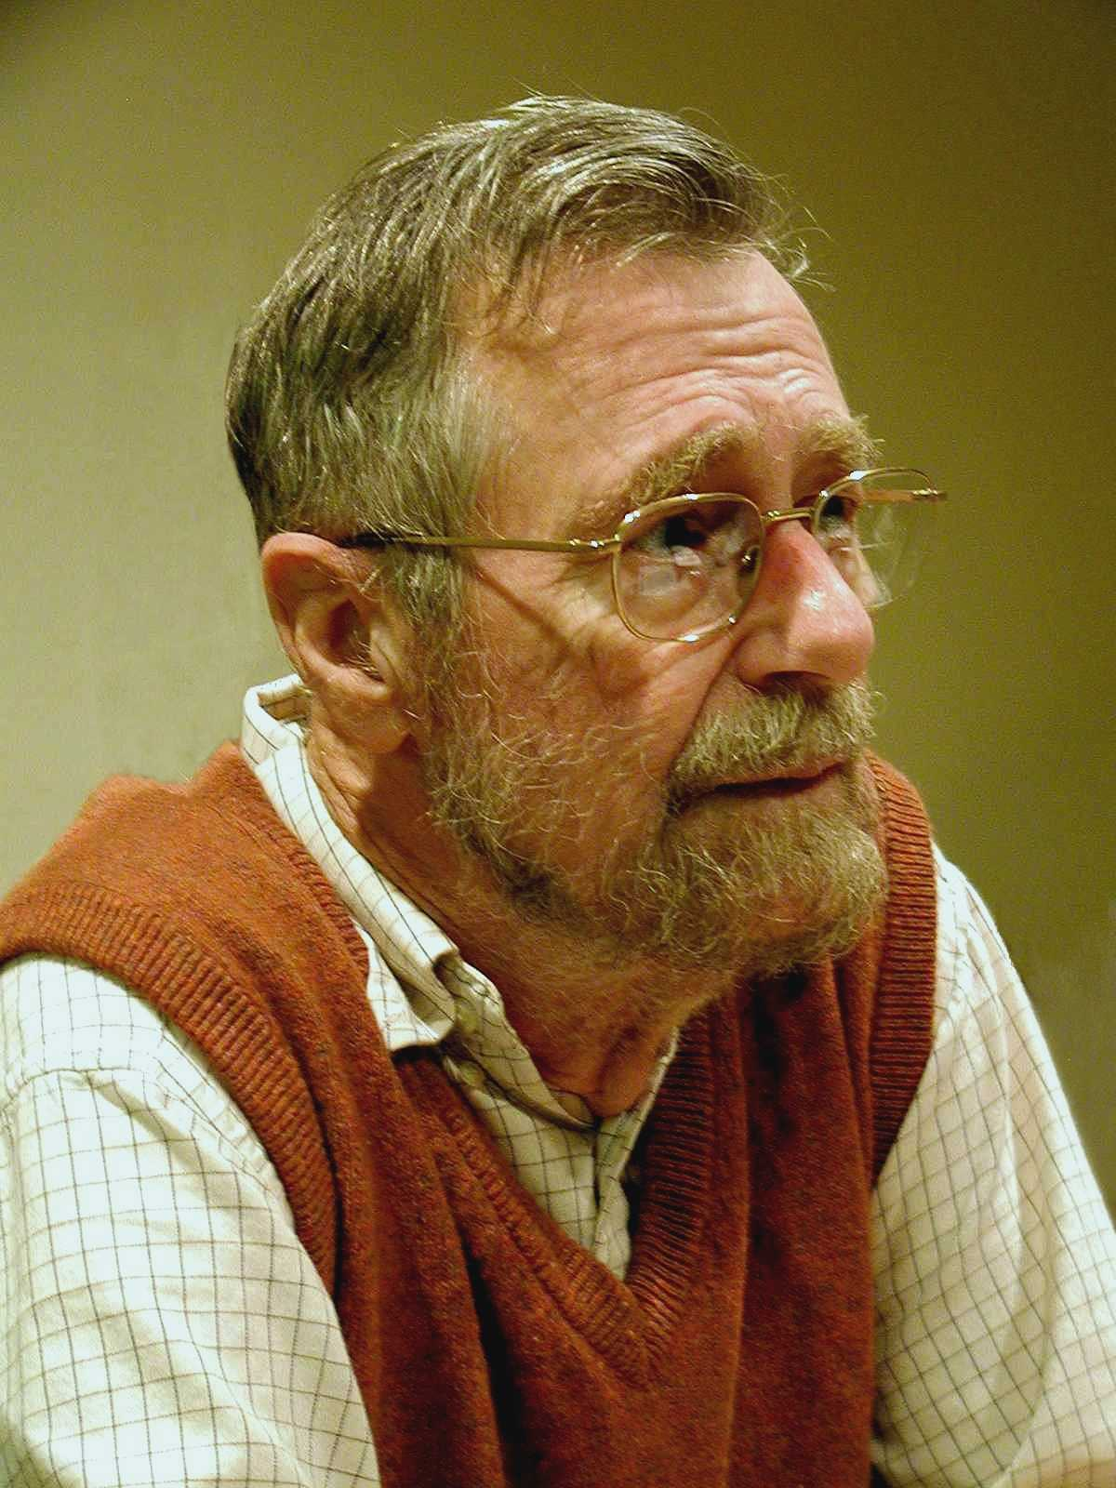
“THE”-Multiprogramming System Edsger W. Dijkstra
Received Turing Award in 1972
Contributions
Shortest Path Algorithm, Reverse Polish Notation, Bankers algorithm, semaphore’s, self-stabilization
Known for disliking ‘goto’ statements and using computers!

Slide 25
“THE”-Multiprogramming System Edsger W. Dijkstra
Never named “THE” system; instead, abbreviation for "Technische Hogeschool Eindhoven”
Batch system (no human intervention) that supported multitasking (processes share CPU)
THE was not multiuser
Introduced
software-based memory segmentation
Cooperating sequential processes
semaphores

Slide 26
Design
Layered structure
Later Multics has layered structure, ring segmentation
Layer 0 – the scheduler
Allocated CPU to processes, accounted for blocked proc’s
Layer 1 – the pager
Layer 2 – communication between OS and console
Layer 3 – managed I/O
Layer 4 – user programs
Layer 5 – the user
“Not implemented by us”!

Slide 27
Perspective
Layered approach
Design small, well defined layers
Higher layers dependent on lower ones
Helps prove correctness
Helps with debugging
Sequential process and Semaphores

Slide 28
Next Time
Read and write review:
SEDA: An Architecture for Well Conditioned, Scalable Internet Services, Matt Welsch, David Culler, and Eric Brewer. Proceedings of the Eighteenth ACM Symposium on Operating Systems Principles (Banff, Alberta, Canada, 2001), pages 230--243
On the duality of operating system structures, H. C. Lauer and R. M. Needham. ACM SIGOPS Operating Systems Review Volume 12, Issue 2 (April 1979), pages 3--19.

Slide 29
Next Time
Read and write review:
MP1 – available later today and due in two weeks and milestone due next week
Project Proposal due end of next week
talk to me and other faculty and email and talk to me
Check website for updated schedule

