Slide 1
Serving Photos at Scaaale: Caching and Storage
An Analysis of Facebook Photo Caching. Huang et al.
Finding a Needle in a Haystack. Beaver et al.
Vlad Niculae for CS6410
Most slides from Qi Huang (SOSP 2013) and Peter Vajgel (OSDI 2010)

Slide 2



Slide 3
Dynamic (hard to cache; TAO)
Static
(photos, normally easy to cache)

Slide 4
Dynamic (hard to cache; TAO)
Static
(photos, normally easy to cache)

Slide 5
Dynamic (hard to cache; TAO)
CDN
Static
(photos, normally easy to cache)
Notes:
You have a repo with hard disks and stuff, and use a content delivery network to cache static content.

Slide 6

An Analysis of Facebook Photo Caching
Qi Huang, Ken Birman, Robbert van Renesse (Cornell),
Wyatt Lloyd (Princeton, Facebook),
Sanjeev Kumar, Harry C. Li (Facebook)

Slide 7
Dynamic (hard to cache; TAO)
CDN
Static
(photos, normally easy to cache)
“Normal” site CDN hitrate ~99%
Notes:
You have a repo with hard disks and stuff, and use a content delivery network to cache static content.

Slide 8
Dynamic (hard to cache; TAO)
CDN
Static
(photos, normally easy to cache)
“Normal” site CDN hitrate ~99%
For Facebook, CDN hitrate ~80%

Slide 9
Dynamic (hard to cache; TAO)
CDN
Static
(photos, normally easy to cache)
“Normal” site CDN hitrate ~99%
For Facebook, CDN hitrate ~80%
Challenge #1

Slide 10
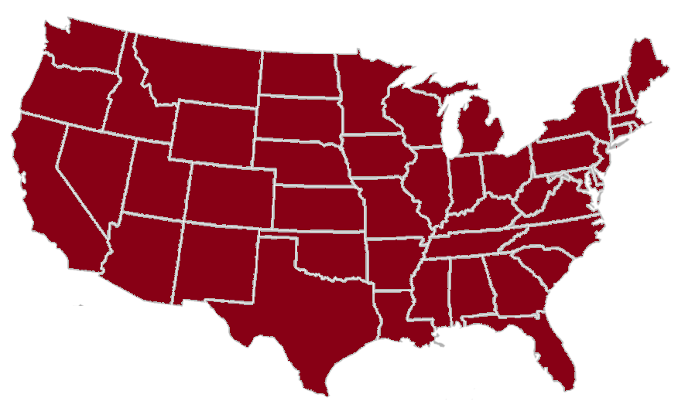
Challenge #2
Dynamic (hard to cache; TAO)
CDN
Static
(photos, normally easy to cache)
“Normal” site CDN hitrate ~99%
For Facebook, CDN hitrate ~80%
Challenge #1

Slide 11
Cache
Layers
Storage Backend

Slide 12

Facebook Edge Cache
Datacenter
Client
Browser
Cache
Akamai
Origin Cache
Backend
Cache layers

Slide 13
Facebook Edge Cache
Datacenter
Client
Browser
Cache
Akamai
Origin Cache
Backend
(no access)
Cache layers

Slide 14
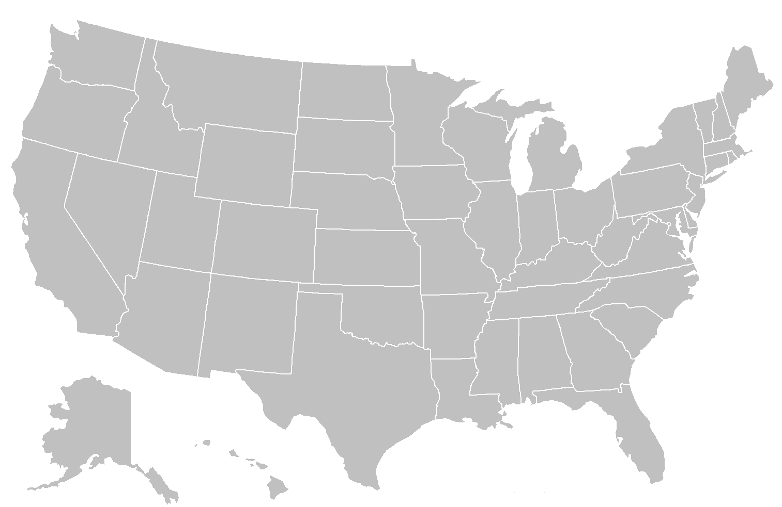
Points of presence:
Independent
FIFO
Main goal:
reduce bandwidth
Datacenter
Client
Facebook Edge Cache
Browser
Cache
Origin Cache
Backend
Cache layers

Slide 15
Origin:
Coordinated
FIFO
Main goal:
traffic sheltering
Datacenter
Client
Facebook Edge Cache
Browser
Cache
Origin Cache
Backend
Cache layers

Slide 16
Origin:
Coordinated.
FIFO
Main goal:
traffic sheltering
hash
Datacenter
Client
Facebook Edge Cache
Browser
Cache
Origin Cache
Backend
Cache layers

Slide 17
Analyze traffic in production!
Instrument client JS
Correlate across layers.
Datacenter
Client
Facebook Edge Cache
Browser
Cache
Origin Cache
Backend
Log successful requests.
Cache layers
Notes:
Qi did this
Over 1 month

Slide 18
Sampling on Power-law
Object-based
Object rank
Object-based: fair coverage of unpopular content
Sample 1.4M photos, 2.6M photo objects

Slide 19
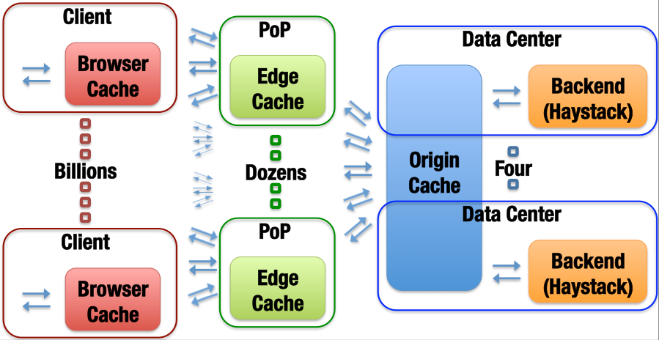

Slide 20
Data analysis

Slide 21

Client
PoP
Data Center
Browser
Cache
Edge
Cache
Origin
Cache
Backend (Haystack)
R
77.2M
26.6M
65.5%
11.2M
58.0%
7.6M
31.8%
Traffic Share
65.5%
20.0%
4.6%
9.9%
Notes:
Origin isn’t impressive, but there’s not much left to cache at that level. Haystack still gets 10%!

Slide 22
Object rank

Slide 23
Popularity Distribution
Backend resembles a stretched exponential dist.

Slide 24
Popularity Impact on Caches
70% Haystack
Backend serves the tail

Slide 25
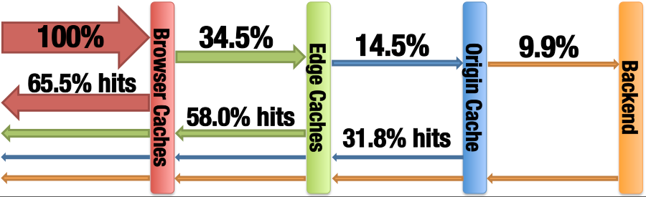

Slide 27
What if?

Slide 28
Edge Cache with Different Sizes
Picked San Jose edge (high traffic, median hit ratio)
68%
65%
59%
“x” estimates current deployment size (59% hit ratio)

Slide 29
Edge Cache with Different Sizes
Picked San Jose edge (high traffic, median hit ratio)
Infinite Cache
68%
65%
59%
“Infinite” size ratio needs 45x of current capacity

Slide 30
Edge Cache with Different Algos
Infinite Cache
Both LRU and LFU outperform FIFO slightly

Slide 31
S4LRU
Cache Space
L3
More Recent
L2
L1
L0

Slide 32
S4LRU
Cache Space
L3
More Recent
L2
L1
L0
Missed Object

Slide 33
S4LRU
Cache Space
L3
Hit
More Recent
L2
L1
L0

Slide 34
S4LRU
Cache Space
L3
Evict
More Recent
L2
L1
L0

Slide 35
Edge Cache with Different Algos
Infinite Cache
68%
59%
1/3x
S4LRU improves the most

Slide 36
Edge Cache with Different Algos
Infinite Cache
Clairvoyant => room for algorithmic improvement.

Slide 37
Origin Cache
Infinite Cache
14%
S4LRU improves Origin more than Edge
Notes:
Transition here. So with this minor tweak we do better. But is the overall architecture the right one?

Slide 38
Geographic Coverage of Edge
Small working set

Slide 39
Geographic Coverage of Edge
Atlanta has 80% requests served by remote Edges. Not uncommon!
5% NYC
10% Chicago
5% California
35% D.C.
Atlanta
20% local
5% Dallas
20% Miami

Slide 40
Geographic Coverage of Edge
Amplified working set

Slide 41
Collaborative Edge

Slide 42
Collaborative Edge
18%
Collaborative
“Collaborative” Edge increases hit ratio by 18%

Slide 43
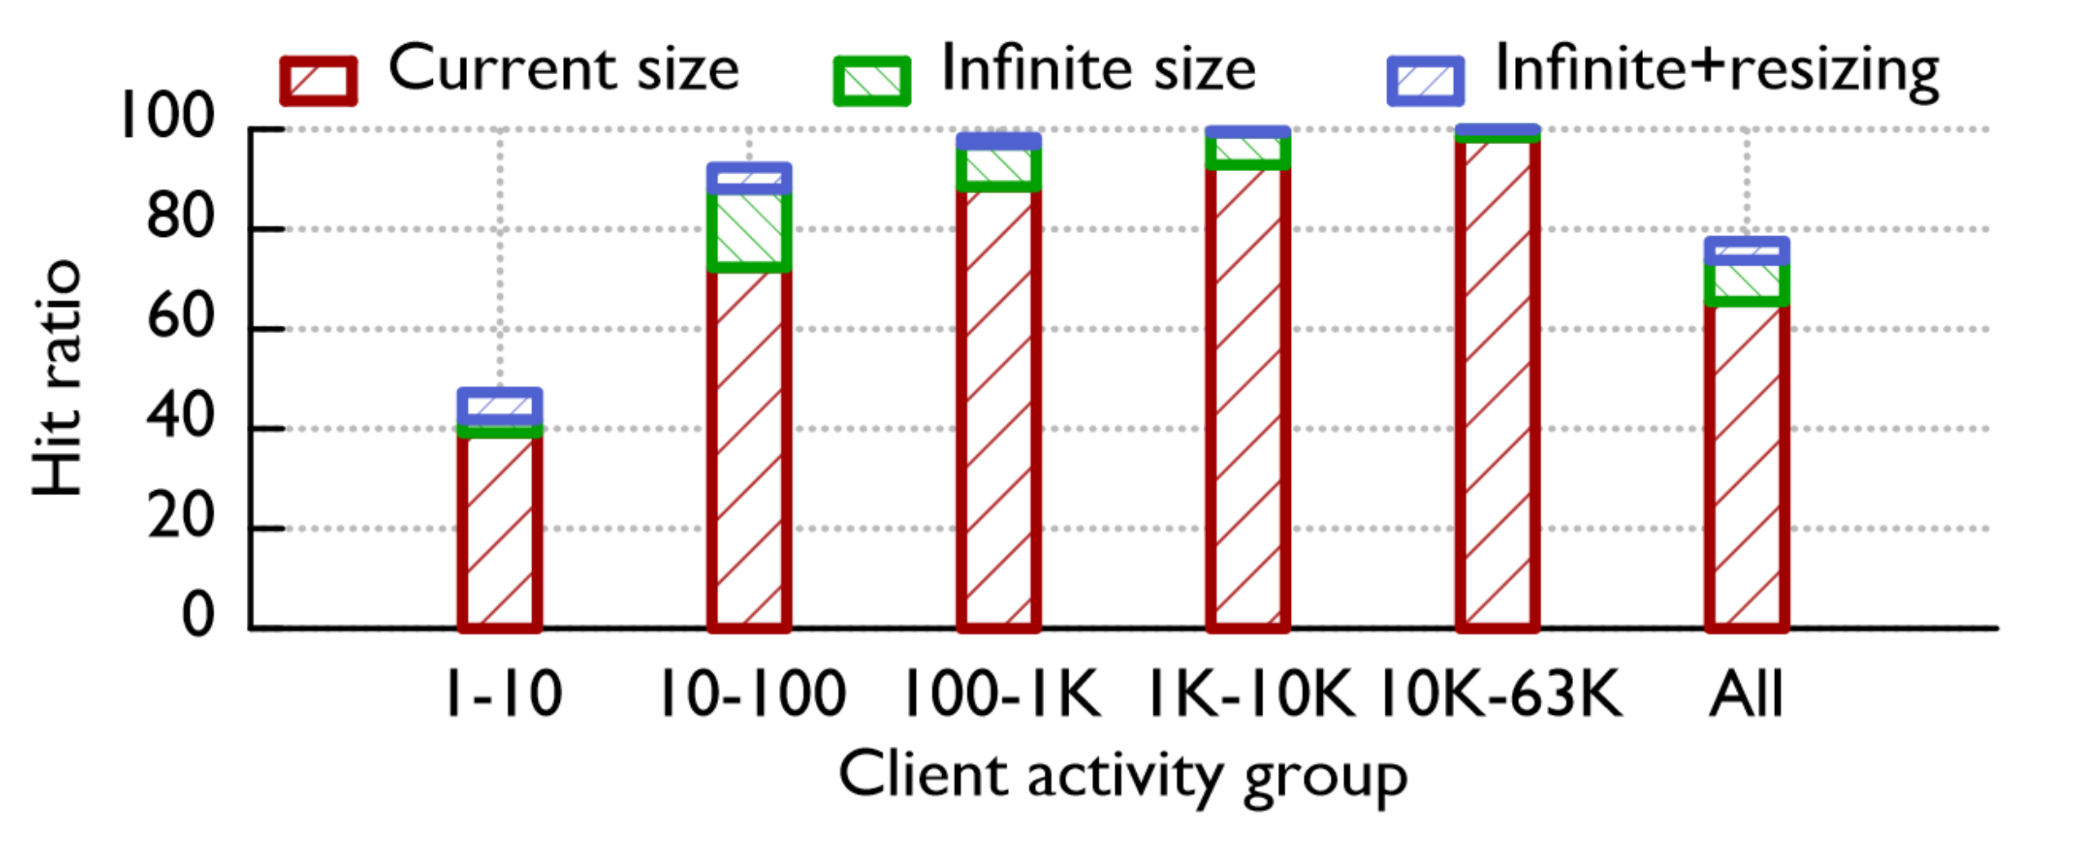

Slide 44
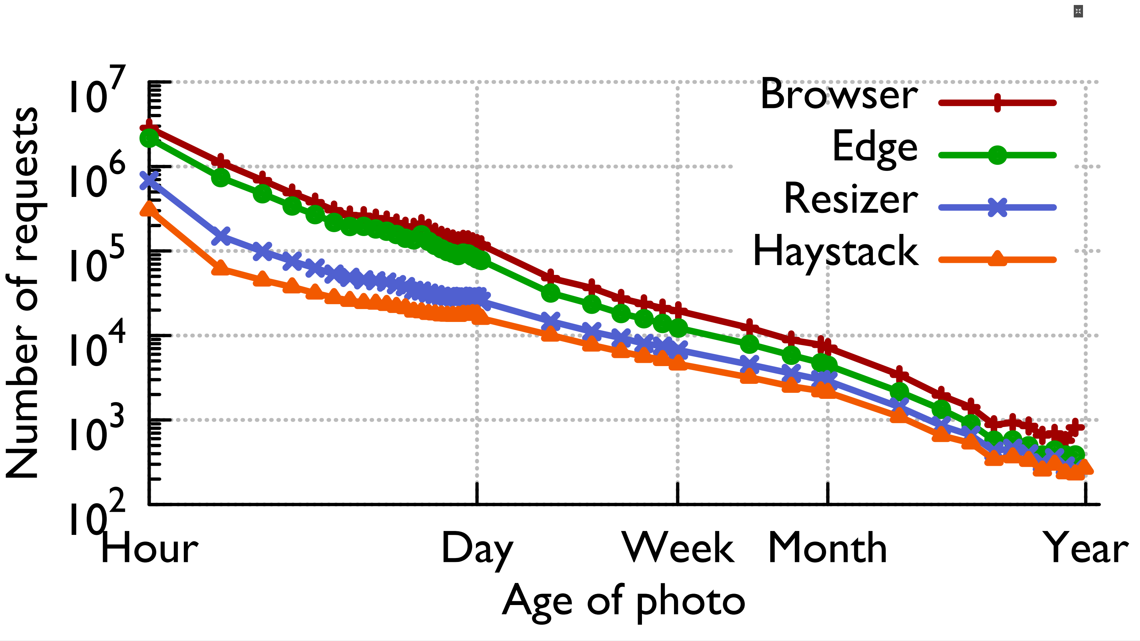

Slide 45
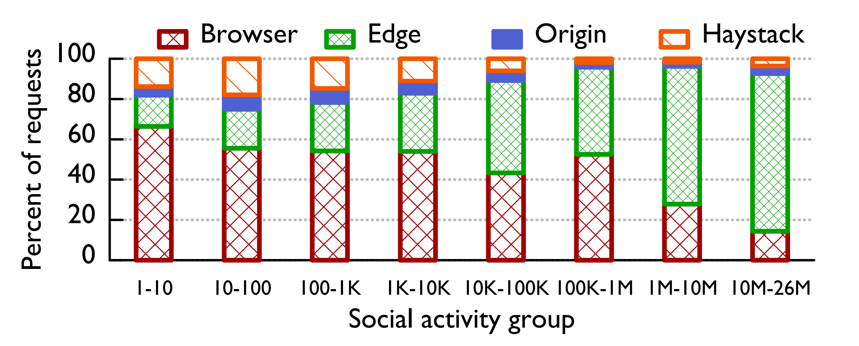

Slide 46
What Facebook Could Do:
Improve cache algorithm (+invest in cache algo research)
Coordinate Edge caches
Let some phones resize their own photos
Use more machine learning at this layer!

Slide 47
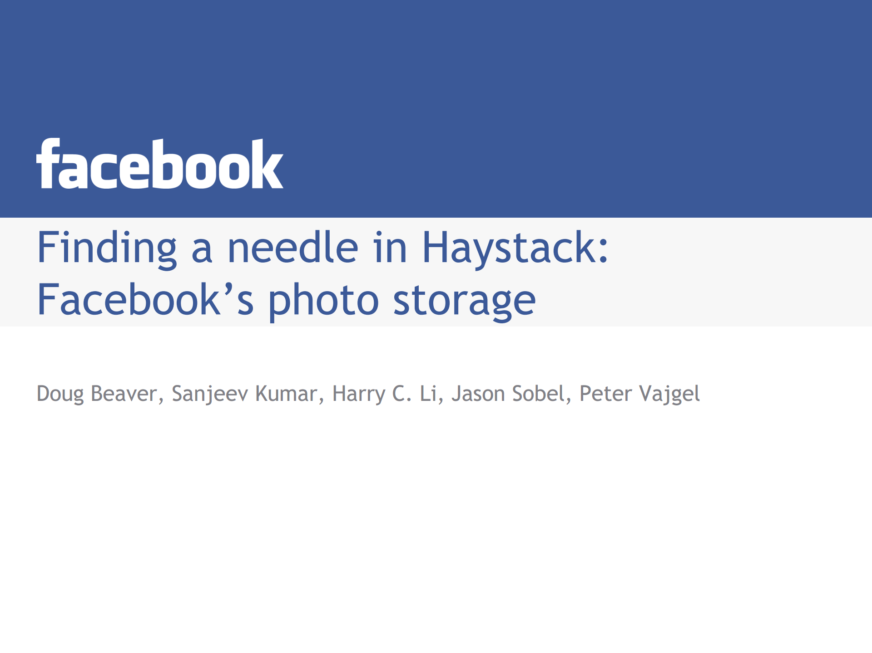
Notes:
~50% of the talk is bragging about facebook’s scale

Slide 48
Backend storage for blobs
Some requests are bound to miss the caches.
Reads >> writes >> deletes.
Writes often come in batches (Photo Albums)
In this regime, Facebook found default solutions not to work.

Slide 49
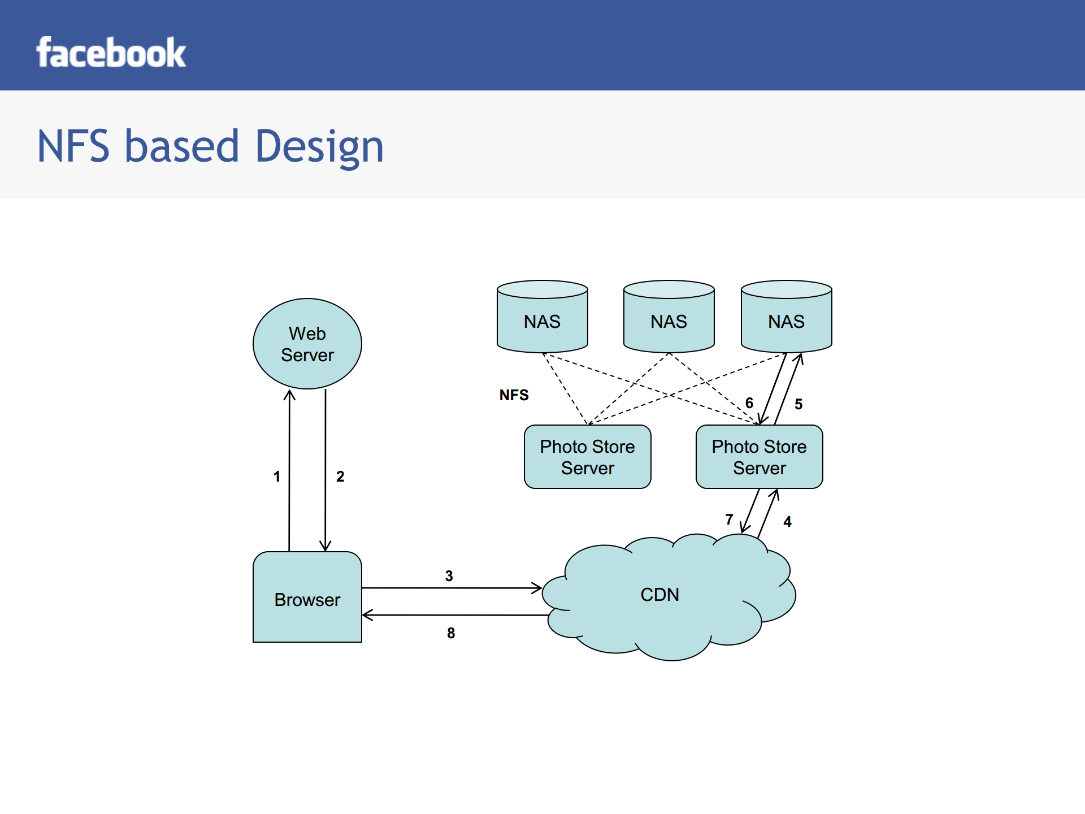

Slide 50
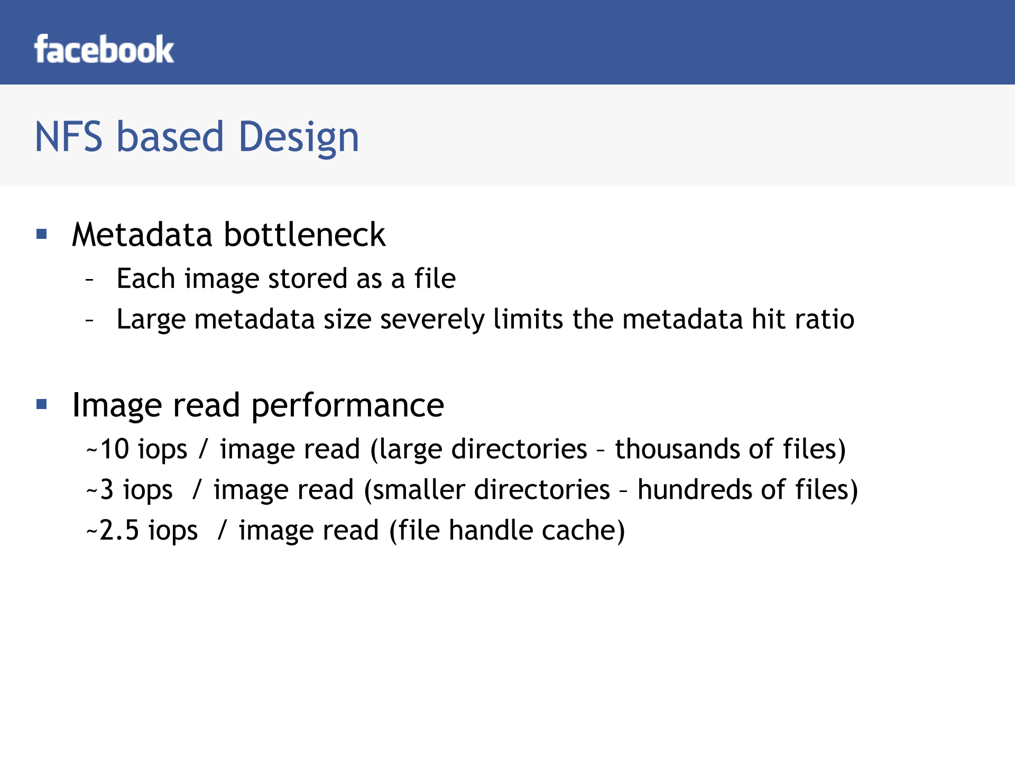
Notes:
The problem is: many small files = large metadata.

Slide 51
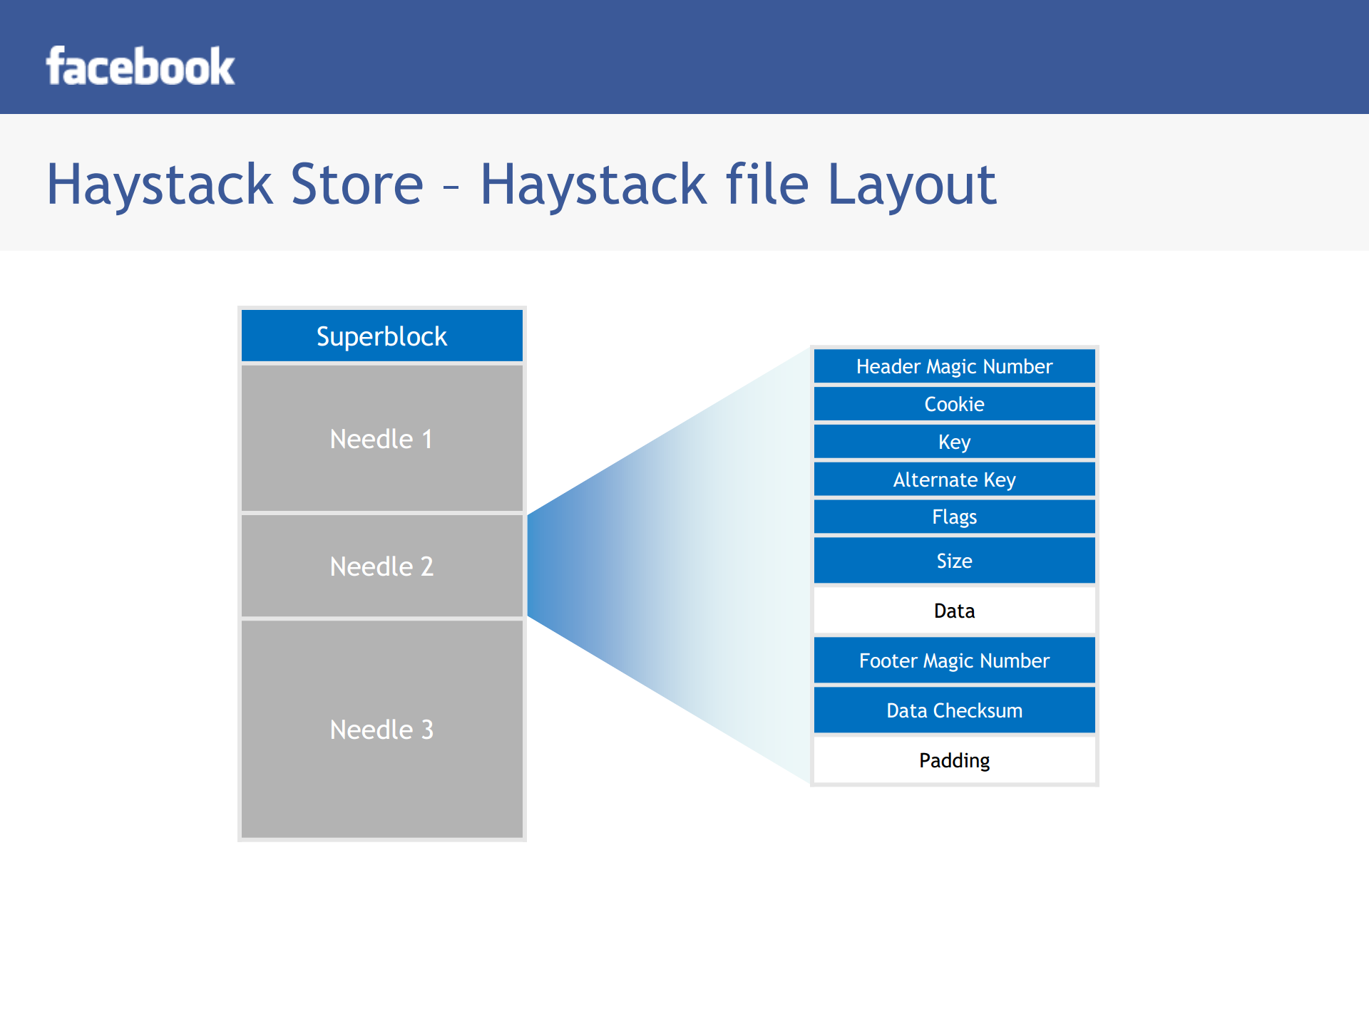

Slide 52
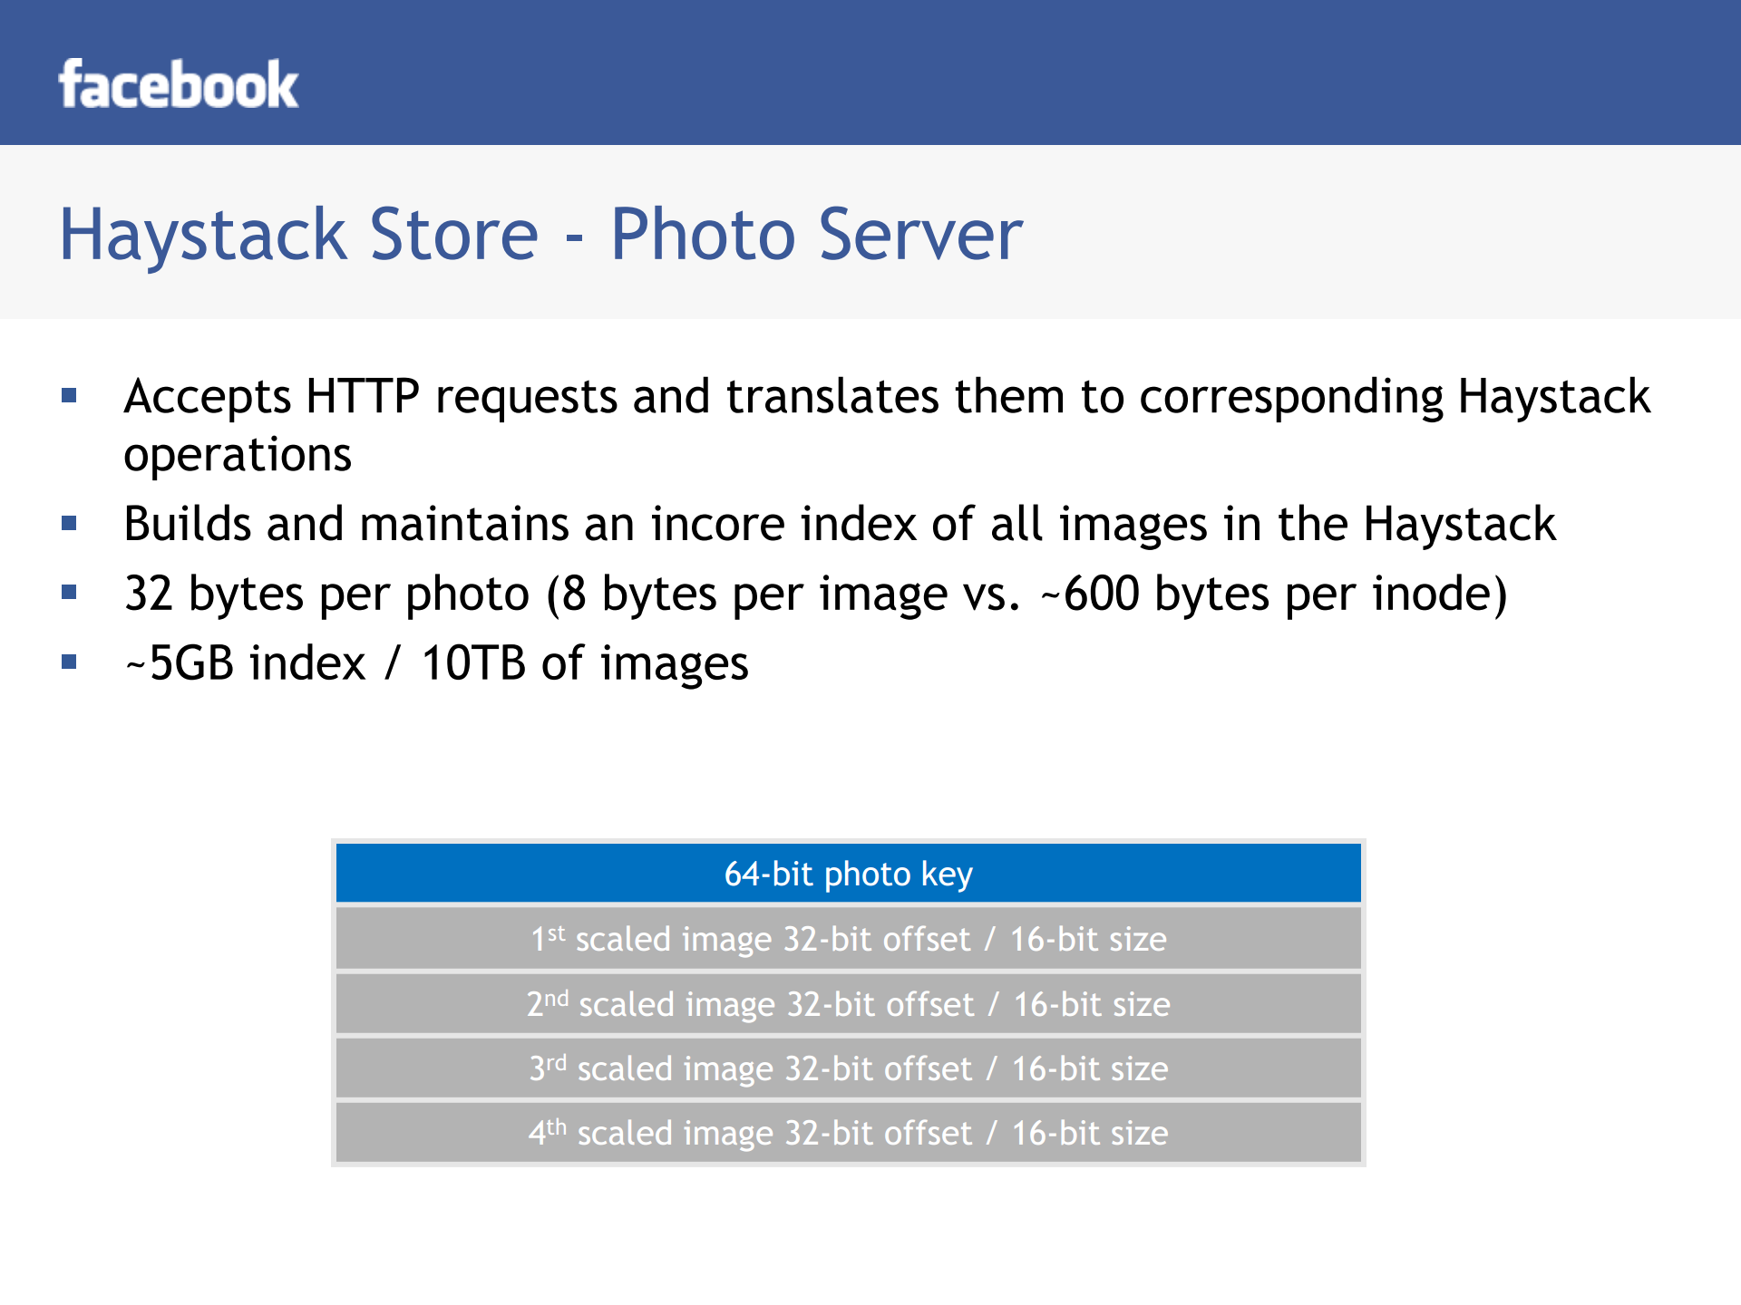

Slide 53
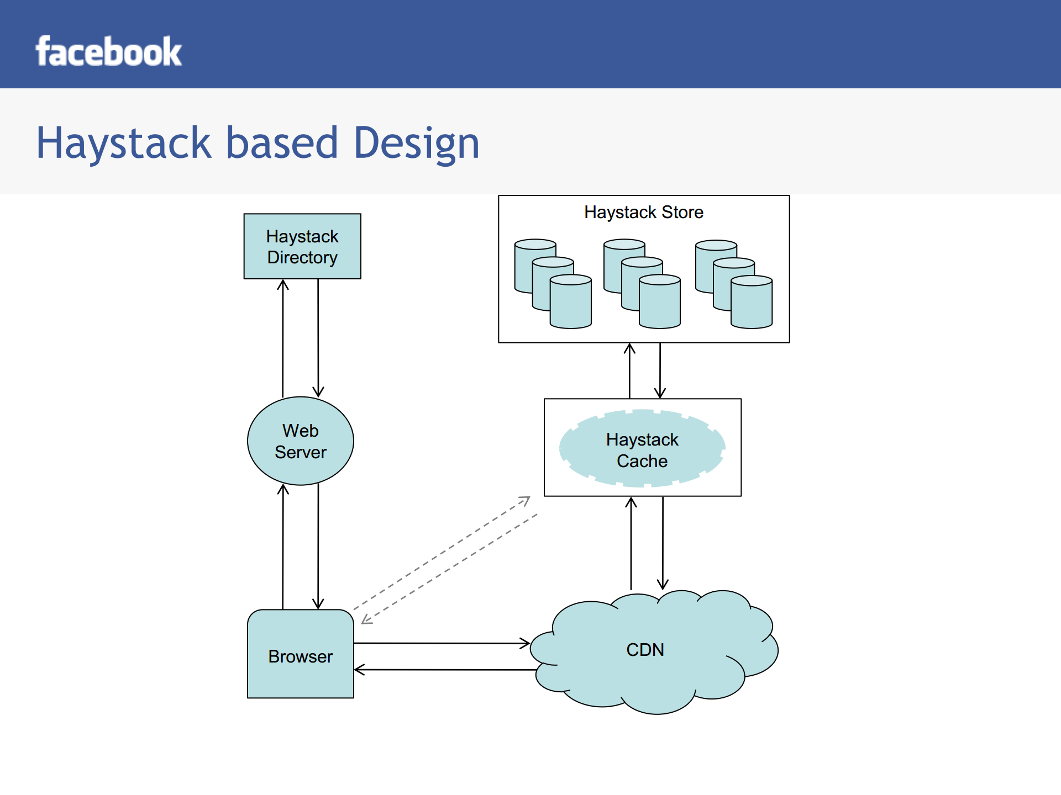
Notes:
3 (phys) haystacks per 1 logical volume: redundancy. 1/3 is geographically remote

Slide 54
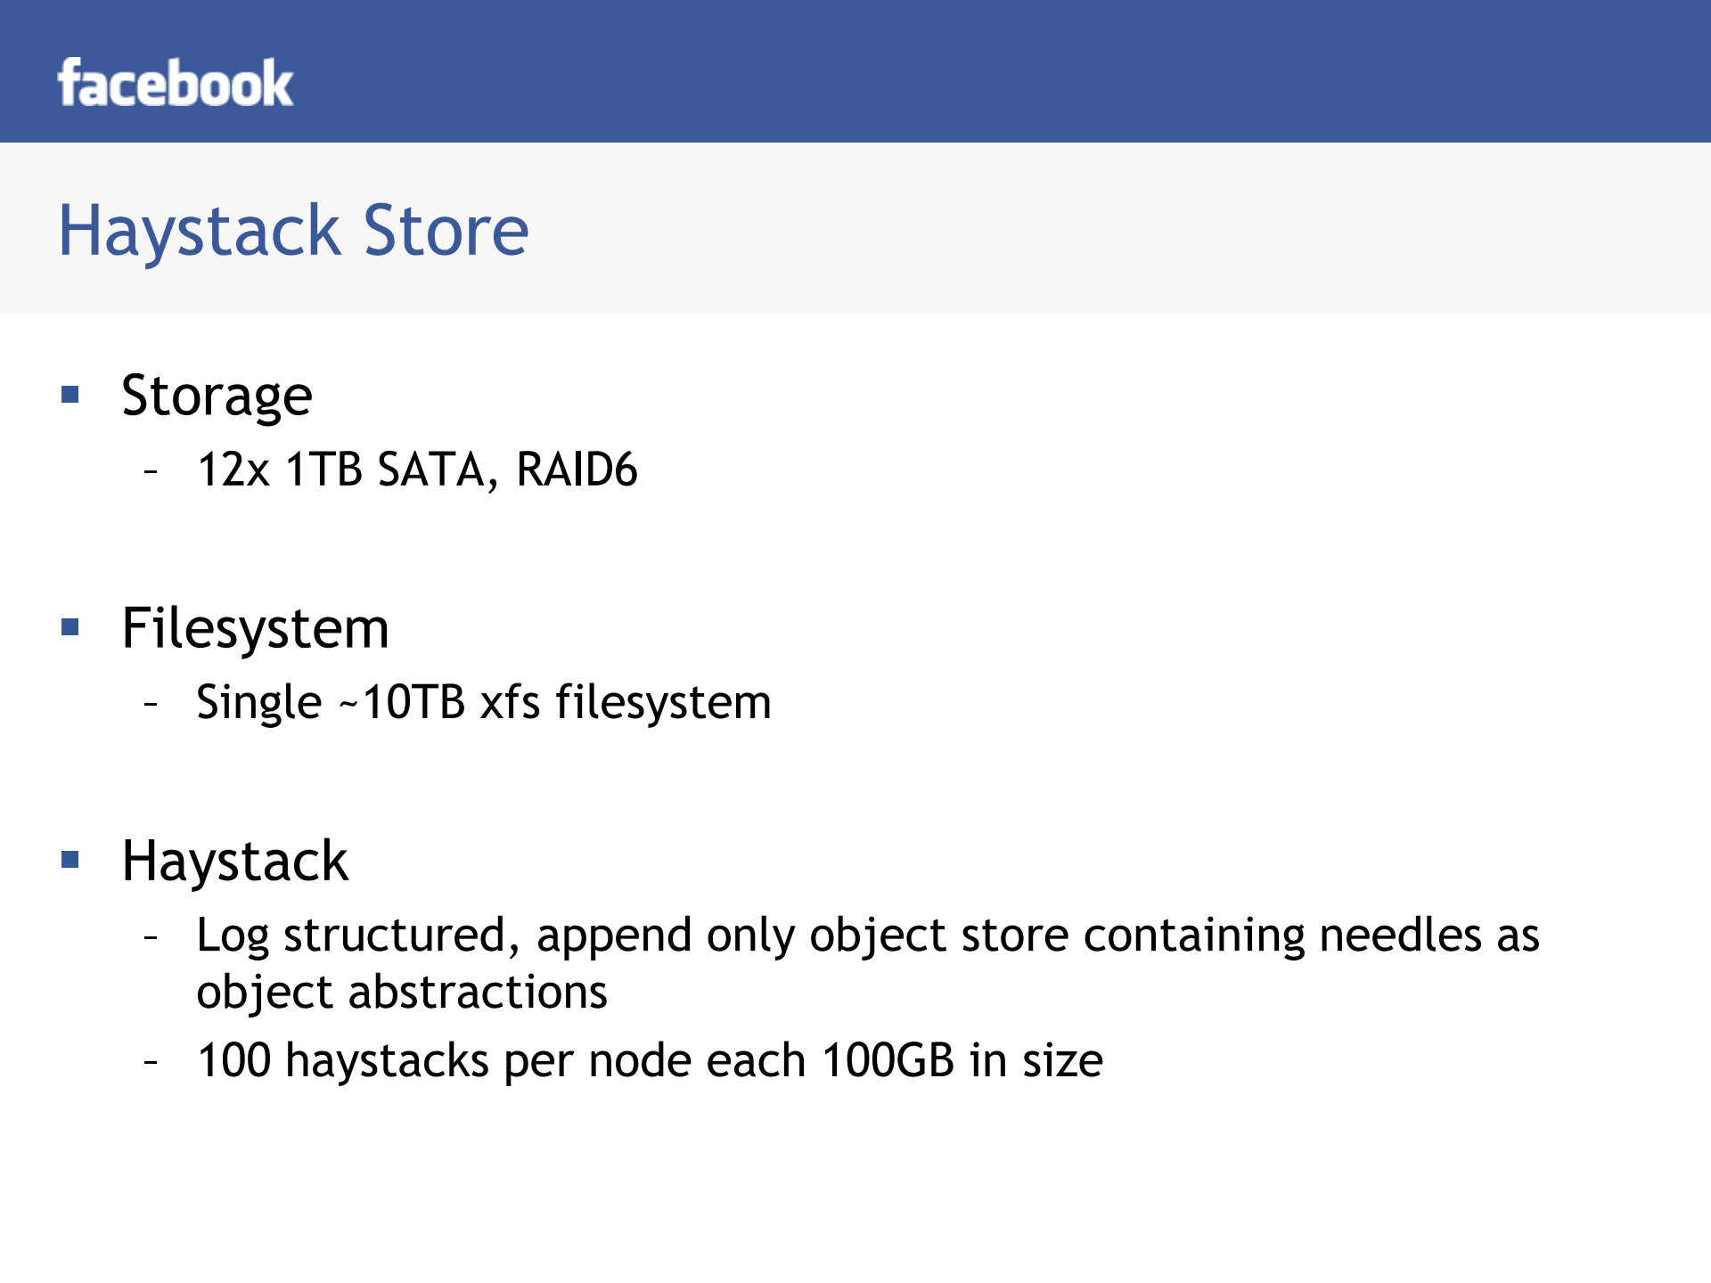

Slide 55
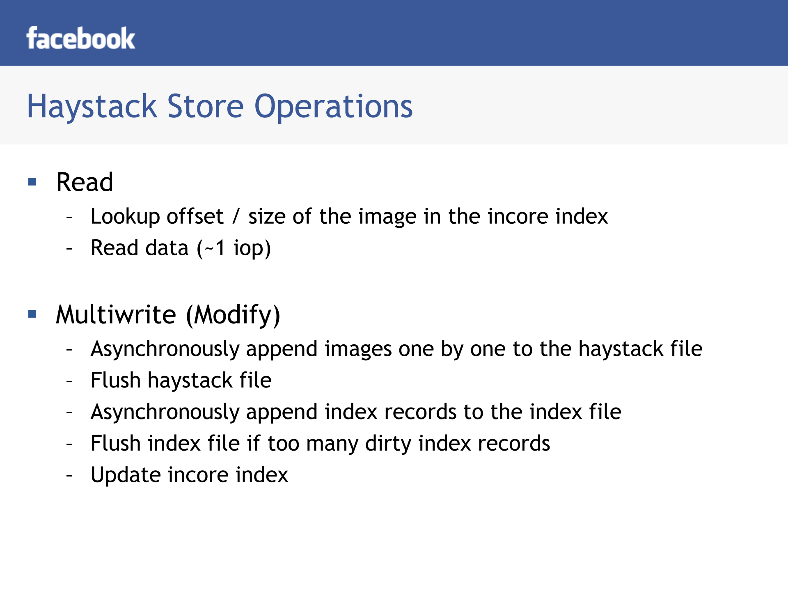

Slide 56
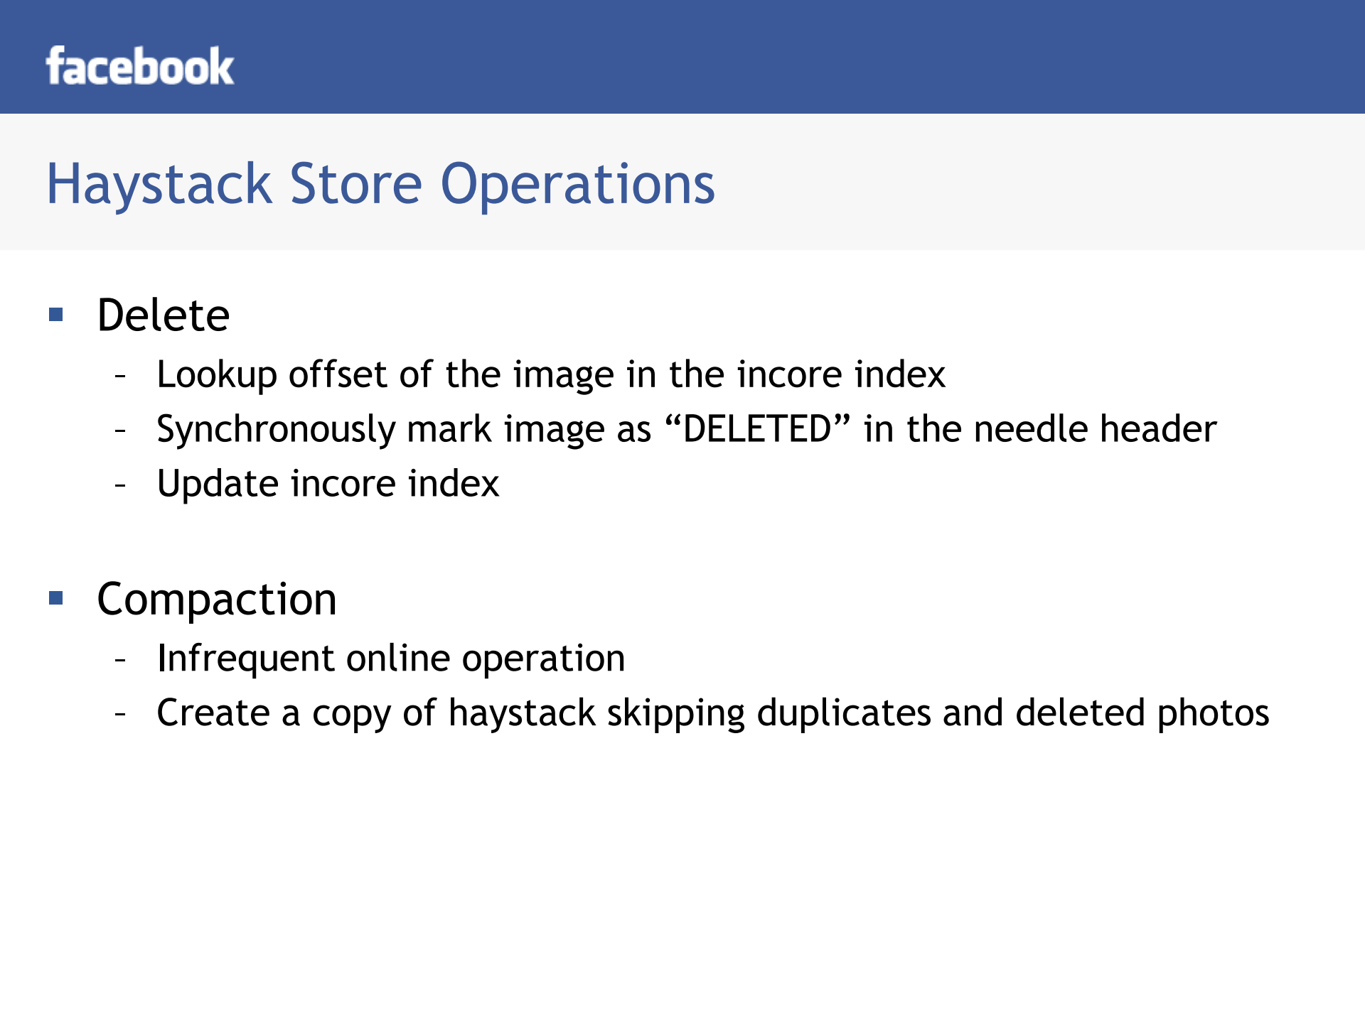

Slide 57
