Slide 1
Fault Tolerance
Ken Birman

Slide 2
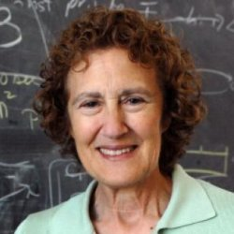

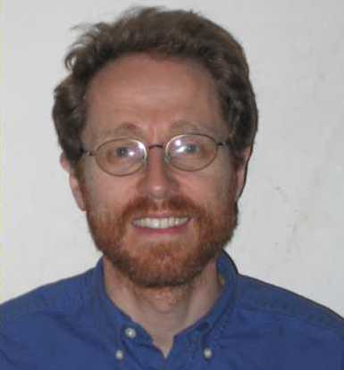

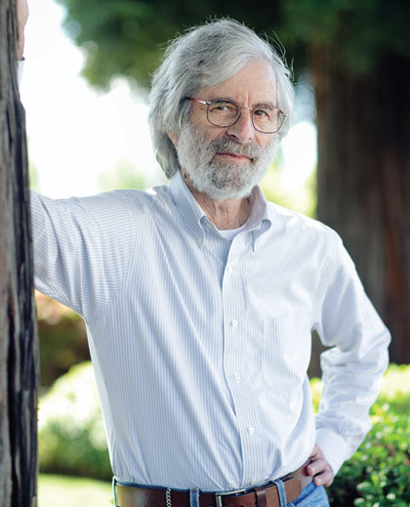
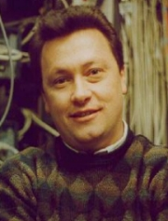

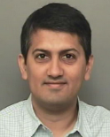
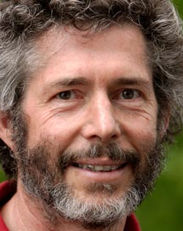
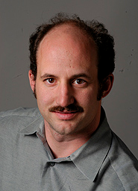

Too many seminal concepts
Lorenzo Alvisi’s Byzantine twin wants you to use 2f+1 replicas
Bonjour!
Process pairs, primary-backup
2PC and 3PC, Quorums
Atomic Transactions
State machine replication
RAID storage solutions
Consensus ◊W: consensus
FLP + oracle
Checkpoints, Message Logging
Byzantine Agreement
Gossip protocols
Virtual synchrony model
Paxos
Zookeeper
CATOCS CAP
Theory … Skepticism

Slide 3
Quicksilver
Sender
based
Unified
Receiver
based
Chubby
Zookeeper
VM
chkpts
Transis
Snapshot
Serializability
Fawn
Hypervisor
RAID
Chain
Replication
Time,
Clocks
Zookeeper
Nested
Transactions
QuickSilver
Linearizability
Bimodal
Multicast
Checkpoint
Rollback
Storage
Solutions
Paxos
BAR
Gossip
Argus
Isolate, recover from driver faults
Isis
Thor
LINQ
ZYZZYVA
PRACTI
2PC
3PC
RDMA
Verbs
State Machine Replication
Transactions
VIA
Infiniband
BFT
Quorums
U-Net
Consensus
Gossip
Capability
Based
Methods
Dryad
Fault
Isolation
IPMC
Recovery
Blocks
Protocol Building Blocks
OS Infrastructure and Tools
Too much for 25 minutes…
Focus on state machine replication with crash failures

Slide 4
Fault-Tolerance via Replication: Rich History
Early debate about the question itself
  Some believed that the OS layer is the wrong place to
  offer strong properties…
Today that debate has reemerged:
  Some believe that the cloud can’t afford strong properties!

Slide 5
Theory

Slide 6
Basic questions
What sort of system are we talking about?
What do we mean by “failure”?
What does “tolerating” mean?

Slide 7
Thinking of Fault-Tolerance in terms of Safety
Consistent State: A system-specific invariant: Pred(S)
S is fault-tolerant if:
    S maintains/restores Pred(S) even if something fails
Normally, we also have timeliness requirements.

Slide 8
Principles from the theory side…
FLP: Protocols strong enough to solve asynchronous consensus cannot guarantee liveness (progress under all conditions).
If running a highly available database with network partition, conflicting transactions induce inconsistencies (CAP theorem).
Need 3f+1 replicas to overcome Byzantine faults

Slide 9
Systems

Slide 10
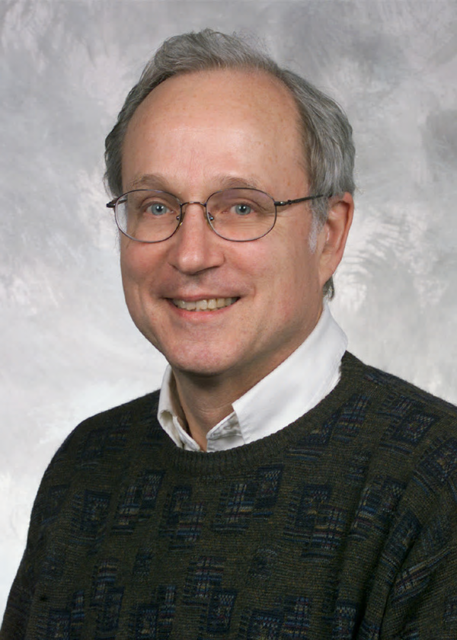

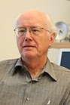
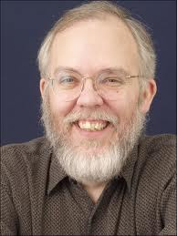
Principles from the systems side…
Make core elements as simple as possible
  Pare down, optimize the critical path
  Captures something fundamental about systems.
Butler
Generalized End-to-End argument:
  Let the application layer pick its own models.
  Limit core systems to fast, flexible building blocks.
Jerry
B. Lampson. Hints for computer system design. ACM Operating Systems Rev. 1983.
J. Saltzer/D. Reed/D. Clark. End-To-End Arguments in System Design. 1984.
Dave
Dave

Slide 11
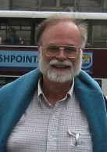
Gray: How do systems really fail?
Jim Gray
Studied Tandem’s “non-stop” platforms
Failures caused by bugs, user mistakes, poor designs.
Few hardware failures, and nothing malicious.
Jim’s advice? Focus our efforts on the real needs
J. Gray. Why Do Computers Stop and What Can Be Done About It? SOSP, 1985.

Slide 12
Tensions
Why aren’t existing OS mechanisms adequate?
Is fault-tolerance / consistency too complex or costly?
Do the needed mechanisms enable or impose models?

Slide 13
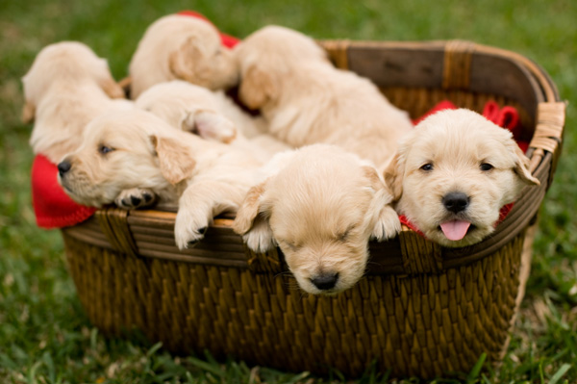
Do we need fault-tolerant replication?
Not just for making systems tolerant of failures
  Cloud computing: Provision lots of servers
  Performance-limiting for many machine-learning systems
So we agree, hopefully: replication is awesome!
But is there a core OS mechanism here?

Slide 14
It comes down to performance and scalability
As systems researchers, abstracted properties are…
  Useful when designing and testing
  Valuable tools for explaining behavior to users
  Not obstacles: “Impossible” problems don’t scare us…
Performance is a more fundamental challenge
  Can fault-tolerance mechanisms be fast?

Slide 15
Existing core OS support: Inadequate
IP multicast just doesn’t work…
  Amazon AWS disables IPMC and tunnels over TCP
TCP is the main option, but it has some issues:
  No support for reliable transfer to multiple receivers
  Uncoordinated model for breaking connections on failure
  Byte stream model is mismatched to RDMA

Slide 16
… Higher-level replication primitives?
Isis: In 1985 used state machine replication on objects
  Core innovation was its group membership model, which integrates membership dynamics with ordered multicast.
  Durability tools: help application persist its state
Paxos*: Implements state machine replication (1990)
  A durable database of events (not an ordered multicast)
  Runs in “quasi-static” groups.
*Homework: First version of Paxos protocol?

Slide 17
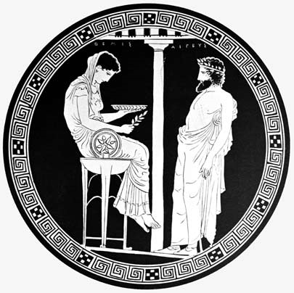
Delays on the critical path: Isis
Original Isis Tookit:
State machine replication of user-defined objects.
Durability was optional.
Oracle
  Uses quorums
  Outputs “Views”
  Bisimulates Paxos
Critical Path
  Asynchronous, pipelined
  Flush when view changes
  Only pay for properties used
Refactor (‘87)
Paxos: Many optimizations, often via transformations like the Isis ones
But Paxos theory and formal methodology are very clean, elegant...
Virtual Synchrony: Model + menu of choices
[Note: CATOCS controversy arose here…]

Slide 18
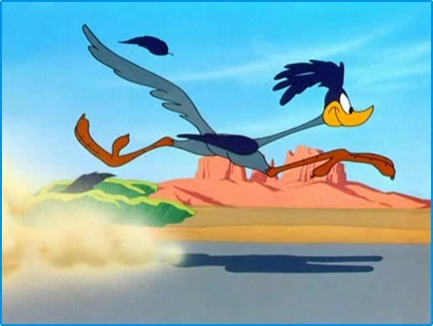
How does one speed such systems up?
© Time Warner Brothers
Start with simple, easily analyzed solution... Study the code
  The critical paths often embody inefficiencies, like requesting total order for actions already in order, or that commute.
  Often, synchronous events can be asynchronously pipelined
Restructure critical paths to leverage your insights
  Hopefully, the correctness argument still holds…
Pattern shared by Isis, Paxos, Zookeeper, Chain Replication, Zyzzyva, many others…

Slide 19
… Real systems informed by sound theory
Isis: Widely adopted during the 1995-2005 period
  French ATC system, US Navy AEGIS, NYSE...
Paxos: Very wide uptake 2005-now
  Locking, file replication, HA databases…
  Clean methodology and theory appeal to designers
  Corfu is the purest Paxos solution: robust logging

Slide 20

CATOCS: A case against consistent replication
Too complex
Violates End-to-End by imposing model on the user
No matter what form of update order is supported, user won’t like it
Ordering is just too slow, won’t scale
Dave Cheriton
Dale Skeen

Slide 21
So were CATOCS claims true?
Early replication solutions really were too slow.
  Later ones were faster, but more complex.
But CATOCS analysis of ordering was dubious.
Yet… what about that missing low-level building block?
  … a puzzle (we’ll come back to it later)

Slide 22
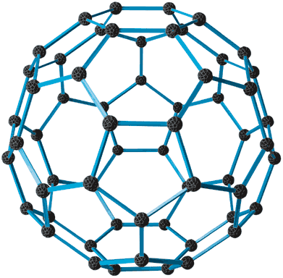
The “consensus” family…
Chain replication
Chubby
Isis2
◊W consensus
Horus
Paxos
Viewstamped Replication
Ensemble
Corfu
Isis
JGroups
Transis
Zookeeper
Can transform one to another… optimizations driven by desired properties.
For me, durability remains puzzling
  Is the goal durability of the application, or of its “state”?

Slide 23
… a few winners:
State Machine Replication, Paxos, ACID transactions
Chubby, Zookeeper, Corfu
Primary + Warm backup… Chain Replication
Conceptual
Tools
Real Systems

Slide 24
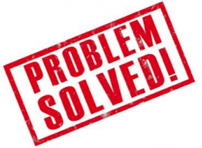
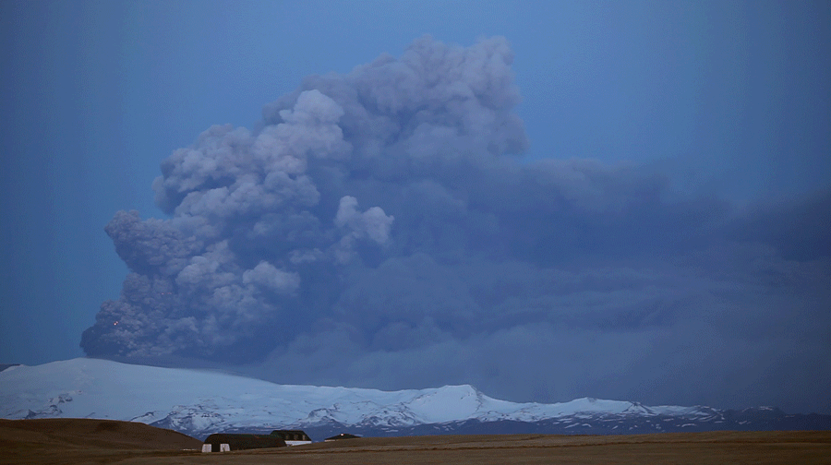
Meanwhile, along came a cloud!
Servers: 3-5 nodes
A cloud-hosted service could run on 5,000 nodes in each of dozens of data centers

Slide 25
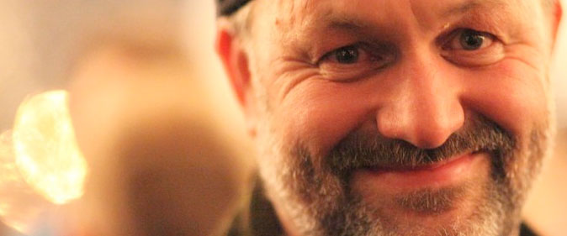
… Cloud rebellion: “Just say no!”
Werner Vogels
State Machine Replication, Paxos, ACID transactions
Chubby, Zookeeper, Corfu
Primary + Warm backup… Chain Replication
Dynamo: Eventual consistency (BASE), NoSQL KVS
Conceptual
Tools
Real Systems
ACID

Slide 26
Is consistency just too costly?
Eric Brewer
CAP: Two of {Consistency, Availability, Partition-Tolerance}
  Widely cited by systems that cache or replicate data
  Relaxed consistency eliminates blocking on the critical path
  CAP theorem: proved for a WAN partition of an H/A database
BASE (eBay, Amazon)
  Start with a transactional design, but then weaken atomicity
  Eventually sense inconsistencies and repair them

Slide 27
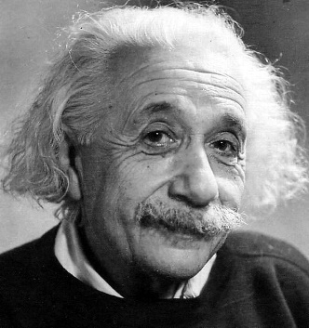
… but does CAP+BASE work?
CAP folk theorem: “don’t even try to achieve consistency.”
… meaning what?
  “Anything goes”? “Bring it on?”
Einstein: “A thing should be as simple as possible,
but not simpler.”

Slide 28
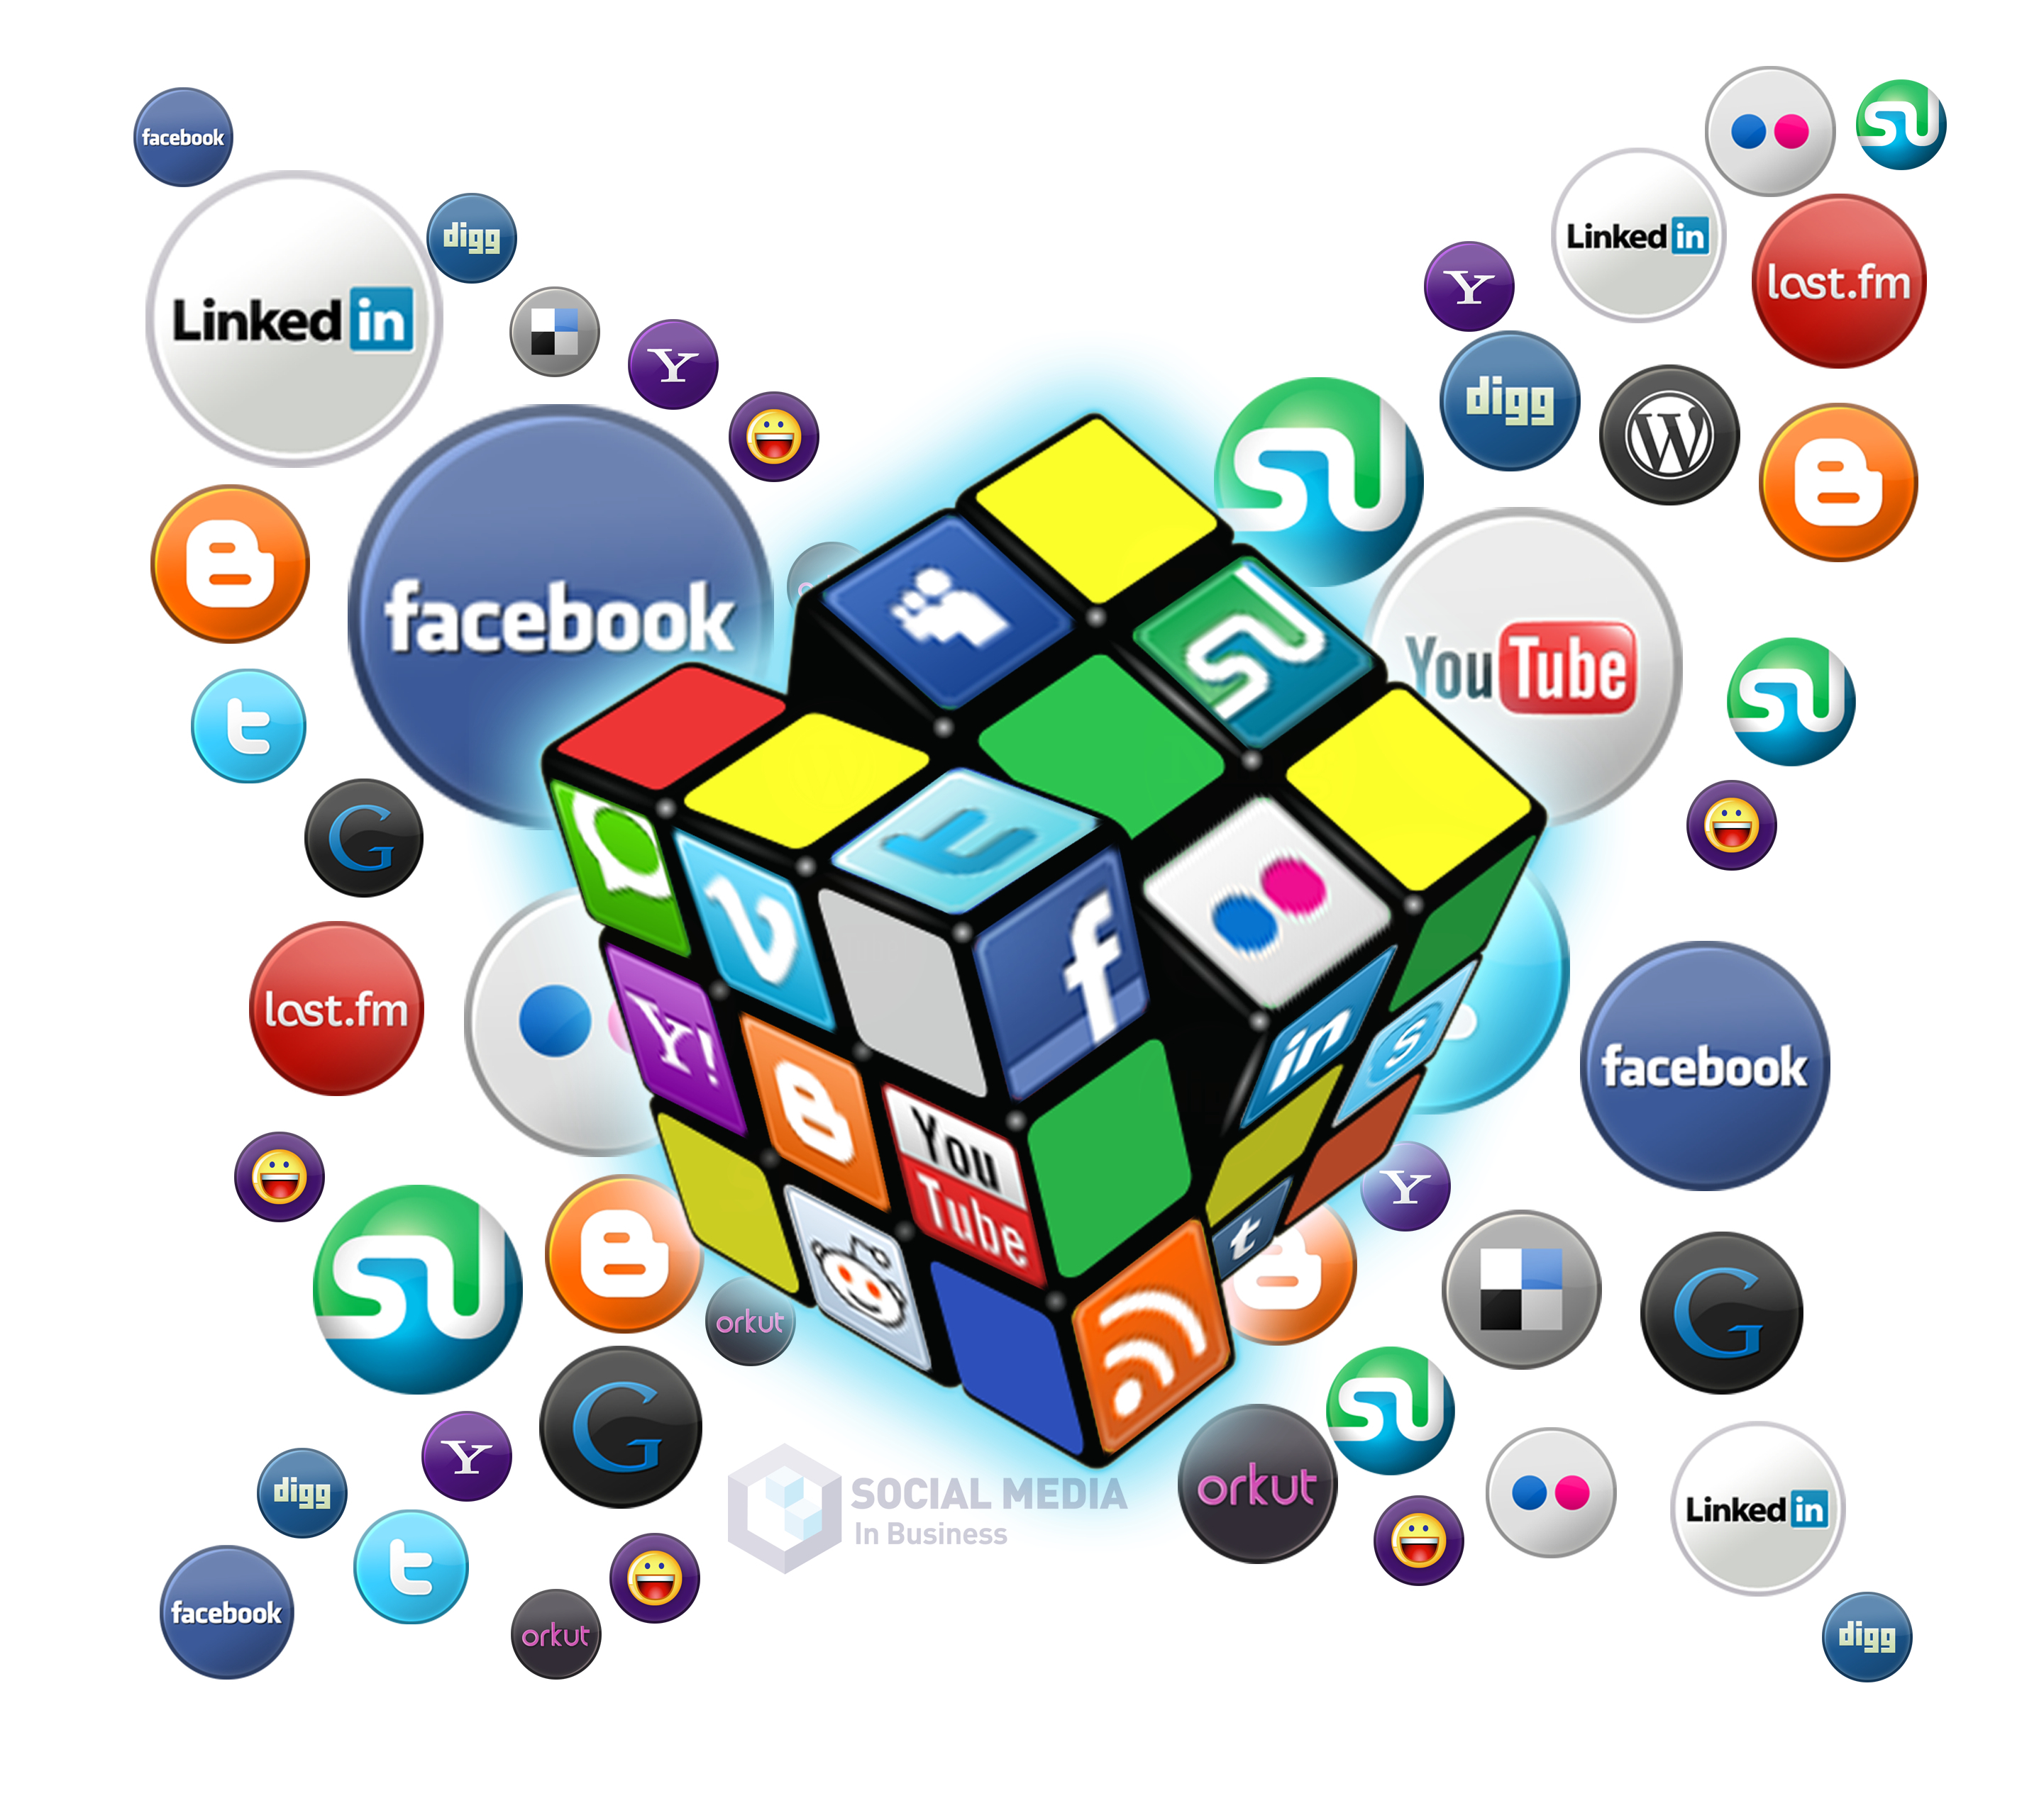
… but does CAP+BASE work?
CAP folk theorem: “don’t even try to achieve consistency.”
CAP + BASE are successful for a reason:
  In the applications that dominate today’s
  cloud, stale cache reads have negative utility
  but don’t cause safety violations.
  In effect a redefinition, not a rejection, of consistency

Slide 29
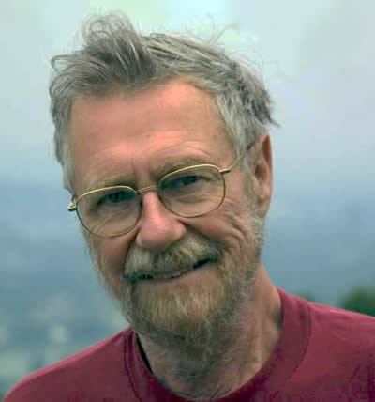
A fascinating co-evolution
The cloud fits the need; the applications fit the cloud.
At first, fault-tolerance wasn’t given much thought.
  Jim Gray : “Why do systems fail?”
  Today: Why don’t CAP+BASE systems fail?
Could we apply Dijkstra’s theory of “self-stabilization” to BASE?
Edsger Dijkstra
Dijkstra: Self-stabilizing systems in spite of distributed control, CACM 17 (11): 1974.

Slide 30
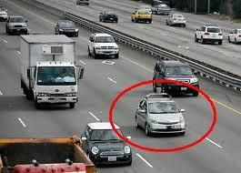
Future Shock: Disruption is coming
Life and safety-critical cloud computing…
  Smart power grid, homes, cities
  Self-driving cars
  Cloud-hosted banking, medical care
Weakened consistency won’t suffice for these uses.

Slide 31
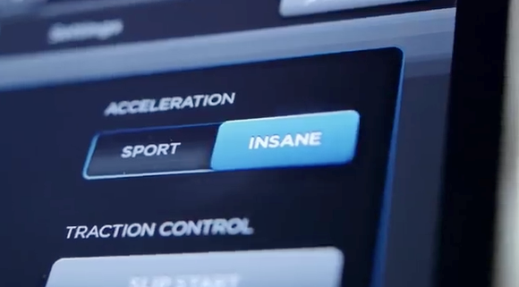
Homework (due date: SOSP 2017)
Start with a clean slate (but do learn from the past)
Embrace a modern architecture
  Cloud-scale systems…
  Multicore servers with NVRAM storage
  RDMA (like Tesla’s “insane speed” button).
Propose a new approach to cloud-scale consistency

Slide 32

Future Cloud…
The O/S has been an obstacle… even embraced inconsistency.
  The future cloud should embrace consistency.
Key: Elegance, speed, support real needs of real developers
Need a core OS building block that works, integrated with developer tools and IDEs that are easy to use.

