Slide 1
Can Cloud Computing Systems Offer High Assurance Without Losing Key Cloud Properties?
CS6410
Ken Birman, Cornell University

Slide 2

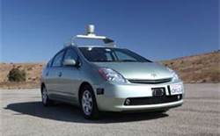

High Assurance in Cloud Settings
A wave of applications that need high assurance is fast approaching
  Control of the “smart” electric power grid
  mHealth applications
  Self-driving vehicles….
To run these in the cloud, we’ll need better tools
  Today’s cloud is inconsistent and insecure by design
  Issues arise at every layer (client… Internet… data center) but we’ll focus on the data center today

Slide 3
Isis² System
update
“join
myGroup”
update
state transfer
myGroup
Core functionality: groups of objects
  … fault-tolerance, speed (parallelism), coordination
  Intended for use in very large-scale settings
The local object instance functions as a gateway
  Read-only operations performed on local state
  Update operations update all the replicas

Slide 4
Isis² Functionality
We implement a wide range of basic functions
  Multicast (many “flavors”) to update replicated data
  Multicast “query” to initiate parallel operations and collect the results
  Lock-based synchronization
  Distributed hash tables
  Persistent storage…
Easily integrated with application-specific logic

Slide 5
Example: Cloud-Hosted Service
Standard Web-Services method invocation
A B C D
Some service
A distributed request that updates group “state”...
SafeSend
SafeSend
SafeSend
... and the response
SafeSend is a version of Paxos.

Slide 6
Isis² System
C# library (but callable from any .NET language) offering replication techniques for cloud computing developers
Based on a model that fuses virtual synchrony and state machine replication models
Research challenges center on creating protocols that function well despite cloud “events”
Elasticity (sudden scale changes)
Potentially heavily loads
High node failure rates
Concurrent (multithreaded) apps
Long scheduling delays, resource contention
Bursts of message loss
Need for very rapid response times
Community skeptical of “assurance properties”

Slide 7
Isis2 makes developer’s life easier
Benefits of Using Formal model
Importance of Sound Engineering
Formal model permits us to achieve correctness
Think of Isis2 as a collection of modules, each with rigorously stated properties
These help in debugging (model checking)
Isis2 implementation needs to be fast, lean, easy to use, in many ways
Developer must see it as easier to use Isis2 than to build from scratch
Need great performance under “cloudy conditions”

Slide 8
Isis² makes developer’s life easier
First sets up group
Join makes this entity a member. State transfer isn’t shown
Then can multicast, query. Runtime callbacks to the “delegates” as events arrive
Easy to request security (g.SetSecure), persistence
“Consistency” model dictates the ordering aseen for event upcalls and the assumptions user can make
Group g = new Group(“myGroup”);
Dictionary<string,double> Values = new Dictionary<string,double>();
g.ViewHandlers += delegate(View v) {
  Console.Title = “myGroup members: “+v.members;
};
g.Handlers[UPDATE] += delegate(string s, double v) {
Values[s] = v;
};
g.Handlers[LOOKUP] += delegate(string s) {
g.Reply(Values[s]);
};
g.Join();
g.SafeSend(UPDATE, “Harry”, 20.75);
List<double> resultlist = new List<double>();
nr = g.Query(ALL, LOOKUP, “Harry”, EOL, resultlist);

Slide 9
Isis² makes developer’s life easier
First sets up group
Join makes this entity a member. State transfer isn’t shown
Then can multicast, query. Runtime callbacks to the “delegates” as events arrive
Easy to request security (g.SetSecure), persistence
“Consistency” model dictates the ordering seen for event upcalls and the assumptions user can make
Group g = new Group(“myGroup”);
Dictionary<string,double> Values = new Dictionary<string,double>();
g.ViewHandlers += delegate(View v) {
  Console.Title = “myGroup members: “+v.members;
};
g.Handlers[UPDATE] += delegate(string s, double v) {
Values[s] = v;
};
g.Handlers[LOOKUP] += delegate(string s) {
g.Reply(Values[s]);
};
g.Join();
g.SafeSend(UPDATE, “Harry”, 20.75);
List<double> resultlist = new List<double>();
nr = g.Query(ALL, LOOKUP, “Harry”, EOL, resultlist);

Slide 10
Isis² makes developer’s life easier
Group g = new Group(“myGroup”);
Dictionary<string,double> Values = new Dictionary<string,double>();
g.ViewHandlers += delegate(View v) {
  Console.Title = “myGroup members: “+v.members;
};
g.Handlers[UPDATE] += delegate(string s, double v) {
Values[s] = v;
};
g.Handlers[LOOKUP] += delegate(string s) {
g.Reply(Values[s]);
};
g.Join();
g.SafeSend(UPDATE, “Harry”, 20.75);
List<double> resultlist = new List<double>();
nr = g.Query(ALL, LOOKUP, “Harry”, EOL, resultlist);
First sets up group
Join makes this entity a member. State transfer isn’t shown
Then can multicast, query. Runtime callbacks to the “delegates” as events arrive
Easy to request security (g.SetSecure), persistence
“Consistency” model dictates the ordering seen for event upcalls and the assumptions user can make

Slide 11
Isis² makes developer’s life easier
First sets up group
Join makes this entity a member. State transfer isn’t shown
Then can multicast, query. Runtime callbacks to the “delegates” as events arrive
Easy to request security (g.SetSecure), persistence
“Consistency” model dictates the ordering seen for event upcalls and the assumptions user can make
Group g = new Group(“myGroup”);
Dictionary<string,double> Values = new Dictionary<string,double>();
g.ViewHandlers += delegate(View v) {
  Console.Title = “myGroup members: “+v.members;
};
g.Handlers[UPDATE] += delegate(string s, double v) {
Values[s] = v;
};
g.Handlers[LOOKUP] += delegate(string s) {
g.Reply(Values[s]);
};
g.Join();
g.SafeSend(UPDATE, “Harry”, 20.75);
List<double> resultlist = new List<double>();
nr = g.Query(ALL, LOOKUP, “Harry”, EOL, resultlist);

Slide 12
Isis² makes developer’s life easier
First sets up group
Join makes this entity a member. State transfer isn’t shown
Then can multicast, query. Runtime callbacks to the “delegates” as events arrive
Easy to request security (g.SetSecure), persistence
“Consistency” model dictates the ordering seen for event upcalls and the assumptions user can make
Group g = new Group(“myGroup”);
Dictionary<string,double> Values = new Dictionary<string,double>();
g.ViewHandlers += delegate(View v) {
  Console.Title = “myGroup members: “+v.members;
};
g.Handlers[UPDATE] += delegate(string s, double v) {
Values[s] = v;
};
g.Handlers[LOOKUP] += delegate(string s) {
g.Reply(Values[s]);
};
g.Join();
g.SafeSend(UPDATE, “Harry”, 20.75);
List<double> resultlist = new List<double>();
nr = g.Query(ALL, LOOKUP, “Harry”, EOL, resultlist);

Slide 13
Isis² makes developer’s life easier
First sets up group
Join makes this entity a member. State transfer isn’t shown
Then can multicast, query. Runtime callbacks to the “delegates” as events arrive
Easy to request security, persistence, tunnelling on TCP...
“Consistency” model dictates the ordering seen for event upcalls and the assumptions user can make
Group g = new Group(“myGroup”);
Dictionary<string,double> Values = new Dictionary<string,double>();
g.ViewHandlers += delegate(View v) {
  Console.Title = “myGroup members: “+v.members;
};
g.Handlers[UPDATE] += delegate(string s, double v) {
Values[s] = v;
};
g.Handlers[LOOKUP] += delegate(string s) {
g.Reply(Values[s]);
};
g.SetSecure(myKey);
g.Join();
g.SafeSend(UPDATE, “Harry”, 20.75);
List<double> resultlist = new List<double>();
nr = g.Query(ALL, LOOKUP, “Harry”, EOL, resultlist);

Slide 14
Consistency model: Virtual synchrony meets Paxos (and they live happily ever after…)
  Membership epochs: begin when a new configuration is installed and reported by delivery of a new “view” and associated state
  Protocols run “during” a single epoch: rather than overcome failure, we reconfigure when a failure occurs
A=3
B=7
B = B-A
A=A+1
Non-replicated reference execution
Synchronous execution
Virtually synchronous execution

Slide 15
Exact comparison
What I am calling a synchronous (by which I mean “step by step”) execution actually matches what Paxos offers, but Paxos, as we will see, uses quorum operations to implement this without group views
Virtual synchrony has managed group membership, but also has some optimistic steps (early message delivery, which speeds things up, but it comes at the price of needing to do a “flush” to sync to the network)
  Analogy: when you write to a file often the IO system buffers and until you do a file-sync, data might not yet be certain to have reached the disk

Slide 16
Formalizing the model
Must express the picture in temporal logic equations
Closely related to state machine replication, but optimistic early delivery of multicasts (optional!) is tricky.
What can one say about the guarantees in that case?
  Either I’m going to be allowed to stay in the system, in which case all the properties hold
  … or the majority will kick me out. Then some properties are still guaranteed, but others might actually not hold for those optimistic early delivery events
  User is expected to combine optimistic actions with Flush to mask speculative lines of execution that could turn out to be risky

Slide 17
Core issue: How is replicated data used?
High availability
Better capacity through load-balanced read-only requests, which can be handled by a single replica
Concurrent parallel computing on consistent data
Fault-tolerance through “warm standby”

Slide 18
Do users find formal model useful?
Developer keeps the model in mind, can easily visualize the possible executions that might arise
  Each replica sees the same events
  … in the same order
  … and even sees the same membership when an event occurs. Failures or joins are reported just like multicasts
All sorts of reasoning is dramatically simplified

Slide 19
But why complicate it with optimism?
Optimistic early delivery kind of breaks the model, although Flush allows us to hide the effects
To reason about a system must (more or less) erase speculative events not covered by Flush. Then you are left with a more standard state machine model
Yet this standard model, while simpler to analyze, is actually too slow for demanding use cases

Slide 20



Roles for formal methods
Proving that SafeSend is a correct “virtually synchronous” implementation of Paxos?
  I worked with Robbert van Renesse and Dahlia Malkhi to optimize Paxos for the virtual synchrony model.
    Despite optimizations, protocol is still bisimulation equivalent
  Robbert later coded it in 60 lines of Erlang. His version can be proved correct using NuPRL
  Leslie Lamport was initially involved too. He
  suggested we call it “virtually synchronous Paxos”.
Virtually Synchronous Methodology for Dynamic Service Replication. Ken Birman, Dahlia Malkhi, Robbert van Renesse. MSR-2010-151. November 18, 2010. Appears as Appendix A in Guide to Reliable Distributed Systems. Building High-Assurance Applications and Cloud-Hosted Services. Birman, K.P. 2012, XXII, 730p. 138 illus.

Slide 21
The resulting theory is of limited value
If we apply it only to Isis² itself, we can generally get quite far. The model is valuable for debugging the system code because we can detect bad runs.
If we apply it to a user’s application plus Isis², the theory is often “incomplete” because the theory would typically omit any model for what it means for the application to achieve its end-user goals
  This pervasive tendency to ignore the user is a continuing issue throughout the community even today. It represents a major open research topic.

Slide 22
The fundamental issue...
How to formalize the notion of application state?
How to formalize the composition of a protocol such as SafeSend with an application (such as replicated DB)?
No obvious answer… just (unsatisfying) options
  A composition-based architecture: interface types (or perhaps phantom types) could signal user intentions. This is how our current tool works.
  An annotation scheme: in-line pragmas (executable “comments”) would tell us what the user is doing
  Some form of automated runtime code analysis

Slide 23
A further issue: Performance causes complexity
A one-size fits-all version of SafeSend wouldn’t be popular with “real” cloud developers because it would lack necessary flexibility
  Speed and elasticity are paramount
  SafeSend is just too slow and too rigid: Basis of Brewer’s famous CAP conjecture (and theorem)
Let’s look at a use case in which being flexible is key to achieving performance and scalability

Slide 24
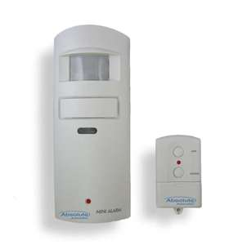

Building an online medical care system
Motion sensor, fall-detector
Healthcare provider monitors large numbers of remote patients
Medication station tracks, dispenses pills
Integrated glucose monitor and Insulin pump receives instructions wirelessly
Cloud Infrastructure
Monitoring subsystem
Home healthcare application

Slide 25
Two replication cases that arise
Replicating the database of patient records
  Goal: Availability despite crash failures, durability, consistency and security.
  Runs in an “inner” layer of the cloud: A back-end database
Replicating the state of the “monitoring” framework
  It monitors huge numbers of patients
  (cloud platform will monitor many, intervene rarely)
  Goal is high availability, high capacity for “work”
  Probably runs in the “outer tier” of the cloud
Patient Records DB
Patient Records DB
Patient Records DB

Slide 26
Real systems demand tradeoffs
The database with medical prescription records needs strong replication with consistency and durability
  The famous ACID properties. A good match for Paxos
But what about the monitoring infrastructure?
  A monitoring system is an online infrastructure
  In the soft state tier of the cloud, durability isn’t available
  Paxos works hard to achieve durability. If we use Paxos, we’ll pay for a property we can’t really use

Slide 27
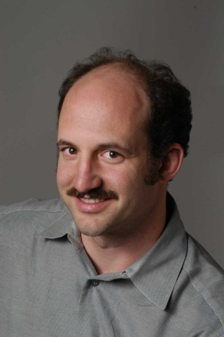
Why does this matter?
Durability is expensive
  Basic Paxos always provides durability
  SafeSend is like Paxos and also has this guarantee
If we weaken durability we get better performance and scalability, but we no longer mimic Paxos
Generalization of Brewer’s CAP conjecture:
one-size-fits-all won’t work in the cloud.
You always confront tradeoffs.

Slide 28
Weakening properties in Isis²
SafeSend: Ordered+Durable
OrderedSend+Flush: Ordered but “optimistic” delivery
Send, CausalSend+Flush: FIFO or Causal order
RawSend: Unreliable, not virtually synchronous
Out of Band file transfer: Uses RDMA to asynchronously move big objects using RDMA network; Isis² application talks “about” these objects but doesn’t move the bytes (might not even touch the bytes)

Slide 29
Monitoring in a soft-state service with a primary owner issuing the updates
Update the monitoring and alarms criteria for Mrs. Marsh as follows…
g.Send is an optimistic, early-deliverying virtually synchronous multicast. Like the first phase of Paxos
Execution timeline for an individual first-tier replica
A B C D
Flush pauses until prior Sends have been acknowledged and become “stable”. Like the second phase of Paxos.
In our scenario, g.Send + g.Flush ≈ g.SafeSend
Soft-state first-tier service
Response delay seen by end-user would also include Internet latencies
Send
Send
Local response delay
Send
Confirmed
flush
In this situation we can replace SafeSend with Send+Flush.
But how do we prove that this is really correct?

Slide 30
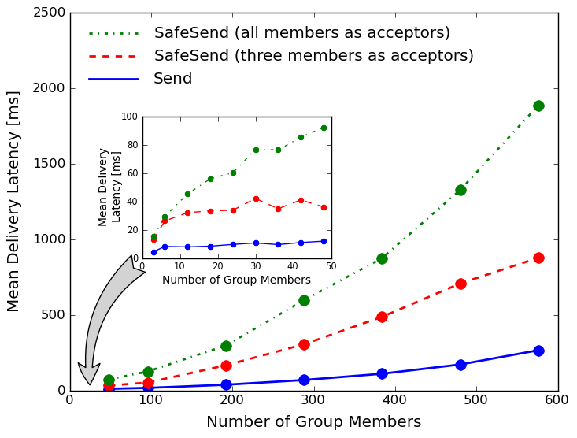
Isis²: Send v.s. SafeSend
Send scales best, but SafeSend with
modern disks (RAM-like performance) and small
numbers of acceptors isn’t terrible.

Slide 31
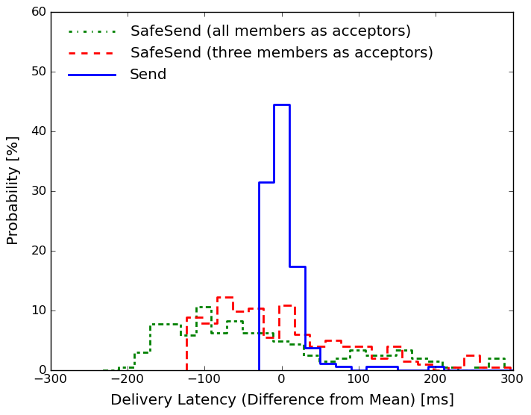
Jitter: how “steady” are latencies?
The “spread” of latencies is much
better (tighter) with Send: the 2-phase
SafeSend protocol is sensitive to
scheduling delays
Variance from mean, 32-member case

Slide 32
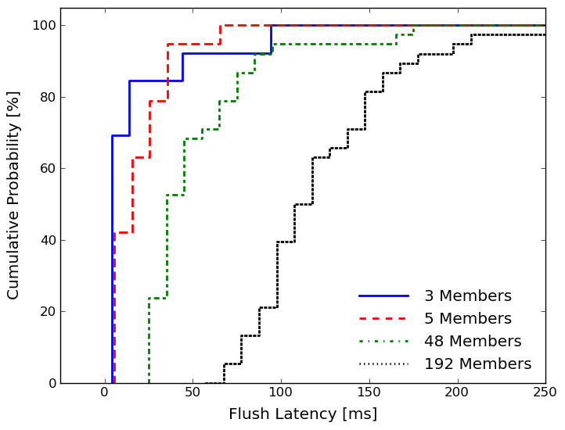
Flush delay as function of shard size
Flush is fairly fast if we only wait for
acks from 3-5 members, but is slow
if we wait for acks from all members.
After we saw this graph, we changed
Isis² to let users set the threshold.

Slide 33
What does the data tell us?
With g.Send+g.Flush we can have
  Strong consistency, fault-tolerance, rapid responses
  Similar guarantees to Paxos (but not identical)
  Scales remarkably well, with high speed
The experiment isn’t totally fair to Paxos
  Even 5 years ago, hardware was actually quite different
  With RDMA and NVRAM the numbers all get (much) better!

Slide 34
Sinfonia
A more recent system somewhat in the same style, but very different API and programming model
Starts with a kind of atomic transaction model, which more recent work (this year’s SOSP!) has made more explicit

Slide 35
Key Sinfonia idea
Allow the application to submit “mini-transactions”
  Not the full SQL + begin / commit / abort, but rather “RISC” in style
They consist of:
  Precomputation: Application prepares a mini-transaction however it likes
  Validation step: objects and versions: the mini-transaction will not be performed (will abort) if any of these objects have been updated
  Action step: If validation is successful, a series of updates to those objects, which will generate new versions. The actions are done atomically.

Slide 36
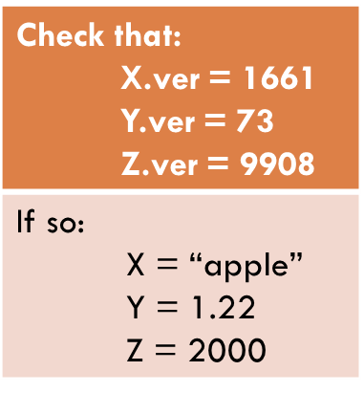
Illustration
Check that: X.ver = 1661 Y.ver = 73 Z.ver = 9908
If so: X = “apple” Y = 1.22 Z = 2000
Sinfonia Core: A kind of state machine replicated process group
Totally ordered protocol, like OrderedSend
Success!
The server members are exact replicas, so all either perform the action or reject it. So the data replicas stay in the identical state

Slide 37
Precomputation step
This gives Sinfonia remarkable scalability
Idea is that we can keep cached copies of the system state, or even entire read-only replicas, and run any code we wish against it
State = Any collection of data with some form of records we can identify and version numbers on each record
Code = Database transaction, graph crawl, whatever…

Slide 38
Why does this give scalability?
At the edge, we soak up the potentially slow, complex compute costs
  Transactions can be very complex to carry out (joins, projections, aggregation operations, complex test logic…)
  All of this can be done “offline” from the perspective of the core
Then we either commit the request all at once if the versions still match, or abort it all at once if not, so Sinfonia core stays in a consistent state
  In fact, the edge can manage perfectly well with a slightly stale cache!

Slide 39
Generality?
Paper explains how this model can support a great variety of use cases from the web, standard databases, financial settings (banking or stock trading), etc.
  Basically, you just need an adaptor to “represent” your data in Sinfonia format with data records and version numbering
And in recent work at Vmware, they add sharding (partitioning), automatic support for commutative actions, many other features, and get even more impressive performance

Slide 40

Summary?
We set out to bring formal assurance guarantees to the cloud
  And succeeded: Many systems like Isis² exist now and are in wider and wider use (Corfu, Zookeeper, Zab, Raft, libPaxos, Sinfonia, and the list goes on)
  Industry is also reporting successes (e.g. entire SOSP program this year)
  Formal tools are also finding a major role now (model checking and constructive logic used to prove these kinds of systems correct)
Can the cloud “do” high assurance?
  At Cornell, and in Silicon Valley, the evidence now is “yes”
  … but even so, much more research is still needed because they are slow “on first try” and much optimization generally has to occur to make them fast

