Slide 1
Bimodal Multicast Astrolabe
CS6410
Ken Birman

Slide 2
Gossip 201
Recall from early in the semester that gossip spreads in log(system size) time
But is this actually “fast”?
1.0
% infected
0.0
Time →

Slide 3
Gossip in distributed systems
Log(N) can be a very big number!
With N=100,000, log(N) would be 12
So with one gossip round per five seconds, information needs one minute to spread in a large system!
Some gossip protocols combine pure gossip with an accelerator
A good way to get the word out quickly

Slide 4
Bimodal Multicast
To send a message, this protocol uses IP multicast
We just transmit it without delay and we don’t expect any form of responses
Not reliable, no acks
No flow control (this can be an issue)
In data centers that lack IP multicast, can simulate by sending UDP packets 1:1 without acks

Slide 5
What’s the cost of an IP multicast?
In principle, each Bimodal Multicast packet traverses the relevant data center links and routers just once per message
So this is extremely cheap... but how do we deal with systems that didn’t receive the multicast?

Slide 6
Making Bimodal Multicast reliable
We can use gossip!
Every node tracks the membership of the target group (using gossip, just like with Dr. Multicast)
Bootstrap by learning “some node addresses” from some kind of a server or web page
But then exchange of gossip used to improve accuracy

Slide 7
Making Bimodal Multicast reliable
Now, layer in a gossip mechanism that gossips about multicasts each node knows about
Rather than sending the multicasts themselves, the gossip messages just talk about “digests”, which are lists
Node A might send node B
I have messages 1-18 from sender X
I have message 11 from sender Y
I have messages 14, 16 and 22-71 from sender Z
Compactly represented...
This is a form of “push” gossip

Slide 8
Making Bimodal Multicast reliable
On receiving such a gossip message, the recipient checks to see which messages it has that the gossip sender lacks, and vice versa
Then it responds
I have copies of messages M, M’and M’’ that you seem to lack
I would like a copy of messages N, N’ and N’’ please
An exchange of the actual messages follows

Slide 9
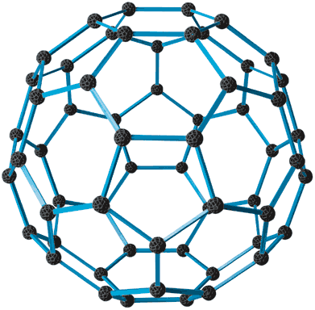
Two data centers… WAN link
Interesting case that requires further optimizations
Half the traffic will run on the WAN link!
N/2 nodes
N/2 nodes

Slide 10
Two data centers… WAN link
Interesting case that requires further optimizations
Now only 1/3 of A’s gossip has a target in B, but 2/3’s of B’s gossips will have a target in A
2N/3 nodes
N/3 nodes

Slide 11
Why is this a problem?
Think of a Europe/US scenario
Local gossip is probably very fast (100us latency) but WAN gossip will be slow (125ms latency…)
Same data will be offered again and again on the WAN connection, and while waiting for it could be pulled again and again too!

Slide 12
WAN optimizations…
A should treat all of B as a single destination, and B treats all of A as a single destination
Less gossip will cross the WAN link, but this is good because the naïve approach is very redundant

Slide 13
Optimizations
Bimodal Multicast resends using IP multicast if there is “evidence” that a few nodes may be missing the same thing
E.g. if two nodes ask for the same retransmission
Or if a retransmission shows up from a very remote node (IP multicast doesn’t always work in WANs)
It also prioritizes recent messages over old ones
Reliability has a “bimodal” probability curve: either nobody gets a message or nearly everyone does

Slide 14

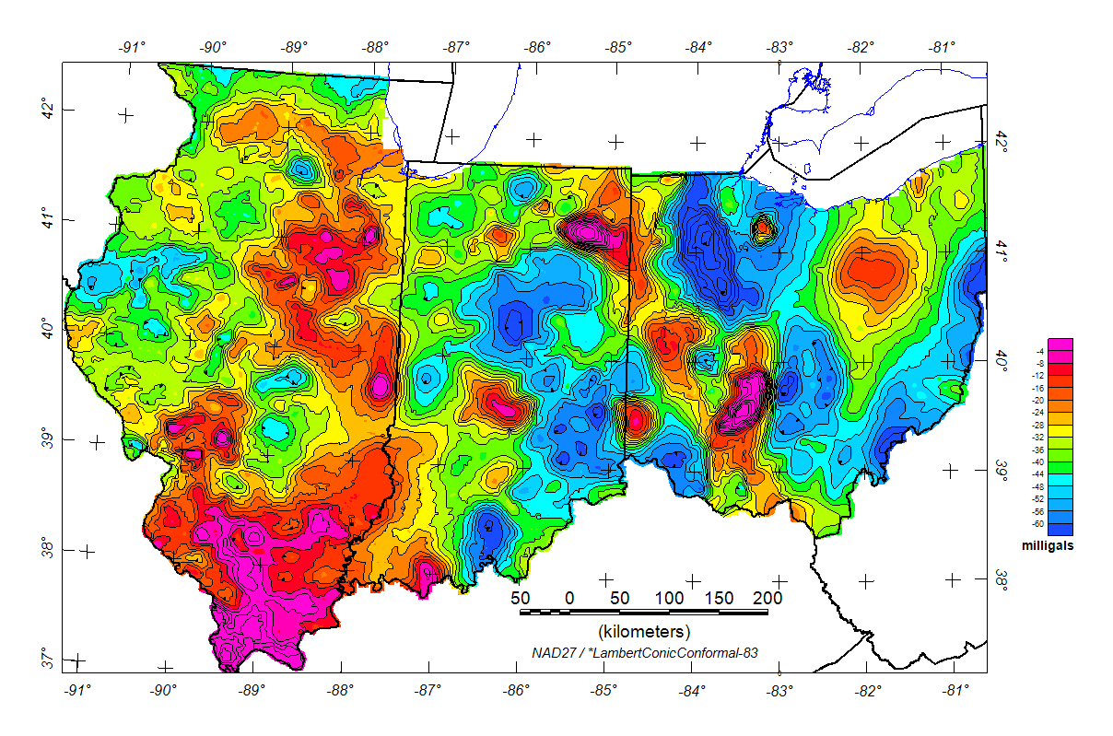
Gravitational Gossip
Key idea was due to Kate Jenkins
Assumes a large system, participants gossip on topics
Each subscribes with some sort of “level of interest”
E.g. I want to see all status reports for the local power grid but a 5% sample from the neighboring power grid in Ohio
Trick: use gossip but shape the contents of messages to conform a “gravity well” model. Very robust and much more efficient than having one epidemic per topic. But sampling is random.
Adaptive Gravitational Gossip: A Gossip-Based Communication Protocol with User-Selectable Rates. Ken Hopkinson, Kate Jenkins, et. al. IEEE TPDS 20:12, Feb 2009.

Slide 15
Gravity well trick: Single topic example
Think of each gossip item as a marble rolling in a dish
The marble is eager to roll along the bottom of the valley or downhill into it, but not to roll uphill
Turns out that this model gives the desired behavior (marble ≡ gossip msg)
100% 50%
25%

Slide 16
lpbcast variation
In this variation on Bimodal Multicast instead of gossiping with every node in a system, we modify the Bimodal Multicast protocol
It maintains a “peer overlay”: each member only gossips with a smaller set of peers picked to be reachable with low round-trip times, plus a second small set of remote peers picked to ensure that the graph is very highly connected and has a small diameter
Called a “small worlds” structure by Jon Kleinberg
Lpbcast is often faster, but equally reliable!

Slide 17
Speculation... about speed
When we combine IP multicast with gossip we try to match the tool we’re using with the need
Try to get the messages through fast... but if loss occurs, try to have a very predictable recovery cost
Gossip has a totally predictable worst-case load
This is appealing at large scales
How can we generalize this concept?

Slide 18
A thought question
What’s the best way to
Count the number of nodes in a system?
Compute the average load, or find the most loaded nodes, or least loaded nodes?
Options to consider
Pure gossip solution
Construct an overlay tree (via “flooding”, like in our consistent snapshot algorithm), then count nodes in the tree, or pull the answer from the leaves to the root…

Slide 19
… and the answer is
Gossip isn’t very good for some of these tasks!
There are gossip solutions for counting nodes, but they give approximate answers and run slowly
Tricky to compute something like an average because of “re-counting” effect, (best algorithm: Kempe et al)
On the other hand, gossip works well for finding the c most loaded or least loaded nodes (constant c)
Gossip solutions will usually run in time O(log N) and generally give probabilistic solutions

Slide 20
Yet with flooding… easy!
Recall how flooding works
Basically: we construct a tree by pushing data towards the leaves and linking a node to its parent when that node first learns of the flood
Can do this with a fixed topology or in a gossip style by picking random next hops
2
3
Labels: distance of the node from the root
1
3
2
3

Slide 21
This is a “spanning tree”
Once we have a spanning tree
To count the nodes, just have leaves report 1 to their parents and inner nodes count the values from their children
To compute an average, have the leaves report their value and the parent compute the sum, then divide by the count of nodes
To find the least or most loaded node, inner nodes compute a min or max…
Tree should have roughly log(N) depth, but once we build it, we can reuse it for a while

Slide 22
Not all logs are identical!
When we say that a gossip protocol needs time log(N) to run, we mean log(N) rounds
And a gossip protocol usually sends one message every five seconds or so, hence with 100,000 nodes, 60 secs
But our spanning tree protocol is constructed using a flooding algorithm that runs in a hurry
Log(N) depth, but each “hop” takes perhaps a millisecond.
So with 100,000 nodes we have our tree in 12 ms and answers in 24ms!

Slide 23
Insight?
Gossip has time complexity O(log N) but the “constant” can be rather big (5000 times larger in our example)
Spanning tree had same time complexity but a tiny constant in front
But network load for spanning tree was much higher
In the last step, we may have reached roughly half the nodes in the system
So 50,000 messages were sent all at the same time!

Slide 24
Gossip vs “Urgent”?
With gossip, we have a slow but steady story
We know the speed and the cost, and both are low
A constant, low-key, background cost
And gossip is also very robust
Urgent protocols (like our flooding protocol, or 2PC, or reliable virtually synchronous multicast)
Are way faster
But produce load spikes
And may be fragile, prone to broadcast storms, etc

Slide 25
Introducing hierarchy
One issue with gossip is that the messages fill up
With constant sized messages…
… and constant rate of communication
… we’ll inevitably reach the limit!
Can we inroduce hierarchy into gossip systems?

Slide 26

Astrolabe
Intended as help for applications adrift in a sea of information
Structure emerges from a randomized gossip protocol
This approach is robust and scalable even under stress that cripples traditional systems
Developed at RNS, Cornell
By Robbert van Renesse, with many others helping…
Technology was adopted at Amazon.com (but they build their own solutions rather than using it in this form)

Slide 27
Astrolabe is a flexible monitoring overlay
Name | Time | Load | Weblogic? | SMTP? | Word Version
swift | 2011 | 2.0 | 0 | 1 | 6.2
falcon | 1971 | 1.5 | 1 | 0 | 4.1
cardinal | 2004 | 4.5 | 1 | 0 | 6.0
Name | Time | Load | Weblogic? | SMTP? | Word Version
swift | 2271 | 1.8 | 0 | 1 | 6.2
falcon | 1971 | 1.5 | 1 | 0 | 4.1
cardinal | 2004 | 4.5 | 1 | 0 | 6.0
swift.cs.cornell.edu
Periodically, pull data from monitored systems
Name | Time | Load | Weblogic? | SMTP? | Word Version
swift | 2003 | .67 | 0 | 1 | 6.2
falcon | 1976 | 2.7 | 1 | 0 | 4.1
cardinal | 2201 | 3.5 | 1 | 1 | 6.0
Name | Time | Load | Weblogic? | SMTP? | Word Version
swift | 2003 | .67 | 0 | 1 | 6.2
falcon | 1976 | 2.7 | 1 | 0 | 4.1
cardinal | 2231 | 1.7 | 1 | 1 | 6.0
cardinal.cs.cornell.edu

Slide 28
Astrolabe in a single domain
Each node owns a single tuple, like the management information base (MIB)
Nodes discover one-another through a simple broadcast scheme (“anyone out there?”) and gossip about membership
Nodes also keep replicas of one-another’s rows
Periodically (uniformly at random) merge your state with some else…

Slide 29
State Merge: Core of Astrolabe epidemic
Name | Time | Load | Weblogic? | SMTP? | Word Version
swift | 2011 | 2.0 | 0 | 1 | 6.2
falcon | 1971 | 1.5 | 1 | 0 | 4.1
cardinal | 2004 | 4.5 | 1 | 0 | 6.0
swift.cs.cornell.edu
Name | Time | Load | Weblogic? | SMTP? | Word Version
swift | 2003 | .67 | 0 | 1 | 6.2
falcon | 1976 | 2.7 | 1 | 0 | 4.1
cardinal | 2201 | 3.5 | 1 | 1 | 6.0
cardinal.cs.cornell.edu

Slide 30
State Merge: Core of Astrolabe epidemic
Name | Time | Load | Weblogic? | SMTP? | Word Version
swift | 2011 | 2.0 | 0 | 1 | 6.2
falcon | 1971 | 1.5 | 1 | 0 | 4.1
cardinal | 2004 | 4.5 | 1 | 0 | 6.0
swift.cs.cornell.edu
swift | 2011 | 2.0
cardinal | 2201 | 3.5
Name | Time | Load | Weblogic? | SMTP? | Word Version
swift | 2003 | .67 | 0 | 1 | 6.2
falcon | 1976 | 2.7 | 1 | 0 | 4.1
cardinal | 2201 | 3.5 | 1 | 1 | 6.0
cardinal.cs.cornell.edu

Slide 31
State Merge: Core of Astrolabe epidemic
Name | Time | Load | Weblogic? | SMTP? | Word Version
swift | 2011 | 2.0 | 0 | 1 | 6.2
falcon | 1971 | 1.5 | 1 | 0 | 4.1
cardinal | 2201 | 3.5 | 1 | 0 | 6.0
swift.cs.cornell.edu
Name | Time | Load | Weblogic? | SMTP? | Word Version
swift | 2011 | 2.0 | 0 | 1 | 6.2
falcon | 1976 | 2.7 | 1 | 0 | 4.1
cardinal | 2201 | 3.5 | 1 | 1 | 6.0
cardinal.cs.cornell.edu

Slide 32
Observations
Merge protocol has constant cost
One message sent, received (on avg) per unit time.
The data changes slowly, so no need to run it quickly – we usually run it every five seconds or so
Information spreads in O(log N) time
But this assumes bounded region size
In Astrolabe, we limit them to 50-100 rows

Slide 33
Big systems…
A big system could have many regions
Looks like a pile of spreadsheets
A node only replicates data from its neighbors within its own region

Slide 34
Scaling up… and up…
With a stack of domains, we don’t want every system to “see” every domain
Cost would be huge
So instead, we’ll see a summary
Name | Time | Load | Weblogic? | SMTP? | Word Version
swift | 2011 | 2.0 | 0 | 1 | 6.2
falcon | 1976 | 2.7 | 1 | 0 | 4.1
cardinal | 2201 | 3.5 | 1 | 1 | 6.0
Name | Time | Load | Weblogic? | SMTP? | Word Version
swift | 2011 | 2.0 | 0 | 1 | 6.2
falcon | 1976 | 2.7 | 1 | 0 | 4.1
cardinal | 2201 | 3.5 | 1 | 1 | 6.0
Name | Time | Load | Weblogic? | SMTP? | Word Version
swift | 2011 | 2.0 | 0 | 1 | 6.2
falcon | 1976 | 2.7 | 1 | 0 | 4.1
cardinal | 2201 | 3.5 | 1 | 1 | 6.0
Name | Time | Load | Weblogic? | SMTP? | Word Version
swift | 2011 | 2.0 | 0 | 1 | 6.2
falcon | 1976 | 2.7 | 1 | 0 | 4.1
cardinal | 2201 | 3.5 | 1 | 1 | 6.0
Name | Time | Load | Weblogic? | SMTP? | Word Version
swift | 2011 | 2.0 | 0 | 1 | 6.2
falcon | 1976 | 2.7 | 1 | 0 | 4.1
cardinal | 2201 | 3.5 | 1 | 1 | 6.0
Name | Time | Load | Weblogic? | SMTP? | Word Version
swift | 2011 | 2.0 | 0 | 1 | 6.2
falcon | 1976 | 2.7 | 1 | 0 | 4.1
cardinal | 2201 | 3.5 | 1 | 1 | 6.0
Name | Time | Load | Weblogic? | SMTP? | Word Version
swift | 2011 | 2.0 | 0 | 1 | 6.2
falcon | 1976 | 2.7 | 1 | 0 | 4.1
cardinal | 2201 | 3.5 | 1 | 1 | 6.0
cardinal.cs.cornell.edu

Slide 35
Astrolabe builds a hierarchy using a P2P protocol that “assembles the puzzle” without any servers
Dynamically changing query output is visible system-wide
SQL query “summarizes” data
Name | Avg Load | WL contact | SMTP contact
SF | 2.6 | 123.45.61.3 | 123.45.61.17
NJ | 1.8 | 127.16.77.6 | 127.16.77.11
Paris | 3.1 | 14.66.71.8 | 14.66.71.12
Name | Avg Load | WL contact | SMTP contact
SF | 2.6 | 123.45.61.3 | 123.45.61.17
NJ | 1.8 | 127.16.77.6 | 127.16.77.11
Paris | 3.1 | 14.66.71.8 | 14.66.71.12
Name | Avg Load | WL contact | SMTP contact
SF | 2.2 | 123.45.61.3 | 123.45.61.17
NJ | 1.6 | 127.16.77.6 | 127.16.77.11
Paris | 2.7 | 14.66.71.8 | 14.66.71.12
Name | Load | Weblogic? | SMTP? | Word Version | …
swift | 2.0 | 0 | 1 | 6.2
falcon | 1.5 | 1 | 0 | 4.1
cardinal | 4.5 | 1 | 0 | 6.0
Name | Load | Weblogic? | SMTP? | Word Version | …
swift | 2.0 | 0 | 1 | 6.2
falcon | 1.5 | 1 | 0 | 4.1
cardinal | 4.5 | 1 | 0 | 6.0
Name | Load | Weblogic? | SMTP? | Word Version | …
swift | 1.7 | 0 | 1 | 6.2
falcon | 2.1 | 1 | 0 | 4.1
cardinal | 3.9 | 1 | 0 | 6.0
Name | Load | Weblogic? | SMTP? | Word Version | …
gazelle | 1.7 | 0 | 0 | 4.5
zebra | 3.2 | 0 | 1 | 6.2
gnu | .5 | 1 | 0 | 6.2
Name | Load | Weblogic? | SMTP? | Word Version | …
gazelle | 1.7 | 0 | 0 | 4.5
zebra | 3.2 | 0 | 1 | 6.2
gnu | .5 | 1 | 0 | 6.2
Name | Load | Weblogic? | SMTP? | Word Version | …
gazelle | 4.1 | 0 | 0 | 4.5
zebra | 0.9 | 0 | 1 | 6.2
gnu | 2.2 | 1 | 0 | 6.2
San Francisco
New Jersey

Slide 36
Large scale: “fake” regions
These are
Computed by queries that summarize a whole region as a single row
Gossiped in a read-only manner within a leaf region
But who runs the gossip?
Each region elects “k” members to run gossip at the next level up.
Can play with selection criteria and “k”

Slide 37
Hierarchy is virtual… data is replicated
Yellow leaf node “sees” its neighbors and the domains on the path to the root.
Name | Avg Load | WL contact | SMTP contact
SF | 2.6 | 123.45.61.3 | 123.45.61.17
NJ | 1.8 | 127.16.77.6 | 127.16.77.11
Paris | 3.1 | 14.66.71.8 | 14.66.71.12
Gnu runs level 2 epidemic because it has lowest load
Falcon runs level 2 epidemic because it has lowest load
Name | Load | Weblogic? | SMTP? | Word Version | …
swift | 2.0 | 0 | 1 | 6.2
falcon | 1.5 | 1 | 0 | 4.1
cardinal | 4.5 | 1 | 0 | 6.0
Name | Load | Weblogic? | SMTP? | Word Version | …
gazelle | 1.7 | 0 | 0 | 4.5
zebra | 3.2 | 0 | 1 | 6.2
gnu | .5 | 1 | 0 | 6.2
San Francisco
New Jersey

Slide 38
Hierarchy is virtual… data is replicated
Green node sees different leaf domain but has a consistent view of the inner domain
Name | Avg Load | WL contact | SMTP contact
SF | 2.6 | 123.45.61.3 | 123.45.61.17
NJ | 1.8 | 127.16.77.6 | 127.16.77.11
Paris | 3.1 | 14.66.71.8 | 14.66.71.12
Name | Load | Weblogic? | SMTP? | Word Version | …
swift | 2.0 | 0 | 1 | 6.2
falcon | 1.5 | 1 | 0 | 4.1
cardinal | 4.5 | 1 | 0 | 6.0
Name | Load | Weblogic? | SMTP? | Word Version | …
gazelle | 1.7 | 0 | 0 | 4.5
zebra | 3.2 | 0 | 1 | 6.2
gnu | .5 | 1 | 0 | 6.2
San Francisco
New Jersey

Slide 39
Worst case load?
A small number of nodes end up participating in O(log_{fanout}N) epidemics
Here the fanout is something like 50
In each epidemic, a message is sent and received roughly every 5 seconds
We limit message size so even during periods of turbulence, no message can become huge.

Slide 40
Who uses Astrolabe?
Amazon uses Astrolabe throughout their big data centers!
For them, Astrolabe helps them track overall state of their system to diagnose performance issues
They can also use it to automate reaction to temporary overloads

Slide 41
Example of overload handling
Some service S is getting slow…
Astrolabe triggers a “system wide warning”
Everyone sees the picture
“Oops, S is getting overloaded and slow!”
So everyone tries to reduce their frequency of requests against service S
What about overload in Astrolabe itself?
Could everyone do a fair share of inner aggregation?

Slide 42
A fair (but dreadful) aggregation tree
∅ H owns this role, but has nothing to do
D
L
B
F
J
N
A
C
E
G
I
K
M
O
An event e occurs at H
P learns O(N) time units later!
G gossips with H and learns e
A B C D E F G H I J K L M N O P

Slide 43
What went wrong?
In this horrendous tree, each node has equal “work to do” but the information-space diameter is larger!
In fact, Astrolabe needs an “expander graph”
But this tree is not an expander
Astrolabe normally benefits from “instant” knowledge because the epidemic at each level is run by someone elected from the level below

Slide 44
Insight: Two kinds of shape
We’ve focused on the aggregation tree
But in fact should also think about the information flow tree

Slide 45
Information space perspective
Bad aggregation graph: Not an expander, diameter O(n)
Astrolabe version: Expander, hence diameter (log(n))
H – G – E – F – B – A – C – D – L – K – I – J – N – M – O – P
A B
I – J
C – D
K L
E F
M – N
G – H
O P

Slide 46
Summary
First we saw a way of using Gossip in a reliable multicast (although the reliability is probabilistic)
Then looked at using Gossip for aggregation
Pure gossip isn’t ideal for this… and competes poorly with flooding and other urgent protocols
But Astrolabe introduces hierarchy and is an interesting option that gets used in at least one real cloud platform
Power: make a system more robust, self-adaptive, with a technology that won’t make things worse
But performance can still be sluggish

