Slide 1
VMMs: DISCO and XEN
Ken Birman
CS6410

Slide 2
Disco (First version of VMWare)
Edouard Bugnion, Scott Devine, and Mendel Rosenblum

Slide 3
Virtualization
“a technique for hiding the physical characteristics of computing resources from the way in which other systems, applications, or end users interact with those resources. This includes making a single physical resource appear to function as multiple logical resources; or it can include making multiple physical resources appear as a single logical resource”

Slide 4
Old idea from the 1960s
IBM VM/370 – A VMM for IBM mainframe
Multiple OS environments on expensive hardware
Desirable when few machine around
Popular research idea in 1960s and 1970s
Entire conferences on virtual machine monitors
Hardware/VMM/OS designed together
Interest died out in the 1980s and 1990s
Hardware got more cheaper
Operating systems got more powerful (e.g. multi-user)

Slide 5
A Return to Virtual Machines
Disco: Stanford research project (SOSP ’97)
Run commodity OSes on scalable multiprocessors
Focus on high-end: NUMA, MIPS, IRIX
Commercial virtual machines for x86 architecture
VMware Workstation (now EMC) (1999-)
Connectix VirtualPC (now Microsoft)
Research virtual machines for x86 architecture
Xen (SOSP ’03)
plex86
OS-level virtualization
FreeBSD Jails, User-mode-linux, UMLinux

Slide 6
Overview
Virtual Machine
A fully protected and isolated copy of the underlying physical machine’s hardware. (definition by IBM)”
Virtual Machine Monitor
A thin layer of software that's between the hardware and the Operating system, virtualizing and managing all hardware resources.
Also known as “Hypervisor”

Slide 7
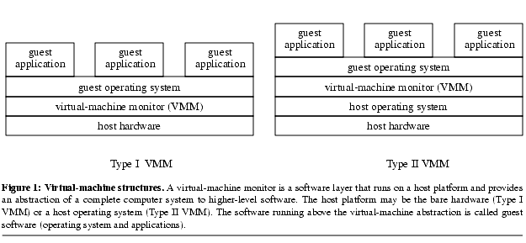
Classification of Virtual Machines
Notes:
Reference:- http://www.eecs.umich.edu/virtual/papers/king03.pdf

Slide 8
Classification of Virtual Machines
Type I
VMM is implemented directly on the physical hardware.
VMM performs the scheduling and allocation of the system’s resources.
IBM VM/370, Disco, VMware’s ESX Server, Xen
Type II
VMMs are built completely on top of a host OS.
The host OS provides resource allocation and standard execution environment to each “guest OS.”
User-mode Linux (UML), UMLinux
Notes:
Reference:- http://www.eecs.umich.edu/virtual/papers/king03.pdf

Slide 9
Disco: Challenges
Overheads
Additional Execution
Virtualization I/O
Memory management for multiple VMs
Resource Management
Lack of information to make good policy decisions
Communication & Sharing
Interface to share memory between multiple VMs
Baseed on slides from 2011fa: Ashik R

Slide 10
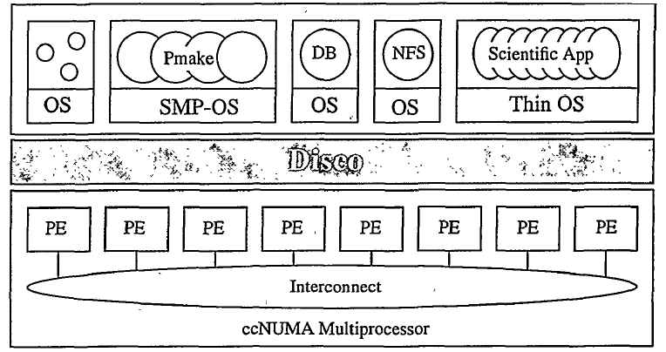
Disco: Interface
Processors – Virtual CPU
Memory
I/O Devices

Slide 11
Disco: Virtual CPUs
Physical CPU
Direct Execution on the real CPU
Intercept Privileged Instructions
Different Modes:
Kernel Mode: Disco
Supervisor Mode: Virtual Machines
User Mode: Applications
Disco
Normal Computation
DMA
Virtual CPU
Notes:
Virtual CPUs
Different Modes:
Kernel Mode: Disco
Supervisor Mode: Virtual Machines
User Mode: Applications
Direct Execution on the real CPU
Intercept Privileged Instructions such as TLB modification or DMA
Schedules VCPUs on Physical CPU by storing the state of the VCPU

Slide 12
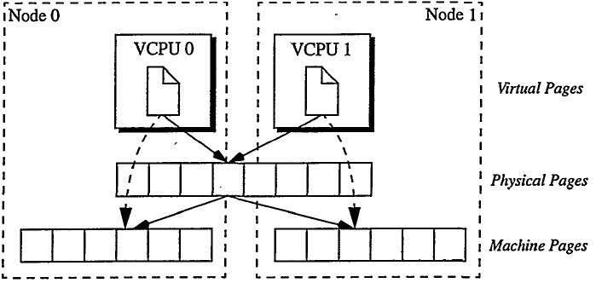
Disco: Memory Virtualization
Adds a level of address translation
Uses Software reloaded TLB and pmap
Flushes TLB on VCPU Switch
Uses second level Software TLB
Notes:
Memory Virtualization
Adds a level of address translation and maintains Virtual to Machine Address Mapping
Uses Software reloaded TLB and pmap
Flushes TLB on VCPU Switch
Simplifies VCPU Switch but increases workload
Uses second level Software TLB to lessen the effect of flushing TLB

Slide 13
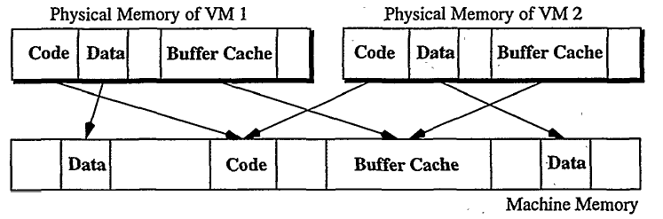
Disco: Memory Management
Affinity Scheduling
Page Migration
Page Replication
memmap
Notes:
Memory Management
Allocates memory to virtual machines
Page Migration: pages that are heavily accessed by a single node are migrated to that node
Page Replication: pages which are read shared are replicated to the nodes.
Uses cache miss counting facility of FLASH and memmap for this approach

Slide 14
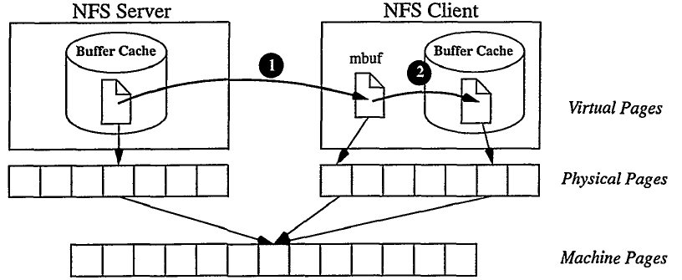
Disco: I/O Virtualization
Virtualizes access to I/O devices and intercepts all device access
Adds device drivers in to OS
Special support for Disk and Network access
Copy-on-write
Virtual Subnet
Allows memory sharing between VMs that are otherwise “unaware” of each other
Notes:
I/O Virtualization
Virtualizes access to I/O devices and intercepts all device access
Adds device drivers for common I/O devices into the OS
DMA requests to disks and N/W interface are intercepted and handled by Disco’s device drivers
Copy-on-write disks allow memory sharing between VMs unaware of other VMs
Virtual N/W devices allow efficient communication among different VMs

Slide 15
Running Commodity OSes
Changes for MIPS Architecture
Required to relocate the unmapped segment
Device Drivers
Added device drivers for I/O devices.
Changes to the HAL
Inserted some monitor calls in the OS
Notes:
Changes for MIPS Architecture
Required to relocated the unmapped segment
Device Drivers
Added special drivers for I/O devices. For other devices the IRIX drivers are used.
Changes to the HAL
Inserted some monitor calls in the OS to get high level knowledge about resource management

Slide 16
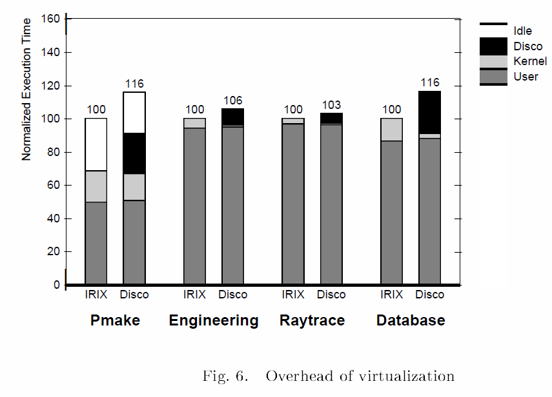
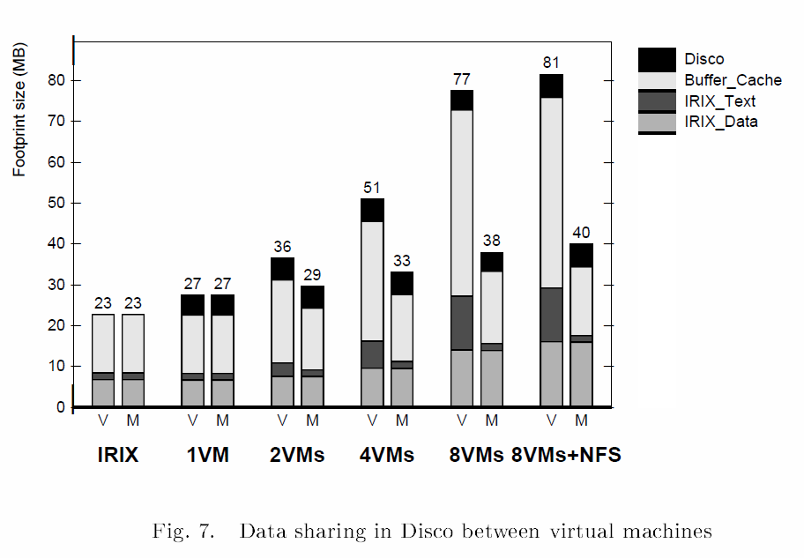
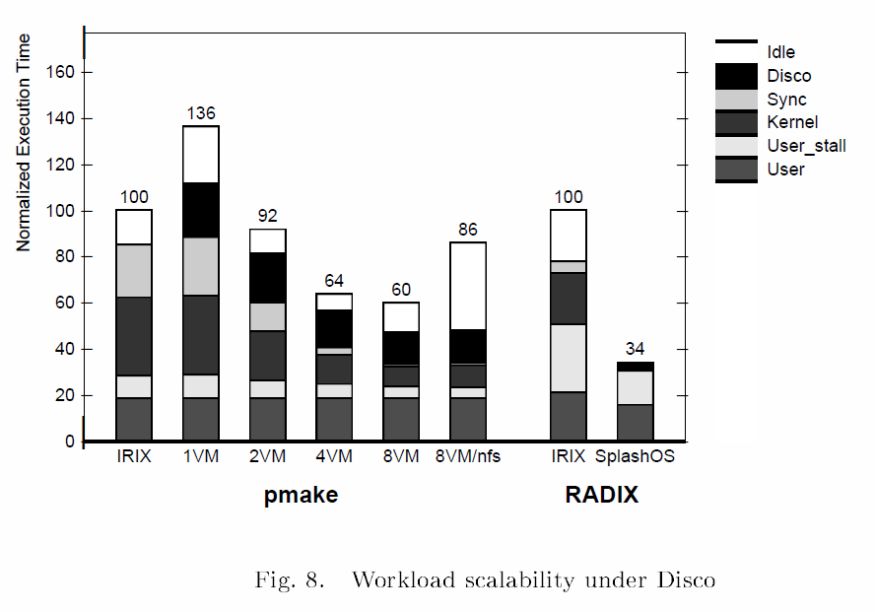
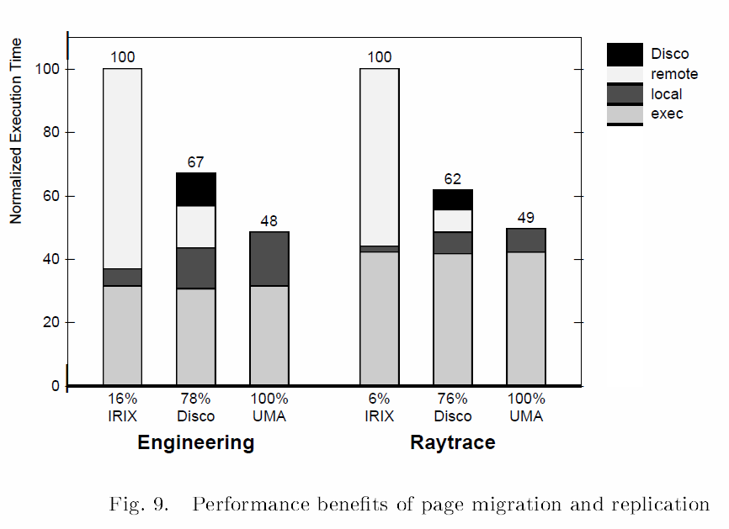
Experimental Results
Uses Sim OS Simulator for Evaluations

Slide 17
Disco: Takeaways
Develop system s/w with less effort
Low/Modest overhead
Simple solution for Scalable Hardware
Subsequent history
Rewritten into VMWare, became a major product
Performance hit a subject of much debate but successful even so, and of course evolved greatly
Today a huge player in cloud market

Slide 18
XEN AND THE ART OF VIRTUALIZATION
Paul Barham, Boris Dragovic, Keir Fraser, Steven Hand, Tim Harris,
Alex Ho, Rolf Neugebauery, Ian Pratt, Andrew Wareld

Slide 19
Xen’s Virtualization Goals
Isolation
Support different Operating Systems
Performance overhead should be small

Slide 20
Reasons to Virtualize
Systems hosting multiple applications on a shared machine must cope with some tough problems:
Do not support adequate isolation
Affect of Memory Demand, Network Traffic, Scheduling Priority and Disk Access on process’s performance
System Administration becomes Difficult

Slide 21
XEN : Introduction
A Para-Virtualized Interface: The hosted OS must be modified, but gains much increased performance by virtue of that.
Can host Multiple and different Operating Systems
Supports Isolation
Performance Overhead is minimum
Can Host up to 100 Virtual Machines even on a fairly limited machine

Slide 22
XEN : Approach
Drawbacks of Full Virtualization with respect to x86 architecture
Support for virtualization not inherent in x86 architecture
Certain privileged instructions did not trap to the VMM
Virtualizing the MMU efficiently was difficult
Other than x86 architecture deficiencies, it is sometimes required to view the real and virtual resources from the guest OS point of view
Xen’s Answer to the Full Virtualization problem:
It presents a virtual machine abstraction that is similar but not identical to the underlying hardware -para-virtualization
Requires Modifications to the Guest Operating System
No changes are required to the Application Binary Interface (ABI)

Slide 23
Terminology Used
Guest Operating System (OS) – refers to one of the operating systems that can be hosted by XEN.
Domain – refers to a virtual machine within which a Guest OS runs and also an application or applications.
Hypervisor – XEN (VMM) itself.

Slide 24
XEN’s Virtual Machine Interface
The virtual machine interface can be broadly
classified into 3 parts. They are:
Memory Management
CPU
Device I/O

Slide 25
XEN’s VMI : Memory Management
Problems
x86 architecture uses a hardware managed TLB
Segmentation
Solutions
One way would be to have a tagged TLB, which is currently supported by some RISC architectures
Guest OS are held responsible for allocating and managing the hardware page tables but under the control of Hypervisor
XEN should exist (64 MB) on top of every address space
Benefits
Safety and Isolation
Performance Overhead is minimized

Slide 26
XEN’s VMI : CPU
Problems
Inserting the Hypervisor below the Guest OS means that the Hypervisor will be the most privileged entity in the whole setup
If the Hypervisor is the most privileged entity then the Guest OS has to be modified to execute in a lower privilege level
Exceptions

Slide 27
XEN’s VMI : CPU
Solutions
x86 supports 4 distinct privilege levels – rings
Ring 0 is the most and Ring 3 is the least
Allowing the guest OS to execute in ring 1- provides a way to catch the
privileged instructions of the guest OS at the Hypervisor
Exceptions such as memory faults and software traps are solved by registering the handlers with the Hypervisor
Guest OS must register a fast handler for system calls with the Hypervisor
Each guest OS will have their own timer interface

Slide 28
XEN’s VMI: Device I/O
Existing hardware Devices are not emulated
A simple set of device abstractions are used – to ensure protection and isolation
Data is transferred to and fro using shared memory, asynchronous buffer descriptor rings – performance is better
Hardware interrupts are notified via a event delivery mechanism to the respective domains

Slide 29
XEN : Cost of Porting Guest OS
Linux is completely portable on the Hypervisor - the OS is called XenoLinux
Windows XP is in the Process
Lot of modifications are required to the XP’s architecture Independent code – lots of structures and unions are used for PTE’s
Lot of modifications to the architecture specific code was done in both the OSes
In comparing both OSes – Larger Porting effort for XP

Slide 30
XEN : Control and Management
Xen exercises just basic control operations such as access control, CPU scheduling between domains etc.
All the policy and control decisions with respect to Xen are undertaken by management software running on one of the domains – domain0
The software supports creation and deletion of VBD, VIF, domains, routing rules etc.

Slide 31
XEN : Detailed Design
Control Transfer
Hypercalls – Synchronous calls made from domain to XEN
Events – Events are used by Xen to notify the domain in an asynchronous manner
Data Transfer
Transfer is done using I/O rings
Memory for device I/O is provided by the respective domain
Minimize the amount of work to demultiplex data to a specific domain

Slide 32
XEN : Data Transfer in Detail
I/O Ring Structure
I/O Ring is a circular queue of descriptors
Descriptors do not contain I/O data but indirectly reference a data buffer as allocated by the guest OS.
Access to each ring is based on a set of pointers namely producer and consumer pointers
Guest OS associates a unique identifier with each request, which is included into the response, so that the OS can (1) maintain request ordering, (2) pair response with the proper request

Slide 33
XEN : Sub System Virtualization
The important Xen subsystems are :
CPU Scheduling
Time and Timers
Virtual Address Translation
Physical Memory
Network Management
Disk Management

Slide 34
XEN : CPU Scheduling
Xen uses Borrowed Virtual Time scheduling algorithm for scheduling the domains
Per-domain scheduling parameters can be adjusted using domain0
Advantages
Work–conserving: The method is very efficient
Low–latency dispatch: The use a technique of “virtual time warping”

Slide 35
XEN : Time and Timers
Guest OSes are provided information about real time, virtual time and wall clock time
Real Time – Time since machine boot and is accurately maintained with respect to the processor’s cycle counter and is expressed in nanoseconds
Virtual Time – This time is increased only when the domain is executing – to ensure correct time slicing between application processes on its domain
Wall clock Time – an offset that can be added to the current real time.

Slide 36
XEN : Virtual Address Translation
Register guest OSes page tables directly with the MMU
Restrict Guest OSes to Read only access
Page table Updates should be validated through the hypervisor to ensure safety
Each page frame has two properties associated with it namely type and reference count
Each page frame at any point in time will have just one of the 5 mutually exclusive types:
Page directory (PD), page table (PT), local descriptor table (LDT), global descriptor table (GDT), or writable (RW).
A page frame is allocated to page table use after validation and it is pinned to PD or PT type.
A frame can’t be re-tasked until reference=0 and it is unpinned.
To minimize overhead of the above operations in a batch process.
The OS fault handler takes care of frequently checking for updates to the shadow page table to ensure correctness.

Slide 37
XEN : Physical Memory
Physical Memory Reservations or allocations are made at the time of creation which are statically partitioned, to provide strong isolation.
A domain can claim additional pages from the hypervisor but the amount is limited to a reservation limit.
Xen does not guarantee to allocate contiguous regions of memory, guest OSes will create the illusion of contiguous physical memory.
Xen supports efficient hardware to physical address mapping through a shared translation array, readable by all domains – updates to this are validated by Xen.

Slide 38
XEN : Network Management
Xen provides the abstraction of a virtual firewall router (VFR), where each domain has one or more Virtual network interface (VIF) logically attached to this VFR.
The VIF contains two I/O rings of buffer descriptors, one for transmitting and the other for receiving
Each direction has a list of associated rules of the form (<pattern>,<action>) – if the pattern matches then the associated action applied.
Domain0 is responsible for implementing the rules over the different domains.
To ensure fairness in transmitting packet they implement round-robin packet scheduler.

Slide 39
XEN : Disk Management
Only Domain0 has direct unchecked access to the physical disks.
Other Domains access the physical disks through virtual block devices (VBDs) which is maintained by domain0.
VBS comprises a list of associated ownership and access control information, and is accessed via I/O ring.
A translation table is maintained for each VBD by the hypervisor, the entries in the VBD’s are controlled by domain0.
Xen services batches of requests from competing domains in a simple round-robin fashion.

Slide 40
XEN : Building a New Domain
Building initial guest OS structures for new domains is done by domain0.
Advantages are reduced hypervisor complexity and improved robustness.
The building process can be extended and specialized to cope with new guest OSes.

Slide 41
XEN : EVALUATION
Different types of evaluations:
Relative Performance.
Operating system benchmarks.
Concurrent Virtual Machines.
Performance Isolation.
Scalability

Slide 42
XEN : Experimental Setup
Dell 2650 dual processor 2.4GHz Xeon server with 2GB RAM
A Broadcom Tigon 3 Gigabit Ethernet NIC.
A single Hitachi DK32EJ 146GB 10k RPM SCSI disk.
Linux Version 2.4.21 was used throughout, compiled for architecture for native and VMware guest OS experiments– i686
Xeno-i686 architecture for Xen.
Architecture um for UML (user mode Linux)
The products to be compared are native Linux (L), XenoLinux (X), VMware Workstation 3.2 (V) and User Mode Linux (U)

Slide 43
XEN : Relative Performance
Complex application-level benchmarks that exercise the whole system have been employed to characterize performance.
First suite contains a series of long-running computationally-intensive applications to measure the performance of system’s processor, memory system and compiler quality.
Almost all execution are all in user-space, all VMMs exhibit low overhead.
Second, the total elapsed time taken to build a default configuration of the Linux 2.4.21 kernel on a local ext3 file system with gcc 2.96
Xen – 3% overhead, others more significant slowdown.
Third and fourth, experiments performed using PostgreSQL 7.1.3 database, exercised by the Open Source Database Benchmark Suite (OSDB) for multi-user Information Retrieval (IR) and On-Line Transaction Processing (OLTP) workloads
PostgreSQL places considerable load on the operating system which leads to substantial virtualization overheads on VMware and UML.

Slide 44
XEN : Relative Performance
Fifth, dbench program is a file system benchmark derived from ‘NetBench’
Throughput experienced by a single client performing around 90,000 file system operations.
Sixth, a complex application-level benchmark for evaluating web servers and the file systems
30% are dynamic content generation, 16% are HTTP POST operations and 0.5% execute a CGI script. There is up to 180Mb/s of TCP traffic and disk activity on 2GB dataset.
XEN fares well with 1% performance of native Linux, VMware and UML less than a third of the number of clients of the native Linux system.

Slide 45
XEN : Relative Performance

Slide 46
XEN : Operating System Benchmarks

Slide 47
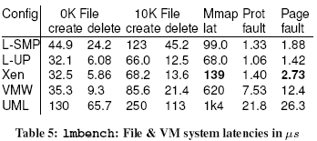
XEN : Operating System Benchmarks
Table 5, mmap latency and page fault latency.
Despite two transitions into Xen per page, the overhead is relatively modest.
Table 6, TCP performance over Gigabit Ethernet LAN.
Socket size of 128kb
Results are median of 9 experiments transferring 400MB
Default Ethernet MTU of 1500 bytes and dial-up MTU of 500-byte.
XenoLinux’s page-flipping technique achieves very low overhead.

Slide 48
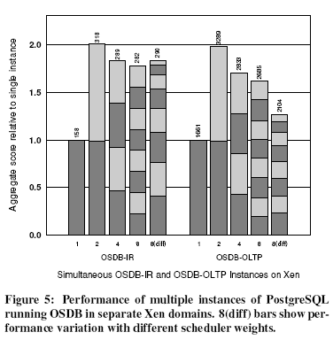
XEN : Concurrent Virtual Machines
In Figure 4,Xen’s interrupt load balancer identifies the idle CPU and diverts all interrupt processing to it, and also the number of domains increases, Xen’s performance improves.
In Figure 5, Increase in number of domains further causes reduction in throughput which can be attributed to increased context switching and disk head movement.

Slide 49
XEN : Scalability
They examine Xen to scale of 128 domains.
The minimum physical memory for a domain booted with XenoLinux is 64MB. And Xen itself maintains only 20kB of state per domain.
Figure 6, performance overhead of context switching between large number of domains.

Slide 50
Debate
What should a VMM actually “do”?
Hand: Argues that Xen is the most elegant solution and that the key is to efficiently share resources while avoiding “trust inversions”
Disco: Premise is that guest O/S can’t easily be changed and hence must be transparently ported
These two are not the only perspectives…
Heiser: For him, key is that smaller kernel can be verified more completely (leads to L4... then SEL4)
Tornado, Barrelfish: Focus on multicore leads to radically new architectures. How does this impact virtualization debate?

