Slide 1
CS 6410: Advanced Systems Ken Birman
Fall 2015
A PhD-oriented course about research in systems

Slide 2
About me...
My research is focused on “high assurance”
In fact as a graduate student I was torn between machine learning in medicine and distributed systems
I’ve ended up working mostly in systems, on topics involving fault-tolerance, consistency, coordination, security and other kinds of high-assurance
My current hot topics?
Cloud-scale high assurance via platform and language support (often using some form of machine learning)
Using the cloud to monitor/control the smart power grid
... but CS6410 is much broader than just “Ken stuff”

Slide 3
Goals for Today
What is CS6410 “about”?
What will be covered, and what background is assumed?
Why take this course?
How does this class operate?
Class details
Non-goal: We won’t have a real lecture today
This is because our lectures are always tied to readings

Slide 4
Coverage
The course is about the cutting edge in computer systems – the topics that people at conferences like ACM Symposium on Operating Systems Principles (SOSP) and the Usenix Conference on Operating Systems Design and Implementation (OSDI) love
We look at a mix of topics:
Classic insights and classic systems that taught us a great deal or that distilled key findings into useable platform technologies
Fundamental (applied theory) side of these questions
New topics that have people excited right now

Slide 5
Lots of work required
First and foremost: Attend every class, participate
You’ll need to do a lot of reading.
You’ll write a short (1-2 page) summary of the papers each time
Whoever presents the paper that day grades these (√-, √, √+)
You can skip up to 5 of them, whenever you like. Hand in “I’m skipping this one” and the grader will record that. But not more than 5.
You’ll have two “homework assignments” during first six weeks
Build (from scratch) a parallel version of the game of life designed to extract maximum speed from a multicore processor (2 is fine, 12 would be awesome)
Distributed coordination service running on EC2 (use a preexisting version of Paxos, and access it via Elastic Beanstalk). Study to identify bottlenecks, but no need to change the version of Paxos we provide
Then will do a more substantial semester-long independent project
Most students volunteer to present a paper. Not required but useful

Slide 6
Takeway?
You could probably take one other class too
But if you have any desire to have any kind of life at all, plus to begin to explore a research area, you can’t take more than two classes like this!
Not so much that it is “hard” (by and large, systems isn’t about hard ideas so much as challenging engineering), but it definitely takes time

Slide 7

Systems: Three “arcs” over 40 years
Risk: Cool theory but impractical result that can’t be deployed . Sometimes even the model is unrealistic!
Advantage: At massive scale your intuition breaks down. Just doing it is a major undertaking!
Advantage: Think with your hands. Elegant abstractions emerge as you go
Advantage: Really clear, rigorous statements and proofs
Risk: Works well, but can’t explain exactly when or exactly how
In the early days it was all one area
Today, these lines are more and more separated
Some people get emotional over which is best!
Risk: Totally unprincipled spaghetti
PODC
SOSP
Prove stuff about something
Build/evaluate a research prototype
SOCC
Report on amazing industry successes

Slide 8
Background: Ken’s stuff
I’m obsessed with reliable, super-fast data replication and applications that use that model.
But I try not to let it show…

Slide 9
My work blends theory and building
This isn’t unusual, many projects overlap lines
But it also moves me out of the mainstream SOSP community: I’m more of a “distributed systems” researcher than a “core systems” researcher
My main interest: How should theories of consistency and fault-tolerance inform the design of high-assurance applications and platforms?

Slide 10
Questions this poses
Which theory to use? We have more than one theoretical network model (synchronous, asynchronous, stochastic) and they differ in their “power”
How to translate this to a provably sound systems construct and to embed that into a platform (we use a model shared with Lamport’s Paxos system)
Having done all that, how to make the resulting system scale to run on the cloud, perform absolutely as fast as possible, exhibit stability... how to make it “natural” to use and easy to work with...

Slide 11
Current passion: my new Isis² System
C# library (but callable from any .NET language) offering replication techniques for cloud computing developers
Based on a model that fuses virtual synchrony and state machine replication models
Research challenges center on creating protocols that function well despite cloud “events”
Elasticity (sudden scale changes)
Potentially heavily loads
High node failure rates
Concurrent (multithreaded) apps
Long scheduling delays, resource contention
Bursts of message loss
Need for very rapid response times
Community skeptical of “assurance properties”

Slide 12
Isis² makes developer’s life easier
Benefits of Using Formal model
Importance of Sound Engineering
Formal model permits us to achieve correctness
Isis² is too complex to use formal methods as a development too, but does facilitate debugging (model checking)
Think of Isis² as a collection of modules, each with rigorously stated properties
Isis² implementation needs to be fast, lean, easy to use
Developer must see it as easier to use Isis² than to build from scratch
Seek great performance under “cloudy conditions”
Forced to anticipate many styles of use

Slide 13
Isis² makes developer’s life easier
Group g = new Group(“myGroup”);
g.ViewHandlers += delegate(View v) {
Console.Title = “myGroup members: “+v.members;
};
g.Handlers[UPDATE] += delegate(string s, double v) {
Values[s] = v;
};
g.Handlers[LOOKUP] += delegate(string s) {
Reply(Values[s]);
};
g.Join();
g.Send(UPDATE, “Harry”, 20.75);
List<double> resultlist = new List<double>;
nr = g.Query(LOOKUP, ALL, “Harry”, EOL, resultlist);
First sets up group
Join makes this entity a member. State transfer isn’t shown
Then can multicast, query. Runtime callbacks to the “delegates” as events arrive
Easy to request security (g.SetSecure), persistence
“Consistency” model dictates the ordering aseen for event upcalls and the assumptions user can make

Slide 14
Isis² makes developer’s life easier
Group g = new Group(“myGroup”);
g.ViewHandlers += delegate(View v) {
Console.Title = “myGroup members: “+v.members;
};
g.Handlers[UPDATE] += delegate(string s, double v) {
Values[s] = v;
};
g.Handlers[LOOKUP] += delegate(string s) {
Reply(Values[s]);
};
g.Join();
g.Send(UPDATE, “Harry”, 20.75);
List<double> resultlist = new List<double>;
nr = g.Query(LOOKUP, ALL, “Harry”, EOL, resultlist);
First sets up group
Join makes this entity a member. State transfer isn’t shown
Then can multicast, query. Runtime callbacks to the “delegates” as events arrive
Easy to request security (g.SetSecure), persistence
“Consistency” model dictates the ordering seen for event upcalls and the assumptions user can make

Slide 15
Isis² makes developer’s life easier
Group g = new Group(“myGroup”);
g.ViewHandlers += delegate(View v) {
Console.Title = “myGroup members: “+v.members;
};
g.Handlers[UPDATE] += delegate(string s, double v) {
Values[s] = v;
};
g.Handlers[LOOKUP] += delegate(string s) {
Reply(Values[s]);
};
g.Join();
g.Send(UPDATE, “Harry”, 20.75);
List<double> resultlist = new List<double>;
nr = g.Query(LOOKUP, ALL, “Harry”, EOL, resultlist);
First sets up group
Join makes this entity a member. State transfer isn’t shown
Then can multicast, query. Runtime callbacks to the “delegates” as events arrive
Easy to request security (g.SetSecure), persistence
“Consistency” model dictates the ordering seen for event upcalls and the assumptions user can make

Slide 16
Isis² makes developer’s life easier
Group g = new Group(“myGroup”);
g.ViewHandlers += delegate(View v) {
Console.Title = “myGroup members: “+v.members;
};
g.Handlers[UPDATE] += delegate(string s, double v) {
Values[s] = v;
};
g.Handlers[LOOKUP] += delegate(string s) {
Reply(Values[s]);
};
g.Join();
g.Send(UPDATE, “Harry”, 20.75);
List<double> resultlist = new List<double>;
nr = g.Query(LOOKUP, ALL, “Harry”, EOL, resultlist);
First sets up group
Join makes this entity a member. State transfer isn’t shown
Then can multicast, query. Runtime callbacks to the “delegates” as events arrive
Easy to request security (g.SetSecure), persistence
“Consistency” model dictates the ordering seen for event upcalls and the assumptions user can make

Slide 17
Isis² makes developer’s life easier
Group g = new Group(“myGroup”);
g.ViewHandlers += delegate(View v) {
Console.Title = “myGroup members: “+v.members;
};
g.Handlers[UPDATE] += delegate(string s, double v) {
Values[s] = v;
};
g.Handlers[LOOKUP] += delegate(string s) {
Reply(Values[s]);
};
g.Join();
g.Send(UPDATE, “Harry”, 20.75);
List<double> resultlist = new List<double>;
nr = g.Query(LOOKUP, ALL, “Harry”, EOL, resultlist);
First sets up group
Join makes this entity a member. State transfer isn’t shown
Then can multicast, query. Runtime callbacks to the “delegates” as events arrive
Easy to request security (g.SetSecure), persistence
“Consistency” model dictates the ordering seen for event upcalls and the assumptions user can make

Slide 18
Isis² makes developer’s life easier
Group g = new Group(“myGroup”);
g.ViewHandlers += delegate(View v) {
Console.Title = “myGroup members: “+v.members;
};
g.Handlers[UPDATE] += delegate(string s, double v) {
Values[s] = v;
};
g.Handlers[LOOKUP] += delegate(string s) {
Reply(Values[s]);
};
g.Join();
g.Send(UPDATE, “Harry”, 20.75);
List<double> resultlist = new List<double>;
nr = g.Query(LOOKUP, ALL, “Harry”, EOL, resultlist);
First sets up group
Join makes this entity a member. State transfer isn’t shown
Then can multicast, query. Runtime callbacks to the “delegates” as events arrive
Easy to request security (g.SetSecure), persistence
“Consistency” model dictates the ordering seen for event upcalls and the assumptions user can make

Slide 19
Isis² makes developer’s life easier
Group g = new Group(“myGroup”);
g.ViewHandlers += delegate(View v) {
Console.Title = “myGroup members: “+v.members;
};
g.Handlers[UPDATE] += delegate(string s, double v) {
Values[s] = v;
};
g.Handlers[LOOKUP] += delegate(string s) {
Reply(Values[s]);
};
g.SetSecure();
g.Join();
g.Send(UPDATE, “Harry”, 20.75);
List<double> resultlist = new List<double>;
nr = g.Query(LOOKUP, ALL, “Harry”, EOL, resultlist);
First sets up group
Join makes this entity a member. State transfer isn’t shown
Then can multicast, query. Runtime callbacks to the “delegates” as events arrive
Easy to request security (g.SetSecure), persistence
“Consistency” model dictates the ordering seen for event upcalls and the assumptions user can make

Slide 20
Consitency model: Virtual synchrony meets Paxos (and they live happily ever after…)
Virtual synchrony is a “consistency” model:
Membership epochs: begin when a new configuration is installed and reported by delivery of a new “view” and associated state
Protocols run “during” a single epoch: rather than overcome failure, we reconfigure when a failure occurs
A=3
B=7
B = B-A
A=A+1
Non-replicated reference execution
Synchronous execution
Virtually synchronous execution

Slide 21
How would we replicate mySQL?
We build the group as the system runs. Each participant just adds itself.
The leader monitors membership. This particular version doesn’t handle failures but the “full” version is easy.
We can trust the membership. Even failure notifications reflect a system-wide consensus.
Group g = new Group(“myGroup”);
g.ViewHandlers += delegate(View v) {
IMPORT “db-replica:”+v.GetMyRank();
};
g.Handlers[UPDATE] += delegate(string s, double v)
{
START TRANSACTION;
UPDATE salary = v WHERE SET name=s;
COMMIT;
};
...
g.SafeSend(UPDATE, “Harry”, “85,000”);
Modify the view handler to bind to the appropriate replicate (db-replica:0, ...)
Apply updates in the order received
Use the Isis² implementation of Paxos: SafeSend
Paxos guarantees agreement on message set, the order in which to perform actions and durability: if any member learns an action, every member will learn it.
This code requires that mySQL is deterministic and that the serialization order won’t be changed by QUERY operations (read-only, but they might get locks). As it happens, those assumptions are valid.

Slide 22
Example Application: Smart Power Grid
Today’s electric power grid is aging, inefficient
Some studies suggest that as much as 65% is wasted
Poor job of integrating renewable energy (wind, solar)
Two distinct forms of smart grid (both matter):
Deploy sensors in the power grid itself (PMUs), plus switchable lines and other new technologies
Some like to think of this as a new power grid “network“
But keep in mind that power doesn’t flow in packets
Smart meters in the home: controlled demand/response

Slide 23
No time for all of it today…
Focus will be on the “bulk” power network
And within this, on capturing and computing on PMU data in real-time
Assumptions
Human operators will be part of the equation for a long time into the future
Later could extend into the power distribution network and explore ways of automating certain control tasks

Slide 24
Cloud Computing for the Smart Grid
Real-time collection of data from widely deployed PMU and other SCADA data sources
PMU = Synchronized Phasor Measurement Unit
Each PMU device captures 44 byte records at 30Hz
One per “bus”: Data rates within large regions high
Robust real-time tracking enables shared, consistent situational awareness and coordination

Slide 25
Cloud Computing for the Smart Grid
Core premise: Use the cloud!
By reusing today’s scalable cloud infrastructure, we:
Benefit from a low-cost solution
Leverage a proven, universally accessible technology
The cloud is hosted at geographically diverse places
But our need is for stronger assurance than the cloud can normally offer

Slide 26
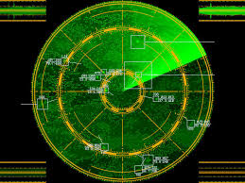
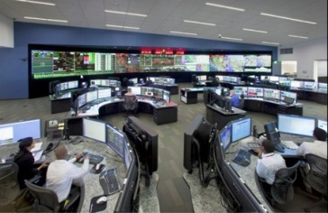

Killer Applications?
Over the horizon “grid radar” helps operators understand wide-area grid stress, disturbances
Tools (“apps for the smart grid”) help operators cooperate to solve problems, search knowledge base for past situations with similar fingerprint, explore what-if scenarios

Slide 27

Does the Cloud Have an Achilles Heel?
Today’s cloud is optimized for applications with weak security needs. It offers scalable snappy response, but lacks robust guarantees. Lacks:
Hardened network protocols aimed at consistent but tightly controlled sharing for collaboration
A new distributed security model supporting total control by regional operator, controlled data flows
To leverage the cloud, we need a new smart-grid technology built within today’s cloud technology!

Slide 28
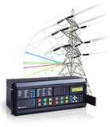
From the sensor to the shard
Internet portion
The shard members keep logs of values received indexed by time.
Due to network delay, not all have the same data at the same time.
Transport could be via GridStat, IP multicast, Isis² multicast (which runs on IP multicast) or even TCP connections
1
Private network portion
1
1

Slide 29
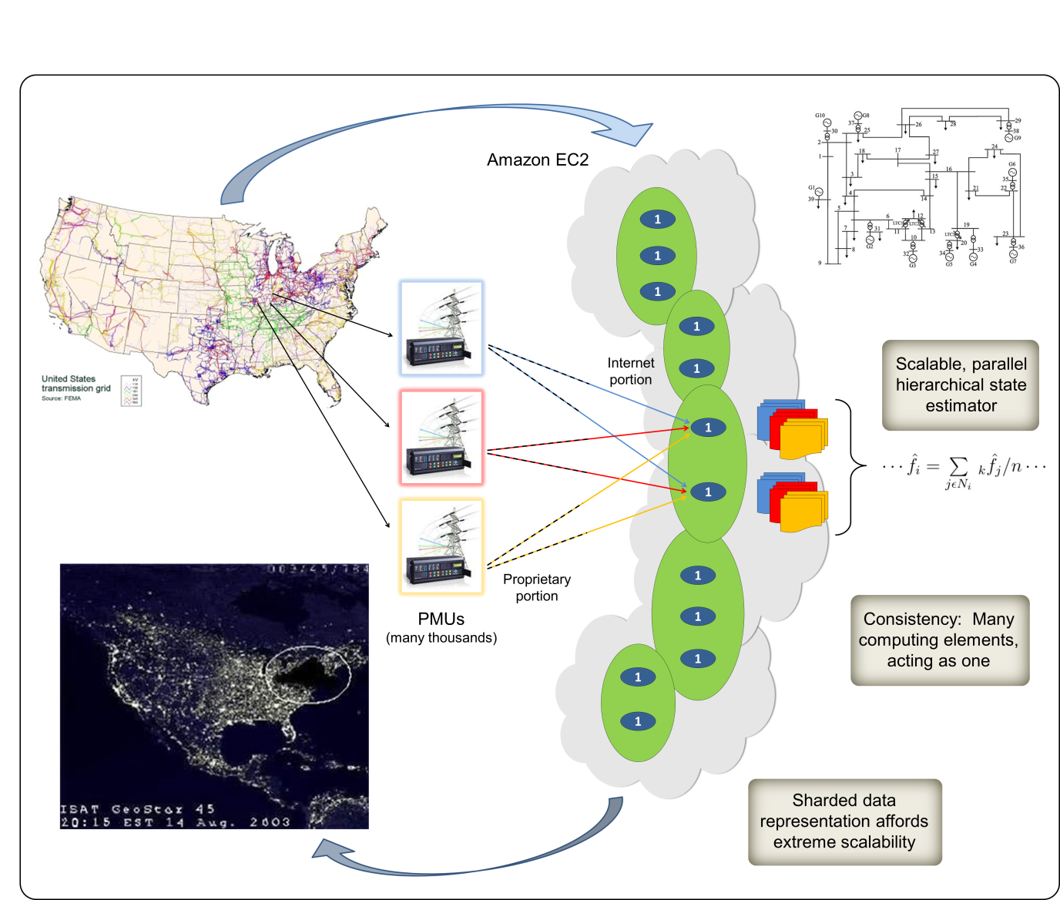
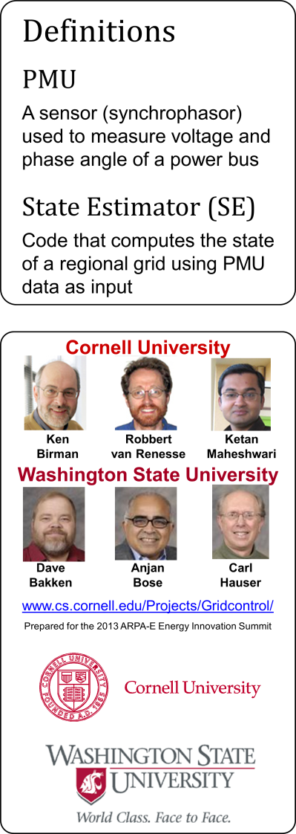
GridCloud: Mile high perspective

Slide 30
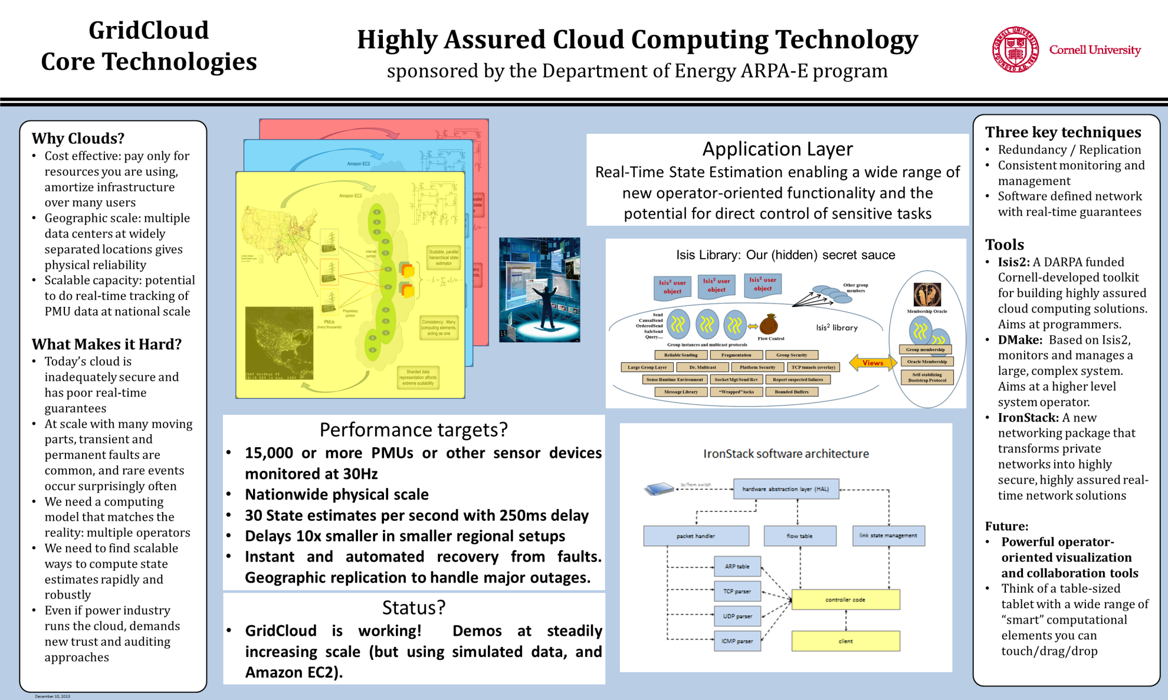
Deployed for Collaboration

Slide 31
Main Components: GC-FS
GridCloud File System: A file system for secure, strongly consistent real-time mirrored data sharing
It spreads data over multiple servers keeping data in memory for fast performance and scalability.
The data mirrored can be updated in real-time. (For example files of PMU data).
Really cool feature: it can pull up snapshots of past file states – huge numbers of them at very low cost. We plan to use this with Hadoop (MapReduce) applications
Leader developer: Weijia Song. Using .NET FileSystem class + Isis² (Birman)

Slide 32

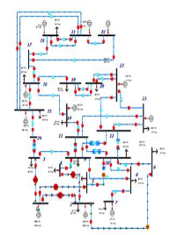
Main Components: GC-Collab
GridCloud Collaboration Tool: A tool for creating a kind of sharable virtual iPad
It graphs the current power network and can show you the status of any line at a click
Various “apps” can be dragged onto the network and this triggers actions, like a transient stability analysis or listing “similar network states seen in the past” (we’re the framework. Other people build these apps)
Shared with real-time consistency as needed
Based on: Live Distributed Objects + Isis² (Ostrowski, Birman)

Slide 33
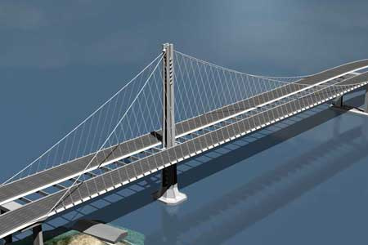
Main Components: IronStack
IronStack: A software defined network manager
You run normal TCP/IP and UDP protocols over it
Guarantees secure, real-time fault-tolerance
Only allows data flow according to security policies
It encrypts data, sends it redundantly for robustness. Can tolerate multiple failures
Operator console optimally schedules repairs after major damage, warns if failures threaten connectivity
Elegant…
Rock Solid
Lead developer: Z Teo

Slide 34

Main Components: DMake
DMake: Manages your GridCloud applications
Based on the popular Unix “makefile” concept
But generalized to support distributed programs where their operating parameters can be modified at runtime
It handles system repair after failures, load balancing, mapping of your computation to the cloud computing nodes, etc
Incredibly easy to use.
Lead developer: Theo Gkountouvas, uses Isis²

Slide 35
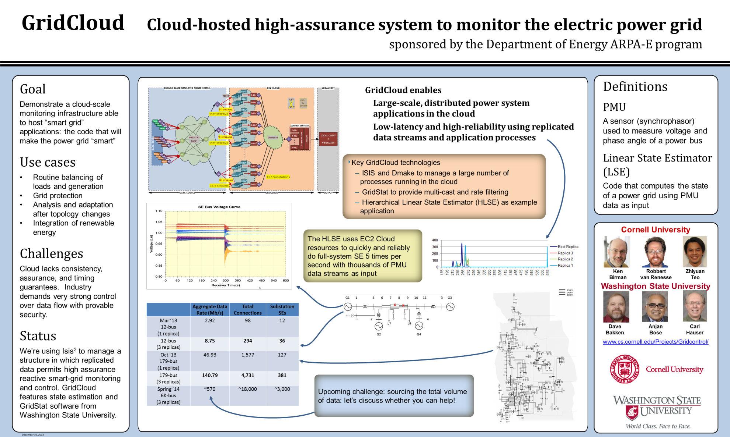

Slide 36
Demonstration Application
GridStat State Estimator:
Linear hierarchical state estimator
Based on work by Anjan Bose and his team at WSU
Runs today on GridCloud prototype, we’ve scaled it to handle 1900 PMUs distributed nationally
Can operate on a private cloud or Amazon EC2
Designed to “conceal” failures
Lead developers: Dave Anderson, Carl Hauser (WSU)

Slide 37
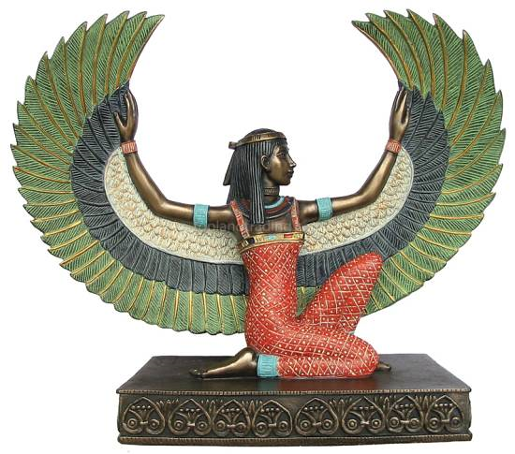
Under the Covers: Powered by Isis²
Used internally by these other tools
Provides secure, fault-tolerant data replication, coordination and self-repair. Lead: Birman
Employs cutting edge “virtual synchrony” programming model (basis of CORBA FT standard)
Open source, more than 4000 downloads to date from isis2.codeplex.com
Egyptian myth: After her brother Osiris was torn apart by Seth, Isis restored him to life

Slide 38
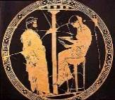

Why not just UDP multicast?
Isis² user object
Isis² user object
Isis² user object
Other group members
Send CausalSend OrderedSend SafeSend Query....
Membership Oracle
Isis² library
Flow Control
Group instances and multicast protocols
Group membership
Reliable Sending
Fragmentation
Group Security
Views
Oracle Membership
Large Group Layer
Dr. Multicast
Platform Security
TCP tunnels (overlay)
Sense Runtime Environment
Socket Mgt/Send/Rcv
Report suspected failures
Self-stabilizing
Bootstrap Protocol
Message Library
“Wrapped” locks
Bounded Buffers
These systems are complex, especially if you want to run on platforms like EC2

Slide 39
Why not just UDP multicast?
SafeSend and Send are two of the protocol components hosted over what we call the large-scale properties sandbox. The sandbox addresses issues like flow control, security, etc. All protocols share and benefit from those properties
Isis² user object
Isis² user object
Isis² user object
Other group members
Send CausalSend OrderedSend SafeSend Query....
Membership Oracle
Isis² library
Flow Control
Group instances and multicast protocols
Group membership
Reliable Sending
Fragmentation
Group Security
Views
Oracle Membership
Large Group Layer
Dr. Multicast
Platform Security
TCP tunnels (overlay)
Sense Runtime Environment
Socket Mgt/Send/Rcv
Report suspected failures
Self-stabilizing
Bootstrap Protocol
Message Library
“Wrapped” locks
Bounded Buffers
These systems are complex, especially if you want to run on platforms like EC2

Slide 40
Why not just UDP multicast?
SafeSend and Send are two of the protocol components hosted over what we call the large-scale properties sandbox. The sandbox addresses issues like flow control, security, etc. All protocols share and benefit from those properties
Isis² user object
Isis² user object
Isis² user object
Other group members
The SandBox itself is mostly composed of “convergent” protocols that use probabilistic methods
Send CausalSend OrderedSend SafeSend Query....
Membership Oracle
Isis² library
Flow Control
Group instances and multicast protocols
Group membership
Reliable Sending
Fragmentation
Group Security
Views
Oracle Membership
Large Group Layer
Dr. Multicast
Platform Security
TCP tunnels (overlay)
Sense Runtime Environment
Socket Mgt/Send/Rcv
Report suspected failures
Self-stabilizing
Bootstrap Protocol
Message Library
“Wrapped” locks
Bounded Buffers
These systems are complex, especially if you want to run on platforms like EC2

Slide 41
Other work: Differential Privacy for the Smart Grid
We are also working on a new approach to achieve differential privacy for smart meters in the home (joint with Edward Tremel, Mark Jelasity, Bobby Kleinberg)
In our scheme the meters run a cooperative protocol to jointly build the optimization models needed by the system operator to match supply and demand
Utility operates the solution, yet only learns the model!
But we don’t have time to discuss this today

Slide 42
Back to CS6410 stuff
Pinning down the plan

Slide 43
Why take this course
Learn about systems abstractions, principles, and artifacts that have had lasting value,
Understand attributes of systems research that is likely to have impact,
Become comfortable navigating the literature in this field,
Learn to present papers in a classroom setting
Gain experience in thinking critically and analytically about systems research, and
Acquire the background needed to work on research problems currently under study at Cornell and elsewhere.

Slide 44
Who is the course “for”?
Most of our CS6410 students are either
PhD students (but many are from non-CS fields, such as ECE, CAM, IS, etc)
Two year MS students who might switch into PhD
Undergraduates seriously considering a PhD
Fall 2015: Too big to allow MEng students.
MEng program offers lots of other options;
CS6410 has a unique role for the core CS PhD group

Slide 45
CS6410 versus just-read-papers
A paper on Isis² might just brag about how great it is, how well it scales, etc
Reality is often complex and reflects complex tensions and decisions that force compromises
In CS6410 our goal is to be honest about systems: see what the authors had to say, but think outside of the box they were in when they wrote the papers

Slide 46
Details
Instructor: Ken Birman
ken@cs.cornell.edu
Office Location: 114 Gates
TA: Theo Gkountouvas
Lectures:
CS 6410: Tu, Th: 10:10 – 11:25 PM, 114 Gates

Slide 47
Course Help
Course staff, office hours, announcements, etc:
http://www.cs.cornell.edu/courses/cs6410/2015fa
Please look at the course syllabus: the list of papers is central to the whole concept of this class
Research project ideas are also listed there

Slide 48
CS 6410: Overview
Prerequisite:
Mastery of CS3410, CS 4410 material
Fundamentals of computer architecture and OS design
How parts of the OS are structured
What algorithms are commonly used
What are the mechanisms and policies used
Some insights into storage systems, database systems “helpful”
Some exposure to networks, web, basic security ideas like public keys

Slide 49
CS 6410: Topics:
Operating Systems
Core concepts, multicore, virtualization, uses of VMs, other kinds of “containment”, fighting worms/viruses.
Cloud-scale stuff
Storage systems for big data, Internet trends, OpenFlow
Foundational theory
Models of distributed computing, state machine replication and atomicity, Byzantine Agreement.
Impact of social networks, P2P models, Self-Stabilization
A few lectures will focus on new trends: RDMA, BitCoin (a distributed protocol!), etc

Slide 50
CS 6410: Readings
Required reading for each lecture: 2 or 3 papers
Reflecting contrasting approaches, competition, criticism,…
Papers pulled from, best journals and conferences
TOCS, SOSP, OSDI, …
26 lectures, 54 (required) papers + 50 or so “recommended”!
Read papers before each class and bring notes
takes ~1 to 2 hrs per paper, write notes and questions
At the most, one or two papers may take 4 hours to understand
Write a review and turn in at least one hour before class
Turn on online via Course Management System (CMS)
No late reviews will be accepted, but you can skip 5 of them
Graded by the person doing that lecture on a simple √-,√,√+ basis plus written comments.

Slide 51
Mini-Projects
New, early part of semester
Two of them
Hands on experience with multicore parallelism in C or C++
Hands on experience with cloud computing on EC2

Slide 52
CS 6410: Two small projects
Goal: Get the rust off your systems skills!
Mini-project one: Build a multi-threaded, multicore version of the game of life, in C or C++ unless you absolutely cannot use those languages. Make it really, really fast.
Mini-project two: Take a standard Paxos and run it on Amazon’s EC2 using Elastic Beanstalk. Identify bottlenecks (we aren’t asking you to fix them)

Slide 53
CS 6410: Writing Reviews
Each student is required to prepare notes on each paper before class and to bring them to class for use in discussion.
Your notes should list assumptions, innovative contributions and criticisms.
Every paper in the reading list has at least one major weakness.
Don’t channel the authors: your job is to see the bigger questions!
Turn paper reviews in online before class via CMS
Be succinct—One paragraph per paper
Short summary of paper (two or three sentences)
Two to three strengths/contributions
and at least one weaknesses
One paragraph to compare/contrast papers
In all, turn in two to three paragraphs

Slide 54
CS 6410: Paper Presentations
Ideally, each person will present a paper, depending on the stable class size
Read and understand both required and suggested papers
Learning to present a paper is a big part of the job!
The presenting person also grades the essays for that topic
Two and a half weeks ahead of time
Meet with professor to agree on ideas to focus on
One and a half weeks ahead of time
Have presentation prepared and show slides or “chalk talk” to professor
One week ahead of time
Final review / do a number of dry-runs

Slide 55
CS 6410: Class Format
45-50 minutes presentation,
30 minutes discussion/brainstorming.
In that order, or mixed.
All students are required to participate!
Counts in final grading.

Slide 56
CS 6410: Research Project
One major project per person
Or two persons for a very major project
Initial proposal of project topic – due mid-September
Survey of area (related works)–due begin of October
Midterm draft paper – due begin of November
Peer reviews—due a week later
Final demo/presentation–due begin of December
Final project report – due a week later

Slide 57
CS 6410: Project Suggestions
Operating system features to better leverage RDMA
New cloud-scale computing services, perhaps focused on applications such as the smart power grid, smart self-driving cars, internet of things, smart homes
Study the security and distributed systems properties of BitCoin
New systems concepts aimed at better supporting “self aware” applications in cloud computing settings (or even in other settings)
Building better memory-mapped file systems: current model has become outmoded and awkward
Tools for improving development of super fast multicore applications like the one in mini-project one.
Software defined network infrastructure on the systems or network side (as distinct from Nate’s focus on the PL side)
… and you can invent more of your own!

Slide 58
Important Project Deadlines
9/11 | Submit your topic of interest proposal
9/25 | Submit 2-3 pages survey on topic
(Oct) | Discuss project topic with Matt/me
11/4 | Midterm draft paper of project
12/4 | Final demo/presentation of project
 | Final paper on project

Slide 59
CS 6410: Grading
Class Participation ~ 40%
lead presentation, reading papers, write reviews, participation in class discussion
Projects ~ 50%
Probably 20% will be the two mini-projects, 30% the big term one
Proposal, survey, draft, peer review, final demo/paper
Subjective ~ 10%
This is a rough guide

Slide 60
Academic Integrity
Submitted work should be your own
Acceptable collaboration:
Clarify problem, C syntax doubts, debugging strategy
You may use any idea from any other person or group in the class or out, provided you clearly state what you have borrowed and from whom.
If you do not provide a citation (i.e. you turn other people's work in as your own) that is cheating.
Dishonesty has no place in any community
May NOT be in possession of someone else’s homework/project
May NOT copy code from another group
May NOT copy, collaborate or share homework/assignments
University Academic Integrity rules are the general guidelines
Penalty can be as severe as an ‘F’ in CS 6410
Notes:
To draw a very clear line, you may use any idea from any other person or group in the class or out, provided you clearly state what you have borrowed and from whom. If you do not provide a citation---that is, you turn other people's work in as your own---that is cheating. Anything else is fair game. Of course, we will be grading you on the ideas you have added, but you should always borrow as much as you can as a starting point as there is no point in reinventing the wheel.

Slide 61
Stress, Health and Wellness
Need to pace yourself to manage stress
Need regular sleep, eating, and exercising
Don’t miss class... but....
Do not come to class sick (with the flu)!
Email me ahead of time that you are not feeling well
People not usually sick more than once in a semester

Slide 62
Before Next time
Rank-order 2 papers to present (first and second half)
Read first papers below and write review
End-to-end arguments in system design, J.H. Saltzer, D.P. Reed, D.D. Clark. ACM Transactions on Computer Systems Volume 2, Issue 4 (November 1984), pages 277--288.
http://portal.acm.org/citation.cfm?id=357402
Hints for computer system design, B. Lampson. Proceedings of the Ninth ACM Symposium on Operating Systems Principles (Bretton Woods, New Hampshire, United States) 1983, pages 33--48.
http://portal.acm.org/citation.cfm?id=806614
Check website for updated schedule

