Slide 1
TAO Facebook’s Distributed Data Store for the Social Graph
Nathan Bronson, Zach Amsden, George Cabrera, Prasad Chakka, Peter Dimov, Hui Ding, Jack Ferris, Anthony Giardullo, Sachin Kulkarni, Harry Li, Mark Marchukov, Dmitri Petrov, Lovro Puzar, Yee Jiun Song, Venkat Venkataramani
Presented at USENIX ATC – June 26, 2013

Slide 2
The Social Graph
USER
LOCATION
AT
GPS_DATA
FRIEND
AUTHOR
CHECKIN
PHOTO
USER
Carol
POST
LIKE
PHOTO
FRIEND
LIKE
LIKE
USER
LIKE
USER
USER
EXIF
COMMENT
EXIF_INFO
USER
COMMENT
(hypothetical encoding)
AUTHOR
Notes:
NOTES: spend less time here
So what is the social graph? The most basic nodes are obviously users and their relationships, but we also use it to model physical things and to encode all of a users activity on Facebook.
Consider this post, where I uploaded a photo of myself at the top of a climb in the Sierras.
…
OK, so now we have a flexible and powerful representation of the data behind this post, how do we go about rendering it?

Slide 3
Dynamically Rendering the Graph
USER
Web Server (PHP)
LOCATION
AT
GPS_DATA
FRIEND
CHECKIN
AUTHOR
PHOTO
USER
Carol
POST
LIKE
PHOTO
FRIEND
LIKE
USER
LIKE
USER
LIKE
USER
EXIF
UPLOAD_ FROM
COMMENT
EXIF_INFO
USER
COMMENT
APP
iPhoto
AUTHOR
Notes:
Now that we have this flexible and fine-grained representation of the content of this post, we need to actually turn it into HTML. We do this in a straightforward fashion, by having the web servers query the graph, filter, aggregate, and then render the result. A fundamental feature of the Facebook workload is that we do this aggregation every time; we dynamically render the site during every request.

Slide 4
Dynamically Rendering the Graph
TAO
USER
Web Server (PHP)
LOCATION
GPS_DATA
AT
AUTHOR
FRIEND
CHECKIN
PHOTO
LIKE
USER
Carol
PHOTO
POST
FRIEND
LIKE
USER
LIKE
USER
LIKE
USER
EXIF
UPLOAD_ FROM
COMMENT
EXIF_INFO
USER
COMMENT
APP
iPhoto
AUTHOR
1 billion queries/second
many petabytes of data
Notes:
Okay, so now we’ve got enough boxes and arrows on the screen that I can show you where TAO fits. For the data types it handles, TAO is responsible for the right side of the picture.
TAO is a service that stores the graph and allows the web servers to read and write it.
So how do we go about actually turning the typed nodes and typed edges into HTML? At a high level, we basically dynamically render from the graph every time.
No page caching
Dynamically generate the page every time

Slide 5
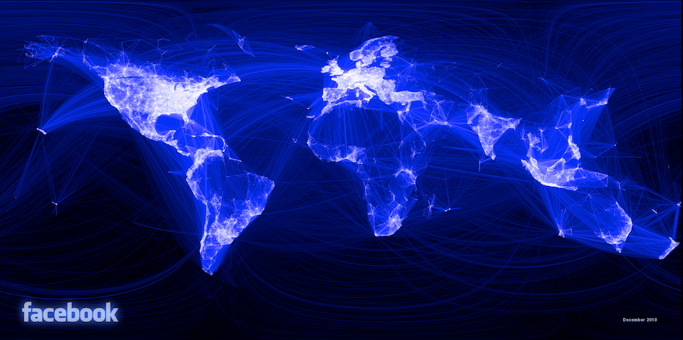
What Are TAO’s Goals/Challenges?
Efficiency at scale
Notes:
Efficiency at scale – more than 1 G qps, many PB of data
Dynamic data dependency resolution requires multiple rounds of graph queries to render page, so reads need to be fast. Our data centers are geographically distributed, so reads need to come from the local data center.
Facebook is a communication medium, so modifications to the graph should become immediately available.
Query amplification …

Slide 6
Dynamic Resolution of Data Dependencies
POST
1
CHECKED_IN
COMMENT
AUTHOR
ATTACH
LIKED_BY
LOCATION
COMMENT
PHOTO
USER
Carol
USER
2
AUTHOR
UPLOAD_ FROM
USER
3
APP
iPhoto
Notes:
Let’s dig a little deeper into how the web server renders the page. The edges are dynamic data dependencies that we resolve by doing multiple query rounds

Slide 7
What Are TAO’s Goals/Challenges?
Efficiency at scale
Low read latency
Timeliness of writes
High Read Availability
Notes:
Efficiency at scale – more than 1 G qps, many PB of data
Dynamic data dependency resolution requires multiple rounds of graph queries to render page, so reads need to be fast. Our data centers are geographically distributed, so reads need to come from the local data center.
Facebook is a communication medium, so modifications to the graph should become immediately available.
Query amplification …

Slide 8
Graph in Memcache
memcache
(nodes, edges, edge lists)
Web Server (PHP)
Obj & Assoc API
mysql
USER
LOCATION
GPS_DATA
AT
AUTHOR
FRIEND
CHECKIN
PHOTO
LIKE
USER
Carol
PHOTO
POST
FRIEND
LIKE
USER
LIKE
USER
LIKE
USER
EXIF
UPLOAD_ FROM
COMMENT
EXIF_INFO
USER
COMMENT
APP
iPhoto
AUTHOR
Notes:
Facebook’s workload has had these constraints for a long time, even before we constructed a graph-specific data store. 6 or 7 years ago engineers developed the objects and associations API …

Slide 9
Objects = Nodes
Associations = Edges
Identified by unique 64-bit IDs
Typed, with a schema for fields
Identified by <id1, type, id2>
Bidirectional associations are two edges, same or different type
id: 1807 =>
type: POST
str: “At the summ…
<1807,COMMENT,2003>
time: 1,371,704,655
id: 2003 =>
type: COMMENT
str: “how was it …
<308,AUTHORED,2003>
time: 1,371,707,355
id: 308 =>
type: USER
name: “Alice”
<2003,AUTHOR,308>
time: 1,371,707,355
Notes:
objects …
associations …
If you consider the edges out of a particular node, there is often a natural ordering. For the association between a post and its comments, for example, …
The time-ordering of edges is so common in the social graph that we make it part of the API, using it to express the outbound edges as an ordered list instead of a set. We call this an association list.

Slide 10
Association Lists
<id1, type, *>
Descending order by time
Query sublist by position or time
Query size of entire list
id: 1807 =>
type: POST
str: “At the summ…
<1807,COMMENT,4141>
time: 1,371,709,009
newer
id: 4141 => type: COMMENT
str: “Been wanting to do …
<1807,COMMENT,8332>
time: 1,371,708,678
id: 8332 => type: COMMENT
str: “The rock is flawless, …
<1807,COMMENT,2003>
time: 1,371,707,355
id: 2003 => type: COMMENT
str: “how was it, was it w…
older
Notes:
…
So in addition to the ability to query a single object or association, we also include in the API the ability to return a portion of a single association list.
The API only provides operations to read an object, an association, or an association list. This effectively means that the only fields that are indexed are ids, types, and time.

Slide 11
Objects and Associations API
Reads – 99.8%
Point queries
obj_get 28.9%
assoc_get 15.7%
Range queries
assoc_range 40.9%
assoc_time_range 2.8%
Count queries
assoc_count 11.7%
Writes – 0.2%
Create, update, delete for objects
obj_add 16.5%
obj_update 20.7%
obj_del 2.0%
Set and delete for associations
assoc_add 52.5%
assoc_del 8.3%
Notes:
TODO: replace wall of text with pie chart

Slide 12
What Are TAO’s Goals/Challenges?
Efficiency at scale
Low read latency
Timeliness of writes
High Read Availability

Slide 13
Independent Scaling by Separating Roles
Stateless
Web servers
TAO
Cache
Objects
Assoc lists
Assoc counts
Sharded by id
Servers –> read qps
Sharded by id
Servers –> bytes
Database
Notes:
Even though database has cache, this system lets us tune
Practical advantages to this system:
mature storage layer
complete tool set for free – backups, replication, bulk migrations, data export
incremental turn-up

Slide 14
Subdividing the Data Center
Inefficient failure detection
Many switch traversals
Web servers
Cache
Many open sockets
Lots of hot spots
Database
Notes:
The separation of cache and databases gives us linear scaling, but only up to a point. Hot spots in the cache become more numerous as the individual servers account for a smaller fraction of the total capacity. There are a fixed number of ports on cost-effective ethernet switches, so the networking even in a single building is not homogeneous between every server. Every web server talks to every cache server, which starts to stress the operating system. The communications stack in the web server also needs to detect failures in cache servers, so as the number of distinct clients grows the failure detectors get less effective. We can reduce the impact of all of these problems by subdividing both the web and cache servers, and arranging for web servers to talk to a subset of cache servers that is fewer switch hops away.

Slide 15
Subdividing the Data Center
Web servers
Cache
Distributed write control logic
Thundering herds
Database

Slide 16
Follower and Leader Caches
Web servers
Follower cache
Leader cache
Database

Slide 17
What Are TAO’s Goals/Challenges?
Efficiency at scale
Low read latency
Timeliness of writes
High Read Availability

Slide 18
Write-through Caching – Association Lists
Web servers
X –> Y
ok
Follower cache
X,A,B,C
Y,A,B,C
X,A,B,C
Y,A,B,C
refill X
X –> Y
ok
refill X
Leader cache
range get
X,A,B,C
Y,A,B,C
X –> Y
ok
Database
X,…
Y,…
Notes:
Using invalidates to repair the cache after a write works fine for objects, because they are individually invalidated. If we invalidate one of the edges in an association list, however, we will also have to discard all of the edges that come after it. In this example, we want to update the first element of an association list containing X, A, B, and C. The write proceeds in the same way as before, but instead of sending an invalidation we send a refill message. This causes any caches that hold X to requery the containing association list from the leader.
Refills have the nice property that they are idempotent, so we don’t have to send them synchronously as part of the write, and we can log them for replay if they fail.
Idempotent cache consistency messages are very useful from an operational perspective.

Slide 19
Asynchronous DB Replication
Master data center
Replica data center
Web servers
Writes forwarded to master
Follower cache
Inval and refill embedded in SQL
Leader cache
Database
Delivery after DB replication done

Slide 20
What Are TAO’s Goals/Challenges?
Efficiency at scale
Low read latency
Timeliness of writes
High Read Availability

Slide 21
Improving Availability: Read Failover
Master data center
Replica data center
Web servers
Follower cache
Leader cache
Database

Slide 22
TAO Summary
Efficiency at scale Read latency
Separate cache and DB
Graph-specific caching
Subdivide data centers
Write timeliness
Write-through cache
Asynchronous replication
Read availability
Alternate data sources

Slide 24
Inverse associations
Bidirectional relationships have separate a→b and b→a edges
inv_type(LIKES) = LIKED_BY
inv_type(FRIEND_OF) = FRIEND_OF
Forward and inverse types linked only during write
TAO assoc_add will update both
Not atomic, but failures are logged and repaired
Nathan
FRIEND_OF
FRIEND_OF
AUTHORED_BY
Carol
AUTHOR
LIKES
LIKED_BY
“On the summit”

Slide 25
Single-server Peak Observed Capacity
Notes:
TODO: maybe add a number for each of the high-level points?

Slide 26
Write latency
Notes:
TAO’s writes are performed synchronously in the master region, so a write in a slave region includes an inter- region round trip. Figure 11 compares the latency in two data centers, the master and a remote region 58.1 milliseconds away (average round trip). Average write latency in the master region was 12.1 msec; in the remote region it was 74.4 = 58.1 + 16.3 msec.

Slide 27
More In the Paper
The role of association time in optimizing cache hit rates
Optimized graph-specific data structures
Write failover
Failure recovery
Workload characterization

