Slide 1
Classic Systems: Unix and Mach
Ken Birman
CS6410

Slide 2
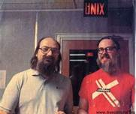
The UNIX Time-Sharing System Dennis Ritchie and Ken Thompson
Background of authors at Bell Labs
Both won Turing Awards in 1983
Dennis Ritchie
Key developer of The C Programming Lanuage, Unix, and Multics
Ken Thompson
Key developer of the B programming lanuage, Unix, Multics, and Plan 9
Also QED, ed, UTF-8
Unix slides based on Hakim’s Fall 2011 materials
Mach slides based on materials on the CMU website

Slide 3
The UNIX Time-Sharing System Dennis Ritchie and Ken Thompson

Slide 4
The UNIX Time-Sharing System Dennis Ritchie and Ken Thompson
Classic system and paper
described almost entirely in 10 pages
Key idea
elegant combination: a few concepts that fit together well
Instead of a perfect specialized API for each kind of device or abstraction, the API is deliberately small

Slide 5
System features
Time-sharing system
Hierarchical file system
Device-independent I/O
Shell-based, tty user interface
Filter-based, record-less processing paradigm
Major early innovations: “fork” system call for process creation, file I/O via a single subsystem, pipes, I/O redirection to support chains

Slide 6
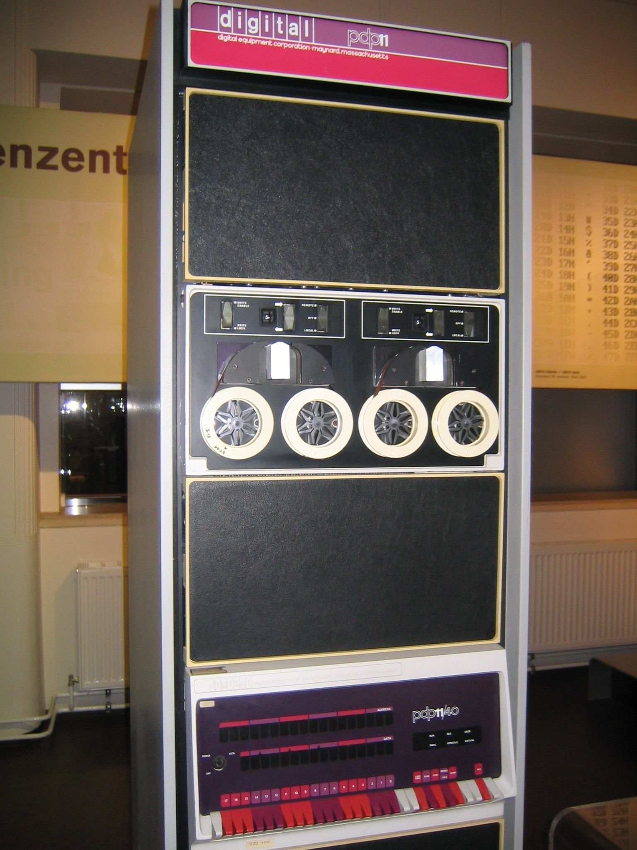
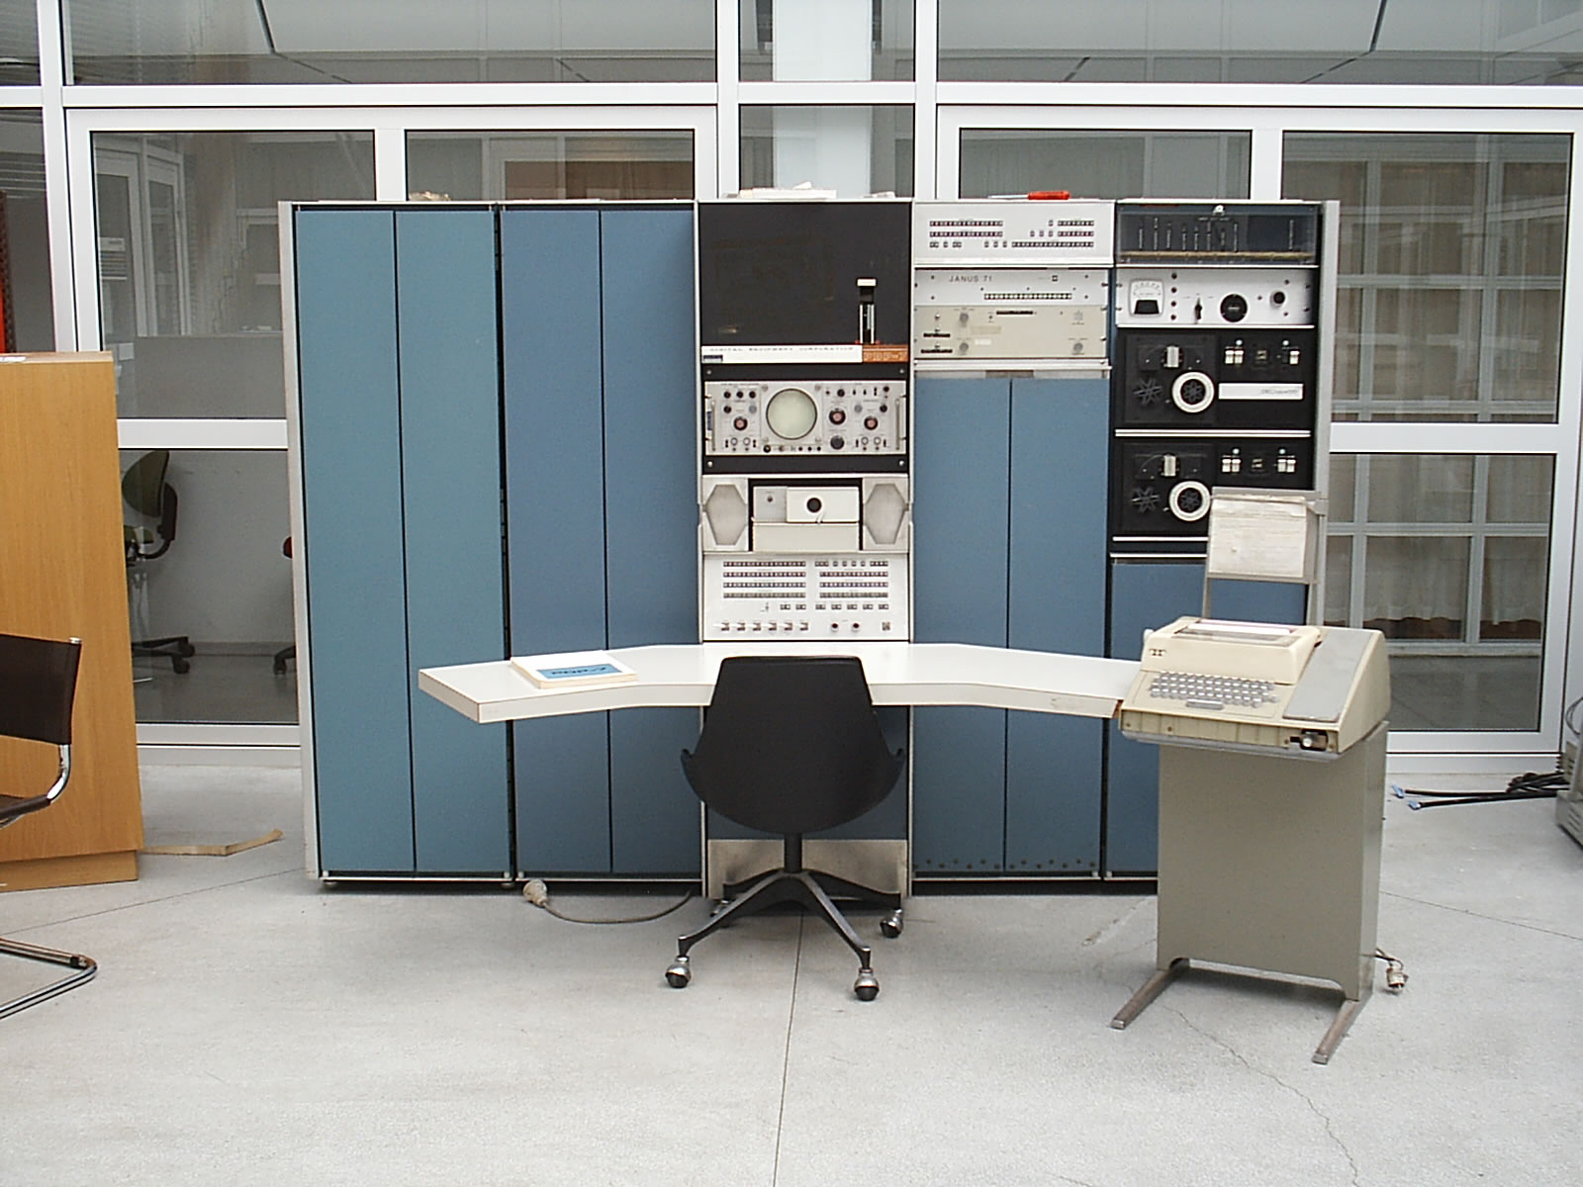
Version 3 Unix
1969: Version 1 ran PDP-7
1971: Version 3 Ran on PDP-11’s
Costing as little as $40k!
< 50 KB
2 man-years
to write
Written in C
PDP-7
PDP-11

Slide 7
File System
Ordinary files (uninterpreted)
Directories (protected ordinary files)
Special files (I/O)

Slide 8
Uniform I/O Model
open, close, read, write, seek
Uniform calls eliminates differences between devices
Two categories of files: character (or byte) stream and block I/O, typically 512 bytes per block
other system calls
close, status, chmod, mkdir, ln
One way to “talk to the device” more directly
ioctl, a grab-bag of special functionality
lowest level data type is raw bytes, not “records”

Slide 9
Directories
root directory
path names
rooted tree
current working directory
back link to parent
multiple links to ordinary files

Slide 10
Special Files
Uniform I/O model
Each device associated with at least one file
But read or write of file results in activation of device
Advantage: Uniform naming and protection model
File and device I/O are as similar as possible
File and device names have the same syntax and meaning, can pass as arguments to programs
Same protection mechanism as regular files

Slide 11
Removable File System
Tree-structured
Mount’ed on an ordinary file
Mount replaces a leaf of the hierarchy tree (the ordinary file) by a whole new subtree (the hierarchy stored on the removable volume)
After mount, virtually no distinction between files on permanent media or removable media

Slide 12
Protection
User-world, RWX bits
set-user-id bit
super user is just special user id

Slide 13
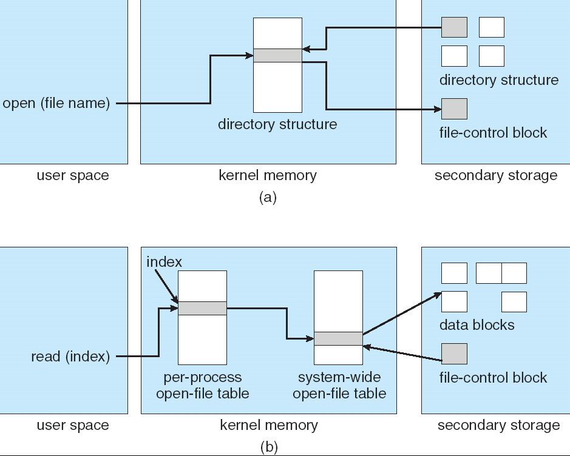
File System Implementation
System table of i-numbers (i-list)
i-nodes
path names (directory is just a special file!)
mount table
buffered data
write-behind

Slide 14
I-node Table
short, unique name that points at file info.
allows simple & efficient fsck
cannot handle accounting issues
Inode
File name
Inode#

Slide 15
Many devices fit the block model
Disks
Drums
Tape drives
USB storage
Early version of the ethernet interface was presented as a kind of block device (seek disabled)
But many devices used IOCTL operations heavily

Slide 16
Processes and images
text, data & stack segments
process swapping
pid = fork()
pipes
exec(file, arg1, ..., argn)
pid = wait()
exit(status)

Slide 17
Easy to create pipelines
A “pipe” is a process-to-process data stream, could be implemented via bounded buffers, TCP, etc
One process can write on a connection that another reads, allowing chains of commands
% cat *.txt | grep foo | wc
In combination with an easily programmable shell scripting model, very powerful!

Slide 18
The Shell
cmd arg1 ... argn
stdio & I/O redirection
filters & pipes
multi-tasking from a single shell
shell is just a program
Trivial to implement in shell
Redirection, background processes, cmd files, etc

Slide 19
Traps
Hardware interrupts
Software signals
Trap to system routine

Slide 20
Perspective
Not designed to meet predefined objective
Goal: create a comfortable environment to explore machine and operating system
Other goals
Programmer convenience
Elegance of design
Self-maintaining

Slide 21
Perspective
But had many problems too. Here are a few:
File names too short and file system damaged on crash
Didn’t plan for threads and never supported them well
“Select” system call and handling of “signals” was ugly and out of character w.r.t. other features
Hard to add dynamic libraries (poor handling of processes with lots of “segments”)
Shared memory and mapped files fit model poorly
...in effect, the initial simplicity was at least partly because of some serious limitations!

Slide 22
Even so, Unix has staying power!
Today’s Linux systems are far more comprehensive yet the core simplicity of Unix API remains a very powerful force
Struggle to keep things simple has helped keep O/S developers from making the system specialized in every way, hard to understand
Even with modern extensions, Unix has a simplicity that contrasts with Windows .NET API...

Slide 23
μ-Kernel trend
Even at outset we wanted to support many versions of Unix in one “box” and later, Windows and IBM operating systems too
A question of cost, but also of developer preference
Each platform has its merits
Led to a research push: build a micro-kernel, then host the desired O/S as a customization layer on it
NOT the same as a virtual machine architecture!
In a μ-Kernel, the hosted O/S is an “application”, whereas a VM mimics hardware and runs the real O/S

Slide 24
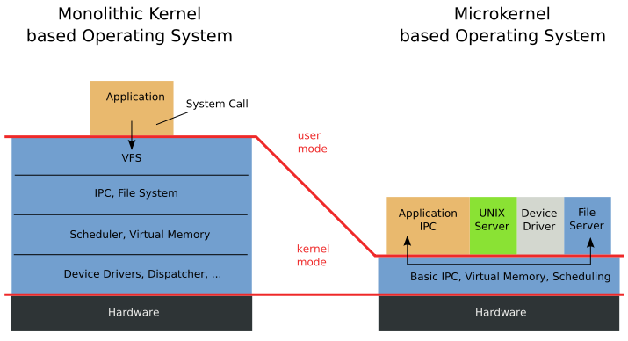
Microkernel vs. Monolithic Systems
Source: http://en.wikipedia.org/wiki/File:OS-structure.svg

Slide 25
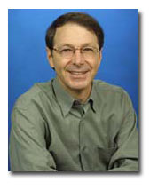
Mach History
CMU Accent operating system
No ability to execute UNIX applications
Single Hardware architecture
BSD Unix system + Accent concepts
Mach
OpenStep
GNU Hurd
Professor at Rochester, then CMU. Now Microsoft VP Research
XNU
OSF/1
Darwin
Mac OS X

Slide 26
Design Principles
Maintain BSD Compatibility
Simple programmer interface
Easy portability
Extensive library of utilities/applications
Combine utilities via pipes
PLUS
Diverse architectures.
Varying network speed
Simple kernel
Distributed operation
Integrated memory management and IPC
Heterogeneous systems

Slide 27
System Components
text region
message
threads
port
task
Task
Thread
Port
Port set
Message
Memory object
port set
data region
secondary
storage
memory object

Slide 28
Memory Management and IPC
Memory Management using IPC:
Memory object represented by port(s)
IPC messages are sent to those ports to request operation on the object
Memory objects can be remote → kernel caches the contents
IPC using memory-management techniques:
Pass message by moving pointers to shared memory objects
Virtual-memory remapping to transfer large contents (virtual copy or copy-on-write)

Slide 29
Mach innovations
Extremely sophisticated use of VM hardware
Extensive sharing of pages with various read/write mode settings depending on situation
Unlike a Unix process, Mach “task” had an assemblage of segments and pages constructed very dynamically
Most abstractions were mapped to these basic VM ideas, which also support all forms of Mach IPC

Slide 30
Process Management Basic Structure
Tasks/Threads
Synchronization primitives:
Mach IPC:
Processes exchanging messages at rendezvous points
Wait/signal associated with semaphores can be implemented using IPC
High priority event-notification used to deliver exceptions, signals
Thread-level synchronization using thread start/stop calls

Slide 31
Process Management C Thread package
User-level thread library built on top of Mach primitives
Influenced POSIX P Threads standard
Thread-control:
Create/Destroy a thread
Wait for a specific thread to terminate then continue the calling thread
Yield
Mutual exclusion using spinlocks
Condition Variables (wait, signal)

Slide 32
Process Management CPU Scheduler
Only threads are scheduled
Dynamic thread priority number (0 – 127)
based on the exponential average of its CPU usage.
32 global run queues + per processor local queues (ex. driver thread)
No Central dispatcher
Processors consult run queues to select next thread
List of idle processors
Thread time quantum varies inversely with total number of threads, but constant over the entire system

Slide 33
Process Management Exception Handling
Implemented via RPC messages
Exception handling granularities:
Per thread (for error handling)
Per task (for debuggers)
Emulate BSD style signals
Supports execution of BSD programs
Not suitable for multi-threaded environment

Slide 34
Interprocess Communication Ports + messages
Allow location independence + communication security
Sender/Receiver must have rights (port name + send or receive capability)
Ports:
Protected bounded queue in the kernel
System Calls:
Allocate new port in task, give the task all access rights
Deallocate task’s access rights to a port
Get port status
Create backup port
Port sets: Solves a problem with Unix “select”

Slide 35
Interprocess Communication Ports + messages
Messages:
Header + typed data objects
Header: destination port name, reply port name, message length
In-line data: simple types, port rights
Out-of-line data: pointers
Via virtual-memory management
Copy-on-write
Sparse virtual memory

Slide 36
Interprocess Communication Ports + messages
NetMsgServer:
user-level capability-based networking daemon
used when receiver port is not on the kernel’s computer
Forward messages between hosts
Provides primitive network-wide name service
Mach 3.0 NORMA IPC
Syncronization using IPC:
Used in threads in the same task
Port used as synchronization variable
Receive message → wait
Send message → signal

Slide 37
Memory Management
Memory Object
Used to manage secondary storage (files, pipes, …), or data mapped into virtual memory
Backed by user-level memory managers
Standard system calls for virtual memory functionality
User-level Memory Managers:
Memory can be paged by user-written memory managers
No assumption are made by Mach about memory objects contents
Kernel calls to support external memory manager
Mach default memory manager

Slide 38
Memory Management Shared memory
Shared memory provides reduced complexity and enhanced performance
Fast IPC
Reduced overhead in file management
Mach provides facilities to maintain memory consistency on different machines

Slide 39
Programmer Interface
System-call level
Emulation libraries and servers
Upcalls made to libraries in task address space, or server
C Threads package
C language interface to Mach threads primitives
Not suitable for NORMA systems
Interface/Stub generator (MIG) for RPC calls

Slide 40
Mach versus Unix
Imagine a threaded program with multiple input sources (I/O streams) and also events like timeouts, mouse-clicks, asynchronous I/O completions, etc.
In Unix, need a messy select-based central loop.
With Mach, a port-group can handle this in a very elegant and general way. But forces you to code directly against the Mach API if the rest of your program would use the Unix API

Slide 41
Mach Microkernel summary
Simple kernel abstractions
Hard work is that they use them in such varied ways
Optimizing to exploit hardware to the max while also matching patterns of use took simple things and made them remarkably complex
Even the simple Mach “task” (process) model is very sophisticated compared to Unix
Bottom line: an O/S focused on communication facilities
System Calls:
IPC, Task/Thread/Port, Virtual memory, Mach 3 NORMA IPC

Slide 42
Mach Microkernel summary
User level
Most use was actually Unix on Mach, not pure Mach
Mach team build several major servers
Memory Managers
NetMsgServer
NetMemServer
FileServer
OS Servers/Emulation libraries
C Threads user-level thread management package

Slide 43
Big picture questions to ask
Unix focuses on a very simple process + I/O model
Mach focused on a very basic / general VM model, then uses it to support Unix, Windows, and “native” services
If Mach mostly is a VM infrastructure, was this the best way to do that? If Linux needed to extend Unix, was Unix simplicity as much of a win as people say?
Did Mach exhbit a mismatch of goals: a solution (fancy paging) in search of a platform using those features?
Fate of Mach: Some ideas live on in Apple OS/X, Windows!

