Slide 1
Software-Defined Networking: OpenFlow and Frenetic
Mohamed Ismail

Slide 2
Background

Slide 3
Problem: Programming Networks is Hard

Slide 4
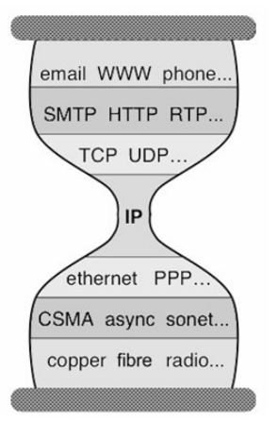
Network Stack Pros
Key to the success of the Internet
Layers and layers of abstraction
Independent innovation at each layer
Communication media
Ethernet standards
Transport layer protocols
Follows end-to-end argument
(Source: Shenker, 2011)

Slide 5
Network Stack Cons
Network switches and routers built and optimized for internet traffic
Network components and internet protocols set in stone
Difficulty to switch from IPv4 to IPv6
Difficult to perform research on Internet
Problem:
Network infrastructure has “ossified”
(Source: Shenker, 2011)

Slide 6
Functions of a switch/router
Packet
In
Packet
Out
Switch/Router
Receive a packet and send to appropriate destination
Prevent a packet from reaching a certain destination

Slide 7
Programming a switch/router
Packet
In
Packet
Out
Flow Table
Switch/Router
Use a limited API to program the switch/router flow table
Must program each network device separately
Programming dependent on topology
Does not scale
Problem: No generalized API for programming scalable networks

Slide 8
Data Plane vs. Control Plane
Data Plane
Control Plane
Receive a packet
Forward packet based on flow table
Network stack abstractions are data plane abstractions
Update flow table to specify where packets should go
Update flow table to specify where packets should not go
No abstractions for updating the control plane

Slide 9
Programming networks is hard because…
Network stack is an abstraction for the data plane
Network infrastructure has “ossified” due to the success of the internet
Switch and router internals vary by manufacturer and there is no standard API for the control plane
Without any abstractions for control plane, research and innovation in network programming is near impossible
Must compute configuration of each device
Can only work with given network-level protocol (i.e. IP)

Slide 10
OpenFlow

Slide 11
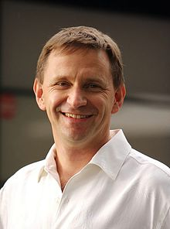
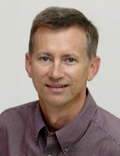
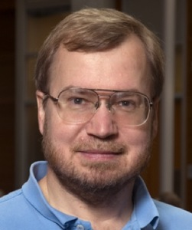
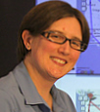
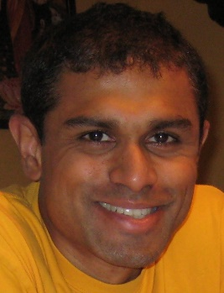
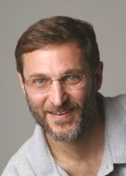
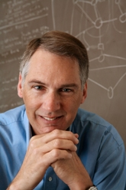

Authors
Nick McKeown
‘95 PhD UC Berkeley
Co-founded Nicira Networks, ONF
Faculty at Stanford
Tom Anderson
‘91 PhD Univ. of Wash.
UC Berkeley ‘91-’97
Faculty at Univ. of Wash.
Hari Balakrishnan
‘98 PhD UC Berkeley
Faculty at MIT
Guru Parulkar
‘87 PhD Univ. of Deliware
Many network-related startups
Executive director of Clean Slate Internet Design Program
Larry Peterson
‘85 PhD Purdue University
GENI project chair
Faculty at Princeton
Jennifer Rexford
‘96 PhD Univ. of Mich.
AT&T Labs ‘96-’05
Broader Gateway Protocol
Faculty at Princeton
Scott Shenker
‘83 PhD Univ. of Chig.
XEROX Parc
Co-founder of Nicira Networks, ONF
Faculty at Berkeley
Jonathan Turner
Faculty at Washington University in St. Louis

Slide 12
Goals
Run experiments on campus networks
Reluctance to using experimental equipment on college network
Isolation: Control over network without disruptions to normal traffic
What functionality is needed for experiments?
Software-based approach
Low performance
Low port density
Low cost
Take advantage of existing infrastructure
Closed platforms from vendors

Slide 13
Goals and Challenges
Run experiments on campus networks
Reluctance by admins to using experimental equipment on college network
Isolation: Control over network without disruptions to normal traffic
What functionality is needed for experiments?
Software-based approach
Software-based solutions have low performance
Software-based solutions support low port density
Low cost
Take advantage of existing infrastructure
Closed platforms from vendors

Slide 14
Take Aways
OpenFlow allows network devices to decouple the data plane from the control plane
Data plane processing done by network device
Data plane abstraction is the network stack
Control plane processing done by controller
New control stack for OpenFlow devices provides standardized API and abstractions necessary to innovate in field of network management

Slide 15
Design
Separate data plane from control plane
Data plane
High performance forwarding
Control plane
Flow table is programmable
Accessed through controller using OpenFlow Protocol
OpenFlow
Packet
In
Packet
Out
Flow Table
Switch/Router

Slide 16
OpenFlow API
Forward packets to given port (or ports)
Forward packets to controller
Usage: Can analyze and process packets
Drop the packet
Usage: Protect against attacks by removing suspicious packets

Slide 17
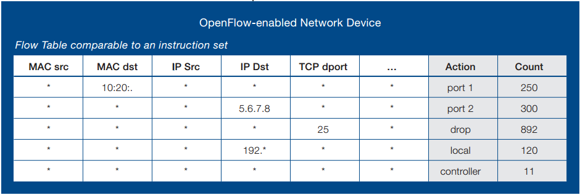
Flow Table Entry
Packet header to define flow
Action to be performed
Statistics
(Source: ONF, 2012)

Slide 18
Isolation
Two Options:
Add another action to the OpenFlow API
Forward packets through normal pipeline
OR
Define separate VLANs
No overlap over production and experimental traffic

Slide 19
Discussion
What is easy to accomplish with the OpenFlow solution?
What is still hard to do with OpenFlow?

Slide 20
Controllers
Must communicate using OpenFlow protocol
Individual controllers for multiple switches or single controller for all switches
Use with Network OS
NOX
Should provide some permissions to prevent mixing of traffic or unauthorized flow table changes
Implementation details left unspecified

Slide 21
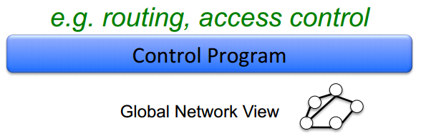
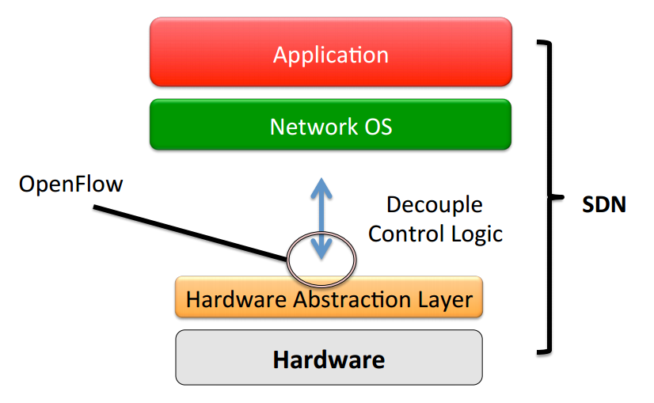
Control Stack
OpenFlow is only a means to achieve the decoupling needed for Software-Defined Networking
Network OS provides common control functionality that can be used by multiple applications
(Sources: Casado, 2011; Shenker, 2011)

Slide 22
Discussion
What functionality should the Network OS have?
What layers or abstractions are missing from the control stack?

Slide 23
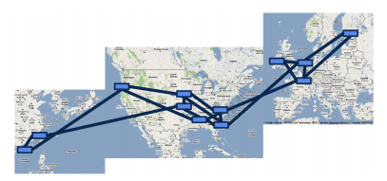
Google B4
Provides connectivity among Google datacenters
Use SDN and OpenFlow
Centralized traffic engineering application
Resource contention
Multipath forwarding/tunneling to leverage network capacity according to application priority
Dynamically relocate bandwidth
Many links run at near 100% utilization for extended periods of time
(Source: Jain, 2013)

Slide 24
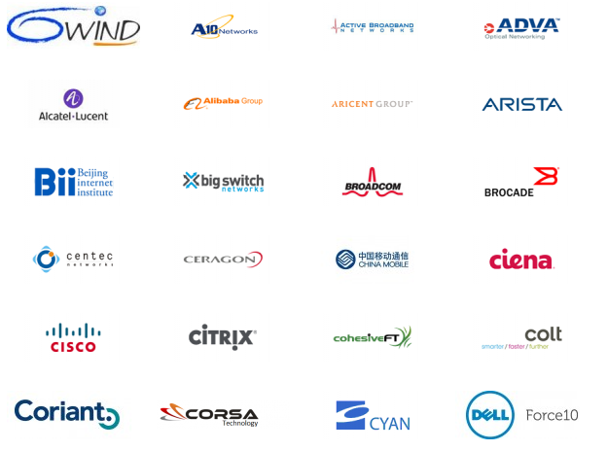
Open Network Foundation
Promote adoption of Sotware-Defined Networking through open standards such as OpenFlow
Partners:

Slide 25
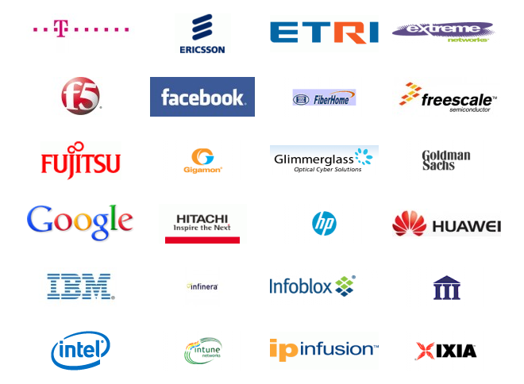
Open Network Foundation
Promote adoption of Sotware-Defined Networking through open standards such as OpenFlow
Partners:

Slide 26
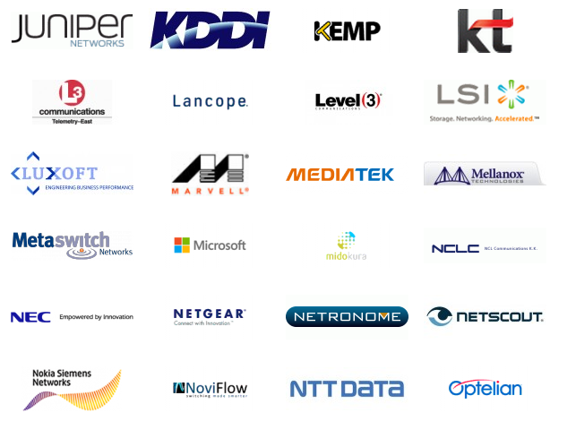
Open Network Foundation
Promote adoption of Sotware-Defined Networking through open standards such as OpenFlow
Partners:

Slide 27
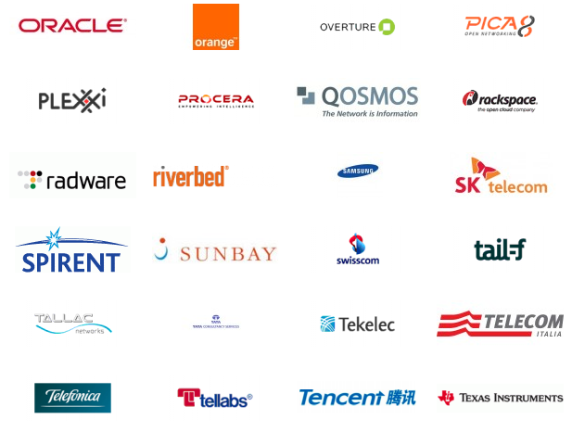
Open Network Foundation
Promote adoption of Sotware-Defined Networking through open standards such as OpenFlow
Partners:

Slide 28
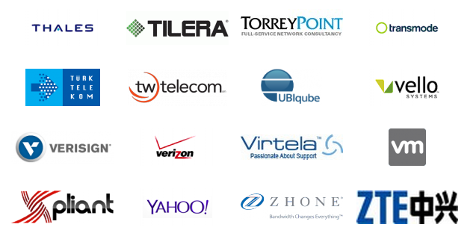
Open Network Foundation
Promote adoption of Sotware-Defined Networking through open standards such as OpenFlow
Partners:

Slide 29
Take Aways
OpenFlow allows network devices to decouple the data plane from the control plane
Data plane processing done by network device
Data plane abstraction is the network stack
Control plane processing done by controller
New control stack for OpenFlow devices provides standardized API and abstractions necessary to innovate in field of network management

Slide 30
Frenetic

Slide 31

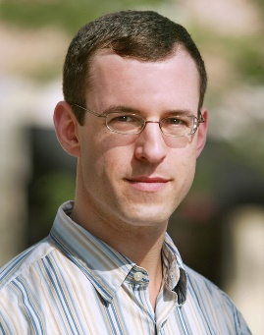
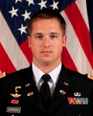

Authors
Nate Foster
‘09 PhD Upenn
Faculty at Cornell
Rob Harrison
‘11 Masters Princeton
Westpoint
Matthew L. Meola
?
Michael J. Freedman
PhD NYU
CoralCDN
Faculty at Princeton
Jennifer Rexford
‘96 PhD Univ. of Mich.
AT&T Labs ‘96-’05
Broader Gateway Protocol
Faculty at Princeton
David Walker
‘01 PhD Cornell (Morrisett)
Faculty at Princeton

Slide 32
Problems
OpenFlow is a “machine language”
Directly reflects underlying hardware
High level policy may require multiple low-level rules
Network programs are not isolated from each other
No equivalent of virtual memory space
Composition of programs is a manual process and error prone
Controller does not see all traffic, so some information may be hidden
Delay in programming switches and routers
Must take care of additional corner cases
Hard to effectively program OpenFlow tables using NOX

Slide 33
Take Aways
OpenFlow is the “machine language” of network programming
Difficult to program correctly and efficiently
Not enough layers of abstraction for programmers
Frenetic addresses issues with composibility, low-level interaction, and providing a unified view through the Frenetic run-time system and Frenetic programming language

Slide 34
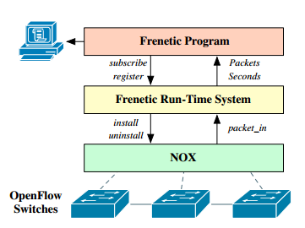
Approach
Add a layer of abstraction
Run-time system converts between high-level program to correct low-level network rules
Frenetic programming language based on functional reactive programming (FRP)
“See every packet” abstraction
Composition
Rich pattern algebra
(Source: Foster, 2010)

Slide 35
Example w/o Frenetic
def repeater(switch):
p1 = {IN_PORT:1}
p2 = {IN_PORT:2}
a1 = [output(2)]
a2 = [output(1)]
install(switch, p1, a1, DEFAULT)
install(switch, p2, a2, DEFAULT)
def monitor(switch):
p = {IN_PORT:2,TP_SRC:80}
install(switch, p, [], DEFAULT)
query_stats(switch, p)
def repeater_monitor(switch):
p1 = {IN_PORT:1}
p2 = {IN_PORT:2}
p2web = {IN_PORT:2,TP_SRC:80}
a1 = [output(2)]
a2 = [output(1)]
install(switch, p1, a1, DEFAULT)
install(switch, p2, a2, DEFAULT)
install(switch, p2web, a2, HIGH)
query_stats(switch, p2web)

Slide 36
Example w/ Frenetic
def monitor_sf():
return(Filter(inport_p(2) & srcport_p(80)) |o|
GroupByTime(30) |o|
SumSizes())
rules = [Rule(inport_p(1), [output(2)]),
Rule(inport_p(2), [output(1)])]
def repeater_monitor():
register_static(rules)
stats = Apply(Packets(), monitor_sf())
print_stream(stats)

Slide 37
Discussion
Are there any issues with OpenFlow that Frenetic could not address?
How does Frenetic reinforce the idea that innovation in this field will come through abstractions and layering?
Does Frenetic or OpenFlow help address the issue of “ossification” of the internet?

Slide 38
Take Aways
OpenFlow is the “machine language” of network programming
Difficult to program correctly and efficiently
Not enough layers of abstraction for programmers
Frenetic addresses issues with composibility, low-level interaction, and providing a unified view through the Frenetic run-time system and Frenetic programming language

Slide 39
References
OpenFlow: Enabling innovation in campus networks. Nick McKeown et al. (2008-04). ACM Communications Review.
Frenetic: A High-Level Langauge for OpenFlow Networks. Nate Foster, Rob Harrison, Matthew L. Meola, Michael J. Freedman, Jennifer Rexford, and David Walker. In ACM Workshop on Programmable Routers for Extensible Services of Tomorrow (PRESTO), Philadelphia, PA, November 2010.
Open Network Foundation. http://opennetworking.org
Origins and Evolution of OpenFlow/SDN. Martin Casado. In Open Networking Summit, Stanford, CA, October 2011.
The Future of Networking, and the Past of Protocols. Scott Shenker. In Open Networking Summit, Stanford, CA, October 2011.
B4: Experience with a Globally-Deployed Software Deﬁned WAN. Sushant Jain, Alok Kumar, Subhasree Mandal, Joon Ong, Leon Poutievski, Arjun Singh, Subbaiah Venkata, Jim Wanderer, Junlan Zhou, Min Zhu, Jonathan Zolla, Urs Hölzle, Stephen Stuart and Amin Vahdat. In SIGCOMM 2013.

