Slide 1
Formally Verified Operating Systems
Singularity and seL4

Slide 2
Outline
Formal Verification & Type Systems
Singularity
  Software-Isolated Processes
  Contract-Based Channels
  Manifest-Based Programs
  Formal Verification
seL4
  Assumptions
  Design Path
  Costs of Verification

Slide 3
Formal Verification in a nutshell
Create a collection of rules
Claim/Prove that those rules describe certain properties
Check whether/Prove that something adheres to those rules
  If yes, then that something has the above properties
Properties may be very weak or very strong
  Weak properties: easy to prove
  Strong properties: may not be provable
    Rice’s theorem: it is impossible to prove anything non-trivial for arbitrary programs

Slide 4

Formal Verification Example
Hoare Logic:
$\{P\} s \{Q\}$
            fun tenmod (mod) { mod $≠$ 0 }
            returns ret { ret = 10 % mod }
            is
            return 10 % mod;
            end;
$$\left\{P_{1}\right\} x≔5;\left\{P_{1}∖\left(x=…\right)∪\left(x=5\right)\right\}$$

Slide 5
Type Systems
“The world’s best lightweight formal method” (Benjamin Pierce)
Mainly for safety properties
Static type-checking
  Proving properties of your program
  May need annotations from the programmer
Almost all programming languages have type systems
  But the static guarantees vary a lot

Slide 6
Annotations
fun factorial(n) is
if ( n == 1 )
return 1;
else
return n * factorial( n – 1 );
end;
fun factorial(n : int) returns int is
if ( n == 1 )
return 1;
else
return n * factorial( n – 1 );
end;
fun factorial(n : int) { n > 0 }
returns r : int { r == n! } is
if ( n == 1 )
return 1;
else
return n * factorial( n – 1 );
end;

Slide 7

Note
Not all equivalent programs are equally amenable to verification
void swap(ptr A, ptr B)
{
ptr C := A;
A := B;
B := C;
}
void swap(ptr A, ptr B)
{
A := A xor B;
B := A xor B;
A := A xor B;
}
vs.
Postcondition: $A_{post}=B_{pre}∧B_{post}=A_{pre}$

Slide 8
Singularity – Takeaway Goal
PL techniques can make kernel & programs a lot safer
Safe programs can run in kernel-space
IPC is really fast when programs run in kernel-space
(Reasonable?) restrictions on programs make the job of the OS much easier

Slide 9
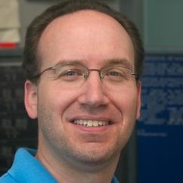

Singularity - Authors
Galen Hunt
University of Rochester (PhD, 1998)
Created prototype of Windows Media Player
Led Menlo, Experiment 19 and Singularity projects
Jim Larus
UC Berkeley (PhD, 1989)
University of Wisconsin-Madison (1989-1999)
University of Washington (2000-)
Microsoft Research (1997-)
  eXtreme Computing Group (2008-2012)
Notes:
Menlo: Windows Phone UI
Experiment 19: Replace Windows CE with Windows NT+CLR -> Windows Phone 8/Windows RT

Slide 10
Singularity – Design Goals
- A dependable system
  Catch errors as soon as possible
Compile Time > Installation Time > Run Time
Design Time
Load Time

Slide 11
Singularity - 3 Core Ideas
Software-Isolated Processes (SIPs)
Contract-Based Channels
Manifest-Based Programs

Slide 12
Software-Isolated Processes
Programs written in a memory-safe language
  Cannot access data of other processes
Cannot dynamically load code
Can only communicate with other processes via messages
  Sender and receiver always known
Kernel respects the above limitations, too
Programs run in kernel-space
Every process has its own runtime and GC

Slide 13
Contract-enforcing channels
The only way of inter-process communication
Endpoints always belong to specific threads
  Can be passed to other programs via channels
Sending data also transfers ownership of data
  Process cannot access data anymore after sending it
Adherence to communication protocol statically verifiable

Slide 14
Contract-enforcing channels
contract C1 {
in message Request(int x) requires x>0;
out message Reply(int y);
out message Error();
state Start: Request?
-> (Reply! or Error!)
-> Start;
}
Source: Singularity Technical Report, Hunt et al. (MSR-TR-2005-135)

Slide 15
Manifests
Manifests describe :
  the complete program code
    The program itself
    All dependencies
  the resources a program might access
  the communication channels it offers
  Can be statically verified
  Guide install-time compilation

Slide 16
Manifests
<manifest>
<application identity="S3Trio64" />
<assemblies>
<assembly filename="S3Trio64.exe" />
<assembly filename="Namespace.Contracts.dll" version="1.0.0.2299"/>
<assembly filename="Io.Contracts.dll" version="1.0.0.2299" />
<assembly filename="Corlib.dll" version="1.0.0.2299" />
<assembly filename="Corlibsg.dll" version="1.0.0.2299" />
<assembly filename="System.Compiler.Runtime.dll“ version="1.0.0.2299" />
<assembly filename="Microsoft.SingSharp.Runtime.dll“ version="1.0.0.2299" />
<assembly filename="ILHelpers.dll" version="1.0.0.2299" />
<assembly filename="Singularity.V1.ill" version="1.0.0.2299" />
</assemblies>
<driverCategory>
<device signature="/pci/03/00/5333/8811" />
<ioMemoryRange index="0" baseAddress="0xf8000000"
rangeLength="0x400000" />
<ioMemoryRange baseAddress="0xb8000" rangeLength="0x8000“ fixed="True" />
<ioMemoryRange baseAddress="0xa0000" rangeLength="0x8000“ fixed="True" />
<ioPortRange baseAddress="0x3c0" rangeLength="0x20" fixed="True" />
<ioPortRange baseAddress="0x4ae8" rangeLength="0x2" fixed="True" />
<ioPortRange baseAddress="0x9ae8" rangeLength="0x2" fixed="True" />
<extension startStateId="3" contractName="Microsoft.Singularity.Extending.ExtensionContract" endpointEnd="Exp“ assembly="Namespace.Contracts" />
<serviceProvider startStateId="3" contractName="Microsoft.Singularity.Io.VideoDeviceContract" endpointEnd="Exp"assembly="Io.Contracts" />
</driverCategory>
...
</manifest>
Source: Singularity Technical Report, Hunt et al. (MSR-TR-2005-135)

Slide 17
Verification
Mostly safety properties
  Safe memory access
  Guaranteed by the type system
Support for contract-based verification
  Enables verification of functional correctness
  Not ubiquitously applied in kernel
  Some parts are checked
    Channel contracts
    Manifests

Slide 18
Benefits of safety properties
Source: Singularity Technical Report, Hunt et al. (MSR-TR-2005-135)

Slide 19
Singularity’s Money Graph
Source of Data: Sealing OS Processes to Improve Dependability and Safety, Hunt et al., EuroSys 2007
Notes:
Singularity: <1000cycles

Slide 20
Takeaway
PL techniques can make kernel & programs a lot safer
Safe programs can run in kernel-space
IPC is really fast when programs run in kernel-space
(Reasonable?) restrictions on programs make the job of the OS much easier
Discussion
Can systems programmers live without C?
Is the sharing of data between processes really not important?

Slide 21
seL4 – Takeaway Goal
Functional verification of microkernels is possible
Performance of verified kernels can be OK
BUT:
Verification is a colossal effort
Still needs to assume compiler correctness (➔ huge trusted base)

Slide 22








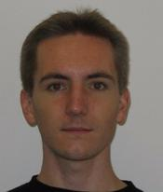


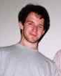

seL4 - Authors
Gerwin Klein
Kevin Elphinstone
Gernot Heiser
June Andronick
David Cock
Philip Derrin
Kai Engelhardt
Michael Norrish
Harvey Tuch
Dhammika Elkaduwe
Rafal Kolanski
Thomas Sewell
Simon Winwood

Slide 23
seL4 – Project Leaders
Gerwin Klein
TU Munich (PhD)
University of New South Wales
Does not put a CV on his webpage
Gernot Heiser
ETH Zurich (PhD, 1991)
University of New South Wales
Created Startup “Open Kernel Labs”
to sell L4 technology
Collaborated with Jochen Liedtke (L4)
Kevin Elphinstone
University of New South Wales
Does not put a CV on his webpage
Collaborated with Jochen Liedtke (L4)

Slide 24
Secure L4 – Design Goal
Create a formal model of a microkernel
Implement the microkernel
Prove that it always behaves according to the specification

Slide 25
Assumptions
Hardware works correctly
Compiler produces machine code that fits their formalization
Some unchecked assembly code is correct
Boot loader is correct

Slide 26
How to design kernel + spec?
Bottom-Up-Approach:
Concentrate on low-level details to maximize performance
Problem:
Produces complex design, hard to verify

Slide 27
Reminder
Not all equivalent programs are equally amenable to verification
void swap(ptr A, ptr B)
{
ptr C := A;
A := B;
B := C;
}
void swap(ptr A, ptr B)
{
A := A xor B;
B := A xor B;
A := A xor B;
}
vs.
Postcondition: $A_{post}=B_{pre}∧B_{post}=A_{pre}$

Slide 28
How to design kernel + spec?
Top-Down-Approach:
Create formal model of kernel
  Generate code from that
Problem:
High level of abstraction from hardware

Slide 29
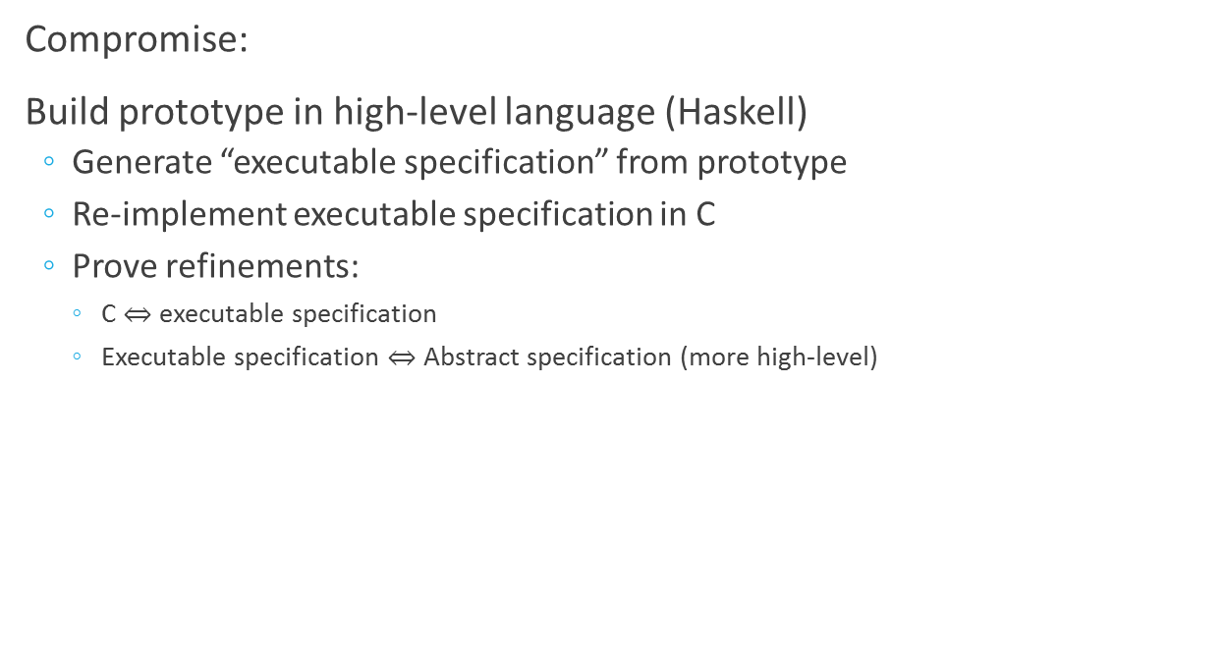
How to design kernel + spec?
Compromise:
Build prototype in high-level language (Haskell)
  Generate “executable specification” from prototype
  Re-implement executable specification in C
  Prove refinements:
    C $⇔$ executable specification
    Executable specification $⇔$ Abstract specification (more high-level)

Slide 30
Concurrency is a problem
Multiprocessors not included in the model
  seL4 can only run on a single processor
Interrupts are still there
  Yield points need to establish all system invariants

Slide 31
Cost of Verification
Source: seL4, Klein et al.

Slide 32
Cost of Verification
Source of Data: seL4, Klein et al.

Slide 33
Takeaway
Functional verification of microkernels is possible
Performance of verified kernels can be OK
BUT:
Verification is a colossal effort
Still needs to assume compiler correctness (➔ huge trusted base)
Discussion
Is proving functional correctness worth the effort?

Slide 34
Singularity vs. seL4
Goal
Singularity | seL4
A verifiably safe system. Kernel should fail “safely” when an error occurs. | A verifiably correct system. There just should not be any errors.
Ease of Verification
Singularity | seL4
Most guarantees come for free Annotations and contracts can give more guarantees | Several person-years just for proving about 80 invariants.

Slide 35
Perspective
Lots of room between Singularity and seL4
  I.e.: more parts of Singularity can be verified for functional correctness
Both are verified microkernels
  Good Isolation → additional components can be verified independently

