Slide 1
Network File System: NFS and Coda
Presented by Hakim Weatherspoon

Slide 2
Evolution of networked file systems
NFS: 1984, now in its 4th version. Developed by Sun.
AFS: 1987, developed at CMU.
Coda: post-AFS, also developed at CMU.

Slide 3
Design and Implementation of the Sun Network File System
Russel Sandberg, David Goldberg, Steve Kleiman, Dan Walsh, and Bob Lyon
Appears in USENIX Annual Technical Conference 1985

Slide 4
Goals
Designed in early/mid 80s.
Before: each computer had its own private file disk + file system.
Fine for expensive central time-sharing.
Awkward for individual workstation.
New model: One server, LAN full of client workstations. Not WAN.
Allow users to share files easily.
Allow a user to sit at any workstation.
Diskless workstations could save money

Slide 5
Implementation Goals
Had to work with existing applications.
Had to be easy to retro-fit into UNIX O/S.
Had to implement same semantics as local UNIX FFS.
Had to be not too UNIX specific
work w/ DOS, for example.
Had to be fast enough to be tolerable
(but willing to sacrifice some).

Slide 6
Kernel FS Structure before NFS
Specialized to local file system called Fast File System (FFS).
Disk inodes.
O/S keeps in-core copies of inodes that are in use.
File descriptors, current directories, executing programs.
File system system calls used inodes directly.
To find e.g. disk addresses for read().
Disk block cache.
Indexed by disk block #.

Slide 7
Why not a Network Disk (ND)?
What was ND?
Server supplied a block store, with JUST read/write block RPCs.
This makes read/write sharing awkward.
Clients would have to carefully lock disk data structures.
How is NFS different from ND?
Moves complex operations to server.
Why might NFS be slower than ND?
Have to worry about consistency between multiple clients

Slide 8
Virtual File System (VFS) Interface
New "vnode" plan, invented to support NFS.
Need a layer of indirection, to hide implementation.
A file might be FFS, NFS, or something else.
Replace inode with vnode object.
vnode has lots of methods:
open, close, read, remove.
Each file system type has its own implementation methods.
What about disk cache?
Replaced with per-vnode list of cached blocks.

Slide 9
NFS Implementation
Three main layers:
System call layer:
Handles calls like open, read and close
Virtual File System Layer:
Maintains table with one entry (v-node) for each open file
v-nodes indicate if file is local or remote
If remote it has enough info to access them
For local files, FS and i-node are recorded
NFS Service Layer:
This lowest layer implements the NFS protocol

Slide 10
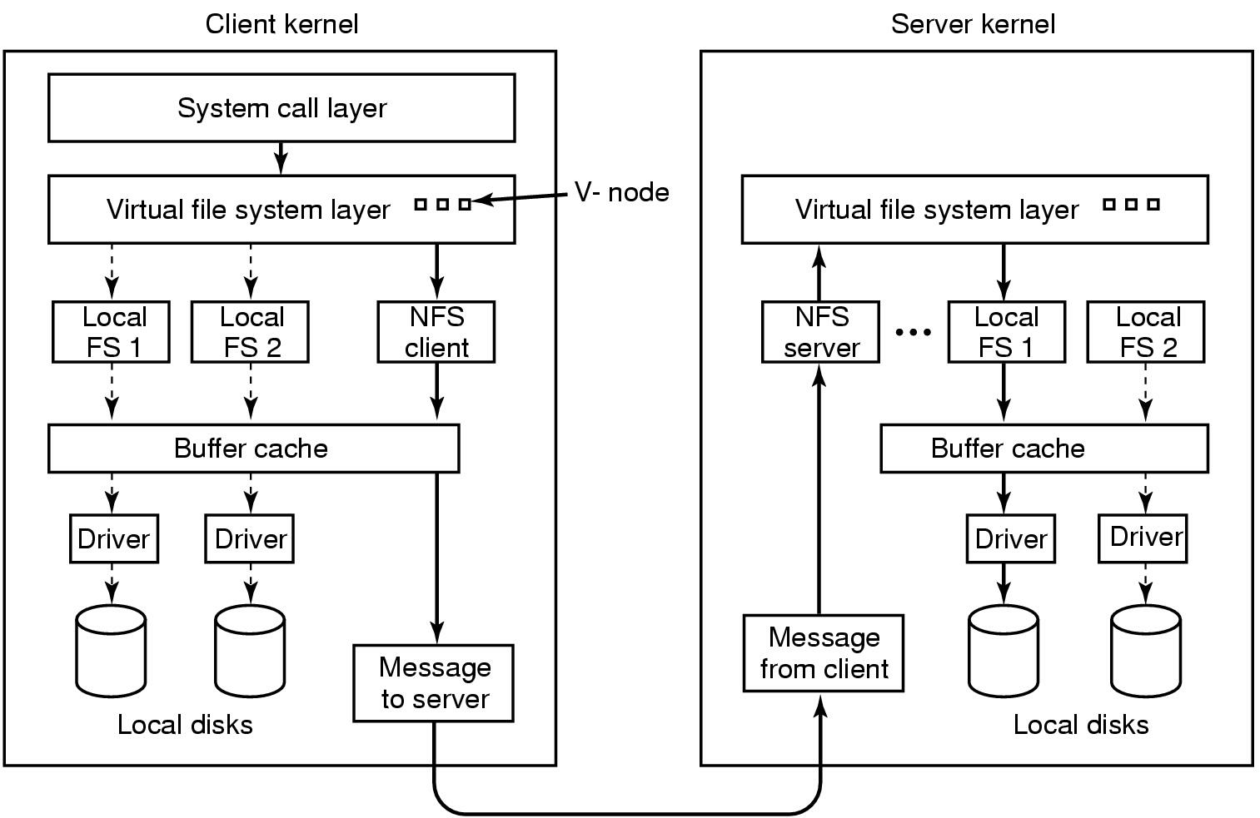
NFS Layer Structure

Slide 11
NFS Client/Server Structure
Client programs have file descriptors, current directory, &c.
Inside kernel, these refer to vnodes of type NFS.
When client programs make system calls:
NFS vnode implementation sends RPC to server.
Kernel half of that program waits for reply.
So we can have one outstanding RPC per program.

Slide 12
NFS Client/Server Structure
Server kernel has NFS threads, waiting for incoming RPCs.
NFS thread acts a lot like user program making system call.
Find *vnode* in server corresponding to client's vnode.
Call that vnode's relevant method.
Server vnodes are typically of type FFS.
This saves a lot of code in the server.
This means NFS will work with different local file systems.
This means files are available on server in the ordinary way.
NFS server thread blocks when needed.

Slide 13
How does NFS RPC designate file to read?
E.g. a read RPC
Could use file name.
Client NFS vnode would contain name, send in rpc.
Easy to implement in the server.
Why doesn't this work?
Doesn't preserve UNIX file semantics.
Client 1: chdir("dir1");
fd = open("file");
Client 2: rename("dir1", "dir2");
rename("dir3", "dir1");
Client 1: read(fd, buf, n);
Does client read current dir1/file, or dir2/file?
UNIX says dir2/file.

Slide 14
The NFS File Handle
What else goes in file handle, besides i-number?
File system ID - because server may server multiple file systems
Generation number - what is this?
Suppose an inode gets deleted & recycled while file/dir still open
Don't want old file descriptor referring to new file--very dangerous
Solution: Store generation number in inode on disk, change when recycled
What happens to read/write of old handle when generation number changes?
NFS stale file handle error
Sometimes: Inode of export point
So server can disallow lookup ("..") past export point
(not secure)

Slide 15
The NFS File Handle
File systems already need a way to name files/inodes
E.g., How do directory entries refer to files?
Map name -> i-node number ("i-number”)
Don't want to expose i-node number details to client
I.e. client should never have to make up a file reference.
So file handles are opaque.
Client sees them as 32-byte blob.
Client gets all file handles from the server.
Every client NFS vnode contains the file's handle.
Client sends back same handle to server.

Slide 16
NFS RPCs
lookup
read
write
getattr
create
remove, setattr, rename, readlink, link, symlink, mkdir, rmdir, readdir
(no open, close, chdir) – why not?
Requires state to be maintained at server

Slide 17
Example
fd = open("./notes", O_RDONLY);
read(fd, buf, n);
Client process has a reference to current directory's vnode.
Sends LOOKUP(dir-vnode, "notes") to server.
Server extracts i-number from file handle.
Asks local file system to turn that into a local vnode.
Every local file system must support file handles...
Calls the local vnode's lookup method.
dir->lookup("notes") returns "notes" vnode.
NFS server code extracts i-number from vnode, creates new file handle.
Server returns new file handle to client.
Client creates new vnode, sets its file handle.
Client creates new file descriptor pointing to new vnode.
Client app issues read(fd, ...).
Results in READ(file-handle, ...) being sent to server.

Slide 18
Where does first File Handle come from?
Every NFS RPC has to be contain a file handle
A valid file handle
Server's mount daemon maps file system name to root file handle.
Client kernel marks mount point on local file system as special.
Remembers vnode (and thus file handle) of remote file system.

Slide 19
Crash Recovery
Suppose server crashes and reboots.
Clients might not even know.
File handles held by clients must still work!
That's why file handle holds i-number, which is basically a disk address.
Rather than, say, server NFS code creating an arbitrary map.
That is, server is stateless!

Slide 20
What if open file gets deleted by different client?
UNIX semantics
file still exists until I stop using it.
Would require server to keep reference count per file.
Would require open() and close() RPCs to help mantain that count.
Which would have to persist across server reboots.
So NFS just does the wrong thing!
RPCs will fail if some other client deletes a file I have open.
this is part of the reason why there is no open() or close() RPC.

Slide 21
What about performance?
Does *every* program system call go over the wire to the server?
No: client cache for better performance.
Per-vnode block cache, name->file handle cache, attribute cache.
Can satisfy read()s, for example, from block cache.

Slide 22
What about consistency?
Is it enough to make the data cache write-through?
No: I read a file, another client writes it, I read it again.
How do I realize my cache is stale?

Slide 23
Consistency
What are the semantics of read and write system calls?
One possibility:
read() sees data from most recent write().
This is what local UNIX file systems implement.
How to implement these strong semantics?
Turn off client caching altogether.
Or have clients check w/ server before every read.
Or have server notify clients when other clients write.

Slide 24
NFS chooses poor consistency
In V2 implementation described, very poor consistency
In newer implementations, close-to-open consistency
If I write() and then close(), then you open() and read(), you see my data.
Otherwise you may see stale data.
How to implement these strong semantics?
Writing client must force dirty blocks during close().
Reading client must check w/ server during open().
Ask if file has been modified since data were cached.
This is much less expensive than strong consistency.
Though maybe not very scalable; every open() produces an rpc.

Slide 25
Optimizations
NFS server and block I/O daemons
Caching!
Client-side buffer cache
(write-behind w. flush-on-close)
Client-side attribute cache
Name cache
XDR directly to/from mbufs
Fill-on-demand clustering, swap in small programs

Slide 26
What about Security?
Server has list of IP addresses.
Fully trusts any client with that address.
Client O/S expected to enforce user IDs, send to server.

Slide 27
Other issues
soft vs hard mounts
replay cache.
I can execute files I can't read.
what if I open(), then chmod u=?
owner always allowed to read/write…
dump+restore may wreck client file handles.

Slide 28
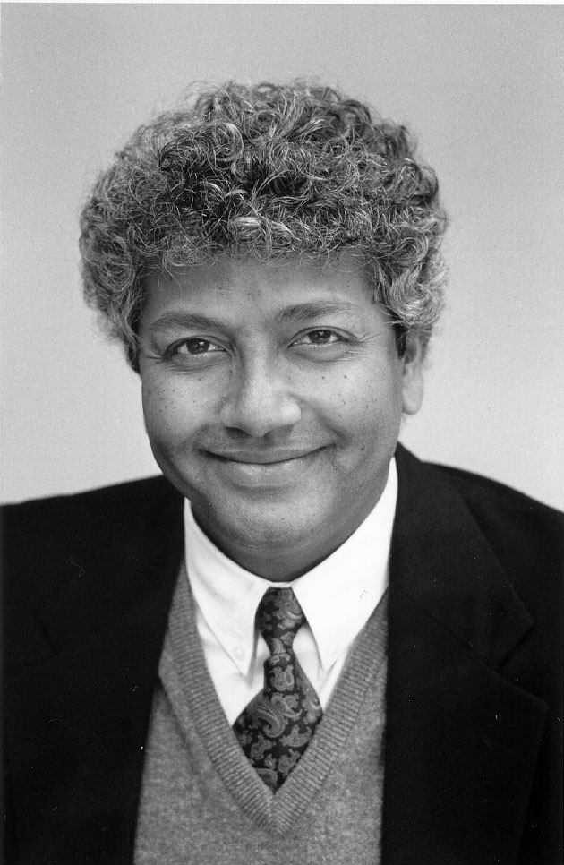
Coda: A Highly Available File System for a Distributed Workstation Environment
Mahadev Sayyanarayanan (“Satya”), James J. Kistler, Puneet Kumar, Maria E. Okasaki, Ellen H. Siegel, and David C. Steere

Slide 29
Motivation for Coda
Epilogue to the Andrew File System (AFS)
AFS was found to be vulnerable to server and network failures
Not that different from NFS
Limits scalability of AFS
Coda provides high data availability
Server replication (optimistic replication)
Disconnected operation

Slide 30
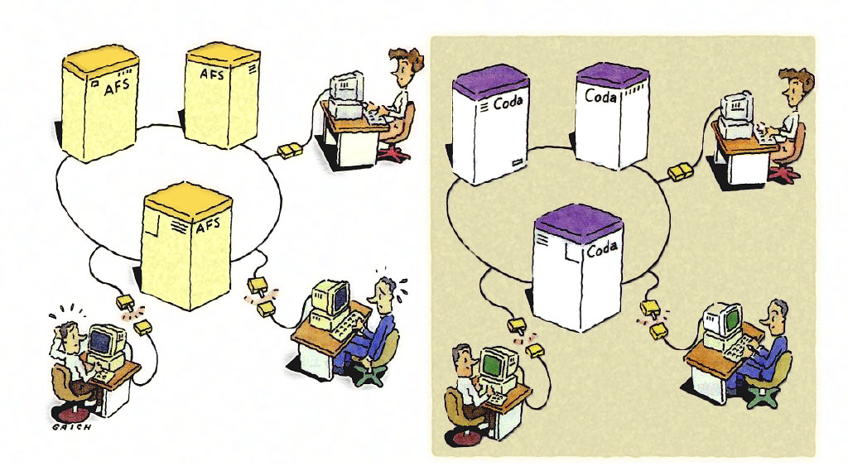
Coda Cartoon
http://www.cs.cmu.edu/~coda/images/nikkei-PAGE-213.JPG

Slide 31
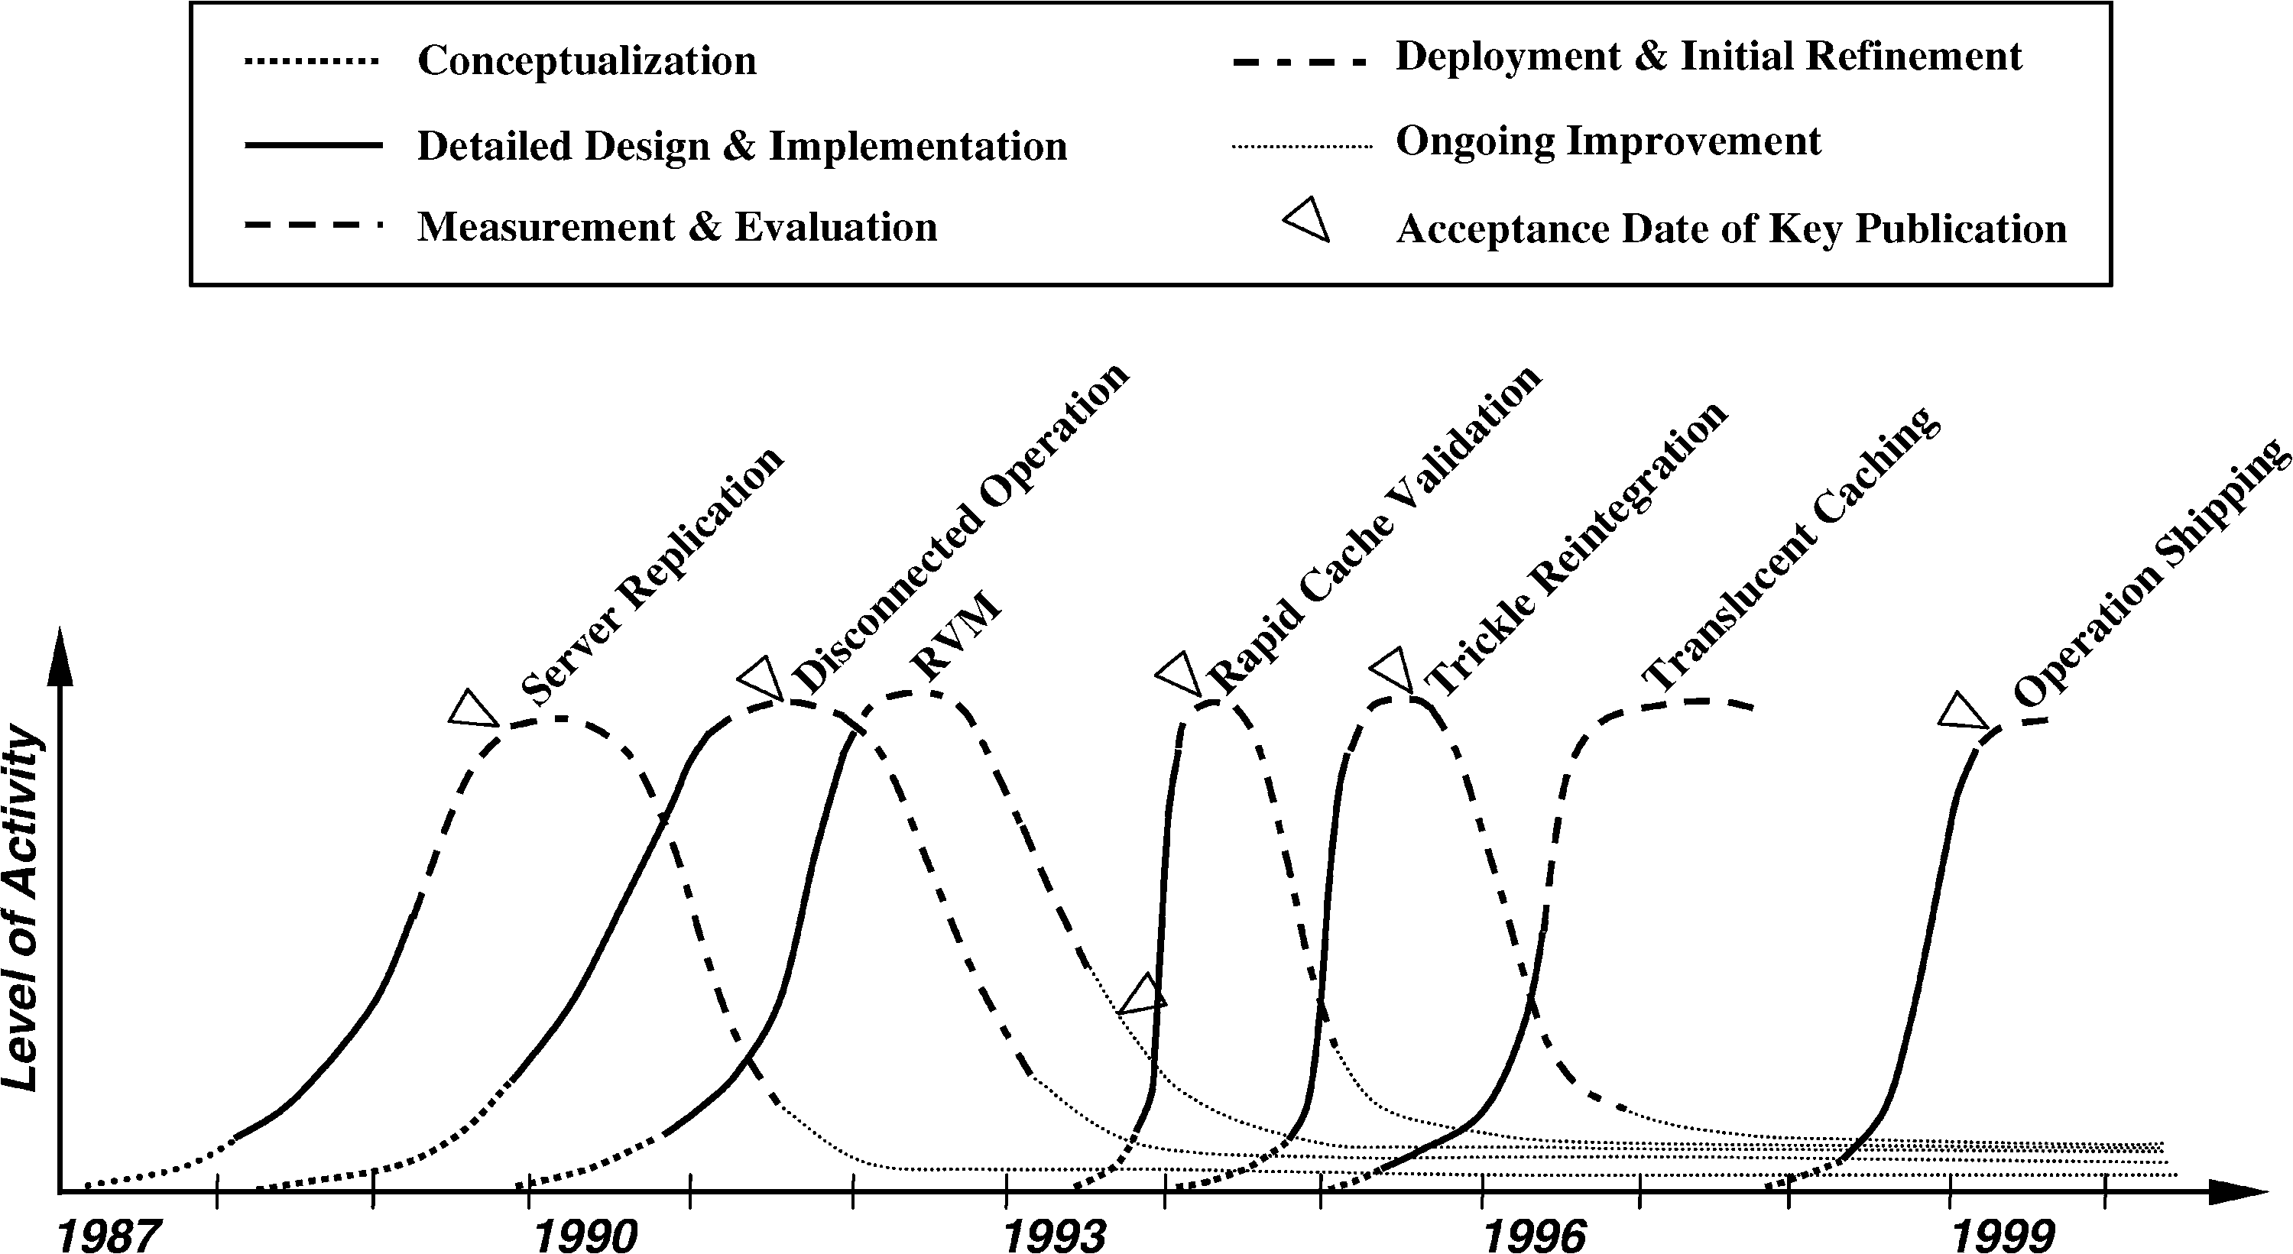
Timeline
Notes:
Lets talk about long tail

Slide 32
Lessons Learned from 20 years of Coda
Optimistic replication can work
Must use for performance
Real systems research needs
Real system artifacts
Real users
Timing
Need to be lucky
Research vs product
Long ‘product’ tail
Moores law
Worked then. Does it work now?

Slide 33
Lessons Learned from 20 years of Coda
Code reuse is a double edged sword
Good initially, but locks you into a particular regime
Need system admins
Deeply held secret
Small projects never die
Also small features hard to remove

Slide 34
Server Replication: 1987-1991
Optimistic replication control protocols allow access in disconnected mode
Tolerate temporary inconsistencies
Promise to detect them later
Provide much higher data availability
Optimistic replication control requires a reliable tool for detecting inconsistencies among replicas
Better than LOCUS tool

Slide 35
Server Replication
Unit of replication is volume (subtree of files)
Set of servers containing replicas of a volume is volume storage group (VSG)
Currently accessible subset of VSG is accessible volume storage group (AVSG)
Tracked by cache manager of client (Venus):

Slide 36
Read protocol
Read-one-data, read-all-status, write-all
Each client
Has a preferred server (VS)
Still checks with other servers to find which one has the latest version of a file
Reads are aborted if a conflict is detected
Otherwise a callback is established with all servers in AVSG

Slide 37
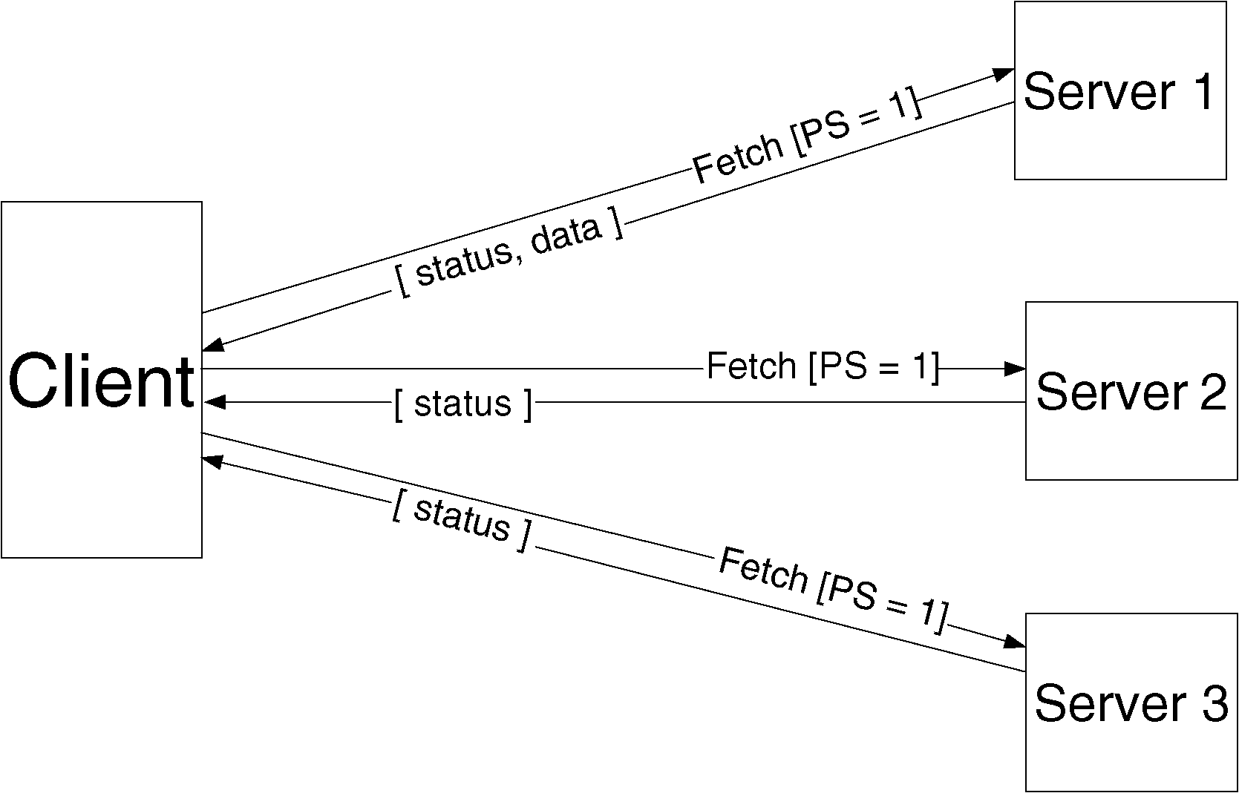
Read protocol

Slide 38
Client Structure
Application
Venus
(connects with Coda servers)
System call interface
Vnode interface
Coda MiniCache (handles local accesses)

Slide 39
Update protocol
When a file is closed after modification, updated file is transferred in parallel to all members of the AVSG
Directory updates are also written through to all members of AVSG
Coda checks for replica divergence before and after each update
Update protocol is non-blocking

Slide 40
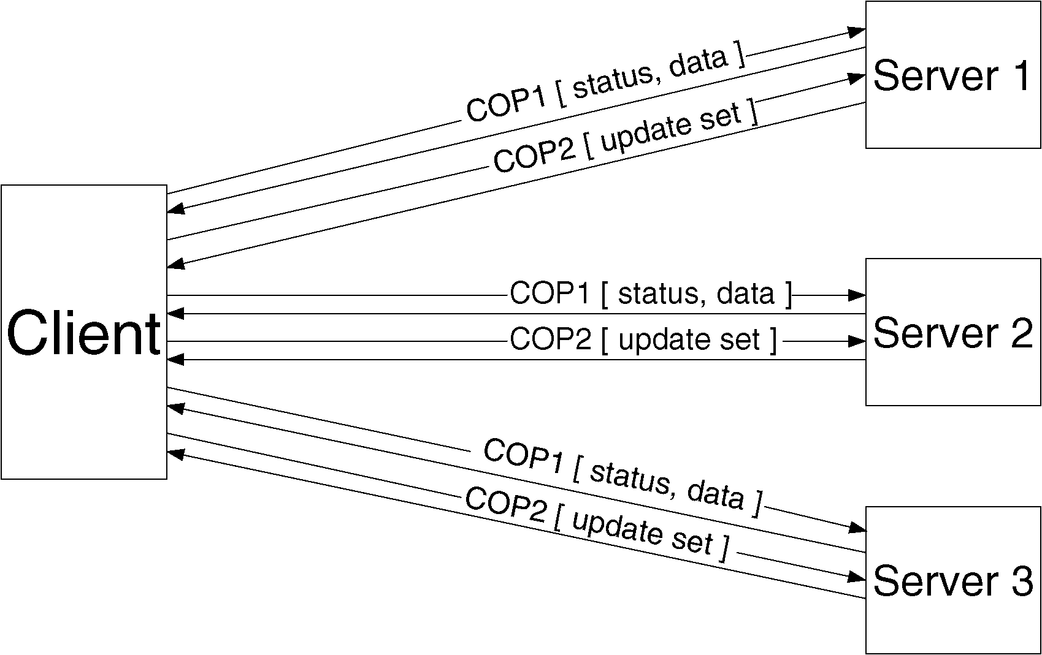
Update protocol

Slide 41
Consistency model
Client keeps track of subset s of servers it was able to connect the last time it tried
Updates s at least every τ seconds
At open time, client checks it has the most recent copy of file among all servers in s
Guarantee weakened by use of callbacks
Cached copy can be up to τ minutes behind the server copy

Slide 42
Fault-tolerance
Correctness of update protocol requires atomicity and permanence of metadata updates
Used first Camelot transaction management system:
Too slow and Mach-specific
Coda uses instead its own recoverable virtual memory (RVM)
Implemented as a library

Slide 43
Disconnected Operation: 1988-1993
Network isolation
Correlated server crashes
Overloaded or faulty routers
Caching
Optimistic replication
Improve availability

Slide 44
Disconnected Operation
Complimentary to server replication
Server replicas are first-class replicas
Cached replicas are secondary replicas

Slide 45
Implementation
Hoarding
disconnection
Logical reconnection
Emulating
Recovering
Physical reconnection

Slide 46
Hoarding
Implicit / Explicit sources of implementation
Hoard database (HDB)
Specifies files to be cached
Users update directly or via command scripts
Venus periodically reevaluates every ten minutes

Slide 47
Emulation / Reintegration
While disconnected, All changes are written to a log, Client modification log (CML)
After reconnection, perform reintegration for each volume independently.
Venus sends CML to all volumes
Each volume performs a log replay algorithm

Slide 48
Conflict Resolution
Syntactic approach to detect absence of conflicts.
Server replication
Version checks during the hoarding and reintegration
Semantic approach to resolve conflicts
Different control for directory and file resolution

Slide 49
Conflict Resolution: Objectives
No updates should ever be lost without explicit user approval
The common case of no conflict should be fast
Conflicts are ultimately an application-specific concept
The buck stops with the user

Slide 50
Directory Resolution
Automatic resolution by Coda
After disconnected operation
Apply the CML
During connected operation
Resolution log
Recovery protocol locks the replicas merges the logs and distributes the merged logs.

Slide 51
Application-Specific File resolution
Application-specific resolvers (ASRs) are executed entirely on clients.

Slide 52
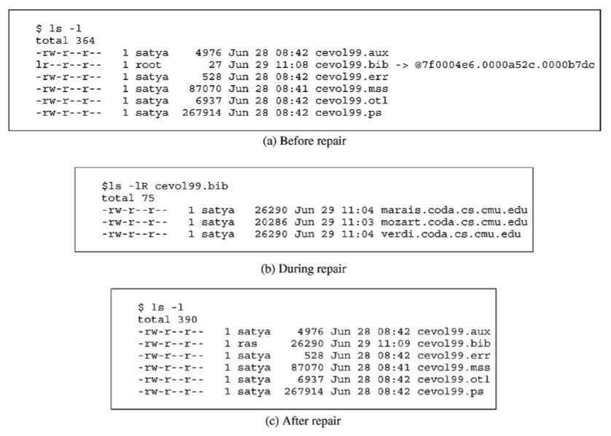
Conflict representation

Slide 53
Weakly Connected Operation: 1993-1996
Broad principles
Do not punish strongly connected clients
Do not make life worse when disconnected
Do it in the background if you can
Rapid validation of cache
Trickle Reintegration

Slide 54
Lessons Learned from 20 years of Coda
Optimistic replication can work
Must use for performance
Real systems research needs
Real system artifacts
Real users
Timing
Need to be lucky
Research vs product
Long ‘product’ tail
Moores law
Worked then. Does it work now?

Slide 55
Lessons Learned from 20 years of Coda
Code reuse is a double edged sword
Good initially, but locks you into a particular regime
Need system admins
Deeply held secret
Small projects never die
Also small features hard to remove

Slide 56
Next Time
Read and write review. Turn into CMS before class:
Mach: A new kernel foundation for UNIX development, Mike Accetta, Robert Baron, William Bolosky, David Golub, Richard Rashid, Avadis Tevanian, and Michael Young. Proceedings of the USENIX Summer Conference, Atlanta, GA, 1986, pages 93--112.
The Performance of µ-Kernel-based Systems. Härtig et al. 16th SOSP, Oct 1997.
Check website for updated schedule
Sign up to present

