Slide 1
Affinity in Distributed Systems
Thesis defense
Ymir Vigfusson
Joint work with:
Hussam Abu-Libdeh, Mahesh Balakrishnan, Ken Birman, Gregory Chockler, Qi Huang, Jure Leskovec, Deepak Nataraj and Yoav Tock.

Slide 2

Group communication
Most network traffic is unicast communication (one-to-one).
But a lot of content is identical:
  Audio streams, video broadcasts, system updates, etc.
To minimize redundancy, would be nice to multicast communication (one-to-many).

Slide 3


Multicast by Unicast

Slide 4
IP Multicast

Slide 5
Gossip

Slide 6
Group communication
Mechanism | Deliv. Speed | Redundancy | Scalable in # users? | Scalable in # groups?
Point-to-point unicast | Slow | High | No | Yes*
IP Multicast (IPMC) | Fast | None | Yes | No
Gossip | Slow | Low | Yes | No

Slide 7
Talk Outline
Dr. Multicast (MCMD)
  Group scalability in IP Multicast.
Gossip Objects (GO) platform
  Group scalability in gossip.
Affinity
  GO+MCMD optimizations based on group overlaps
  Explore the properties of overlaps in data sets
Conclusion

Slide 8
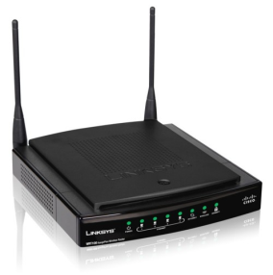
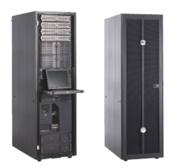
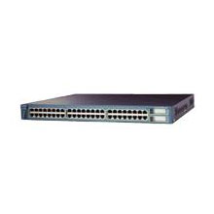
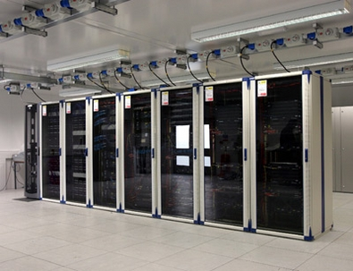
IP Multicast in Data Centers
Smaller scale – well defined hierarchy
Single administrative domain
Firewalled – can ignore malicious behavior

Slide 9


IP Multicast in Data Centers
Useful, but rarely used.
Various problems:
  Security
  Stability
  Scalability

Slide 10
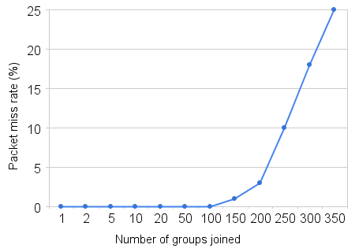
IP Multicast in Data Centers

Slide 11
IP Multicast in Data Centers
Useful, but rarely used.
Various problems:
  Security
  Stability
  Scalability
Bottom line: Administrators have no control over IPMC.
  Thus they choose to disable it.

Slide 12
Wishlist
  Policy: Enable control of IPMC.
  Transparency: Should be backward compatible with hardware and software.
  Scalability: Needs to scale in number of groups.
  Robustness: Solution should not bring in new problems.

Slide 13
Acceptable Use Policy
  Assume a higher-level network management tool compiles policy into primitives.
  Explicitly allow a process (user) to use IPMC groups.
    allow-join(process ID, logical group ID)
    allow-send(process ID, logical group ID)
  Point-to-point unicast always permitted.
  Additional restraints.
    max-groups(process ID, limit)
    force-udp(process ID, logical group ID)

Slide 14
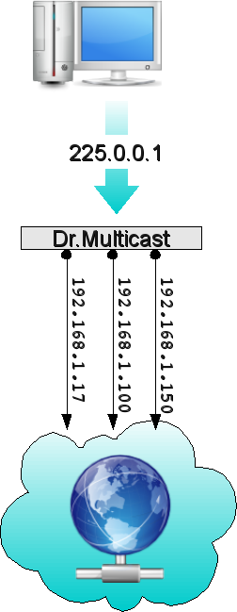
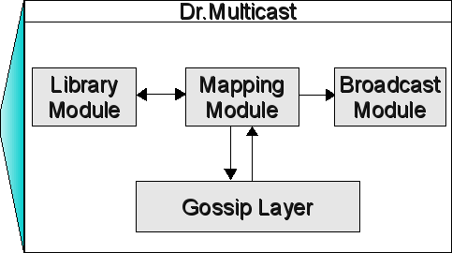
Dr. Multicast (MCMD)
Translates logical IPMC groups into either physical IPMC groups or multicast by unicast.
Optimizes resource use.

Slide 15
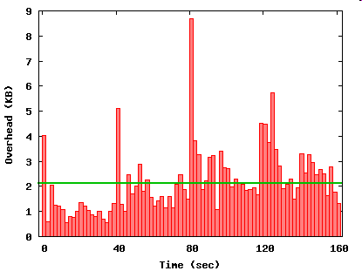
Network Overhead
  Gossip Layer uses constant background bandwidth on average
2.1 kb/s

Slide 16
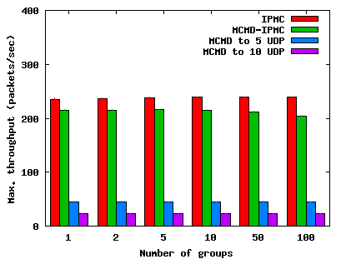
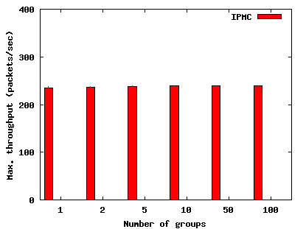
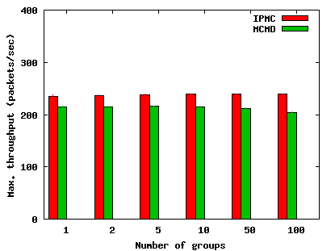
Application Overhead
  Insignificant overhead when mapping logical IPMC group to physical IPMC group.

Slide 17
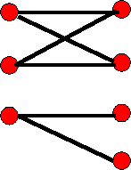
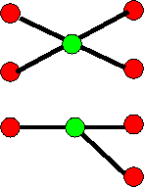
Optimization questions
Multicast
BLACK
Users Groups
Users Groups

Slide 18
Optimization Questions
    Assign IPMC and unicast addresses s.t.
      Min. receiver filtering
      Min. network traffic
      Min. # IPMC addresses
      … yet have all messages delivered to interested parties

Slide 19
Optimization Questions
    Assign IPMC and unicast addresses s.t.
      % receiver filtering (hard)
      Min. network traffic
      # IPMC addresses (hard)
(1)
Prefers sender load over receiver load.
Control knobs part of administrative policy.

Slide 20

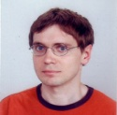


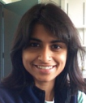

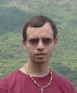


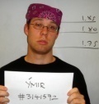
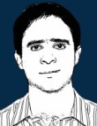

MCMD Heuristic
Groups in `user-interest’ space
Grad Students
Free Food
(1,1,1,1,1,0,1,0,1,0,1,1)
(0,1,1,1,1,1,1,0,0,1,1,1)

Slide 21
MCMD Heuristic
Groups in `user-interest’ space
224.1.2.4
224.1.2.3
224.1.2.5

Slide 22
MCMD Heuristic
Groups in `user-interest’ space
Sending cost:
MAX
Filtering cost:

Slide 23
MCMD Heuristic
Unicast
Groups in `user-interest’ space
Sending cost:
MAX
Filtering cost:

Slide 24
MCMD Heuristic
Unicast
Unicast
Groups in `user-interest’ space
224.1.2.4
224.1.2.3
224.1.2.5

Slide 25

Dr. Multicast
  Policy: Permits data center operators to selectively enable and control IPMC.
  Transparency: Standard IPMC interface to user, standard IGMP interface to network.
  Scalability: Uses IPMC when possible, otherwise point-to-point unicast.
  Robustness: Distributed, fault-tolerant service.

Slide 26
Talk Outline
Dr. Multicast (MCMD)
  Group scalability in IP Multicast.
Gossip Objects (GO) platform
  Group scalability in gossip.
Affinity
  GO+MCMD optimizations based on group overlaps
  Explore the properties of overlaps in data sets
Conclusion

Slide 27
Gossip
Def: Exchange information with a random node once per round.
Has appealing properties:
  Bounded network traffic.
  Scalable in group size.
  Robust against failures.
  Simple to code.
When # of groups scales up, lose

Slide 28
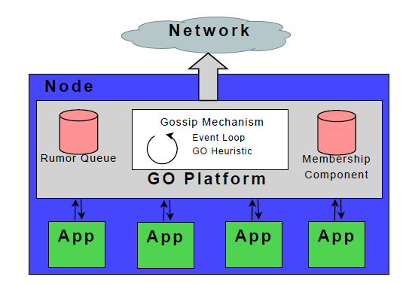
GO Platform

Slide 29
Random gossip
Recipient selection:
  Pick node d uniformly at random.
Content selection:
  Pick a rumor r uniformly at random.

Slide 30
Observations
Gossip rumors usually small:
  Incremental updates.
  Few bytes hash of actual information.
Packet size below MTU irrelevant.
  Stack rumors in a packet.
  But which ones?
Rumors can be delivered indirectly.
  Uninterested node might forward

Slide 31
Random gossip w. stacking
Recipient selection:
  Pick node d uniformly at random.
Content selection:
  Fill packet with rumors picked uniformly at random.

Slide 32
GO Heuristic
Recipient selection:
  Pick node d biased towards higher group traffic.
Content selection:
  Compute the utility of including rumor r
    Probability of r infecting an uninfected host when it reaches the target group.
  Pick rumors to fill packet with probability proportional to utility.

Slide 33



GO Heuristic
Recipient selection:
  Pick node d biased towards higher group traffic.
Content selection:
  Compute the utility of including rumor r
    Probability of r infecting an uninfected host when it reaches the target group.
  Pick rumors to fill packet with probability proportional to utility.
Target group of r
Include r ?

Slide 34
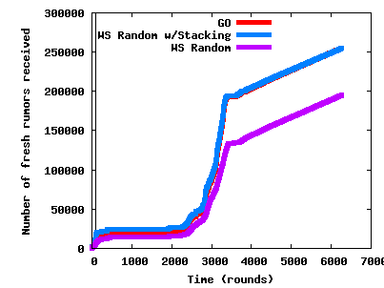
Evaluation
IBM Websphere trace (1364 groups)

Slide 35
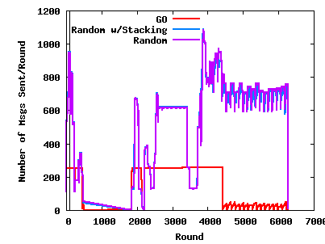
Evaluation
IBM Websphere trace (1364 groups)

Slide 36
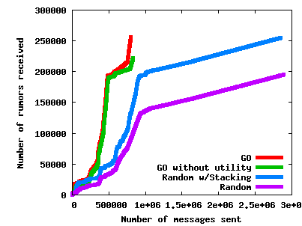
Evaluation
IBM Websphere trace (1364 groups)

Slide 37
Talk Outline
Dr. Multicast (MCMD)
  Group scalability in IP Multicast.
Gossip Objects (GO) platform
  Group scalability in gossip.
Affinity
  GO+MCMD optimizations based on group overlaps.
  Explore the properties of overlaps in data sets.
Conclusion

Slide 38
Affinity
Both MCMD and GO have optimizations that depend on pairwise group overlaps (affinity).
What degree of affinity should we expect to arise in the real-world?

Slide 39
Data sets/models
What’s in a ``group’’ ?
Social:
  Yahoo! Groups
  Amazon Recommendations
  Wikipedia Edits
  LiveJournal Communities
  Mutual Interest Model
Systems:
  IBM Websphere
  Hierarchy Model
Users Groups

Slide 40
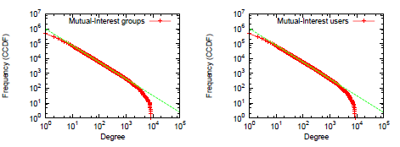
Social data sets
User and group degree distributions appear to follow power-laws.
Power-law degree distributions often modeled by preferential attachment.
Mutual Interest model:
  Preferential attachment for bipartite graphs.
Groups
Users

Slide 41
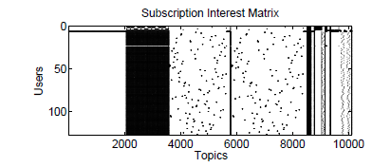
Systems Data Set
IBM Websphere has remarkable structure!
Typical for real-world systems?
  Only one data point.

Slide 42

Systems Data Set
Distributed systems tend to be hierarchically structured.
Hierarchy model
  Motivated by Live Objects.
Thm: Expect a pair of users to overlap in
groups .

Slide 43
Data sets/models
Social:
  Yahoo! Groups
  Amazon Recommendations
  Wikipedia Edits
  LiveJournal Communities
  Mutual Interest Model
Systems:
  IBM Websphere
  Hierarchy Model
Users Groups

Slide 44
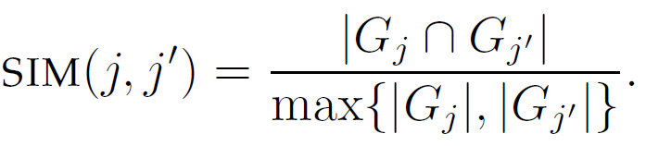


Group similarity
Def: Similarity of groups j,j’ is
Wikipedia
LiveJournal

Slide 45

Group similarity
Def: Similarity of groups j,j’ is
Mutual Interest Model

Slide 46
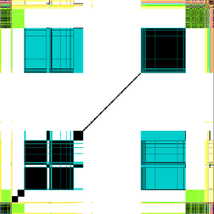

Group similarity
Def: Similarity of groups j,j’ is
IBM Websphere
Hierarchy model

Slide 47
Baseline overlap
Is the similarity we see a real effect?
Consider a random graph with the same degree distributions as a baseline.
Spokes model:

Slide 48

Baseline overlap
Plot difference between data and Spokes
At most 50 samples per group size pair.
Data set/model | Avg. Δ value
Wikipedia | - 0.004
Amazon | 0.031
Yahoo! Groups | 0.000
Mutual Interest Model | 0.006
IBM Websphere | 0.284
Hierarchy Model | 0.358
Looking pretty random

Slide 49
Conclusions
Group communication important, but group scalability is lacking.
Dr. Multicast harnesses IPMC in data centers.
  Impact: HotNets paper + NSDI Best Poster award.
  Solution being adopted by CISCO and IBM.

Slide 50
Conclusions
GO provides group scalability for gossip.
  Impact: LADIS paper + Invited to the P2P Conference.
  Platform will run under the Live Objects framework.
Characterizing and exploiting group affinity in systems is exciting current and future work.

Slide 51
Publications
GO: Platform Support For Gossip Applications.
With Ken Birman, Qi Huang, Deepak Nataraj. LADIS ‘09. Invited to P2P '09.
Adaptively Parallelizing Distributed Range Queries.
With Adam Silberstein, Brian Cooper, Rodrigo Fonseca. VLDB ’09.
Slicing Distributed Systems.
With Vincent Gramoli, Ken Birman, Anne-Marie Kermarrec, Robbert van Renesse. PODC ’08 (short). In IEEE Transactions on Computers 2009.
Dr. Multicast: Rx for Data Center Communication Scalability.
With Hussam Abu-Libdeh, Mahesh Balakrishnan, Ken Birman, Yoav Tock. Hotnets ‘08. LADIS ‘08. NSDI ‘08 (Best Poster).
Hyperspaces for Object Clustering and Approximate Matching in P2P Overlays.
With Bernard Wong, Emin Gun Sirer. HotOS ‘07.

Slide 53
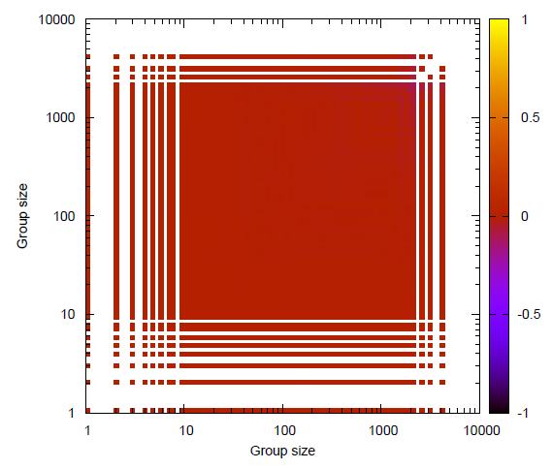
Baseline overlap
Plot difference between data and Spokes
Cell: Avg. Δ over particular group sizes.
Wikipedia

Slide 54
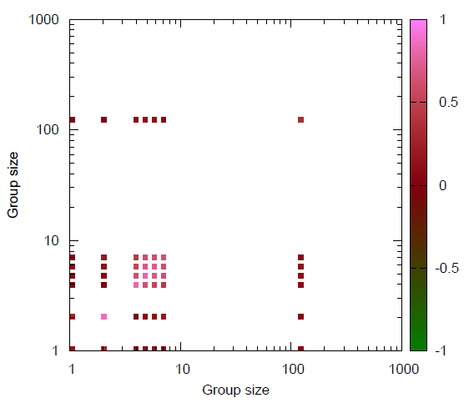
Baseline overlap
Plot difference between data and Spokes
Cell: Avg. Δ over particular group sizes.
Websphere

Slide 55
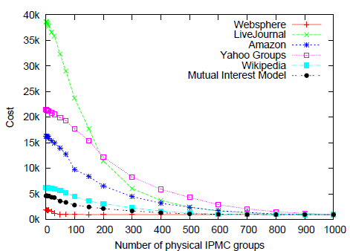
Affinity results
  Social affinity pretty random.
  Websphere has substantial overlaps.
  MCMD Heuristic does well in all cases:

Slide 56

Conclusions
Group communication important, but group scalability is lacking.
Dr. Multicast harnesses IPMC in data centers.
  Impact: HotNets paper + NSDI Best Poster award.
  Solution being adopted by CISCO and IBM.
GO provides group scalability for gossip.
  Impact: LADIS paper + Invited to the P2P Conference.
  Platform will run under the Live Objects framework.
Characterizing and exploiting group affinity in systems is exciting current and future work.

Slide 57
Publications
GO: Platform Support For Gossip Applications.
With Ken Birman, Qi Huang, Deepak Nataraj. LADIS ‘09. Invited to P2P '09.
Adaptively Parallelizing Distributed Range Queries.
With Adam Silberstein, Brian Cooper, Rodrigo Fonseca. VLDB ‘09.
Slicing Distributed Systems.
With Vincent Gramoli, Ken Birman, Anne-Marie Kermarrec, Robbert van Renesse. PODC ‘08. In IEEE Transactions on Computers 2009.
Dr. Multicast: Rx for Datacenter Communication Scalability.
With Hussam Abu-Libdeh, Mahesh Balakrishnan, Ken Birman, Yoav Tock. Hotnets ‘08. LADIS ‘08. NSDI ‘08 (Best Poster).
Hyperspaces for Object Clustering and Approximate Matching in P2P Overlays.
With Bernard Wong, Emin Gun Sirer. HotOS ‘07.

