Slide 1
Specifying Security Policy: ORCA
Ken Birman
CS6410

Slide 2
Context
As we roll out increasingly ambitious distributed platforms, and share them among demanding users who have “it’s all mine” mentalities, we get really challenging resource sharing scenarios
Today’s PlanetLab illustrates the risks
Internet-scale experimental resource (created by Larry Peterson and team members)
More than 400 small clusters that comprise a global platform for experiments
Used by researchers worldwide

Slide 3
How does Planetlab fit the “cloud”?
Cloud platforms are supported by data centers: large clusters (very large), but the similarity is real
And at multiple locations worldwide
They try to keep their systems running near full load
But PlanetLab has no way to limit users from overloading their machines
So in the cloud, we often see “full” but not “massive overload”; PlanetLab can easily be totally swamped

Slide 4
GENI
Goal is to replace PlanetLab the GENI testbed
Eventually, a world-wide infrastructure
Whereas PlanetLab offers a standard Unix VM environment, GENI permits “raw” access to layer-2 of the network. So one can define new kinds of routing services and “tunnel” traffic through GENI applications
GENI vision: developers create services or even entire overlay networks that could even control dedicated network links, if those are available
Notice that this is actually like a VLAN in a datacenter...

Slide 5
What might these services do?
One could imagine a wide range
A system for monitoring the Internet and continuously tracking loads: a form of continuous tomography
A new kind of service for building secure end-to-end network paths
A next generation of cloud-hosted technologies for “monitoring” the real world (the “Internet of Things”)
A completely new “overlay” Internet with great realtime (or security, or “streaming”...) properties
A platform that caches objects on behalf of mobile users so that their connectivity experience is improved
New kinds of discovery services, fancier than DNS...

Slide 6
So... GENI’s job is to...
... host the experimental prototypes of these kinds of next-generation Internet applications and services
Our hope would be that many result in fantastic research papers in the networks community (SIGCOMM, NSDI, SOSP, SIGCOMM-IMC) and that some transition and become exciting new products
GENI could be an incredible enabler... if successful

Slide 7
What’s the big risk?
Even in the cloud, sharing machines is a really hard thing to pull off successfully
Not every style of computing works well in the cloud
Some applications experience too many delays and break: various scheduling requirements are violated
Hakim: In Planetlab, as much as 60% of the resources in your slice tend to be unavailable or flakey!
In GENI, where many services will have realtime needs, special resource ownership requirements or other kinds of “rules”, overload could be a disaster

Slide 8
How to deal with contention?
On today’s cloud platforms, the approach is fairly ad-hoc
Scheduler tries to “pack” each physical machine with enough work to keep it fairly busy
Because of variable loads, the usual approach is to “learn” a load model for each application and use the learned behavior in the scheduler packing algorithm
This works, but can leave nodes overcommitted
If that happens, many cloud systems just kill some of the excess load and restart those tasks elsewhere

Slide 9
GENI goals
Each user has an associated “slice” of GENI
Slices has a predicted resource use profile
GENI wants to guarantee that these profiles will be respected
Better to refuse a requested allocation than to grant it but then be overloaded and unable to meet demand
Leads to a requirement: a way for GENI users to specify their needs

Slide 10
Principals
Researcher: A user that wishes to run an experiment or service in a slice, or a developer that provides a service used by other researchers.
A slice authority (SA) is responsible for the behavior of a set of slices, vouching for the users running experiments in each slice and taking appropriate action should the slice misbehave.
A management authority (MA) is responsible for some subset of substrate components: providing operational stability for those components, ensuring the components behave according to acceptable use policies, and executing the resource allocation wishes of the component owner.
Next few slides By Aaron Falk

Slide 11

Components & Resources
Component
Transmission Channel
Route ρr
Cable ρc
Fiber ρf
Spectrum ρs
Endpoint ID ρe
S/N measurements μe
Computer
CPU
Memory
Disk
BW
Optical Switch
Fiber ID ρ
Switch Port
Channel
Band
Resource
Some resources describe non-configurable characteristics of the component.
Some measurements are available as resources
Other resources are pools which may be allocated under some constraints.
Spectrum Analyzer
Location
Sample period
Sample BW
Component: An object representing a physical device in the GENI substrate. A component consists of collection of resources. Such physical resources belong to precisely one component. Each component runs a component manager that implements a well-defined interface for the component. In addition to describing physical devices, components may be defined that represent logical devices as well.
Measurement equipment may also appear as components

Slide 12
Component Managers
Computer
CPU
Memory
Disk
BW
Each component is controlled via a component manager (CM), which exports a well-defined, remotely accessible interface. The component manager defines the operations available to user-level services to manage the allocation of component resources to different users and their experiments. A management authority (representing the wishes of the owner) establishes policies about how the component's resources are assigned to users.

Slide 13
Slivers & Slices
Transmission Channel
Route ρr
Cable ρc
Fiber ρf
Spectrum ρs
Endpoint ID ρe
Transmission Channel
Route ρr
Cable ρc
Fiber ρf
Spectrum ρs
Endpoint ID ρe
Computer
CPU
Memory
Disk
BW
Optical Switch
Fiber ID ρ1, ρ2, ρ3, ρ4
Switch Port
Channel
Band
slice
sliver
sliver
slice
sliver
sliver
sliver
From a researcher's perspective, a slice is a substrate-wide network of computing and communication resources capable of running an experiment or a wide-area network service. From an operator's perspective, slices are the primary abstraction for accounting and accountability—resources are acquired and consumed by slices, and external program behavior is traceable to a slice, respectively. A slice is defined by a set of slivers spanning a set of network components, plus an associated set of users that are allowed to access those slivers for the purpose of running an experiment on the substrate. That is, a slice has a name, which is bound to a set of users associated with the slice and a (possibly empty) set of slivers.

Slide 14
Identifiers
Held by component/slice possessing the GID
private key
Easy-to-use handle
GID
(X.509 cert)
128bit UUID
For verifying integrity & authenticity of GID, UUID.
All researchers, slices, and components have a Global Identifier (GID). A GID is represented as an X.509 certificate [X509, RFC-3280] that binds a Universally Unique Identifier (UUID) [X.667] to a public key. The object identified by the GID holds the private key, thereby forming the basis for authentication.
public key
Says who is responsible by pointing up the chain of authority. (optional).
authority’s signature

Slide 15
Registries & Names
Names are human-readable and hierarchical
Top-level authority name: geni Top-level authority GID:
Sub-authority name | Sub-authority GID | Sub-authority contact info (e.g., URI, etc) | other
geni.sl |  | http://geni.net/ops/sl
geni.cm |  | http://geni.net/ops/cmp
GID
GID
GID
A name registry binds strings to GIDs, as well as to other domain-specific information about the corresponding object (e.g., the URI at which the object’s manager can be reached, an IP or hardware address for the machine on which the object is implemented, the name and postal address of the organization that hosts the object, and so on).
The component registry maintains information about a hierarchy of management authorities, along with the set of components for which the MAs are responsible. This registry binds a human-readable name for components and MAs to a GID, along with a record of information that includes the URI at which the component’s manager can be accessed; other attributes and identifiers that might commonly be associated with a component (e.g., hardware addresses, IP addresses, DNS names); and in the case of an MA, contact information for the organization and operators responsible for the set of components.
The slice registry maintains information about a hierarchy of slice authorities, along with the set of slices for which the SAs have taken responsibility. This registry binds a human-readable name for slices and SAs to a GID, along with a record of information that includes email addresses, contact information, and public keys for the set of users associated with the slice; and in the case of an SA, contact information for the organization and people responsible for the set of slices.

Slide 16
Component Registration
3. MA (because it has sufficient credentials) registers name, GID, URIs and some descriptive info.
NSF GENI
clearinghouse
Aggregate Mgmt
Authority
GID
Component Registry
4. MA delegates rights to NSF GENI so that NSF GENI users can create slices.
Notes:
Identity and authorization are decoupled in this architecture. GIDs are used for identification only. Credentials are used for authorization. I.e., the GID says only who the component is and nothing about what it can do or who can access it.
Assuming aggregate MA already has credentials permitting access to component registry
2. CM sends GID to MA; out of band methods are used to validate MA is willing to vouch for component. CM delegates MA the ability to create slices.
Optical
Switch
Usage Policy
Engine
Fiber ID ρ
1. CM self-generates GID: public and private keys
Switch Port
Channel
Band

Slide 17
User Registration
2. User presents his GID and other identifying information to a SA that is willing to vouch for him
NSF GENI
clearinghouse
1. User self-generates GID: public and private keys.
Notes:
Assuming SA is registered at GENI Slice & User registry
Assuming SA is outside of the clearinghouse, associated with a research institution.
GID
3. SA provides user credentials (“this is a Duke researcher”)
0. SA obtains credentials from GENI clearinghouse
4. The user’s identity and permissions are registered at the clearinghouse.
Usage Policy
Engine
Slice
Authority
GID
Slice & User Registry

Slide 18
Slice Creation
NSF GENI
clearinghouse
1. User sends his credentials to the SA requesting a slice.
2. SA validates users identity and credentials, grants a slice ID to the user.
GID
Notes:
A slice can exist with no components in it. So, the minimal slice consists of a slice ID bound to a user.
3. SA registers the slice ID and the binding between the user id and slice ID at Clearinghouse.
Slice
Authority
GID
Slice Registry

Slide 19
Today’s papers
First paper focuses on the resource scheduling and management challenges they face in GENI
Second paper is about the proposed security infrastructure, which is based on identity and trust
Third (optional) paper shows how the trust mechanisms map to logic formalism

Slide 20
Paper 1: Controlling dynamic guests
Presents the GENI slice model
Slice hosts user “appliances”
Each appliance visible at one or more GENI hosting sites
Each appliance communicates its needs via what they call a “guest controller”
Allows appliance to dynamically vary its needs, e.g. add or remove VMs from the deployment, or other resources
Schedules resource use within the appliance deployment
A set of applicances, managed by ORCA, can then be deployed onto a collection of GENI nodes

Slide 21
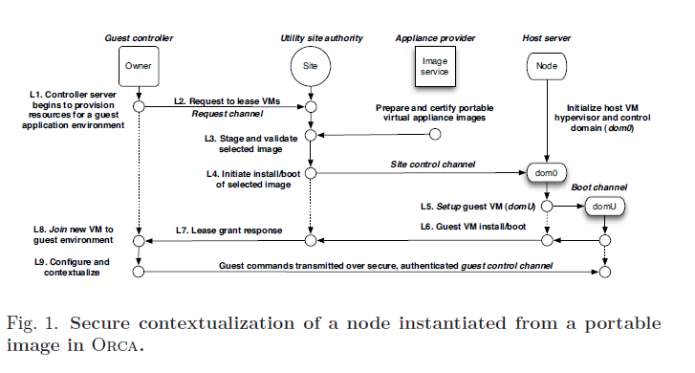
Secure instantiation of an appliance on an ORCA-managed node

Slide 22
Each guest lives in a form of VLAN
A virtual LAN is a kind of subnet architecture
Mimics a dedicated ethernet
Widely used in enterprise data centers
GENI deployment on a set of nodes is “like” a VLAN in that the appliances are isolated from one-another and see a virtual, private, infrastructure
But resources are “leased”
When lease expires, GENI will reclaim them

Slide 23
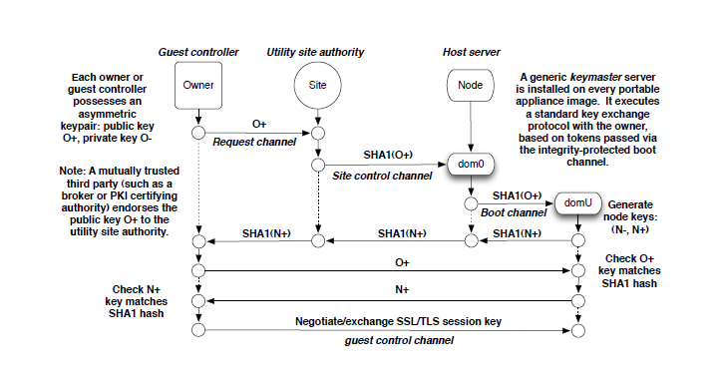
Security keys play a central role
GENI has an efficient security key exchange scheme
Uses public keys to efficiently create SSL or TLS session keys

Slide 24
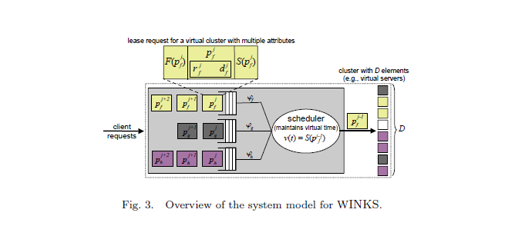
Fair resource sharing
Based on a modified “weighted fair queuing” algorithm (originally invented by Alan Demers!)

Slide 25
Guest controller API
Guest controller has options to:
Issue requests that span multiple hosts (“wide” requests)
Maintain flow ordering even during resource allocation
Perform “calendar” scheduling (advance reservations)
Backfill scheduling: First schedules wide requests, then “backfills” with smaller tasks
Dynamic resizing (to the extent feasible)

Slide 26
Identity and authorization
For these purposes GENI uses a Stanford-based logic (RT/ABAC) for trust-based role management
The logic is a mathematical framework for expressing:
Identity (individual and group entities),
Relationships (as in “John is a Cornell student and is taking CS6410”), or “Ken is a consultant to Z’s Red Sky Corp.”
Policies written using these base elements, such as “Cornell CS6410 students are entitled to a 20% discount on Ken’s book if they buy it directly from Springer Verlag”
Previous logics were much less expressive

Slide 27
Features of RT/ABAC
Authorization based on user identity, group affiliations, nature of the specific activity (slice)
Flexible support for delegation of rights, including “capability”-based access control
In this model, if you present a valid ticket for a resource that ticket (capability) will ensure access
Flexible authorization policies and delegated policy evaluation that allows policies from multiple agents to be combined
Captures trust policies in a declarative way with a rigorous formalism that reduces to an inductive logic

Slide 28
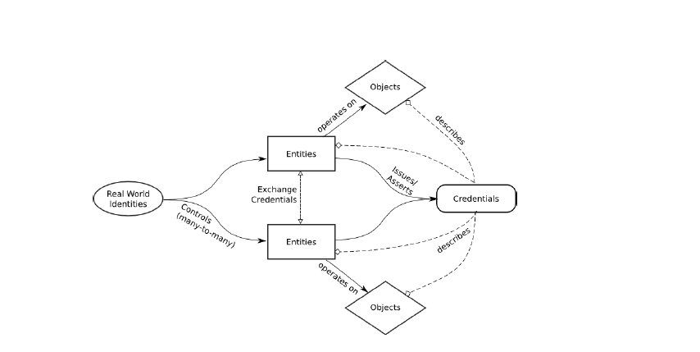
Applying RT/ABAC to GENI

Slide 29
Implementation approach
Public keys used for communication internal to and between elements of the system
An entity is a component that can send and receive messages using a secured channel (e.g. SSL/TLS)
ORCA security architecture employs only signed messages, allows each entity to know what entities it is interacting with in an unbreakable way
All notions of identity are implemented using “roles”

Slide 30
Role
In ORCA, the decision of an entity to trust another entity is determined by roles bound to it
A role is like an attribute: a form of named property
A single entity can have arbitrarily many roles and new roles can be defined dynamically
Roles can be extended and also can be retracted
An “entity domain” is a set of users for some institution, like “Cornell University” or “Microsoft”
ORCA also allows creation of groups, like “CS6410 students”

Slide 31
Federating identities
ORCA is designed to federate collections of identies managed via ORCA but by different organizations
E.g. Cornell manages Cornell entities
Z’s Red Sky company manages its own entities
ORCA is still able to carry out a policy in which Red Sky permits Cornell CS6410 students to experiment with Z’s new network sensor devices

Slide 32
Key elements of the trust logic
The logic is normally written using a simple high-level notation standard for deductive frameworks
“Compiles” into datalog: a kind of database for storing logic tuples and performing computation on them
Deciding if an action should be authorized becomes a datalog computation of this kind, e.g. by asking “does Ken belong to { entities allowed to edit X }”?

Slide 33
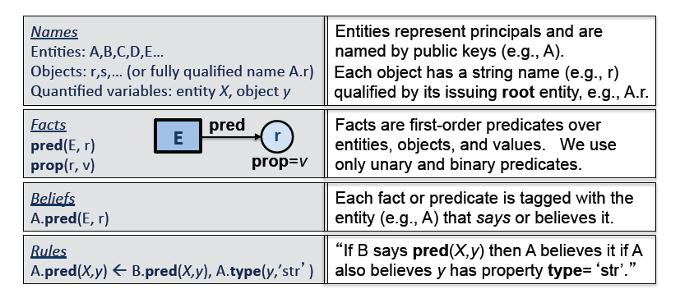
Trust logic syntax
Notation: A.pred(X,y) means “A says that pred holds for entity X, object y. A.pred*(X,y) means A can delegate whatever “pred” represents

Slide 34
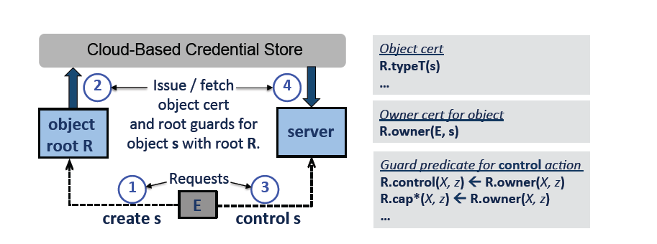
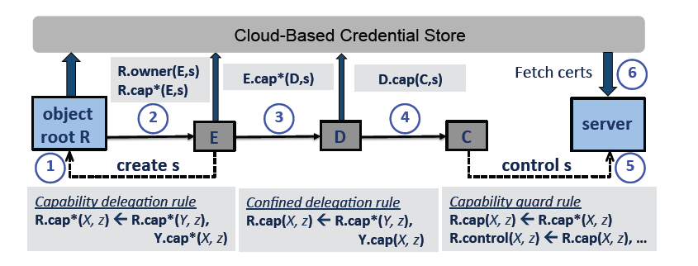
Creation and use of a global object
Creating an object and using it
Delegating a capability to perform some action on an object

Slide 35
Example: Coordinator entities and credential flow for GENI resource use
Identity Provider (IdP) is any entity that is trusted to assert attributes of a real-world identity without proof. Every GENI user must possess a keypair that is endorsed by a GENI-approved IdP.
Project Authority (PA) approves the creation of projects. A decision to approve a project is based at least in part on validated attributes of the requester. A PA acts as the root entity for projects that it approves: it issues a credential declaring the project and binding it to a name and other attributes. The PA also issues a credential designating the requester as the leader of the new project.
Slice Authority (SA) approves the creation of slices. A decision to approve a slice is based at least in part on validated attributes of the requesting user and the user's association with a project. An SA acts as the root entity for slices that it approves: it issues a credential declaring the slice and binding it to a project, a name, and other attributes. The SA also issues a credential designating the requester as the owner of the slice, conferring a privilege to control the slice.

Slide 36
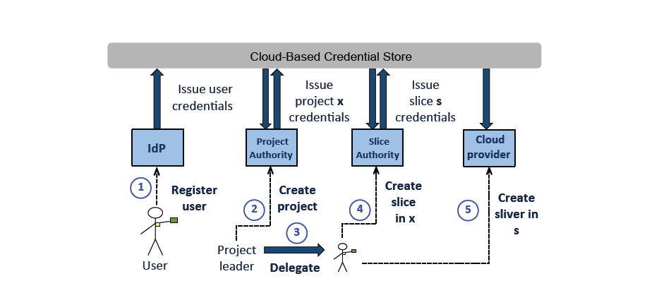
Example: Coordinator entities and credential flow for GENI resource use
Each virtual resource instance (“sliver") is obtained from a single resource provider (“aggregate"), and is bound to a project and slice that have been approved by authorities trusted by that aggregate according to its policy.
Access is fast because projects and slices are coarse-grained objects, and credentials for them are cached at the aggregates.

Slide 37
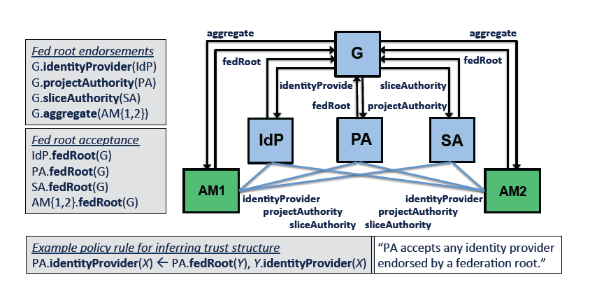
Trust structure that arises

Slide 38
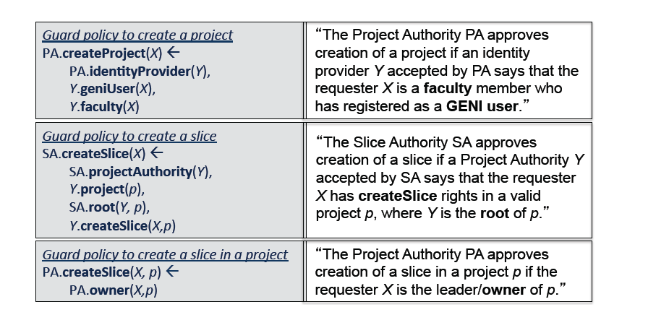
Summary of policies

Slide 39
Li/Mitchell/Winsborough
This paper provides the mathematic framework on which ORCA was implemented
Defines the full identity, role and trust framework
Offers a careful logic semantics for each action
Expressed as a base logic, RT₀, RT₁, RT₂, RT^{D} and RT^{T}
Each builds on the prior one (without breaking it), typically by showing how a construct can “map” to the more basic construct
For example, RT₁ adds parametized roles to RT₀ using a scheme a bit like macro expansion in a language like C
Shows that the resulting scheme is highly expressive and decidable: any expressed policy can be decided using a fast procedure that encodes nicely into Datalog

Slide 40
Summary and conclusions
GENI/ORCA exemplify a trend
A general move to offer more powerful security languages in systems
These permit extremely flexible, expressive policies but they also bring complexity
Implementation centers on cryptographic “identity” combined with proofs
But deduction is slow, hence use capabilities as a kind of pre-certified proof
Even so, speed of ORCA is not discussed in Chase’s paper

