Slide 1
Virtualizing Time
Ken Birman
CS6410

Slide 2
Is Time Travel Feasible?
Yes! But only if you happen to be a distributed computing system with the right properties
Today’s two papers both consider options for moving faster than the speed of light in distributed computing settings, without loss of consistency
They look at a practical issue that also has a nice theory side; we’ll focus on these “engineered artifacts” now, then revisit the theory later

Slide 3
Central shared theme
Time is a kind of performance barrier in many kinds of applications and systems
Assume a system of many processes or threads that interact via messages or events
Any complex distributed application
Event driven simulation code
Both papers ask whether some form of “optimistic” or “speculative” execution can be beneficial

Slide 4
Idea behind speculation
Suppose we have some task and “think” we have the needed inputs to perform it
For example, we have a guess as to the inputs for some computational step in a simulation. We could already start to run that step
Or we want to run an application in a risky, not-backed-up mode. If something crashes, we would need to role it back. But checkpoints are costly and the cost of frequent checkpoints would be prohibitive.
Speculation can let us leverage “spare” CPU power

Slide 5
Computing faster than the speed of light
Normally, wait for the data before computing
Speed of light = fastest that computation can be done with the full data
But if we can somehow guess the data we can precompute the result
If we got things right, we win and break light-speed
If wrong... we paid an overhead. But if we had idle CPUs lying around, that cost may be trivial!

Slide 6
Speculation is a broad tool
Work has been on using speculation to roll back applications that crash on certain inputs
Let the application eat the input and run (“optimism”)
If it succeeds, great...
... but if it crashes, then role it back to the state prior to seeing that input and rerun either
Without the input (e.g. sever the connection)
Or with the input but in a “careful” mode (i.e. watching for buffer overruns or other kinds of faults)
Database transactions are a powerful speculation tool, very widely used in large systems
Speculation is key to speed in modern chips

Slide 7
What limits the potential for speculation?
In systems that interact with external resources, a speculative action could leave visible traces
Consume inputs on I/O channels
Display information visible to users
Modify files
Launch other actions, send messages to other programs, launch the rocket, dispense the cash, etc
Clearly, when a task is running speculatively we need to prevent these kinds of actions

Slide 8
Speculation: Broad pattern
Reach a point at which it becomes feasible to start a costly computation a bit early
Inhibit any outside impacts (ideally including slowdown for the base system)
Once knowledge is complete, either permit it to make progress, or “erase” the speculated state

Slide 9
Time Warp O/S
A real system built to support event-oriented simulations of complex systems
Developed at the NASA research center in California where they do extensive simulations of spacecrafts and other mission-related applications
Often these have multiple stages that interact via events, so event-based simulation is natural

Slide 10
Core of any event-based simulator
Create a single big task queue, ordered by time, call it “the worldline of the simulator”
Implemented in a distributed way, but if we merge the many event queues, we would have the worldline
Simulation steps are triggered by events: the first event, at time T₀ is simply “start”
Think of events as asynchronously dispatched procedure calls: “compute F(x), then tell me the answer”
Reply is an event too
Event occurs at a time that would reflect things like network latency, time to operate a camera, etc.

Slide 11
Central problem in time warp
Suppose that some simulator thread is on a lightly loaded CPU core and basically idle
The thread knows the current state of simulator component Φ, at time T, and knows of an event that Φ should process (e.g. we should run Φ.F(X)) at time T+δ. When can we safely perform this task?

Slide 12
Possible answers
We should wait until every simulator component has reached time T+δ:
Events are always placed on the worldline “now” or “in the future”, at time now+ε for some ε
Once every component reaches some point in time, we definitely know the correct inputs to every action that should occur at time T+δ.
But this is very conservative and may leave our system mostly idle

Slide 13
Why “mostly idle”?
Recall that this is a simulator, not a real system
Suppose that simulation of some physical thing is just very costly to do
Perhaps, it is very costly to accurately simulate deployment of the Mars rover parachute at ballistic speeds in the upper atmosphere
A computation that takes hours to compute seconds of physical events

Slide 14
Impact of that slow task?
All the other threads in our simulator pause waiting
This is true even if it is unlikely that the parchute simulation task would cause events relevant to them
E.g. is the “warmup the hover engine fuel unit” task likely to be impacted by the parachute task?
Perhaps, if there is a violent turbulence event
But probably not “often” or “usually”

Slide 15
So our vision is of...
... a massively parallel simulation, with thousands of hard computational tasks ready to run
... all waiting for the right time at which to run
... and yet one might be able to demonstrate that in general, they waited for hours of real-time only to run in the same state they were in hours earlier!

Slide 16
(back to) Possible answers
This leads to option 2
Suppose we simply run a task as soon as we can
Every component eagerly runs, acting as if the events currently on the worldline are the full event set
Thus we could aggressively run the engine warmup simulation for time T+δ right now if we think we know the state prior to T+δ.

Slide 17
Issues with option 2?
It definitely keeps our HPC system humming!
But our speculation may have been wrong, perhaps an event relevant to the engine warmup simulation task does occur
Perhaps, the “heat shield detach” task simulates breakup of a portion of the shield
A fragment-trajectory task runs and decides that this fragment hits an engine fuel-line component
That fuel-line simulation task decides that the fuel-line is now dented and has reduced flow capacity
This would matter to the engine warmup task so an event is sent to it at time T+α, for some α<δ
Our simulation of the engine warmup state was incorrect!

Slide 18
Proposed solution?
We can just roll back the warmup simulation
Discard any state it created when speculatively running
Restart it in the prior state, but now run the event at time T+α
Unsend any messages it sent to other simulation components: send “anti-messages” on the worldline
How do these work?
If the worldline has a message m and an anti-message m shows up, m and m cancel each other
If m was already consumed, m triggers a rollback by the consumer task, and so forth
Clearly, need a way to “name” events that will be unique and unambiguous, and to track the history of events
Time Warp O/S has an event-naming scheme that solves this

Slide 19
Visualizing a time-warp execution
Waves of speculative execution overlap with waves of rollback
A speculative task runs, sending events to other tasks
These events trigger more speculative work
Meanwhile, as slow tasks (“laggards”) send events, rollbacks can be triggered, spawning waves of antimessages that in turn trigger further rollbacks
Does progress occur at all? Or can this degenerate into a chaotic state?

Slide 20
Implication?
Speculation may pay off if we don’t depend on too many “risky assumptions” (namely, too many other speculative threads)
Time-Warp O/S seems to not notice this issue!
But the payoff diminishes exponentially quickly
Until their cluster saturates (overload) we should see some evidence of this: exponentially growing rate of rollback

Slide 21
Theory of Time Warp
Jefferson argues that in fact, his system state can always be topologically sorted: a kind of forest of rooted trees (some inner nodes may have multiple roots, of course)
Focus on those roots: tasks that cannot be forced to roll back because they are at the earliest clock time known in the system
To make these roll back, an event from the past would need to arrive. But no active task could generate such an event
Analysis can be extended to deal with events still in the communication channels of Time Warp

Slide 22
Downside to speculation?
When we run a task in a speculative mode, we consume many kinds of resources
Network traffic is created, hence network is slower
Disk I/O occurs, hence disk will be less responsive for other uses
We create intermediary state checkpoints, which can be large and slow to store
We need lists of events that were consumed, and shadow copies in order to “unconsume” them if a rollback occurs
Moreover, if a rollback occurs, this has costs too

Slide 23
I/O?
One practical challenge involves files and other I/O occuring during the simulation run
Time Warp treats the file system itself as a kind of event-driven simulation task
Events create files, modify, delete them
Permits the same model to deal with elimination of files created speculatively, or modified speculatively
But does require that Time Warp keep logs of old versions or deltas, for use in rolling back, and these can easily get very large

Slide 24
Worst case?
It is easy to see how Time Warp can spawn a kind of exponentially branching world of speculative activities that all will need to roll back
Should this occur, we’ll spend all our time speculating and rolling back, none of our time doing useful simulation!
Moreover, tasks will run slower because of cold caches: speculation/rollback will often flush caches simply by overwriting contents with other stuff used speculatively

Slide 25
Core speedup-limiting issue?
Suppose thread C depends on k speculative threads (A and B in this example)
Now suppose those threads roll back with iid probability p
How likely is it that C won’t roll back
... (1-p)^{k}
committed work
Speculation event
Speculative “thread” A
Doubly dependent thread C
Speculative “thread” B

Slide 26
Time Warp practical challenges
Trick is to speculate wisely, depends on estimating risk of rollback (in our calculation we pretended it was fixed)
Today we would see this as a machine-learning problem:
Training data: For a given simulator, learn to categorize the tasks and, for each category, learn the probability of rollback for that category
Use of the training set: At runtime, only speculate if the predicted value greatly outweighs the predicted risk
At the time, Jefferson used heuristics

Slide 27
Time Warp practical challenges
Garbage collection is a big issue
Time Warp accumulates a LOT of speculative state and rollback state
Task states, file system deltas, shadow copies of messages that have been consumed but might still be unconsumed, etc
Clearly a garbage collector is required
Solution: periodically compute the “oldest time active in the system”. Safe to garbage-collect rollback data older than this computed time: they won’t be needed

Slide 28
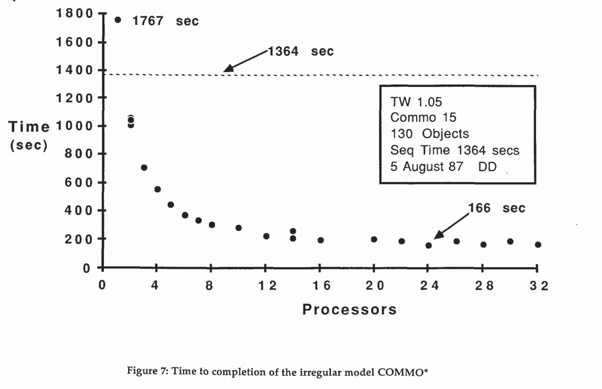
Results obtained?

Slide 29
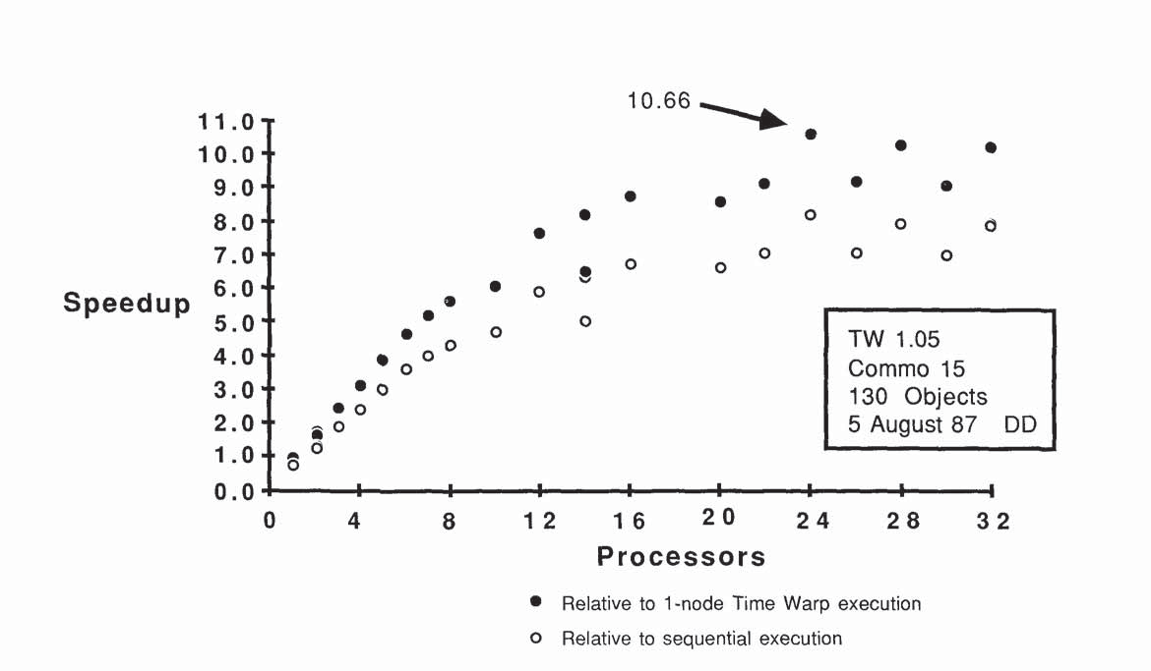
Results obtained?

Slide 30
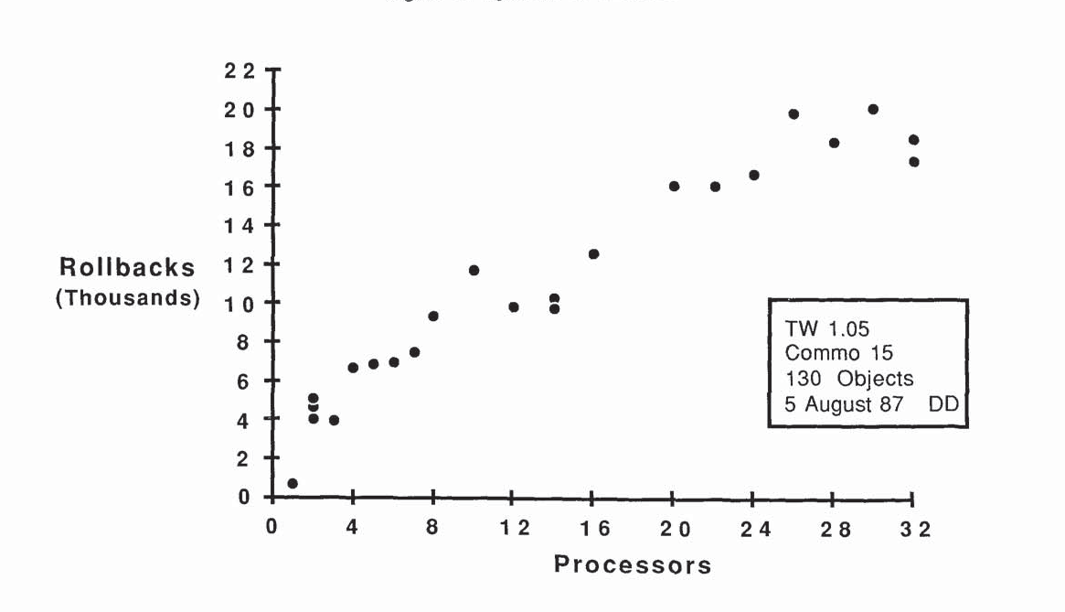
Results obtained?

Slide 31
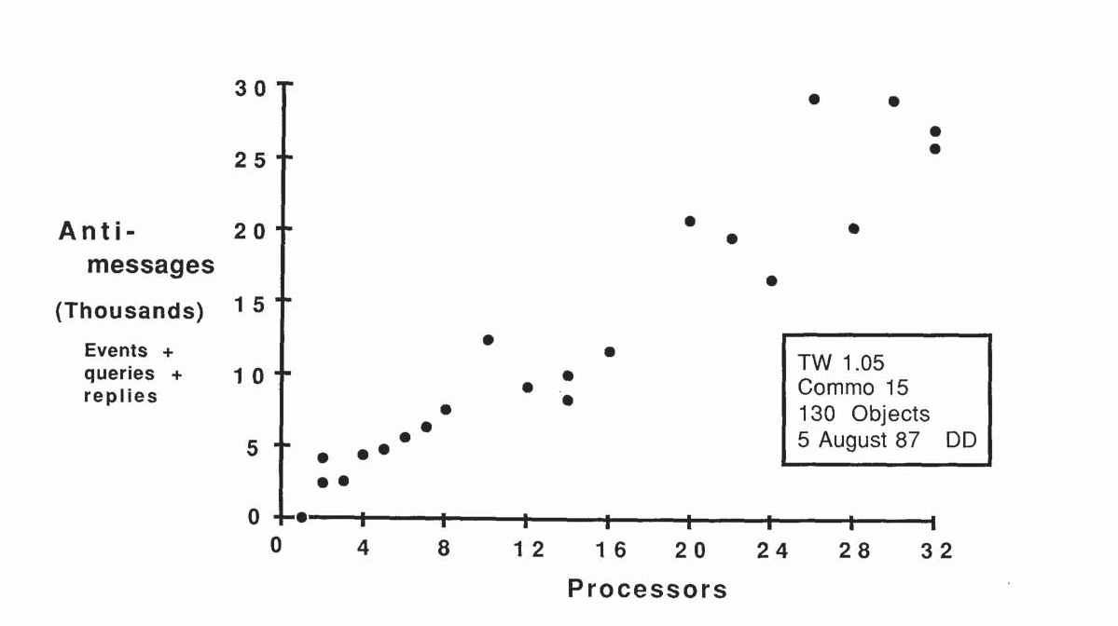
Results obtained?

Slide 32
How well did TW heuristics work?
Rate of rollback isn’t increasing exponentially quickly, which suggests that they are somewhat smart about when to speculate and when to wait
But this could also simply be evidence that their cluster is running flat out
They didn’t really measure the frequency of rollback as a function of how many speculative events a thread depends upon (and it isn’t an easy thing to instrument)

Slide 33
Applying similar ideas in real systems
Time Warp was all about simulation
But many real systems have lots of moving parts
Today’s cloud computing systems are built by scripts that assemble complex components from smaller building blocks: objects that interact via events
Situation is this very much like Time Warp
Do real systems present speculation opportunities?

Slide 34
Logging
Main issue in Alvisi’s paper centers on failures
Suppose a componentized system only makes checkpoints rarely, and components run by event-passing
How should we track “speculative states” that components enter, and how can they roll back when needed?
He points out that there are three choices
Checkpoints
Sender-maintained event (message) logs
Receiver-maintained event logs
Proposes a universal speculation model

Slide 35
What triggers rollback?
For Alvisi, main concern is failure
If some component crashes and we want to restart it, perhaps in a slightly “fixed” state, we need to roll back to a prior checkpoint state
His goal is to ensure system-wide consistency by a mechanism similar to the one in Time Warp
Anti-messages that anihilate the prior message if it is still in the queue of the receiver, else trigger a new rollback
In general, we have several rollback options

Slide 36
Alvisi observations
Treat interaction with the outside world as a special situation in which we need to be in a safe (non-speculative) state
External-interaction “barrier”
Must also treat interactions with many O/S features (clock, fork(), pipe I/O, ...) as managed events
Employ aggressive task scheduling when risk of rollback seems sufficiently low.

Slide 37
Alvisi approach
Seeks to offer a flexible framework in which we
Use rollback to a checkpoint if doing so is likely to have the least cost
Send anti-messages to trigger a more selective rollback if logs are available and the corresponding messages have not yet been consumed
This unified model is elegant, but it does assume that messages linger on input queues for a long enough period of time to offer a benefit

Slide 38
Results obtained
Theory of message logging
Coverage of a wide range of possible behaviors including sender logging, receiver logging, checkpoints
Careful proofs showing precisely when it is safe to garbage collect data, and precisely when a computation must roll back (and to what point)

Slide 39
Discussion
Speculation buys us a great deal within model CPU architectures
Branch-prediction
Speculative cache prefetching
Permits the chip designer to exploit parallelism at the lowest levels, but does require barriers to prevent speculative states from leaking into main memory

Slide 40
Speculation in protocols
When we looked briefly at Van Renesse’s Horus architecture, we saw another use of speculation
Pre-execute the non-data-touching code for the next message, under assumption that next event will be a message
If the Horus protocol stack sees some other event, Van Renesse had to roll back to a pre-speculation state

Slide 41
Speculation in systems
Time Warp and Alvisi’s unified logging scheme are just two of many examples
Speculation can be used in a file system, by guessing that if file A was touched, file B will be needed, and prefetching file B
Some modern systems use extra cycles to make a spare copy of B next to A, for quicker access if needed: a speculative form on on-disk replication
Speculation to consume a risky incoming message, roll back if it turns out to cause a crash or contain a virus

Slide 42
Broad tradeoff
When we look at modern systems we often see large portions sitting idle waiting for permission to take some action
Broadly speaking, speculation is about machine learning: if we can accurately predict what will happen next, we can sometimes jump the gun
Cost is the overhead of rollback when needed

