Slide 1
Game Theory
Presented by Hakim Weatherspoon

Slide 2
Game Theory
Main Question: Can we cheat (and get away with it)?
BitTorrent
  P2P file distribution tool designed with
  incentives for contribution
  Users contribute resources to get good performance
Do Incentives Build Robustness in BitTorrent?
  Can BitTorrent be gamed?
BAR Gossip
  Can content distribution be tamed?

Slide 3
BitTorrent
Written by Bram Cohen (in Python) in 2001
“Pull-based” “swarming” approach
  Each file split into smaller pieces
  Nodes request desired pieces from neighbors
    As opposed to parents pushing data that they receive
  Pieces not downloaded in sequential order
  Previous multicast schemes aimed to support “streaming”; BitTorrent does not
Encourages contribution by all nodes
BitTorrent slides from CS 5410, Ken Birman

Slide 4
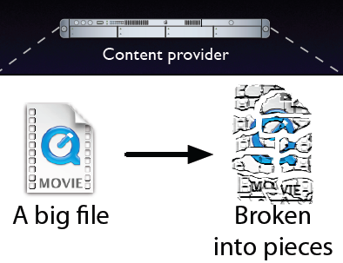
BitTorrent
Slides from Michael Piatek’s NSDI presentation

Slide 5
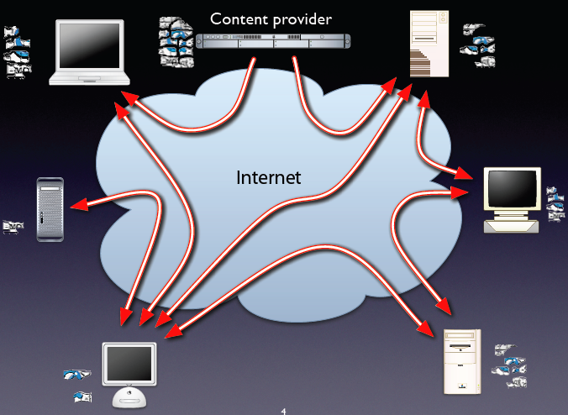
BitTorrent

Slide 6
BitTorrent Swarm
Swarm
  Set of peers all downloading the same file
  Organized as a random mesh
Each node knows list of pieces downloaded by neighbors
Node requests pieces it does not own from neighbors
  Exact method explained later

Slide 7
How a node enters a swarm for file “popeye.mp4”
File popeye.mp4.torrent hosted at a (well-known) webserver
The .torrent has address of tracker for file
The tracker, which runs on a webserver as well, keeps track of all peers downloading file

Slide 8
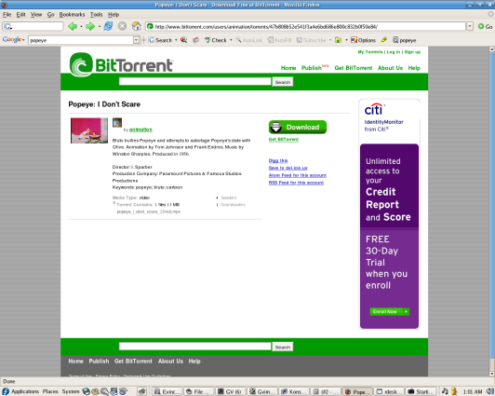
How a node enters a swarm for file “popeye.mp4”
www.bittorrent.com
File popeye.mp4.torrent hosted at a (well-known) webserver
The .torrent has address of tracker for file
The tracker, which runs on a webserver as well, keeps track of all peers downloading file
1
Peer
popeye.mp4.torrent

Slide 9
How a node enters a swarm for file “popeye.mp4”
www.bittorrent.com
File popeye.mp4.torrent hosted at a (well-known) webserver
The .torrent has address of tracker for file
The tracker, which runs on a webserver as well, keeps track of all peers downloading file
Peer
2
Addresses of peers
Tracker

Slide 10
How a node enters a swarm for file “popeye.mp4”
www.bittorrent.com
File popeye.mp4.torrent hosted at a (well-known) webserver
The .torrent has address of tracker for file
The tracker, which runs on a webserver as well, keeps track of all peers downloading file
Peer
3
Tracker
Swarm

Slide 11
Contents of .torrent file
URL of tracker
Piece length – Usually 256 KB
SHA-1 hashes of each piece in file
  For reliability
“files” – allows download of multiple files

Slide 12
Terminology
Seed: peer with the entire file
  Original Seed: The first seed
Leech: peer that’s downloading the file
  Fairer term might have been “downloader”
Sub-piece: Further subdivision of a piece
  The “unit for requests” is a subpiece
  But a peer uploads only after assembling complete piece

Slide 13
Peer-peer transactions:
Choosing pieces to request
Rarest-first: Look at all pieces at all peers, and request piece that’s owned by fewest peers
  Increases diversity in the pieces downloaded
    avoids case where a node and each of its peers have exactly the same pieces; increases throughput
  Increases likelihood all pieces still available even if original seed leaves before any one node has downloaded entire file

Slide 14
Choosing pieces to request
Random First Piece:
  When peer starts to download, request random piece.
    So as to assemble first complete piece quickly
    Then participate in uploads
  When first complete piece assembled, switch to rarest-first

Slide 15
Choosing pieces to request
End-game mode:
  When requests sent for all sub-pieces, (re)send requests to all peers.
  To speed up completion of download
  Cancel request for downloaded sub-pieces

Slide 16
Tit-for-tat as incentive to upload
Want to encourage all peers to contribute
Peer A said to choke peer B if it (A) decides not to upload to B
Each peer (say A) unchoke at most 4 interested peers at any time (Azureus client)
  The three with the largest upload rates to A
    Where the tit-for-tat comes in
  Another randomly chosen (Optimistic Unchoke)
    To periodically look for better choices
  4 is size of active set, but can be more dynamic

Slide 17
Anti-snubbing
A peer is said to be snubbed if each of its peers chokes it
To handle this, snubbed peer stops uploading to its peers
Optimistic unchoking done more often
  Hope is that will discover a new peer that will upload to us

Slide 18
Why BitTorrent took off?
Better performance through “pull-based” transfer
  Slow nodes don’t bog down other nodes
Allows uploading from hosts that have downloaded parts of a file
  In common with other end-host based multicast schemes

Slide 19
Why BitTorrent took off?
Practical Reasons (perhaps more important!)
  Working implementation (Bram Cohen) with simple well-defined interfaces for plugging in new content
  Many recent competitors got sued / shut down
    Napster, Kazaa
  Doesn’t do “search” per se. Users use well-known, trusted sources to locate content
    Avoids the pollution problem, where garbage is passed off as authentic content

Slide 20
Pros and cons of BitTorrent
Pros
  Proficient in utilizing partially downloaded files
  Discourages “freeloading”
    By rewarding fastest uploaders
  Encourages diversity through “rarest-first”
    Extends lifetime of swarm
Works well for “hot content”

Slide 21
Pros and cons of BitTorrent
Cons
  Assumes all interested peers active at same time; performance deteriorates if swarm “cools off”
  Even worse: no trackers for obscure content
Recent studies by team at U. Washington found that many swarms “fail” because there are few changes for repeated interaction with the same peer
  They suggest fixes, such as “one hop reputation” idea presented at NSDI 2008

Slide 22
Pros and cons of BitTorrent
Dependence on centralized tracker: pro/con?
  ☹ Single point of failure: New nodes can’t enter swarm if tracker goes down
  Lack of a search feature
    ☺ Prevents pollution attacks
    ☹ Users need to resort to out-of-band search: well known torrent-hosting sites / plain old web-search

Slide 23
Do Incentives Build Robustness in BitTorrent?
Michael Piatek
  Grad Student @ UW
Tomas Isdal
  Grad Student @ UW
Tom Anderson
  Prof @ UW. Author of Nacho’s OS
Arvind Krishnamurthy
  Prof @ UW
Arun Venkataramani
  Prof @ Umass Amerst.

Slide 24
BitTorrent
BitTorrent is a protocol for bulk data transfer
The more you give, the more you get
Tit-for-tat
  Not really

Slide 25
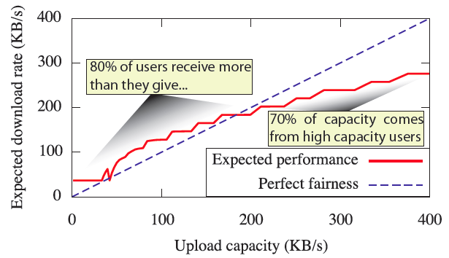
Altruism
Not really TFT
  80% of users get more than they give
  70% of capacity comes from high capacity users

Slide 26
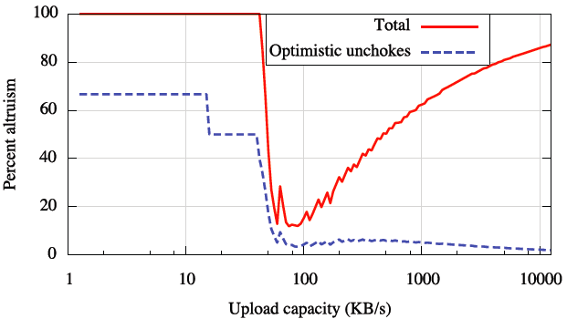
Altruism
Not really TFT
  80% of users get more than they give
  70% of capacity comes from high capacity users
  Not really a fair protocol
    Operates based on altruism of high capacity users

Slide 27
Exploiting Altruism
Selfish users
  Rational
  Want to cheat (as long as they won’t get caught!)
  Can download with many low-speed connections rather than 1 high-speed

Slide 28
Building BitTyrant
Maximize reciprocation bandwidth per connection
  Find peers that give the most for the least
Maximize number of reciprocating peers
  Get as many peers as possible
  Until benefit of new peer is outweighed by cost of reduced reciprocation from other peers
Deviate from equal
  Decrease uploading on each connection
  Until peer stops reciprocating

Slide 29
Results
BitTyrant improves average download performance by 70%
Regardless of capacity, using BitTyrant is in the selfish interest of every peer individually
When all peers behave selfishly, average performance degrades for all peers, even those with high capacity

Slide 30
Take-away
BitTorrent works because people use the default client
  No cheating
BitTyrant is now available in the wild
  This is a test – Do incentives build robustness?
  Maybe users will continue to donate excess bandwidth
  Maybe users will be selfish
    Proven to reduce overall capacity

Slide 31
BAR Gossip
Henry Li, Allen Clement, Edmund Wong, Jeff Napper, Indrajit Roy, Lorenzo Alvisi, and Michael Dahlin

Slide 32
BAR Model
Byzantine (Arbitrary) Nodes
Altruistic (Generous) Nodes
Rational (Selfish) Nodes

Slide 33
BAR Gossip Vision
In presence of:
  Selfish nodes
  Byzantine nodes
We want:
  Predictable throughput
  Low latency

Slide 34
BAR Gossip Differences
Data exchange in short periods
No long-term reputation
Exchanges small blocks of data
Robust to both Selfish and Byzantine behavior

Slide 35
BAR Gossip Assumptions
One data broadcaster
Static Membership
Reliable Cryptographic primitives (SHA1,RSA)
Unique keys and signatures for nodes

Slide 36
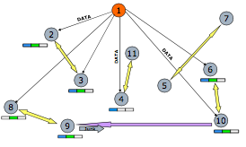
Overview

Slide 37
Core Idea
Balanced Exchange
  When a peer gives some data in exchange of some data. “Trade data for data.“
Optimistic Push
  Every peer will willingly help others by giving them data for free. Be a good person and give data for free.
What about when I don’t have anything to trade off with, am I out of the game then ?

Slide 38
Take-away
Current gossip protocols are ill-suited for selfish environments.
Bar Gossip
  Verifiable pseudo-randomness
  Signatures
  Balanced Exchange, achieves 98% reliability.
  With Optimistic Push, increases to almost 99.9%

Slide 39
Next Time
Final Presentations
  Room 5126 (from 9am-3pm)
  9am – 3:00pm, Thursday, December 1st
  15 - 20 minute presentations, 5 -10 minute questions
  Signup for presentation slot via CMS
Final paper
  Due next Thursday, December 8th
  Complete paper and comprehensive evaluation
Thank you!

