Slide 1
Virtual Synchrony
Scott Phung
Nov 15, 2011
Some slides borrowed from Jared (‘09)

Slide 2
Motivation
Build Distributed Systems with:
Fault-Tolerance
Consistency
Concurrency
Easy programmability

Slide 3
Timeline
Year | Event | Author
1975 | ARPANET | ARPANET
1978 | Time, Clocks, and the Ordering of Events in a Distributed System | Lamport
1978, 84, 90 | State Machine Replication | Lamport, Schneider
1981 | Database serializability, 2PC, 3PC | Berstein, Goodman, Skeen
1982 | Byzantine General’s Problem | Lamport, Shostak, Pease
1983 | Impossibility of Distributed Consensus with One Faulty Process | Fischer, Lynch, Paterson
1983+ | Virtual Synchrony | Birman et al
1985 | Group Communication primitives, “process group” OS construct | Cheriton, Deering, Zwaenepoel
1990 | Paxos | Lamport
Notes:
ARPANET – predecessor to internet, first distributed system that came out of a need to give researchers across the USA access to a limited number of large, powerful research computers.
First message delivered in 1969 was “lo” (“logon” but crashed)

Slide 4

The Process Group Approach to Reliable Distributed Computing (‘93)
Ken Birman
Professor, Cornell University
Virtual Synchrony / Isis / Isis²
Quicksilver
Live Object

Slide 5
Assumptions
Asynchronous communication
Message Passing
Fail-Crash Failure Model
Timeout suspects stopped or slow processes through
Processes considered to have failed
WAN of LANs

Slide 6
Virtual Synchrony
Distributed execution model that gives the appearance of synchronous execution
Eases program development
will talk more later
Features
Process Groups
Ordered and Concurrent Message Delivery
Reliable Multicast

Slide 7
Motivation
Build Distributed Systems with:
Fault-Tolerance
Consistency
Concurrency
Easy programmability
How to achieve Fault-Tolerance, Consistency and Easy Programmability? Process Groups.

Slide 8
Outline
Problem
Process Groups (Implementation)
Solution
Close Synchrony
Virtual Synchrony
Isis

Slide 9
Process Groups
Communication framework that structures members of a distributed system into groups:
Provides an easy development framework:
Group Communication
Group Membership
Synchronization

Slide 10
Process Groups
Process Groups provides:
Fault Tolerance
State Machine Replication
Consistency
Membership changes, Message Delivery Order

Slide 11
Process Groups Issues
Problems building using Conventional Technologies (UDP, RPC, TCP):
No reliable multicast (Group Communication)
Membership churn (Group Membership)
Message ordering (Synchronization)
State transfers (Group Membership)
Failure atomicity (Group Membership)

Slide 12
No Reliable Multicast
Ideal
Reality
p
q
r
UDP, TCP, Multicast not good enough
What is the correct way to recover?
Notes:
Talk about the different protocols and their weaknesses
- UDP, TCP, Multicast
Multicast is useful for replication, but we want it to be reliable
Making it reliable results in acknowledgement explosion
Even if app implemented this, it’s not clear how to correct for failures
TCP is reliable point-to-point
Impossible to know if multicast reaches all receivers without additional logic
Reliable multicast is application’s responsibility

Slide 13
Membership Churn
Receives new membership
p
q
r
Never sent
Membership changes are not instant
How to handle failure cases?
Notes:
Send messages to an up-to-date membership?
1. Membership RPC service -> single point of failure, slow
2. Request and cache -> fast but stale memberships
Solution: locks
Multicast →read-lock
Membership change →write-lock
ISIS uses this idea but replicates knowledge of membership among members (Group Membership service)

Slide 14
Message Ordering
1
2
p
q
r
Lamport’s Notion of Time: Causality
How to prevent causal messages delivered out of order (Ex 2)?
Notes:
No causality
Causality
Receive messages concurrently?
Concurrent and totally ordered wrt. membership changes
Related Messages
Will they come in order?
The problem
Will programmers anticipate it?
Concurrent messages: 2 choices:
a) handle it or
b) delay messages so that they’re in order.
Real problem = this is overlooked!

Slide 15
State Transfers
p
q
r
New nodes must get current state
Does not happen instantly
How do you handle nodes failing/joining?
Notes:
Transfer state to new node which can take a long time
Membership churn → inconsistent
Solution is too complex

Slide 16
Failure Atomicity
Ideal
Reality
p
x
q
r
?
Nodes can fail mid-transmit
Some nodes receive message, others do not
Inconsistencies arise!
Notes:
What if sender fails mid-broadcast?
Inconsistent state would result
Simple solutions exist
solution: 3-phase reliable broadcast, with recipients covering for sender if it crashes

Slide 17
Process Groups Issues Recap
Problems building using Conventional Technologies (UDP, RPC, TCP):
No reliable multicast (Group Communication)
Membership churn (Group Membership)
Message ordering (Synchronization)
State transfers (Group Membership)
Failure atomicity (Group Membership)
Can we build a system that solves these?

Slide 18
Outline
Problem
Process Groups (Implementation)
Solution
Close Synchrony
Virtual Synchrony
Isis

Slide 19
Close Synchrony
Synchronous Execution Model
Multicast delivered to all group members as a single, reliable instantaneous event.
Solves all Process Group problems!

Slide 20
Close Synchrony
Synchronous execution
Execution moves in lock-step
p
q
r
s
t
u
Ken’s Slides - 2006

Slide 21
Close Synchrony
Process Group problems solved:
No Reliable Multicast
Multicast is always reliable
Membership Churn
Membership is always consistent
Message Ordering
Totally ordered message delivery
State Transfers
State-transfer happens instantaneously
Failure Atomicity
Multicast is a single event

Slide 22
Close Synchrony
Problem
We don’t have instantaneous events
It is impossible in the presence of failures
Expensive (waits for slowest member)
What can we do?

Slide 23
Asynchronous Execution
p
q
r
s
t
u
Ken’s Slides - 2006
Notes:
Pipelined Execution
Does not wait for reply from destination

Slide 24
Virtual Synchrony
Close Synchrony using Asynchronous protocols
Group Communication
Notion of time: Use Lamport’s Happens-Before relationship
Causal & Concurrent Ordered Message Delivery (CBCAST)
This causal order matches some equivalent Close Synchronous execution (total order).
Group Membership
Synchronized Membership View Changes
Replicated Group Membership Service sends final word on failures & joins to all members
Notes:
Devise Asynchronous execution protocols to provide Close Synchrony semantics
Group Communication
-Notion of time: Use Lamport’s happen-before relationship
CBCAST, ABCAST for causal and total order message delivery
GMS for Membership Views
-Voting / Quorum on membership failures (and joins?)

Slide 25
Causal Message Ordering
CBCAST (Casual Atomic Broadcast Primitive)
Asynchronous, fast
Causal Order Delivery (within group)
Vector clock, delay of messages
Concurrent messages can be delivered OOO
Batch multiple messages
Most-used primitive in Virtual Synchrony
Notes:
Need a picture

Slide 26
Total Message Ordering
ABCAST (Atomic Broadcast Primitive)
Synchronous, slow
Total Order Delivery (within a group)
No message can be delivered to any user until all previous ABCAST messages have been delivered

Slide 27
Distributed Algorithms
How can Process Groups solve Consensus?

Slide 28
Distributed Algorithms
How can Process Groups perform Distributed Snapshots?

Slide 29
Isis
Framework that offers Group communication with Virtual Synchrony
Takes care of group communication, membership changes and failures through a single, event oriented execution model (Virtual Synchrony).
You just concentrate on the member code!

Slide 30
Isis
Used In:
NYSE, Swiss Stock Exchange
French Air Traffic Control System
US Navy AEGIS

Slide 31
Isis - Weakness
Large Groups - Multicast reply explosion
Isis² Group Aggregation, Dr. Multicast
No reduction ability within Groups
Isis² Group Aggregation
Messages sent are not durable
Isis² SafeSend (Paxos Mode)

Slide 32
Isis² Group Aggregation
Used if group is really big
Request, updates: still via multicast
Response is aggregated within a tree
query
v_{a}
v_{b}
v_{c}
v_{d}
Level 0
a
b
c
d
Agg(v_{a} v_{b})
Agg(v_{c} v_{d})
a
c
Example: nodes {a,b,c,d} collaborate to perform a query
a
reply
Birman: DARPA MRC Kickoff, Washington, Nov 3-4 2011

Slide 33
Takeaways
Virtual Synchrony Benefits
Group Communication, Membership Changes, State Transfers and Failures in a single event execution model (Close Synchrony)
Key Contributions
Dynamic Group Membership
Integration of Failure detection into communication subsystems
Ordered and Total Message Delivery

Slide 34


Understanding the Limitations of Causally and Totally Ordered Communication (‘93)
David Cheriton
Professor, Stanford
PhD – Waterloo
V Operating System
Dale Skeen
PhD – UC Berkeley, former Cornell Assistant Prof.
Distributed pub/sub communication, 3PC
Co-founded TIBCO, Vitria

Slide 35
CATOCS Problems
Causal And Totally Ordered Communication Support
Message delivery is atomic, but not durable
Incidental ordering
CATOCS is at communication level but consistency requirements are at application state
Violates end-to-end argument.
Notes:
.

Slide 36
Limitations of CATOCS in communication layer
Unrecognized Causality
Can’t say “for sure”
No Semantic Ordering
Can’t say the “whole story”
Lack of serialization ability
Can’t say “together”
Lack of Efficiency Gain over State-level Techniques
Can’t say “efficiently”

Slide 37
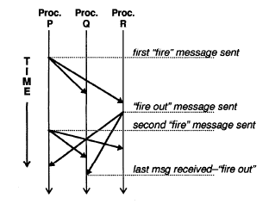
Unrecognized Causality Can’t say “for sure”
Causal relationships at semantic level are not recognizable
External or ‘hidden’ communication channel.
Notes:
Soln: Version numbers (application state)

Slide 38
Can’t say “together”
Serializable ordering, cannot order a group of messages together
Seems to only provide shared-memory w/lock examples, do other Message Passing systems offer serializable ordering?
Notes:
Soln: Locks to handle a group of messages atomically

Slide 39
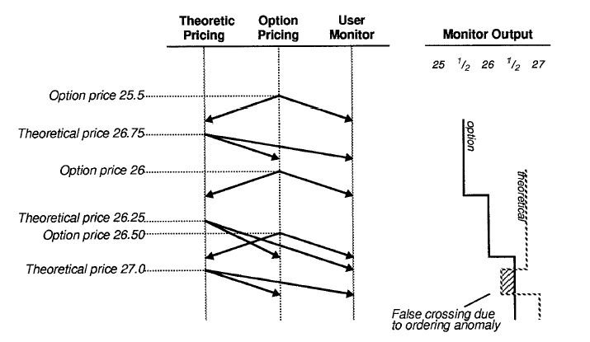
Can’t say “whole story”
Semantic ordering are not ensured

Slide 40
Can’t say “efficiently”
No efficiency gain over state-level techniques
False Causality
Not scalable
Overhead of message reordering
Buffering requirements grow quadratically

Slide 41
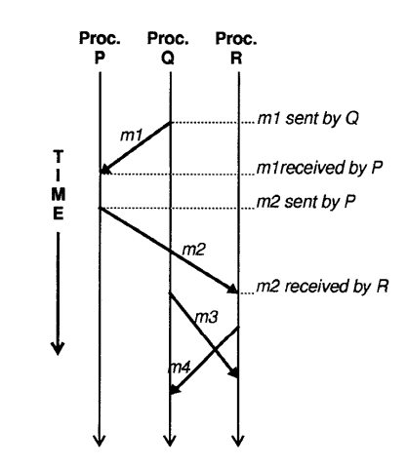
False Causality
What if m2 happened to follow m1, but was not causally related?

Slide 42
Birman’s Response (‘93)
Ordering is important to guarantee consistency
when combined with an Execution model (Virtual Synchrony) produces a system with powerful reliability guarantees.
This point was completely neglected.
Causal ordering
is cheap and prevents some failures.
flow control and congestion handling more important.
Hidden Channels
Rare, mostly in Shared Memory, which you protect with a lock.
No system can say for sure for the example constructed.

Slide 43
Birman’s Response (‘93)
Semantic vs Causal Ordering
Causal order provides some ordering guarantees.
Tag with timestamps or create causal dependency from theoretical price to actual price.
Can Say “efficiently”
Buffering requirements do not grow quadratic, they are usu. constant.
VS is efficient, otherwise leave group membership, communication, synchronization to application developer ==> less efficient system
Theoretical Proofs carry little weight in this domain
FLP, yet systems are still built that solve consensus.
3PC, yet most DB systems use 2PC.

