Slide 1
Byzantine Fault Tolerance
Eleanor Birrell
November 23, 2010

Slide 2
x
SIG(x, i)
SIG(y, i)
y
SIG(x,i)
Notes:
Equivocation (A2M), sig vs. MAC
Why is this an interesting/applicable problem? – commit vs. roll-back, replication as fault-tolerance

Slide 3



Authenticated Messages
Digital Signatures
Message Authentication Codes (MAC)
Public-Key
Inefficient
Secret-Key
3 orders of magnitude faster
M,
SK_{A}
SIG
⟨M⟩_{SKA}
SK_{A}
⟨M⟩_{SKA},
PK_{A}
b ∈ {yes, no}
SIG_{SHA}(M,SK_{A}) = SHA(SK_{A}||SHA(SK_{A}||f(M)))
SIG_{RSA}(M,SK_{A}) = f(M)^{SKA} mod n
VER

Slide 4
Authenticators
MACs cannot be authenticated by a third party
  Solution: create vector of MACs (called authenticator) with one code for each node
  Verification O(1) but generation O(n)
M,
SK_{A}
SIG
⟨M⟩_{SKA}
⟨M⟩_{SKA},
SK_{A}
b ∈ {yes, no}
SIG_{AUTH}(M,SK_{A1}, …, SK_{An})
= (SIG_{SHA}(M,SK_{A1}) ,…, SIG_{SHA}(M,SK_{An}) )
VER

Slide 5
Byzantine Fault Tolerance
(Results)
(m = traitors, n = total) | Synchronous | Semi-Sync | Asynchronous
Oral Messages: Negative
Positive
Authenticated: Negative
Positive

Slide 6
Byzantine Fault Tolerance
(Results)
(m = traitors, n = total) | Synchronous | Semi-Sync | Asynchronous
Oral Messages: Negative | n ≤ 3m [LSP80] |  | m ≥ 1 [FLP82]
Positive | n ≥ 3m+1 [LSP80]
Authenticated: Negative |  |  | m ≥ 1 [FLP82]
Positive | n ≥ 1 [LSP80] | n ≥ 3m+1 [CL99]

Slide 7
Byzantine Fault Tolerance
(Results)
(m = traitors, n = total) | Synchronous | Semi-Sync | Asynchronous
Oral Messages: Negative | n ≤ 3m [LSP80] |  | m ≥ 1 [FLP82]
Positive | n ≥ 3m+1 [LSP80]
Authenticated: Negative |  |  | m ≥ 1 [FLP82]
Positive | n ≥ 1 [LSP80] | n ≥ 3m+1 [CL99] | ???

Slide 8
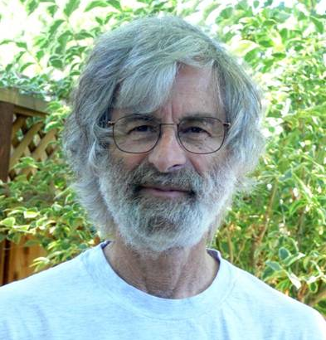

L. Lamport, R. Shostak, and M. Pease. The Byzantine Generals Problem (1982)
Leslie Lamport
  PhD Brandeis 1972 (Math)
  SRI, DEC, Compaq, MSR
  Clocks, Paxos, LaTex
Robert Shostak
  PhD Harvard 1974
  SRI, Ansa (Paradox), Portera, Vocera
Marshall Pease
  SRI International

Slide 9

A
R

Slide 10
Byzantine Generals Problem
Interactive consistency conditions (ICCs):
Commanding general i sends
v_{j}(i) to Lt. j :
  All loyal Lt. obey same order
  If i is loyal, every loyal Lt. j obeys order v_{j}(i)
Solution if ICCs hold for all i
Simpler Model:
  Army of n Generals
  Com. Gen. i has opinion
  v(i) ∈ {Attack, Retreat}
Goals:
  Agree on i’s opinion
  Agree on right opinion
Model:
  Army of n Generals
  Each Gen. i has opinion
  v(i) ∈ {Attack, Retreat}
Goals:
  Agree on plan
  Agree on good plan
Notes:
Definitions of bad plan (State machines, bad = no loyal suggests)

Slide 11
BFT with Un-Auth. Messages
(A1) Every message is delivered correctly
(A2) The receiver knows who sent the message
(A3) The absence of a message can be detected

Slide 12
Impossibility Results
Sync. Communication [LSP80]
Async. Communication [FLP82]
Impossible: n ≤ 3m + 1
Impossible: m ≥ 1
Bivalent
A
A
A
A
A
R
0
0
0
1
1
0
0
1
1
1
0
R
R
R
Univalent
Notes:
Model assumptions and results table before this (after model intro)
4th node
Circle indistinguishable
Async grayed out

Slide 13
A Solution with Oral Messages
( n ≥ 3m + 1 )
OM(i, v, n, 0):
OM(i, v, n, m):
v
?
y
v
y
y
v
x
y
v
x
v
x
x
v
v
y
y
v
y
y
v
v
y
v
x
y
x
y
v
v
{x,x,y,y,x,x}
y
y

Slide 14
A Solution with Oral Messages
( n ≥ 3m + 1 )
OM(i, v, n, 0):
  Com. Gen. i sends v_{i,j} = v to every Lt. j
  All Lt. j uses the value v_{i,j} (default = RETREAT)
OM(i, v, n, m):
  Com. Gen i sends v_{i,j} = v to every Lt. j
  Lt. j initiates OM(j, v_{i,j}, m-1, n-1) to send the value v_{i,j} to each of the n-2 other Lts. (default = RETREAT)
  Let v_{j,k} be the value Lt. k received from Lt. j in step 2, default RETREAT. Lt. k uses the value MAJ(v₁ , …, v_{n-1} ).
Notes:
After impossibility (before add signatures)
Picture instead of text

Slide 15
Byzantine Fault Tolerance
(Results)
(m = traitors, n = total) | Synchronous | Semi-Sync | Asynchronous
Oral Messages: Negative | n ≤ 3m [LSP80] |  | m ≥ 1 [FLP82]
Positive | n ≥ 3m+1 [LSP80]
Authenticated: Negative
Positive

Slide 16
Byzantine Fault Tolerance
(Results)
(m = traitors, n = total) | Synchronous | Semi-Sync | Asynchronous
Oral Messages: Negative | n ≤ 3m [LSP80] |  | m ≥ 1 [FLP82]
Positive | n ≥ 3m+1 [LSP80]
Authenticated: Negative |  |  | m ≥ 1 [FLP82]
Positive

Slide 17
BFT with Auth. Messages
(A1) Every message is delivered correctly
(A2) The receiver knows who sent the message
(A3) The absence of a message can be detected
(A4) A loyal general’s signature cannot be forged, alterations are detected, authenticity can be verified by all
Notes:
State unauthent. Earlier

Slide 18
A Solution with Signed Messages
{x, y}
{x}
{}
{x, y}
{x}
{}
SIG(x,i)
SIG(x,i,j)
SIG(y,i,k,j)
SIG(y,i,k)
SIG(x,i)
SIG(x,i,j)
SIG(x,i)
SIG(y,i,k,j)
SIG(x,i,j)
{x, y}
SIG(y,i,k,j)
{x}
{}
SIG(y,i,k)
SIG(y,i,k)
{x, y}
{x}
{}
SIG(x,i)
SIG(x,i,j)
SIG(y,i,k,j)
SIG(y,i,k)
SIG(y,i)
SIG(y,i,k)
SIG(x,i,j)
{y}
{}
{x, y}
{}
{x, y}
{x}

Slide 19
A Solution with Signed Messages
SM (m):
  V_{i} = {}
  Com. Gen. i sends v_{i,j}:0 to each Lt. j
  If Lt. j receives v:0:k₁ : ... : k_{l} and v ∉ V_{j}, then
    Lt. j adds v to V_{j}
    If k < m, then he sends the message v:0:k₁: … :k_{l}:i to all Lt. s ≠ 0,k₁, …, k_{l}.
  When Lt. j will receive no more messages, he follows MAJ(V_{j})
Notes:
Picture
What’s wrong with these solutions? Synchrony, efficiency.

Slide 20
So what’s wrong?
Synchronous
Unscalable
(Inefficient)

Slide 21

M. Rabin
Randomized Byzantine Generals (1983)
PhD Princeton (1956)
Professor: MIT, Hebrew University, Harvard
Nondeterminism, primality testing, encryption, oblivious transfer, string search, auctions
Turing Award 1976
Notes:
First Discussion slide on what’s wrong…

Slide 22

A Randomized Solution
Polling
Lottery
Share(b,i)
x
Share(b,i)
shares
b
b = 0 & count(Temp) ≥ n/2
b = 1 & count(Temp) ≥ n – 2m
Temp = MAJ({x,x,y,y,x,z,x})

Slide 23
So what is wrong?
[LSP80]
  Synchronous
  Unscalable
[Rabin83]
  Still too inefficient
Rampart
SecureRing
Notes:
Discussion slide

Slide 24

Fifteen years later…

Slide 25

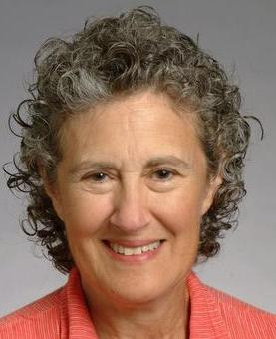
M. Castro and B. Liskov
Practical Byzantine Fault Tolerance (1999)
Miguel Castro
  PhD MIT 2001
  MSR Cambridge
Barbara Liskov
  PhD Stanford 1968
  MIT
  Distributed systems, fault tolerance, prog. languages (OOP)
  Turing Award 2008
Notes:
Emphasize practical
Zyzava? Zz? Other future work (more tentative operations but lose guarantees) --- journal version. Forshadow BAR paper? Byzantine DHT?
Don’t test performance under failure. Rodriego/ez BASE (SOSP 2001) – implements view change?
BASE using abstraction to improve fault tolerance
Byzantine Quorum systems – optimize by taking away ordering (assume no contention)
HQ replication (hybrid quorum
General comment: color with resulting systems

Slide 26
PBFT Assumptions
Asynchronous environment/ communication
  delay(t) doesn’t grow faster than t indefinitely
Independent, Byzantine node failures
  At most n-1/3 faulty
Authenticated messages
  Adversary can’t break signatures/ MACs

Slide 27
Byzantine Fault Tolerance
(Results)
(m = traitors, n = total) | Synchronous | Semi-Sync | Asynchronous
Oral Messages: Negative | n ≤ 3m [LSP80] |  | m ≥ 1 [FLP82]
Positive | n ≥ 3m+1 [LSP80]
Authenticated: Negative |  |  | m ≥ 1 [FLP82]
Positive | n ≥ 1 [LSP80] | n ≥ 3m+1 [CL99]

Slide 28
State Machine Replication
Client c
⟨Request, o, t, c⟩_{σc}
Multicast Request
(3-phase protocol)
3) ⟨Reply, v, t, c, i, r⟩_{σi}
Primary p
…
Backups i₁, …, i_{k}

Slide 29
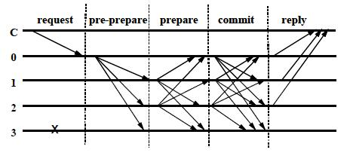
Multicast (3-phase)
  ⟨ ⟨Pre-prepare, v, n, d⟩_{σp}, m⟩
  ⟨Prepare, v, n, d, i⟩_{σi}
Successfully prepared if received
_{2m different prepared copies}
(⇒ honest agree on total ordering)
  ⟨ Commit, v, n, D(m), i⟩_{σi}
…

Slide 30
Backup Plan
(c doesn’t receive m+1 replies)
Broadcast ⟨Request, o, t, c⟩_{σc}
  Resend or
  Relay request to p
Recover
  If p multicasts continue
  Else Change View
…

Slide 31

View Change
⟨ViewChange, v+1, n, C, P, i⟩_{σi}
⟨New-View, v+1, V, O⟩_{σp}
  Signed properly?
  V valid for view v+1?
  Set O is correct?

Slide 32

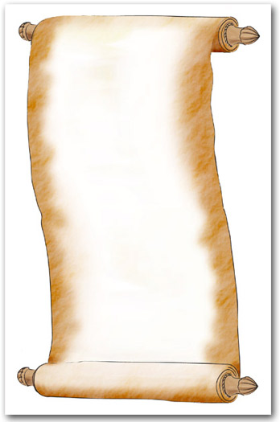

(Stable) Checkpoints
message₁
message₂
.
.
message₃
.
v
⟨Checkpt, n, d( ), i⟩_{σi}
Notes:
Stable when i receives 2m+1 valid checkpoint messages

Slide 33
BFS: A Byzantine-Fault-Tolerant
File System
Replication Library
  Client: invoke
  server: execute make_checkpoint delete_checkpoint get_digest
  get_checkpoint set_checkpoint
Relay
  Mediate comm. b/n NFS and client/replicas
snfsd
  NFS v2 daemon
  Implemented using fixed-size memory-mapped file
snfsd
replication
library
Kernel VM
Andrew
benchmark
relay
replication
library
snfsd
Kernel NFS client
replication
library
Kernel VM
Notes:
point-to-point communication using UDP - It does not implement view-change or retransmission

Slide 34
Performance
phase | BFS |  | NFS-std
 | strict | r/o lookup
1 | .55 (-69%) | .47 (-73%) | 1.75
2 | 9.24 (-2%) | 7.91 (-16%) | 9.46
3 | 7.24 (35%) | 6.45 (20%) | 5.36
4 | 8.77 (32%) | 7.87 (19%) | 6.60
5 | 38.68 (-2%) | 38.38 (-2%) | 39.35
total | 64.48 (3%) | 61.07 (-2%) | 62.52
Table 3: Andrew Benchmark (BFS vs. NFS-std)

Slide 35
Thoughts?

