Slide 1
Remote Procedure Calls
Matt Mukerjee

Slide 2
Why RPC?
Clean, familiar semantics
Distributed Systems are hard to begin with!
Efficient (?)
Generality
parallels single machine functional decomposition
Make the programmer’s life easy!
Notes:
Sun’s NFS system is based on RPC calls at the low level

Slide 3
Implementing RPC
Andrew Birrell
Xerox PARC, then DEC SRC
DEC SRC responsible for Firefly workstation
used in Bershad paper
now at Microsoft Research
Bruce Nelson
Xerox PARC, then Cisco
CMU PhD – thesis the “foundation” of RPC
ACM Software Systems award (for RPC)

Slide 4
RPC – Take Home Points
Treat cross-machine calls like local calls
Let’s make the programmer’s life easy
New Failure conditions
think Brewer’s Conjecture

Slide 5
Overview
RPC Structure
Functions
Stubs
RPCRuntime
RPC Implementation
Binding
Transport Protocol
RPC Evaluation
Issues

Slide 6
Reexamine Local Procedure Calls
A calls B
A waits for B
B does the work, returns control to A
A resumes

Slide 7
Applied to RPC
A calls B on a different machine
A waits for B, other processes run
B does the work, sends a message to A
A resumes

Slide 8
Stubs
Stubs provide:
entry-point into remote functions
functional prototypes
Stubs automatically generated

Slide 9
RPCRuntime
Handles:
retransmissions
acknowledgments
packet routing
encryption

Slide 10
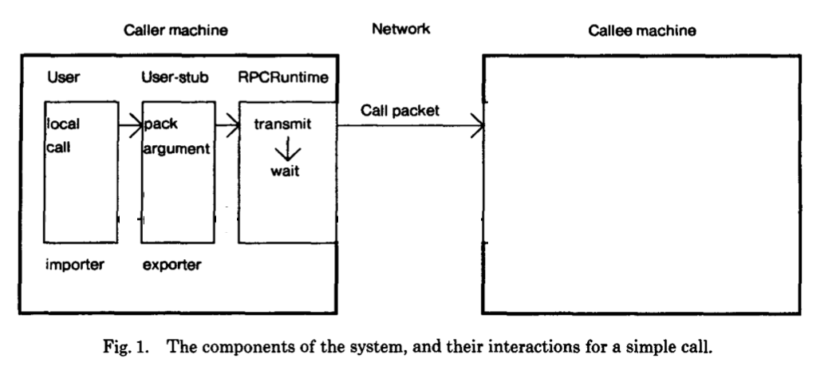
Simple Call

Slide 11
Overview
RPC Structure
Functions
Stubs
RPCRuntime
RPC Implementation
Binding
Transport Protocol
RPC Evaluation
Issues

Slide 12
Binding
Uses types and instances:
Type: mail server
Instance: mail.website.com
Uses “Grapevine” as a lookup server
Similar to DNS
Can bind by:
network address
instance name
type name
Notes:
Bind by type name could be a security issue

Slide 13
RPC Transport Protocol - Requirements
RPC mainly short messages between machines
Latency is important
Small packets with low overhead is ideal
RPC must always fail or execute exactly once
Best case:
Caller sends a call packet to server
Server does the work
sends back a result packet

Slide 14
RPC Transport Protocol – Potential Issues
If the server takes to long to respond:
it could be packet loss!
duplicate packets
Call identifier silently drop duplicate packets
But…both machines must maintain state info
Multi-packet argument case:
Clever acknowledgement system to reduce traffic
But…bad at sending bulk data

Slide 15
Overview
RPC Structure
Functions
Stubs
RPCRuntime
RPC Implementation
Binding
Transport Protocol
RPC Evaluation
Issues

Slide 16
Evaluation
Notes:
Evaluation shows times from an RPC from Machine A to Machine B back to Machine A over 3Mbps Ethernet with light background traffic
Results are hard to make meaningful as they don’t provide any “apples-to-apples” comparisons
They also don’t even measure the time it takes to export/import an interface
Time is in microseconds

Slide 17
Possible Issues
Why do some people dislike RPC?
Machine/communication failure
Overhead from lack of shared address space
Data integrity/security
Grapevine server could fail
DNS-like attack on Grapevine
Notes:
(Also, if the callee never returns, the caller will wait forever, but this is the same for a local procedure call)

Slide 18
Strengths and Weaknesses
It’s “humble”:
“There are certain circumstances in which RPC seems to be the wrong communication paradigm”
Other works not referenced, just alluded to
Benchmarks not meaningful

Slide 19
Where did RPC Go?
Hot topic in the 80’s / 90’s
All but disappeared?
Sockets, etc. caught up…
Moore’s law made it irrelevant
(M. Satyanarayanan – Coda paper)

Slide 20
Lightweight Remote Procedure Call
Brian Bershad
UW PhD, wrote SPIN, now a professor at UW
Thomas Anderson
UW PhD, tons of papers, also professor at UW
Edward Lazowska
UW Professor
Hank Levy
UW Professor, part of the DEC VAX design team
Notes:
Bershad also working at Google now (on leave)

Slide 21
LRPC – Take Home Points
RPC was pervasive
Remote calls
Local calls across “protection domains”
Simple calls with few parameters
Local communication much more frequent
Optimize it
Optimize the common case!
Treat the uncommon case differently
Notes:
Treated as though it were regular RPC very early on in the process

Slide 22
LPRC Motivation
Local RPC had awful performance
Programmers coded around it
LRPC is much faster
Programmers to design better code
Monolithic kernels have no intra-OS processes boundaries
Not secure!
Makes it hard to debug, modify, etc.
Notes:
Code is more secure, etc.
(sounds like Dijkstra’s “THE” system argument)

Slide 23
Overview
LRPC Structure
LRPC Implementation
Domain Caching
LRPC Evaluation
Wrap-up

Slide 24
LRPC Structure
Almost identical to RPC except for the focus on:
Keeping logically separate part separate
RPC does this…by having them on different machines
Keeping control transfer and stubs simple
Sharing VM (parameters) between client and server
Using concurrency
Must keep overhead low in the common case!
Notes:
Microkernels components essentially look like distributed systems to RPC

Slide 25
LRPC Implementation
Many “cute” hacks for speed:
Clients pass data to servers through VM mapping
Procedures in same interface can share “argument stacks”
Keeps “execution stacks” available in server domain
Uses “domain caching” on multiprocessor machines

Slide 26
Multiprocessor LRPC
TLB misses (from context switching) are expensive, so they use domain caching:
Eg: Processor A is idling in kernel-space
Processor B makes LRPC call from user-space to kernel-space
Instead of running in kernel-space on Processor B, the function runs on Processor A
This means no context switch!

Slide 27
Other Benefits of LRPC
Less argument copying needed
Private channel between domains
In cases where parameters are immutable even less copies can be achieved

Slide 28
Overview
LRPC Structure
LRPC Implementation
Domain Caching
LRPC Evaluation
Wrap-up

Slide 29
Evaluation

Slide 30
Evaluation
3 times faster than the built-in RPC
Not an order of magnitude difference
Gets much closer to the theoretical minimal
Multiprocessor version close to throughput cap
Multiprocessor version is scalable

Slide 31
Strengths and Weaknesses
Simple, cute hacks, better than optimized version
Comes up with secondary ideas
Domain caching
Didn’t try to port their code to other architectures
“[it] should be a straightforward task”
Argument stacks in global shared virtual memory
Doesn’t match design specifications
Lowered security

Slide 32
Performance of Firefly RPC
Basically response of the Firefly team to LRPC
Cute hacks for the remote machine case
LRPC covered the local machine case

Slide 33
RPC in the x-Kernel
Clever idea:
RPC-like system, change protocols’ layers at runtime
Change the underlying network layer (from IP to direct-to-Ethernet) at runtime

Slide 34
Discussion

