Slide 1
Extensible Kernels:
Exokernel and SPIN
Presented by Hakim Weatherspoon
(Based on slides from Edgar Velázquez-Armendáriz and Ken Birman)
Notes:
Deniz,
Hari,
Jared
Petko
Taiyen
Bo
Yin
Srivant
Robert

Slide 2
Traditional OS services – Management and Protection
Provides a set of abstractions
  Processes, Threads, Virtual Memory, Files, IPC
  Sys calls and APIs (eg: Win32, POSIX)
Resource Allocation and Management
Accounting
Protection and Security
  Concurrent execution
Notes:
Why resource management?
- resource are shared for efficiency
- fairness
- Scheduling, VM

Slide 3
Context for these papers
Researchers (mostly) were doing special purpose O/S hacks
Commercial market complaining that O/S imposed big overheads on them
O/S research community began to ask what the best way to facilitate customization might be. In the spirit of the Flux OS toolkit…

Slide 4
Problems
(examples coming-up)
Extensibility
  Abstractions overly general
  Apps cannot dictate management
  Implementations are fixed
Performance
  Crossing over into the kernel is expensive
  Generalizations and hiding information affect performance
Protection and Management offered with loss in Extensibility and Performance
Notes:
Microkernels (replaceable trusted servers, fault isolation)
- Process, address space, IPC
- same abstraction to all processes (even with trusted servers)
- is there a need to cross the protection boundary often?
Virtual Machines (multiple VMs on the same host OS)
- virtualization of hardware expensive
- virtualization can be counter-productive (apps LRU pager Vs VMM pager)

Slide 5
Need for Application controlled management (examples)
Buffer Pool Management In DBs (*)
  LRU, prefetch (locality Vs suggestion), flush (commit)
Shared Virtual Memory (+)
  use a page fault to retrieve page from disk / another processor

Slide 6
Examples (cont.)
Concurrent Checkpointing (+)
  Overlap checkpointing and program being checkpointed
  Change rights to R-only on dirty pages
  Copy each page and reset rights
  Allow reads; Use write faults to {copy, reset rights, restart}
* OS Support for Database Management (Stonebraker)
+ Virtual Memory Primitives for User Programs (Andrew W. Appel and Kai Li)

Slide 7
Examples (cont.)
Feedback for file cache block replacement
[Implementation and Performance of Application-Controlled File Caching - Pei Cao, et al.]

Slide 8
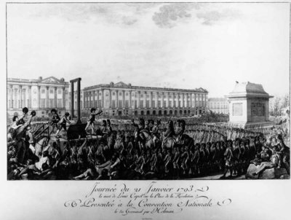
Down with monarchy!
French Revolution - Execution of Louis XVI

Slide 9
Challenges
Extensibility
Security
Performance
Can we have all 3
in a single OS?
From Stefan Savage’s SOSP 95 presentation
Notes:
Extensibility
Ability to use application specific knowledge
Security
Extensions should not compromise security. Applications should still be able to share resourses
Performance

Slide 10
Extensible Kernels
Exokernel (SOSP 1995): safely exports machine resources
  Kernel only multiplexes hardware resources (Aegis)
  Higher-level abstractions in Library OS (ExOS)
  Secure binding, Visible resource revocation, Abort
  Apps link with the LibOS of their choice
SPIN (SOSP 1995): kernel extensions (imported) safely specialize OS services
  Extensions dynamically linked into OS kernel
  Safety ensured by Programming Language facilities
Notes:
Extensibility, Safety and Performance

Slide 11
Notice difference in pt. of view
Exokernel assumes that very significant extensions to the kernel are needed in many settings and that home-brew kernels may remain common for long into the future
  Goal is to enable this sort of work while reducing risk that developer will trash the file system, debugging tools, etc
SPIN is more focused on protecting standard OS against a device driver run amok.
  Sees this as the more common need…

Slide 12
Exokernel
Dawson R. Engler, M. Frans Kaashoek and James O’Toole Jr.
Engler’s Master’s Thesis.
Follow-up publications on 1997 and 2002.
Kaashoek later worked on Corey.

Slide 13
Exokernels - Motivation
Existing Systems offer fixed high-level abstractions which is bad
  Hurt app performance (generalization – eg: LRU)
  Hide information (eg: page fault)
  Limit functionality (infrequent changes – cool ideas don’t make it through)

Slide 14
Motivation (cont.)
Separate protection from management, mgmt in user space
Apps should use domain specific knowledge to influence OS services
Small and simple kernel – adaptable and maintainable

Slide 15
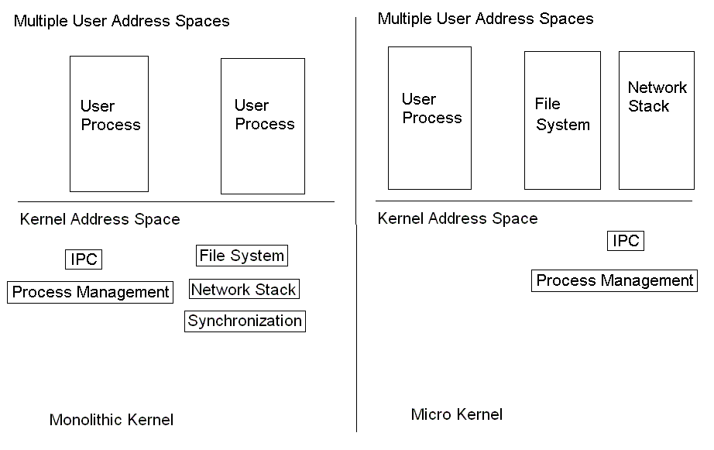
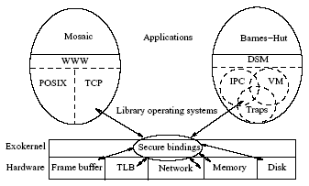
OS Component Layout
Exokernel

Slide 16
Exokernel main ideas
Kernel
  Resource sharing, not policies
Library Operating System
  Responsible for the abstractions
    IPC
    VM
    Scheduling
    Networking

Slide 17
Lib OS and the Exokernel
Lib OS (untrusted) can implement traditional OS abstractions (compatibility)
Efficient (Lib OS in user space)
Apps link with Lib OS of their choice
Kernel allows LibOS to manage resources, protects LibOss

Slide 18
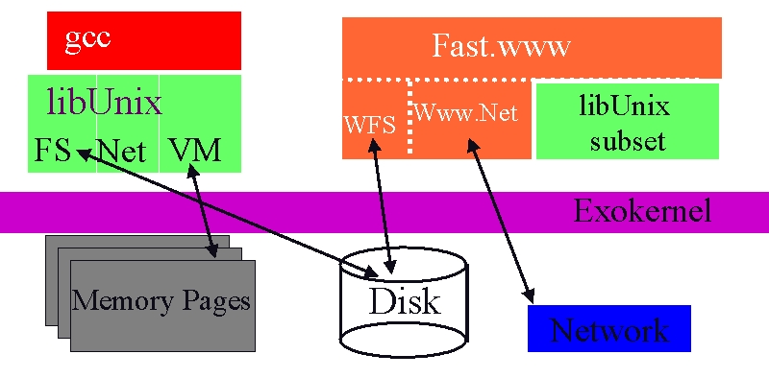
Exokernel Architecture
Exokernels. MIT CSAIL, 1998

Slide 19
Exokernel vs Microkenels vs VM
Exokernel defines only a low-level interface.
A microkernel also runs almost everything on user-level, but has fixed abstractions.
A VM emulates the whole machine, doesn’t provide direct access.

Slide 20
SPIN
University of Washington.
Brian N. Bershad, Stefan Savage, Emin Gun Sirer, Marc E. Fiuczynski, David Becker, Craig Chambers, Susan Eggers
Main ideas continue on Singularity, a C# system by MSR and U.W.

Slide 21
SPIN
Use of language features for Extensions
  Extensibility
    Dynamic linking and binding of extensions
  Safety
    Interfaces. Type safety. Extensions verified by compiler
  Performance
    Extensions not interpreted; Run in kernel space

Slide 22
SPIN structure
From Stefan Savage’s SOSP 95 presentation
Notes:
Almost all ``system'' services are extensions
-- Network protocols
-- File systems
-- System call interface
SPIN only implements services which cannot be safely implemented as extensions
-- Processor execution state
-- Basic interface to MMU and physical memory
-- Device IO/DMA
-- Dynamic linker and Dispatcher

Slide 23
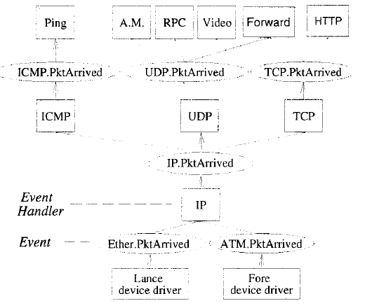
SPIN Architecture

Slide 24
SPIN main ideas
Extend the kernel at runtime through statically-checked extensions.
System and extensions written in Modula-3.
Event/handler abstraction

Slide 25
Language: Modula 3
Interfaces
Type safety
Array bounds checking
Storage Management
Threads
Exceptions

Slide 26
SPIN vs Exokernel
SPIN uses programming language facilities and communicates through procedure calls.
Uses hardware specific calls to protect without further specification.

Slide 27
Agenda
Overview
Design
  Protection
  Memory
  Sharing
  Scheduling
  network
Implementations

Slide 28
Exokernel design
Securely expose hardware
  Decouple authorization from usage
Expose allocation
Expose names
  Raw access to hardware features
Expose revocation
  “Polite” and then forcibly abort
  Repossession
Notes:
Securely expose hardware: hardware, software, download application code

Slide 29
SPIN design
Co-location
  Same memory-space as kernel
Enforces modularity
Local protection domains
  Resolves at link time
Dynamic call binding
  Event handler pattern.

Slide 30
Protection model
Capabilities
  Immutable references to resources
Protection domains
  Names accessible at an execution context
  Provided by the language
  Linking through Resolve and Combine

Slide 31
Exokernel Memory
Guard TLB loads and DMA
Large Software TLB
Library Operating System handles page faults if it’s allowed to.

Slide 32
SPIN Memory
The kernel controls allocation of physical and virtual addresses capabilities.
Extension react to page faults and error through handlers.

Slide 33
Exokernel processor sharing
Round robin allocation of slices.
Library operating system responsible for context switching.
  Can implement own scheduling policy: donate timeslice
It the time a process takes is excessive, it is killed.
Notes:
Quantum 15 ms

Slide 34
SPIN processor sharing
Based on Modula-3 threads.
Organized in strands.
Communicates through Block, Unblock, Checkpoint and Resume events.
Preemptive round-robin schedule of strands

Slide 35
Exokernel Network
Downloadable filters
Application-specific Safe Handlers
Respond directly to traffic

Slide 36
SPIN Network
Protocol stack.
Packet pulled by handlers.

Slide 37
SPIN Network

Slide 38
Agenda
Overview
Design
Implementations

Slide 39
Exokernel
DEC MIPS
Aegis: actual exokernel
  Processor
  Physical memory
  TLB
  Exceptions, Interrupts
ExOS: library operating system
  Processes, IPC, Virtual Memory, Network protocols

Slide 40
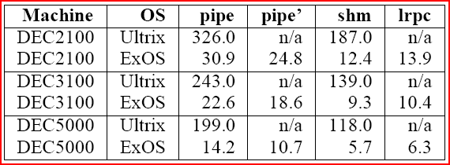
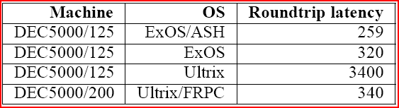
Microbenchmark results

Slide 41
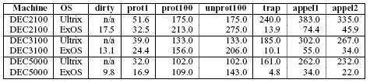
ExOS Virtual Memory
+ Fast Sys call.
- Half the time in look-up (vector).
Repeated access to Aegis STLB and ExOS PageTable
Notes:
Dirty – query if the page is dirty (user level)
Prot1 – change the protection of 1 page
100 – read [un]protect 100 pages
Trap – time to handle page-protection trap
Appel1 – access random protected page – prot (some other) + trap + unprot (faulting page)
Appel2 – prot100 + trap + unprot

Slide 42
SPIN
DEC Alpha
System components
  Sys
  Core
  Rt
  Lib
  Sal (device drivers)

Slide 43
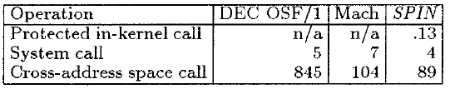
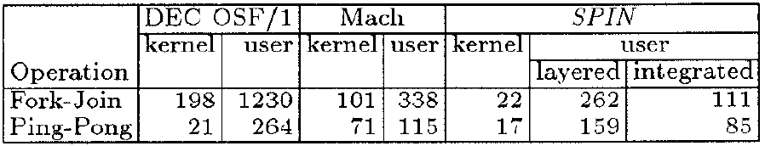
SPIN Microbenchmarks Results
IPC
Sockets, SUN RPC
Mesgs.
In-kernel Call
Thread
Mgmt
All numbers are in microseconds

Slide 44
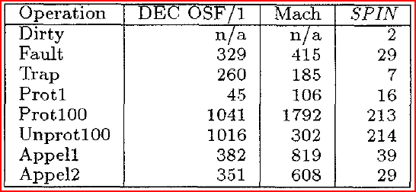
SPIN Microbenchmark Results
In-Kernel calls are more efficient than traps or messages
All numbers are in microseconds

Slide 45
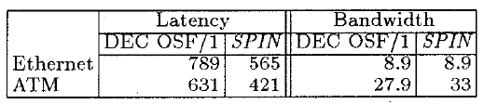
Performance: Networking
Lower RTT because of in-kernel extension
time in microseconds, Bandwidth in Mbps

Slide 46
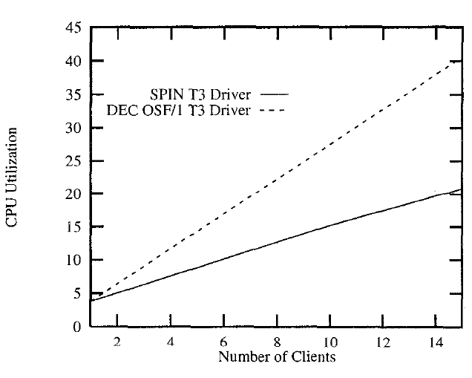
End-to-End Performance
Networked Video
Server CPU utilization
(network interface supports DMA)

Slide 47
Issues
Dispatcher scalability
Handler scheduling
Garbage collection

Slide 48
Perspective
Extensible kernels are actually fast.
End-to-end arguments.
Efficient implementations.
High level languages are not terrible!
Extensibility without loss of security or performance
  Exokernels
    Safely export machine resources
    Decouple protection from management
  SPIN
    kernel extensions (imported) safely specialize OS services
    Safety ensured by Programming Language facilities

Slide 49
Next Time
Read and write review:
  Disco: Running Commodity Operating Systems on Scalable Multiprocessors, Bugnion et al. 16th SOSP, 1997
  Tornado: maximizing locality and concurrency in a shared memory multiprocessor operating system, Gamsa et al. 3rd OSDI, Feb 1999.

Slide 50
Next Time
Read and write review:
Project Proposal
  Return comments later today
Project Survey Paper due next Thursday
Check website for updated schedule

