Slide 1
System Design
Presented by Hakim Weatherspoon

Slide 2
System design
complex act
less precisely defined, changing requirements
Choices
  Affects future choices
  Affects system-wide performance
    But how? Hard to predict during design phase

Slide 3
End-to-End arguments in System Design – Jerry H. Saltzer, David P. Reed, David D. Clark
Background of authors at MIT
Jerry H. Saltzer
  A leader of Multics, key developer of the Internet, and a LAN (local area network) ring topology, project Athena
David P. Reed
  Early development of TCP/IP, designer of UDP
David D. Clark
  I/O of Multics, Protocol architect of Internet
    “We reject: kings, presidents and voting.
    We believe in: rough consensus and running code.”
Notes:
Project Athena was a joint project of MIT, Digital Equipment Corporation, and IBM to produce a campus-wide distributed computing environment for educational use

Slide 4
End-to-End arguments in System Design – Jerry H. Saltzer, David P. Reed, David D. Clark
Helps guide function placement among modules of a distributed system
Argument
  can the higher layer implement the functionality it needs?
    if yes - implement it there, the app knows it's needs best
  implement the functionality in the lower layer only if
    A) a large number of higher layers / applications use this functionality and implementing it at the lower layer improves the performance of many of them AND
    B) does not hurt the remaining applications
Notes:
The principle states that, whenever possible, communications protocol operations should be defined to occur at the end-points of a communications system, or as close as possible to the resource being controlled.
According to the end-to-end principle, protocol features are only justified in the lower layers of a system if they are a performance optimization,

Slide 5
Example : File Transfer (A to B)
6. Route packet
A
4. Pass msg/packet down the protocol stack
5. Send the packet over the network
B
Read File Data blocks
App buffers File Data
Pass (copy) data to the
network subsystem

Slide 6
Example : File Transfer
A
7. Receive packet and buffer msg.
8. Send data to the application
B
9. Store file data blocks

Slide 7
Possible failures
Reading and writing to disk
Transient errors in the memory chip while buffering and copying
network might drop packets, modify bits, deliver duplicates
OS buffer overflow at the sender or the receiver
Either of the hosts may crash

Slide 8
Solutions?
Make the network reliable
  Packet checksums, sequence numbers, retry, duplicate elimination
  Solves only the network problem.
  What about the other problems listed?
  War story: Byte swapping problem while routing @ MIT
Not sufficient and not necessary

Slide 9
Solutions?
Introduce file checksums and verify once transfer completes – end-to-end check.
  On failure – retransmit file.

Slide 10
Solutions? (cont.)
network level reliability would improve performance.
  But this may not benefit all applications
    Huge overhead for say Real-Time speech transmission
    Need for optional layers
Checksum parts of the file.

Slide 11
Formally stated
"The function in question can completely and correctly be implemented only with the knowledge and help of the application standing at the end points of the communication system. Therefore, providing that questioned function as a feature of the communication system itself is not possible. (Sometimes an incomplete version of the function provided by the communication system may be useful as a performance enhancement.)"

Slide 12
Other end-to-end requirements
Delivery guarantees
  Application level ACKs
    Deliver only if action guaranteed
    2 phase commit
    NACKs
End-to-end authentication
Duplicate msg suppression
  Application level retry results in new n/w level packet

Slide 13
TCP/IP
Internet Protocol
  IP is a simple ("dumb"), stateless protocol that moves datagrams across the network, and
Transmission Control Protocol
  TCP is end-to-end.
  It is a smart transport protocol providing error detection, retransmission, congestion control, and flow control end-to-end.
The network
  The network itself (the routers) needs only to support the simple, lightweight IP; the endpoints run the heavier TCP on top of it when needed.

Slide 14
Is argument complete?
E.g. congestion control
  TCP leaves it to the ends
    Should the network trust the ends?
      RED
    In a wireless setting
      packet loss != congestion
performance problems may appear in end-end systems under heavy load
Performance enhancing Proxies
Notes:
Performance enhancing proxies

Slide 15
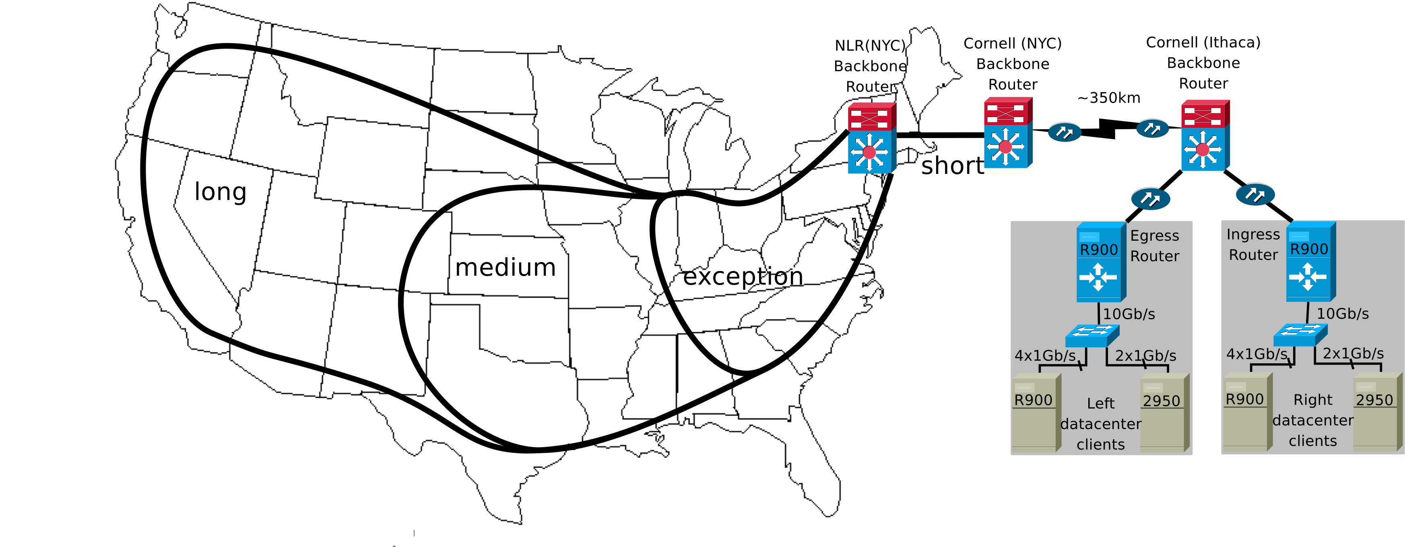
Cornell NLR Rings testbed

Slide 16
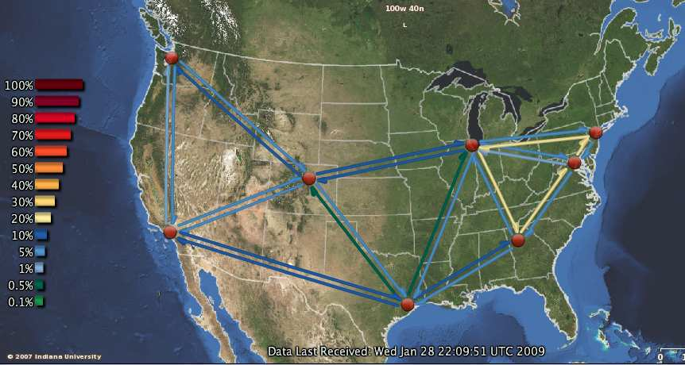
Cornell NLR Rings testbed

Slide 17
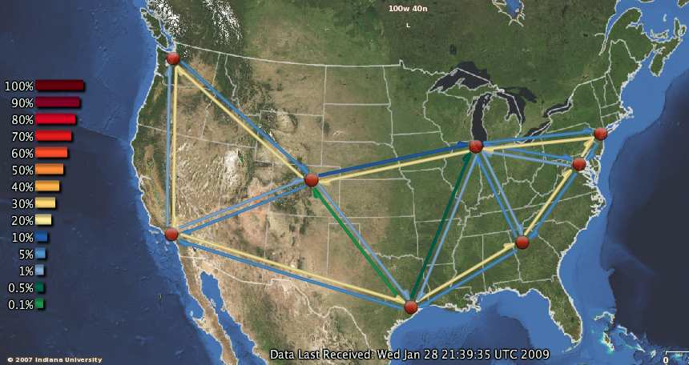
Cornell NLR Rings testbed

Slide 18
Hints for Computer System Design - Butler Lampson
Related to end-to-end argument—guidance for developer
But a collection of experience and wisdom
  Use a hints

Slide 19
Butler Lampson - Background
Founding member of Xerox PARC (1970), DEC (1980s), MSR (current)
ACM Turing Award (1992)
Laser printer design
PC (Alto is considered first actual personal computer)
Two-phase commit protocols
Bravo, the first WYSIWYG text formatting program
Ethernet, the first high-speed local area network (LAN)

Slide 20
Some Projects & Collaborators
Charles Simonyi - Bravo: WYSIWYG editor (MS Office)
Bob Sproull - Alto operating system, Dover: laser printer, Interpress: page description language (VP Sun/Oracle)
Mel Pirtle - 940 project, Berkeley Computer Corp.
Peter Deutsch - 940 operating system, QSPL: system programming language (founder of Ghostscript)
Chuck Geschke, Jim Mitchell, Ed Satterthwaite - Mesa: system programming language

Slide 21
Some Projects & Collaborators (cont.)
Roy Levin - Wildflower: Star workstation prototype, Vesta: software configuration
Andrew Birrell, Roger Needham, Mike Schroeder - Global name service and authentication
Eric Schmidt - System models: software configuration
(CEO/Chairman of Google)
Rod Burstall - Pebble: polymorphic typed language

Slide 22
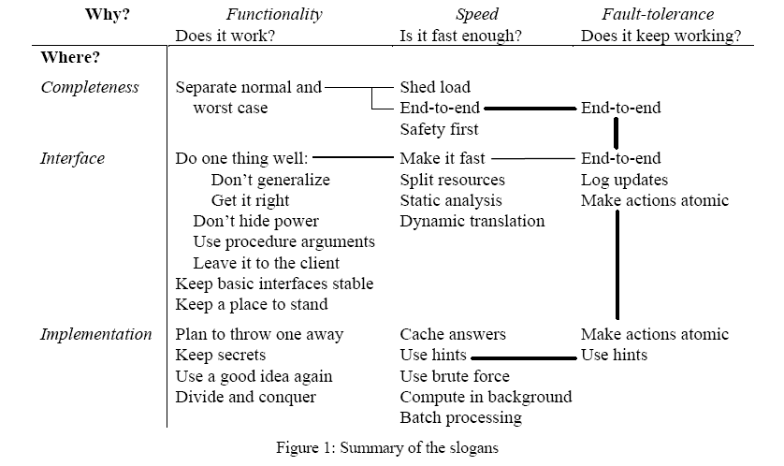
Hints for Computer System Design - Butler Lampson

Slide 23
Functionality
Interface – Contract
  separates implementation from client using abstraction
  Eg: File (open, read, write, close)
Desirable properties
  Simple
  Complete
  Admit small and fast impl.

Slide 24
Simplicity
Interfaces
  Avoid generalizations
    too much = large, slow and complicated impl.
    Can penalize normal operations
      PL/1 generic operations across data types
  Should have predictable (reasonable) cost.
    eg: FindIthField [O(n)], FindNamedfield [O(n^2)]
  Avoid features needed by only a few clients

Slide 25
Functionality Vs Assurance
As a system performs more (complex interface) assurance decreases.

Slide 26
Example
Tenex System
  reference to an unassigned page -> trap to user program
  arguments to sys calls passed by reference
  CONNECT(string passwd) -> if passwd wrong, fails after a 3 second delay
  CONNECT
    for i := 0 to Length(directoryPassword) do
    if directoryPassword[i] != passwordArgument[i] then
    Wait three seconds; return BadPassword
    end if
    end loop;
    connect to directory; return Success

Slide 27
Breaking CONNECT(string passwd)
Assigned Page
Unassigned Page
A
B
Bad Passwd
Invalid page

Slide 28
Breaking CONNECT(string passwd)
Worst case
128*n tries as opposed to 128^n tries
n = passwd length (bytes)
Assigned Page
Unassigned Page
B
A
Z
Bad Passwd
Invalid page

Slide 29
Functionality (cont.)
basic (fast) operations rather than generic/powerful (slow) ones
  Pay for what you want
  RISC Vs CISC
  Unix Pipe
    grep –i 'spock' * | awk -F: '{print $1}' | sort | uniq | wc –l
Use timing tools (80% of the time in 20% of code)
  Avoid premature optimization
    May be useless and/or expensive
  analyze usage and optimize heavily used I/Fs

Slide 30
Avoid abstracting-out desirable properties
  “don't hide power”
  Eg: Feedback for page replacement
  How easy is it to identify desirable properties?
Procedure arguments
  filter procedure instead of a complex language with patterns.
    static analysis for optimization - DB query lang
  failure handlers
  trust?

Slide 31
Continuity
Interfaces
  Changes should be infrequent
    Compatibility issues
  Backward compatibility on change
Implementation
  Refactor to achieve “satisfactory” (small, fast, maintainable) results
  Use prototyping

Slide 32
Implementation
Keep secrets
  Impl. can change without changing contract
  Client could break if it uses Impl. details
  But secrets can be used to improve performance
    finding the balance an art?
Divide and conquer
Reuse a good idea in different settings
  global replication using a transactional model
    local replication for reliably storing transactional logs.

Slide 33
Completeness - handling all cases
Handle normal and worst case separately
  normal case – speed, worst case – progress
  Examples
    caches
    incremental GC
      trace-and-sweep (unreachable circular structures)
    piece-table in the Bravo editor
      Compaction either at fixed intervals or on heavy fragmentation
  “emergency supply” helps in worst-case scenarios

Slide 34
Speed
Split resources in a fixed way
  rather than share and multiplex
  faster access, predictable allocation
  Safety instead of optimality
    over-provisioning ok, due to cheap hardware
Use static analysis where possible
  dynamic analysis as a fallback option
  Eg: sequential storage and pre-fetching based on prior knowledge of how data is accessed
Notes:
Resources - memory, disk, network b/w, processor time

Slide 35
Speed (cont.)
Cache answers to expensive computations
  x, f => f(x)
  f is functional.
Use hints!
  may not reflect the "truth" and so should have a quick correctness check.
  Routing tables
  Ethernet (CSMA/CD)

Slide 36
Speed (cont.)
Brute force when in doubt
  Prototype and test performance
  Eg: linear search over a small search space
  Beware of scalability!
Background processing (interactive settings)
  GC
  writing out dirty pages, preparing pages for replacement.
Shed load
  Random Early Detection
  Bob Morris' red button

Slide 37
Fault Tolerance
End-to-end argument
  Error recovery at the app level essential
  Eg: File transfer
Log updates
  Replay logs to recover from a crash
  form 1: log <name of update proc, arguments>
    update proc must be functional
    arguments must be values
  form 2: log state changes.
    idempotent (x = 10, instead of x++)
Make actions atomic
  Aries algorithm - Atomicity and Durability

Slide 38
Conclusions
Remember these are “hints” from a Guru
Reuse good ideas, but not blindly.
Your experiences

Slide 39
Next Time
Read and write review:
  The UNIX time-sharing system, Dennis M. Ritchie and Ken Thompson. Communications of the ACM Volume 17, Issue 7, July 1974, pages 365 -- 375
  The structure of the "THE"-multiprogramming system, E.W. Dijkstra. Communications of the ACM Volume 11, Issue 5, May 1968, pages 341--346
Do Lab 0
Check website for updated schedule

