Slide 1



Multicast
Qi Huang
CS6410 2009 FA
10/29/09

Slide 2

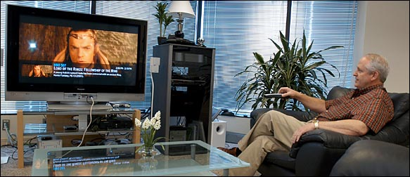

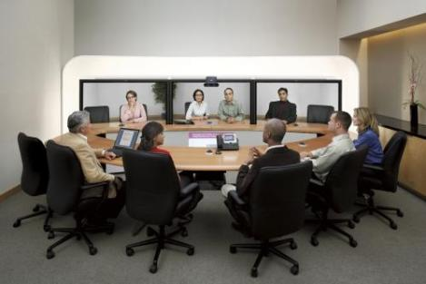
What is multicast?
Basic idea: same data needs to reach a set of multiple receivers
Application:
Notes:
What is multicast? Basically, the idea is simple: some data needs to be sent to multiple receivers. This technology is very useful for many applications, like IPTV, in which TV content needs to be multicast to televisions. Like stock market, the stock quotes should be sent to investors interested in them. We can also count many other popular usage including video conferencing, multiplayer online games, etc.

Slide 3


Why not just unicast?
Unicast
How about using unicast?
Sender’s overhead grows linearly with the group size
Bandwidth of sender will exhaust
Notes:
How does multicast work? Here is a case, we have a sender and three receivers. First, an apparent way is using unicast directly from the sender. But then, with the increasing number of receivers, bandwidth consumption and sending overhead will also increase linearly, which is not scalable.

Slide 4

How does multicast work?
Use intermediate nodes to copy data
Notes:
So, multicast use intermediate nodes to copy the data from sender, shifting the load away from a single point.

Slide 5

How does multicast work?
IP multicast (IPMC)
  Use router to copy data on the network layer, Deering proposed in 1990
Notes:
If we use network layer device, router to copy the data between sender and receivers. It is called IP multicast. Deering poposed IPMC in 1990.

Slide 6
How does multicast work?
Application layer multicast (ALM)
  Use proxy node or end host to copy data on application layer,
Notes:
There is also another way of multicast, using an application layer software, either a proxy server, or the receiver itself to copy the data. We call it application layer multicast.

Slide 7
State of the art
IPMC is disabled in WAN
  Performance issues (Karsruhe, Sigcomm)
  Feasibility issues
  Desirability issues
  Efficient in LAN
ALM has emerged as an option
  Easy to deploy and maintain
  Based on internet preferred unicast
  No generic infrastructure
Notes:
Let us take a look at the state of the art of multicast.
Since day one, IPMC has been dogged by scalability problems. Other than degrading unicast performance, feasibility and desirability issues also leads IPMC to be banned in WAN.
Feasibility: complexity of managing, deployment
Desirability: undesirable fate sharing among mutually distrustful ISP.
In the other hand, ALM has emerged as a main option.

Slide 8
Research focus
Scalability
  Scale with group size
  Scale with group number
Reliability
  Atomicity multicast
  Repair best-effort multicast
Trade-off is decided by the application scenarios
Notes:
Research work on multicast can mainly drop in two lines, scalability and reliability. For different application scenarios, multicast is required for different level of scalability and reliability.

Slide 9
Agenda
Bimodal Multicast
  ACM TOCS 17(2), May 1999
SplitStream: High-Bandwidth Multicast in Cooperative Environments
  SOSP 2003
Notes:
Two papers we will talk about today:

Slide 10


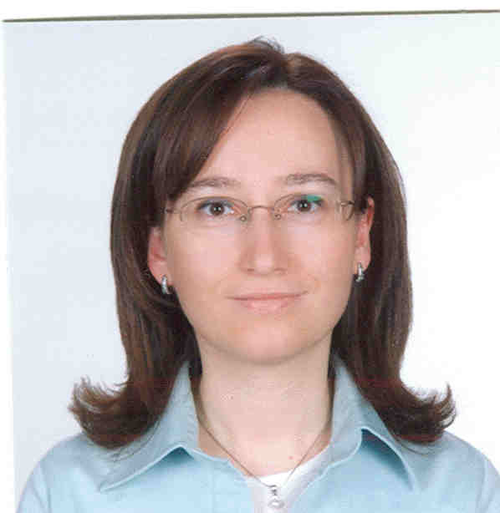



Bimodal Multicast
Ken Birman
Cornell University
Mark Hayden
Digital Research Center
Oznur Ozkasap
Koç University
Zhen Xiao
Peking University
Mihai Budiu
Microsoft Research
Yaron Minsky
Jane Street Capital
Notes:
Ken has worked in the reliably multicast for twenty years, building several famous systems including Isis, Horus and Ensemble, proposing idea of Virtual Synchrony, and this Bimodal multicast.

Slide 11
Application scenario
Bimodal Multicast
Stock exchange, air traffic control
needs:
  Reliability of critical information transmission
  Prediction of performance
  100x scalability under high throughput

Slide 12
Outline
Bimodal Multicast
Problem
Design
Analysis
Experiment
Conclusion
Notes:
Two papers we will talk about today:

Slide 13
Problem
Bimodal Multicast
Virtual Synchrony
  Offer strong relialbility guarantee
Scalable Reliable Multicast (SRM)
  Best effort reliability, scale better
Costly overhead, can not scale under stress
Not reliable, repair can fail under bigger group size and heavy load
Let’s see how these happen:

Slide 14

Problem
Bimodal Multicast
Virtual Synchrony
  Under heavy load, some one may be slow
Most members are healthy….
… but one is slow
i.e. something is contending with the receiver,
delaying its handling of incoming messages…
Notes:
For Virtual Synchrony, some time, some process may have contention problem and thus can be late responsive, but not failed.

Slide 15
Problem
Bimodal Multicast
Virtual Synchrony
  Slow receiver can collapse the system throughput
Virtually synchronous Ensemble multicast protocols
250
group size: 32
group size: 64
group size: 96
200
32
150
average throughput on nonperturbed members
100
96
50
0
0
0.1
0.2
0.3
0.4
0.5
0.6
0.7
0.8
0.9
perturb rate
Notes:
Increasing the perturb rate of slow process, average throughput of the whole system can collapse! And, the bigger the group, the worse the case can be.

Slide 16
Problem
Bimodal Multicast
Virtual Synchrony (reason?)
  Data for the slow process piles up in the sender’s buffer, causing flow control to kick in (prematurely)
  More sensitive failure detector mechanism will rise the risk of erroneous failure classification
Notes:
Why?

Slide 17
Problem
Bimodal Multicast
SRM
  Lacking knowledge of membership, SRM’s NACK and retransmission is multicast
  As the system grows large the “probabilistic suppression” fails (absolute likelihood of mistakes rises, causing the background overhead to rise)
Notes:
Then, how about the other kind of multicast, like SRM?
Some research work has proved SRM’s throughput will degrade with the network noise and increasing group size.
Reasons are:
1st. NACK and retransmission can be duplicated through multicast
2nd. Bigger group size increase the absolute likelihood of mistakes risk, which are prevent through probabilistic suppresstion.

Slide 18
Design
Bimodal Multicast
Two step multicast
  Optimistic multicast to disseminate message unreliably
  Use two-phase anti-entropy gossip to repair
Benefits
  Knowlege of membership achieves better repair control
  Gossip provides:
    Ligher way of detecting loss and repair
    Epidemic model to predict performance

Slide 19
Design
Bimodal Multicast
Start by using unreliable multicast to rapidly distribute the message. But some messages may not get through, and some processes may be faulty. So initial state involves partial distribution of multicast(s)
Notes:
How does bimodal mutlicast works?

Slide 20
Design
Bimodal Multicast
Periodically (e.g. every 100ms) each process sends a digest describing its state to some randomly selected group member. The digest identifies messages. It doesn’t include them.

Slide 21
Design
Bimodal Multicast
Recipient checks the gossip digest against its own history and solicits a copy of any missing message from the process that sent the gossip

Slide 22
Design
Bimodal Multicast
Processes respond to solicitations received during a round of gossip by retransmitting the requested message. The round lasts much longer than a typical RPC time.

Slide 23
Design
Bimodal Multicast
Deliver a message when it is in FIFO order
Garbage collect a message when you believe that no “healthy” process could still need a copy (we used to wait 10 rounds, but now are using gossip to detect this condition)
Match parameters to intended environment
Notes:
Pbcast also has several other mechanisms to assure message ordering, garbage collection.

Slide 24
Design
Bimodal Multicast
Worries
  Someone could fall behind and never catch up, endlessly loading everyone else
  What if some process has lots of stuff others want and they bombard him with requests?
  What about scalability in buffering and in list of members of the system, or costs of updating that list?

Slide 25
Design
Bimodal Multicast
Optimization
  Request retransmissions most recent multicast first
  Bound the amount of data they will retransmit during any given round of gossip.
  Ignore solicitations that have expired round number, reasoning that they are from faulty nodes

Slide 26
Design
Bimodal Multicast
Optimization
  Don’t retransmit duplicate message
  Use IP multicast when retransmitting a message if several processes lack a copy
    For example, if solicited twice
    Also, if a retransmission is received from “far away”
    Tradeoff: excess messages versus low latency
  Use regional TTL to restrict multicast scope

Slide 27
Analysis
Bimodal Multicast
Use epidemic theory to predict the performance
Either sender fails…
… or data gets through w.h.p.

Slide 28
Analysis
Bimodal Multicast
Failure analysis
  Suppose someone tells me what they hope to “avoid”
  Model as a predicate on final system state
  Can compute the probability that pbcast would terminate in that state, again from the model

Slide 29
Analysis
Bimodal Multicast
Two predicates
  Predicate I: More than 10% but less than 90% of the processes get the multicast
  Predicate II: Roughly half get the multicast but crash failures might “conceal” outcome
  Easy to add your own predicate. Our methodology supports any predicate over final system state

Slide 30
Analysis
Bimodal Multicast
Figure 5: Graphs of analytical results

Slide 31
Experiment
Bimodal Multicast
Src-dst latency distributions
Notice that in practice, bimodal multicast is fast!

Slide 32
Experiment
Bimodal Multicast
Revisit the problem figure, 32 processes

Slide 33
Experiment
Bimodal Multicast
Throughput with various scale

Slide 34
Experiment
Bimodal Multicast
Impact of packet loss on reliability and retransmission rate
Notice that when network becomes overloaded, healthy processes experience packet loss!

Slide 35
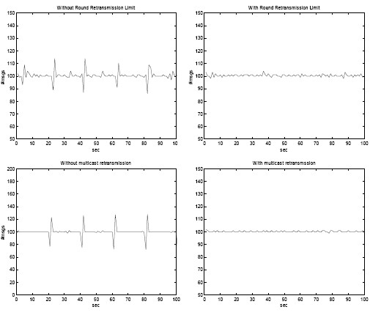
Experiment
Bimodal Multicast
Optimization

Slide 36
Conclusion
Bimodal Multicast
Bimodal multicast (pbcast) is reliable in a sense that can be formalized, at least for some networks
  Generalization for larger class of networks should be possible but maybe not easy
Protocol is also very stable under steady load even if 25% of processes are perturbed
Scalable in much the same way as SRM

Slide 37






Splitstream
Miguel Castro
Microsoft Research
Peter Druschel
MPI-SWS
Anne-Marie Kermarrec
INRIA
Animesh Nandi
MPI-SWS
Antony Rowstron
Microsoft Research
Atul Singh
NEC Research Lab

Slide 38
Applicatoin scenario
P2P video streaming, needs:
  Capacity-aware bandwidth utilization
  Latency-aware overlay
  High tolerance of network churn
  Load balance for all the end hosts

Slide 39
Outline
SplitStream
Problem
Design (with background)
Experiment
Conclusion

Slide 40
Problem
SplitStream
Tree-based ALM
  High demand on few internal nodes
  Cooperative environments
  Peers contribute resources
  We don't assume dedicated infrastructure
  Different peers may have different limitations

Slide 41
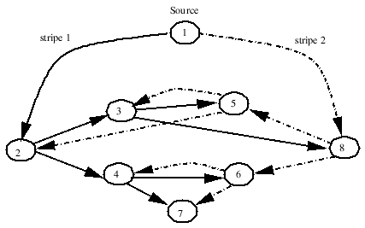
Design
SplitStream
Split data into stripes, each over its own tree
Each node is internal to only one tree
Built on Pastry and Scribe

Slide 42
Background
SplitStream
Pastry
Row 0
Row 1
Row 2
Row 3
log₁₆ N
rows

Slide 43
Background
SplitStream
Pastry
d471f1
d467c4
d462ba
d46a1c
d4213f
Route(d46a1c)
d13da3
65a1fc

Slide 44
Background
SplitStream
Scribe
topicId
Publish
Subscribe topicId

Slide 45
Design
SplitStream
Stripe
  SplitStream divides data into stripes
  Each stripe uses one Scribe multicast tree
  Prefix routing ensures property that each node is internal to only one tree
    Inbound bandwidth: can achieve desired indegree while this property holds
    Outbound bandwidth: this is harder—we'll have to look at the node join algorithm to see how this works

Slide 46
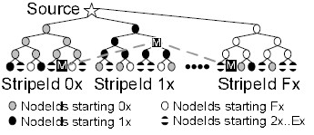
Design
SplitStream
Stripe tree initialize
  # of strips = # of Pastry routing table columns
  Scribe's push-down fails in Splitstream

Slide 47
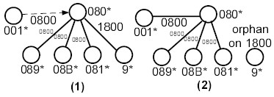
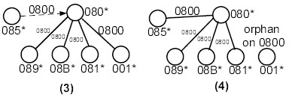
Design
SplitStream
Splitstream push-down
  The child having less prefix match between node ID and stripe ID will be push-down to its sibling

Slide 48
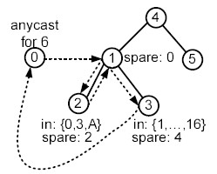
Design
SplitStream
Spare capacity group
  Organize peers with spare capacity as a Scribe tree
  Orphan nodes anycast in the spare capacity group to join

Slide 49
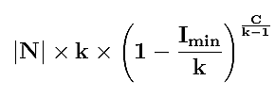
Design
SplitStream
Correctness and complexity
  Node may fail to join a non prefix maching tree
  But the failure of forest construction is unlikely

Slide 50
Design
SplitStream
Expected state maintained by each node is O(log|N|)
Expected number of messages to build forest is O(|N|log|N|) if trees are well balanced and O(|N|²) in the worst case
Trees should be well balanced if each node forwards its own stripe to two other nodes

Slide 51
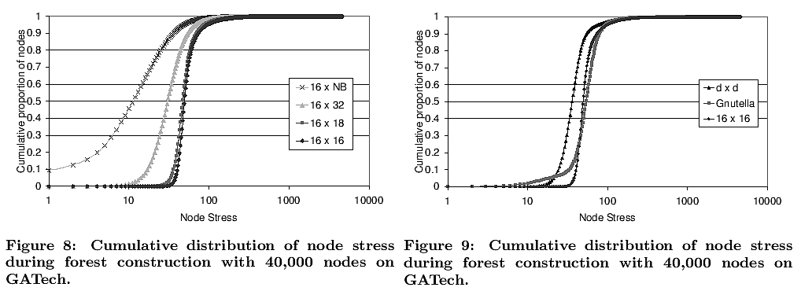
Experiment
SplitStream
Forest construction overhead

Slide 52
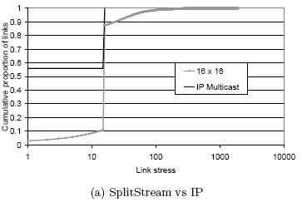
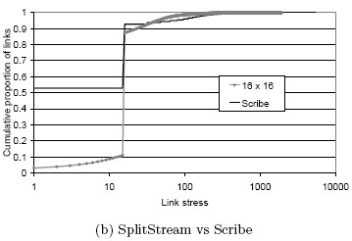
Experiment
SplitStream
Multicast performance

Slide 53
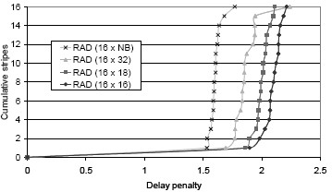
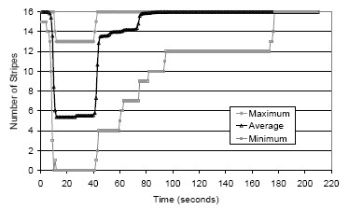
Experiment
SplitStream
Delay and failure resilience

Slide 54
Conclusion
SplitStream
Striping a multicast into multiple trees provides:
  Better load balance
  High resilience of network churn
  Respect of heteogeneous node bandwidth capacity
Pastry support latency aware and cycle free overlay construction

Slide 55
Discussion
Flaws of Bimodal multicast
  Relying on IP multicast may fail
  Tree multicast is load unbalanced and churn vulnarable
Flaws of Splitstream
  Network churn will introduce off-pastry link between parent and child, thus loose the benefit of pastry [from Chunkyspread]
  ID-based constrains is stronger than load constrains

