Slide 1
Network
Haoyuan Li
CS 6410 Fall 2009
10/15/2009

Slide 2
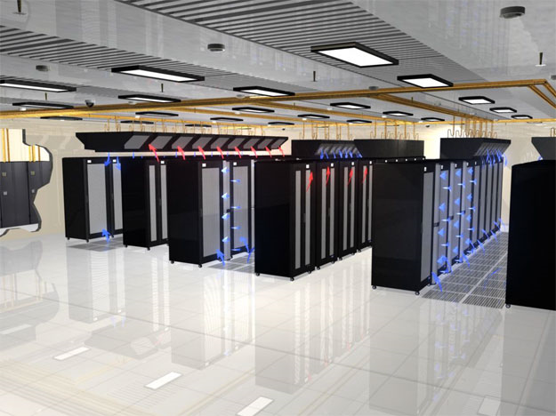
Data Center Arms Race
Notes:
The serene countryside around the Columbia River in the northwestern United States has emerged as a major, and perhaps unexpected, battleground among Internet powerhouses. That’s where Google, Microsoft, Amazon, and Yahoo have built some of the world’s largest and most advanced computer facilities: colossal warehouses packed with tens of thousands of servers that will propel the next generation of Internet applications. Call it the data center arms race. This is the first paragraph from a article written by Randy Katz published in February 2009 on IEEE spectrum. Inside of these data centers, high bandwidth with low latency communication among nodes is very critical from every perspective. What can guarantee this?

Slide 3
System Area Network
SAN
Notes:
Here, we introduce our first term today: System area network, SAN for short. A system area network is a high-performance, connection-oriented network that can link a cluster of computers. A SAN delivers high bandwidth (1 Gbps or greater) with low latency. It is typically switched by hubs that support eight or more nodes. The cable lengths between nodes on a SAN range from a few meters to a few kilometers. However, what’s the industry standard to support this?

Slide 4


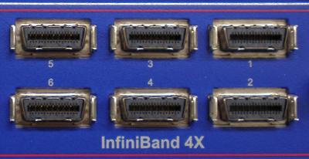

SAN
Virtual Interface Architure
VIA
Notes:
In order to answer this question, we have to show our second term: Virtual Interface Architecture, VIA for short.
The original VIA was created by Microsoft, Intel, and Compaq. It is the industry effort to standardize communication paradigms for System Area Network.
It is an abstract model of a user-level zero-copy network, and is the basis for InfiniBand and iWARP.
Its design focuses on providing low-latency, high-bandwidth, end-to-end communication of two processes in the cluster. To achieve this aim, VIA defines a set of functions, data structures and associated semantics to access network interface directly, bypassing the operating system in a fully protected fashion.
VIA was hugely influenced by one of our two papers we are going to talk about today

Slide 5
Agenda
U-Net: A User-Level Network Interface for Parallel and Distributed Computing
Thorsten von Eicken, Anindya Basu, Vineet Buch, and Werner Vogels
Active Messages: a Mechanism for Integrated Communication and Computation
Thorsten von Eicken, David E. Culler, Seth Copen Goldstein, and Klaus Erik Schauser
Notes:
U-Net: A User-Level Network Interface for Parallel and Distributed Computing, which is kind of successive work of another paper: Active Messages: a Mechanism for Integrated Communication and Computation

Slide 6
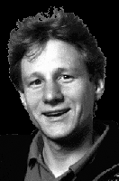




Authors’ fact
Thorsten von Eicken
Werner Vogels
David E. Culler
Seth Copen Goldstein
Klaus Erik Schauser
Notes:
Before getting into real stuff, let’s talk about some authors’ fact here.
The first author of two papers, Thorsten von Eicken, got Ph.D. from UC Berkeley, where he did the older paper. Later on, he joined Cornell, and got tenure by the U-Net paper. Then, he went to industry to serve as Chief Architect at Expertcity.com I designed and developed significant parts of the GoToMyPC, GoToAssist, GoToMeeting, and GoToWebinar products. Expertcity was acquired by Citrix Systems in 2004 and is now the Citrix Online division.
Werner Vogels was a research scientist at our department from 1994 to 2004. Then he joined industry and now he is CTO and Vice President of Amazon, in charge of driving technology innovation within the company.
David is a professor at UC Berkeley. Seth is a professor at CMU. And Klaus is a professor at UCSB.

Slide 7
U-Net: A User-Level Network Interface for Parallel and Distributed Computing
Notes:
OK. Let’s get into our first paper: U-Net: A User-Level Network Interface for Parallel and Distributed Computing

Slide 8
Outline
Motivation
Design
Implementation
SBA-100
SBA-200
Evaluation
Active Messages
Split-C
IP Suite
Conclusion

Slide 9
Outline
Motivation
Design
Implementation
SBA-100
SBA-200
Evaluation
Active Messages
Split-C
IP Suite
Conclusion

Slide 10
Motivation
Processing Overhead
Fabrics bandwidth vs. Software overhead
Flexibility
Design new protocol
Small Message
Remote object executions
Cache maintaining messages
RPC style client/server architecture
Economic driven
Expensive multiprocessors super computers with custom network design
vs.
Cluster of standard workstations connected by off-the-shelf communication hardware
Notes:
The increased availability of high-speed local area networks has shifted the bottleneck in local-area communication from the limited bandwidth of network fabrics to the software path traversed by messages at the sending and receiving ends. In particular, in a traditional UNIX networking architecture, the path taken by messages through the kernel involves several copies and crosses multiple levels of abstraction between the device driver and the user application. The resulting processing overheads limit the peak communication bandwidth and cause high end-to-end message latencies. The effect is that users who upgrade from Ethernet to a faster network fail to observe an application speed-up commensurate with the improvement in raw network performance.
Many new application domains could benefit not only from higher network performance but also from a more flexible interface to the network. By placing all protocol processing into the kernel the traditional networking architecture cannot easily support new protocols or new message send/receive interfaces. Integrating application specific information into protocol processing allows for higher efficiency and greater flexibility in protocol cost management. For example, the transmission of MPEG compressed video streams can greatly benefit from customized retransmission protocols which embody knowledge of the real-time demands as well as the interdependencies among video frames.
The communication bandwidth of a system is often measured by sending a virtually infinite stream from one node to another. While this may be representative of a few applications, the demand for high bandwidths when sending many small messages(e.g., a few hundred bytes) is increasing due to the same trends that demand low latencies. U-Net specifically targets this segment of the network traffic and attempts to provide full network bandwidth with as small messages as possible, mainly by reducing the per-message overheads.

Slide 11
U-Net Design goal
Provide low-latency communication in local area setting
Exploit the full network bandwidth even with small message
Facilitate the use of novel communication protocols
All built on CHEAP hardware!

Slide 12
Outline
Motivation
Design
Implementation
SBA-100
SBA-200
Evaluation
Active Messages
Split-C
IP Suite
Conclusion

Slide 13
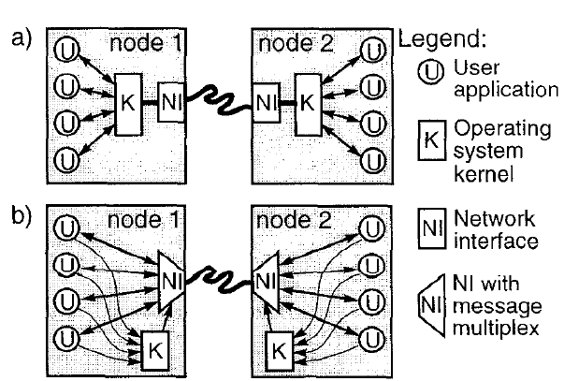
Traditional networking architecture VS. U-Net architecture
Notes:
From the picture, we can see that in Traditional networking architecture….
However, in U-Net architecture:
Virtualize N/W device so that each process has illusion of owning NI
Mux/ Demuxing device virtualizes the NI
Offers protection!
Kernel removed from critical path, placing entire protocol stack at user level, allowing protected user-level access to network
Kernel involved only in setup

Slide 14
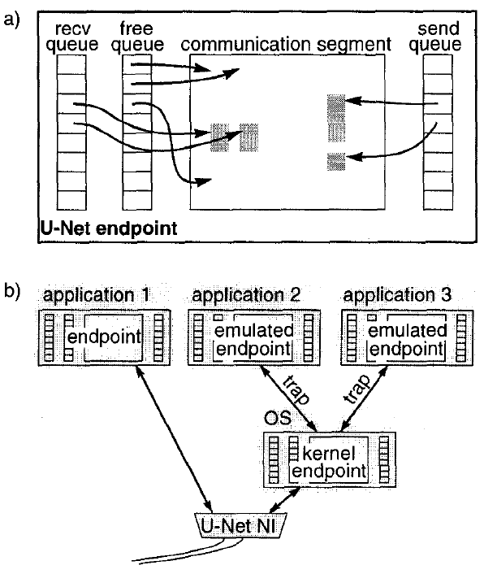
U-Net architecture
Communication Segments
Send queue
Receive Queue
Free Queue
Notes:
The U-Net architecture is composed of three main building blocks, shown in Figure 2: endpoints serve as an application’s handle into the network and contain communication segments which are regions of memory that hold message data, and message queues which hold descriptors for messages that are to be sent or that have been received. Each process that wishes to access the network first creates one or more endpoints, then associates communication segment and a set of send, receive, and free message queues with each endpoint.

Slide 15
U-Net design details
Send and Receive packet
Multiplexing and demultiplexing messages
Zero-copy vs. true Zero-copy
Base-Level U-Net
Kernel emulation of U-Net
Direct-Access U-Net

Slide 16
Sending Packet
Prepare packet and place it in the Communication segment
Place descriptor on the Send queue
U-Net takes descriptor from queue
transfers packet from memory to network
packet
U-Net NI
network
From Itamar Sagi

Slide 17
Receive Packet
U-Net receives message and decide which Endpoint to place it
Takes free space from Free Queue
Place message in Communication Segment
Place descriptor in receive queue
Process takes descriptor from receive queue (polling or signal) and reads message
U-Net NI
network
packet
From Itamar Sagi

Slide 18
Multiplexing and demultiplexing messages
Channel setup and memory allocation
Communication Channel ID
Isolation Protection
Notes:
Kernel is responsible for channel setup and memory allocation, process gets Communication Channel ID from kernel, U-Net gives each message a tag and maps the tags to communication channel ID, kernel is responsible for security-Isolating the processes memory buffers

Slide 19
Zero-copy vs. true Zero-copy
True Zero-copy: No intermediate buffering
Direct-Access U-Net
Communication segment spans the entire process address space
Specify offset where data has to be deposited
Zero-copy: One intermediate copy into a networking buffer
Base-Level U-Net
Communication segment are allocated and pinned to physical memory
Optimization for small messages
Kernel emulation of U-Net
Scarce resources for communication segment and message queues
Notes:
Data can be sent directly out of the application data structure without intermediate buffering and where the NI can transfer arriving data directly into the user-level data structure as well.

Slide 20
Outline
Motivation
Design
Implementation
SBA-100
SBA-200
Evaluation
Active Messages
Split-C
IP Suite

Slide 21
U-Net Implementation
SPARCstations
SunOS 4.1.3
Fore SBA-100 and Fore SBA-200 ATM interfaces by FORE Systems, now part of Ericsson
AAL5
Notes:
The U-Net architecture has been implemented on SPARCstations running SunOS 4.1.3 and using two generations of Fore Systems ATM interfaces. The first implementation usesthe Fore SBA-100 interface and very similar to an Active Messages implementation on that same hardware described elsewhere[28]. The second implementation uses the newer Fore SBA-200 interface and reprograms the on-board i960 processor to implement U-Net directly. Both implementations transport messages in AAL5 packets and take advantage of the ATM virtual channel identifiers in that all communication between two endpoints is associated with a transmit receive VCI pair.
ATM Adaptation Layer 5 (AAL5) is used to send variable-length packets up to 65,535 octets in size across an Asynchronous Transfer Mode (ATM) network.
Unlike most network frames, which place control information in the header, AAL5 places control information in an 8-octet trailer at the end of the packet. The AAL5 trailer contains a 16-bit length field, a 32-bit cyclic redundancy check (CRC) and two 8-bit fields labeled UU and CPI that are currently unused.
Each AAL5 packet is divided into an integral number of ATM cells and reassembled into a packet before delivery to the receiving host. This process is known as Segmentation and Reassembly (see below). The last cell contains padding to ensure that the entire packet is a multiple of 48 octets long. The final cell contains up to 40 octets of data, followed by padding bytes and the 8-octet trailer. In other words, AAL5 places the trailer in the last 8 octets of the final cell where it can be found without knowing the length of the packet; the final cell is identified by a bit in the ATM header (see below), and the trailer is always in the last 8 octets of that cell.
FORE Systems was a leader in internet switching equipment based in Pittsburgh, Pennsylvania. The company is now part of Ericsson, acquisition happened in 1999.
1999
Euristix Ltd., a telecommunications software company based in Dublin, Ireland for $81 million. Euristix delivered network management and Intelligent Networking software expertise.
1998
Berkeley Networks Inc. Fore Systems Inc. acquired the closely held Berkeley Networks Inc. for $250 million in stock and cash, acquiring equipment that speeds data on computer networks run by Microsoft's Windows NT software. Fore, the No. 7 maker of networking equipment, issued 8.48 million shares for all the shares of Berkeley Net.
1996Scalable Networks Inc. FORE Systems Inc. acquired Scalable Networks Inc., an O'Hara Township, Pennsylvania developer of high-performance technology used to access asynchronous transfer mode (ATM) networks for about $34 million. The deal adds a line of local area network (LAN) equipment to FORE's product line and is likely to enhance the company's position in the global ATM market.
1995Alantec Inc. FORE Systems Inc. acquired Alantec Inc. for about $768 million. Alantec, a San Jose, California manufacturer of Ethernet and FDDI switching hubs, provided IEEE 802 Ethernet to ATM aggregation.

Slide 22
U-Net Implementation on Fore SBA-200
Onboard processor
DMA capable
AAL5 CRC generator
Firmware changed to implement U-Net NI on the onboard processor
Notes:
Communication segments and receive queue are pinned on host memory
Send and Free queues in onboard memory
All transfers via DMA
U-Net driver in kernel provides channel registration and security services
Backwards compatibility is kept – old interfaces still valid
Kernel emulates endpoint for processes that do not need their own endpoint (Onboard resources are limited – can manage small number of end points)

Slide 23
Outline
Motivation
Design
Implementation
SBA-100
SBA-200
Evaluation
Active Messages
Split-C
IP Suite
Conclusion

Slide 24
Active Messages Evaluation
Active Messages
A mechanism that allows efficient overlapping of communication with computation in multiprocessors
Implementation of GAM specification over U-Net
Notes:
The U-Net Active Messages (UAM) layer is a prototype that conforms to the Generic Active Messages (GAM) 1.1 specification, Active Messages is a mechanism that allows efficient overlapping of communication with computation in multiprocessors. Communication using Active Messages is in the form of requests and matching replies. An Active Message contains the address of a handler that gets called on receipt of the message followed by up to four words of arguments. The function of the handler is to pull the message out of the network and integrate it into the ongoing computation, A request message handler may or may not send a
reply message. However, in order to prevent live-lock, a reply message handler cannot send another reply.

Slide 25
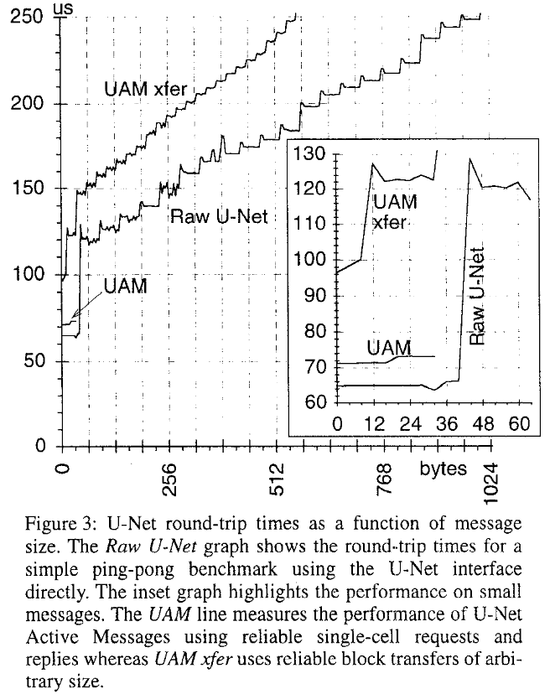
Performance Raw-U-Net and UAM
Notes:
RTT and bandwidth measurements
Small messages 65 μs RTT (optimization for single cells)
Fiber saturated at 800 B

Slide 26
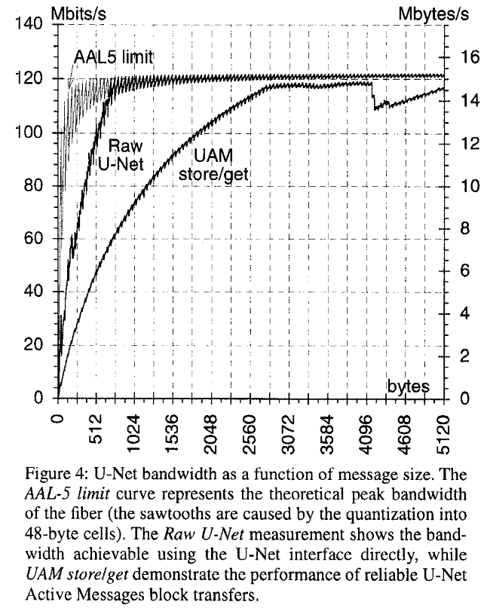
Performance Raw-U-Net and UAM
Notes:
Single-cell RTT, RTT ~ 71 μs for a 0-32 B message, Overhead of 6 μs over raw U-Net – Why?
Block store BW, 80% of the maximum limit with blocks of 2KB size, Almost saturated at 4KB, Good performance!

Slide 27
Split-C Evaluation
Split C based on UAM
Vs.
CM-5
Meiko CS-2
Notes:
Parallel Extension to C
Implemented on top of UAM
Tested on 8 processors
ATM cluster performs close to CS-2

Slide 28
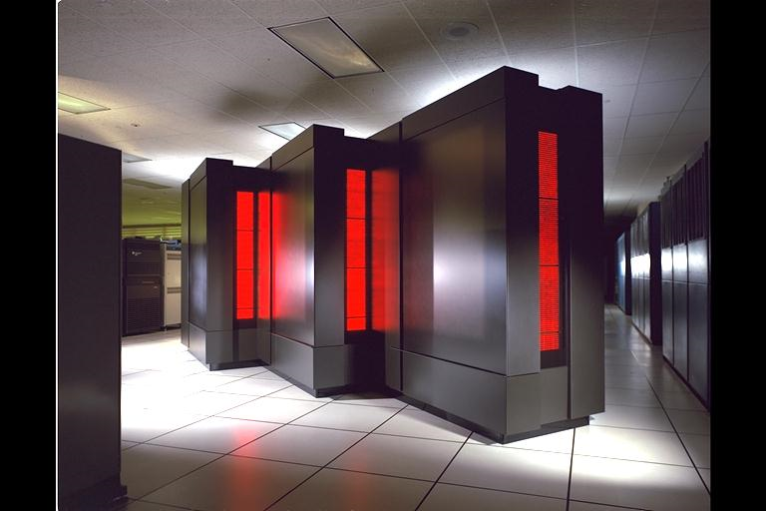
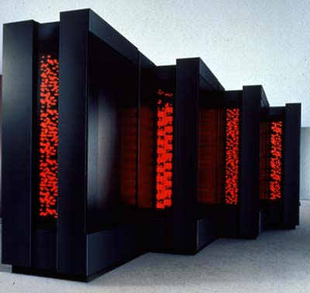
CM-5
Notes:
The Connection Machine was a series of supercomputers that grew out of Danny Hillis's research in the early 1980s at MIT on alternatives to the traditional von Neumann architecture of computation. The Connection Machine was originally intended for applications in artificial intelligence and symbolic processing, but later versions found greater success in the field of computational science.
With the CM-5, announced in 1991, Thinking Machines switched from the CM-2's hypercubic architecture of simple processors to an entirely new MIMD architecture based on a fat tree network of SPARC RISC processors. The later CM-5E replaced the SPARC processors with faster SuperSPARCs.

Slide 29
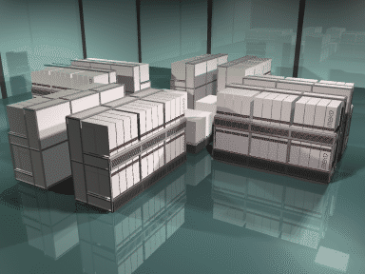
Meiko CS-2
Notes:
Meiko Scientific Ltd. was a British supercomputer company based in Bristol, founded by members of the design team working on the INMOS transputer microprocessor.
The CS-2 was launched in 1993 and was Meiko's second-generation system architecture, superseding the earlier Computing Surface.
The CS-2 was an all-new modular architecture based around SuperSPARC or hyperSPARC processors and, optionally, Fujitsu μVP vector processors. These implemented an instruction set similar to the Fujitsu VP2000 vector supercomputer and had a nominal performance of 200 megaflops on double precision arithmetic and double that on single precision. The SuperSPARC processors ran at 40 MHz initially, later increased to 50 MHz. Subsequently, hyperSPARC processors were introduced at 66, 90 or 100 MHz. The CS-2 was intended to scale up to 1024 processors. The largest CS-2 system built was a 224-processor system installed at Lawrence Livermore National Laboratory[1].
The CS-2 ran a customized version of the Solaris operating system, initially Solaris 2.1, later 2.3 and 2.5.1.

Slide 30
Split-C application benchmarks
Block matrix multiply
Sample sort (2 versions)
Radix sort (2 versions)
Connected component algorithm
Conjugate gradient solver

Slide 31
Performance
Notes:
U-Net comparable to supercomputers
When using small messages the CM-5 dedicated fast network makes it better
When choosing algorithm that use larger messages U-Net is better

Slide 32
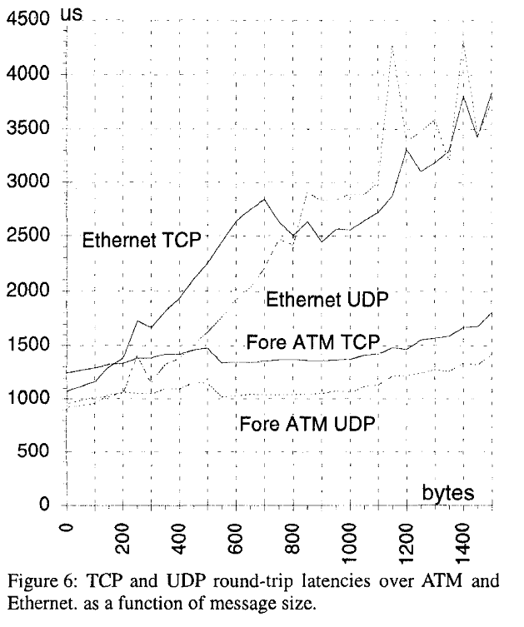
IP Suite Evaluation
Notes:
Unfortunately the performance of kernelized UDP and TCP protocols in SunOS combined with the vendor supplied ATM driver software has been disappointing: the maximum bandwidth with UDP is only achieved by using very large transfer sizes (larger than 8Kbytes), while TCP will not offer more than 5570 of the maximum achievable bandwidth. The observed round-trip latency, however, is even worse: for small messages the latency of both UDP and TCP messages is larger using ATM than going over Ethernet: it simply does not reflect the increased network performance. Figure shows the latency of the Fore-ATM based protocols compared to those over Ethernet.

Slide 33
IP Suite Evaluation
TCP max bandwidth
UDP max bandwidth
Notes:
TCP and UDP implemented over raw U-Net for test purposes as user level library
Shows the effective support of traditional protocols
Many tests exist for traditional protocols used to compare U-Net based to kernel based implementation
Kernel has limited buffers. User level library can use larger buffers
Application can know of network overload and adjust accordingly.
For TCP, the low latency of U-Net allows the application to keep smaller transmit window, saving memory space

Slide 34
Outline
Motivation
Design
Implementation
SBA-100
SBA-200
Evaluation
Active Messages
Split-C
IP Suite
Conclusion

Slide 35
Conclusion
U-Net main objectives achieved:
Provide efficient low latency communication
Offer a high degree of flexibility
U-Net based round-trip latency for messages smaller than 40 bytes: Win!
U-Net flexibility shows good performance on TCP and UDP protocol

Slide 36
Active Messages: a Mechanism for Integrated Communication and Computation

Slide 37
Outline
Large-scale multiprocessors design’s key challenges
Active messages
Message passing architectures
Message driven architectures
Potential hardware support
Conclusions

Slide 38
Large-scale multiprocessors design’s key challenges
Minimize communication overhead
Allow communication to overlap computation
Coordinate the two above without sacrificing processor cost/performance

Slide 39
Outline
Large-scale multiprocessors design’s key challenges
Active messages
Message passing architectures
Message driven architectures
Potential hardware support
Conclusions

Slide 40
Active Messages
Mechanism for sending messages
Message header contains instruction address
Handler retrieves message, cannot block, and no computing
No buffering available
Making a simple interface to match hardware
Allow computation and communication overlap

Slide 41
Active Message Protocol
Sender asynchronous sends a message to a receiver without blocking computing
Receiver pulls message, integrates into computation through handler
Handler executes without blocking
Handler provides data to ongoing computation, but not does any computation

Slide 42
Outline
Large-scale multiprocessors design’s key challenges
Active messages
Message passing architectures
Message driven architectures
Potential hardware support
Conclusions

Slide 43
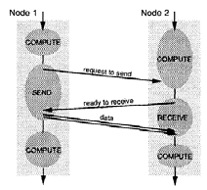
Blocking Send/Recv Model
3-Phase Protocol
Simple
Inefficient
No buffering needed

Slide 44
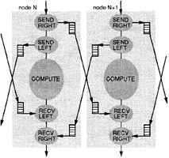
Asynchronous Send/Recv Model
Communication can have overlap with computation
Buffer space allocated throughout computation

Slide 45
Split-C
Extension of C for SPMD Programs
Global address space is partitioned into local and remote
Maps shared memory benefits to distributed memory
Split-phase access
Active Messages serve as interface for Split-C

Slide 46
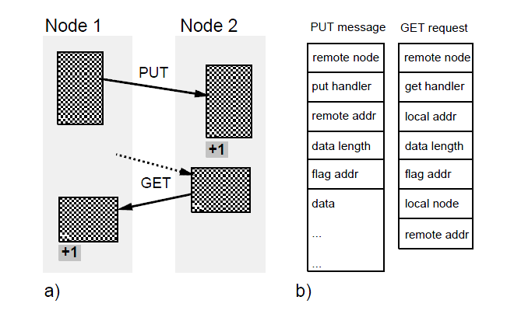
PUT / GET in Split-C

Slide 47
Outline
Large-scale multiprocessors design’s key challenges
Active messages
Message passing architectures
Message driven architectures
Potential hardware support
Conclusions

Slide 48
Message Driven Machines
To support languages with dynamic parallelism
Integrate communication into the processor
Computation is driven by messages, which contain the name of a handler and some data
Computation is within message handlers
May buffer messages upon receipt
Buffers can grow to any size depending on amount of excess parallelism
Less locality

Slide 49
Outline
Large-scale multiprocessors design’s key challenges
Active messages
Message passing architectures
Message driven architectures
Potential hardware support
Conclusions

Slide 50
Potential Hardware support
Network Interface Support
Large messages
Message registers
Reuse of message data
Single network port
Protection
Frequent message accelerators
Processor Support
Fast polling
User-level interrupts
PC injection
Dual processors

Slide 51
Outline
Large-scale multiprocessors design’s key challenges
Active messages
Message passing architectures
Message driven architectures
Potential hardware support
Conclusions

Slide 52
Active Messages’ Benefit
Asynchronous communication
No buffering
Improved Performance
Handlers are kept simple
Notes:
Asynchronous communication : Non-blocking send/receive for overlap
No buffering : Only buffering needed within network is needed and software handles other necessary buffers
Improved Performance: Close association with network protocol
Handlers are kept simple : Serve as an interface between network and computation without complex scheduling etc.
Concern becomes overhead, not latency

Slide 53
Thanks!
Questions?

