Slide 1
Extensible Kernels
Edgar Velázquez-Armendáriz
September 24th 2009

Slide 2
Agenda
Exokernel: An Operating System architecture for Application-Level Resource Management
Extensibility, Safety and Performance in the SPIN Operating System
Notes:
Both SIGOPS 1995

Slide 3
Basic idea
One size fits all… NOT!
Provide a better match between application and system capabilities.
“Extreme” application of end-to-end argument.

Slide 4
Traditional OS Structure
Exokernels. MIT CSAIL, 1998

Slide 5
Exokernel
Dawson R. Engler, M. Frans Kaashoek and James O’Toole Jr.
Engler’s Master’s Thesis.
Follow-up publications on 1997 and 2002.
Kaashoek later worked on Corey.

Slide 6
Exokernel main ideas
Kernel
Resource sharing, not policies
Library Operating System
Responsible for the abstractions
IPC
VM
Scheduling
Networking

Slide 7
Exokernel Architecture
Exokernels. MIT CSAIL, 1998

Slide 8
Exokernel vs Microkenels vs VM
Exokernel defines only a low-level interface.
A microkernel also runs almost everything on user-level, but has fixed abstractions.
A VM emulates the whole machine, doesn’t provide direct access.

Slide 9
SPIN
University of Washington.
Brian N. Bershad, Stefan Savage et. al.
Main ideas continue on Singularity, a C# system by MSR and U.W.

Slide 10
SPIN Architecture

Slide 11
SPIN main ideas
Extend the kernel at runtime through statically-checked extensions.
System and extensions written in Modula-3.
Event/handler abstraction

Slide 12
About Modula-3
Interfaces
Type safety
Garbage collection
Objects
Generics
Threads
Exceptions

Slide 13
SPIN vs Exokernel
SPIN uses programming language facilities and communicates through procedure calls.
Uses hardware specific calls to protect without further specification.

Slide 14
Agenda
Overview
Design
Implementations

Slide 15
Exokernel design
Securely expose hardware
Decouple authorization from usage
Expose allocation
Expose names
Raw access to hardware features
Expose revocation
“Polite” and forcibly abort
Reposession
Notes:
Securely expose hardware: hardware, software, download application code

Slide 16
SPIN design
Co-location
Same memory-space as kernel
Enforces modularity
Local protection domains
Resolves at link time
Dynamic call binding
Event handler pattern.

Slide 17
Protection model
Capabilities
Immutable references to resources
Protection domains
Names accessible at an execution context
Provided by the language
Linking through Resolve and Combine

Slide 18
Exokernel Memory
Guard TLB loads and DMA
Large Software TLB
Library Operating System handles page faults if it’s allowed to.

Slide 19
SPIN Memory
The kernel controls allocation of physical and virtual addresses capabilities.
Extension react to page faults and error through handlers.

Slide 20
Exokernel processor sharing
Round robin allocation of slices.
Library operating system responsible for context switching.
It the time a process takes is excessive, it is killed.
Notes:
Quantum 15 ms

Slide 21
SPIN processor sharing
Based on Modula-3 threads.
Organized in strands.
Communicates through Block, Unblock, Checkpoint and Resume events.
Preemptive round-robin schedule of strands

Slide 22
Exokernel Network
Downloadable filters
Application-specific Safe Handlers
Respond directly to traffic

Slide 23
SPIN Network
Protocol stack.
Packet pulled by handlers.

Slide 24
SPIN Network

Slide 25
Agenda
Overview
Design
Implementations

Slide 26
Exokernel
DEC MIPS
Aegis: actual exokernel
Processor
Physical memory
TLB
Exceptions, Interrupts
ExOS: library operating system
Processes, Virtual Memory, Network protocols

Slide 27
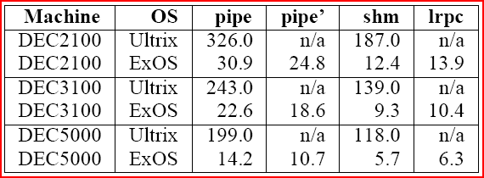
Microbenchmark results

Slide 28
SPIN
DEC Alpha
System components
Sys
Core
Rt
Lib
Sal (device drivers)

Slide 29
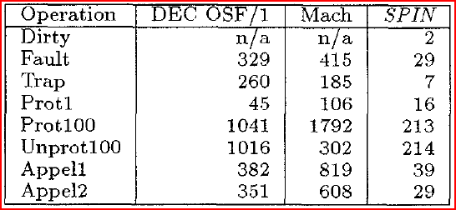
Microbenchmark Results

Slide 30
Catching up
Extensible kernels are actually fast.
End-to-end arguments.
Efficient implementations.
High level languages are not terrible!

