Slide 1
Novel File Systems: The Evolution of Coda
Presented by Hakim Weatherspoon

Slide 2
M. Satyanarayanan
Systems faculty at Carnegie-Mellon University
Andrew Project
Distributed computing environment begun in 1983
IT joint venture between CMU and IBM
Focused on workstations: client-server
Lead Andrew File System
Inspired CODA and another 20 years of research

Slide 3
Paper overview
Reviews the multiple contributions of Coda:
Optimistic replication
Trickle reintegration to support weakly connected workstations
Isolation-only transactions
Operation shipping
Ends with a few lessons learned

Slide 4
Motivation for Coda
Epilogue to the Andrew File System (AFS)
AFS was found to be vulnerable to server and network failures
Not that different from NFS
Limits scalability of AFS
Coda addresses these problems through optimistic replication

Slide 5
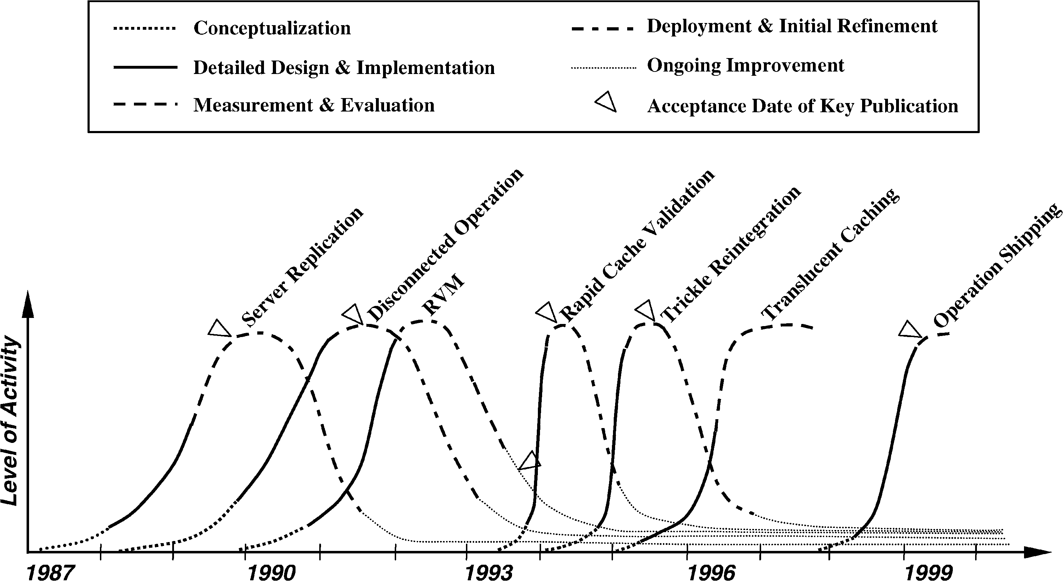
Timeline

Slide 6
Lessons Learned from 20 years of Coda
Optimistic replication can work
Must use for performance
Real systems research needs
Real system artifacts
Real users
Timing
Need to be lucky
Research vs product
Long ‘product’ tail
Moores law
Worked then. Does it work now?

Slide 7
Lessons Learned from 20 years of Coda
Code reuse is a double edged sword
Good initially, but locks you into a particular regime
Need system admins
Deeply held secret
Small projects never die
Also small features hard to remove

Slide 8
Server Replication: 1987-1991
Optimistic replication control protocols allow access in disconnected mode
Tolerate temporary inconsistencies
Promise to detect them later
Provide much higher data availability
Optimistic replication control requires a reliable tool for detecting inconsistencies among replicas
Better than LOCUS tool

Slide 9
Server Replication
Unit of replication is volume (subtree of files)
Set of servers containing replicas of a volume is volume storage group (VSG)
Currently accessible subset of VSG is accessible volume storage group (AVSG)
Tracked by cache manager of client (Venus):

Slide 10
Read protocol
Read-one-data, read-all-status, write-all
Each client
Has a preferred server (VS)
Still checks with other servers to find which one has the latest version of a file
Reads are aborted if a conflict is detected
Otherwise a callback is established with all servers in AVSG

Slide 11
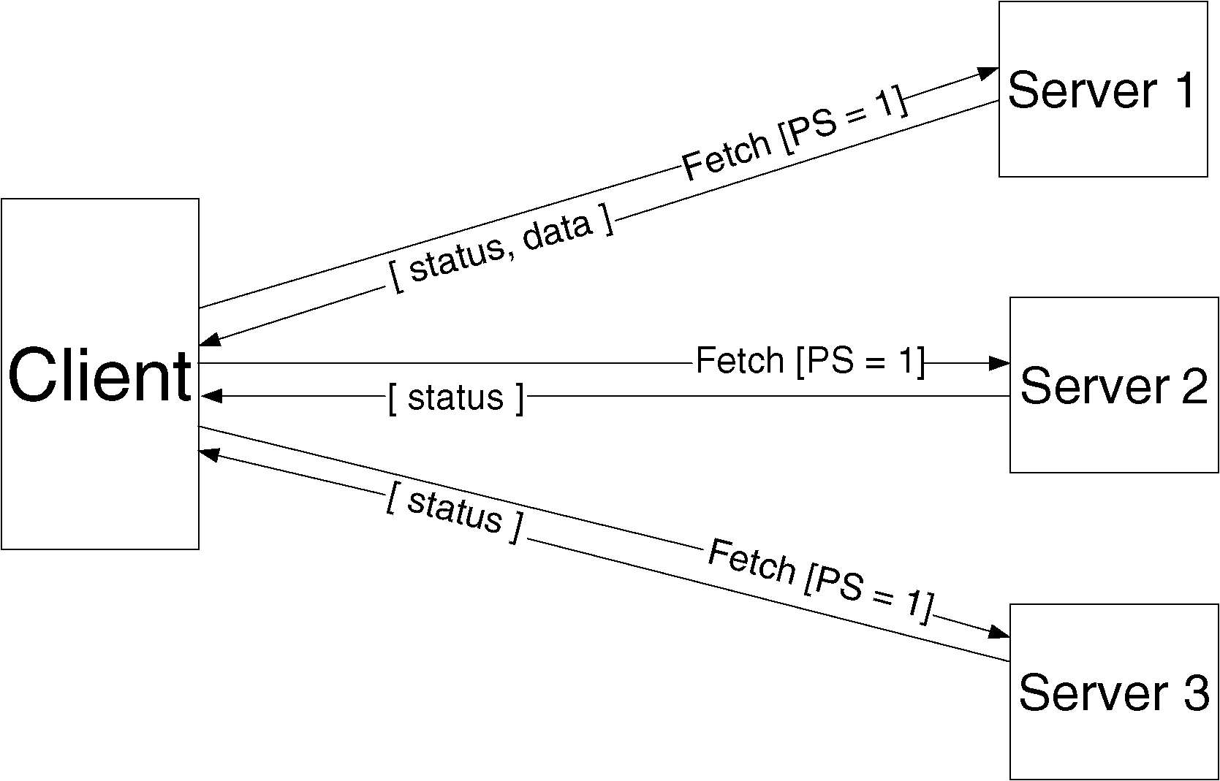
Read protocol

Slide 12
Client Structure
Application
Venus
(connects with Coda servers)
System call interface
Vnode interface
Coda MiniCache (handles local accesses)

Slide 13
Update protocol
When a file is closed after modification, updated file is transferred in parallel to all members of the AVSG
Directory updates are also written through to all members of AVSG
Coda checks for replica divergence before and after each update
Update protocol is non-blocking

Slide 14
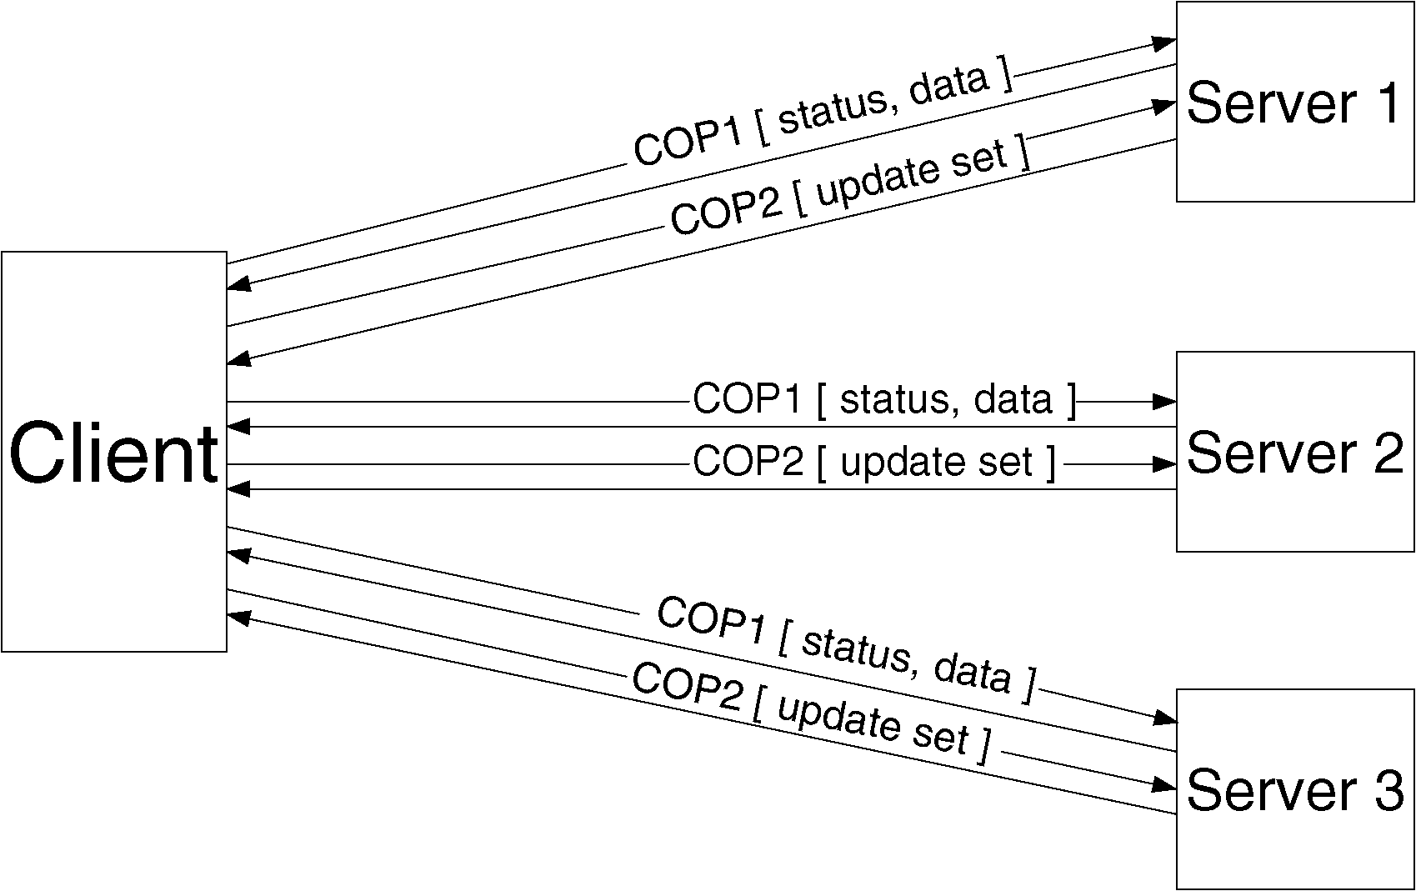
Update protocol

Slide 15
Consistency model
Client keeps track of subset s of servers it was able to connect the last time it tried
Updates s at least every τ seconds
At open time, client checks it has the most recent copy of file among all servers in s
Guarantee weakened by use of callbacks
Cached copy can be up to τ minutes behind the server copy

Slide 16
Fault-tolerance
Correctness of update protocol requires atomicity and permanence of metadata updates
Used first Camelot transaction management system:
Too slow and Mach-specific
Coda uses instead its own recoverable virtual memory (RVM)
Implemented as a library

Slide 17
LRVM
Thesis
RVM ... poses and answers the question "What is the simplest realization of essential transactional properties for the average application?" By doing so, it makes transactions accessible to applications that have hitherto balked at the baggage that comes with sophisticated transactional facilities.
Answer
Library implementing No-Steal, No-Force virtual memory persistence, with manual copy-on-write and redo-only logs.

Slide 18
LRVM
Goal
allow Unix applications to manipulate persistent data structures (such as the meta data for a file system) in a manner that has clear-cut failure semantics.
Existing Solutions
Camelot too heavyweight
Wanted “lite” solution
Do not provide (unneeded) support for distributed and nested transactions, shared logs, etc.
Proposed Solution
Library that provides only recoverable virtual memory

Slide 19
LRVM: Lessons from Camelot
Overhead significant
multiple address spaces
constant IPC between them
programming constraints
Heavyweight facilities impose programming constraints.
Size and complexity
Camelot too big
Too dependent on Mach
maintenance headaches and lack of portability

Slide 20
LRVM: Lessons from Camelot
Camelot had a object and process model.
Its componentization led to lots of IPC.
It had poorly tuned log truncation.
Was perhaps too much of an embrace of Mach.
However, a lot of good learned from Camelot
the golden age of CMU Systems learned a lot from the sharing of artifacts: Mach, AFS, Coda...
A lot of positive spirit in this paper.

Slide 21
LRVM: Architecture
Only addresses the problem of Recovery.
Stores Virtual memory in external data segments found in stable storage.
Portable with a library that is linked in with applications.
“Value simplicity over generality” by adopting a layered approach.
Provides independent control over atomicity and concurrency as well as other problems such as deadlocks and starvations.

Slide 22
Layered Approach of RVM

Slide 23
LRVM: Segments and Regions
Applications map regions of segments into their virtual memory.

Slide 24
LRVM: Sequence of Operations
Select regions in virtual memory to be mapped.
Get a global transaction ID.
Successful commit saves segments in log.

Slide 25
LRVM: Crash Recovery
Recovery consists of reading the log from tail to head and then reconstructing the last committed changes.
Modifications are applied to the external data segment.
Log is emptied.

Slide 26
LRVM: Truncation
Reclaiming space in the log by applying changes to the external data segment.
Necessary because space is finite.

Slide 27
LRVM: Performance
Beats Camelot across the board.
Lack of integration with VM does not appear to be a significant problem as long as ration of Real/Physical memory doesn't grow too large.
Log traffic optimizations provide significant (though not multiple factors) savings.

Slide 28
LRVM: Summary
RVM addresses only the problem of recovery in VM and introduces a “neat” layered structure to address the other problems
manipulate persistent data structures
In manner that has clear-cut failure semantics
Experience
Heavyweight fully general transaction support facility led to lightweight facility that only provides recoverable virtual mem
However,
Paper did not show that layered approach can perform well
Lesson
Bulding OS, do few things well instead of being general

Slide 29
Disconnected Operation:1988-1993
Started as tool allowing a client isolated by a network failure to continue to operate
Made possible thanks to
Optimistic philosophy
File hoarding in client cache
Gained importance with arrival of portable computers
Resulted in voluntary disconnections

Slide 30
Disconnected Operation
File Hoarding:
Coda allows user to specify which files should always remain cached on her workstation and to assign priorities to these files
When workstation gets reconnected, Coda initiates a reintegration process
Changes are propagated and inconsistencies detected

Slide 31
Disconnected Operation
Disconnected operation mode complements but does not replace server replication
Cached replicas are only available when client workstation is turned on
Make server replicas primary replicas and cached replicas secondary replicas

Slide 32
Implementation
Three states:
Hoarding: Normal operation mode
Emulating: Disconnected operation mode
Reintegrating: Propagates changes and detects inconsistencies

Slide 33
Implementation
Hoarding
Emulating
Recovering

Slide 34
Implementation
Coda maintains a per-client hoard database (HDB) specifying files to be cached on client workstation
Client can modify HDB and even set up hoard profiles

Slide 35
Implementation
In disconnected mode:
Attempts to access files that are not in the client caches appear as failures to application
All changes are written in a persistent log, the client modification log (CML)
Venus removes from log all obsolete entries like those pertaining to files that have been deleted

Slide 36
Conflict Resolution: 1988-1995
Coda provides automatic resolution of simple directory update conflicts
Other conflicts are to be resolved manually by the user

Slide 37
Objectives
No updates should ever be lost without explicit user approval: conflicts must be detected
Do they ensure this?
The common case of no conflict should be fast
Is it?
Conflicts are ultimately an application-specific concept: think of updates to a schedule
The buck stops with the user: automatic conflict resolution cannot solve all problems

Slide 38
Approaches to conflict resolution
Syntactic approach:
Uses version information
Fast and efficient
Weak in their ability to resolve conflict
Semantic approach:
Slower but more powerful

Slide 39
Coda solution
Coda uses
Syntactic approach to detect absence of conflicts
Semantic approach to resolve possible conflicts

Slide 40
Directory conflict resolution
Always automatic
Uses a log-based
Two cases to consider
After disconnected operation
Across conflicting replicas

Slide 41
After disconnected operation
Each server tries to apply the client modification log (CML) send by the client during reintegration
If this attempt fails, client directory is marked in conflict.

Slide 42
Across divergent replicas
Each server replicas of a volume has a resolution log containing entire list of directory operations
In reality, it is frequently truncated
Remains almost empty when there are no failures
Recovery protocol locks the replicas merges the logs and distributes the merged logs.

Slide 43
Other solutions
Must keep track of partial deletes:
If one of the two replicas has a directory A, does it correspond to a file
recently created, or
recently deleted.
Must keep ghost entries for directory entries that were recently removed
Hard to know when these entries can be purged

Slide 44
Application-Specific File Resolution
Entirely done at client

Slide 45
Conflict representation
Coda displays read-only versions of inconsistent objects

Slide 46
Frequency of conflicts
Probability of two different users modifying the same object less than a day apart is less than 0.0075

Slide 47
Weakly Connected Operation: 1993-1996
Broad principles
Do not punish strongly connected clients
Do not make life worse when disconnected
Do it in the background if you can
Rapid validation of cache
Trickle Reintegration

Slide 48
Lessons Learned from 20 years of Coda
Optimistic replication can work
Must use for performance
Real systems research needs
Real system artifacts
Real users
Timing
Need to be lucky
Research vs product
Long ‘product’ tail
Moores law
Worked then. Does it work now?

Slide 49
Lessons Learned from 20 years of Coda
Code reuse is a double edged sword
Good initially, but locks you into a particular regime
Need system admins
Deeply held secret
Small projects never die
Also small features hard to remove

Slide 50
Next Time
Read and write review:
Do Lab 1 due tomorrow
Project Mtg today at 2:30pm in Systems Lab
Check website for updated schedule

