Slide 1
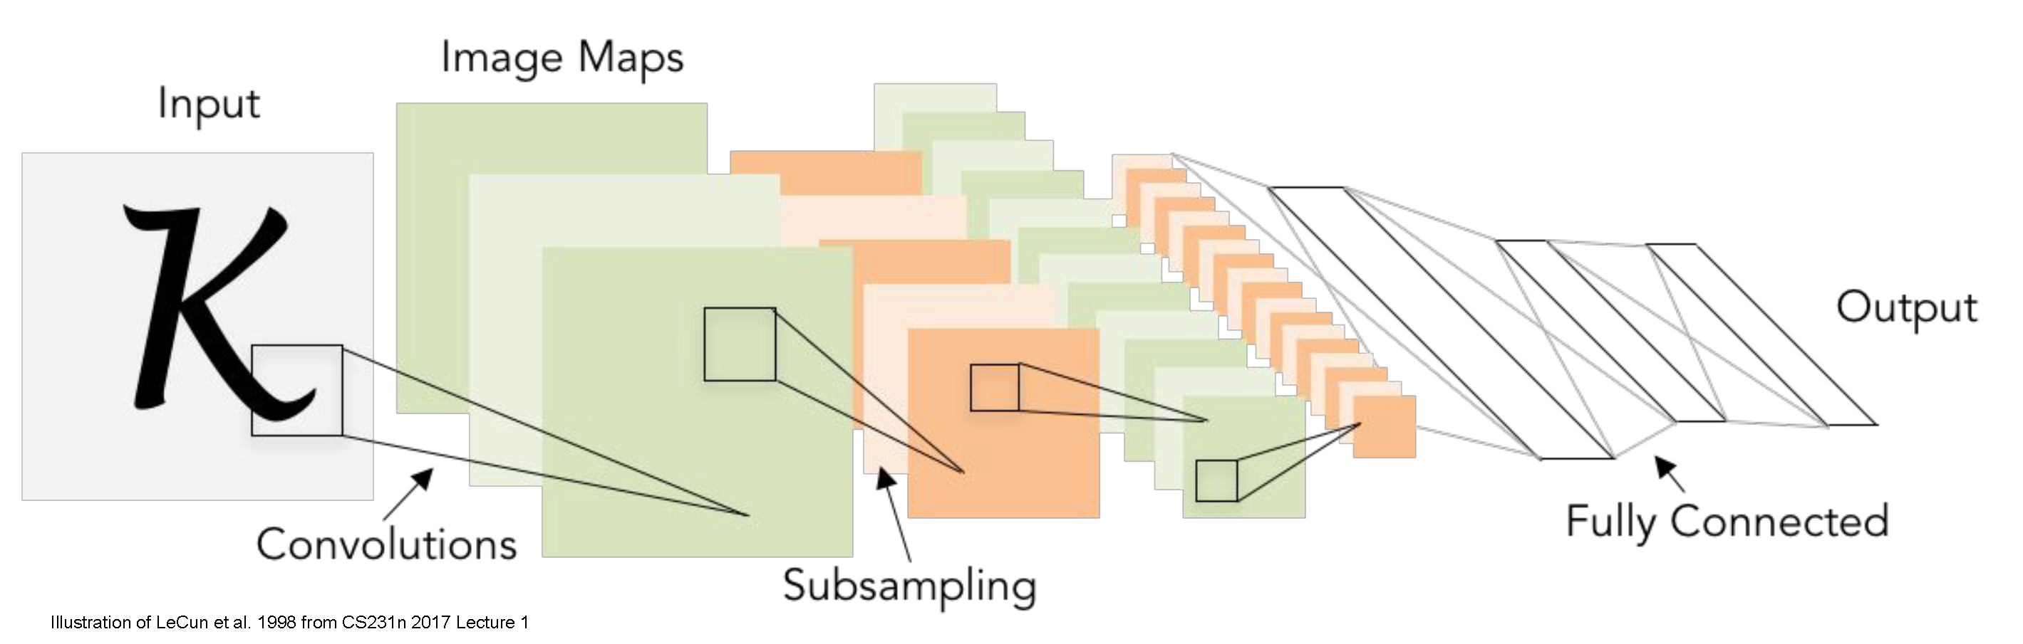
Convolutional neural networks
CS5670: Computer Vision
Slides from Fei-Fei Li, Justin Johnson, Serena Yeung
http://vision.stanford.edu/teaching/cs231n/

Slide 2
Readings
Neural networks
http://cs231n.github.io/neural-networks-1/
http://cs231n.github.io/neural-networks-2/
http://cs231n.github.io/neural-networks-3/
http://cs231n.github.io/neural-networks-case-study/
Convolutional neural networks
http://cs231n.github.io/convolutional-networks/

Slide 3
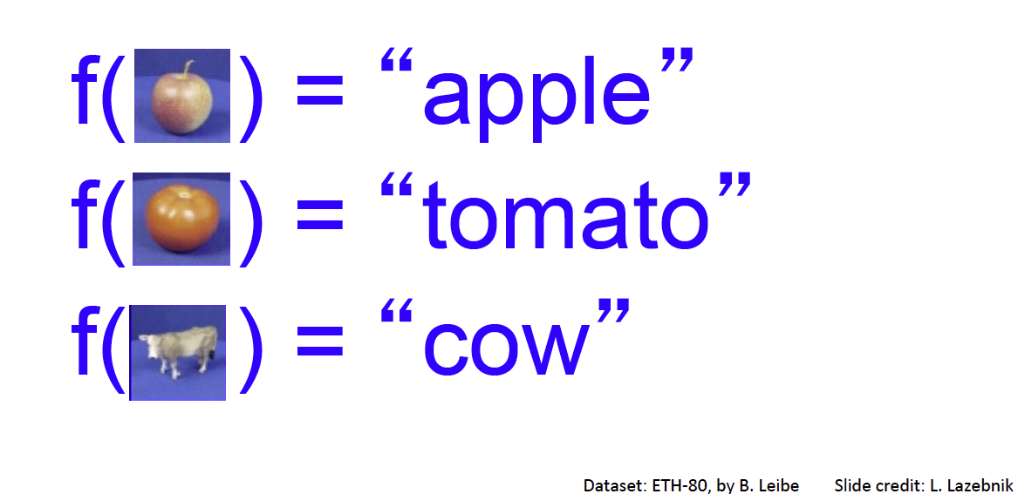
Recap: Image Classification – a core task in computer vision
Assume given set of discrete labels, e.g.
{cat, dog, cow, apple, tomato, truck, … }

Slide 4
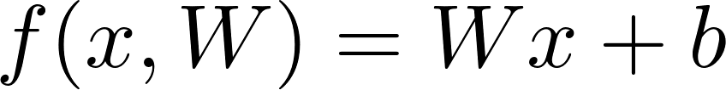
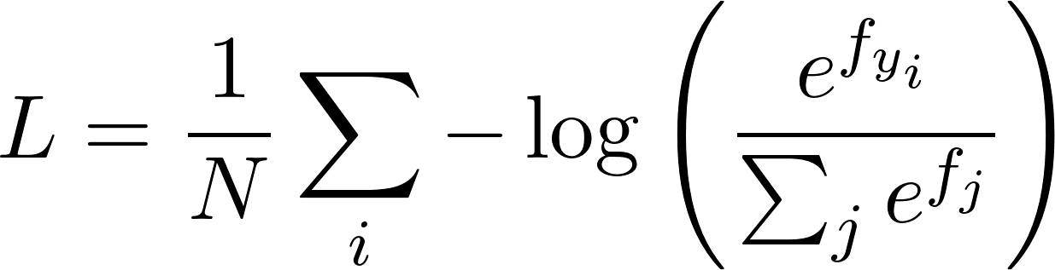
Recap: linear classification
What we have: a score function and loss function
Score function maps an input data instance (e.g., an image) to a vector of scores, one for each category
Last time, our score function is based on linear classifier
Find W and b that minimize a loss over labeled training data, e.g. cross-entropy loss
f: score function
x: input instance
W, b: parameters of a linear (actually affine) function
Notes:
f(x, W) = Wx + b
f(\mathbf{x}, \mathbf{W}) = \mathbf{W}\mathbf{x} + \mathbf{b}
L = \frac{1}{N} \sum_i -\log \left(\frac{e^{f_{y_i}}}{\sum_j e^{f_j}}\right)

Slide 5
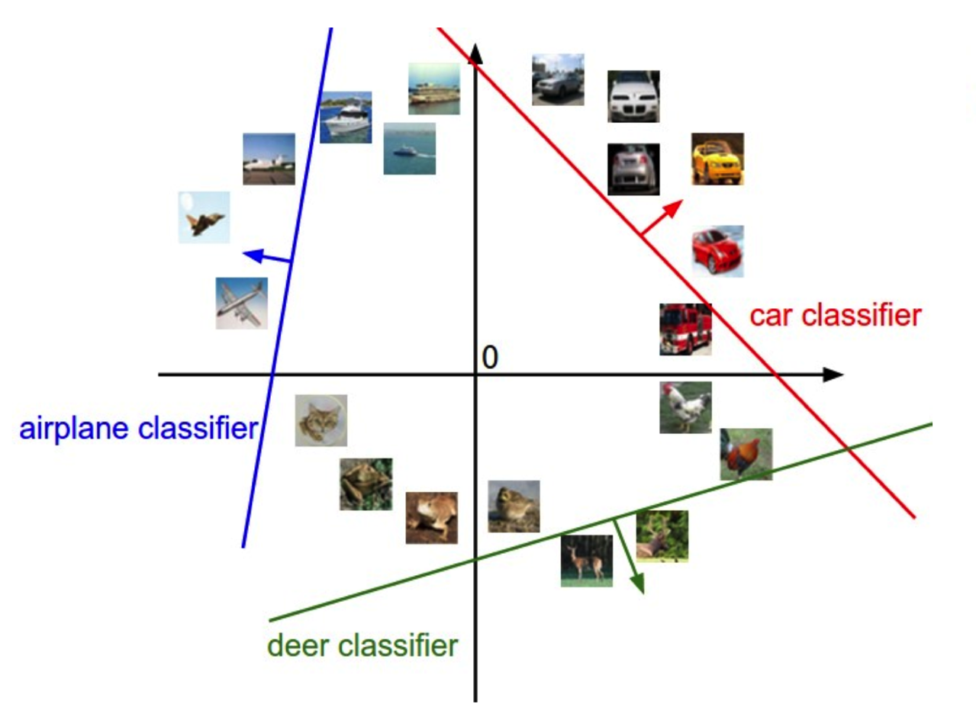
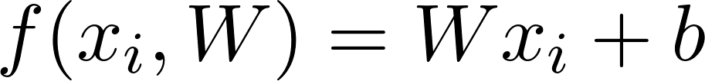
Linear classifiers separate features space into half-spaces
Figure credit: Fei-Fei Li and Andrej Karpathy
Notes:
f(\mathbf{x}_i, \mathbf{W}) = \mathbf{W}\mathbf{x}_i + \mathbf{b}

Slide 6
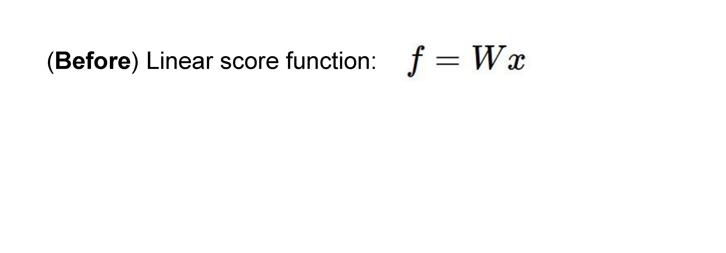
Neural networks
Slide credit: Fei-Fei Li & Andrej Karpathy & Serena Leung

Slide 7
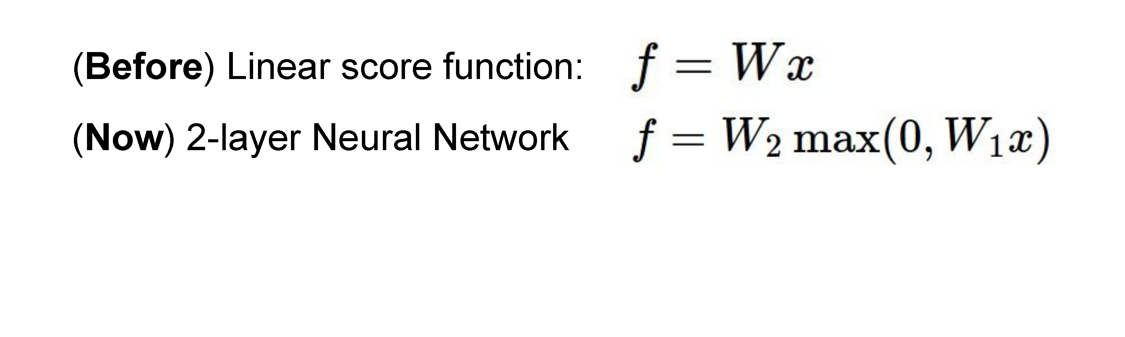
Neural networks
Slide credit: Fei-Fei Li & Andrej Karpathy & Serena Leung

Slide 8
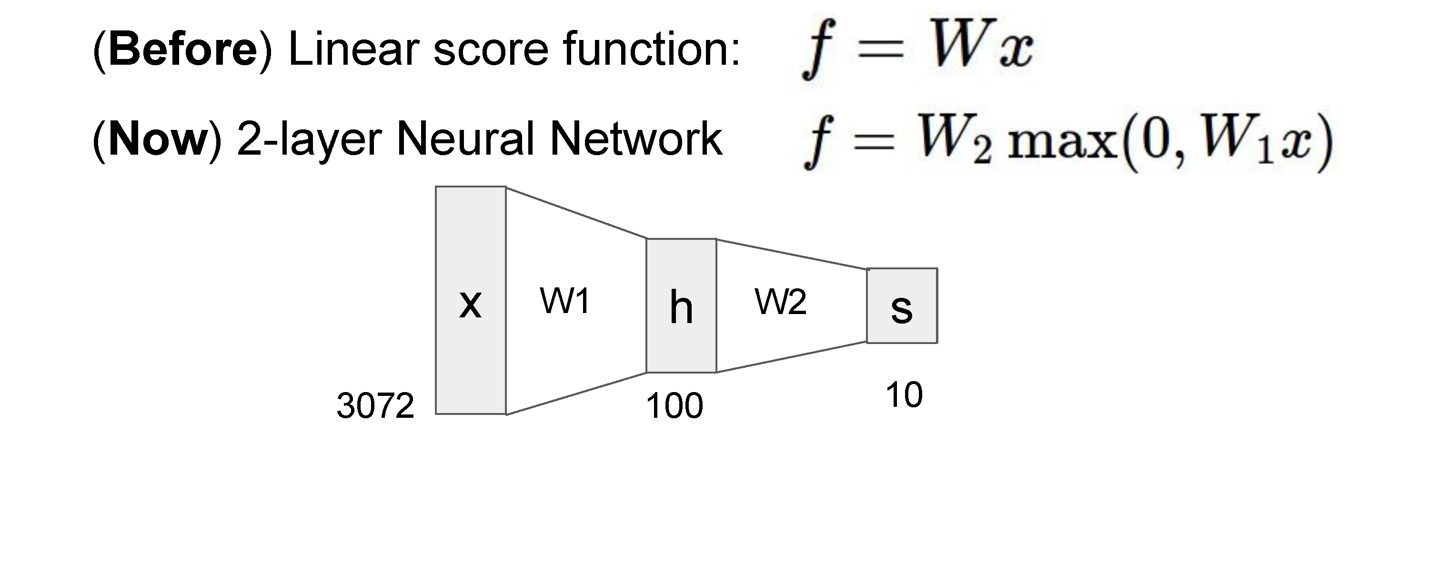

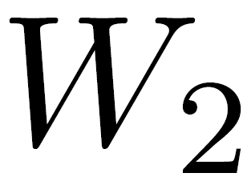

Neural networks
(10 x 100 matrix)
(100 x 3072 matrix)
100D intermediate vector
Slide credit: Fei-Fei Li & Andrej Karpathy & Serena Leung

Slide 9
Neural networks
Total number of weights to learn:
3,072 x 100 + 100 x 10 = 308,200
Adapted from Fei-Fei Li & Andrej Karpathy & Serena Leung

Slide 10
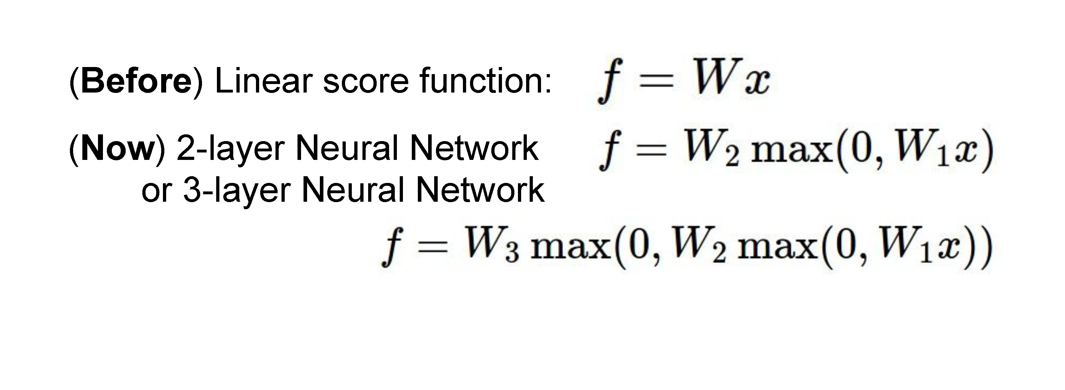
Neural networks
also called “Multilayer Perceptrons” (MLPs)
Adapted from Fei-Fei Li & Andrej Karpathy & Serena Leung

Slide 11

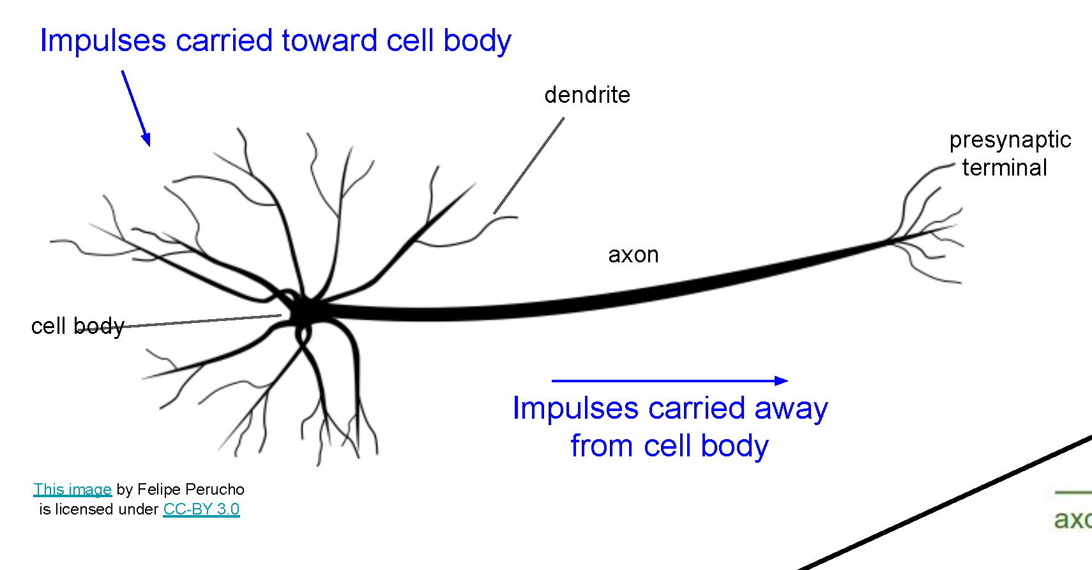
Neural networks
Very coarse generalization of neural networks:
Linear functions chained together and separated by non-linearities (activation functions), e.g. “max”
Why separate linear functions with non-linear functions?
Very roughly inspired by real neurons

Slide 12
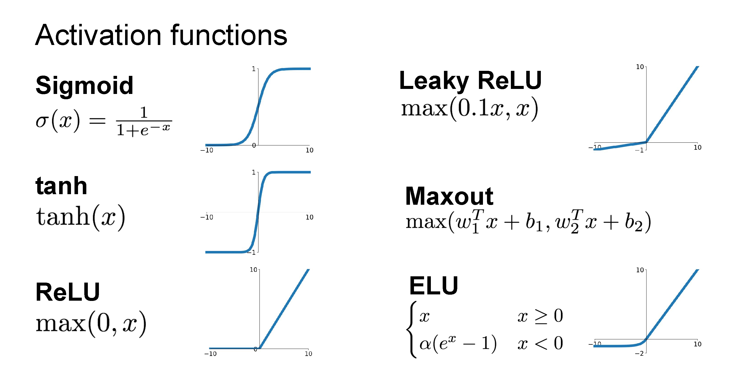
Slide credit: Fei-Fei Li & Andrej Karpathy & Serena Leung

Slide 13
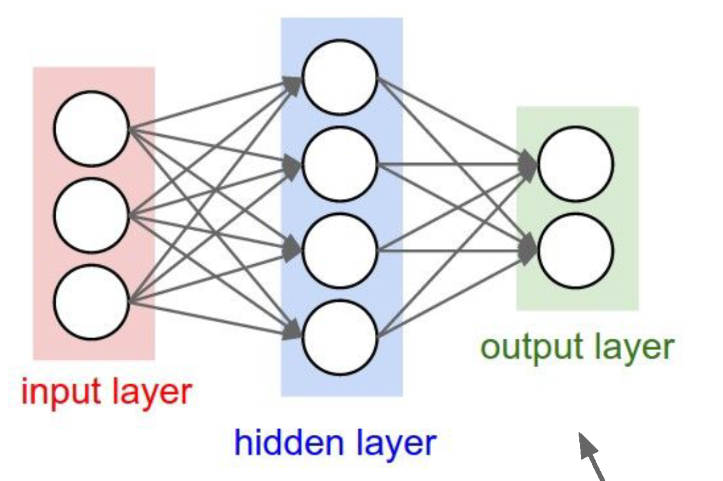
Neural network architecture
Computation graph for a 2-layer neural network
Neuron or unit
Adapted from Fei-Fei Li & Andrej Karpathy & Serena Leung

Slide 14
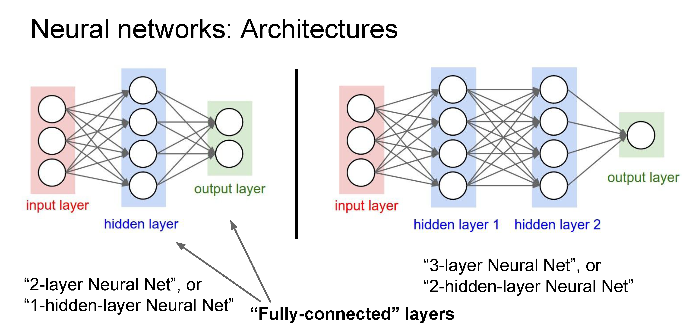
Deep networks typically have many layers and potentially millions of parameters
Adapted from Fei-Fei Li & Andrej Karpathy & Serena Leung

Slide 15
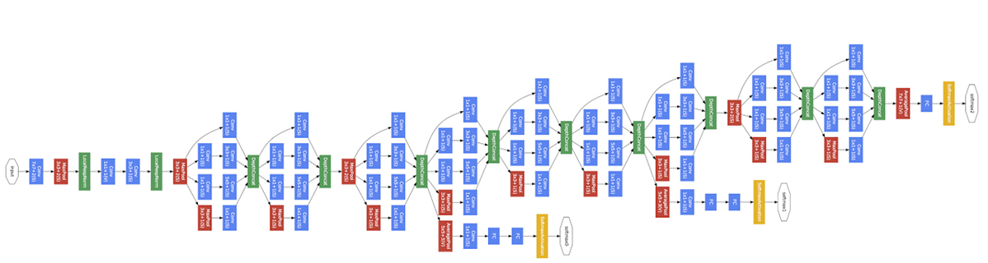
Deep neural network
Inception network (Szegedy et al, 2015)
22 layers
Adapted from Fei-Fei Li & Andrej Karpathy & Serena Leung

Slide 16
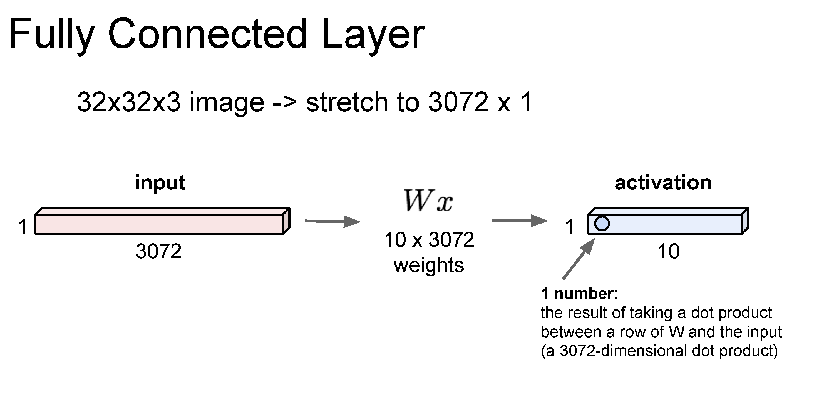
Just like a linear classifer – but in this case, just one layer of a larger network
Adapted from Fei-Fei Li & Andrej Karpathy & Serena Leung

Slide 17
Summary so far
A classic neural network arranges neurons into fully-connected layers
The layer abstraction enables efficient implementations of neural networks using vectorized operations like matrix multiplication
Adapted from Fei-Fei Li & Andrej Karpathy & Serena Leung

Slide 18
Optimizing parameters with gradient descent
How do we find the best W and b parameters?
In general: gradient descent
Start with a guess of a good W and b (or randomly initialize them)
Compute the loss function for this initial guess and the gradient of the loss function
Step some distance in the negative gradient direction (direction of steepest descent)
Repeat steps 2 & 3
Note: efficiently performing step 2 for deep networks is called backpropagation

Slide 19
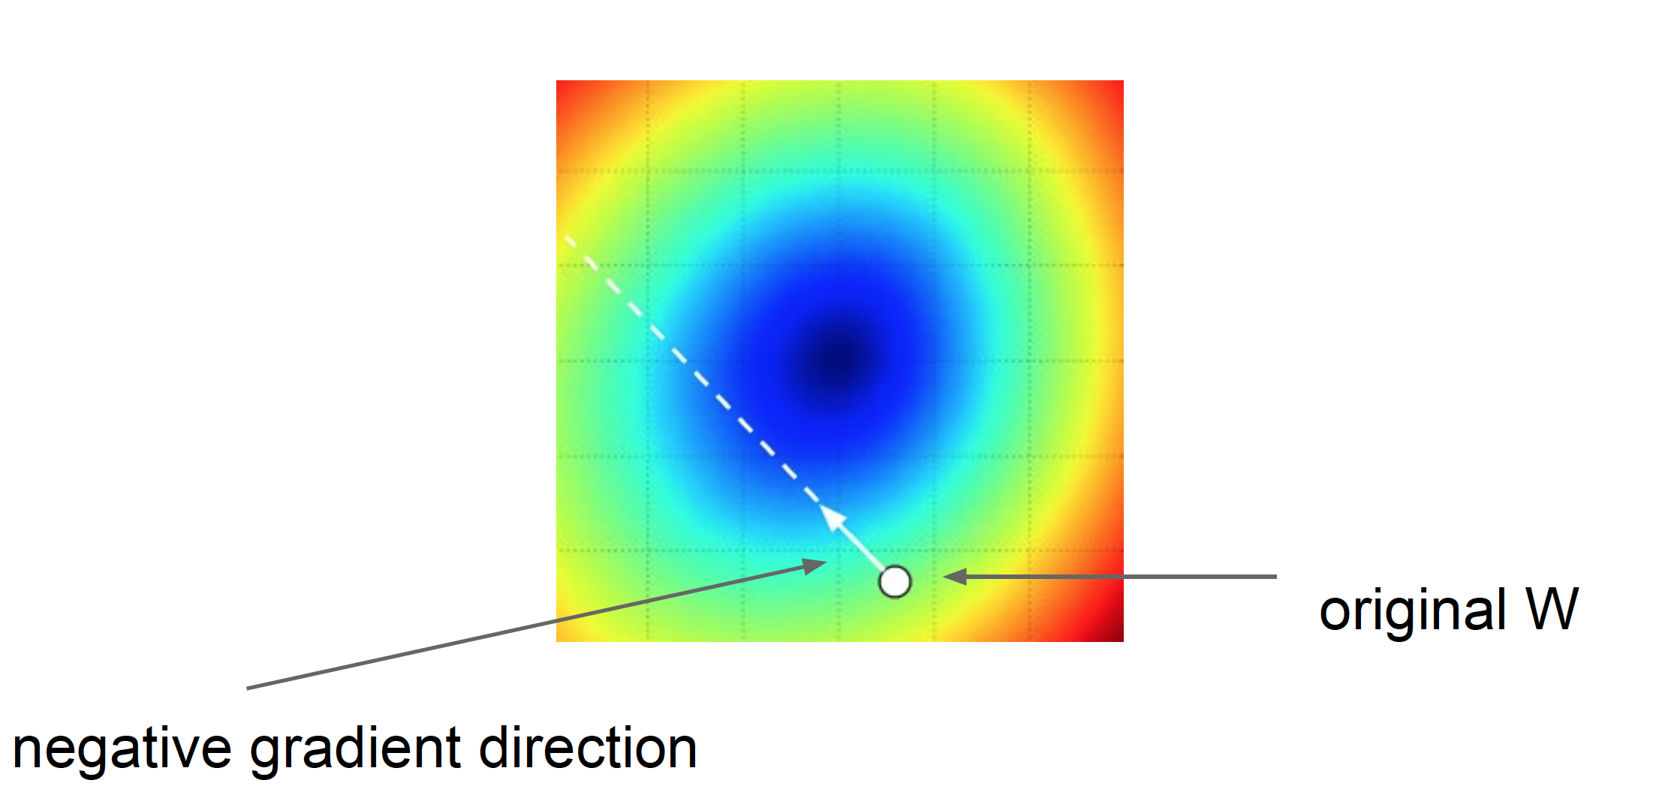
Gradient descent: walk in the direction opposite gradient
Q: How far?
A: Step size: learning rate
Too big: will miss the minimum
Too small: slow convergence

Slide 20
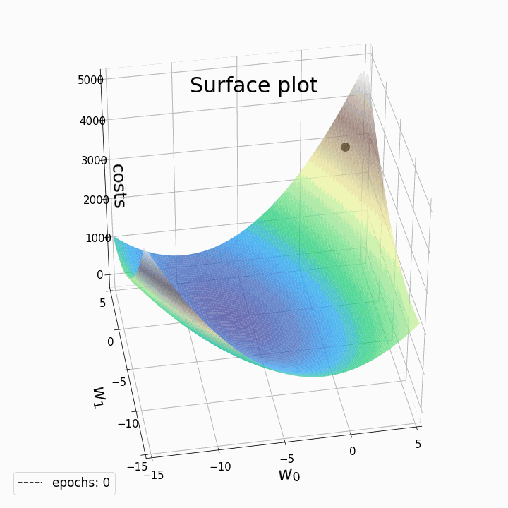
2D example of gradient descent
In reality, in deep learning we are optimizing a highly complex loss function with millions of variables (or more)
More on this later…
https://laptrinhx.com/gradient-descent-animation-2-multiple-linear-regression-3070246823/

Slide 21
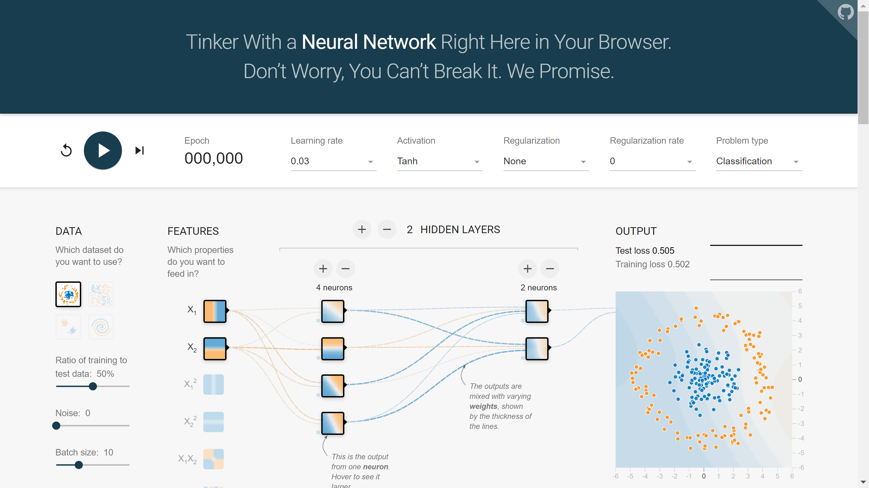
2D example: TensorFlow Playground
https://playground.tensorflow.org

Slide 22
Questions?

Slide 23
Convolutional neural networks (or CNNs, or ConvNets)

Slide 24
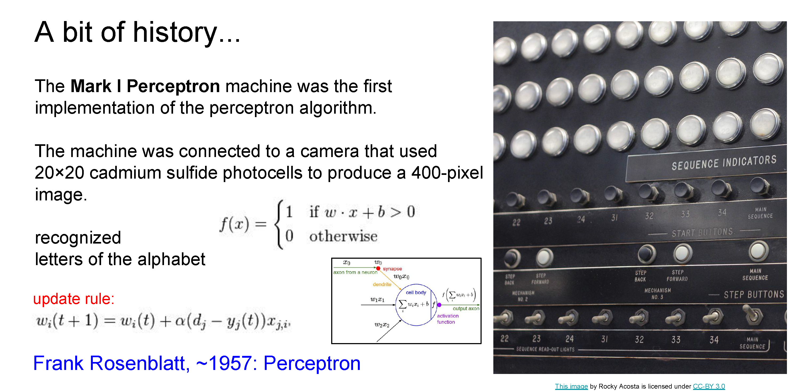
Slide credit: Fei-Fei Li & Andrej Karpathy & Serena Leung

Slide 25
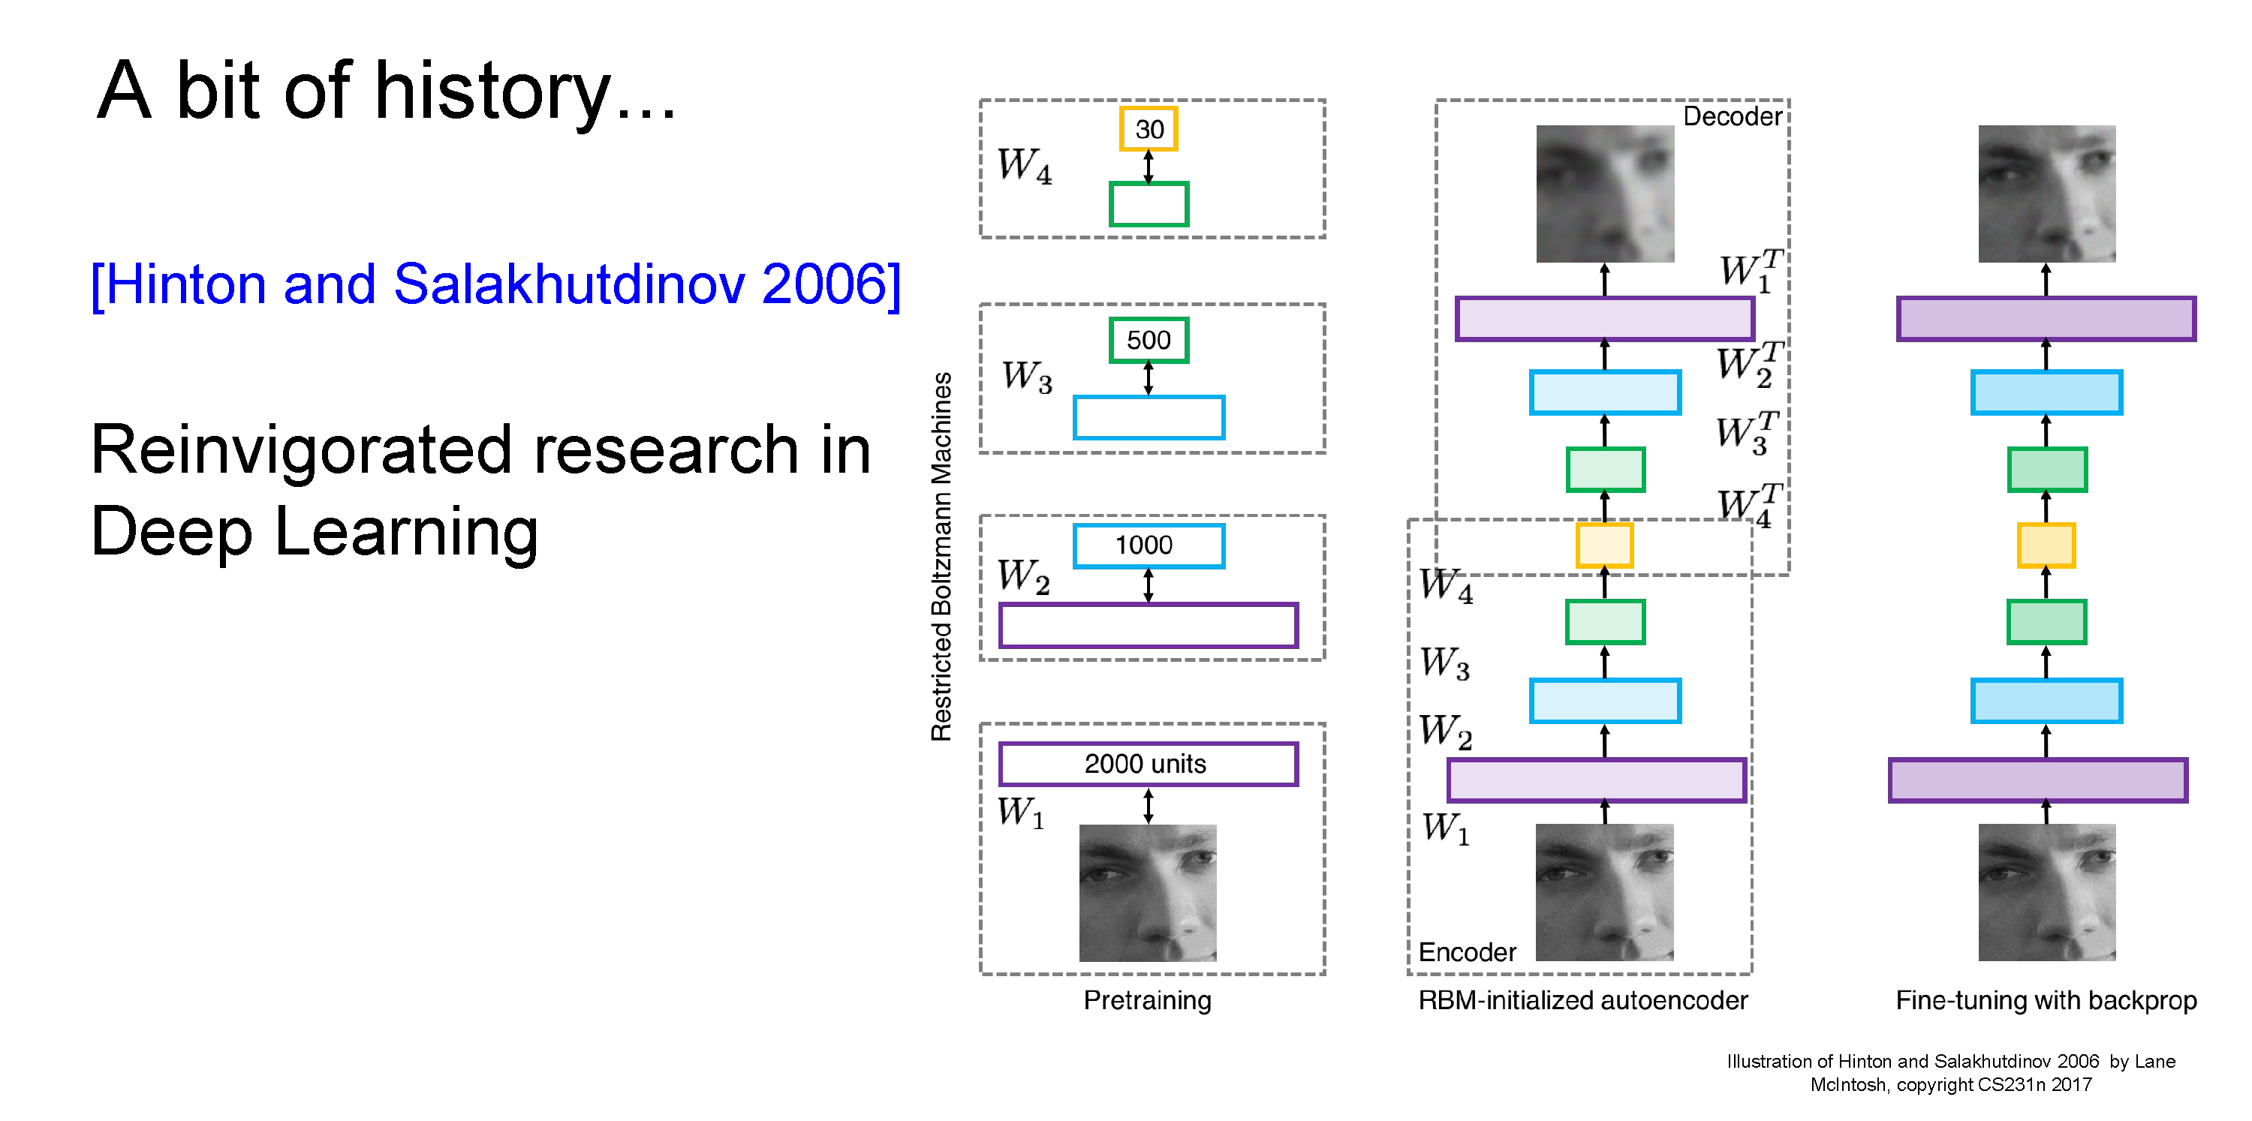
Hinton and Salakhutdinov. Reducing the Dimensionality of Data with Neural Networks. Science, 2016.
Slide credit: Fei-Fei Li & Andrej Karpathy & Serena Leung

Slide 26
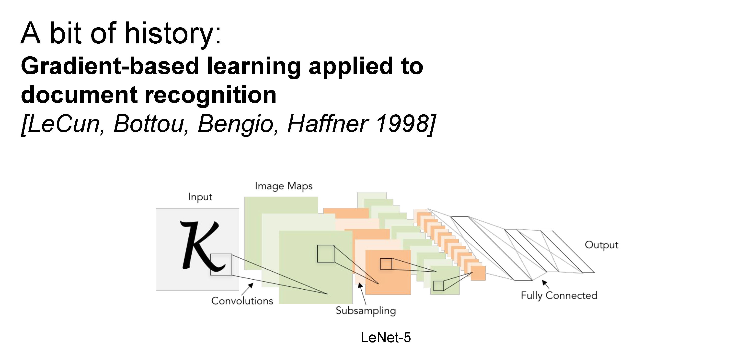
Slide credit: Fei-Fei Li & Andrej Karpathy & Serena Leung

Slide 27
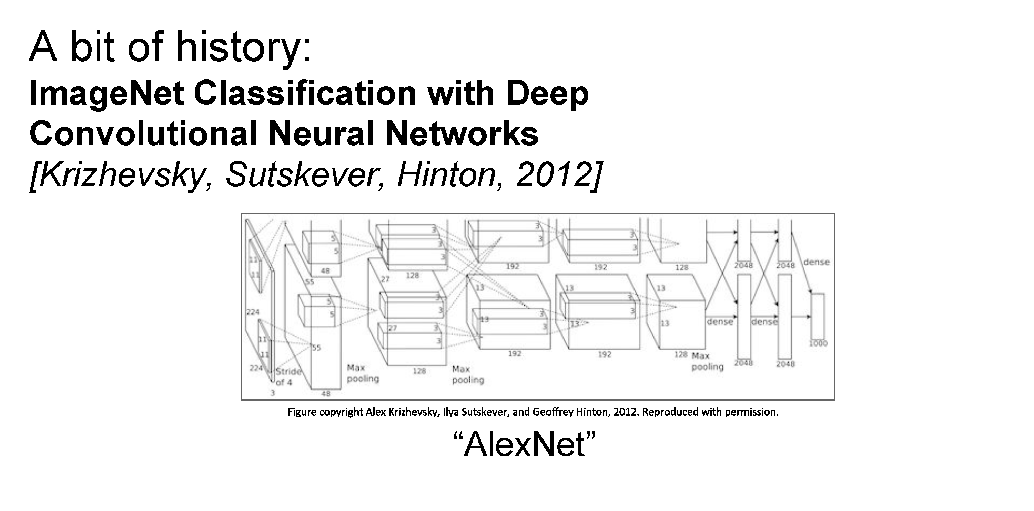
Slide credit: Fei-Fei Li & Andrej Karpathy & Serena Leung

Slide 28
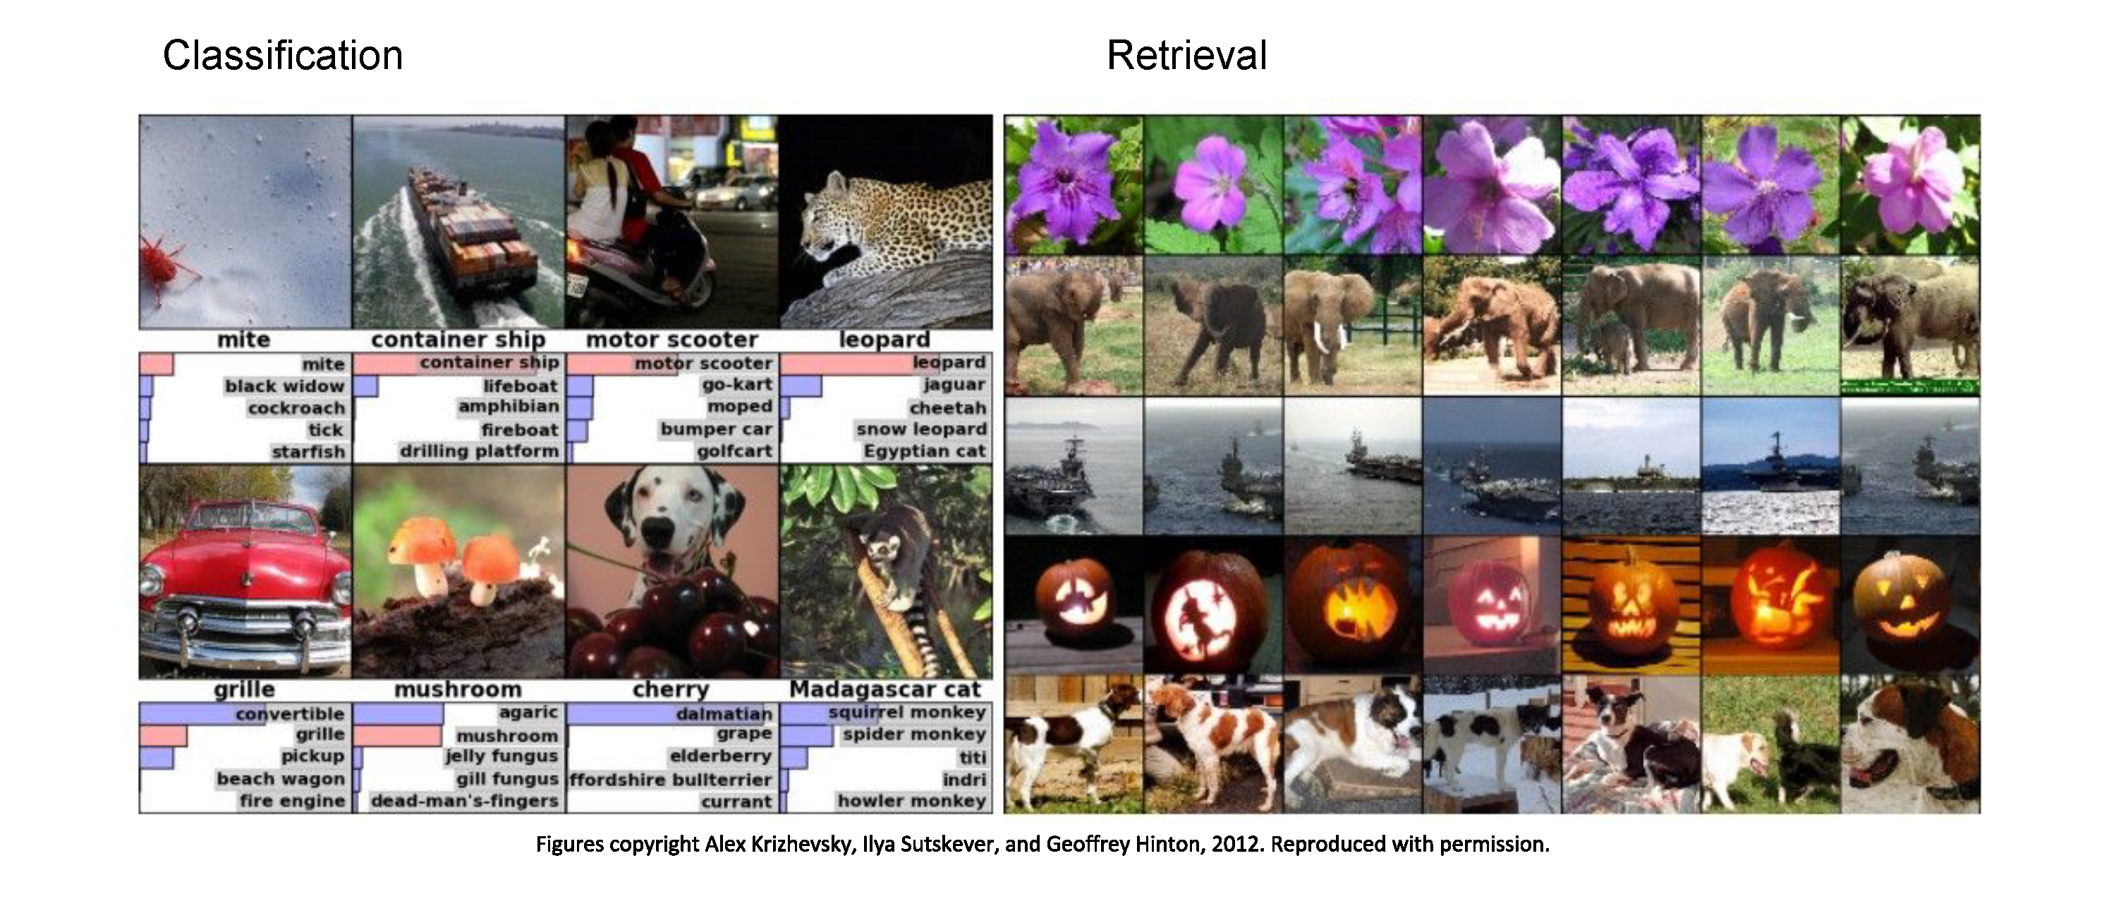
Fast-forward to today: ConvNets* are everywhere
* and other recent architectures, like Transformers
Slide credit: Fei-Fei Li & Andrej Karpathy & Serena Leung

Slide 29

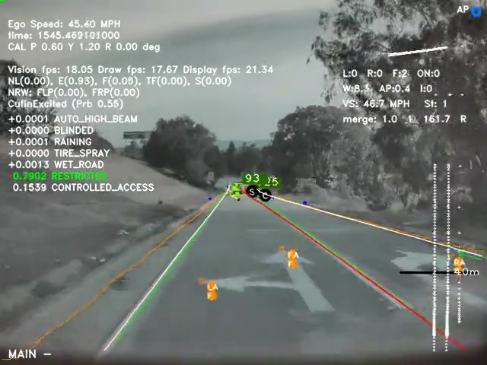
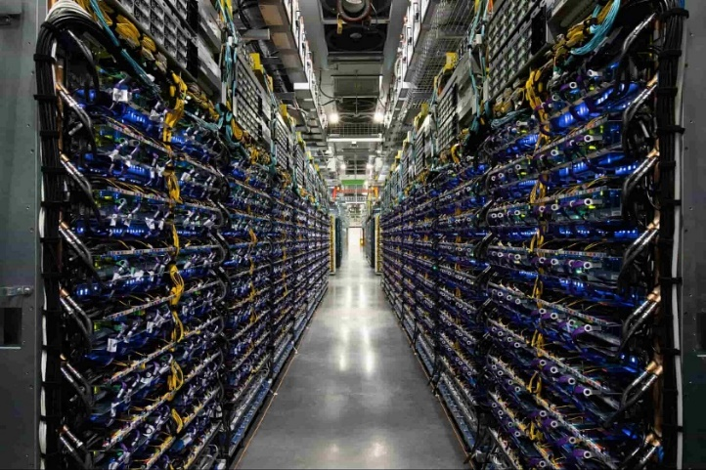
Fast-forward to today: ConvNets are everywhere
Self-driving cars (video courtesy Tesla)
https://www.tesla.com/AI
Cloud TPU v4 Pods
https://cloud.google.com/tpu/

Slide 30
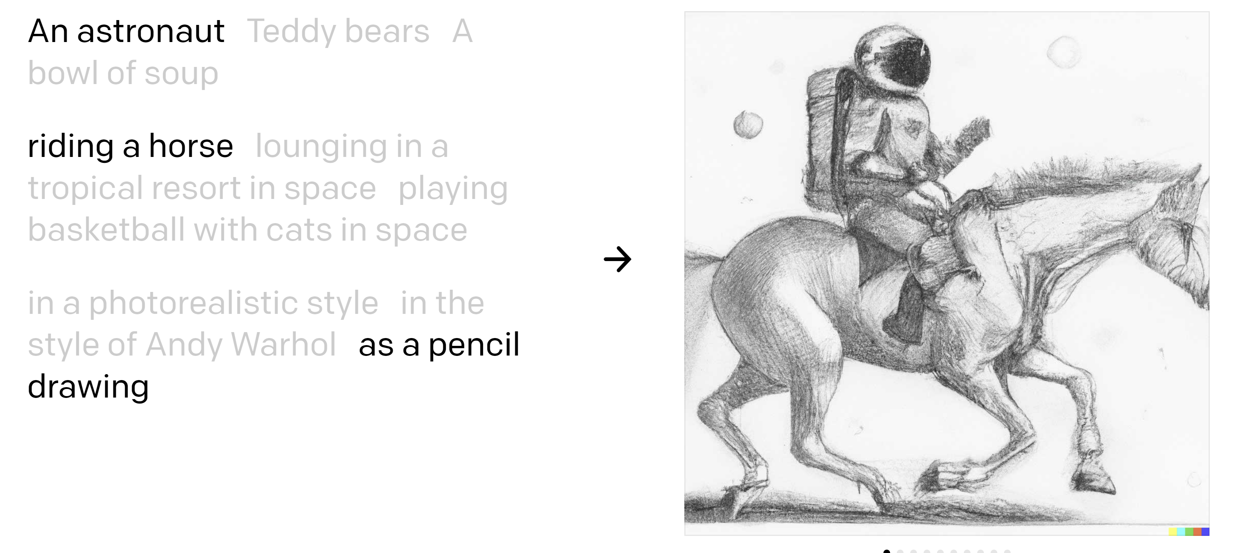
Text-to-image
https://openai.com/dall-e-2/

Slide 31
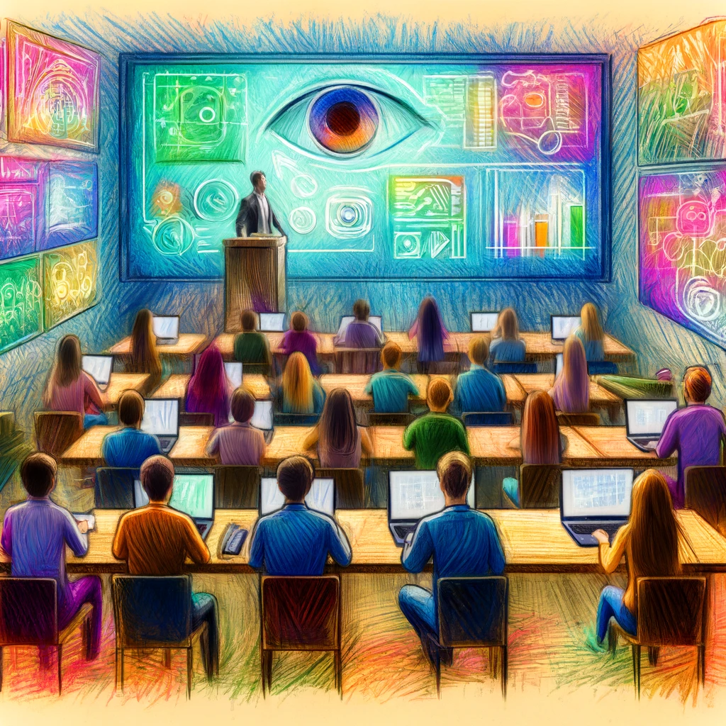
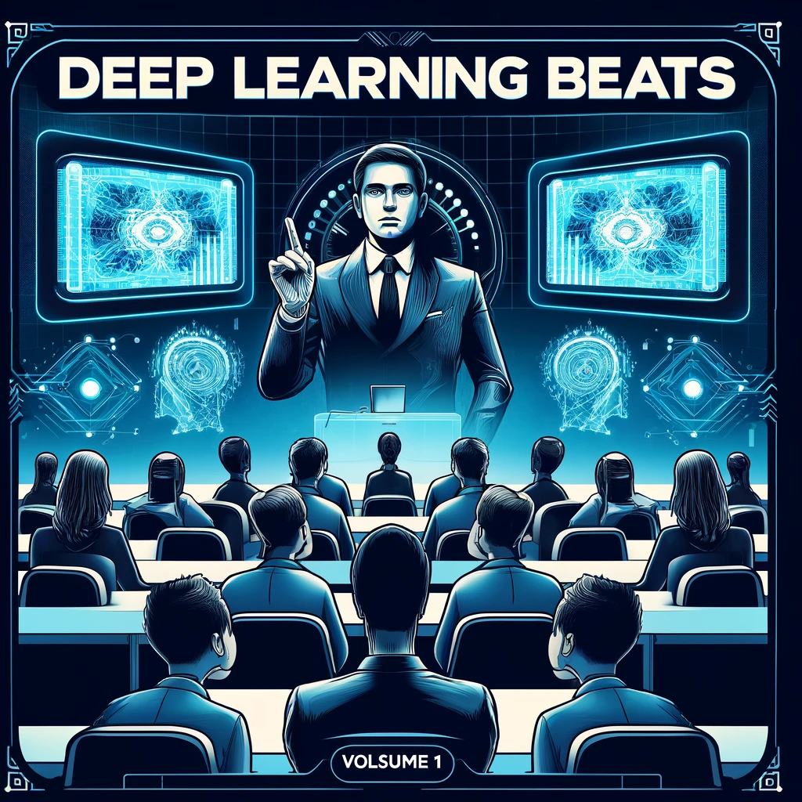
“A computer vision class watching a cool lecture, crayon drawing”
“A computer vision class watching a cool lecture, album cover”

Slide 32
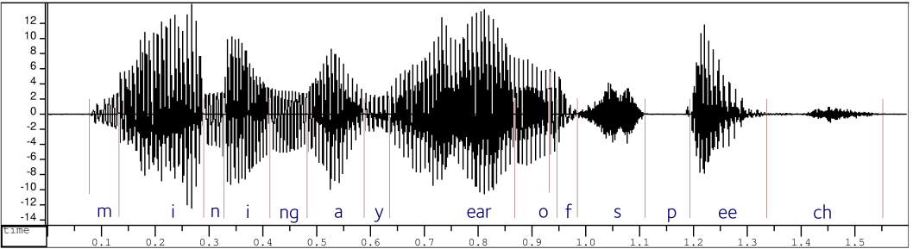
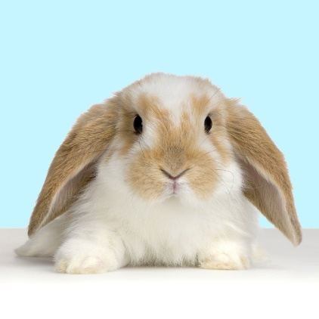
What is a ConvNet?
Version of deep neural networks designed for signals
1D signals (e.g., speech waveforms)
2D signals (e.g., images)

Slide 33
Motivation – Feature Learning

Slide 34
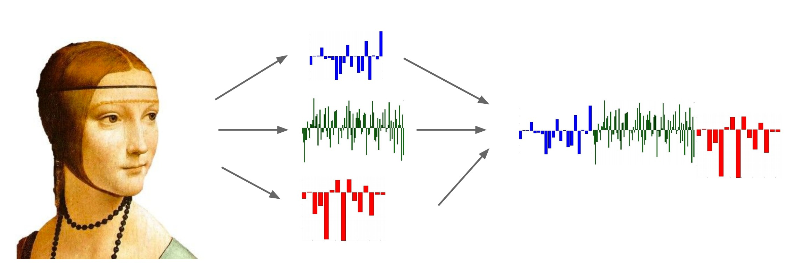
Life Before Deep Learning
SVM
Ans
Input Pixels
Extract Hand-Crafted Features
Concatenate into a vector x
Linear Classifier
Figure: Karpathy 2016

Slide 35
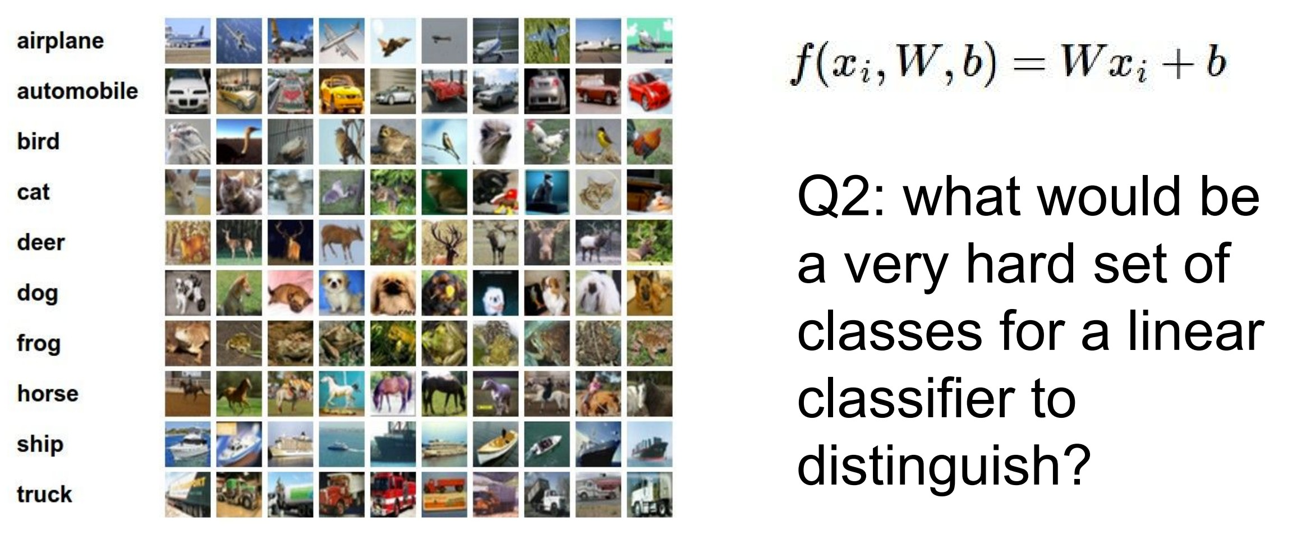
Why use features? Why not pixels?
Q: What would be a
very hard set of classes for a linear classifier to distinguish?
(assuming x = pixels)
Slide from Karpathy 2016

Slide 36
Goal: linearly separable classes

Slide 37
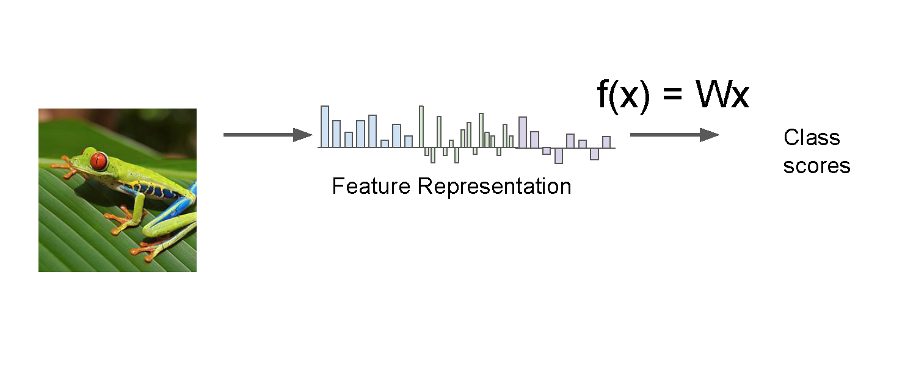
Aside: Image Features
Slide credit: Fei-Fei Li & Andrej Karpathy & Serena Leung

Slide 38
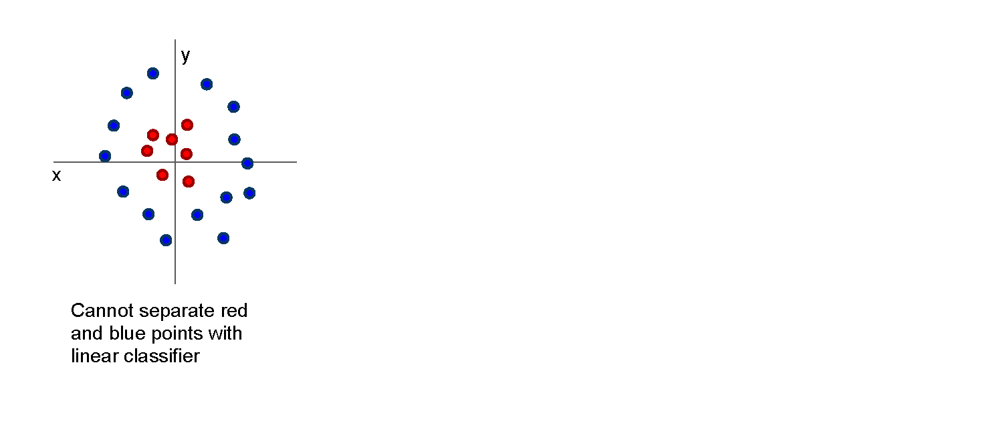
Image Features: Motivation
Slide credit: Fei-Fei Li & Andrej Karpathy & Serena Leung

Slide 39
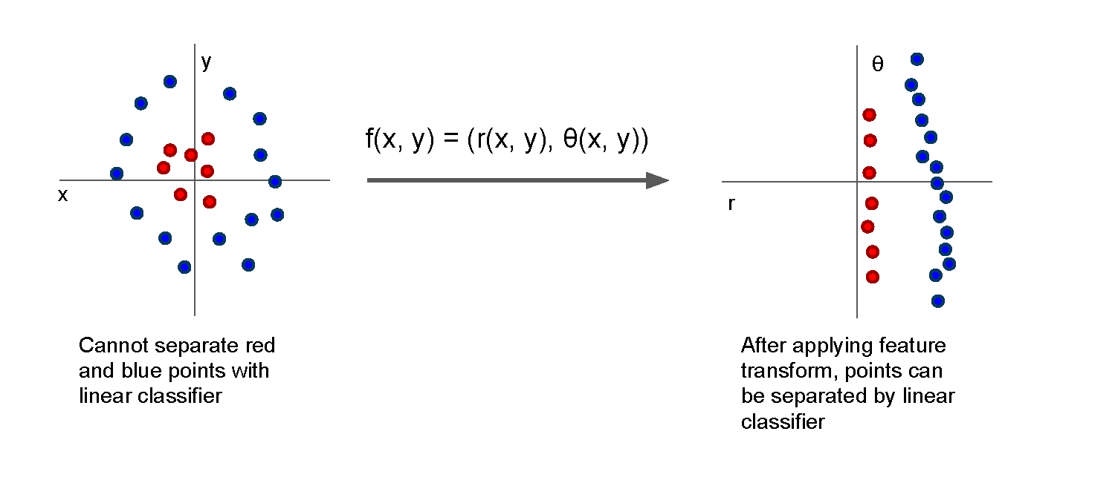
Image Features: Motivation
Slide credit: Fei-Fei Li & Andrej Karpathy & Serena Leung

Slide 40
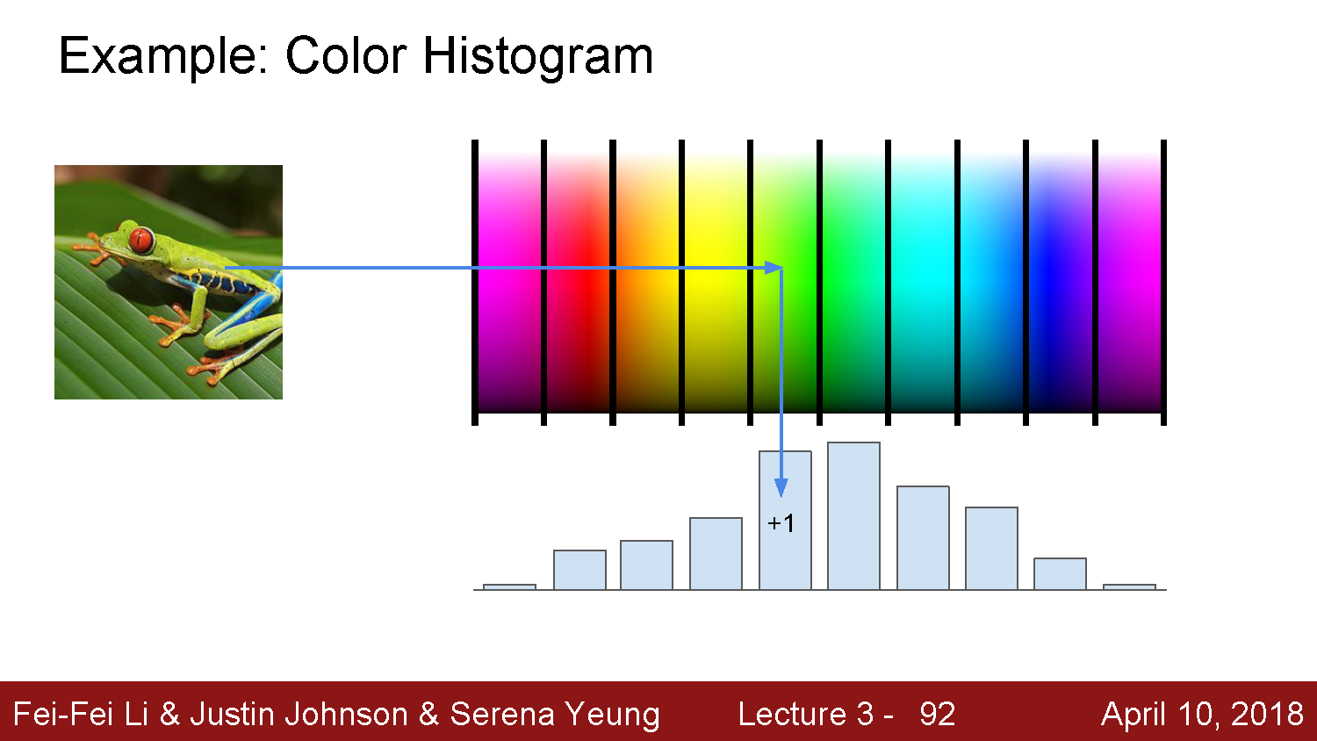
Slide credit: Fei-Fei Li & Andrej Karpathy & Serena Leung

Slide 41
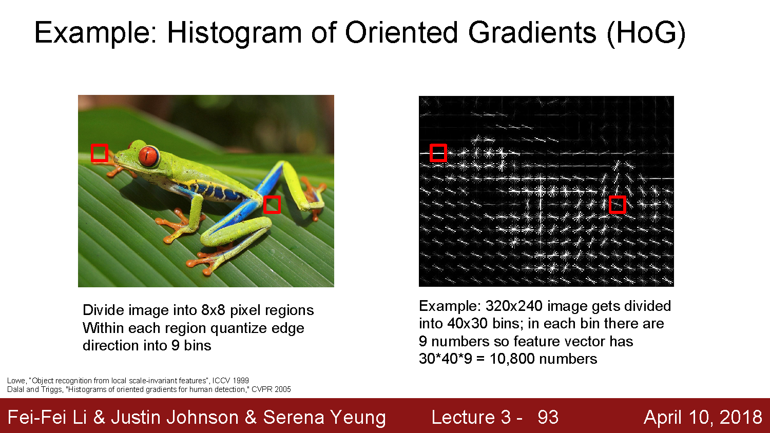
Slide credit: Fei-Fei Li & Andrej Karpathy & Serena Leung

Slide 42
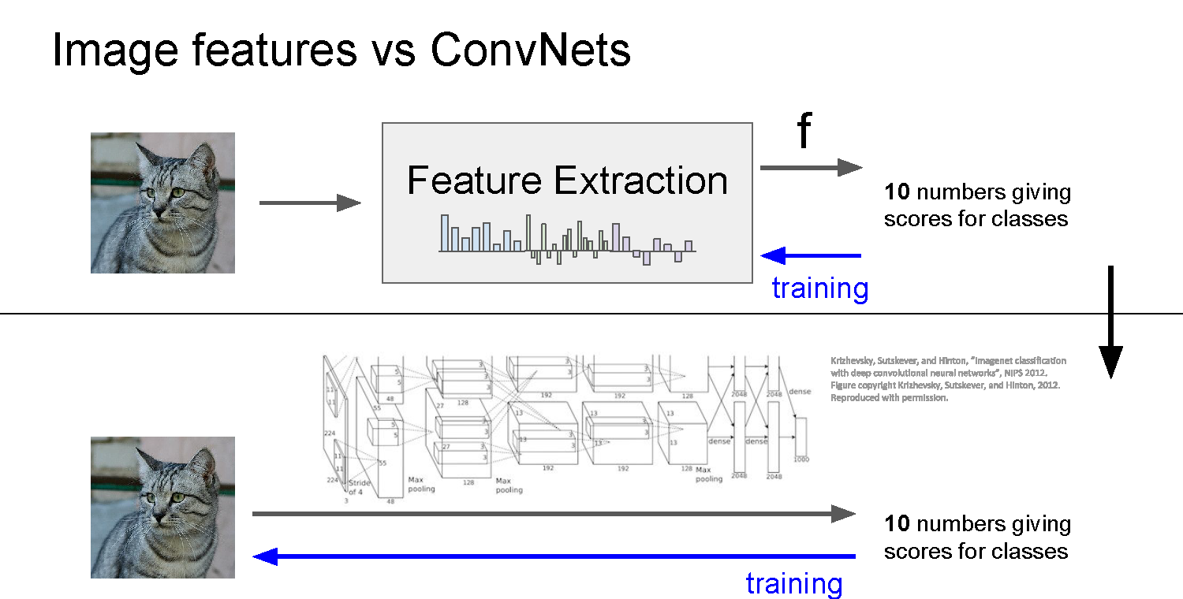
Slide credit: Fei-Fei Li & Andrej Karpathy & Serena Leung

Slide 43
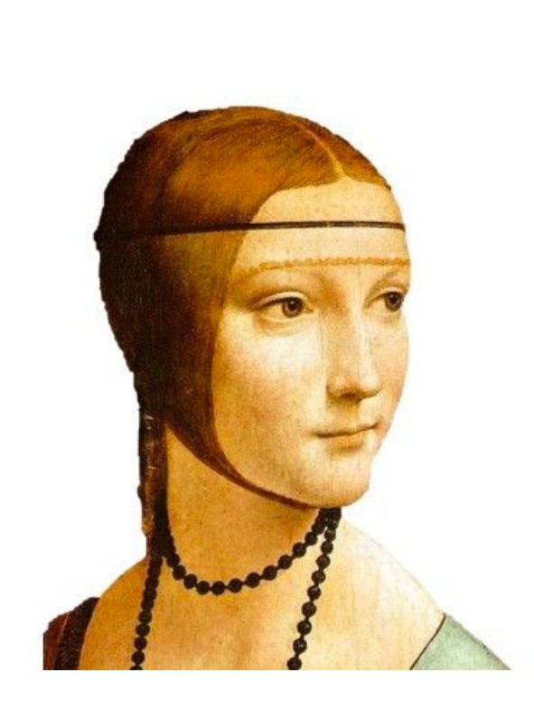
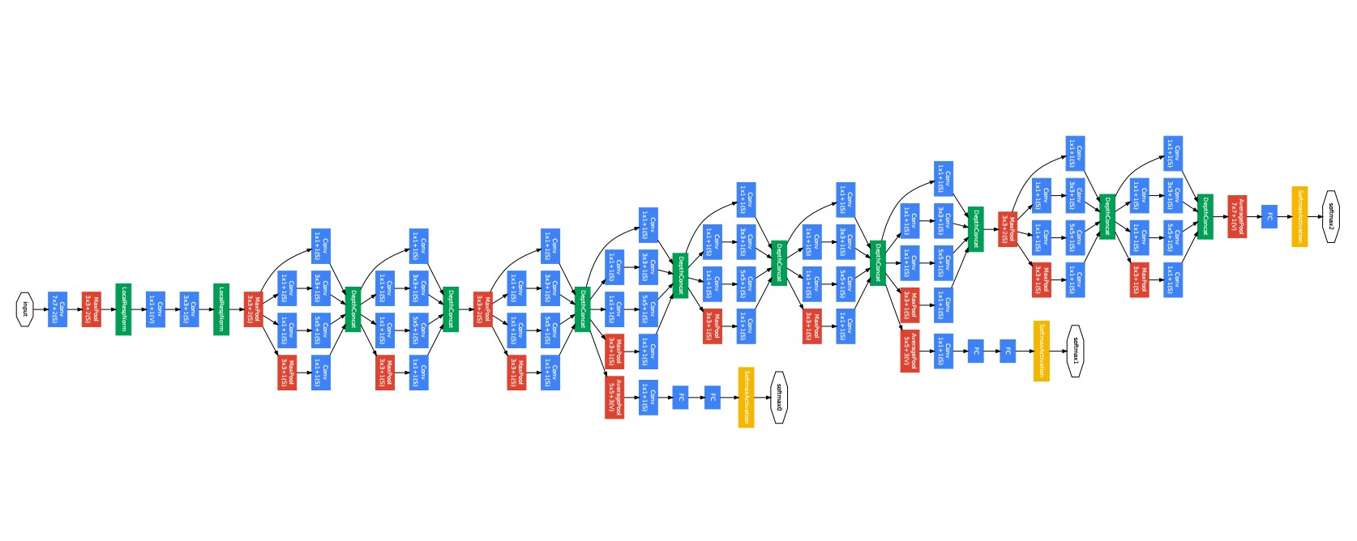
Last layer of many CNNs is a linear classifier
This piece is just a linear classifier
Ans
(GoogLeNet)
Input Pixels
Perform everything with a big neural network, trained end-to-end
Key: perform enough processing so that by the time you get to the end of the network, the classes are linearly separable

Slide 44
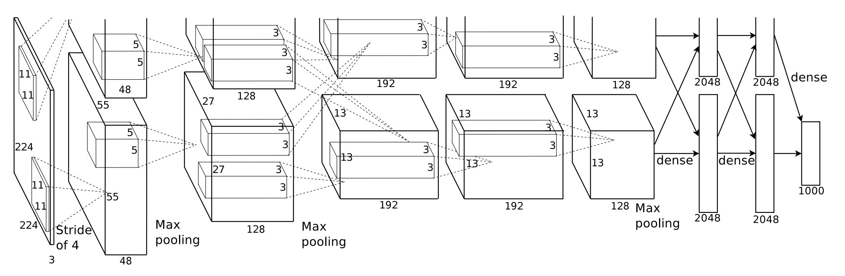
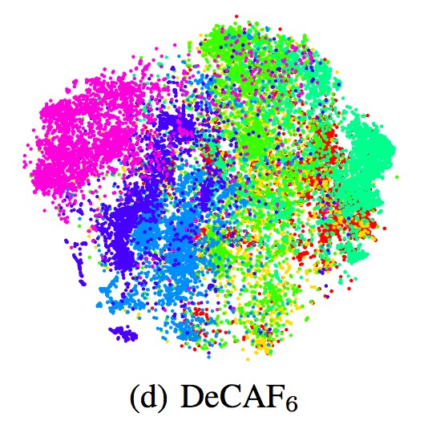
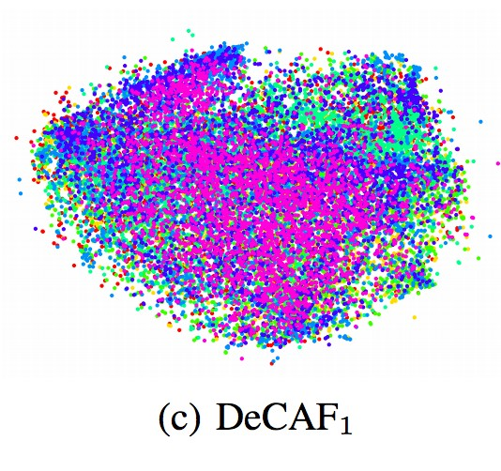
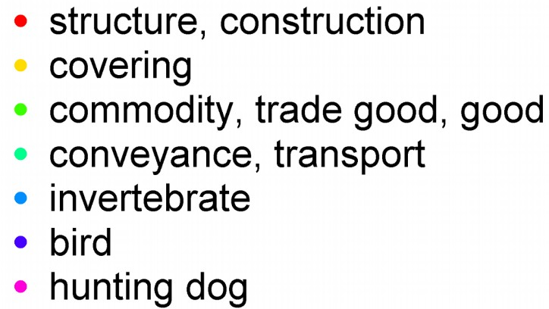
Visualizing AlexNet in 2D with t-SNE
Linear Classifier
(2D visualization using t-SNE)
[Donahue, “DeCAF: DeCAF: A Deep Convolutional …”, arXiv 2013]

Slide 45
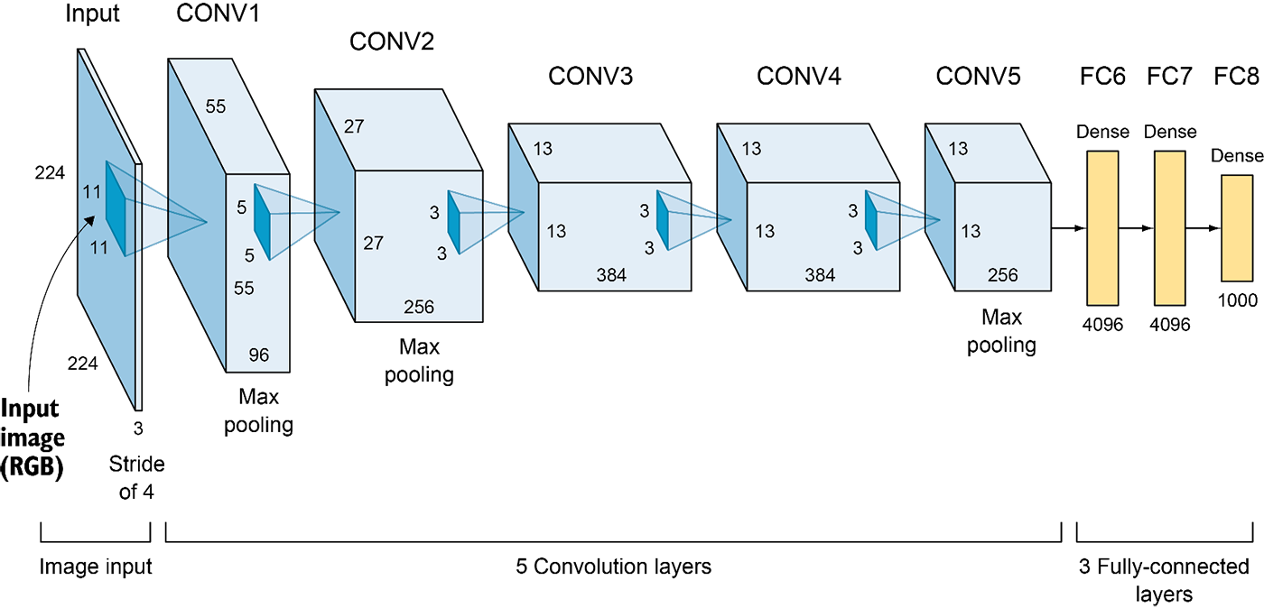
Convolutional neural networks
Layer types:
Convolutional layer
Pooling layer
Fully-connected layer

Slide 46
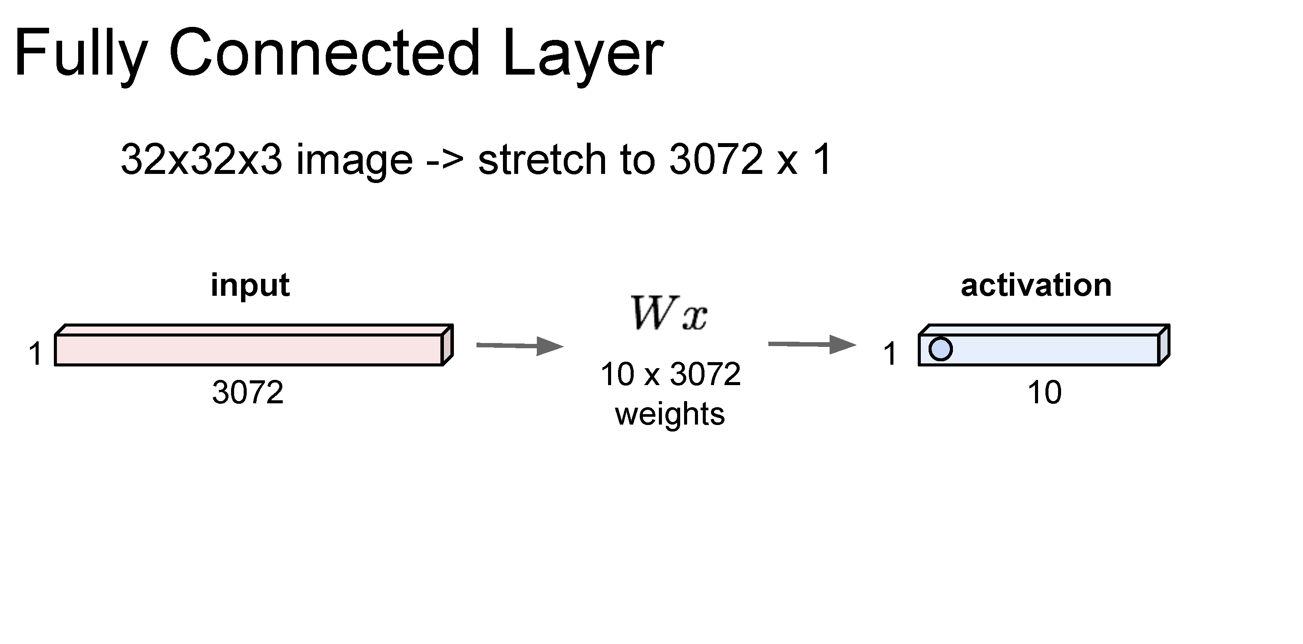
Slide credit: Fei-Fei Li & Andrej Karpathy & Serena Leung

Slide 47
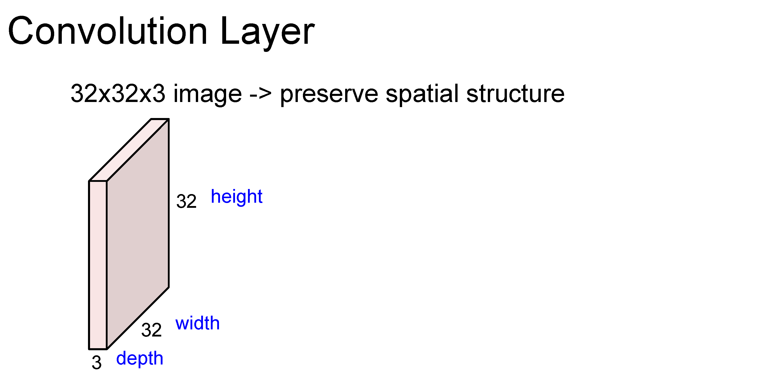
Slide credit: Fei-Fei Li & Andrej Karpathy & Serena Leung

Slide 48
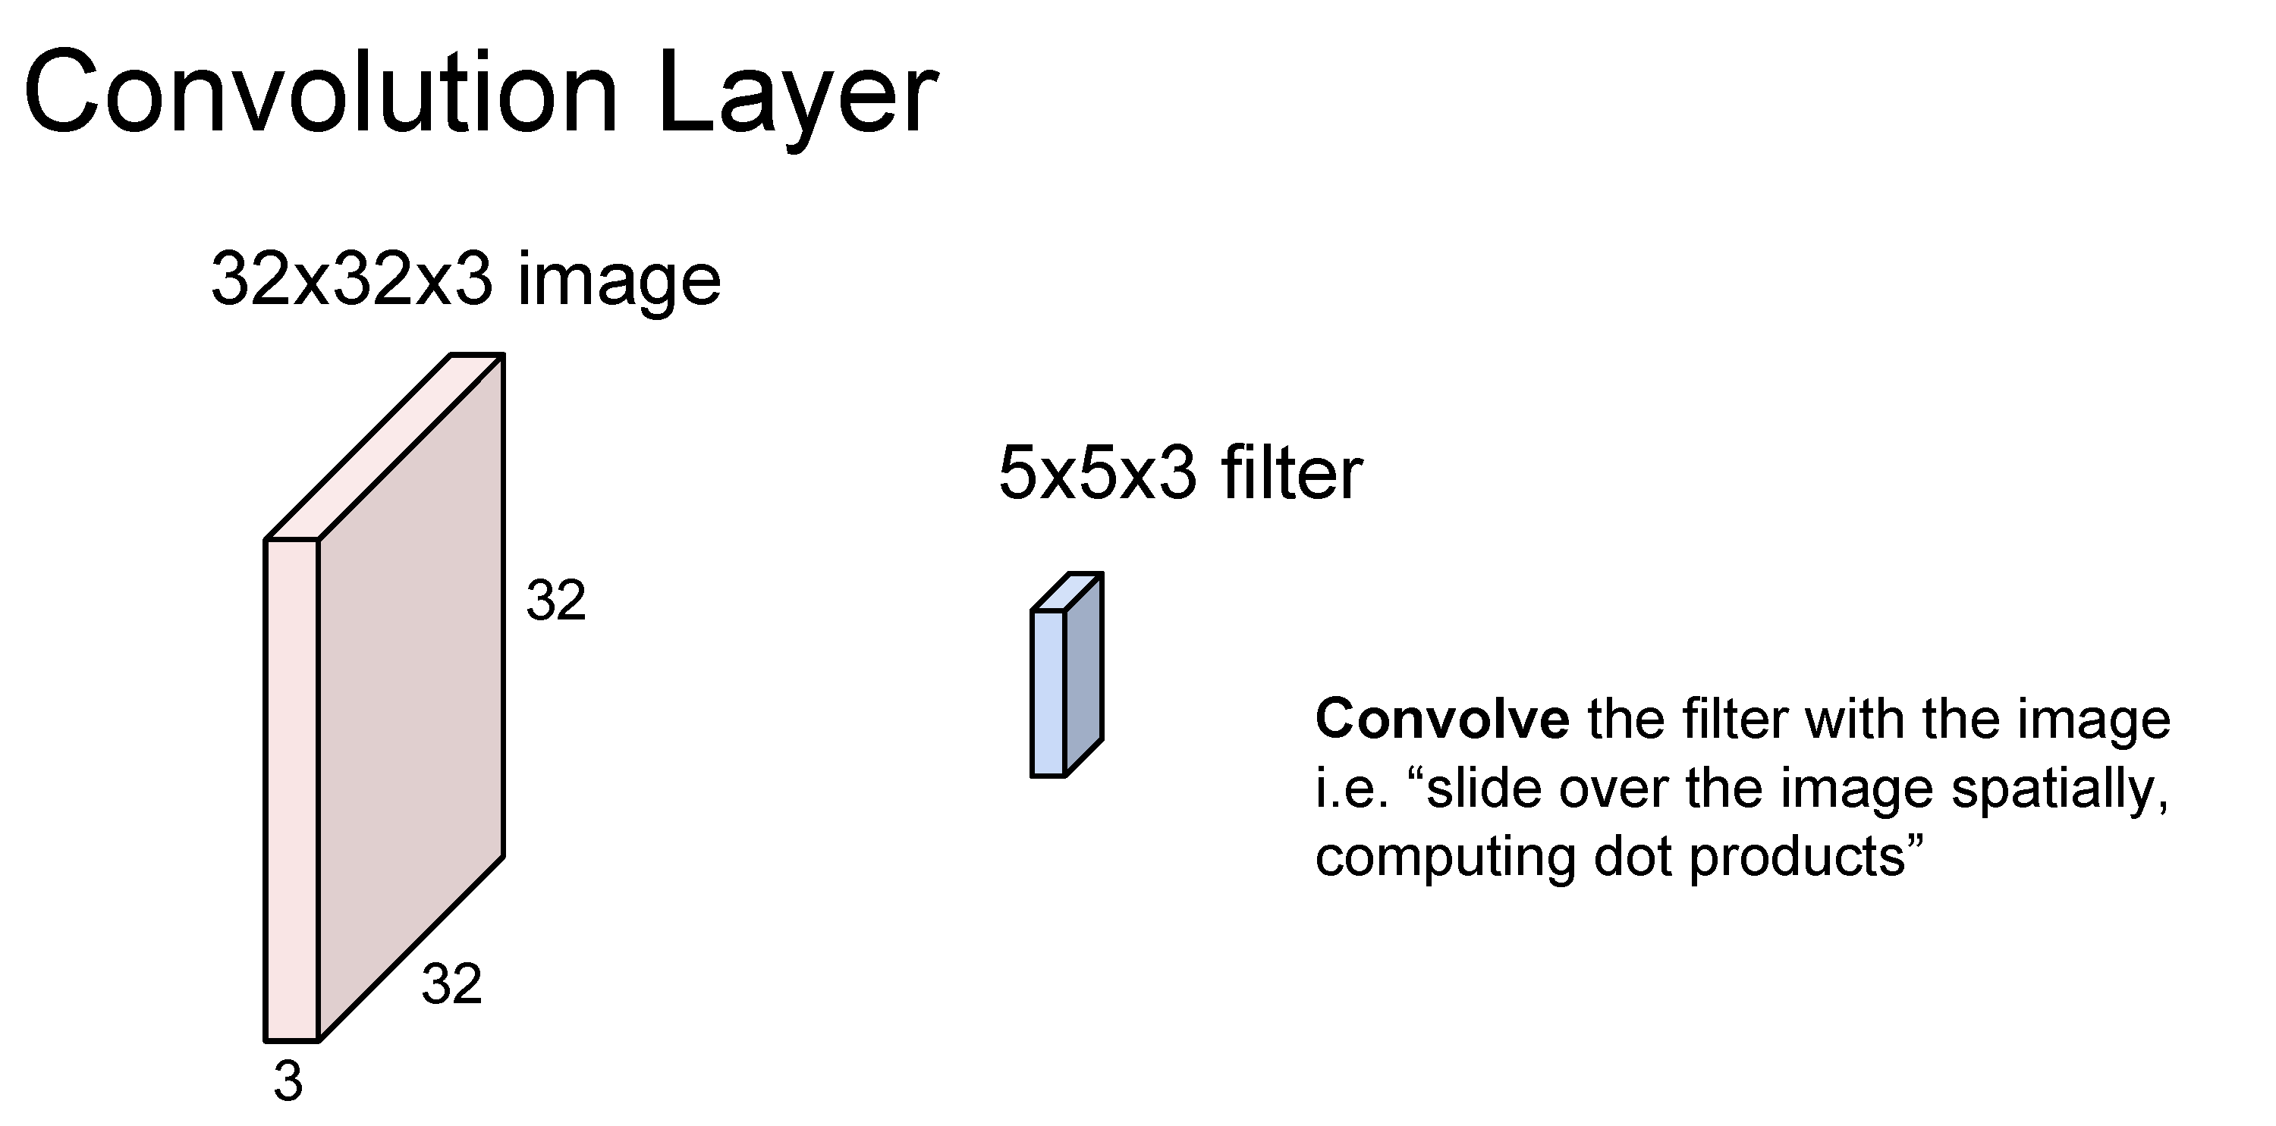
Slide credit: Fei-Fei Li & Andrej Karpathy & Serena Leung

Slide 49

Slide credit: Fei-Fei Li & Andrej Karpathy & Serena Leung

Slide 50
Number of weights: 5 x 5 x 3 + 1 = 76
(vs. 3072 for a fully-connected layer)
(+1 for bias term)
Adapted from Fei-Fei Li & Andrej Karpathy & Serena Leung

Slide 51

Slide credit: Fei-Fei Li & Andrej Karpathy & Serena Leung

Slide 52

Slide credit: Fei-Fei Li & Andrej Karpathy & Serena Leung

Slide 53

Slide credit: Fei-Fei Li & Andrej Karpathy & Serena Leung

Slide 54

(total number of parameters to learn: 6 x (75 + 1) = 456)

Slide 55


How many parameters are in a convolution layer consisting of 3 3x3x1 filters (each with bias term)?
ⓘ Start presenting to display the poll results on this slide.

Slide 56

Slide credit: Fei-Fei Li & Andrej Karpathy & Serena Leung

Slide 57


Slide 58

Slide credit: Fei-Fei Li & Andrej Karpathy & Serena Leung

Slide 59

Slide credit: Fei-Fei Li & Andrej Karpathy & Serena Leung

Slide 60

Slide credit: Fei-Fei Li & Andrej Karpathy & Serena Leung

Slide 61

Slide credit: Fei-Fei Li & Andrej Karpathy & Serena Leung

Slide 62

Slide credit: Fei-Fei Li & Andrej Karpathy & Serena Leung

Slide 63

Slide credit: Fei-Fei Li & Andrej Karpathy & Serena Leung

Slide 64

Slide credit: Fei-Fei Li & Andrej Karpathy & Serena Leung

Slide 65

Slide credit: Fei-Fei Li & Andrej Karpathy & Serena Leung

Slide 66

Slide credit: Fei-Fei Li & Andrej Karpathy & Serena Leung

Slide 67

Slide credit: Fei-Fei Li & Andrej Karpathy & Serena Leung

Slide 68

Slide credit: Fei-Fei Li & Andrej Karpathy & Serena Leung

Slide 69

Slide credit: Fei-Fei Li & Andrej Karpathy & Serena Leung

Slide 70

Slide credit: Fei-Fei Li & Andrej Karpathy & Serena Leung

Slide 71

Slide credit: Fei-Fei Li & Andrej Karpathy & Serena Leung

Slide 72

Slide credit: Fei-Fei Li & Andrej Karpathy & Serena Leung

Slide 73

Slide credit: Fei-Fei Li & Andrej Karpathy & Serena Leung

Slide 74

Slide credit: Fei-Fei Li & Andrej Karpathy & Serena Leung

Slide 75

Slide credit: Fei-Fei Li & Andrej Karpathy & Serena Leung

Slide 76

Slide credit: Fei-Fei Li & Andrej Karpathy & Serena Leung

Slide 77

Slide credit: Fei-Fei Li & Andrej Karpathy & Serena Leung

Slide 78

“1x1 convolutions”
Slide credit: Fei-Fei Li & Andrej Karpathy & Serena Leung

Slide 79
Convolutional layer—properties
Small number of parameters to learn compared to a fully connected layer
Preserves spatial structure—output of a convolutional layer is shaped like an image
Translation equivariant: passing a translated image through a convolutional layer is (almost) equivalent to translating the convolution output (but be careful of image boundaries)

Slide 80

Slide credit: Fei-Fei Li & Andrej Karpathy & Serena Leung

Slide 81

Slide credit: Fei-Fei Li & Andrej Karpathy & Serena Leung

Slide 82

Slide credit: Fei-Fei Li & Andrej Karpathy & Serena Leung

Slide 83

https://cs.stanford.edu/people/karpathy/convnetjs/demo/cifar10.html

Slide 84
AlexNet (2012)
6M parameters in total
Output: 1,000-D vector (probabilities over 1,000 ImageNet categories)
Elgendy, Deep Learning for Vision Systems, https://livebook.manning.com/book/grokking-deep-learning-for-computer-vision/chapter-5/v-3/

Slide 85


Slide 86
Big picture
A convolutional neural network can be thought of as a function from images to class scores
With millions of adjustable weights…
… leading to a very non-linear mapping from images to features / class scores.
We will set these weights based on classification accuracy on training data…
… and hopefully our network will generalize to new images at test time

Slide 87
Data is key—enter ImageNet
ImageNet (and the ImageNet Large-Scale Visual Recognition Challege, aka ILSVRC) has been key to training deep learning methods
J. Deng, W. Dong, R. Socher, L.-J. Li, K. Li and L. Fei-Fei, ImageNet: A Large-Scale Hierarchical Image Database. CVPR, 2009.
ILSVRC: 1,000 object categories, each with ~700-1300 training images. Test set has 100 images per categories (100,000 total).
Standard ILSVRC error metric: top-5 error
if the correct answer for a given test image is in the top 5 categories, your answer is judged to be correct

Slide 88

Performance improvements on ILSVRC
ImageNet Large-Scale Visual Recognition Challenge
Held from 2011-2017
1000 categories, 1000 training images per category
Test performance on held-out test set of images
Pre-deep learning era
{
Deep learning era
AlexNet

Slide 89

Image credit: Zaid Alyafeai, Lahouari Ghouti

Slide 90
Questions?

