Slide 1

Binocular Stereo
CS5670: Computer Vision
What is this?
Single image stereogram, https://en.wikipedia.org/wiki/Autostereogram

Slide 2
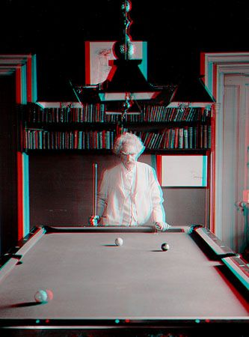
“Mark Twain at Pool Table", no date, UCR Museum of Photography

Slide 3
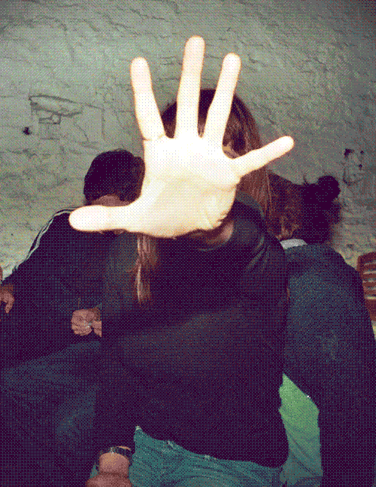
https://giphy.com/gifs/wigglegram-706pNfSKyaDug

Slide 4

Stereo Vision as Localizing Points in 3D
An object point will project to some point in our image
That image point corresponds to a ray in the world
Two rays intersect at a single point, so if we want to localize points in 3D we need 2 eyes

Slide 5
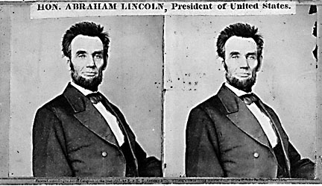
Stereo
Given two images from different viewpoints
  How can we compute the depth of each point in the image?
  Based on how much each pixel moves between the two images

Slide 6
Epipolar geometry
epipolar lines
(x₁, y₁)
(x₂, y₁)
Two images captured by a purely horizontal translating camera
(rectified stereo pair)
x₂ - x₁ = the disparity of pixel (x₁, y₁)

Slide 7
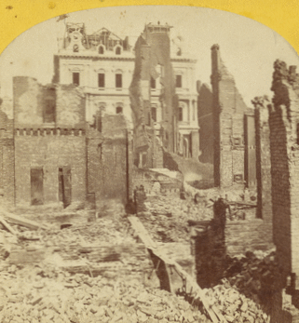
Disparity = inverse depth
http://stereo.nypl.org/view/41729
(Or, hold a finger in front of your face and wink each eye in succession.)

Slide 8
Your basic stereo matching algorithm
Match Pixels in Conjugate Epipolar Lines
  Assume brightness constancy
  This is a challenging problem
  Hundreds of approaches
    A good survey and evaluation: http://www.middlebury.edu/stereo/

Slide 9
Your basic stereo matching algorithm
For each epipolar line
For each pixel in the left image
    compare with every pixel on same epipolar line in right image
    pick pixel with minimum match cost
Improvement: match windows

Slide 10
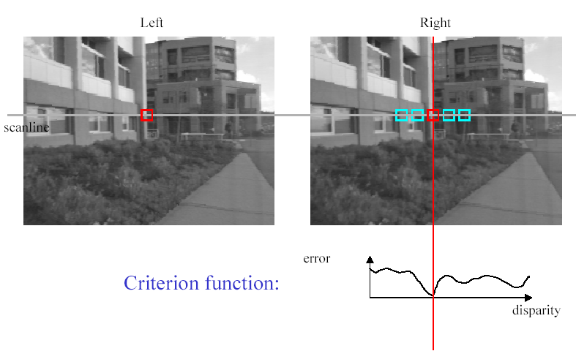
Stereo matching based on SSD
SSD
^{d}min d
Best matching disparity

Slide 11
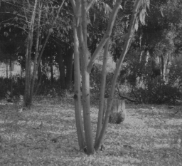
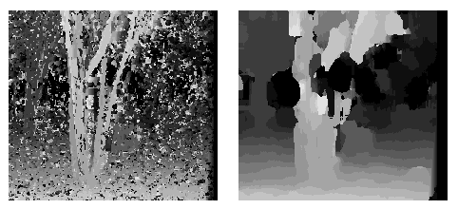
Window size
W = 3
W = 20
Effect of window size
Better results with adaptive window
  T. Kanade and M. Okutomi, A Stereo Matching Algorithm with an Adaptive Window: Theory and Experiment, ICRA 1991.
  D. Scharstein and R. Szeliski. Stereo matching with nonlinear diffusion. IJCV, July 1998
  Smaller window
    more detail
    - more noise
  Larger window
    less noise
    - less detail
Notes:
smaller window: more detail, more noise
bigger window: less noise, more detail

Slide 12
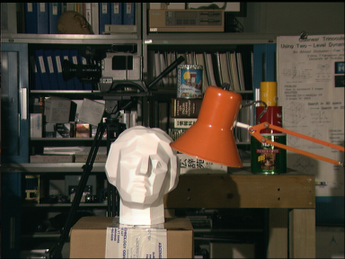

Stereo results
  Data from University of Tsukuba
  Similar results on other images without ground truth
Scene
Ground truth

Slide 13
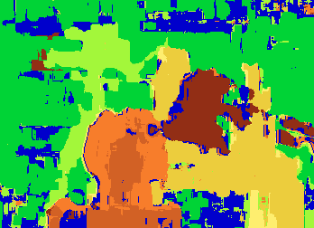

Results with window search
Window-based matching
(best window size)
Ground truth

Slide 14
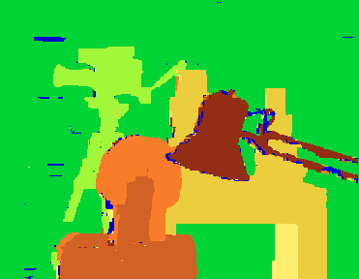
Better methods exist...
Graph cuts-based method
  Boykov et al., Fast Approximate Energy Minimization via Graph Cuts,
  International Conference on Computer Vision 1999.
Ground truth
    For the latest and greatest: http://www.middlebury.edu/stereo/

Slide 15
Stereo as energy minimization
What defines a good stereo correspondence?
  Match quality
    Want each pixel to find a good match in the other image
  Smoothness
    If two pixels are adjacent, they should (usually) move about the same amount

Slide 16

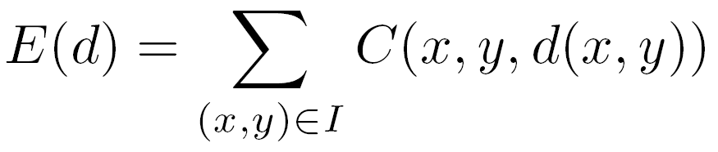

Stereo as energy minimization
Find disparity map d that minimizes an energy function
Simple pixel / window matching
=
SSD distance between windows I(x, y) and J(x + d(x,y), y)

Slide 17
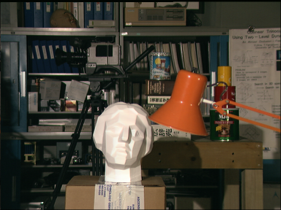
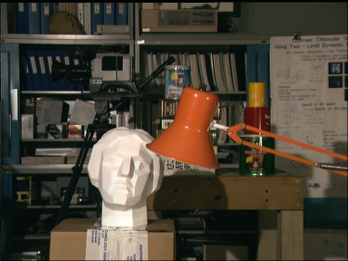
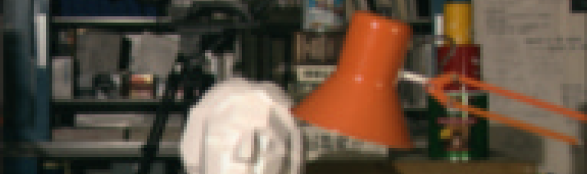
Stereo as energy minimization
y = 141
d
x
C(x, y, d); the disparity space image (DSI)

Slide 18
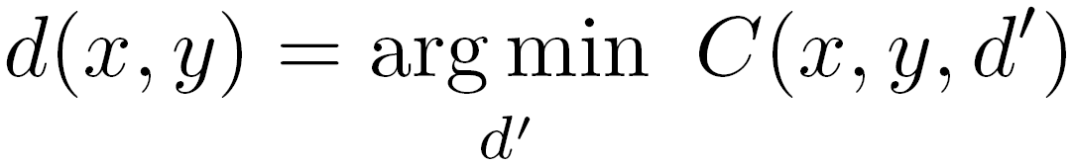
Stereo as energy minimization
y = 141
d
x
Simple pixel / window matching: choose the minimum of each column in the DSI independently:

Slide 19
Greedy selection of best match

Slide 20
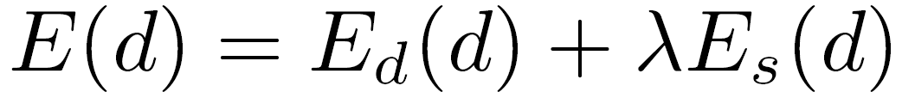
Stereo as energy minimization
Better objective function
{
{
match cost
smoothness cost
    Want each pixel to find a good match in the other image
    Adjacent pixels should (usually) move about the same amount

Slide 21
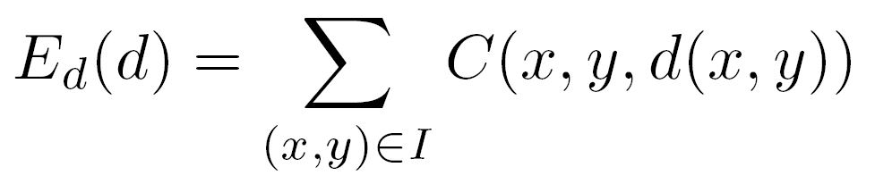
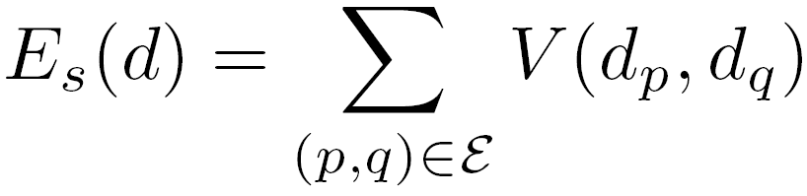

Stereo as energy minimization
match cost:
smoothness cost:
: set of neighboring pixels
4-connected neighborhood
8-connected neighborhood

Slide 22
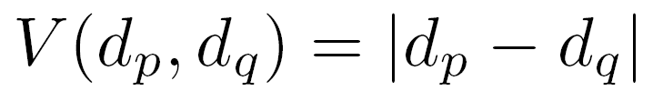
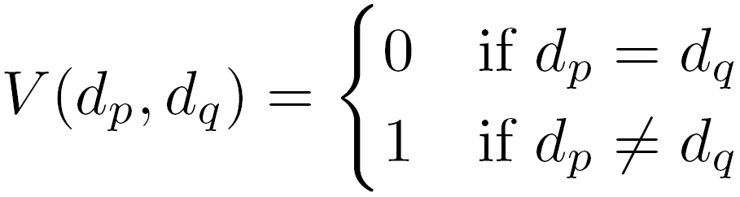
Smoothness cost
How do we choose V?
L₁ distance
“Potts model”

Slide 23
Smoothness cost
If λ = infinity, then we only consider smoothness
Optimal solution is a surface of constant depth/disparity
  Fronto-parallel surface
In practice, want to balance data term with smoothness term

Slide 24
Dynamic programming
Can minimize this independently per scanline using dynamic programming (DP)

Slide 25
Dynamic programming
y = 141
d
x
Finds “smooth”, low-cost path through DPI from left to right
Visiting a node incurs its data cost, switching disparities from one column to the next also incurs a (smoothness) cost

Slide 26
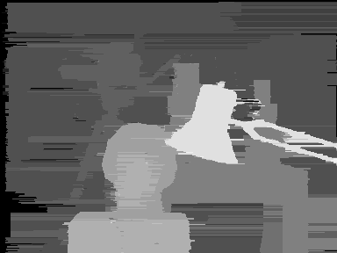
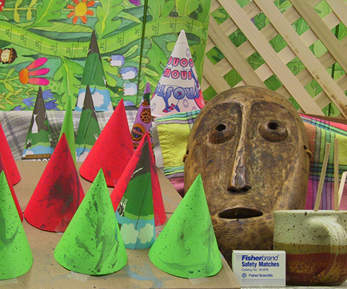
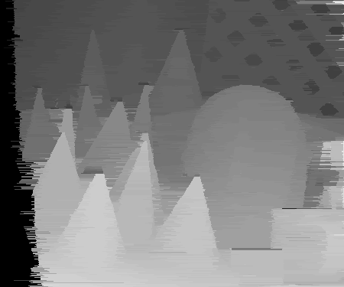
Dynamic Programming

Slide 27
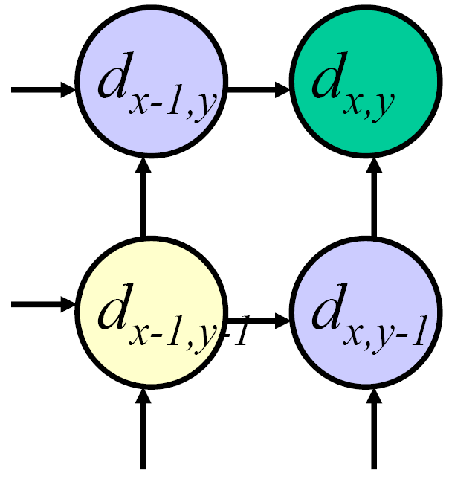
Dynamic programming
Can we apply this trick in 2D as well?
No: the shortest path trick only works to find a 1D path
Slide credit: D. Huttenlocher

Slide 28
Stereo as a minimization problem
The 2D problem has many local minima
  Gradient descent doesn’t work well
And a large search space
  n x m image w/ k disparities has k^{nm} possible solutions
  Finding the global minimum is NP-hard in general
Good approximations exist (e.g., graph cuts algorithms)

Slide 29
Questions?

Slide 30
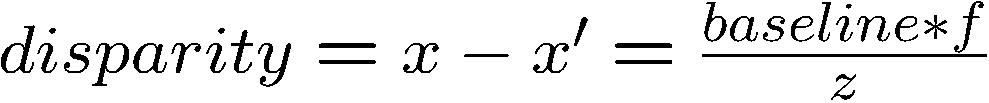
Depth from disparity
X
z
x
x’
f
f
C
baseline
C’

Slide 31
Stereo reconstruction pipeline
Steps
  Calibrate cameras
  Rectify images
  Compute disparity
  Estimate depth
What will cause errors?
  Camera calibration errors
  Poor image resolution
  Occlusions
  Violations of brightness constancy (specular reflections)
  Large motions
  Low-contrast image regions

Slide 32
Variants of stereo

Slide 33
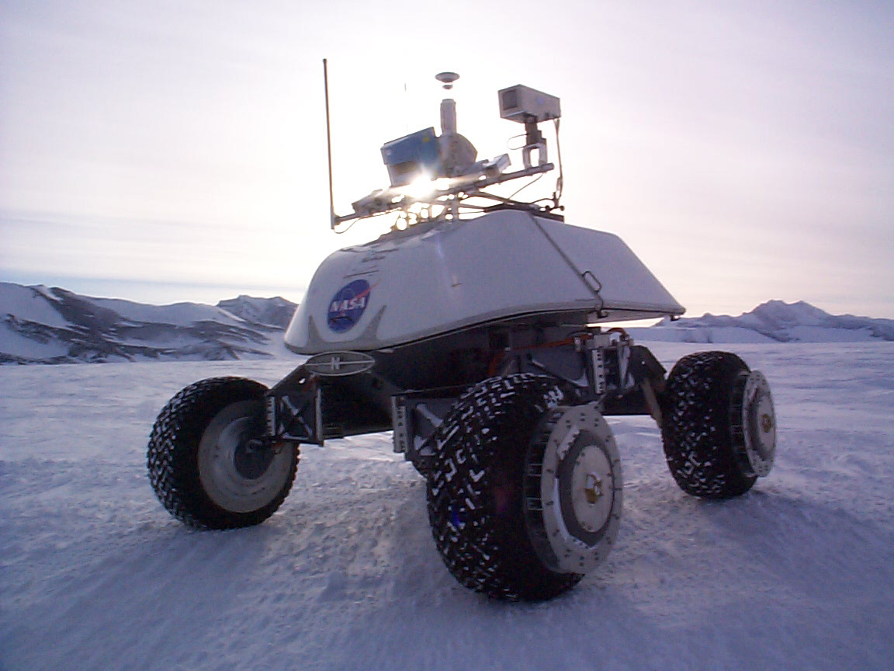
Real-time stereo
Nomad robot searches for meteorites in Antartica
Used for robot navigation (and other tasks)
  Several real-time stereo techniques have been developed (most based on simple discrete search)

Slide 34
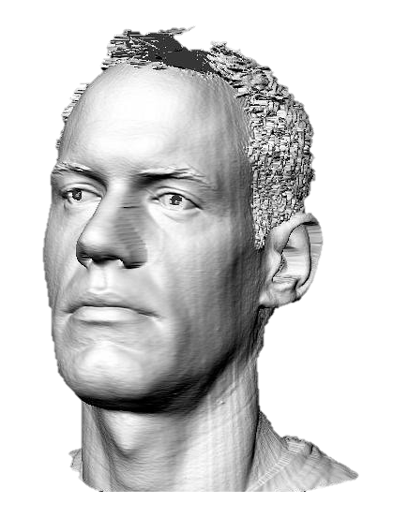
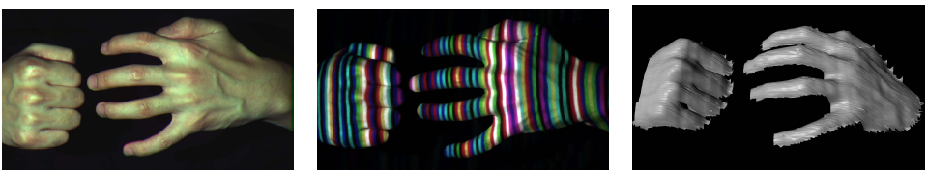
Active stereo with structured light
Li Zhang’s one-shot stereo
camera 1
camera 1
projector
projector
camera 2
Project “structured” light patterns onto the object
  simplifies the correspondence problem
  basis for active depth sensors, such as Kinect and iPhone X (using IR)

Slide 35
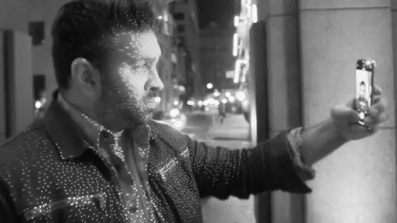
Active stereo with structured light
https://ios.gadgethacks.com/news/watch-iphone-xs-30k-ir-dots-scan-your-face-0180944/

Slide 36
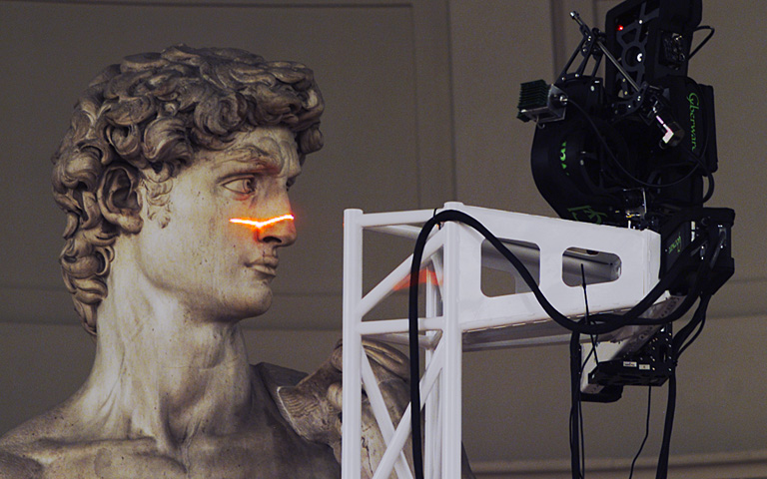
Laser scanning
Digital Michelangelo Project
http://graphics.stanford.edu/projects/mich/
Optical triangulation
  Project a single stripe of laser light
  Scan it across the surface of the object
  This is a very precise version of structured light scanning

Slide 37
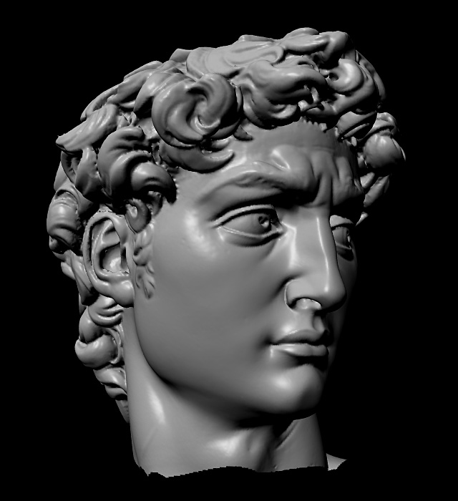
Laser scanned models
  The Digital Michelangelo Project, Levoy et al.

Slide 38
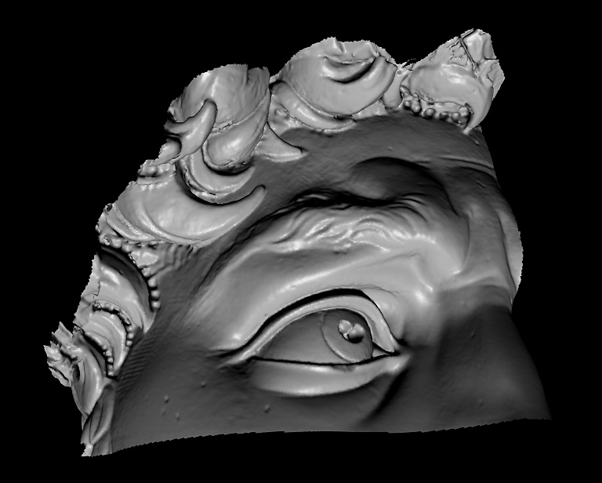
Laser scanned models
  The Digital Michelangelo Project, Levoy et al.

Slide 39
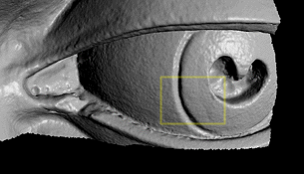
Laser scanned models
  The Digital Michelangelo Project, Levoy et al.

Slide 40
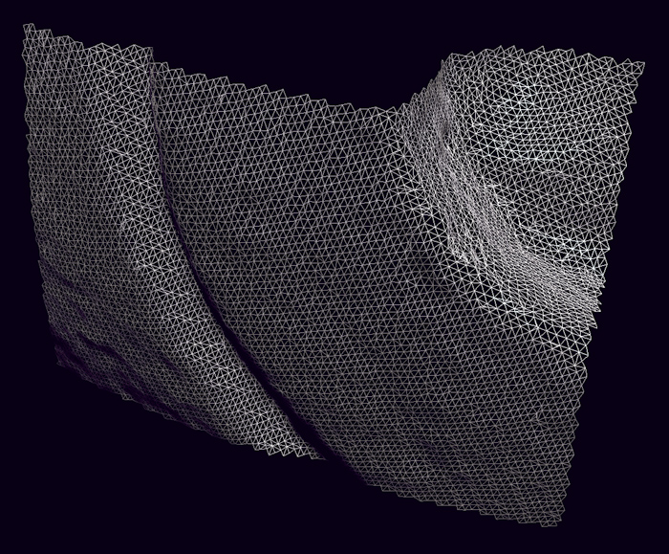
Laser scanned models
  The Digital Michelangelo Project, Levoy et al.

Slide 41
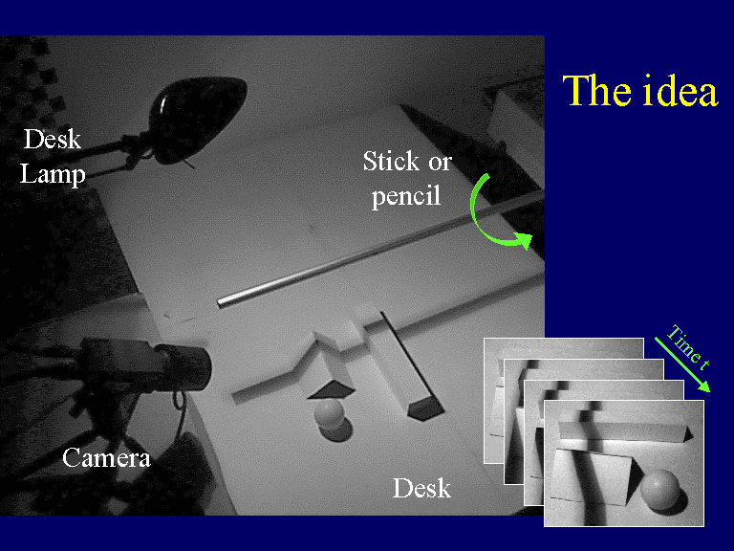


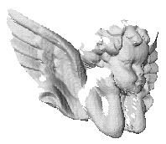
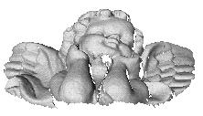
3D Photography on your Desk
http://www.vision.caltech.edu/bouguetj/ICCV98/

Slide 42
Questions?

