Slide 1
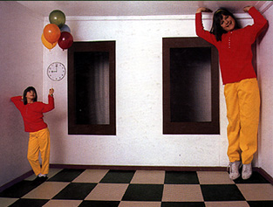
Single-View Modeling
CS5670: Computer Vision

Slide 2
Announcements
Project 3: Autostitch (Panorama Stitching)
  Due on Friday, March 15, by 8pm
  To be done in groups of 2
  If you need help finding a team member, let us know

Slide 3
Single-View Modeling
Ames Room
Reading: Szeliski Chapter 11.1

Slide 4
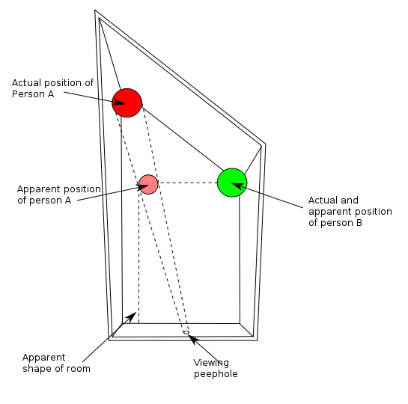
Ames Room

Slide 5
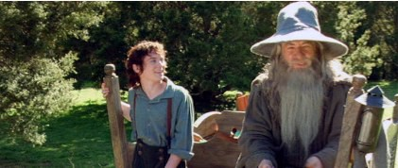
Forced perspective in film
How Lord of the Rings used forced perspective shots with a moving camera
https://www.youtube.com/watch?v=QWMFpxkGO_s

Slide 6

Forced perspective illusions
https://richardwiseman.wordpress.com/magic-illusion/

Slide 7
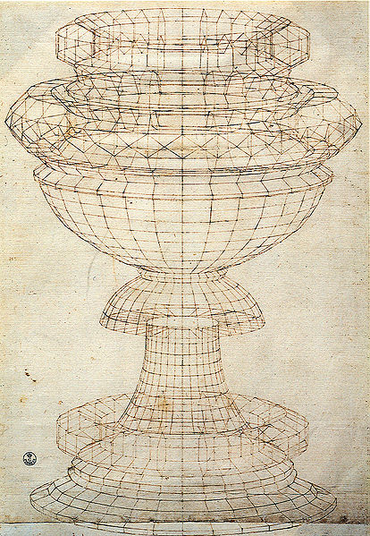
Projective geometry—what’s it good for?
Uses of projective geometry
  Drawing
  Measurements
  Mathematics for projection
  Undistorting images
  Camera pose estimation
  Object recognition
Paolo Uccello

Slide 8
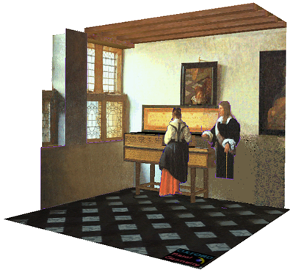
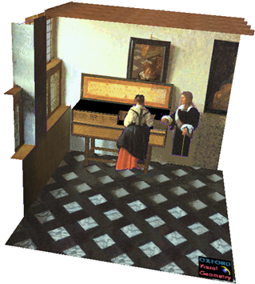

Applications of projective geometry
Vermeer’s Music Lesson
Reconstructions by Criminisi et al.

Slide 9

Making measurements in images

Slide 10
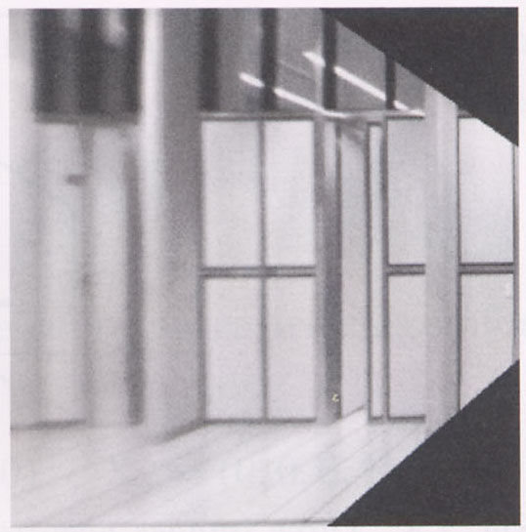
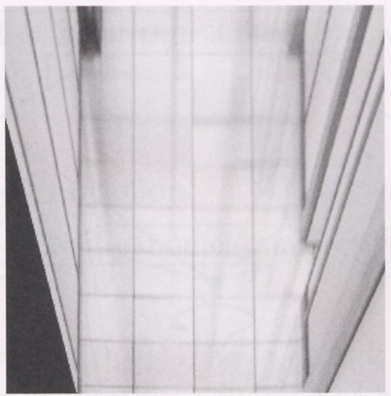
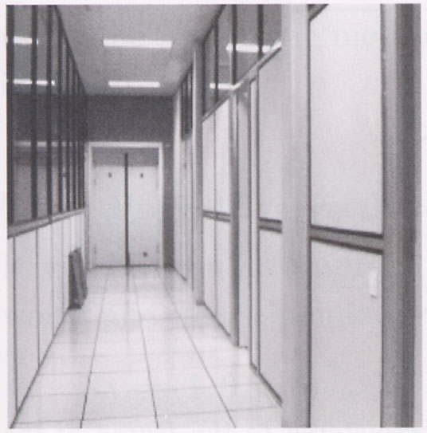
Measurements on planes
4
3
2
1
1
2
3
4
Approach: unwarp then measure
Notes:
homography!

Slide 11
Point and line duality
  A line l is a homogeneous 3-vector
  It is ⊥ to every point (ray) p on the line: l.p=0
p₁
p₂
l₁
p
l
l₂
COP
COP
  What is the line l spanned by points p₁ and p₂ ?
  l is ⊥ to p₁ and p₂ ⇒ l = p₁ × p₂
  l can be interpreted as a plane normal
  What is the intersection of two lines l₁ and l₂ ?
  p is ⊥ to l₁ and l₂ ⇒ p = l₁ × l₂
  Points and lines are dual in projective space

Slide 12
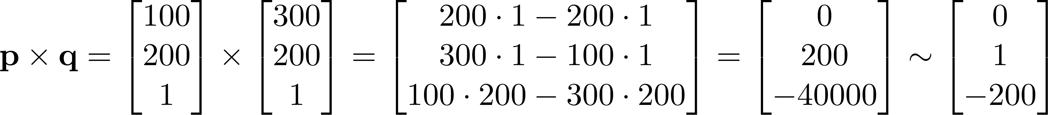
Example
r = (150, 150)
s = (250, 150)
p =(100, 200)
q = (300, 200)
What is the line passing through points p and q?
Notes:
$$
\mathbf{p} \times \mathbf{q} =
\begin{bmatrix} 100 \\ 200 \\ 1 \end{bmatrix}
\times
\begin{bmatrix} 300 \\ 200 \\ 1 \end{bmatrix} =
\begin{bmatrix}
200 \cdot 1 - 200 \cdot 1 \\
300 \cdot 1 - 100 \cdot 1 \\
100 \cdot 200 - 300 \cdot 200 \end{bmatrix} =
\begin{bmatrix} 0 \\ 200 \\ -40000 \end{bmatrix} \sim
\begin{bmatrix} 0 \\ 1 \\ -200 \end{bmatrix}
$$

Slide 13
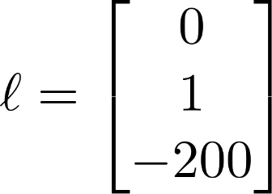
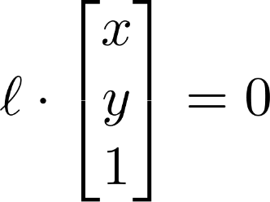

Example
r = (150, 150)
s = (250, 150)
p =(100, 200)
q = (300, 200)
How do we interpret the line ?
Answer: the set of points (x, y) such that , i.e.,
Notes:
$$
\mathbf{\ell} = \begin{bmatrix} 0 \\ 1 \\ -200 \end{bmatrix}
$$
$$
\mathbf{\ell} \cdot \begin{bmatrix} x \\ y \\ 1 \end{bmatrix} = 0
$$

Slide 14
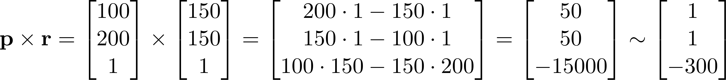

Example
r = (150, 150)
s = (250, 150)
p =(100, 200)
q = (300, 200)
What is the line passing through points p and r?
i.e., all points (x, y) such that
Notes:
$$
\mathbf{p} \times \mathbf{r} =
\begin{bmatrix} 100 \\ 200 \\ 1 \end{bmatrix}
\times
\begin{bmatrix} 150 \\ 150 \\ 1 \end{bmatrix} =
\begin{bmatrix}
200 \cdot 1 - 150 \cdot 1 \\
150 \cdot 1 - 100 \cdot 1 \\
100 \cdot 150 - 150 \cdot 200 \end{bmatrix} =
\begin{bmatrix} 50 \\ 50 \\ -15000 \end{bmatrix} \sim
\begin{bmatrix} 1 \\ 1 \\ -300 \end{bmatrix}
$$

Slide 15
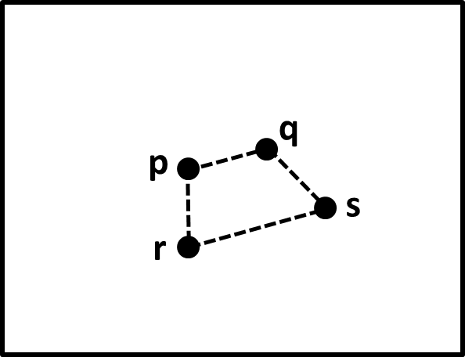
Question time
Consider the above image, with four points p, q, r, s, labeled (assume these are 2D homogeneous points).
What is a simple expression for the point of intersection between the line through p and r and the line through q and s?

Slide 16


Consider the following image, with four points p, q, r, s, labeled (assume these are 2D homogeneous points).
What is a simple expression for the point of intersection between the line through p and r and the line through q and s?
ⓘ Start presenting to display the poll results on this slide.

Slide 17
Question time
Consider the above image, with four points p, q, r, s, labeled (assume these are 2D homogeneous points).
What is a simple expression for the point of intersection between the line through p and r and the line through q and s?
Answer: (p x r) x (q x s)

Slide 18
Ideal points and lines
(a,b,0)
-y
(sx,sy,0)
-y
-w
x
image plane
-w
x
image plane
Ideal point (“point at infinity”)
  p ≅ (x, y, 0) – parallel to image plane
  It has infinite image coordinates
Ideal line
  l ≅ (a, b, 0) – parallel to image plane
  Corresponds to a line in the image (finite coordinates)
    goes through image origin (principal point)

Slide 19
3D projective geometry
These concepts generalize naturally to 3D
  Homogeneous coordinates
    Projective 3D points have four coords: P = (X,Y,Z,W)
  Duality
    A plane N is also represented by a 4-vector
    Points and planes are dual in 3D: N P=0
    Three points define a plane, three planes define a point

Slide 20
3D to 2D: perspective projection
Projection:
Notes:
Preserved: lines, incidence
Not preserved: lengths, angles, parallelism

Slide 21
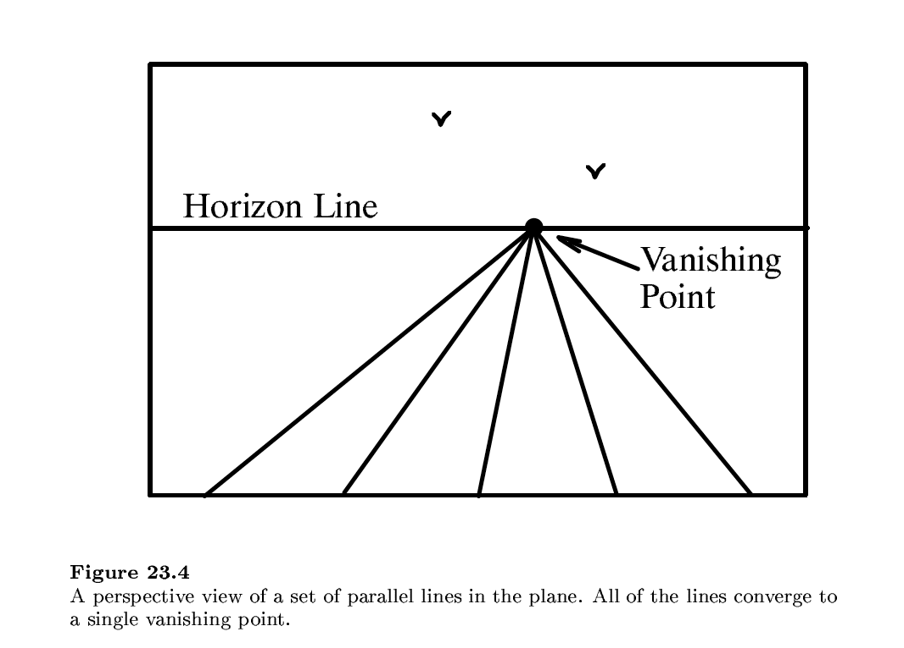

Slide 22
Vanishing points (1D)
image plane
vanishing point
camera
center
ground plane
Vanishing point
  projection of a point at infinity
  can often (but not always) project to a finite point in the image
camera
center
image plane
ground plane

Slide 23
Vanishing points (2D)
image plane
vanishing point
camera
center
line on ground plane

Slide 24
Vanishing points
image plane
vanishing point V
camera
center
C
line on ground plane
line on ground plane
Properties
  Any two parallel lines (in 3D) have the same vanishing point v
  The ray from C through v is parallel to the lines
  An image may have more than one vanishing point
    in fact, every image point is a potential vanishing point
Notes:
How to determine which lines in the scene vanish at a given pixel?

Slide 25
Computing vanishing points
V
P₀
D
Properties
  P∞ is a point at infinity, v is its projection
  Depends only on line direction
  Parallel lines P₀ + tD, P₁ + tD intersect at P∞

Slide 26
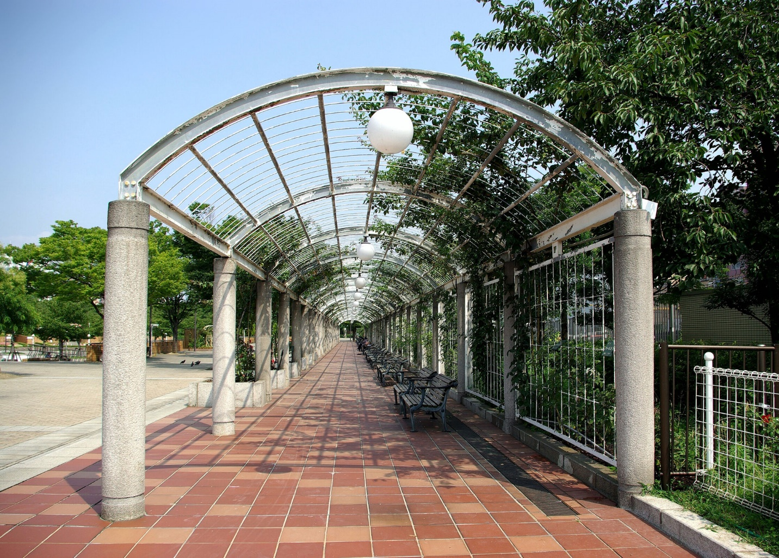
One-point perspective

Slide 27
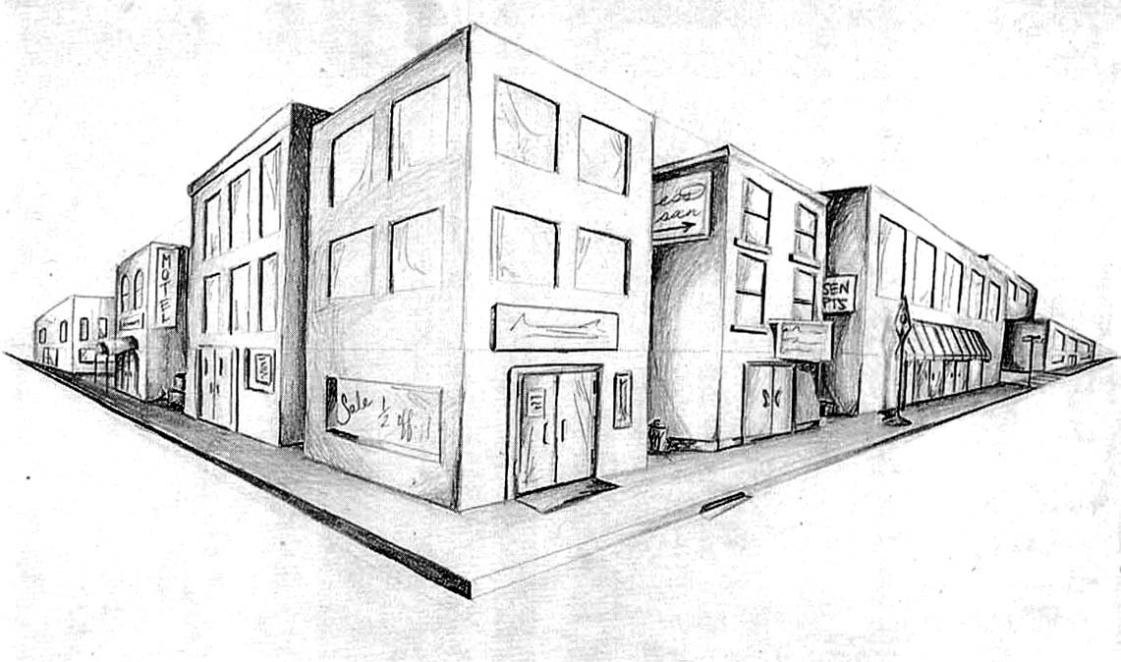
Two-point perspective
v_{y}
v_{x}

Slide 28
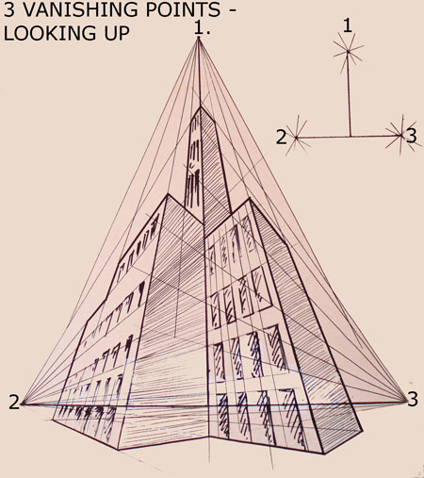
Three-point perspective

Slide 29
Questions?

Slide 30
Vanishing lines
v₁
v₂
Multiple Vanishing Points
  Any set of parallel lines on the plane define a vanishing point
  The union of all of these vanishing points is the horizon line
    also called vanishing line
  Note that different planes (can) define different vanishing lines

Slide 31
Vanishing lines
Multiple Vanishing Points
  Any set of parallel lines on the plane define a vanishing point
  The union of all of these vanishing points is the horizon line
    also called vanishing line
  Note that different planes (can) define different vanishing lines

Slide 32
Computing vanishing lines
v₁
l
v₂
C
l
ground plane
Properties
  l is intersection of horizontal plane through C with image plane
  Compute l from two sets of parallel lines on ground plane
  All points at same height as C project to l
    points higher than C project above l
  Provides way of comparing height of objects in the scene

Slide 33

Notes:
Is this parachuter higher or lower than the person taking this picture?
Lower—he is below the horizon

Slide 34
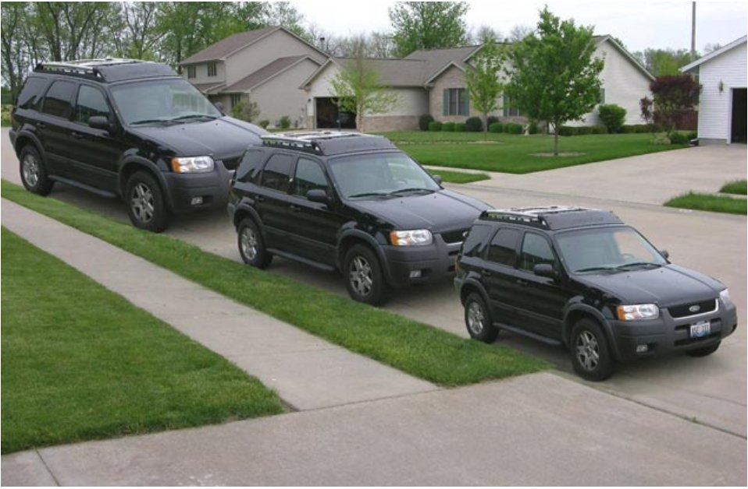
Lots of fun with vanishing points

Slide 35
Perspective cues

Slide 36
Perspective cues

Slide 37
Perspective cues

Slide 38
Comparing heights
Vanishing
Point

Slide 39
Measuring height
5.4
5
How high is the camera?
Camera height
4
3.3
3
2.8
2
1

Slide 40
Computing vanishing points (from lines)
v
q₂
q₁
p₂
p₁
Intersect p₁q₁ with p₂q₂
Least squares version
  Better to use more than two lines and compute the “closest” point of intersection
  See notes by Bob Collins for one good way of doing this:
    http://www-2.cs.cmu.edu/~ph/869/www/notes/vanishing.txt

Slide 41


Measuring height without a ruler
H
R

Slide 42
Measuring height without a ruler
C
Z
ground plane
Compute Z from image measurements
  Need more than vanishing points to do this

Slide 43
The cross ratio
A Projective Invariant
  Something that does not change under projective transformations (including perspective projection)
The cross-ratio of 4 collinear points
P₄
P₃
P₂
P₁
Can permute the point ordering
  4! = 24 different orders (but only 6 distinct values)
This is the fundamental invariant of projective geometry

Slide 44
Measuring height
∞
scene cross ratio
T (top of object)
t
r
R (reference point)
C
H
b
R
image cross ratio
v_{Z}
B (bottom of object)
ground plane
scene points represented as
image points as

Slide 45
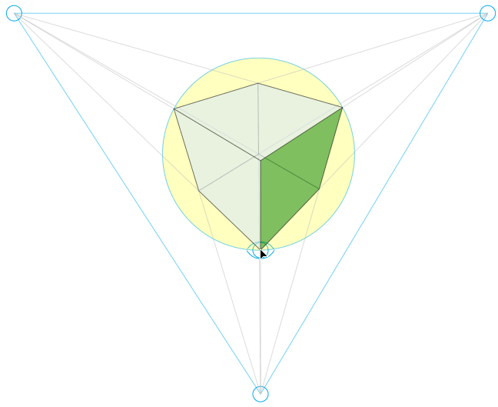
Finding the vertical (z) vanishing point
Find intersection of projections of vertical lines

Slide 46

Measuring height
v_{z}
r
vanishing line (horizon)
t₀
t
v_{x}
v
v_{y}
H
R
H
b₀
b
image cross ratio

Slide 47
Measuring height
v_{z}
r
t₀
vanishing line (horizon)
v_{x}
v
v_{y}
m₀
t₁
b₀
b₁
b
What if the point on the ground plane b₀ is not known?
  Here the person is standing on the box, height of box is known
  Use one side of the box to help find b₀ as shown above

Slide 48

3D modeling from a photograph
St. Jerome in his Study, H. Steenwick
Bringing Pictorial Space to Life: Computer Techniques for the Analysis of Paintings. Antonio Criminisi, Martin Kemp, Andrew Zisserman. 2002.

Slide 49
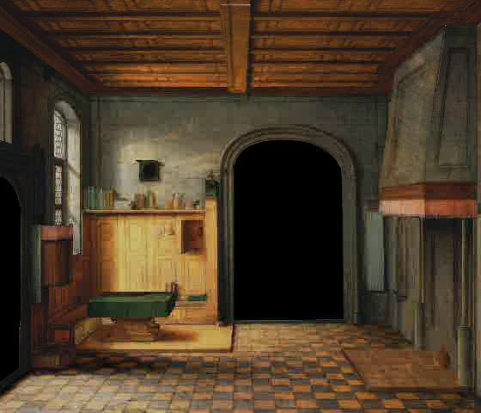
3D modeling from a photograph

Slide 50
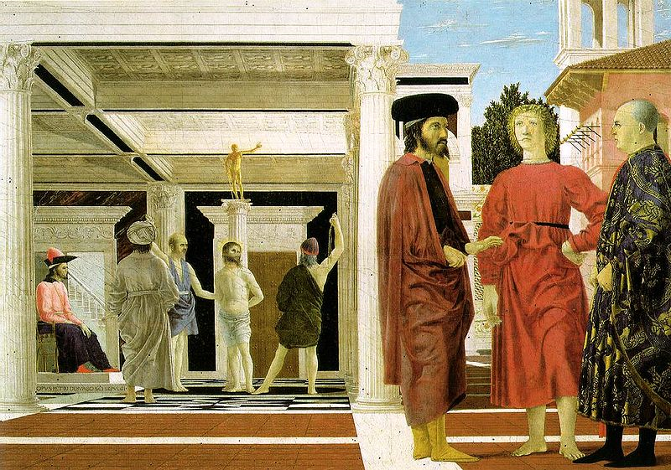
3D modeling from a photograph
Flagellation, Piero della Francesca

Slide 51
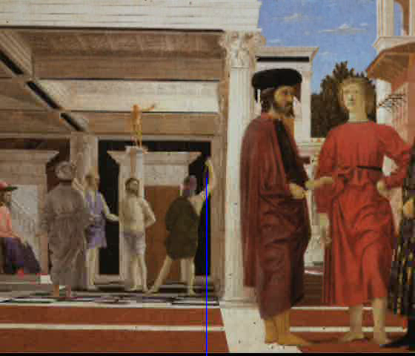
3D modeling from a photograph
video by Antonio Criminisi

Slide 52
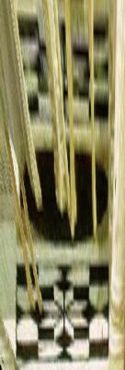
3D modeling from a photograph
Flagellation. Piero della Francesca. c1453.

Slide 53
Related problem: camera calibration
Goal: estimate the camera parameters
  Version 1: solve for 3x4 projection matrix
  Version 2: solve for camera parameters separately
    intrinsics (focal length, principal point, pixel size)
    extrinsics (rotation angles, translation)
    radial distortion

Slide 54
Vanishing points and projection matrix
= v_{x} (X vanishing point)
similarly,
π
=
v
,
π
=
v
2
Y
3
Z
Not So Fast! We only know v’s up to a scale factor
  Can fully specify by providing 3 reference points with known coordinates

Slide 55
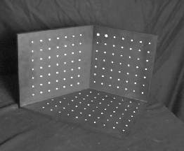
Calibration using a reference object
Place a known object in the scene
  identify correspondence between image and scene
  compute mapping from scene to image
Issues
  must know geometry very accurately
  must know 3D -> 2D correspondence

Slide 56
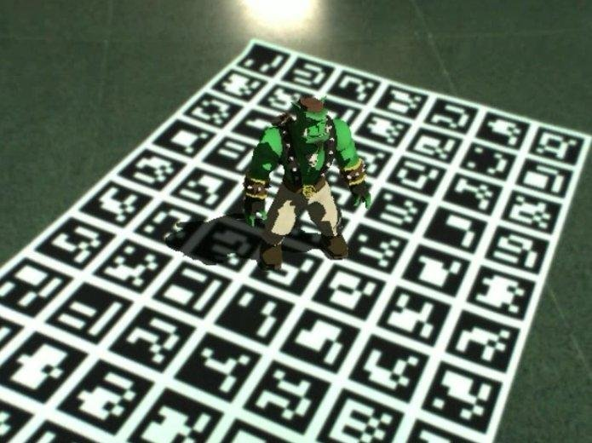
AR codes
ArUco

Slide 57
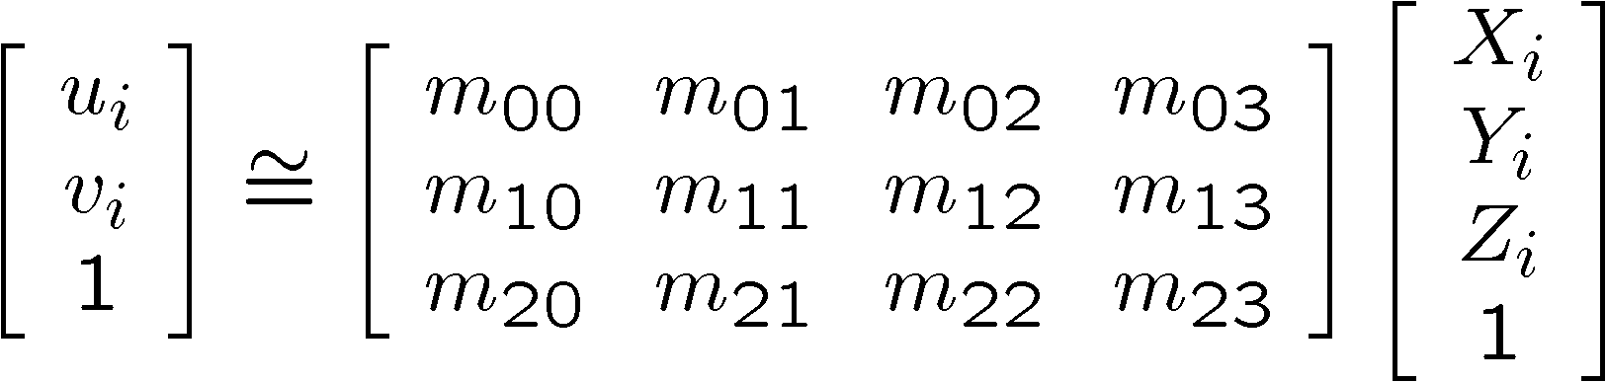
Estimating the projection matrix
Place a known object in the scene
  identify correspondence between image and scene
  compute mapping from scene to image

Slide 58
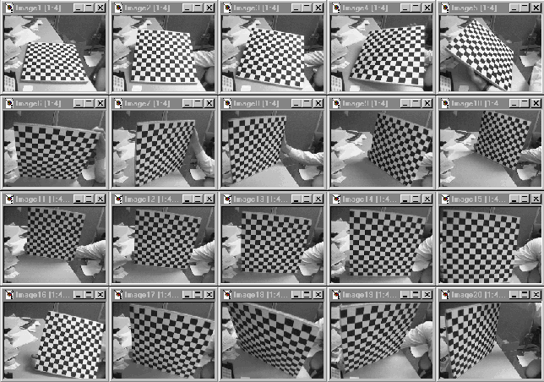
Alternative: multi-plane calibration
Images courtesy Jean-Yves Bouguet
Advantage
  Only requires a plane
  Don’t have to know positions/orientations
  Good code available online! (including in OpenCV)
    Matlab version by Jean-Yves Bouget: http://www.vision.caltech.edu/bouguetj/calib_doc/index.html
    Amy Tabb’s camera calibration software: https://github.com/amy-tabb/basic-camera-calibration

Slide 59
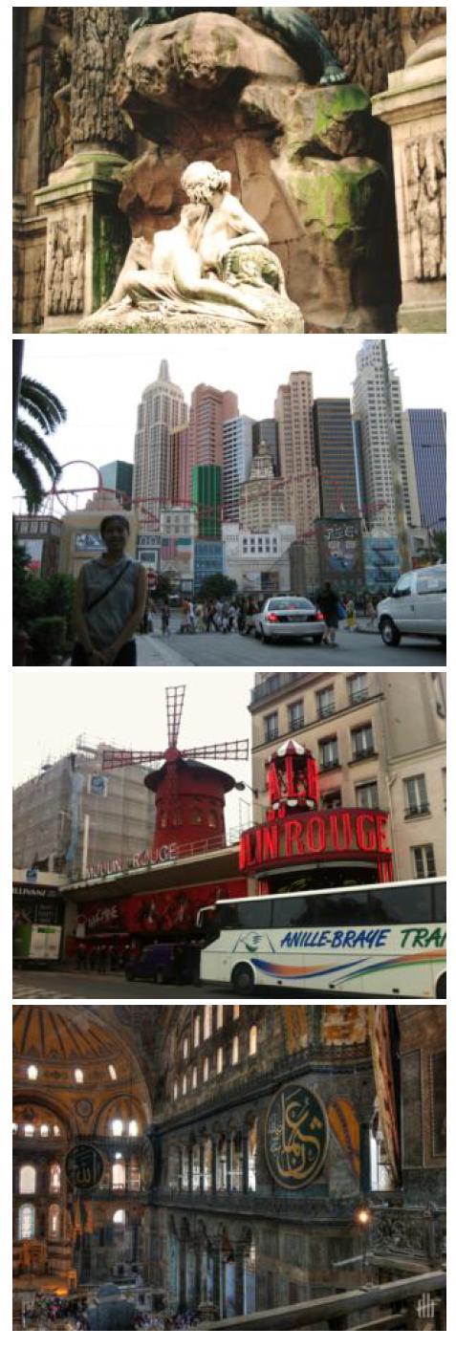
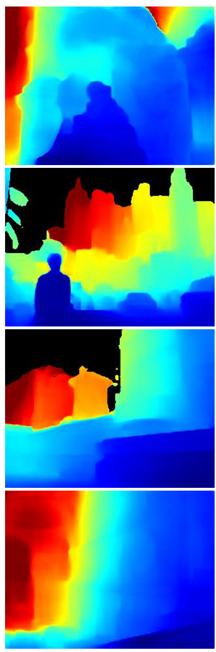
Single-image depth prediction using deep learning
Deep learning
Li and Snavely. Megadepth: Learning single-view depth prediction from internet photos. CVPR 2018.
Image
Depth map

Slide 60

MiDaS depth prediction
Ranftl et al. Towards Robust Monocular Depth Estimation: Mixing Datasets for Zero-shot Cross-dataset Transfer.
https://gradio.app/g/AK391/MiDaS
https://github.com/intel-isl/MiDaS

Slide 61

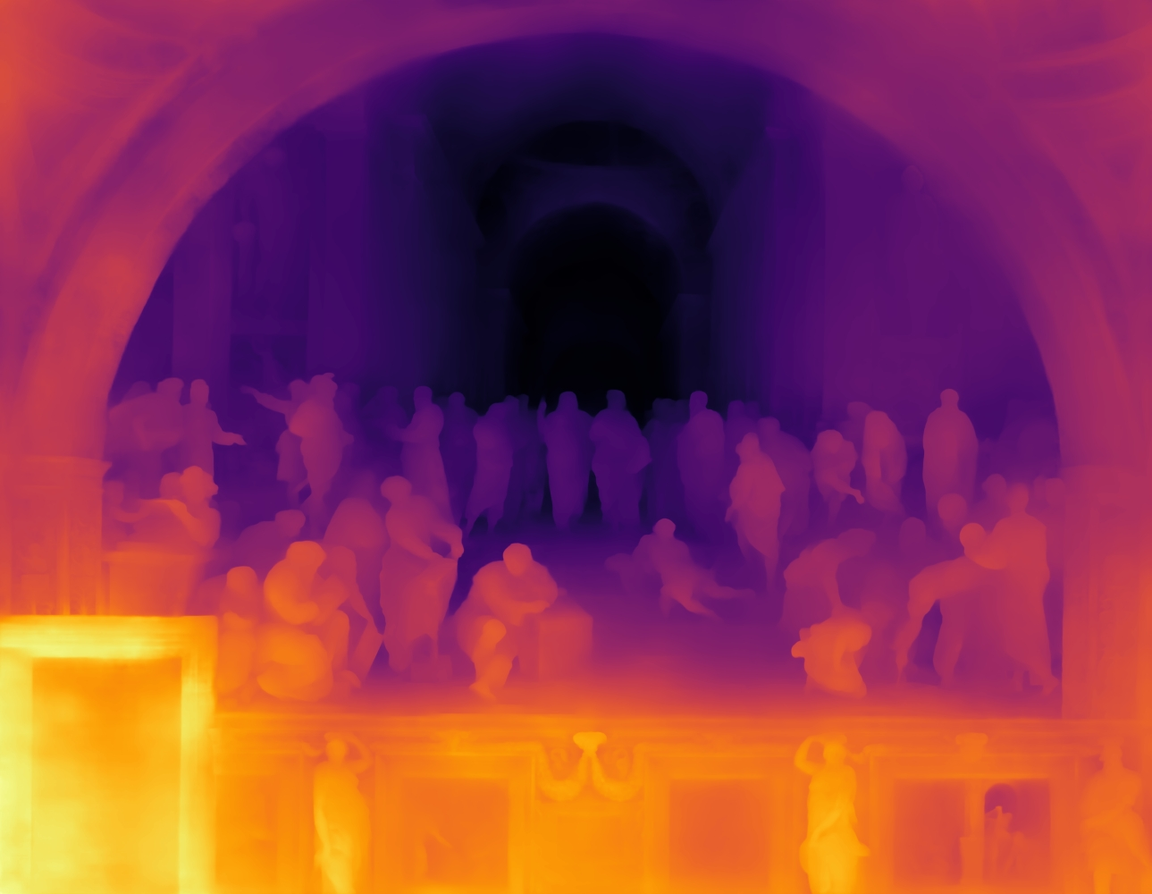

Single-image depth prediction
Picture credit: Magritte, The Treachery of Images, and the Berkeley Computer Vision Group
Miangoleh*, Dille*, Mai, Paris, and Aksoy.
Boosting Monocular Depth Estimation Models to High-Resolution via Content-Adaptive Multi-Resolution Merging.
CVPR 2021.
Notes:
So where to go from here? I think there are a lot of very interesting open directions. Of all of these Im2Scene tasks, single-view depth prediction is one of the most mature.
Beautiful ambiguity of perception.
Yağız Aksoy, SFU

Slide 62
Deep geometry prediction
More on this topic later!

Slide 63
Questions?

