Slide 1
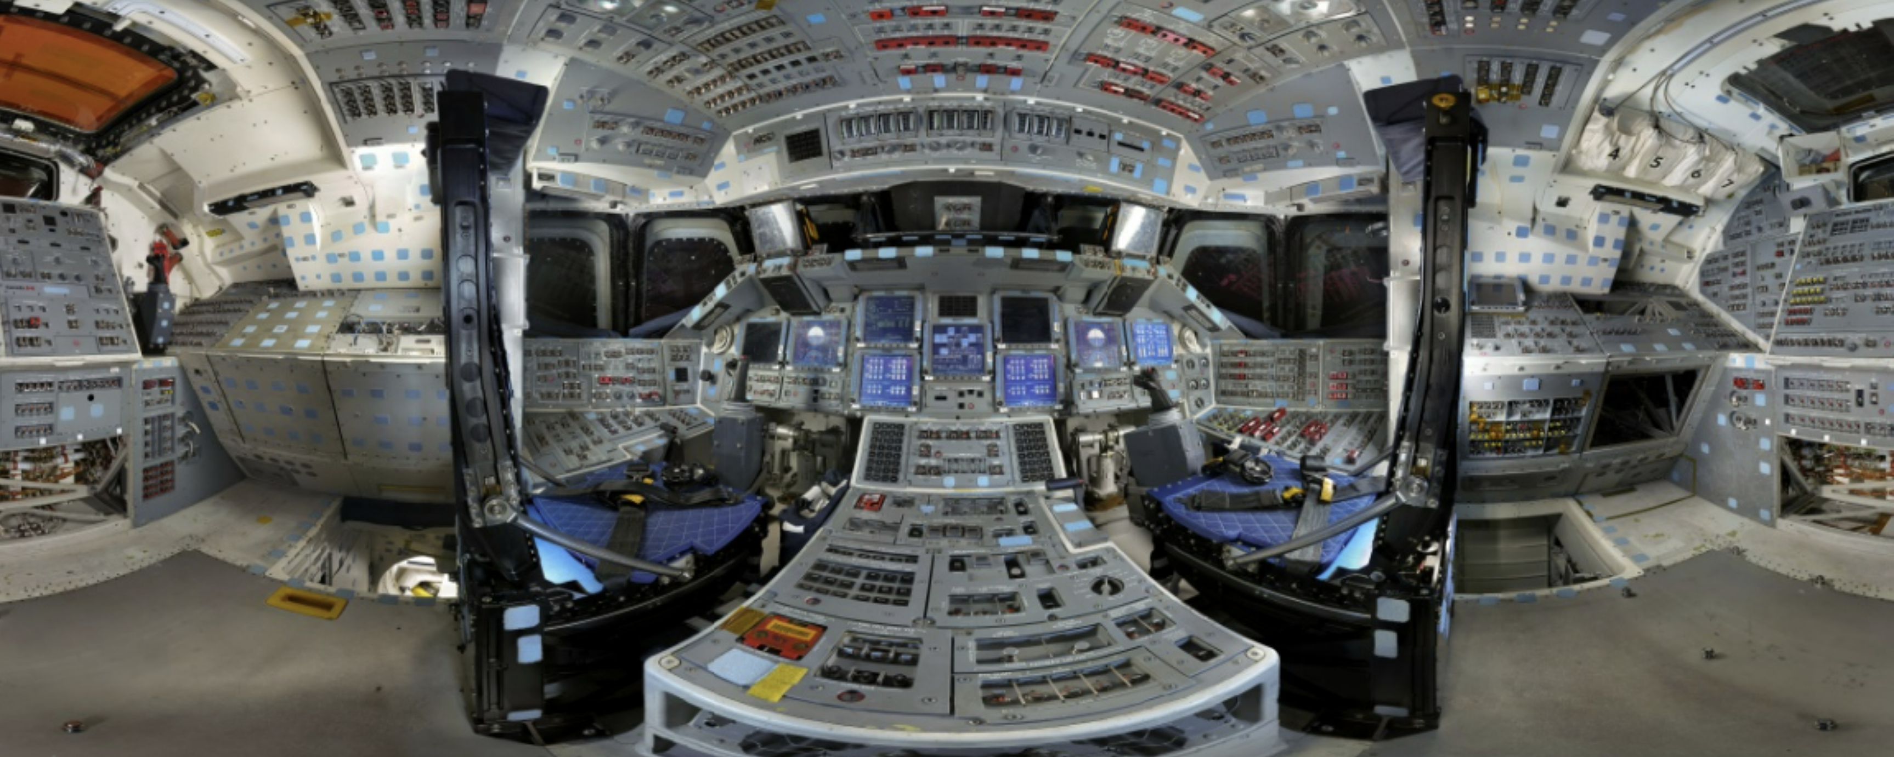
Panoramas
CS5670: Computer Vision
Space Shuttle Discovery Flight Deck, Gigapan

Slide 2
Announcements
Midterm exam due by the start of class today
Project 3: Autostitch (Panorama Stitching)
Released today, March 5
Demo at end of class
Due on Friday, March 15, by 8pm
Artifact due on Monday March 8 by 8pm
To be done in groups of 2
If you need help finding a team member, let us know

Slide 3
First: finishing up camera projection

Slide 4
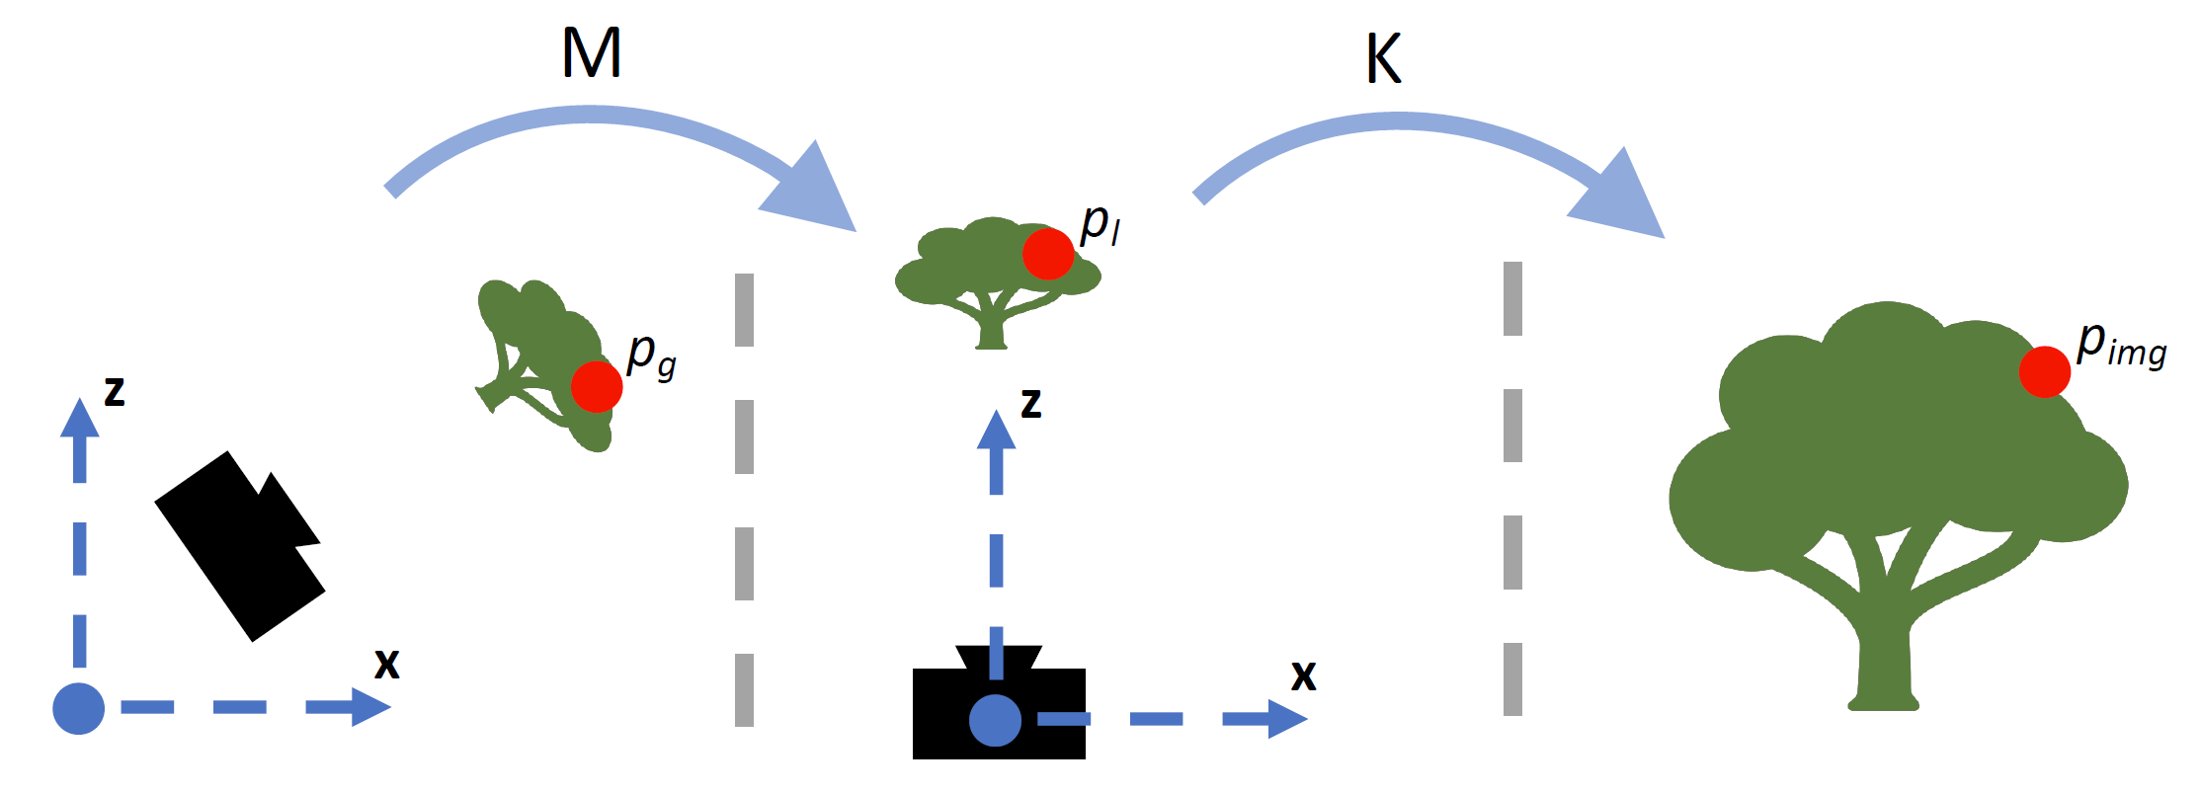
Recap: Coordinate frames
World coordinates
Camera coordinates
Image coordinates
Figure credit: Peter Hedman

Slide 5










Projection matrix
=
0
(in homogeneous image coordinates)

Slide 6
Extrinsics
How do we get the camera to “canonical form”?
Canonical form: Center of projection at the origin, x-axis points right, y-axis points down, z-axis points forwards
Step 1: Translate by -c
0

Slide 7
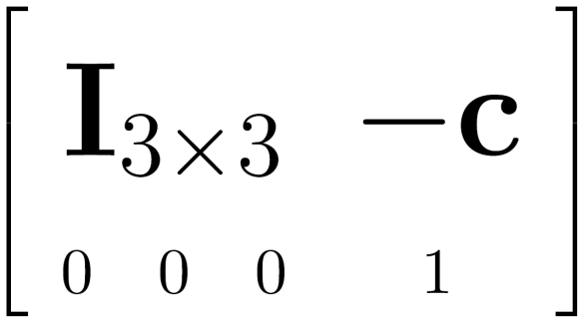

Extrinsics
How do we get the camera to “canonical form”?
Canonical form: Center of projection at the origin, x-axis points right, y-axis points down, z-axis points forwards
Step 1: Translate by -c
How do we represent translation as a matrix multiplication?
0

Slide 8
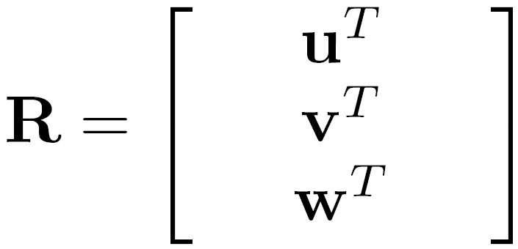
Extrinsics
How do we get the camera to “canonical form”?
Canonical form: Center of projection at the origin, x-axis points right, y-axis points down, z-axis points forwards
Step 1: Translate by -c
Step 2: Rotate by R
0
3x3 rotation matrix

Slide 9
Extrinsics
How do we get the camera to “canonical form”?
Canonical form: Center of projection at the origin, x-axis points right, y-axis points down, z-axis points forwards
Step 1: Translate by -c
Step 2: Rotate by R
0
(with extra row/column of [0 0 0 1])

Slide 10
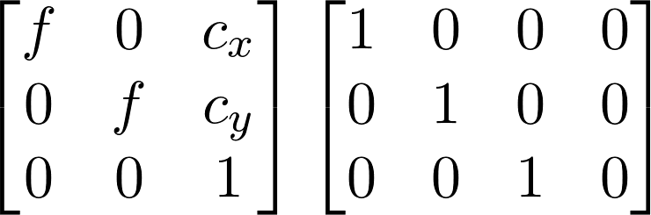

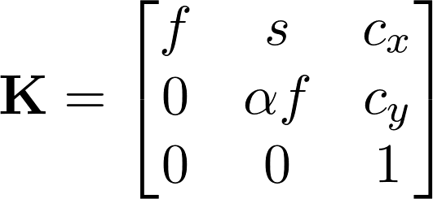



Perspective projection
(converts from 3D rays in camera coordinate system to pixel coordinates)
(intrinsics)
in general,
(upper triangular matrix)
: aspect ratio (1 unless pixels are not square)
: skew (0 unless pixels are shaped like rhombi/parallelograms)
: principal point ((w/2,h/2) unless optical axis doesn’t intersect projection plane at image center)

Slide 11
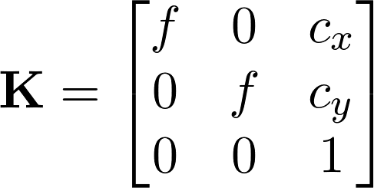
Typical intrinsics matrix
2D affine transform corresponding to a scale by f (focal length) and a translation by (c_{x}, c_{y}) (principal point)
Maps 3D rays to 2D pixels

Slide 12
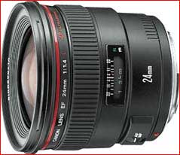
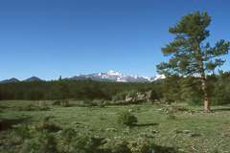
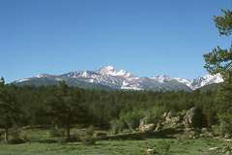
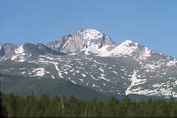
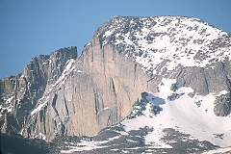
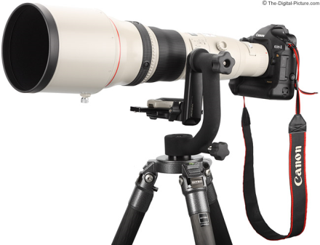
Focal length
Can think of as “zoom”
Also related to field of view
24mm
50mm
200mm
800mm

Slide 13
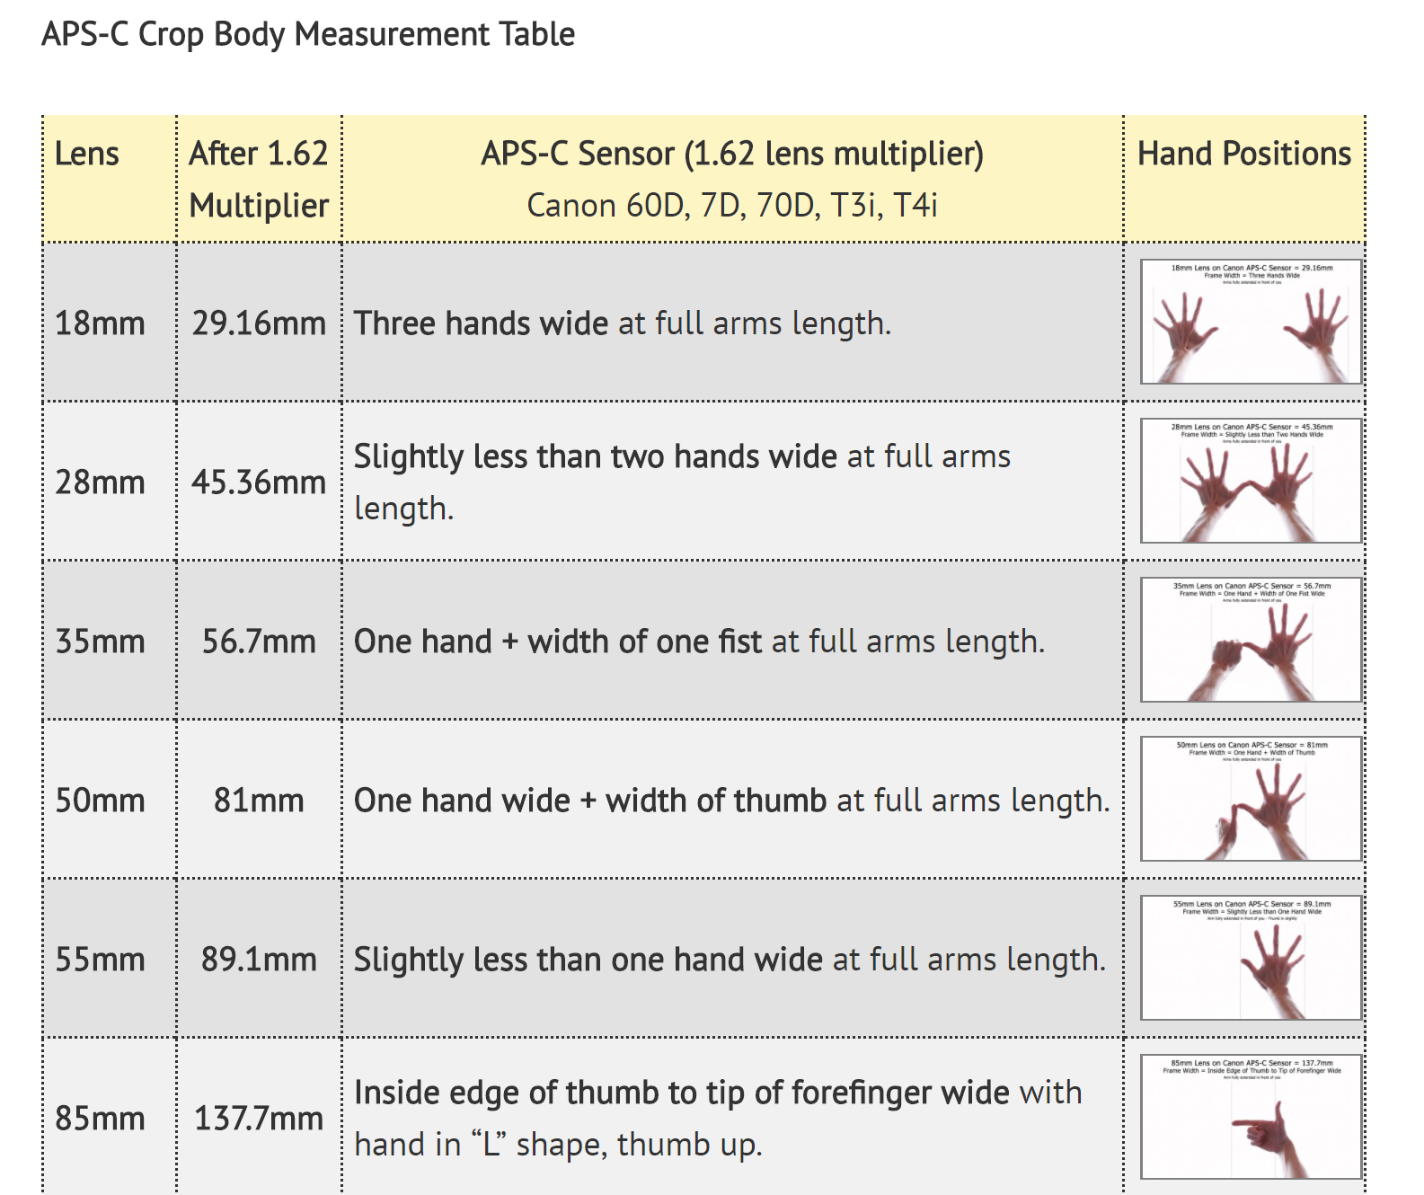
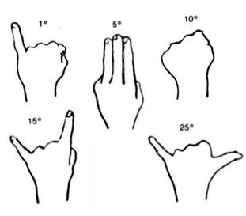
Field of view

Slide 14
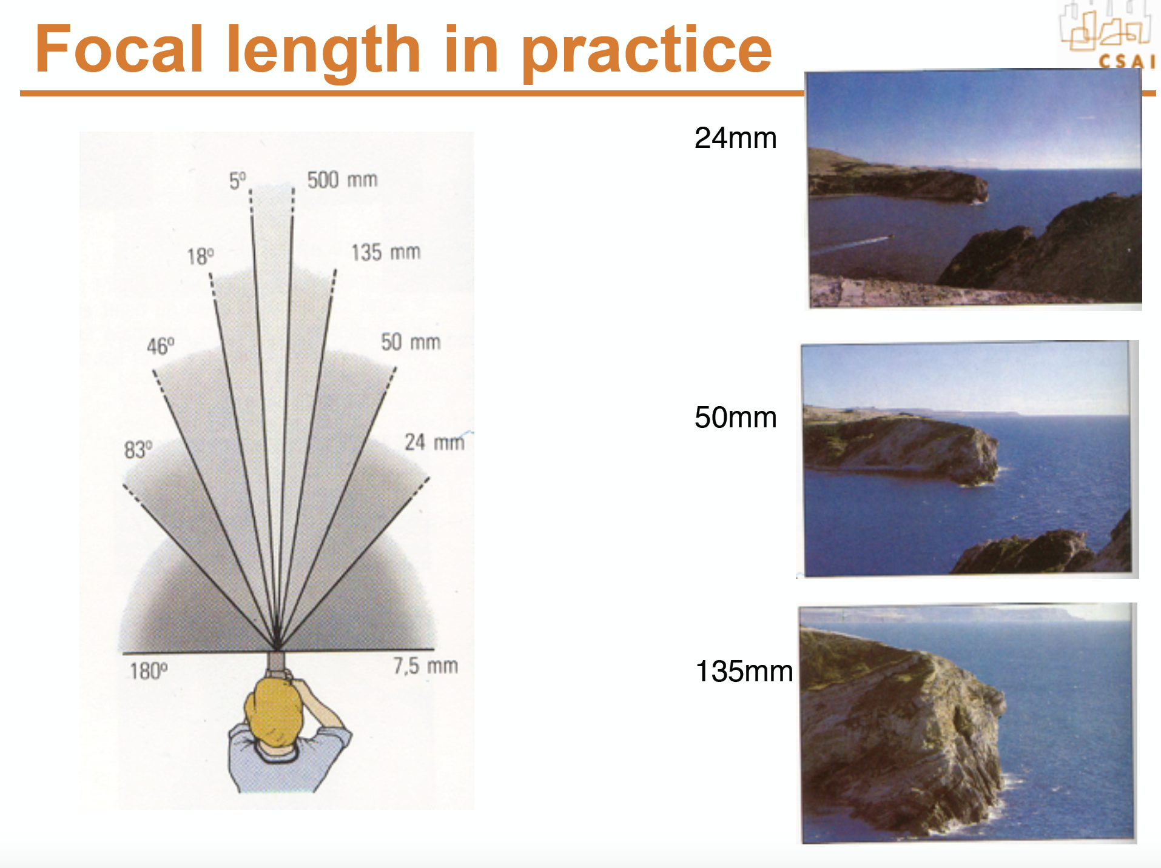

Slide 15
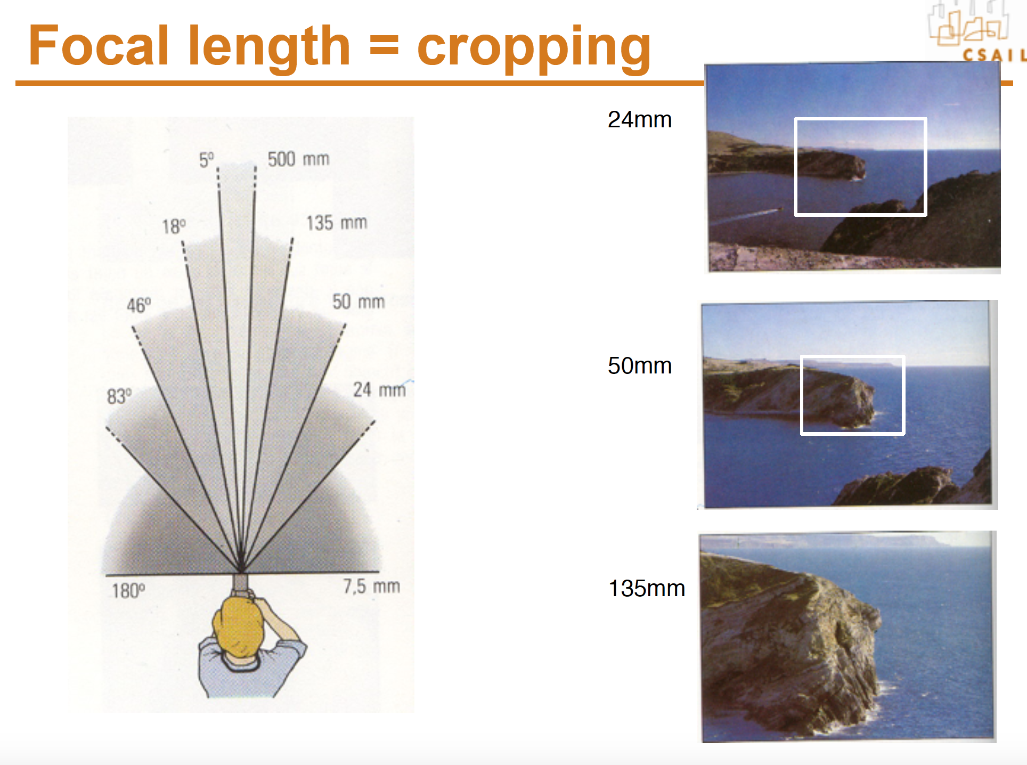

Slide 16
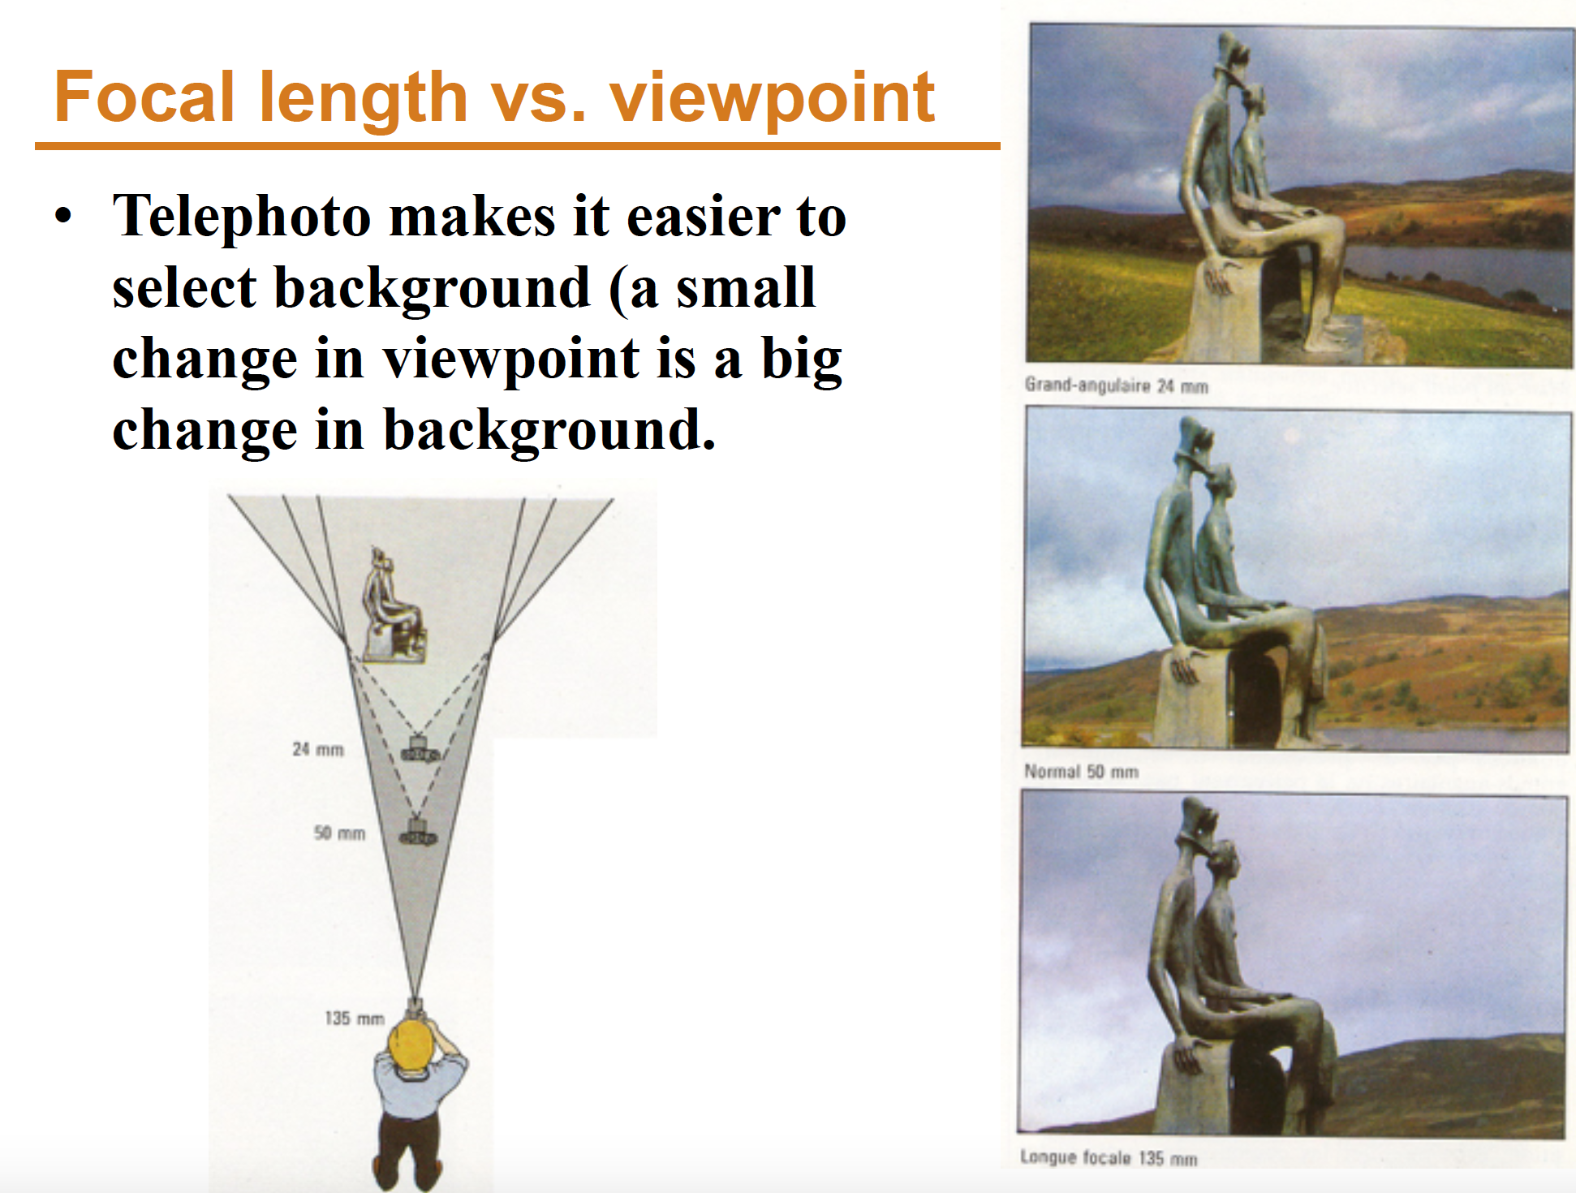

Slide 17
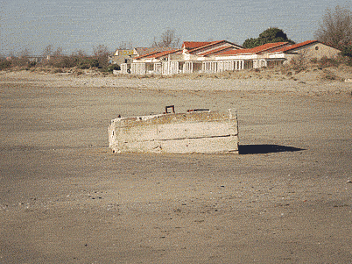

Slide 18
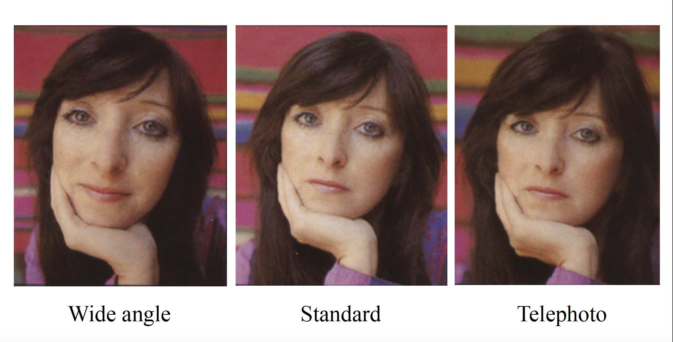
Notes:
http://www.stsite.com/camera/telephoto-wideangle.php
Wide angle deepens
Telephoto magnifies and pulls it in

Slide 19
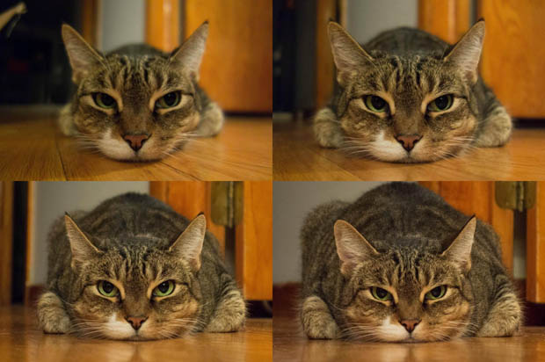
http://petapixel.com/2013/01/11/how-focal-length-affects-your-subjects-apparent-weight-as-seen-with-a-cat/

Slide 20
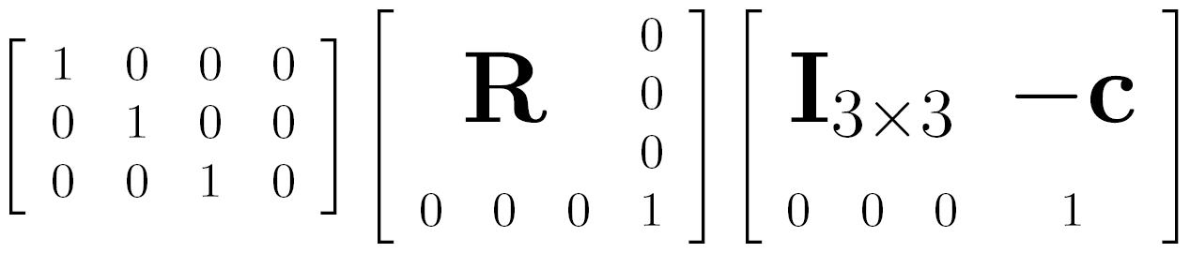

Projection matrix
intrinsics
projection
rotation
translation
This part converts 3D points in world coordinates to 3D rays in the camera’s coordinate system. There are 6 parameters represented (3 for position/translation, 3 for rotation).
The K matrix converts 3D rays in the camera’s coordinate system to 2D image points in image (pixel) coordinates.

Slide 21
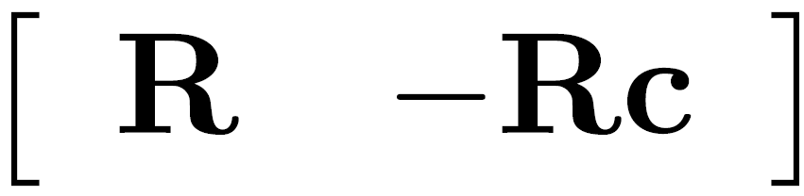

Projection matrix
intrinsics
projection
rotation
translation
(t in book’s notation)

Slide 22
Projection matrix
=
0
(in homogeneous image coordinates)

Slide 23
Questions?

Slide 24
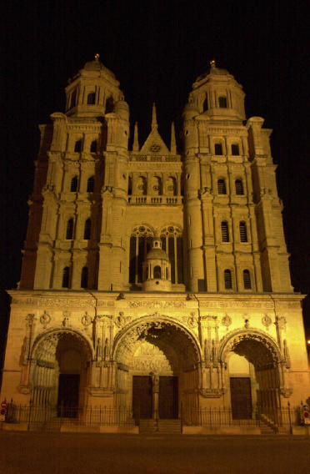
Perspective distortion
Problem for architectural photography: converging verticals
Source: F. Durand

Slide 25
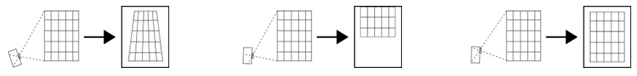
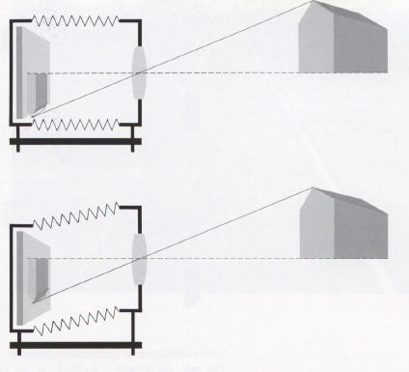
Perspective distortion
Problem for architectural photography: converging verticals
Solution: view camera (lens shifted w.r.t. film)
Tilting the camera upwards results in converging verticals
Keeping the camera level, with an ordinary lens, captures only the bottom portion of the building
Shifting the lens upwards results in a picture of the entire subject
http://en.wikipedia.org/wiki/Perspective_correction_lens
Source: F. Durand

Slide 26
Perspective distortion
Problem for architectural photography: converging verticals
Result:
Source: F. Durand

Slide 27
Perspective distortion
What does a sphere project to?
Image source: F. Durand

Slide 28
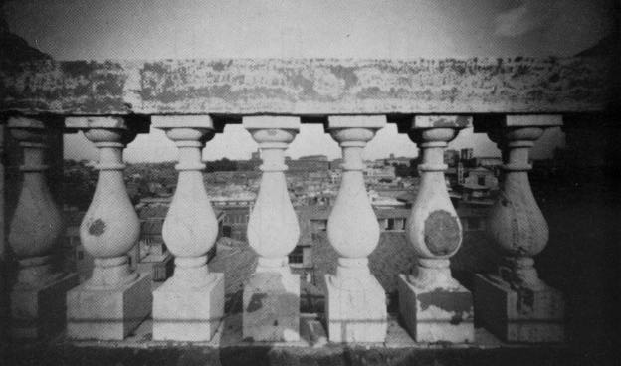
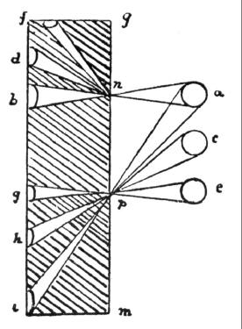
Perspective distortion
The exterior columns appear bigger
The distortion is not due to lens flaws
Problem pointed out by Da Vinci
Slide by F. Durand

Slide 29
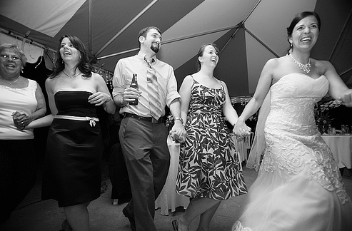
Perspective distortion: People

Slide 30
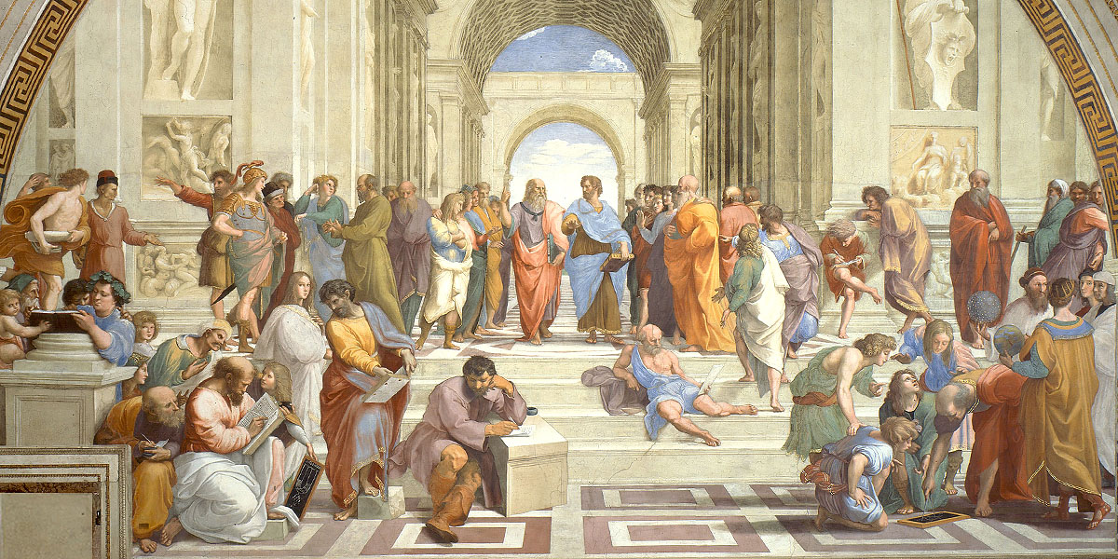
https://aaronhertzmann.com/2022/02/28/how-does-perspective-work.html

Slide 31
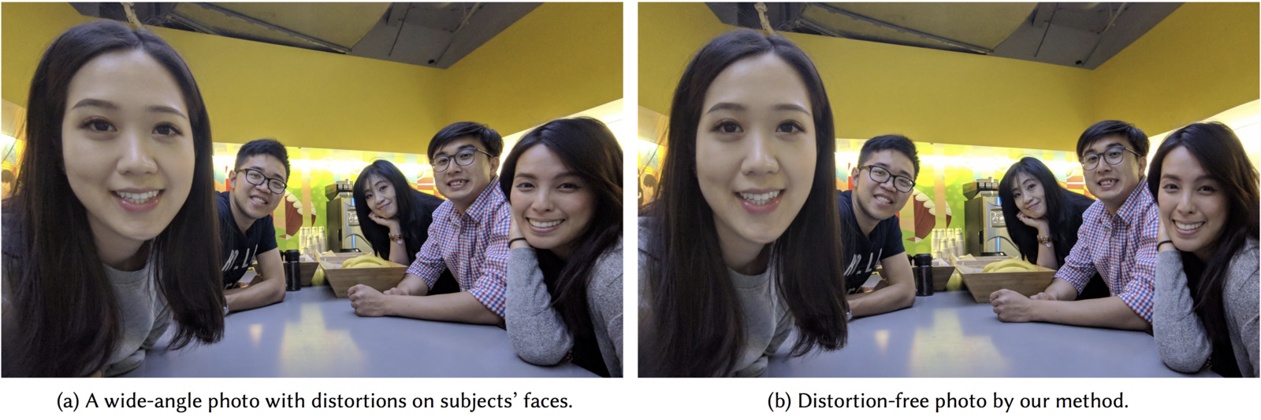
Distortion-Free Wide-Angle Portraits on Camera Phones
YiChang Shih, Wei-Sheng Lai, and Chia-Kai Liang, Distortion-Free Wide-Angle Portraits on Camera Phones, SIGGRAPH 2019
https://people.csail.mit.edu/yichangshih/wide_angle_portrait/

Slide 32
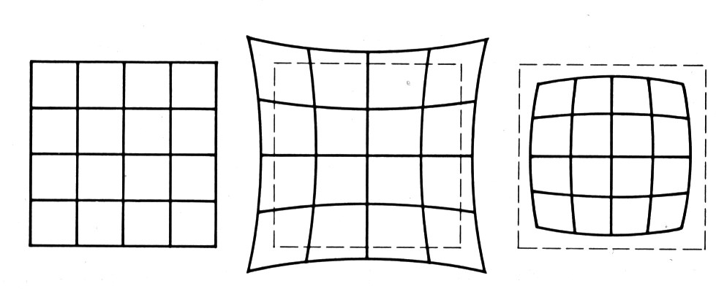
Lens or radial distortion
No distortion
Pin cushion
Barrel
Radial distortion of the image
Caused by imperfect lenses
Deviations are most noticeable for rays that pass through the edge of the lens

Slide 33
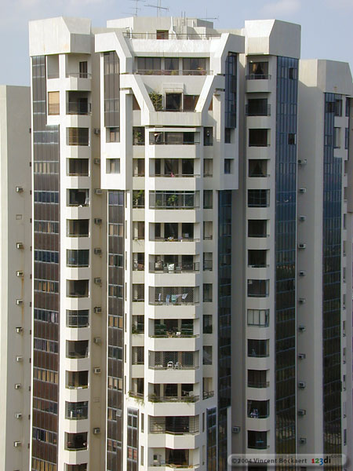
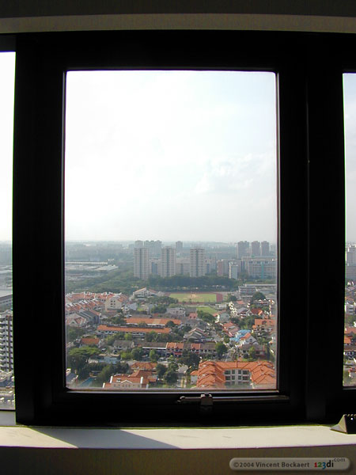

Slide 34
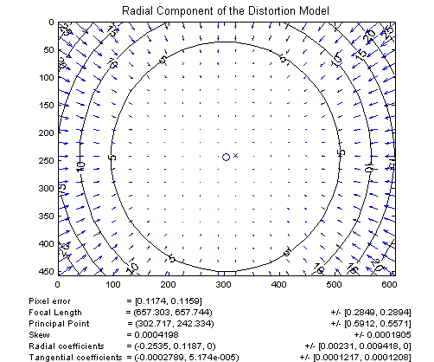
Radial distortion
Arrows show motion of projected points relative to an ideal (distortion-free lens)
[Image credit: J. Bouguet http://www.vision.caltech.edu/bouguetj/calib_doc/htmls/example.html]

Slide 35
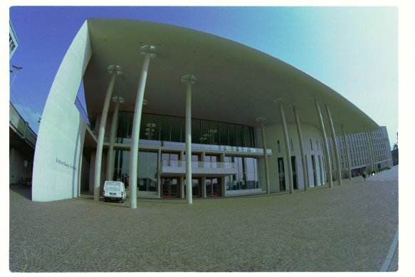
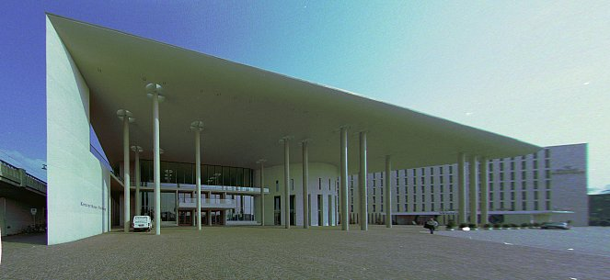
Correcting radial distortion
from Helmut Dersch

Slide 36

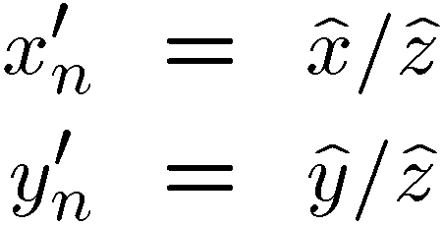
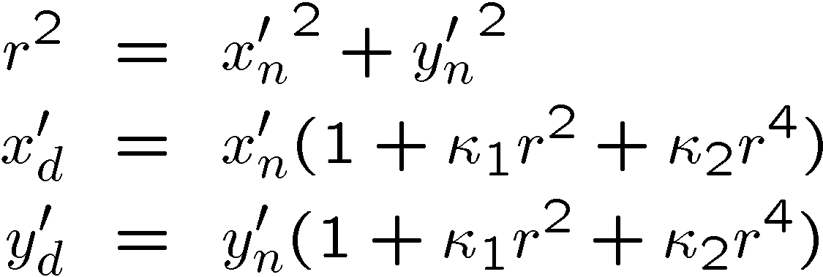
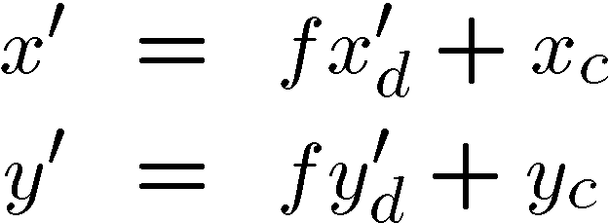
Modeling distortion: projection model
Project to “normalized” image coordinates
Apply radial distortion
Apply focal length translate image center
To model lens distortion
Use above projection operation instead of standard projection matrix multiplication

Slide 37
Other types of projection
Lots of intriguing variants…
(I’ll just mention a few fun ones)

Slide 38
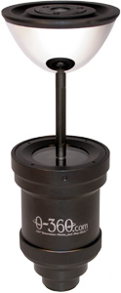
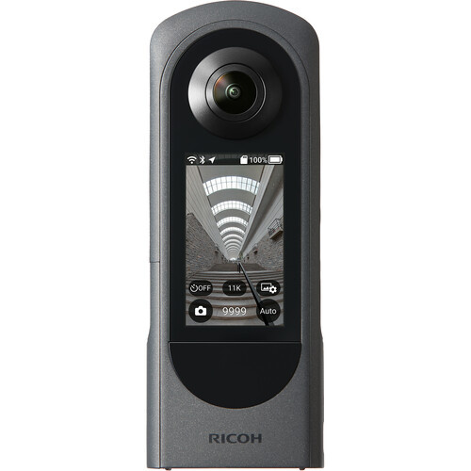
360 degree field of view…
Ricoh Theta
Basic approach
Take a photo of a parabolic mirror with an orthographic lens (Nayar)
Or buy one a lens from a variety of omnicam manufacturers…
See http://www.cis.upenn.edu/~kostas/omni.html
Or buy a 360-degree consumer camera

Slide 39
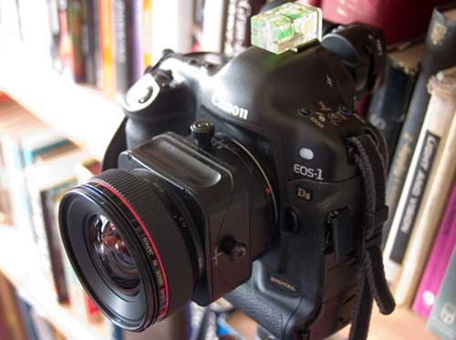
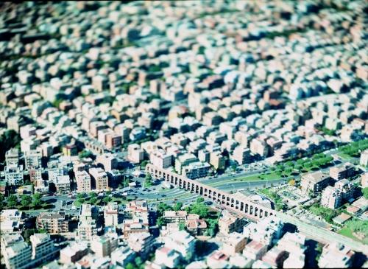
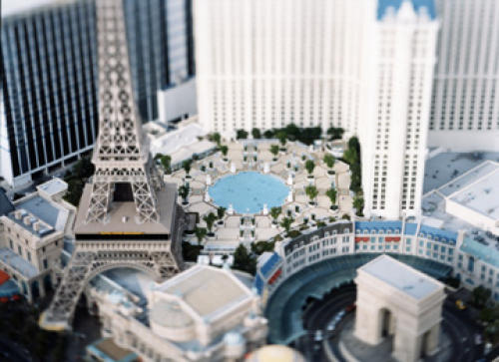
Tilt-shift
http://www.northlight-images.co.uk/article_pages/tilt_and_shift_ts-e.html
Tilt-shift images from Olivo Barbieri and Photoshop imitations

Slide 40
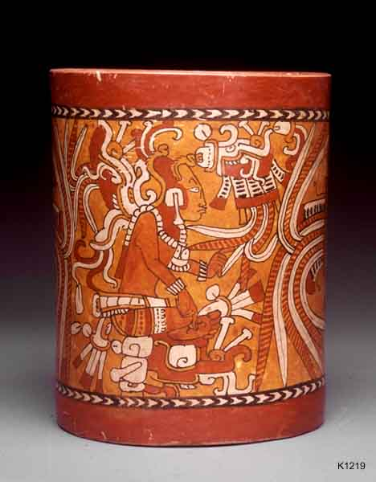
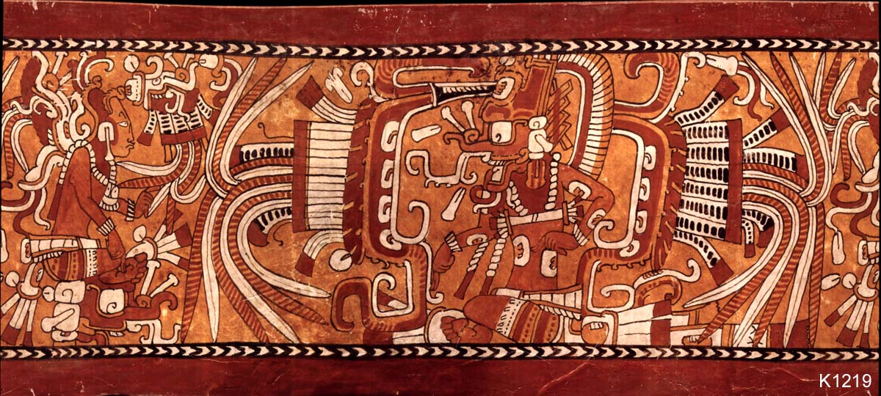
Rotating sensor (or object)
Rollout Photographs © Justin Kerr
http://research.famsi.org/kerrmaya.html
Also known as “cyclographs”, “peripheral images”

Slide 41
Questions?

Slide 42
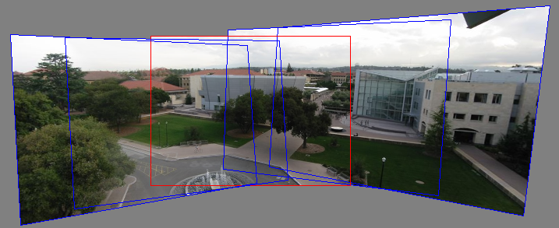
Back to panoramas
Can we use homographies to create a 360 degree panorama?

Slide 43

Idea: project images onto a common plane
“Mosaic”
each image is warped with a homography
We’ll see what this homography means next
Can’t create a 360 panorama this way… we’ll fix this shortly
mosaic projection plane

Slide 44
Creating a panorama
Basic Procedure
Take a sequence of images from the same position
Rotate the camera about its optical center
Compute transformation between second image and first
Transform the second image to overlap with the first
Blend the two together to create a mosaic
If there are more images, repeat

Slide 45
Geometric interpretation of mosaics
Image 2
Optical Center
Image 1
If we capture all 360º of rays, we can create a 360º panorama
The basic operation is projecting an image from one plane to another
The projective transformation is scene-INDEPENDENT
This depends on all the images having the same optical center

Slide 46
Image reprojection
Basic question
How to relate two images from the same camera center?
how to map a pixel from PP1 to PP2
Answer
Cast a ray through each pixel in PP1
Draw the pixel where that ray intersects PP2
PP2
PP1

Slide 47
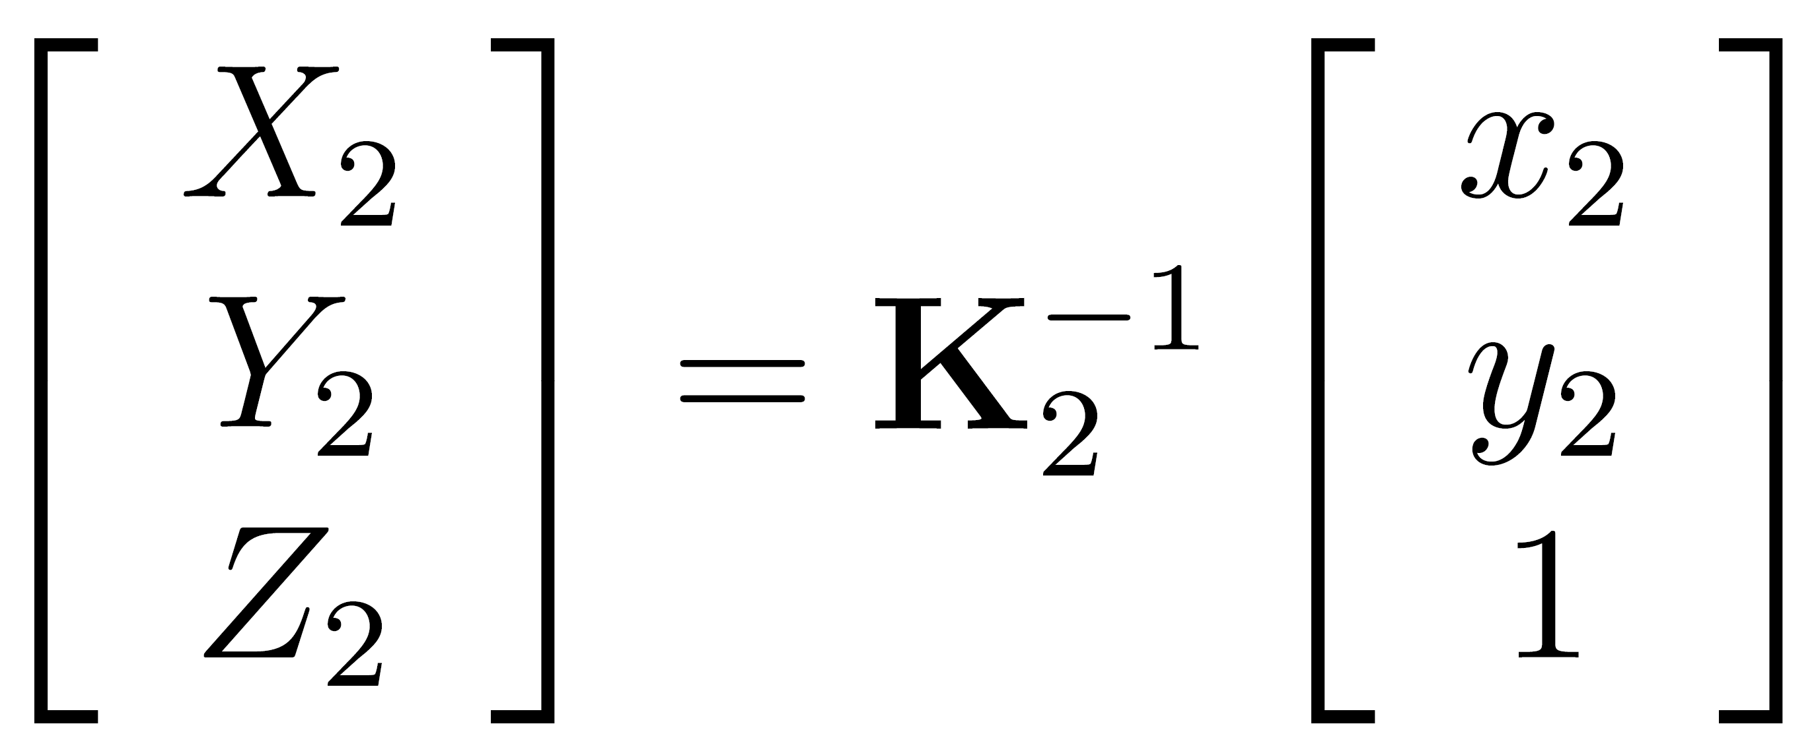
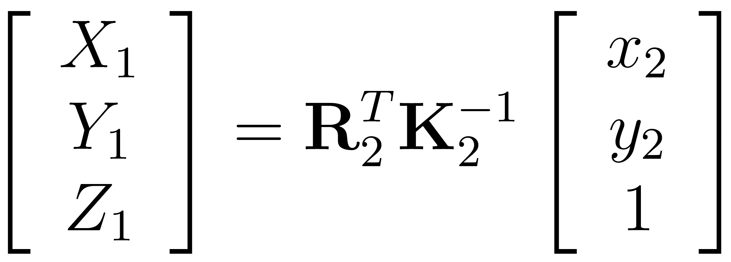





What is the transformation?
Step 1: Convert pixels in image 2 to rays in camera 2’s coordinate system.
Image 2
Optical Center
Step 2: Convert rays in camera 2’s coordinates to rays in camera 1’s coordinates.
Image 1
Step 3: Convert rays in camera 1’s coordinates to pixels in image 1’s coordinates.
How do we map points in image 2 into image 1?
image 1
image 2
intrinsics
extrinsics
(rotation only)
3x3 homography

Slide 48
Can we use homography to create a 360 panorama?

Slide 49
Answer: No
Projection plane
Cameras A, B, C
Camera D
These rays never hit the projection plane

Slide 50
Panoramas
What if you want a 360° field of view?
mosaic Projection Sphere

Slide 51







Spherical projection
Map 3D point (X,Y,Z) onto sphere
Y
Z
X
Convert to spherical coordinates
Convert to spherical image coordinates
unit sphere
s defines size of the final image
often convenient to set s = camera focal length
unwrapped sphere
Spherical image

Slide 52


Unwrapping a sphere
Credit: JHT’s Planetary Pixel Emporium

Slide 53




Spherical reprojection
input
f = 200 (pixels)
f = 400
f = 800
Map image to spherical coordinates
need to know the focal length
Notes:
Therefore, it is desirable if the global motion model we need to recover is translation, which has only two parameters. It turns out that for a pure panning motion, if we convert two images to their cylindrical maps with known focal length, the relationship between them can be represented by a translation.
Here is an example of how cylindrical maps are constructed with differently with f’s. Note how straight lines are curved.
Similarly, we can map an image to its longitude/latitude spherical coordinates as well if f is given.

Slide 54


Aligning spherical images
Suppose we rotate the camera by θ about the vertical axis
How does this change the spherical image?
Notes:
Therefore, it is desirable if the global motion model we need to recover is translation, which has only two parameters. It turns out that for a pure panning motion, if we convert two images to their cylindrical maps with known focal length, the relationship between them can be represented by a translation.
Here is an example of how cylindrical maps are constructed with differently with f’s. Note how straight lines are curved.
Similarly, we can map an image to its longitude/latitude spherical coordinates as well if f is given.

Slide 55
Aligning spherical images
Suppose we rotate the camera by θ about the vertical axis
How does this change the spherical image?
Translation by θ
This means that we can align spherical images by translation
Notes:
Therefore, it is desirable if the global motion model we need to recover is translation, which has only two parameters. It turns out that for a pure panning motion, if we convert two images to their cylindrical maps with known focal length, the relationship between them can be represented by a translation.
Here is an example of how cylindrical maps are constructed with differently with f’s. Note how straight lines are curved.
Similarly, we can map an image to its longitude/latitude spherical coordinates as well if f is given.

Slide 56
Assembling the panorama
Stitch pairs together, blend, then crop

Slide 57
Problem: Drift
Error accumulation
small errors accumulate over time

Slide 58
Problem: Drift
(x₁,y₁)
(x_{n},y_{n})
copy of first image
Solution
add another copy of first image at the end
this gives a constraint: y_{n} = y₁
there are a bunch of ways to solve this problem
add displacement of (y₁ – y_{n})/(n -1) to each image after the first
apply an affine warp: y’ = y + ax [you will implement this for P3]
run a big optimization problem, incorporating this constraint
best solution, but more complicated
known as “bundle adjustment”

Slide 59
Project 3
Take pictures on a tripod (or handheld)
Warp to spherical coordinates (not needed if using homographies to align images)
Extract features
Align neighboring pairs using feature matching + RANSAC
Write out list of neighboring translations
Correct for drift
Read in warped images and blend them
Crop the result and import into a viewer
Roughly based on Autostitch
By Matthew Brown and David Lowe
http://www.cs.ubc.ca/~mbrown/autostitch/autostitch.html

Slide 60






Spherical panoramas
+
+
+
+
Microsoft Lobby: http://www.acm.org/pubs/citations/proceedings/graph/258734/p251-szeliski

Slide 61





Different projections are possible
Cube-map

Slide 62

Blending
We’ve aligned the images – now what?

Slide 63


Blending
Want to seamlessly blend them together

Slide 64



Image Blending

Slide 65



Feathering
+
1
1
0
0
=

Slide 66


Effect of window size
1
left
1
right
0
0

Slide 67


Effect of window size
1
1
0
0

Slide 68

Good window size
1
0
“Optimal” window: smooth but not ghosted
Doesn’t always work...

Slide 69
Alpha Blending
I₃
p
I₁
see Blinn (CGA, 1994) for details:
Compositing, Part 1: Theory
I₂
Encoding blend weights: I(x,y) = (αR, αG, αB, α)
color at p =
Implement this in two steps:
1. accumulate: add up the (α premultiplied) RGBα values at each pixel
2. normalize: divide each pixel’s accumulated RGB by its α value
Q: what if α = 0?
Notes:
A: render as black

Slide 70

Poisson Image Editing
For more info: Perez et al, SIGGRAPH 2003

Slide 71

Some panorama examples
“Before SIGGRAPH Deadline” Photo credit: Doug Zongker

Slide 72


Some panorama examples
Every image on Google Streetview

Slide 73

Magic: ghost removal
M. Uyttendaele, A. Eden, and R. Szeliski. Eliminating ghosting and exposure artifacts in image mosaics. ICCV 2001

Slide 74

Magic: ghost removal
M. Uyttendaele, A. Eden, and R. Szeliski. Eliminating ghosting and exposure artifacts in image mosaics. ICCV 2001
Notes:
How to handle motion?

Slide 75

Other types of mosaics
Can mosaic onto any surface if you know the geometry
See NASA’s Visible Earth project for some stunning earth mosaics

Slide 76


Slide 77

https://www.nasa.gov/centers/wallops/news/frozen_sos.html

Slide 78

Science on a Sphere
https://news.vcu.edu/article/Science_On_a_Sphere_now_at_VCU_offers_a_world_of_possibilities

Slide 79
Questions?

Slide 80
Project 3 Demo

