Slide 1
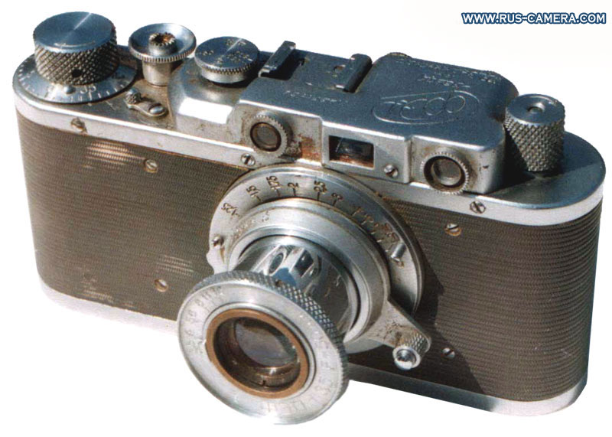
Cameras
CS5670: Computer Vision
Source: S. Lazebnik

Slide 2
Announcements
Take-home midterm will be handed out at the end of class
  Due Tuesday, March 5, by 1:25pm (beginning of class)
Project 2 Code & Report due tonight by 8pm
Project 3: Panorama Stitching
  To be released next Tuesday, March 5
  Due Friday, March 15

Slide 3
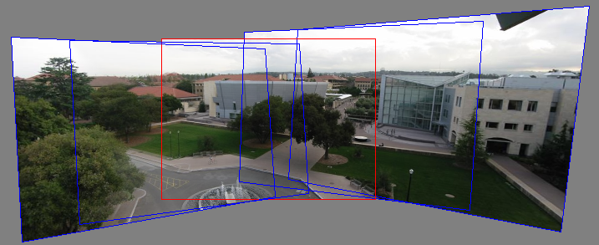
Can we use homographies to create a 360 panorama?
In order to figure this out, we need to learn what a camera is

Slide 4
Image formation
Let’s design a camera
  Idea 1: put a piece of film in front of an object
  Do we get a reasonable image?
  No. This is a bad camera.

Slide 5
Pinhole camera
Add a barrier to block off most of the rays
  This reduces blurring
  The opening known as the aperture
  How does this transform the image?
Notes:
It gets inverted

Slide 6
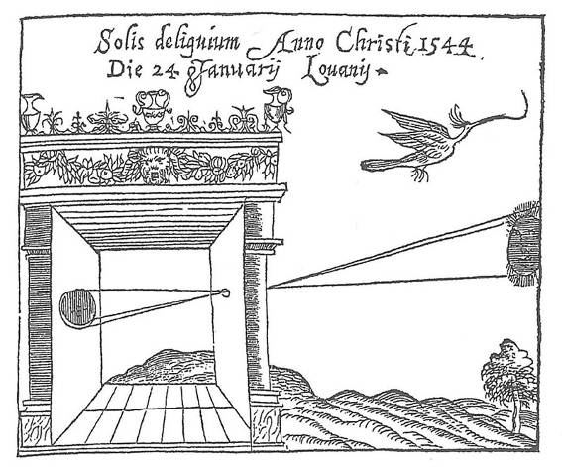
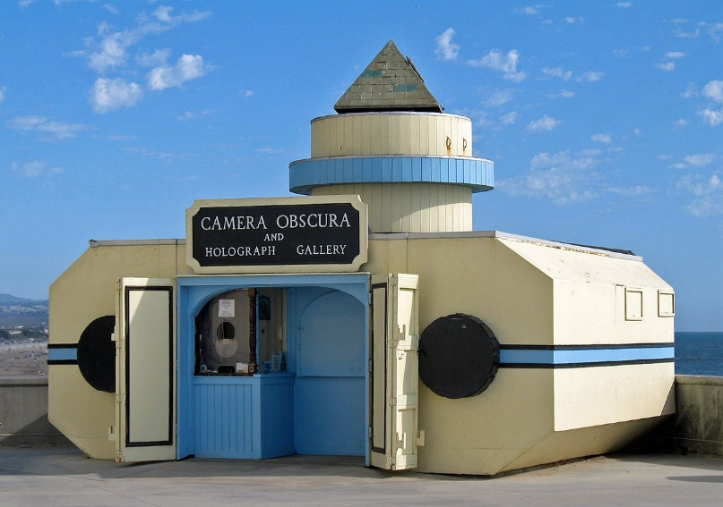
Camera Obscura
Basic principle known to Mozi (470-390 BC), Aristotle (384-322 BC)
Drawing aid for artists: described by Leonardo da Vinci (1452-1519)
Gemma Frisius, 1558
Source: A. Efros

Slide 7
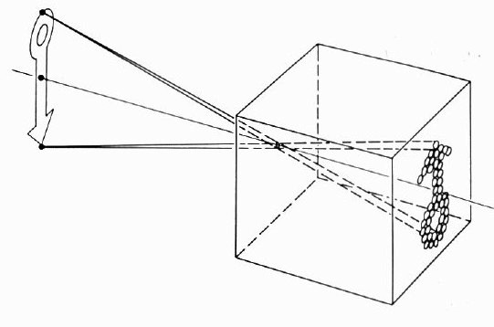
Camera Obscura

Slide 8
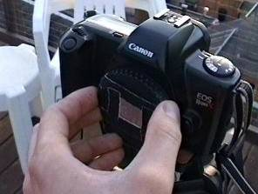
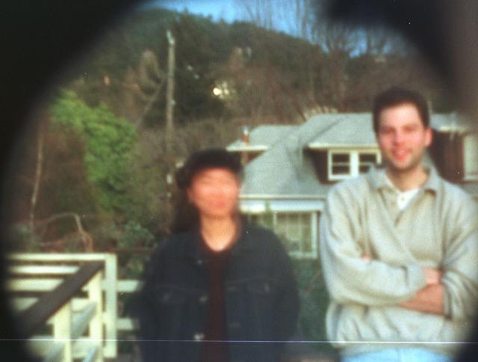
Home-made pinhole camera
Why so blurry?
Slide by A. Efros
http://www.debevec.org/Pinhole/

Slide 9
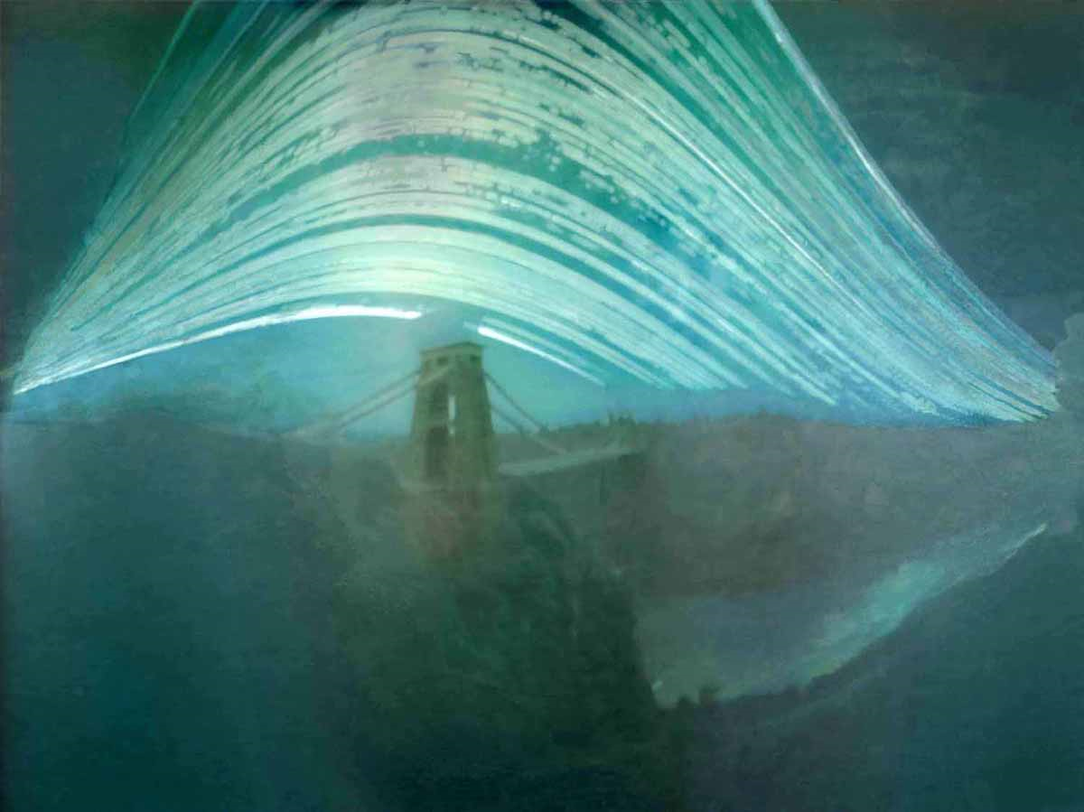
Pinhole photography
Justin Quinnell, The Clifton Suspension Bridge. December 17th 2007 - June 21st 2008
6-month exposure

Slide 10
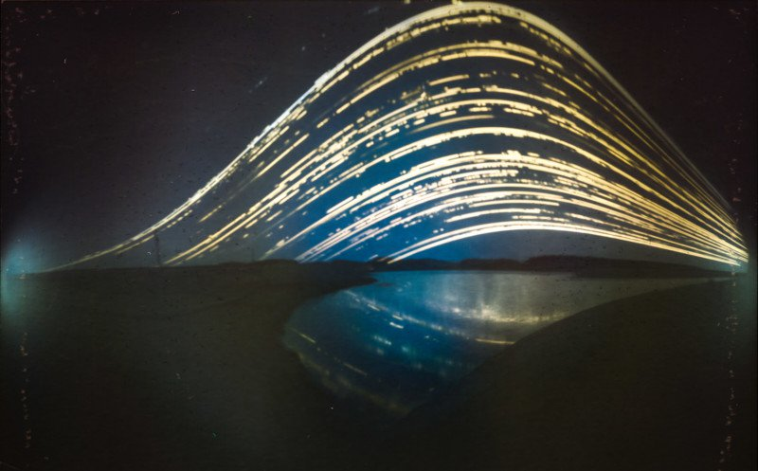
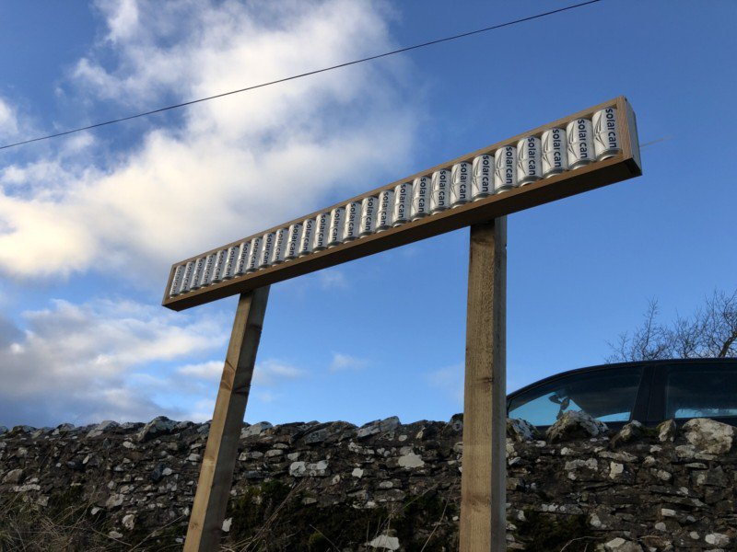
https://petapixel.com/2019/07/17/this-is-the-worlds-first-solargraphy-timelapse/

Slide 11
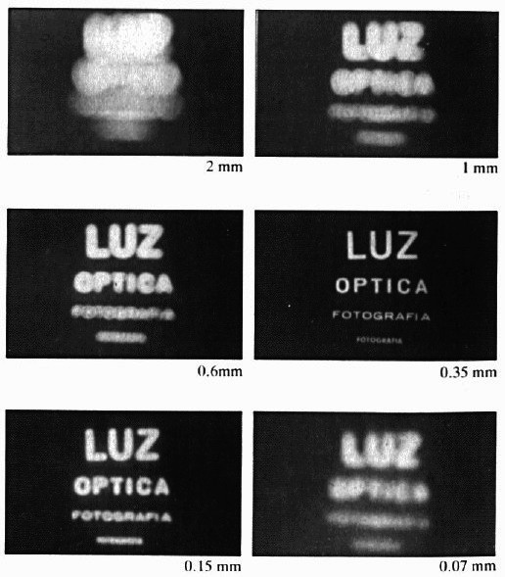
Shrinking the aperture
Why not make the aperture as small as possible?
  Less light gets through
  Diffraction effects...

Slide 12
Shrinking the aperture

Slide 13
Adding a lens
“circle of
confusion”
A lens focuses light onto the film
  There is a specific distance at which objects are “in focus”
    other points project to a “circle of confusion” in the image
  Changing the shape of the lens changes this distance

Slide 14
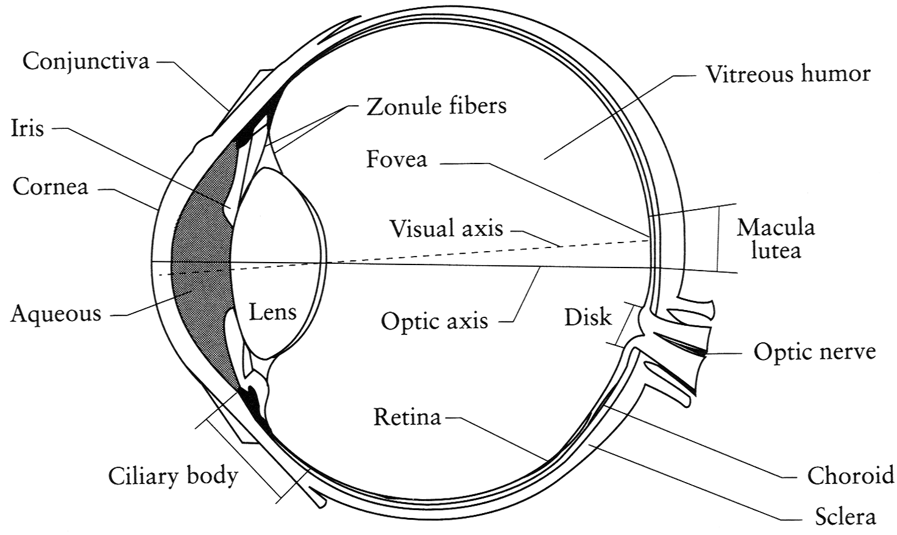
The eye
The human eye is a camera
  Iris - colored annulus with radial muscles
  Pupil - the hole (aperture) whose size is controlled by the iris
  What’s the “film”?
    photoreceptor cells (rods and cones) in the retina
Notes:
Note that the retina is curved

Slide 15
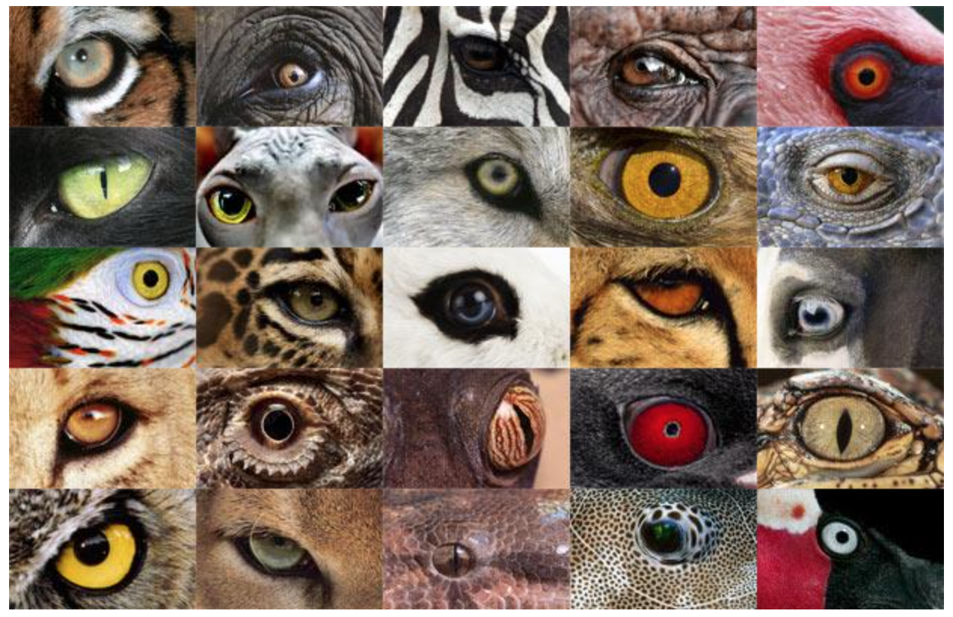
http://www.telegraph.co.uk/news/earth/earthpicturegalleries/7598120/Animal-eyes-quiz-Can-you-work-out-which-creatures-these-are-from-their-eyes.html?image=25

Slide 16
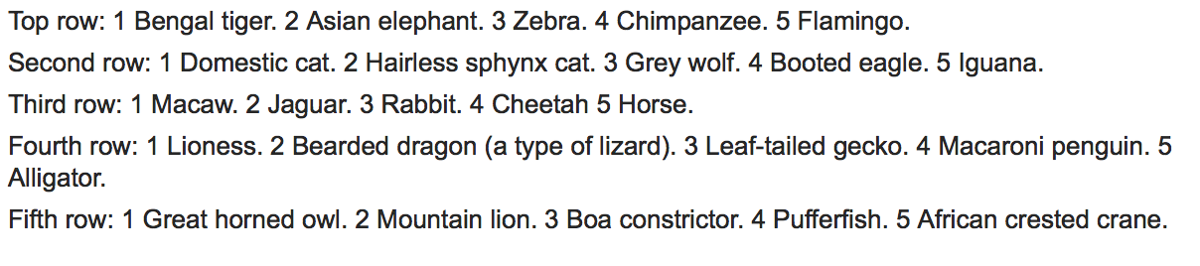
http://www.telegraph.co.uk/news/earth/earthpicturegalleries/7598120/Animal-eyes-quiz-Can-you-work-out-which-creatures-these-are-from-their-eyes.html?image=25

Slide 17

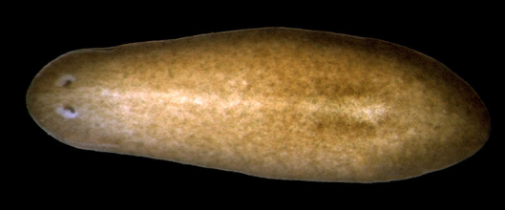
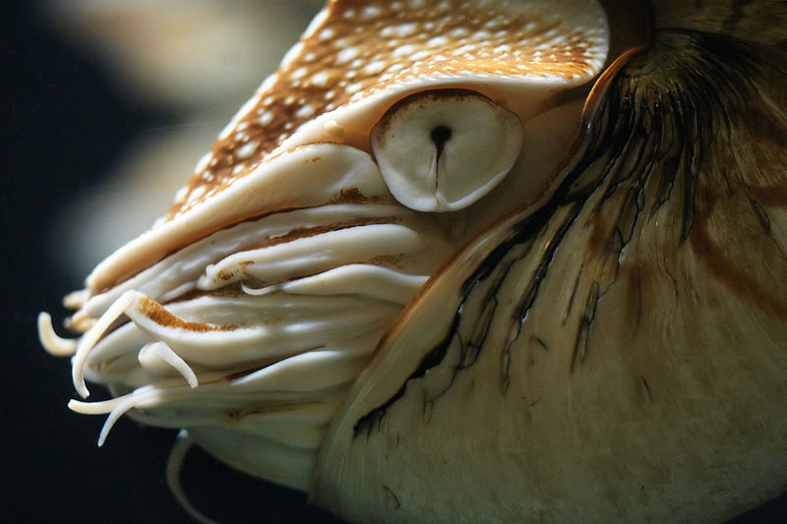
Eyes in nature: eyespots to pinhole camera
http://upload.wikimedia.org/wikipedia/commons/6/6d/Mantis_shrimp.jpg

Slide 18
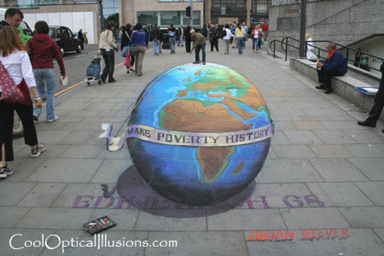
Projection

Slide 19
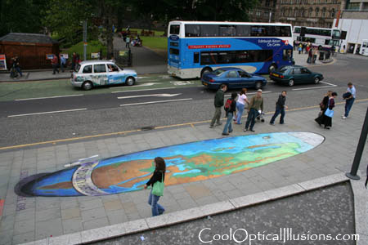
Projection

Slide 20
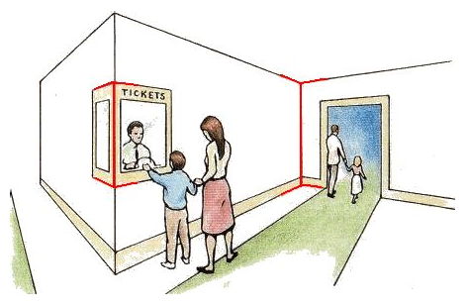
Müller-Lyer Illusion
https://en.wikipedia.org/wiki/Müller-Lyer_illusion

Slide 21
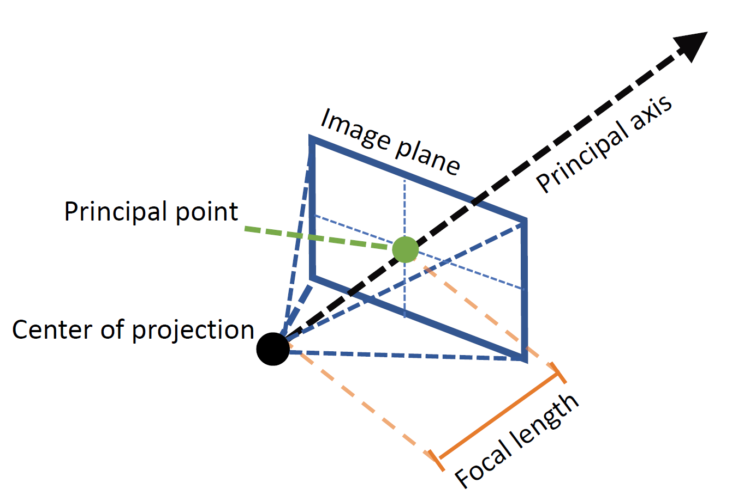
Geometric Model: A Pinhole Camera
Figure credit: Peter Hedman

Slide 22
Modeling projection
Center of Projection (COP)
(x’, y’, f)
The coordinate system
  We use the pinhole model as an approximation
  Put the optical center (aka Center of Projection, or COP) at the origin
  Put the Image Plane (aka Projection Plane) in front of the COP (Why)?
  The camera looks down the positive z-axis, and the y-axis points down
    we like this if we want right-handed-coordinates
    other versions are possible (e.g., OpenGL)
(x, y, z)
z
f
x
Image Plane
y
Notes:
This way the image is right-side-up

Slide 23
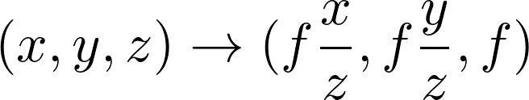
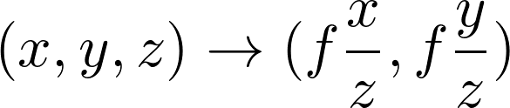
Modeling projection
Center of Projection (COP)
(x’, y’, f)
Projection equations
  Compute intersection with PP of ray from (x,y,z) to COP
  Derived using similar triangles
  We get the projection by throwing out the last coordinate:
(x, y, z)
z
f
x
Image Plane
y
Notes:
This way the image is right-side-up

Slide 24
Great Camera Demo
https://ciechanow.ski/cameras-and-lenses/

Slide 25
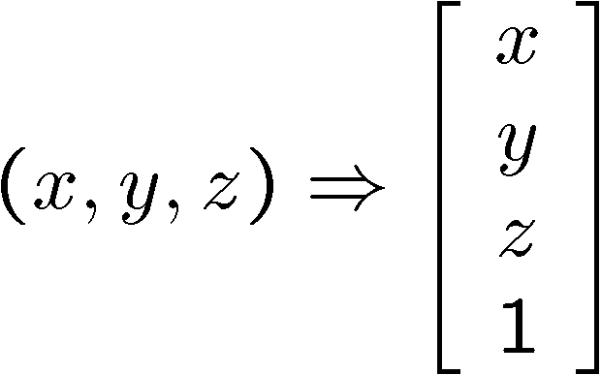
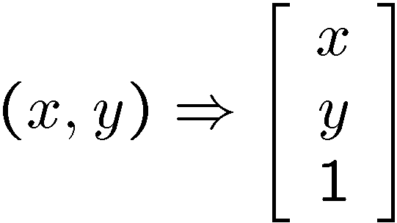
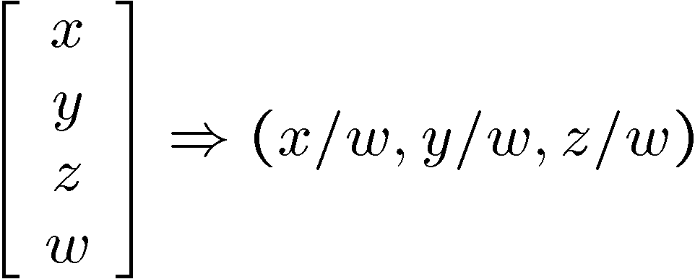
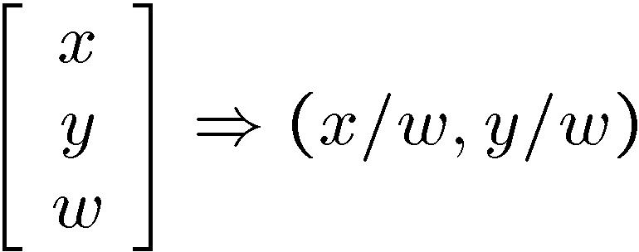
Modeling projection
Is this a linear transformation?
  no—division by z is nonlinear
Homogeneous coordinates to the rescue—again!
homogeneous image
coordinates
homogeneous scene
coordinates
Converting from homogeneous coordinates

Slide 26
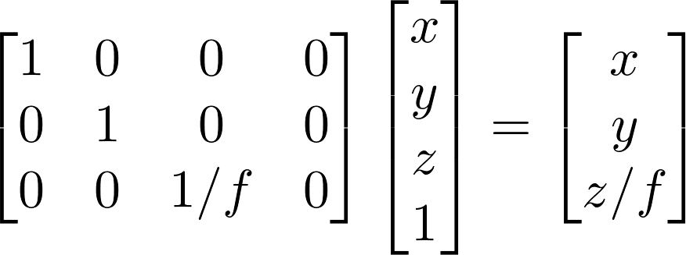
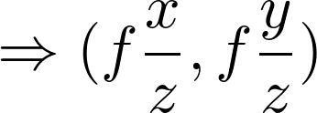
Perspective Projection
Projection is a matrix multiply using homogeneous coordinates:
divide by third coordinate
This is known as perspective projection
  The matrix is the projection matrix
  (Can also represent as a 4x4 matrix – OpenGL does something like this)
Notes:
$$
\begin{bmatrix}
1 & 0 & 0 & 0 \\
0 & 1 & 0 & 0 \\
0 & 0 & 1/f & 0
\end{bmatrix}
\begin{bmatrix}
x \\
y \\
z \\
1
\end{bmatrix}
=
\begin{bmatrix}
x \\
y \\
z / f
\end{bmatrix}
$$

Slide 27
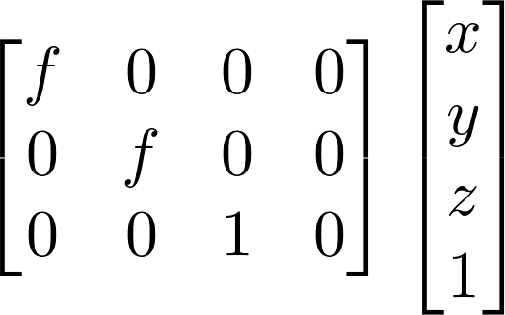
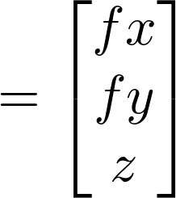
Perspective Projection
How does scaling the projection matrix change the transformation?
Scale by f:
Scaling a projection matrix produces an equivalent projection matrix!

Slide 28
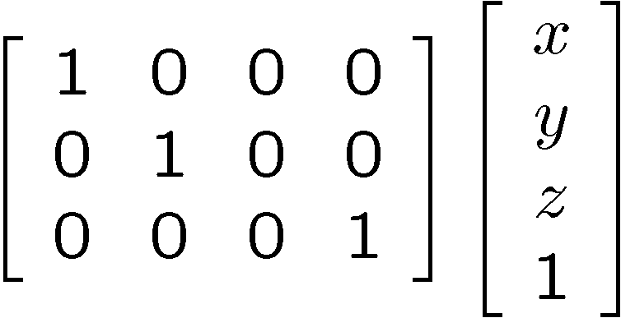
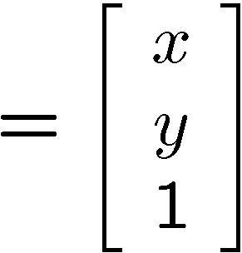

Orthographic projection
Special case of perspective projection
  Distance from the COP to the PP is infinite
  Good approximation for telephoto optics
  Also called “parallel projection”: (x, y, z) → (x, y)
  What’s the projection matrix?
Image
World

Slide 29
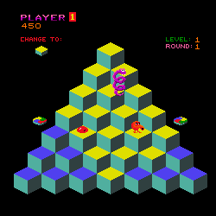
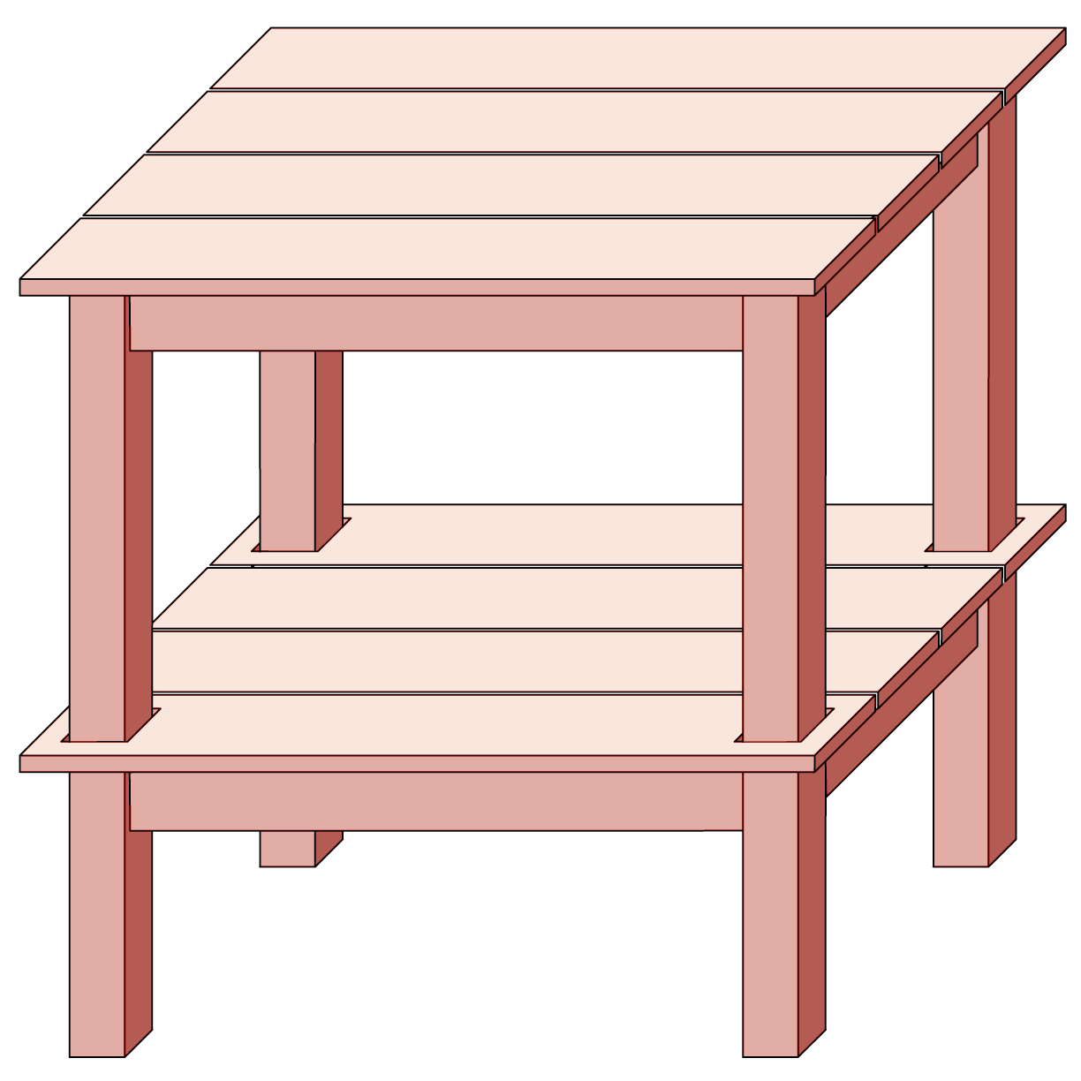
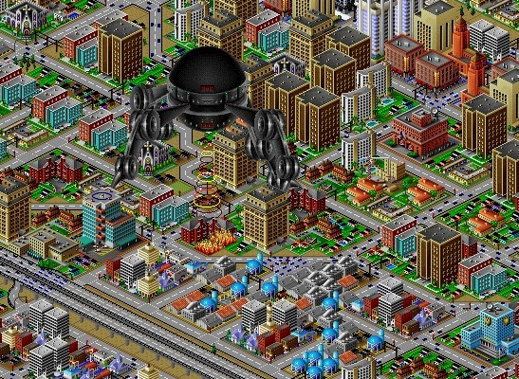
Orthographic projection

Slide 30
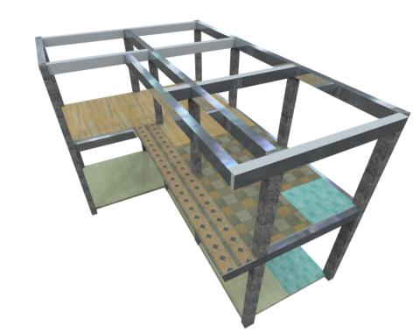
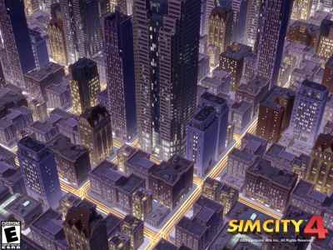
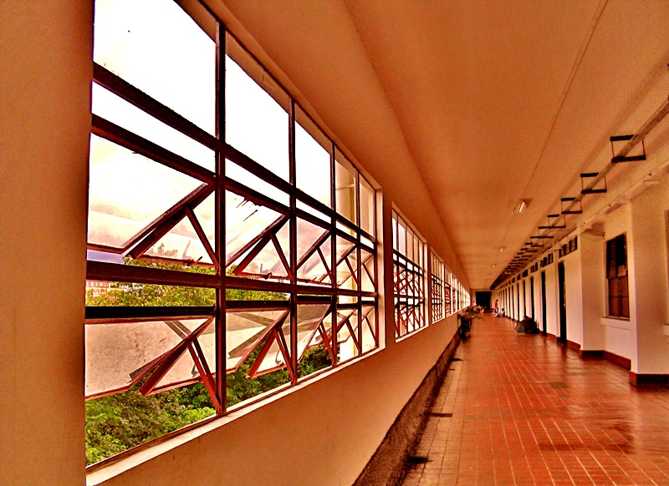
Perspective projection

Slide 31
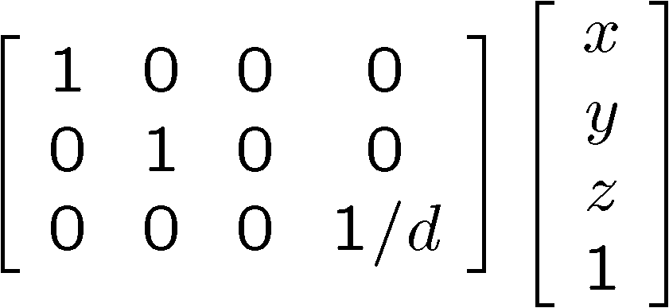
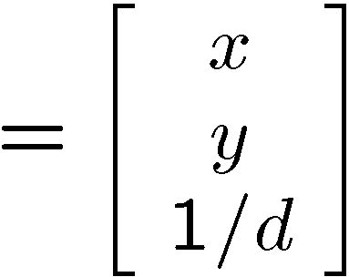

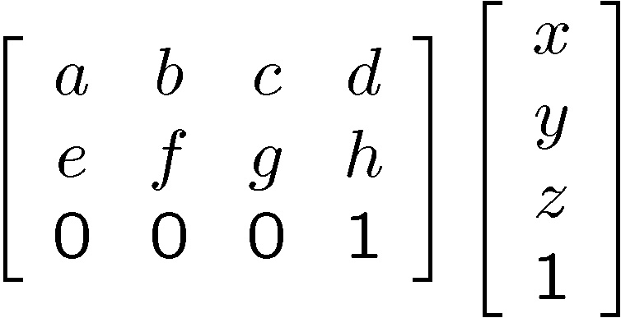
Variants of orthographic projection
Scaled orthographic
  Also called “weak perspective”
Affine projection
  Also called “paraperspective”

Slide 32
Dimensionality Reduction Machine (3D to 2D)
3D world
2D image
What have we lost?
  Angles
  Distances (lengths)
Slide by A. Efros
Figures © Stephen E. Palmer, 2002

Slide 33
Projection properties
Many-to-one: any points along same ray map to same point in image
Points → points
Lines → lines (collinearity is preserved)
  But line through focal point projects to a point
Planes → planes (or half-planes)
  But plane through focal point projects to line

Slide 34
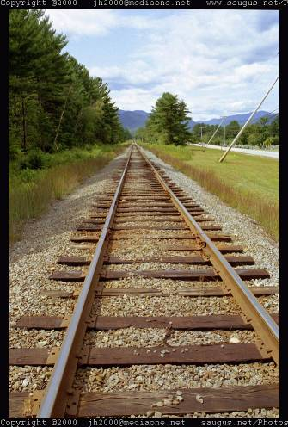
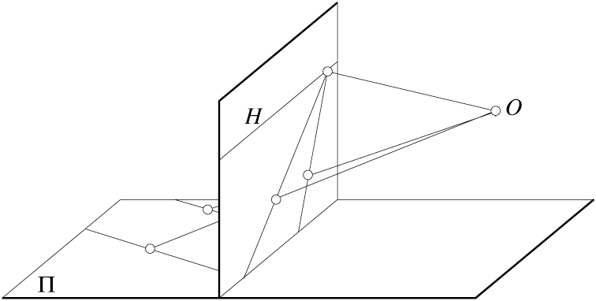
Projection properties
Parallel lines converge at a vanishing point
  Each direction in space has its own vanishing point
  But parallel lines parallel to the image plane remain parallel

Slide 35
Questions?

Slide 36

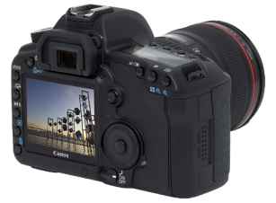
Camera parameters
How can we model the geometry of a camera?
Camera
w
y
(x, y, z)
COP
u
v
Three important coordinate systems:
World coordinates
Camera coordinates
Image coordinates
o
x
z
“The World”
How do we project a given world point (x, y, z) to an image point?

Slide 37
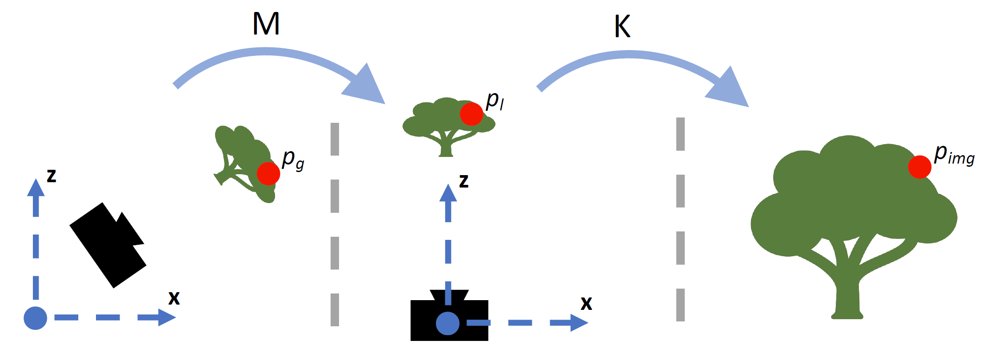
Coordinate frames
World coordinates
Camera coordinates
Image coordinates
Figure credit: Peter Hedman

Slide 38
Camera parameters
To project a point (x, y, z) in world coordinates into a camera
First transform (x, y, z) into camera coordinates
Need to know
  Camera position (in world coordinates)
  Camera orientation (in world coordinates)
Then project into the image plane to get image (pixel) coordinates
  Need to know camera intrinsics

Slide 39

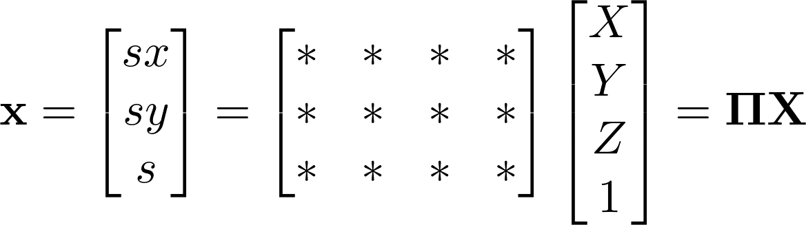


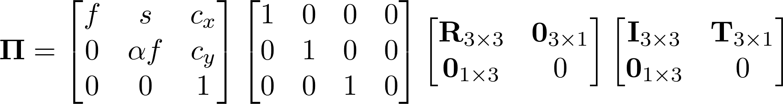
Camera parameters
A camera is described by several parameters
  Translation T of the optical center from the origin of world coords
  Rotation R of the image plane
  focal length f, principal point (c_{x}, c_{y}), pixel aspect size α
  blue parameters are called “extrinsics,” red are “intrinsics”
Projection equation
  The projection matrix models the cumulative effect of all parameters
  Useful to decompose into a series of operations
identity matrix
intrinsics
projection
rotation
translation
  The definitions of these parameters are not completely standardized
    especially intrinsics—varies from one book to another

Slide 40










Projection matrix
=
0
(in homogeneous image coordinates)

Slide 41
Extrinsics
How do we get the camera to “canonical form”?
  Canonical form: Center of projection at the origin, x-axis points right, y-axis points down, z-axis points forwards
Step 1: Translate by -c
0

Slide 42
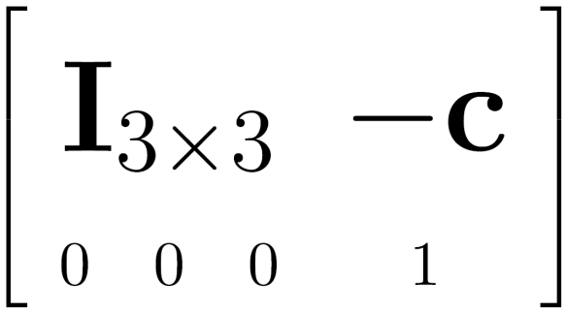

Extrinsics
How do we get the camera to “canonical form”?
  Canonical form: Center of projection at the origin, x-axis points right, y-axis points down, z-axis points forwards
Step 1: Translate by -c
How do we represent translation as a matrix multiplication?
0

Slide 43
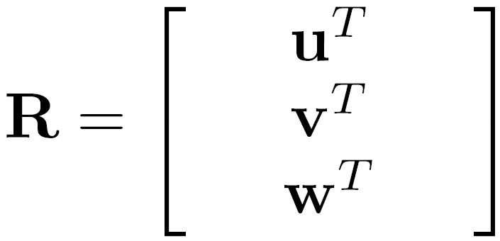
Extrinsics
How do we get the camera to “canonical form”?
  Canonical form: Center of projection at the origin, x-axis points right, y-axis points down, z-axis points forwards
Step 1: Translate by -c
Step 2: Rotate by R
0
3x3 rotation matrix

Slide 44
Extrinsics
How do we get the camera to “canonical form”?
  Canonical form: Center of projection at the origin, x-axis points right, y-axis points down, z-axis points forwards
Step 1: Translate by -c
Step 2: Rotate by R
0
(with extra row/column of [0 0 0 1])

Slide 45
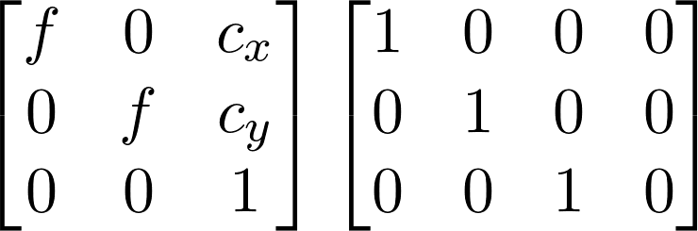





Perspective projection
(converts from 3D rays in camera coordinate system to pixel coordinates)
(intrinsics)
in general,
(upper triangular matrix)
: aspect ratio (1 unless pixels are not square)
: skew (0 unless pixels are shaped like rhombi/parallelograms)
: principal point ((w/2,h/2) unless optical axis doesn’t intersect projection plane at image center)

Slide 46

Typical intrinsics matrix
2D affine transform corresponding to a scale by f (focal length) and a translation by (c_{x}, c_{y}) (principal point)
Maps 3D rays to 2D pixels

Slide 47






Focal length
Can think of as “zoom”
Also related to field of view
24mm
50mm
200mm
800mm

Slide 48


Field of view

Slide 49


Slide 50


Slide 51


Slide 52


Slide 53

Notes:
http://www.stsite.com/camera/telephoto-wideangle.php
Wide angle deepens
Telephoto magnifies and pulls it in

Slide 54

http://petapixel.com/2013/01/11/how-focal-length-affects-your-subjects-apparent-weight-as-seen-with-a-cat/

Slide 55


Projection matrix
intrinsics
projection
rotation
translation
This part converts 3D points in world coordinates to 3D rays in the camera’s coordinate system. There are 6 parameters represented (3 for position/translation, 3 for rotation).
The K matrix converts 3D rays in the camera’s coordinate system to 2D image points in image (pixel) coordinates.

Slide 56


Projection matrix
intrinsics
projection
rotation
translation
(t in book’s notation)

Slide 57
Projection matrix
=
0
(in homogeneous image coordinates)

Slide 58
Questions?

Slide 59

Perspective distortion
Problem for architectural photography: converging verticals
Source: F. Durand

Slide 60


Perspective distortion
Problem for architectural photography: converging verticals
Solution: view camera (lens shifted w.r.t. film)
Tilting the camera upwards results in converging verticals
Keeping the camera level, with an ordinary lens, captures only the bottom portion of the building
Shifting the lens upwards results in a picture of the entire subject
http://en.wikipedia.org/wiki/Perspective_correction_lens
Source: F. Durand

Slide 61
Perspective distortion
Problem for architectural photography: converging verticals
Result:
Source: F. Durand

Slide 62
Perspective distortion
What does a sphere project to?
Image source: F. Durand

Slide 63


Perspective distortion
The exterior columns appear bigger
The distortion is not due to lens flaws
Problem pointed out by Da Vinci
Slide by F. Durand

Slide 64

https://aaronhertzmann.com/2022/02/28/how-does-perspective-work.html

Slide 65

Perspective distortion: People

Slide 66

Distortion-Free Wide-Angle Portraits on Camera Phones
YiChang Shih, Wei-Sheng Lai, and Chia-Kai Liang, Distortion-Free Wide-Angle Portraits on Camera Phones, SIGGRAPH 2019
https://people.csail.mit.edu/yichangshih/wide_angle_portrait/

Slide 67

Distortion
No distortion
Pin cushion
Barrel
Radial distortion of the image
  Caused by imperfect lenses
  Deviations are most noticeable for rays that pass through the edge of the lens

Slide 68



Slide 69

Radial distortion
Arrows show motion of projected points relative to an ideal (distortion-free lens)
[Image credit: J. Bouguet http://www.vision.caltech.edu/bouguetj/calib_doc/htmls/example.html]

Slide 70


Correcting radial distortion
from Helmut Dersch

Slide 71



Distortion

Slide 72




Modeling distortion
Project
to “normalized”
image coordinates
Apply radial distortion
Apply focal length
translate image center
To model lens distortion
  Use above projection operation instead of standard projection matrix multiplication

Slide 73
Other types of projection
Lots of intriguing variants…
(I’ll just mention a few fun ones)

Slide 74

360 degree field of view…
Basic approach
  Take a photo of a parabolic mirror with an orthographic lens (Nayar)
  Or buy one a lens from a variety of omnicam manufacturers…
    See http://www.cis.upenn.edu/~kostas/omni.html

Slide 75



Tilt-shift
http://www.northlight-images.co.uk/article_pages/tilt_and_shift_ts-e.html
Tilt-shift images from Olivo Barbieri
and Photoshop imitations

Slide 76


Rotating sensor (or object)
Rollout Photographs © Justin Kerr
http://research.famsi.org/kerrmaya.html
Also known as “cyclographs”, “peripheral images”

Slide 77
Questions?

