Slide 1
Quiz 7 (on Canvas)
Closed book / closed note
Ends at 1:08pm

Slide 2

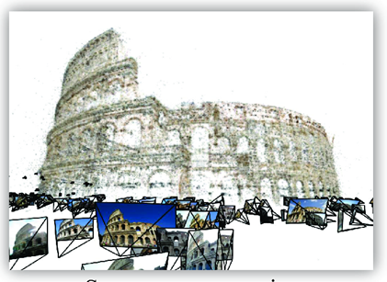
Structure from motion
CS5670: Computer Vision

Slide 3
Readings
Szeliski (2nd Edition), Chapter 11.4

Slide 4
Announcements
Project 4 due tomorrow, 3/31, by 8pm
Project 5 on NeRF coming up after Spring Break

Slide 5
Project 3 Artifact Prizes

Slide 6
Third Place

Slide 7
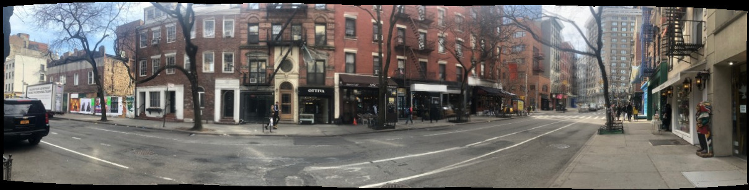
Yuxi Sun and Yaohai Xu

Slide 8
Second Place

Slide 9
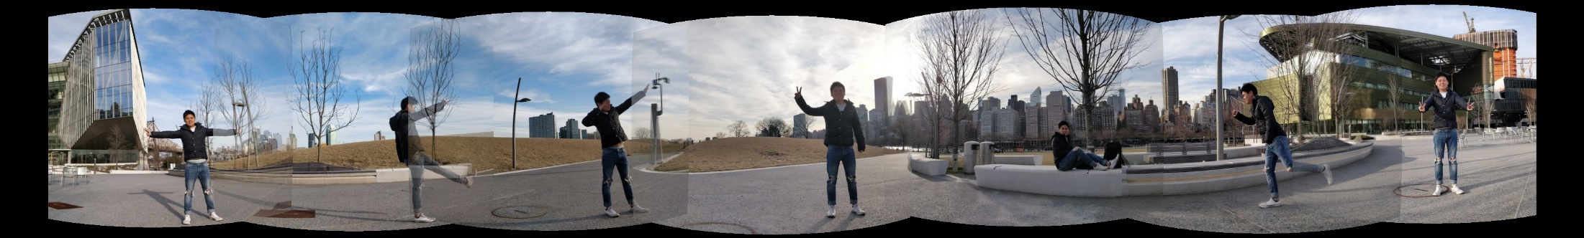
Aayushi Jain and Keith Yu

Slide 10
First Place

Slide 11
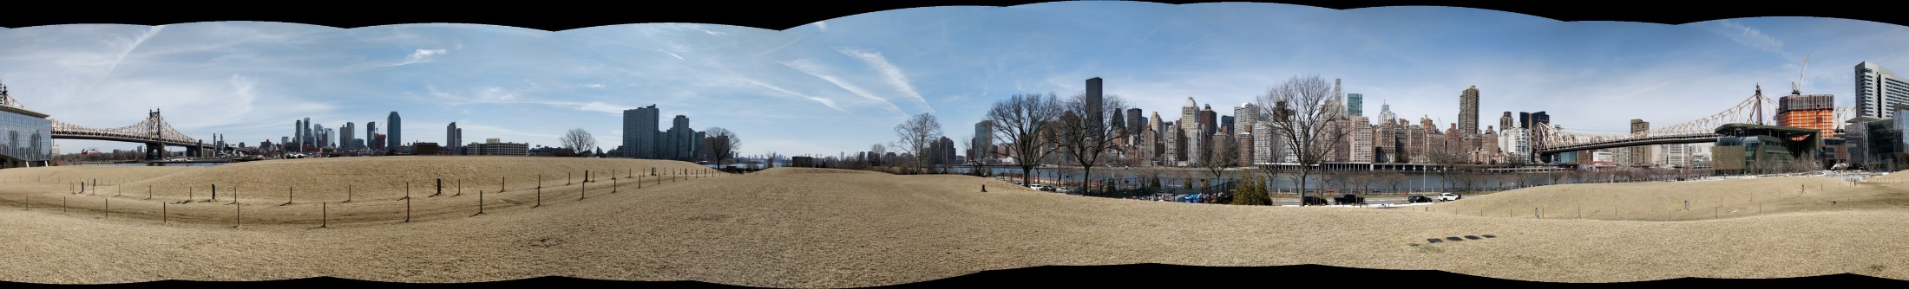
Kulvinder Lotay and Roger Wang

Slide 12
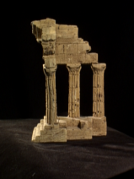
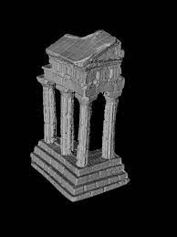
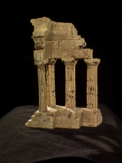
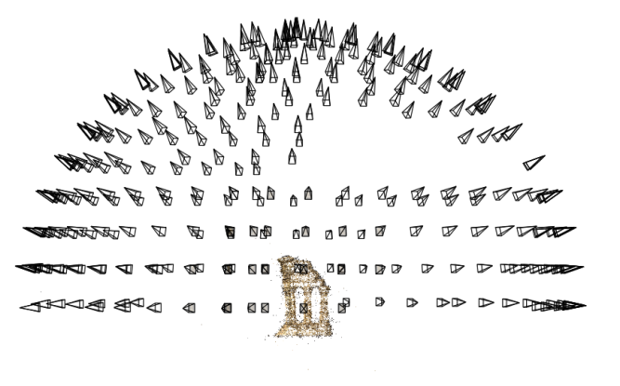
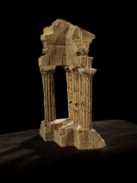
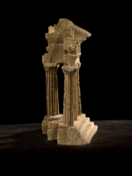
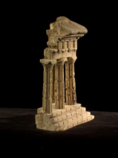
Reminder: multi-view stereo
Problem formulation: given several images of the same object or scene, compute a representation of its 3D shape

Slide 13
Structure from motion
Multi-view stereo assumes that cameras are calibrated
  Extrinsics and intrinsics are known for all views
How do we compute calibration if we don’t know it? In general, this is called structure from motion

Slide 14
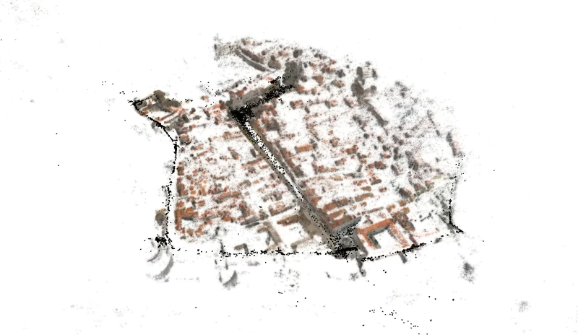
Large-scale structure from motion
Dubrovnik, Croatia. 4,619 images (out of an initial 57,845).
Total reconstruction time: 23 hours
Number of cores: 352

Slide 15


Two views
Solve for Fundamental matrix / Essential matrix
Factorize into intrinsics, rotation, and translation

Slide 16
What about more than two views?
The geometry of three views is described by a 3 x 3 x 3 tensor called the trifocal tensor
The geometry of four views is described by a 3 x 3 x 3 x 3 tensor called the quadrifocal tensor
After this it starts to get complicated…
  Instead, we explicitly solve for camera poses and scene geometry

Slide 17
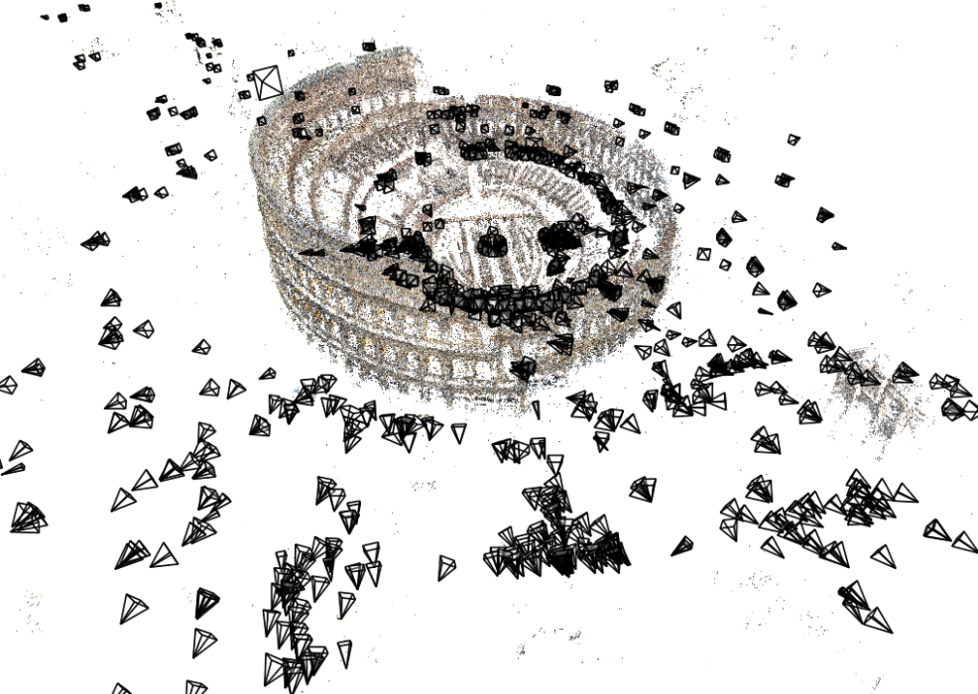
Structure from motion
Given many images, how can we
  a) figure out where they were all taken from?
  b) build a 3D model of the scene?
  This is the structure from motion (SfM) problem

Slide 18
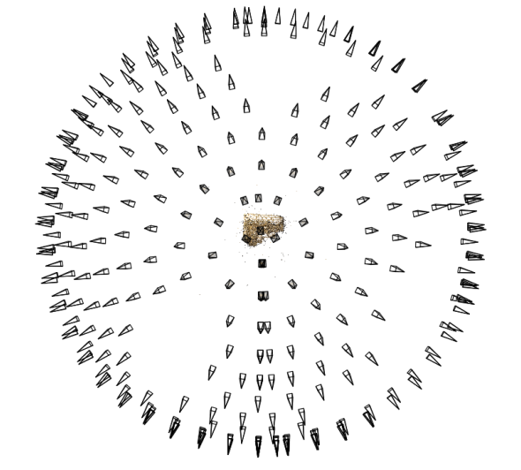
Structure from motion
Reconstruction (side)
(top)
Input: images with 2D points in correspondence p_{i,j} = (u_{i,j},v_{i,j})
Output
  structure: 3D location x_{i} for each point p_{i}
  motion: camera parameters R_{j} , t_{j} & possibly K_{j}
Objective function: minimize reprojection error

Slide 19
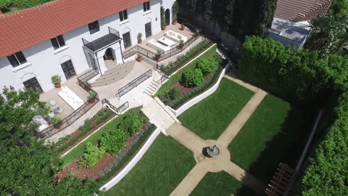
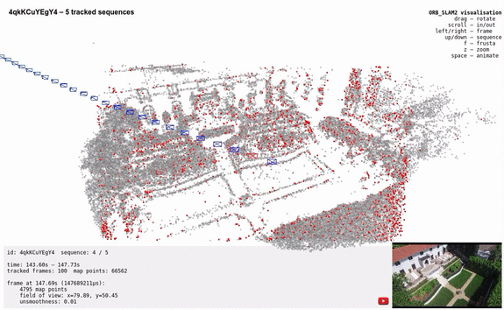
Can also compute camera poses from video (often called Visual SLAM)

Slide 20
What we’ve seen so far…
2D transformations between images
  Translations, affine transformations, homographies…
Fundamental matrices
  Represent relationships between 2D images in the form of corresponding 2D lines
What’s new: Explicitly representing 3D geometry of cameras and points

Slide 21
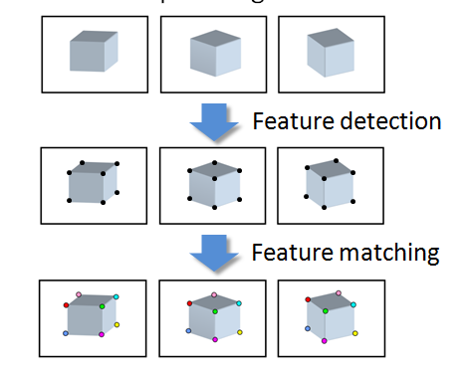
Input

Slide 22
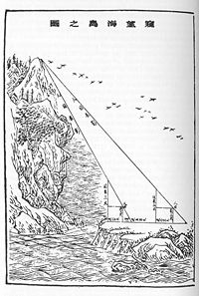
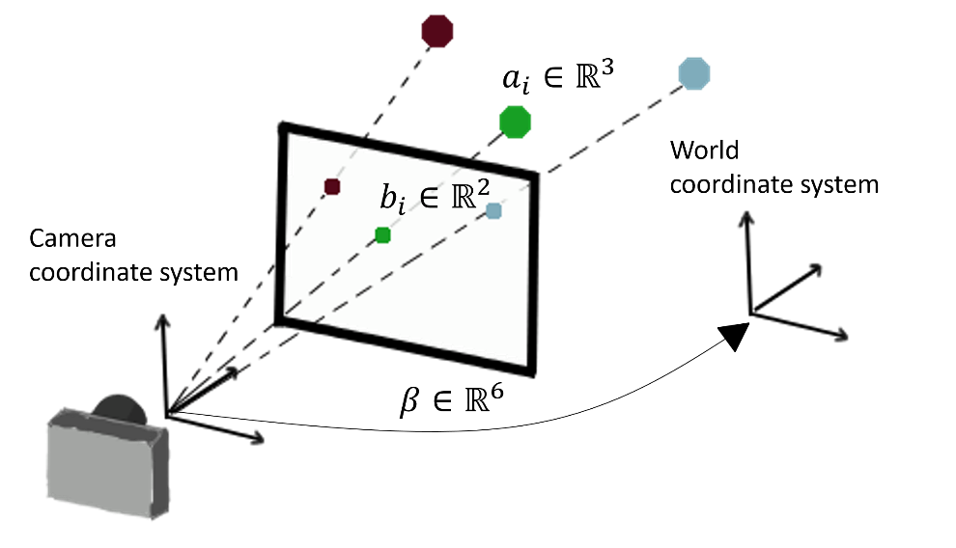
Triangulation & camera calibration
Suppose we have known camera parameters, each of which observes a point
  How can we compute the 3D location of that point?
  This is called triangulation (known since ancient times)
On the other hand: Suppose we have known 3D points
  And have matches between these points and an image
  How can we compute the camera parameters?
  This is called camera calibration (or camera resectioning)
Liu Hui (c. 263), How to measure the height of a sea island.
https://arxiv.org/abs/2003.04626

Slide 23
Structure from motion
What if we don’t know 3D points or camera parameters?
SfM solves both of these problems at once
A kind of chicken-and-egg problem
  (but solvable)

Slide 24
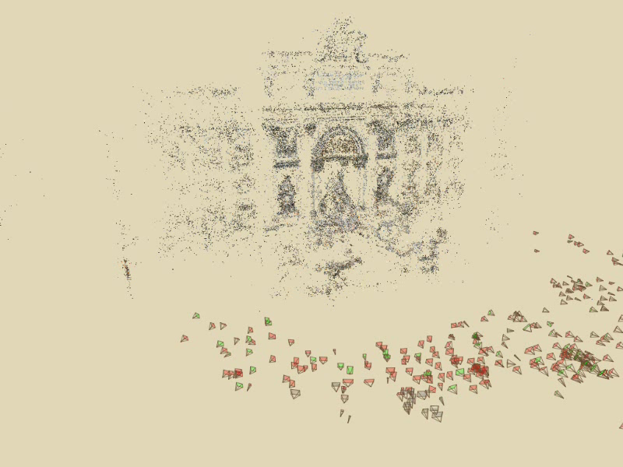
Photo Tourism
Notes:
Here’s how the same set of photos appear in our photo explorer. Our system takes the set of photos and automatically determines the relative positions and orientations from which each photo was taken. We can then load the photos into our immersive 3D browser where the user can visualize and explore the photos using spatial relationships.

Slide 25
First step: how to get correspondence?
Feature detection and matching

Slide 26
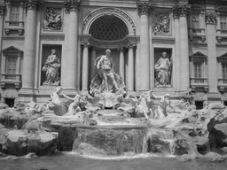

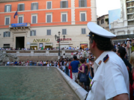
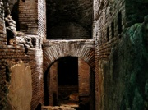

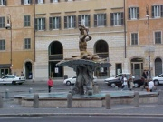
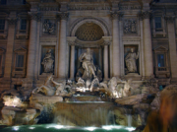
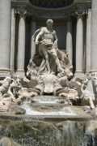


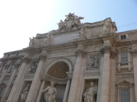
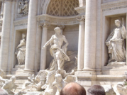


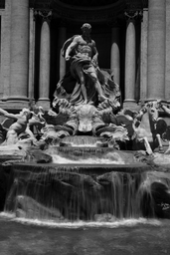

Feature detection
Detect features using SIFT [Lowe, IJCV 2004]
Notes:
So, we begin by detecting SIFT features in each photo.
[We detect SIFT features in each photo, resulting in a set of feature locations and 128-byte feature descriptors…]

Slide 27





Feature detection
Detect features using SIFT [Lowe, IJCV 2004]

Slide 28
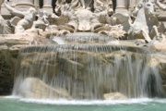



Feature matching
Match features between each pair of images
Notes:
Next, we match features across each pair of photos using approximate nearest neighbor matching.

Slide 29


Feature matching
Refine matching using RANSAC to estimate fundamental matrix between each pair
Notes:
The matches are refined by using RANSAC, which is a robust model-fitting technique, to estimate a fundamental matrix between each pair of matching images and keeping only matches consistent with that fundamental matrix.
We then link connected components of pairwise feature matches together to form correspondences across multiple images.
Once we have correspondences, we run structure from motion to recover the camera and scene geometry. Structure from motion solves the following problem:

Slide 30
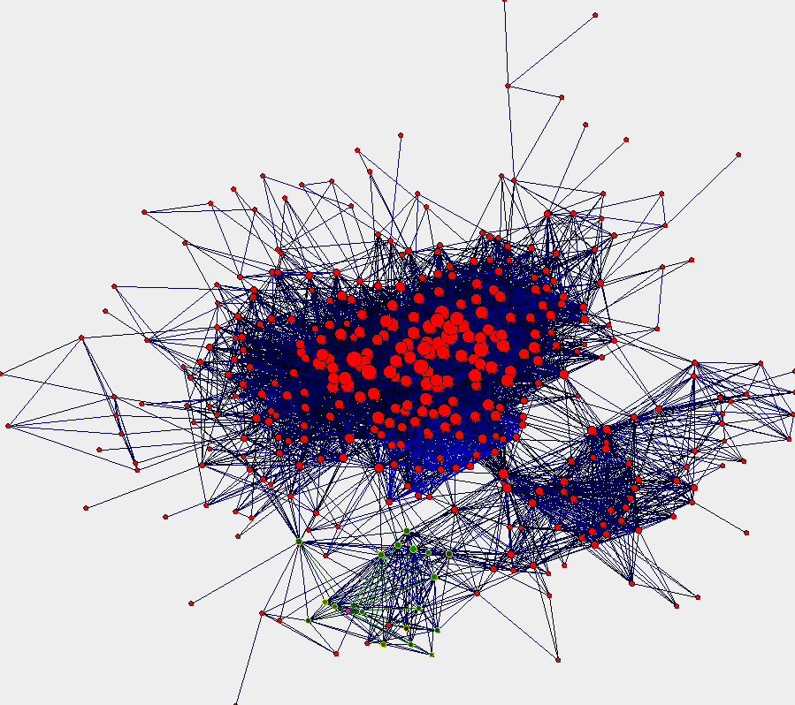
Image connectivity graph
(graph layout produced using the Graphviz toolkit: http://www.graphviz.org/)

Slide 31
Demo

Slide 32
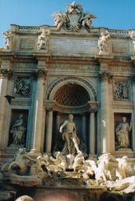
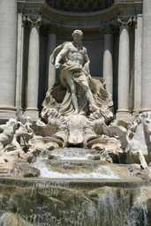
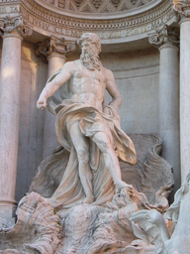
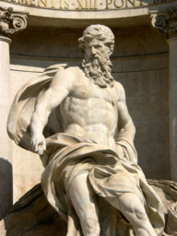
Correspondence estimation
Link up pairwise matches to form connected components of matches across several images
Image 1
Image 2
Image 3
Image 4
Notes:
The next step of our reconstruction algorithm is to link up matches between pairs of images into correspondences between multiple images, by finding connected components of matches. Suppose among these images, these features are matched only between consecutive pairs of images, perhaps because the scales of the images are so different. During correspondence estimation we link these matches and consider them to be 2D projections of a single 3D point in the scene.

Slide 33
Input to Structure from Motion

Slide 34
x₄
x₁
x₃
x₂
x₅
x₇
x₆
p_{1,1}
p_{1,2}
p_{1,3}
Image 1
Image 3
R₁,t₁
R₃,t₃
Image 2
R₂,t₂

Slide 35
Structure from motion
p₄
p₁
p₃
minimize
p₂
f (R, T, P)
p₅
p₇
p₆
Camera 1
Camera 3
R₁,t₁
R₃,t₃
Camera 2
R₂,t₂
Notes:
Structure from motion solves the following problem:
Given a set of images of a static scene with 2D points in correspondence, shown here as color-coded points, find…
a set of 3D points P and
a rotation R and position t of the cameras that explain the observed correspondences. In other words, when we project a point into any of the cameras, the reprojection error between the projected and observed 2D points is low.
This problem can be formulated as an optimization problem where we want to find the rotations R, positions t, and 3D point locations P that minimize sum of squared reprojection errors f. This is a non-linear least squares problem and can be solved with algorithms such as Levenberg-Marquart. However, because the problem is non-linear, it can be susceptible to local minima. Therefore, it’s important to initialize the parameters of the system carefully. In addition, we need to be able to deal with erroneous correspondences.

Slide 36

Structure from motion
X₄
X₁
X₃
minimize
X₂
g(R, T, X)
X₅
non-linear least squares
X₇
X₆
p_{1,1}
p_{1,3}
p_{1,2}
Camera 1
Camera 3
R₁,t₁
R₃,t₃
Camera 2
R₂,t₂
Notes:
Structure from motion solves the following problem:
Given a set of images of a static scene with 2D points in correspondence, shown here as color-coded points, find…
a set of 3D points P and
a rotation R and position t of the cameras that explain the observed correspondences. In other words, when we project a point into any of the cameras, the reprojection error between the projected and observed 2D points is low.
This problem can be formulated as an optimization problem where we want to find the rotations R, positions t, and 3D point locations P that minimize sum of squared reprojection errors f. This is a non-linear least squares problem and can be solved with algorithms such as Levenberg-Marquart. However, because the problem is non-linear, it can be susceptible to local minima. Therefore, it’s important to initialize the parameters of the system carefully. In addition, we need to be able to deal with erroneous correspondences.

Slide 37
Problem size
What are the variables?
  Cameras and points
How many variables per camera?
  6 (if calibrated), more if uncalibrated
How many variables per point?
  3
Trevi Fountain collection
  466 input photos
  + > 100,000 3D points
  = very large optimization problem

Slide 38
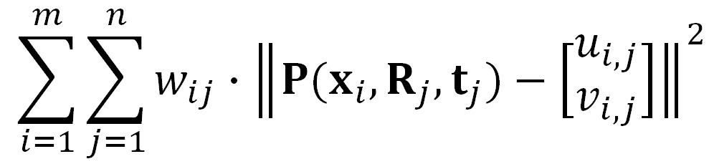

Structure from motion
Minimize sum of squared reprojection errors:
Minimizing this function is called bundle adjustment
  Optimized using non-linear least squares, e.g. Levenberg-Marquardt algorithm
predicted
image location
observed
image location
indicator variable:
is point i visible in image j ?

Slide 39
Is SfM always uniquely solvable?

Slide 40
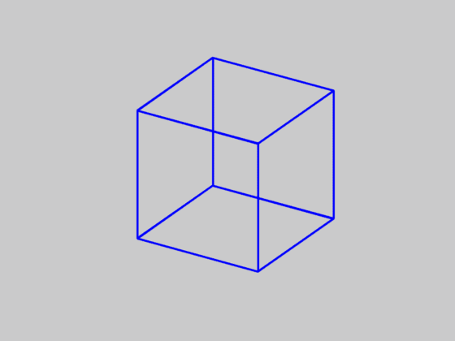
Is SfM always uniquely solvable?
No…

Slide 41


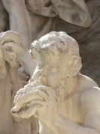


Incremental structure from motion
Notes:
To help get good initializations for all of the parameters of the system, we reconstruct the scene incrementally, starting from two photographs and the points they observe.

Slide 42
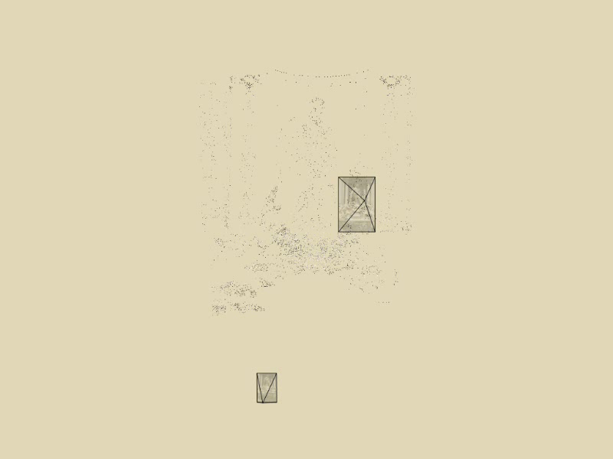
Incremental structure from motion
Notes:
To help get good initializations for all of the parameters of the system, we reconstruct the scene incrementally, starting from two photographs and the points they observe.

Slide 43
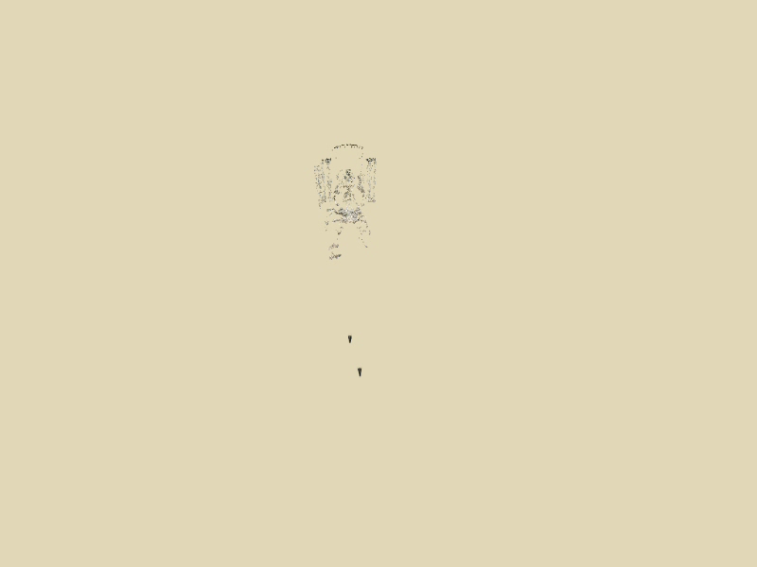
Incremental structure from motion
Notes:
We then add several photos at a time to the reconstruction, refine the model, and repeat until no more photos match any points in the scene.

Slide 44

Incremental structure from motion
Time-lapse reconstruction of Dubrovnik, Croatia, viewed from above

Slide 45
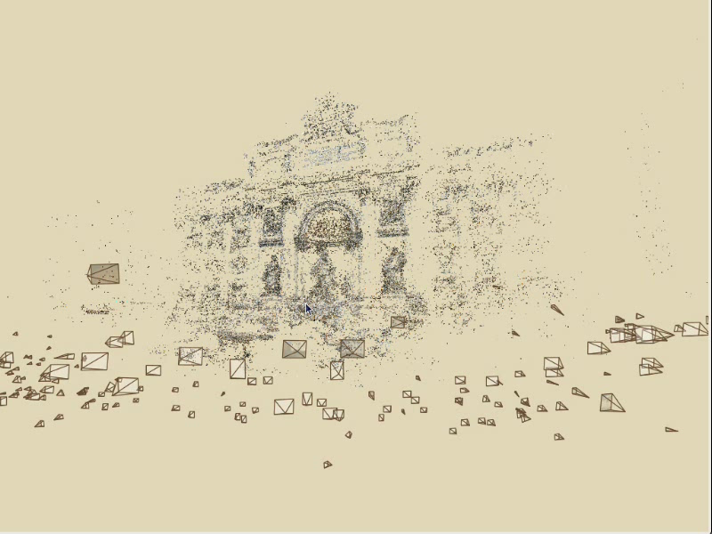
Photo Tourism

Slide 46
Demo

Slide 47
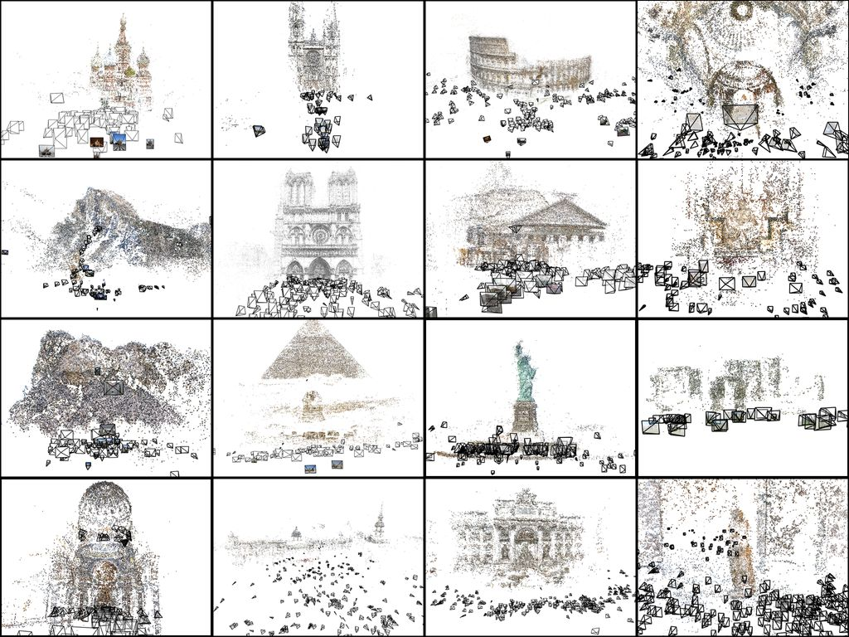

Slide 48
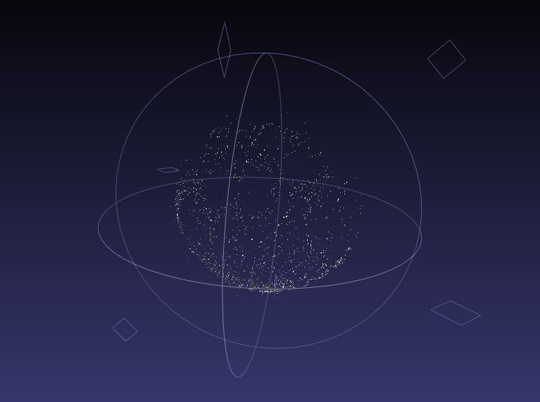

Slide 49
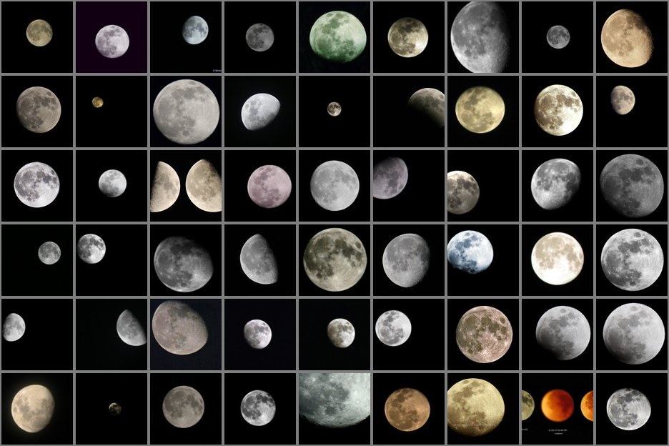

Slide 50
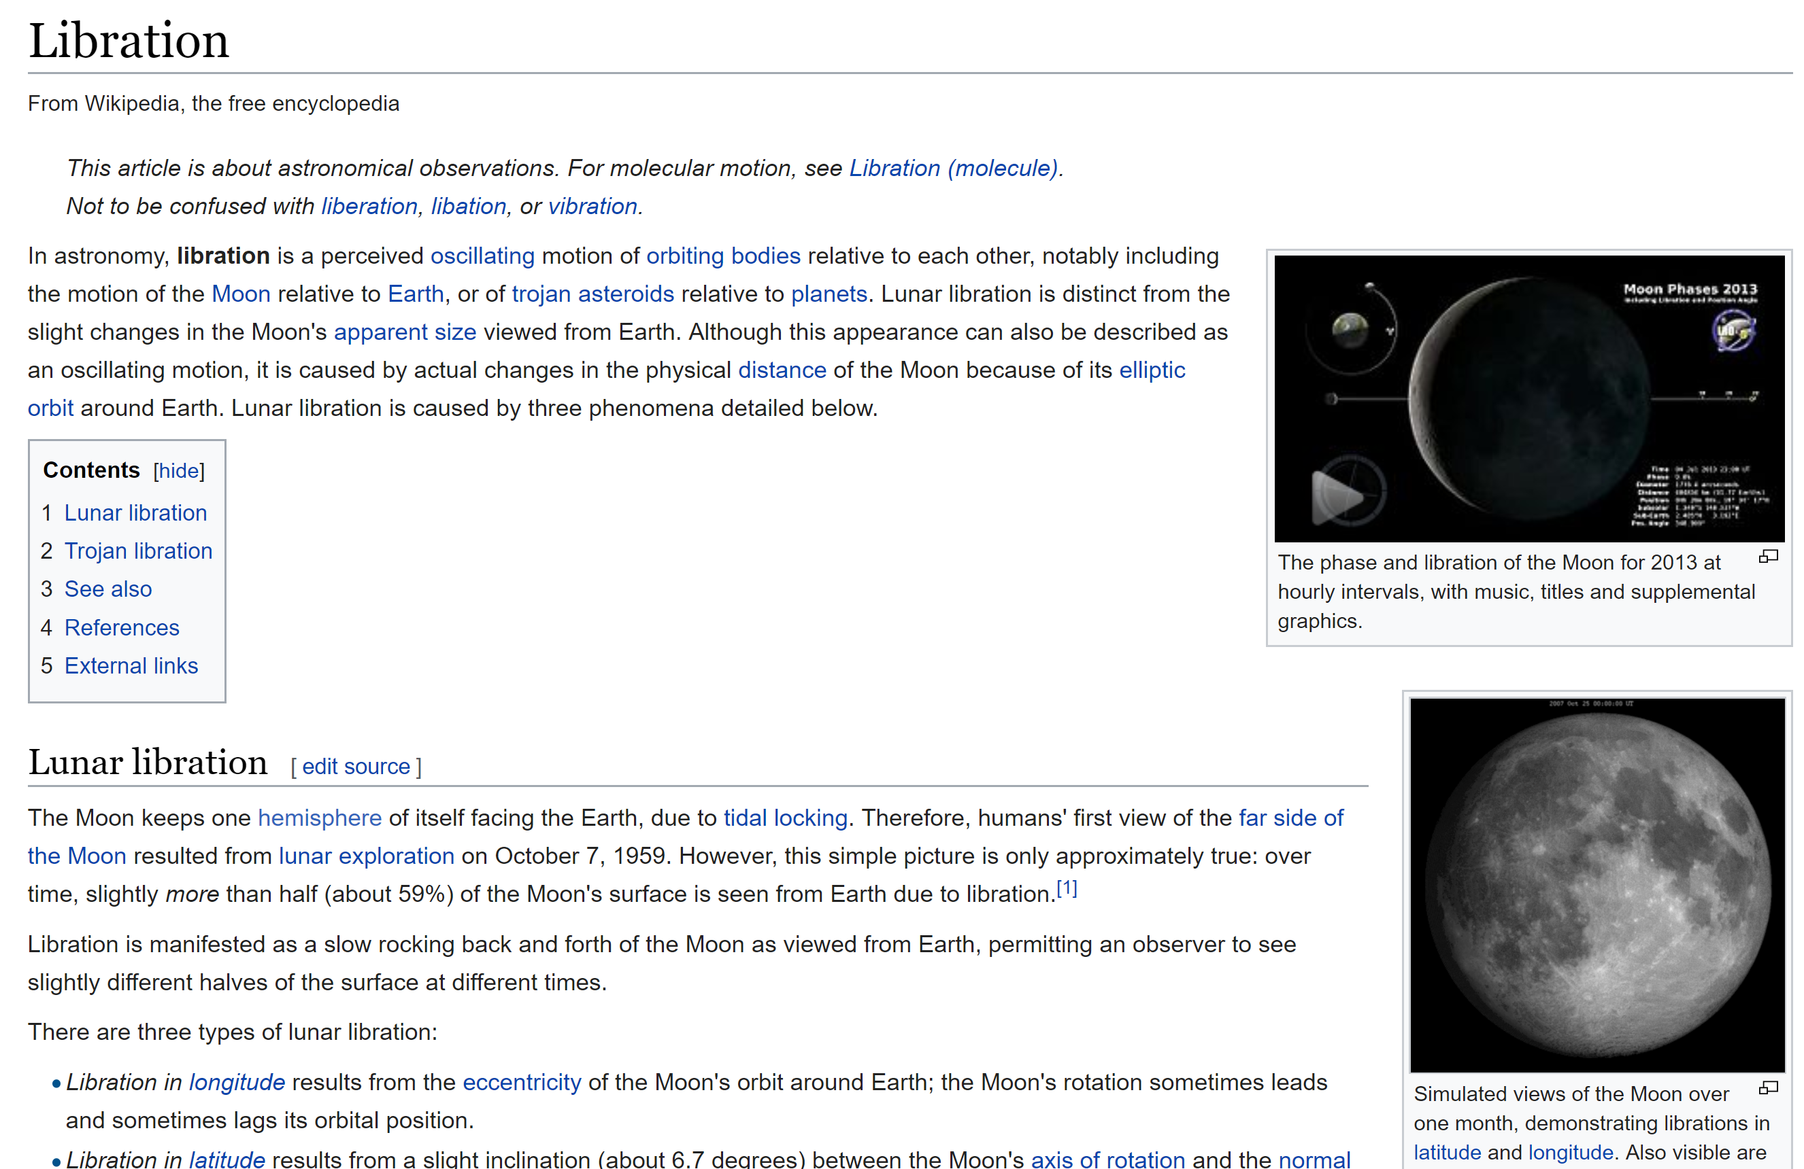
https://en.wikipedia.org/wiki/Libration

Slide 51
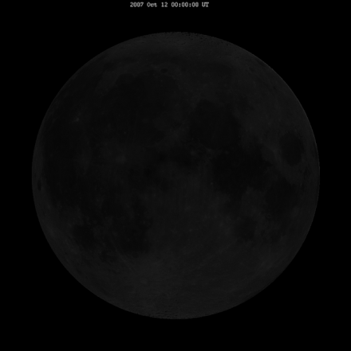
Libration

Slide 52
Questions?

Slide 53
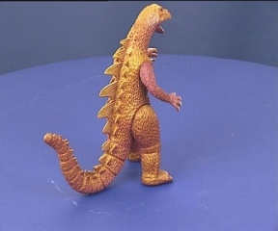
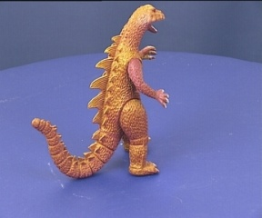
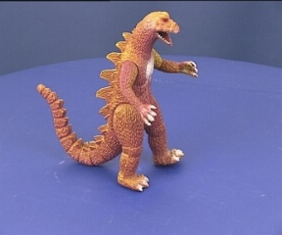
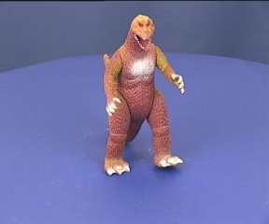





SfM – Failure cases
Necker reversal
Notes:
Necker reversal ambiguity:
This arises because an object rotating by ρ and its mirror image rotating by −ρ generate the same image under parallel projection, see figure 14.9(a). Thus, structure is only recovered up to a reflection about the frontal plane. This ambiguity is absent in the perspective case because the points have different depths in the two interpretations and so do not project to coincident image points.

Slide 54

SfM – Failure cases
Necker reversal:
A rotating object generates the same image as its mirror object rotating in the opposite sense. Under perspective projection the images are different.
Notes:
Necker reversal ambiguity:
This arises because an object rotating by ρ and its mirror image rotating by −ρ generate the same image under parallel projection, see figure 14.9(a). Thus, structure is only recovered up to a reflection about the frontal plane. This ambiguity is absent in the perspective case because the points have different depths in the two interpretations and so do not project to coincident image points.

Slide 55




Structure from Motion – Failure cases
Repetitive structures: Symmetries in man-made scenes

Slide 56




Repetitive structures
https://demuc.de/tutorials/cvpr2017/sparse-modeling.pdf

Slide 57


Repetitive Structure: Solution
• Pre-processing: Remove inconsistent scene graph edges.
Zach et al. 2010, “Disambiguating visual relations using loop constraints”
Wilson and Snavely 2013, “Network Principles for SfM: Disambiguating Repeated Structures with Local Context”
• Post-processing:Identify and correct duplicate structures
Heinly et al. 2014, “Correcting for Duplicate Scene Structure
in Sparse 3D Reconstruction”
https://demuc.de/tutorials/cvpr2017/sparse-modeling.pdf

Slide 58
SfM applications
3D modeling
Surveying
Robot navigation and mapmaking
Visual effects…
  (see video)

Slide 59
SfM applications
3D modeling
Surveying
Robot navigation and mapmaking
Virtual and augmented reality
Visual effects (“Match moving”)
  https://www.youtube.com/watch?v=RdYWp70P_kY

Slide 60

Applications – Photosynth

Slide 61

Applications – Hyperlapse
https://www.youtube.com/watch?v=SOpwHaQnRSY
https://www.youtube.com/watch?v=sA4Za3Hv6ng

Slide 62


Applications: Visual Reality & Augmented Reality
Oculus
Hololens
https://www.youtube.com/watch?v=KOG7yTz1iTA
https://www.youtube.com/watch?v=FMtvrTGnP04

Slide 63


Applications: Simultaneous localization and mapping (SLAM)
https://www.youtube.com/watch?v=k43xJs3Roqg
https://www.youtube.com/watch?v=ZR1yXFAslSk

Slide 64

Applications: Visual Reality & Augmented Reality
Scape: Building the ‘AR Cloud’: Part Three —3D Maps, the Digital Scaffolding of the 21st Century
https://medium.com/scape-technologies/building-the-ar-cloud-part-three-3d-maps-the-digital-scaffolding-of-the-21st-century-465fa55782dd

Slide 65


Application: AR walking directions
https://www.theverge.com/2019/8/8/20776247/google-maps-live-view-ar-walking-directions-ios-android-feature

Slide 66
Questions?

