Slide 1
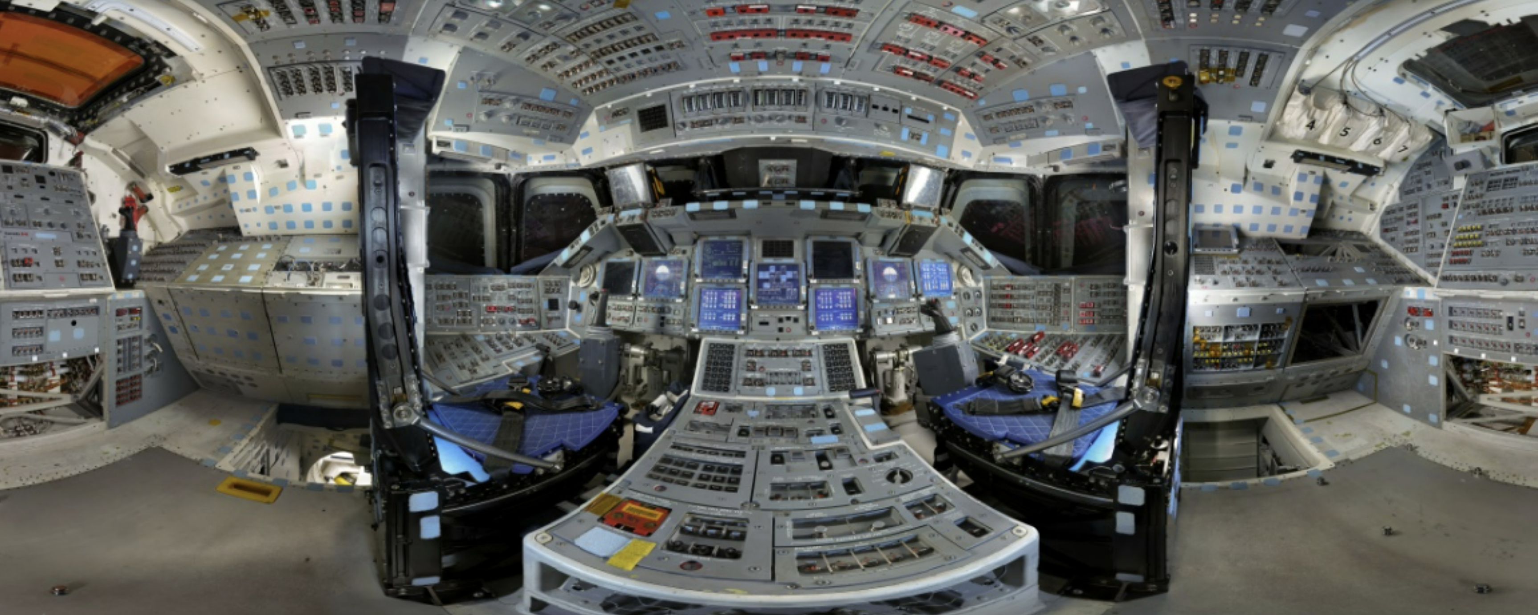
Panoramas
CS5670: Computer Vision
Space Shuttle Discovery Flight Deck, Gigapan

Slide 2
Announcements
Midterm exam due by the start of class today
Project 3: Autostitch (Panorama Stitching)
  Released today, March 7
  Due on Friday, March 17, by 8pm
  Artifact due on Monday March 20 by 8pm
  To be done in groups of 2
  If you need help finding a team member, let us know
Please fill out Midterm Course Evaluations
No quiz on Thursday

Slide 3










From last time: Projection matrix
=
0
(in homogeneous image coordinates)

Slide 4
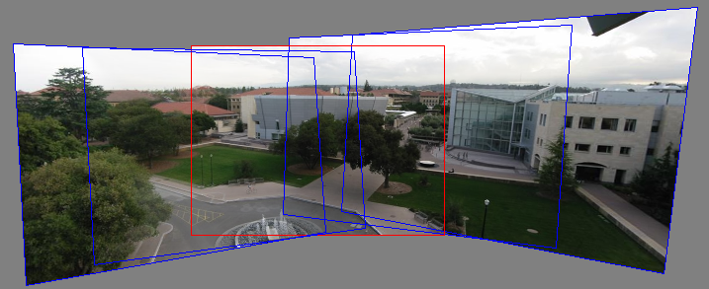
Back to panoramas
Can we use homographies to create a 360 degree panorama?

Slide 5

Idea: project images onto a common plane
“Mosaic”
each image is warped with a homography
We’ll see what this homography means next
Can’t create a 360 panorama this way… we’ll fix this shortly
mosaic projection plane

Slide 6
Creating a panorama
Basic Procedure
  Take a sequence of images from the same position
    Rotate the camera about its optical center
  Compute transformation between second image and first
  Transform the second image to overlap with the first
  Blend the two together to create a mosaic
  If there are more images, repeat

Slide 7
Geometric interpretation of mosaics
Image 2
Optical Center
Image 1
If we capture all 360º of rays, we can create a 360º panorama
The basic operation is projecting an image from one plane to another
The projective transformation is scene-INDEPENDENT
  This depends on all the images having the same optical center

Slide 8
Image reprojection
Basic question
  How to relate two images from the same camera center?
    how to map a pixel from PP1 to PP2
Answer
  Cast a ray through each pixel in PP1
  Draw the pixel where that ray intersects PP2
PP2
PP1

Slide 9
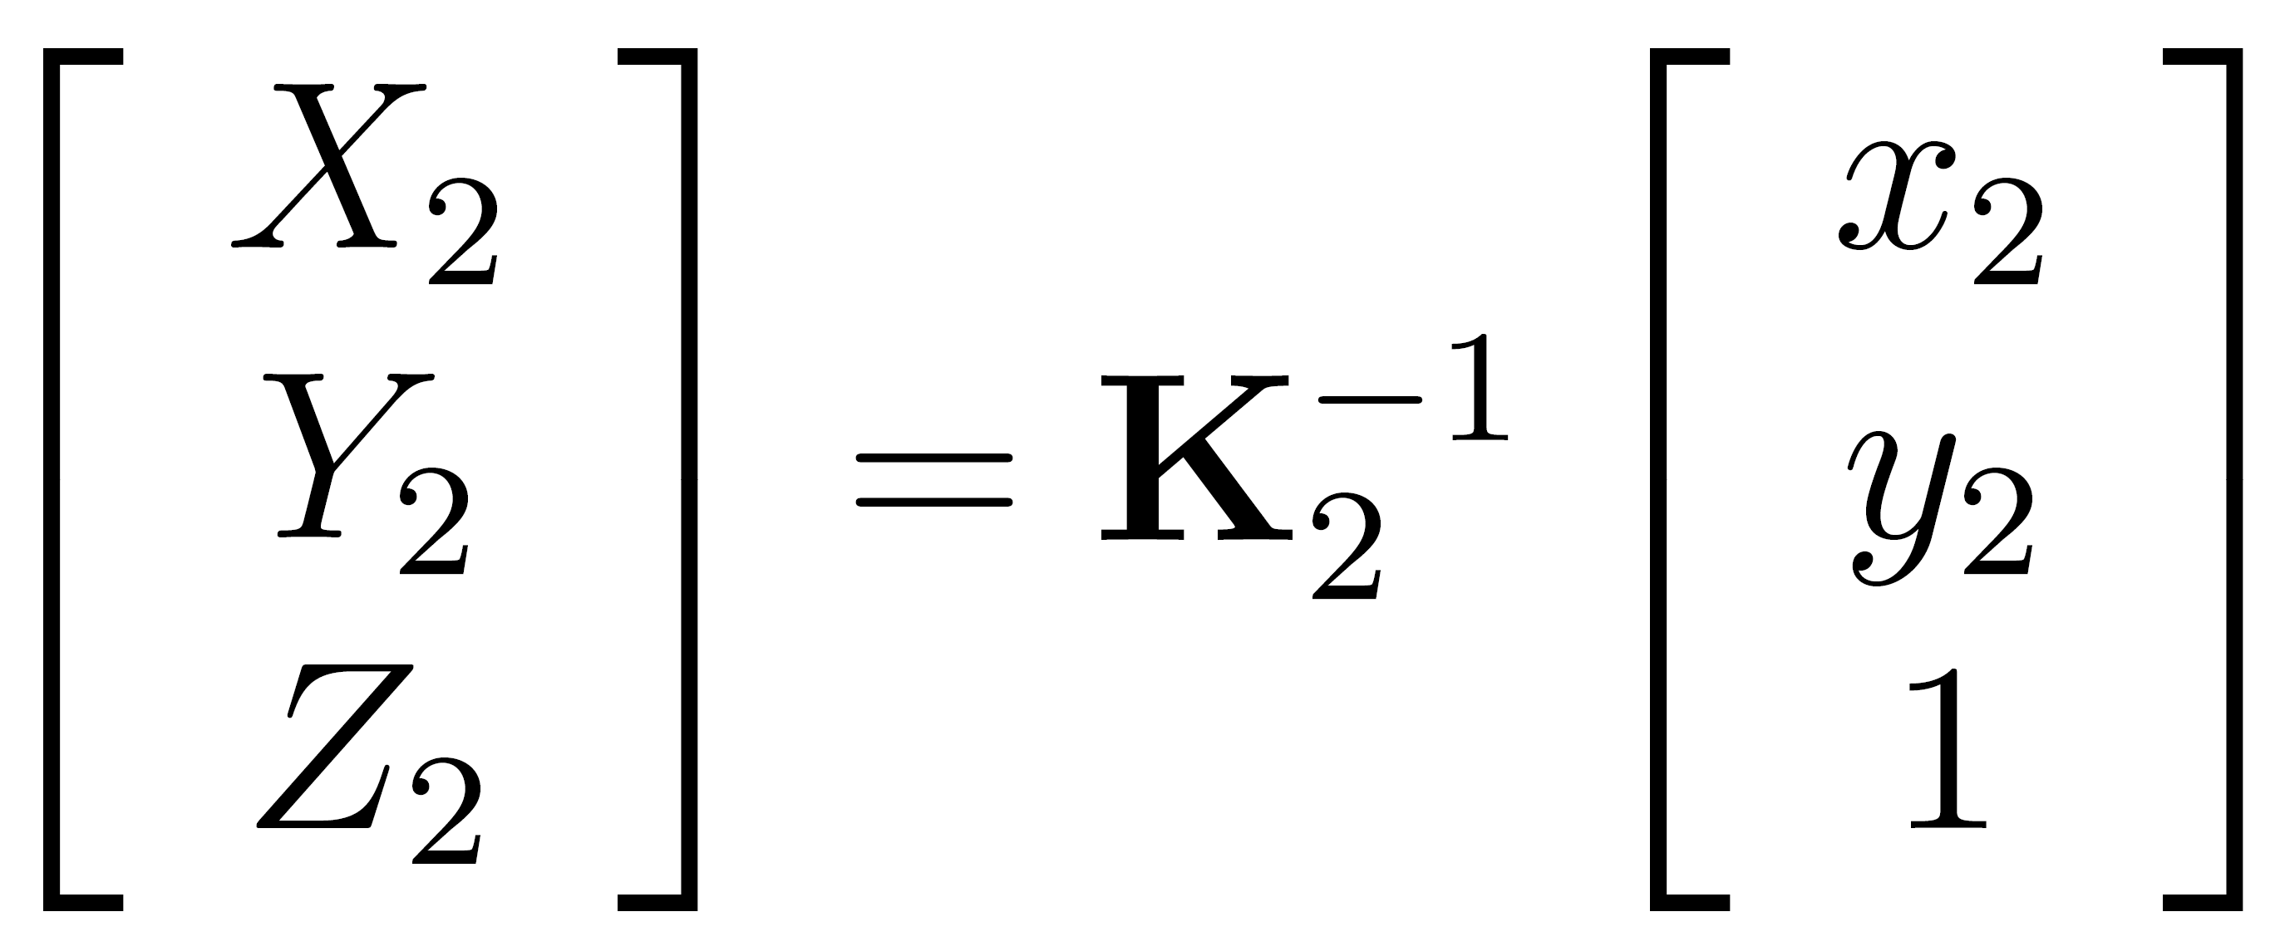
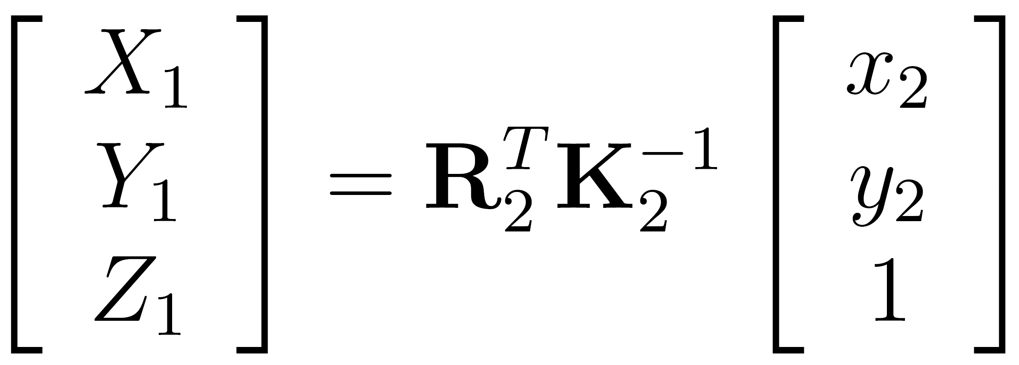
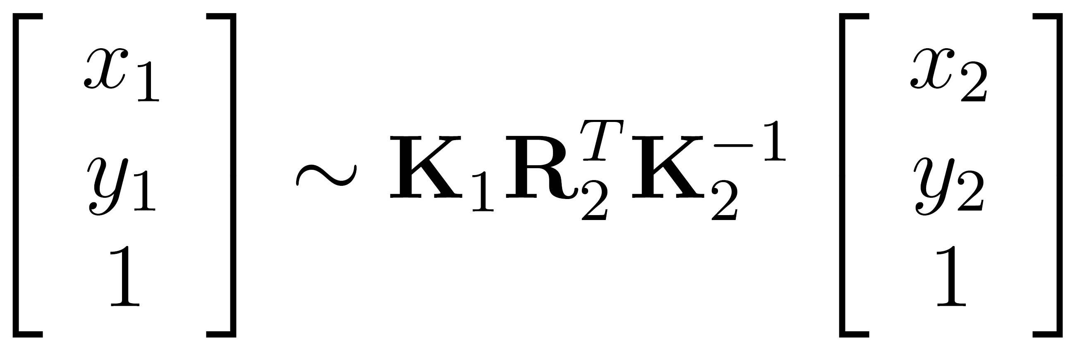




What is the transformation?
Step 1: Convert pixels in image 2 to rays in camera 2’s coordinate system.
Image 2
Optical Center
Step 2: Convert rays in camera 2’s coordinates to rays in camera 1’s coordinates.
Image 1
Step 3: Convert rays in camera 1’s coordinates to pixels in image 1’s coordinates.
How do we map points in image 2 into image 1?
image 1
image 2
intrinsics
extrinsics
(rotation only)
3x3 homography

Slide 10
Can we use homography to create a 360 panorama?

Slide 11
Answer: No
Projection plane
Cameras A, B, C
Camera D
These rays never hit the projection plane

Slide 12
Panoramas
What if you want a 360° field of view?
mosaic Projection Sphere

Slide 13


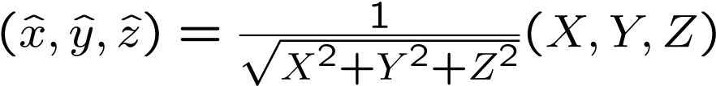





Spherical projection
  Map 3D point (X,Y,Z) onto sphere
Y
Z
X
  Convert to spherical coordinates
  Convert to spherical image coordinates
unit sphere
    s defines size of the final image
      often convenient to set s = camera focal length
unwrapped sphere
Spherical image

Slide 14
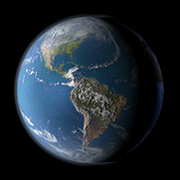
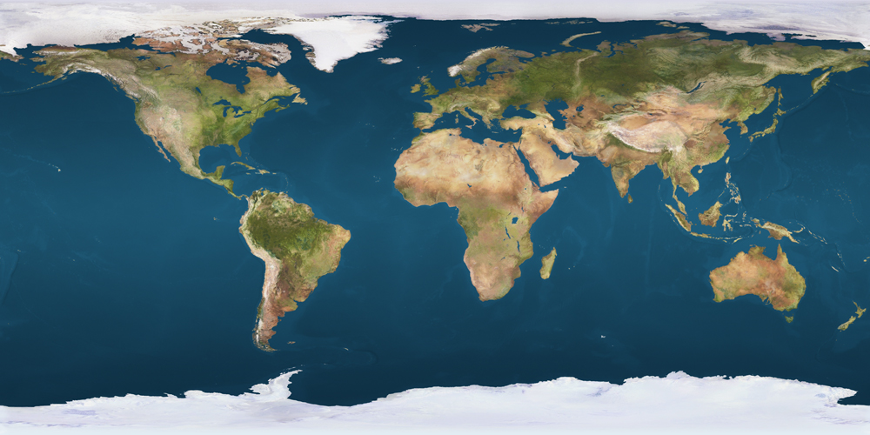
Unwrapping a sphere
Credit: JHT’s Planetary Pixel Emporium

Slide 15
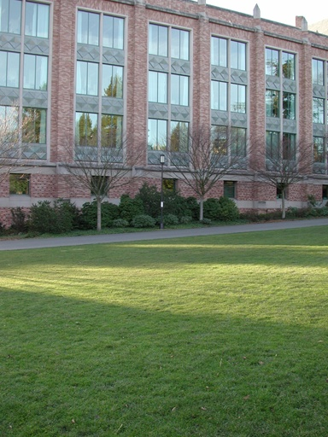
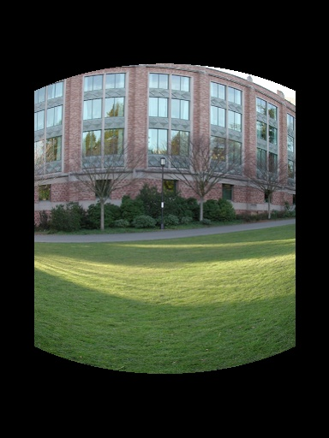
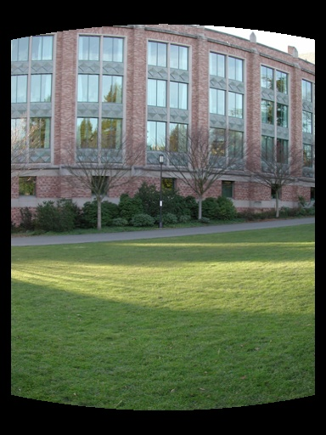
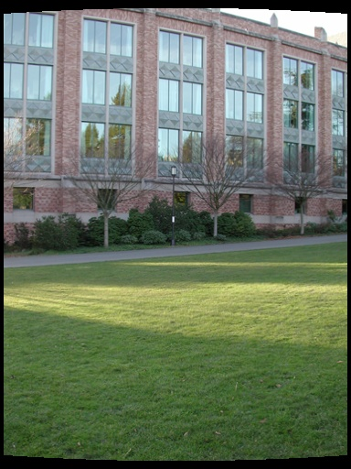
Spherical reprojection
input
f = 200 (pixels)
f = 400
f = 800
Map image to spherical coordinates
  need to know the focal length
Notes:
Therefore, it is desirable if the global motion model we need to recover is translation, which has only two parameters. It turns out that for a pure panning motion, if we convert two images to their cylindrical maps with known focal length, the relationship between them can be represented by a translation.
Here is an example of how cylindrical maps are constructed with differently with f’s. Note how straight lines are curved.
Similarly, we can map an image to its longitude/latitude spherical coordinates as well if f is given.

Slide 16
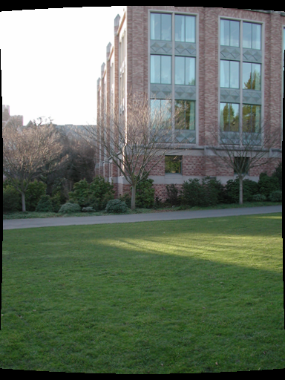
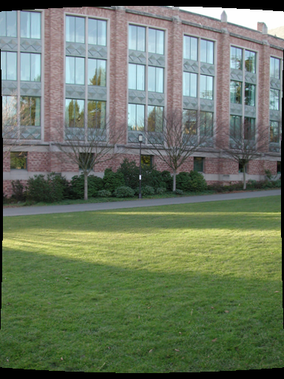
Aligning spherical images
Suppose we rotate the camera by θ about the vertical axis
  How does this change the spherical image?
Notes:
Therefore, it is desirable if the global motion model we need to recover is translation, which has only two parameters. It turns out that for a pure panning motion, if we convert two images to their cylindrical maps with known focal length, the relationship between them can be represented by a translation.
Here is an example of how cylindrical maps are constructed with differently with f’s. Note how straight lines are curved.
Similarly, we can map an image to its longitude/latitude spherical coordinates as well if f is given.

Slide 17
Aligning spherical images
Suppose we rotate the camera by θ about the vertical axis
  How does this change the spherical image?
    Translation by θ
  This means that we can align spherical images by translation
Notes:
Therefore, it is desirable if the global motion model we need to recover is translation, which has only two parameters. It turns out that for a pure panning motion, if we convert two images to their cylindrical maps with known focal length, the relationship between them can be represented by a translation.
Here is an example of how cylindrical maps are constructed with differently with f’s. Note how straight lines are curved.
Similarly, we can map an image to its longitude/latitude spherical coordinates as well if f is given.

Slide 18
Assembling the panorama
Stitch pairs together, blend, then crop

Slide 19
Problem: Drift
Error accumulation
  small errors accumulate over time

Slide 20
Problem: Drift
(x₁,y₁)
(x_{n},y_{n})
copy of first image
Solution
  add another copy of first image at the end
  this gives a constraint: y_{n} = y₁
  there are a bunch of ways to solve this problem
    add displacement of (y₁ – y_{n})/(n -1) to each image after the first
    apply an affine warp: y’ = y + ax [you will implement this for P3]
    run a big optimization problem, incorporating this constraint
      best solution, but more complicated
      known as “bundle adjustment”

Slide 21
Project 3
Take pictures on a tripod (or handheld)
Warp to spherical coordinates (not needed if using homographies to align images)
Extract features
Align neighboring pairs using feature matching + RANSAC
Write out list of neighboring translations
Correct for drift
Read in warped images and blend them
Crop the result and import into a viewer
Roughly based on Autostitch
  By Matthew Brown and David Lowe
  http://www.cs.ubc.ca/~mbrown/autostitch/autostitch.html

Slide 22
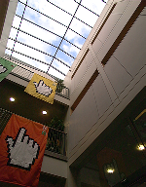
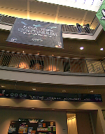
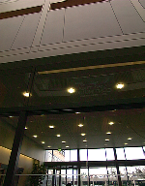
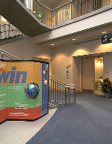
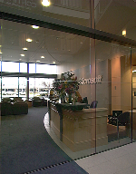
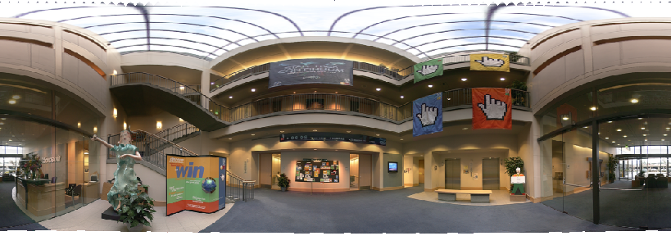
Spherical panoramas
+
+
+
+
Microsoft Lobby: http://www.acm.org/pubs/citations/proceedings/graph/258734/p251-szeliski

Slide 23
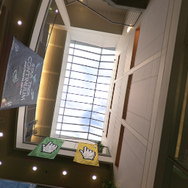
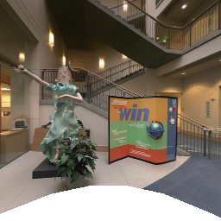
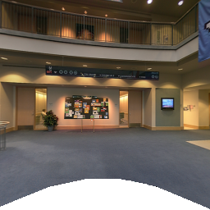
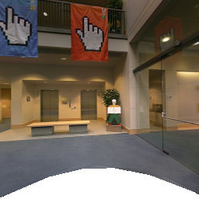
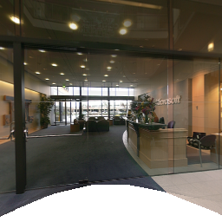
Different projections are possible
Cube-map

Slide 24
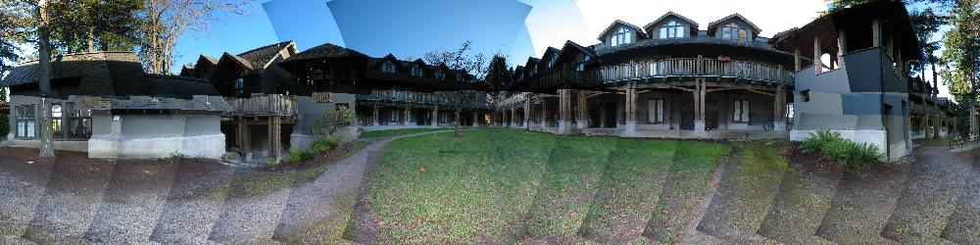
Blending
We’ve aligned the images – now what?

Slide 25
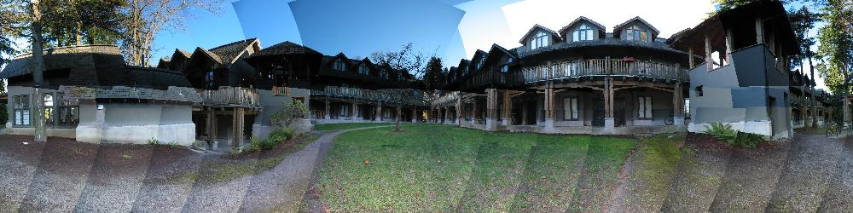
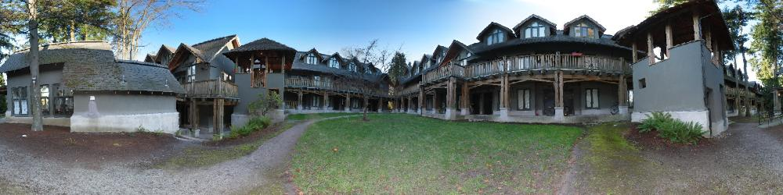
Blending
Want to seamlessly blend them together

Slide 26
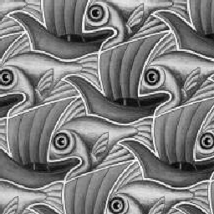
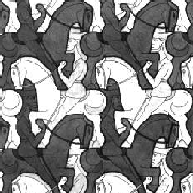
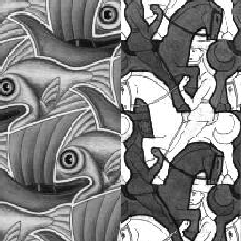
Image Blending

Slide 27
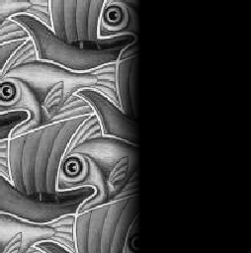
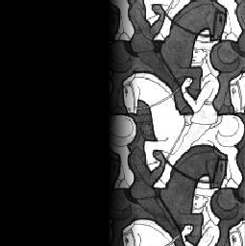

Feathering
+
1
1
0
0
=

Slide 28
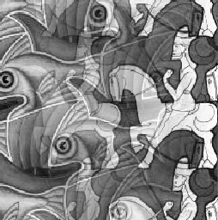
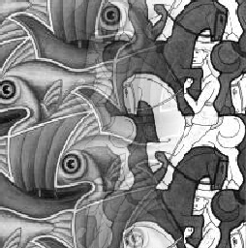
Effect of window size
1
left
1
right
0
0

Slide 29


Effect of window size
1
1
0
0

Slide 30

Good window size
1
0
“Optimal” window: smooth but not ghosted
  Doesn’t always work...

Slide 31
Alpha Blending
I₃
p
I₁
see Blinn (CGA, 1994) for details:
Compositing, Part 1: Theory
I₂
Encoding blend weights: I(x,y) = (αR, αG, αB, α)
color at p =
Implement this in two steps:
  1. accumulate: add up the (α premultiplied) RGBα values at each pixel
  2. normalize: divide each pixel’s accumulated RGB by its α value
    Q: what if α = 0?
Notes:
A: render as black

Slide 32
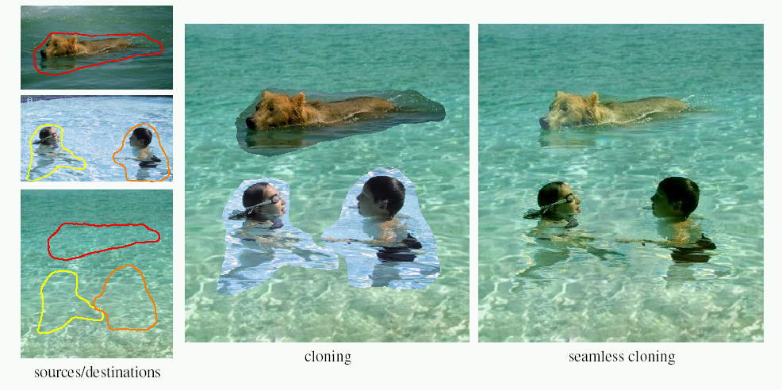
Poisson Image Editing
For more info: Perez et al, SIGGRAPH 2003

Slide 33
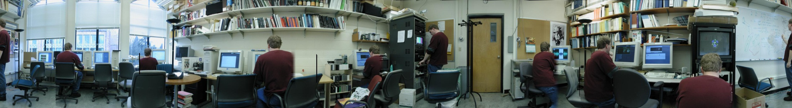
Some panorama examples
“Before SIGGRAPH Deadline” Photo credit: Doug Zongker

Slide 34
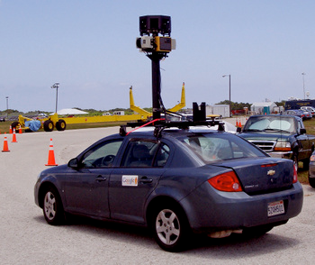
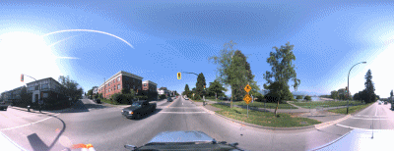
Some panorama examples
Every image on Google Streetview

Slide 35
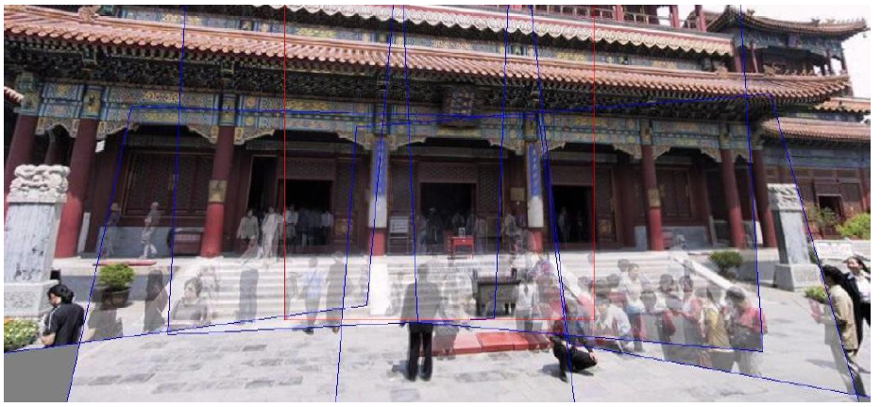
Magic: ghost removal
M. Uyttendaele, A. Eden, and R. Szeliski.
Eliminating ghosting and exposure artifacts in image mosaics.
ICCV 2001

Slide 36
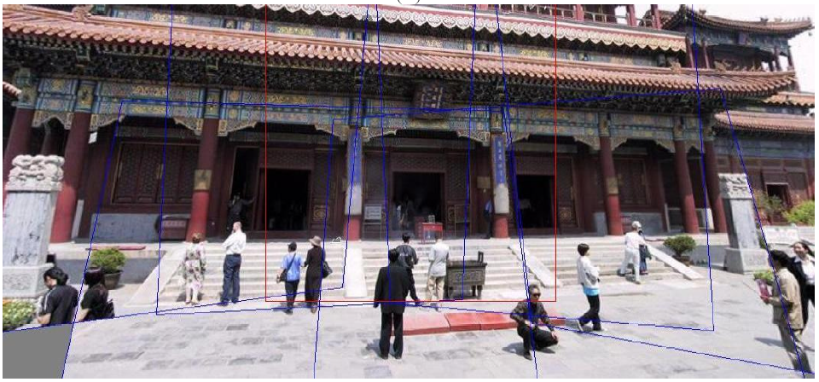
Magic: ghost removal
M. Uyttendaele, A. Eden, and R. Szeliski.
Eliminating ghosting and exposure artifacts in image mosaics.
ICCV 2001
Notes:
How to handle motion?

Slide 37
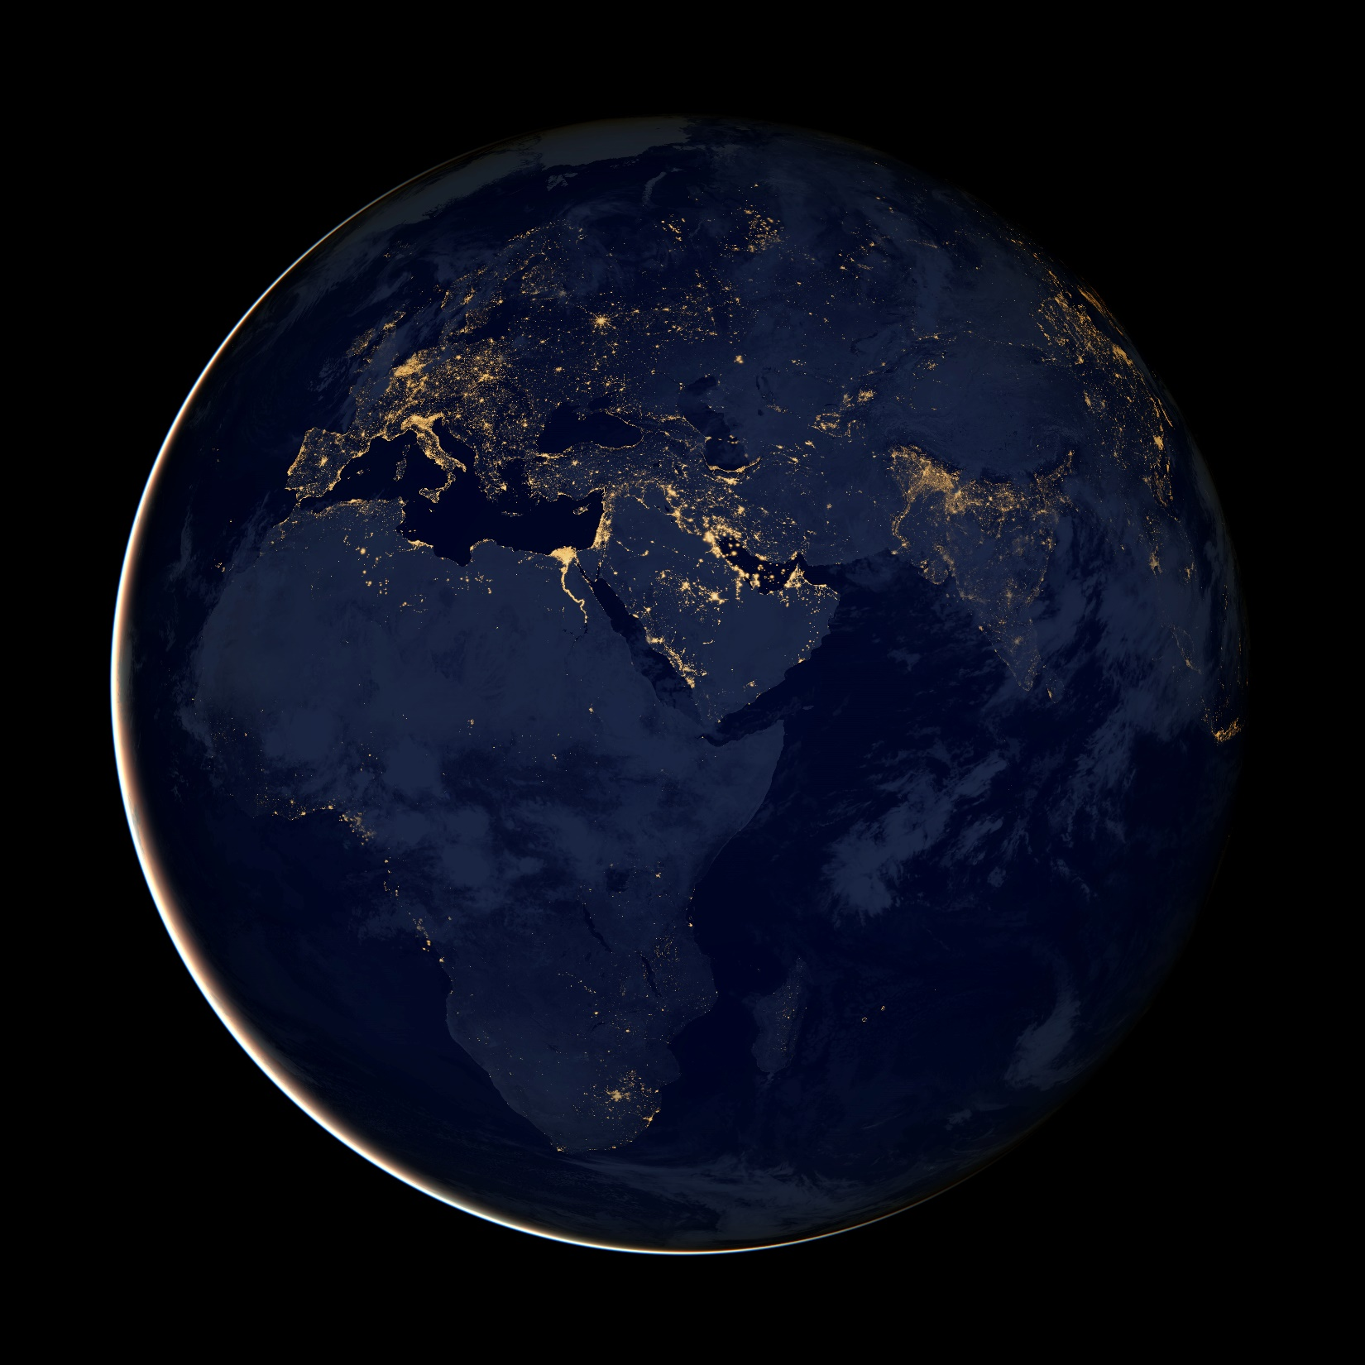
Other types of mosaics
Can mosaic onto any surface if you know the geometry
  See NASA’s Visible Earth project for some stunning earth mosaics

Slide 38
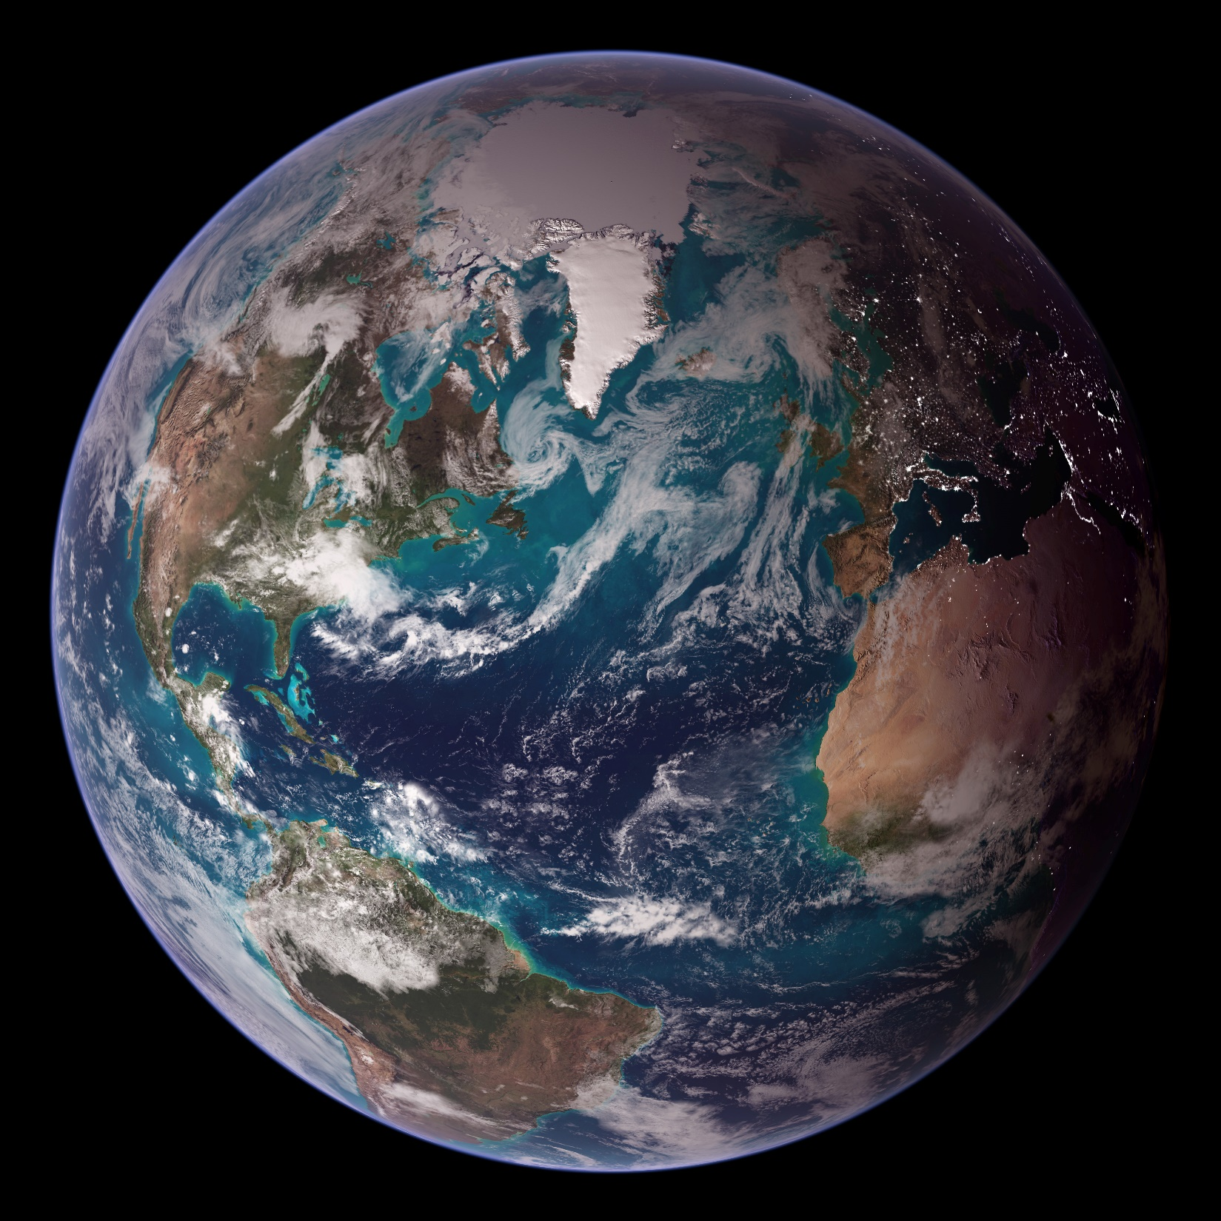

Slide 39
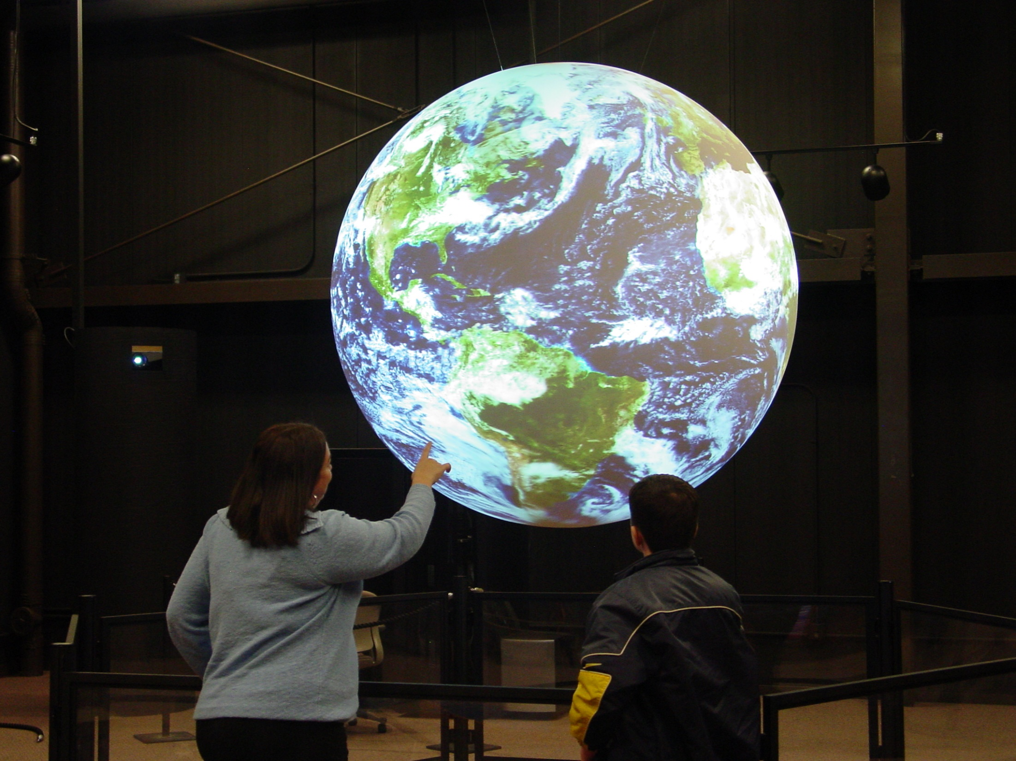
https://www.nasa.gov/centers/wallops/news/frozen_sos.html

Slide 40
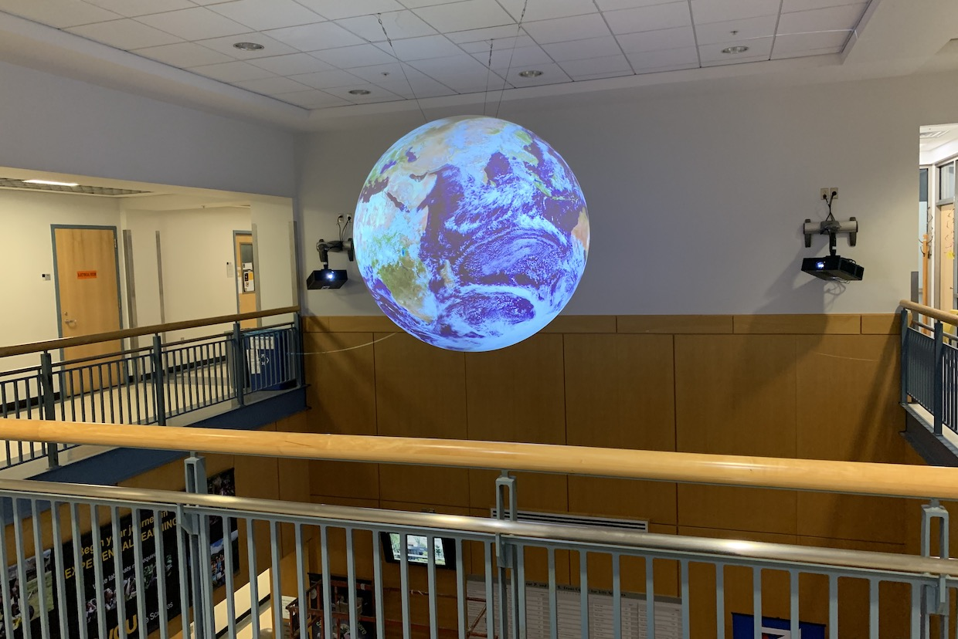
Science on a Sphere
https://news.vcu.edu/article/Science_On_a_Sphere_now_at_VCU_offers_a_world_of_possibilities

Slide 41
Questions?

Slide 42
Project 3 Demo

