Slide 1
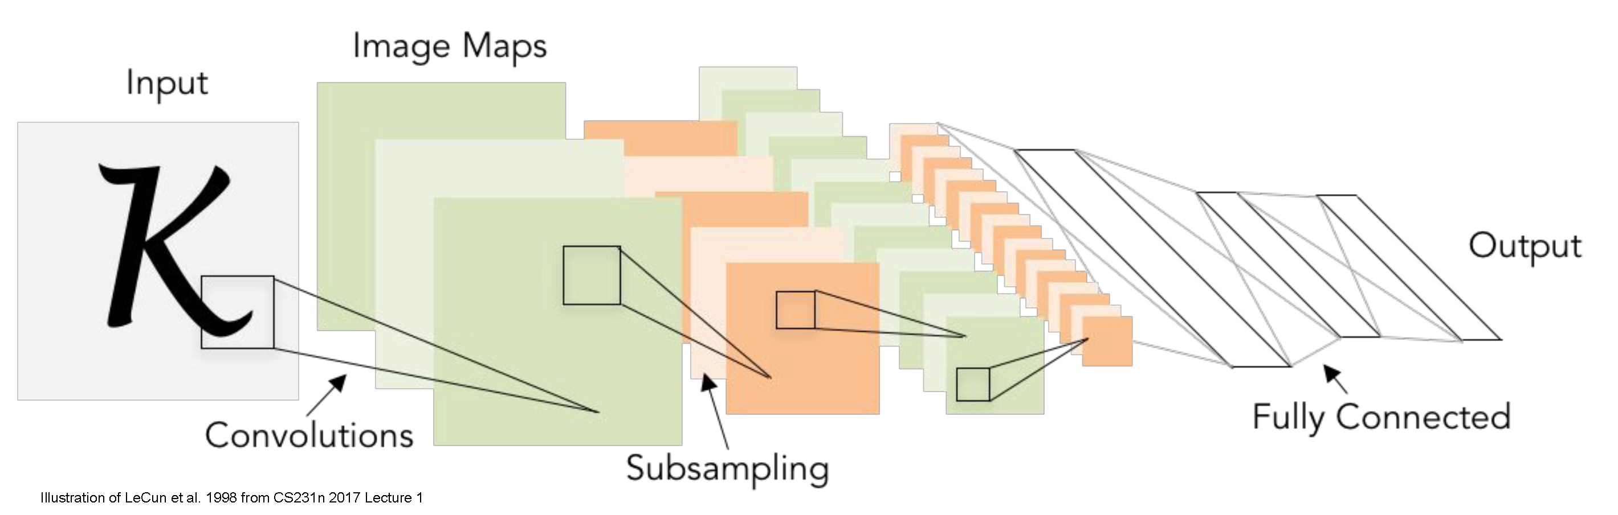
Training Deep Networks
CS5670: Computer Vision
Slides from Fei-Fei Li, Justin Johnson, Serena Yeung
http://vision.stanford.edu/teaching/cs231n/

Slide 2
Announcements
In class final on May 10
Open book, open note
Project 5 (Neural Radiance Fields) due Weds, May 4, 2022 (by 8:00 pm)
Course evaluations are open starting Tuesday, May 3
We would love your feedback!
Small amount of extra credit for filling out
What you write is still anonymous, instructors only see whether students filled it out
Link coming soon

Slide 3
Readings
Convolutional neural networks
http://cs231n.github.io/convolutional-networks/
Stochastic Gradient Descent & Backpropagation
http://cs231n.github.io/optimization-1/
http://cs231n.github.io/optimization-2/
Best practices for training CNNs
http://cs231n.github.io/neural-networks-2/
http://cs231n.github.io/neural-networks-3/

Slide 4
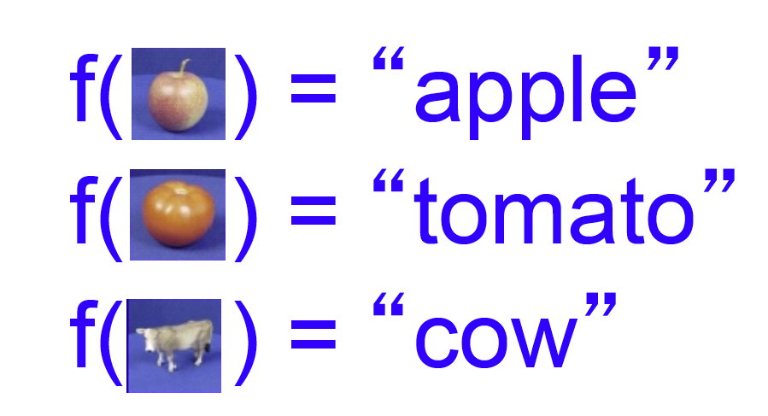
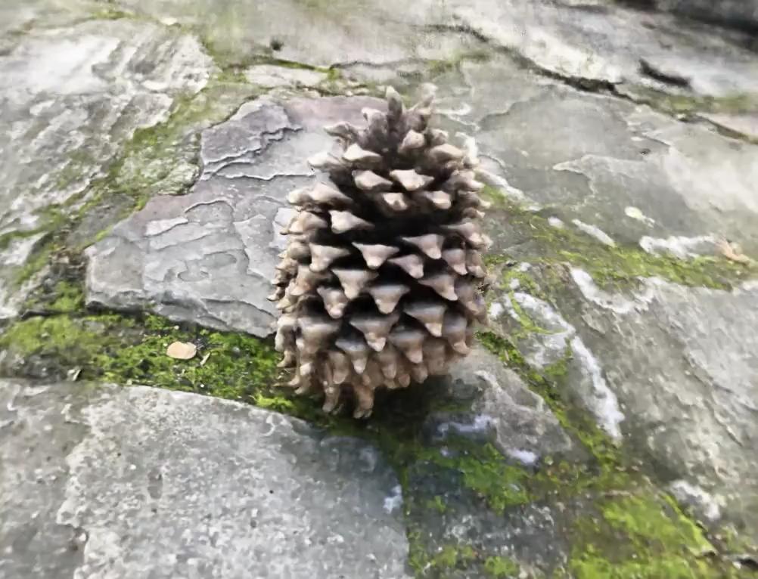
Deep networks can be used for…
Image classification
View synthesis
And much more!

Slide 5
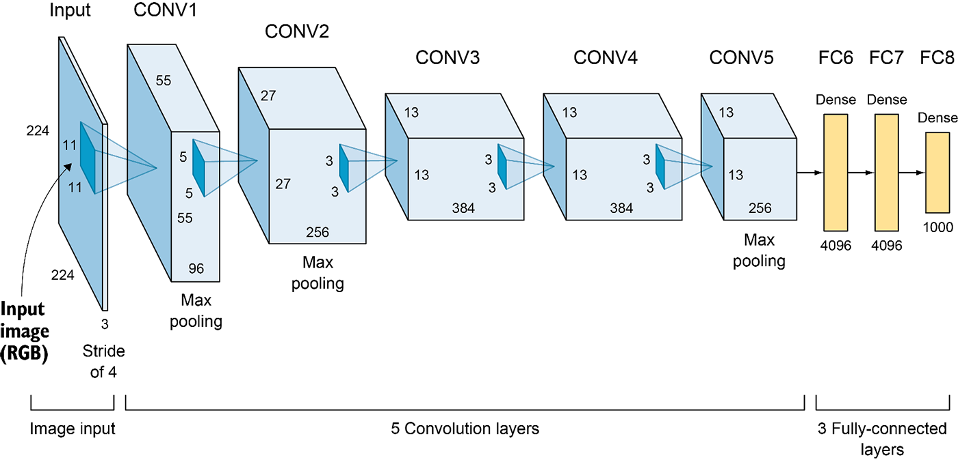
Convolutional neural networks
Layer types:
Convolutional layer
Pooling layer
Fully-connected layer

Slide 6
Training the network
Given a network architecture (CNN, MLP, etc) and some training data, how do we actually set the weights of the network?

Slide 7
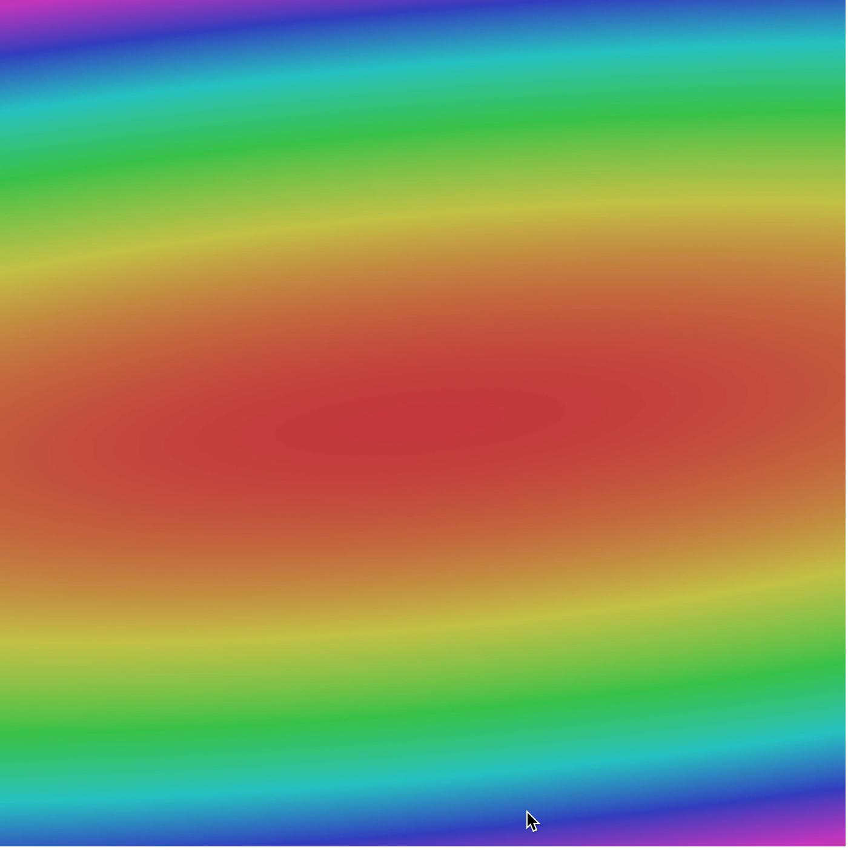
Gradient descent: iteratively follow the slope

Slide 8
Stochastic gradient descent (SGD)
Train on batches of data (e.g., 32 images or 32 rays) at a time
A full pass through the dataset (i.e., using batches that cover the training data) is called an epoch
Usually need to train for multiple epochs, i.e., multiple full passes through the dataset to converge
Stochastic gradient descent approximates the true gradient, but works remarkably well in practice
Use backpropagation to automatically compute gradients on each batch

Slide 9
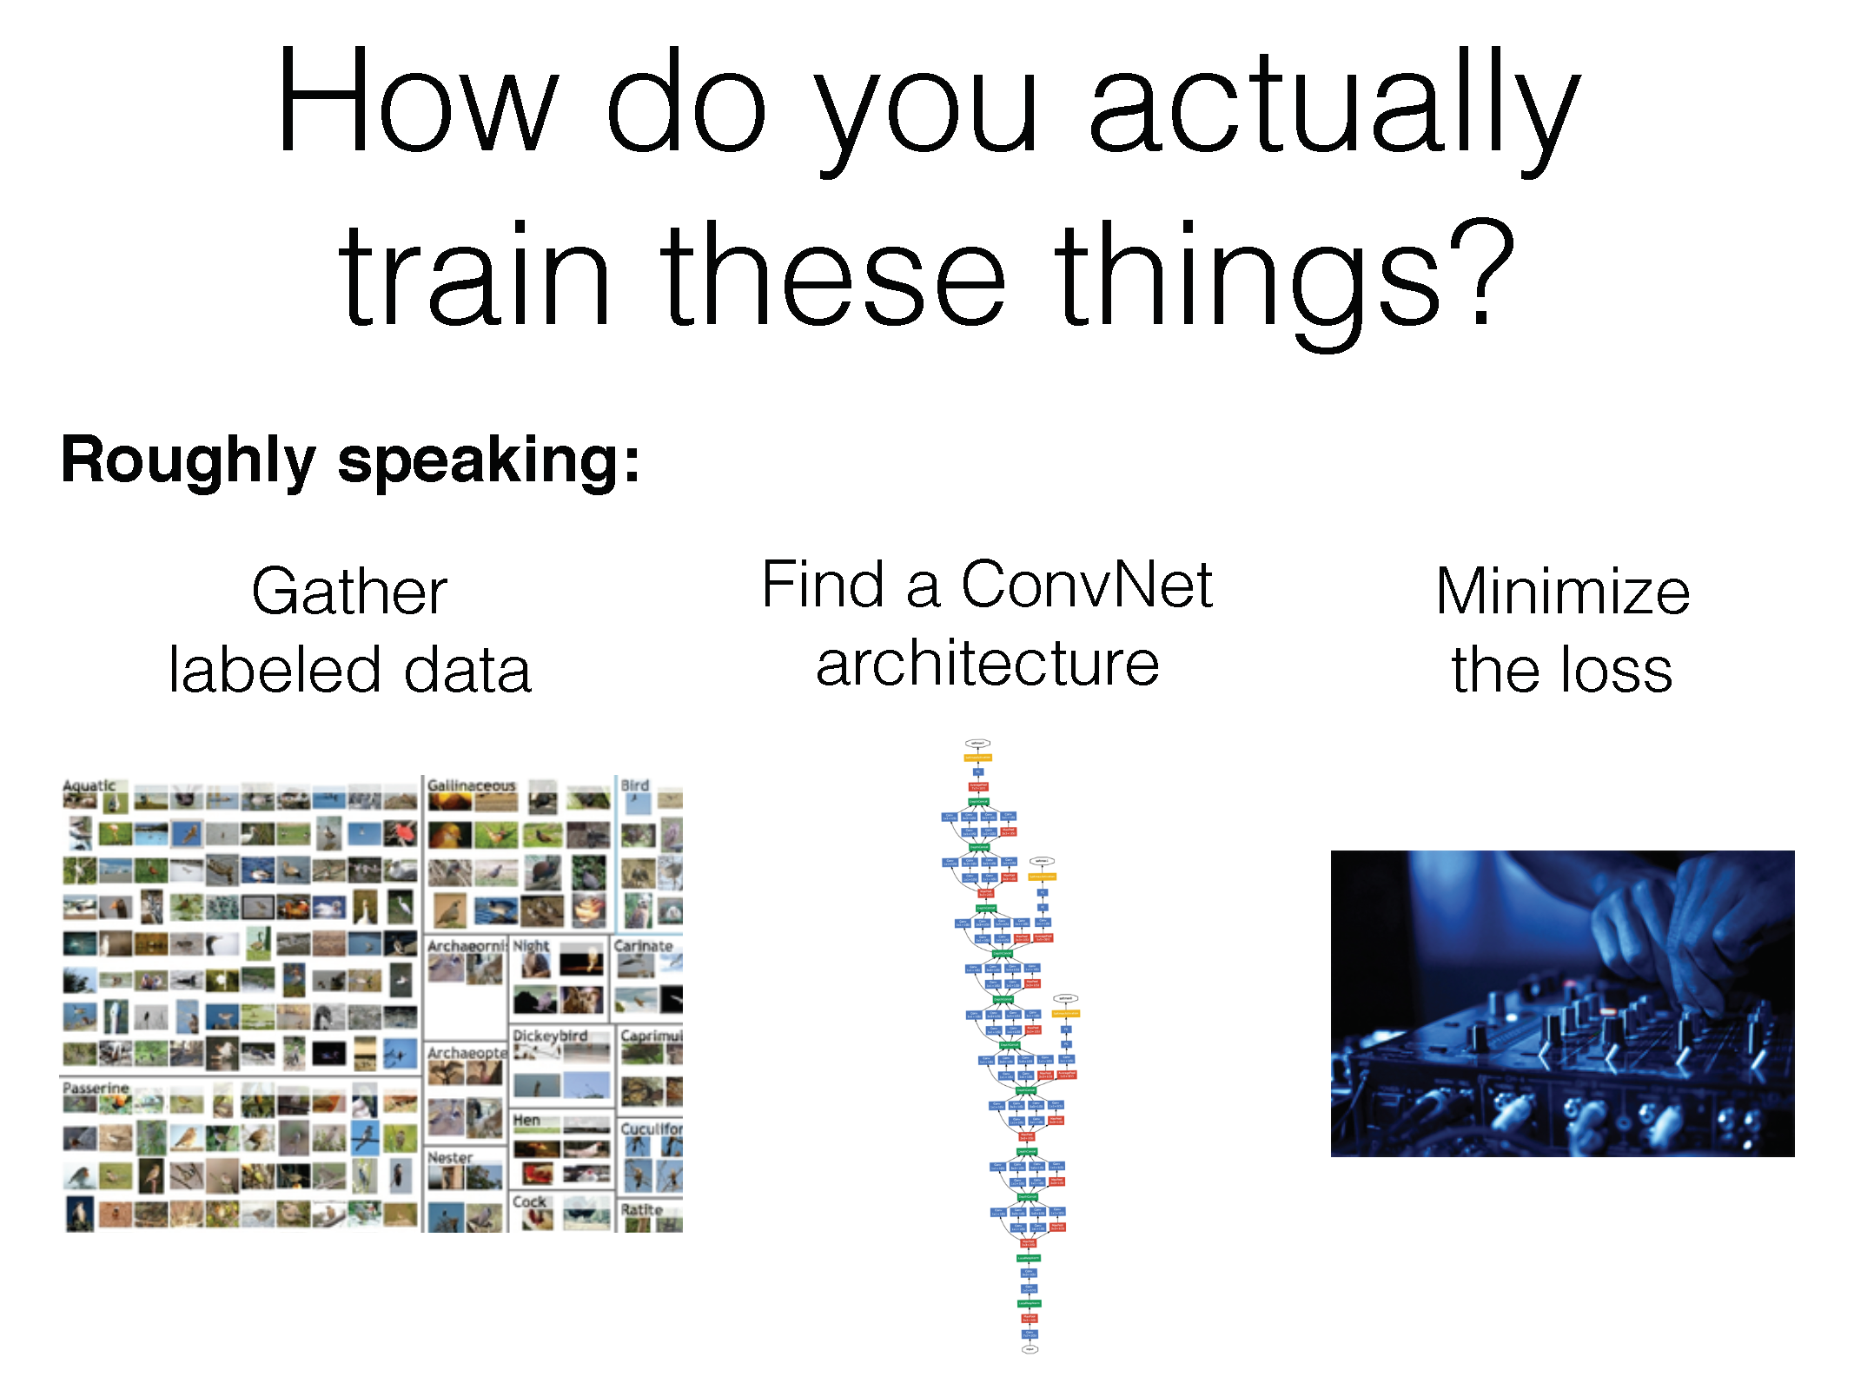

Slide 10
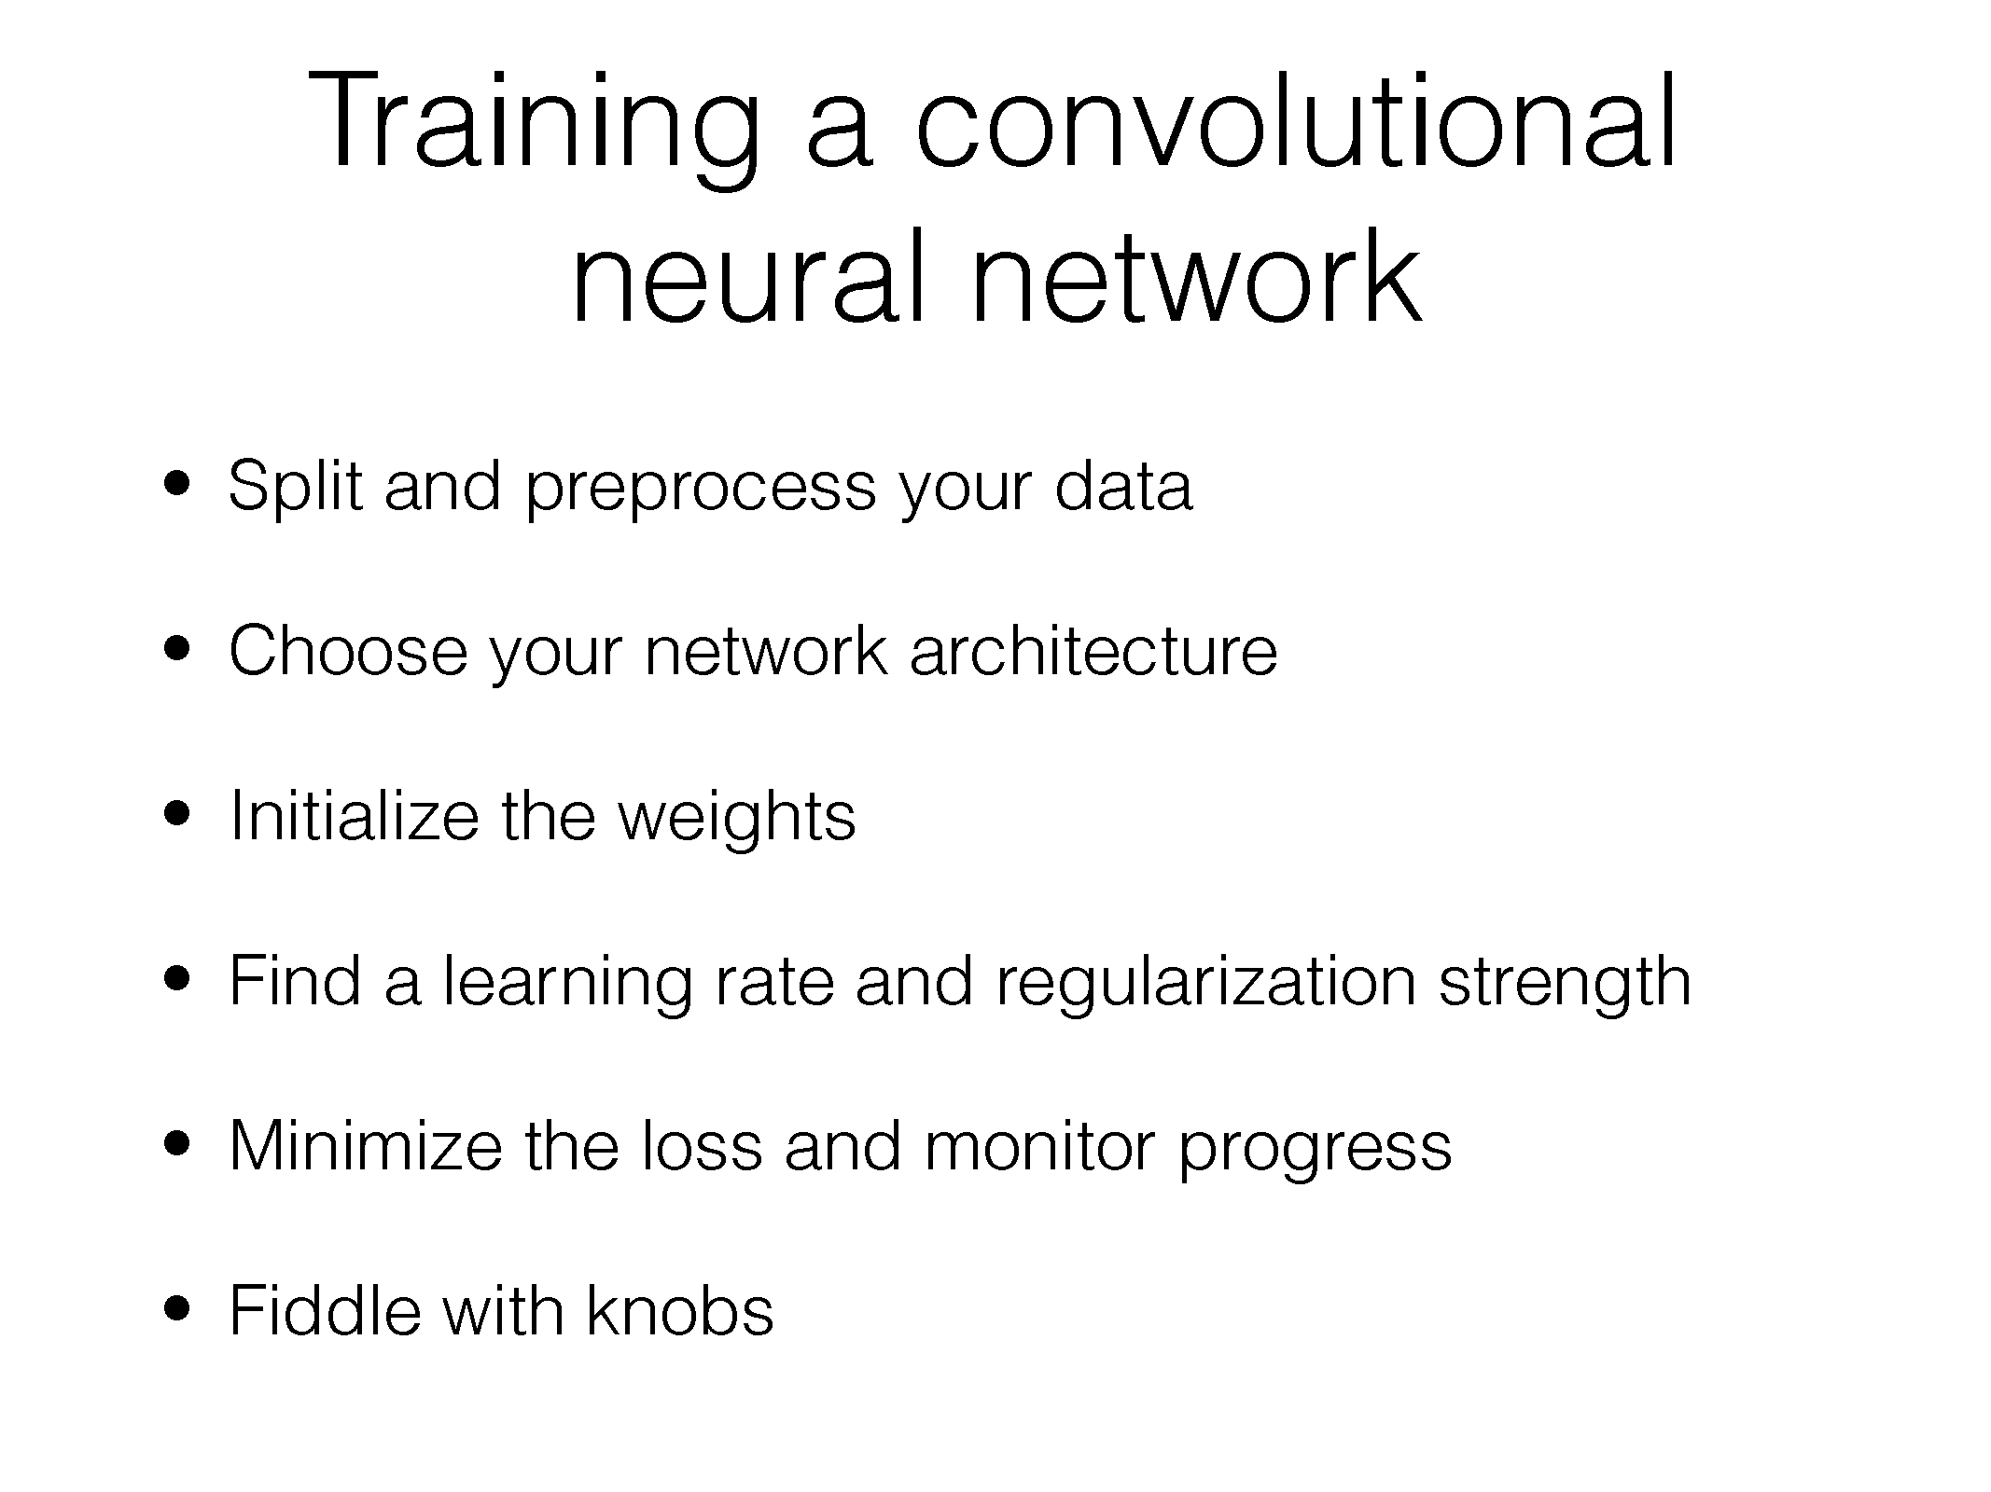

Slide 11
Why so complicated?
Training deep networks can be finicky – lots of parameters to learn, complex, non-linear optimization function

Slide 12
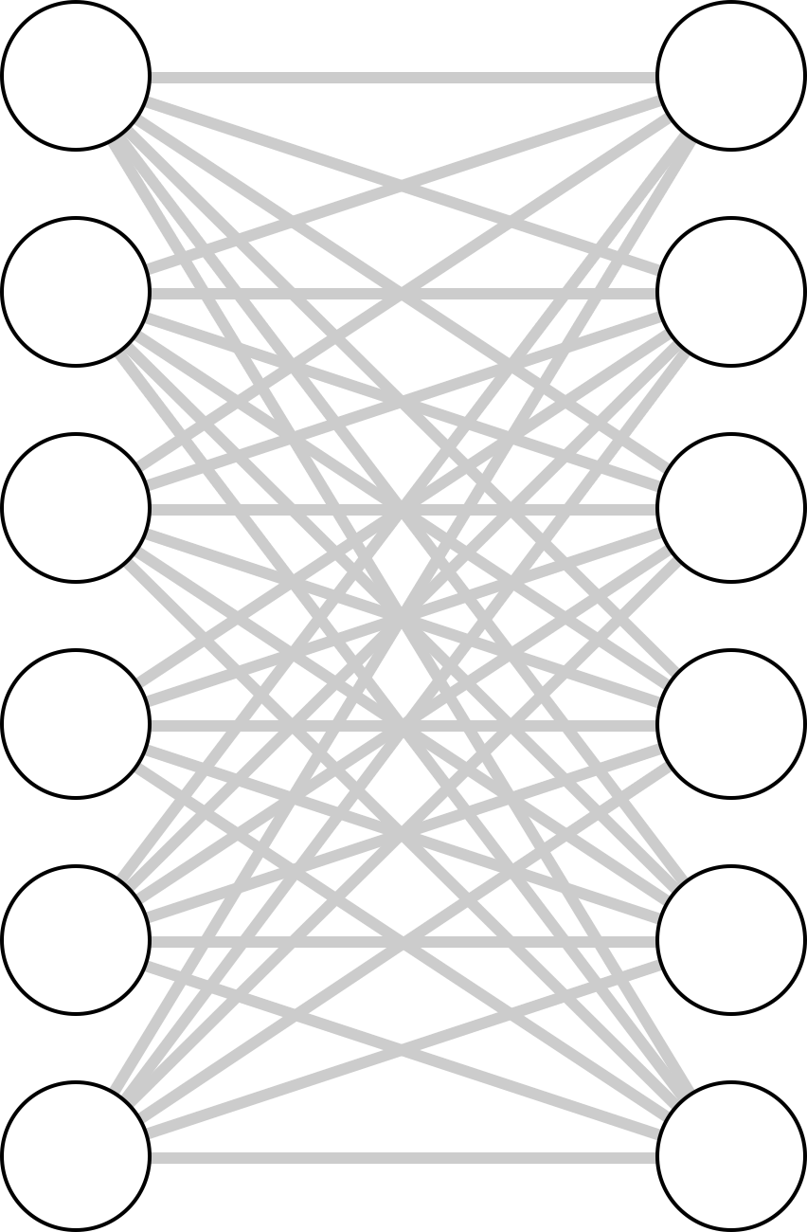
What Makes Training Deep Nets Hard?
It’s easy to get high training accuracy:
Use a huge, fully connected network with tons of layers
Let it memorize your training data
Its hard to get high test accuracy
…
…
This would be an example of overfitting

Slide 13
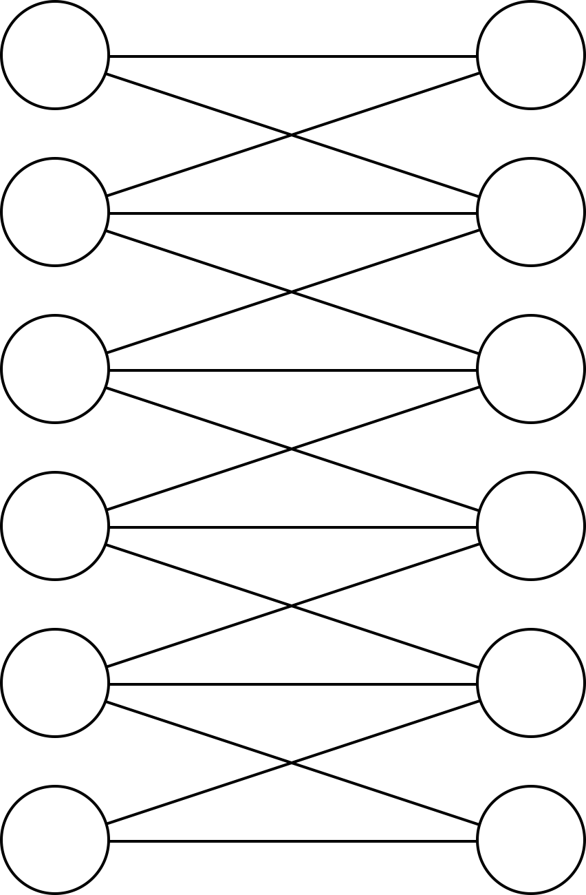
Related Question: Why Convolutional Layers?
A fully connected layer can generally represent the same functions as a convolutional one
Think of the convolutional layer as a version of the FC layer with constraints on parameters
What is the advantage of CNNs?
Convolutional Layer
Fully Connected Layer

Slide 14
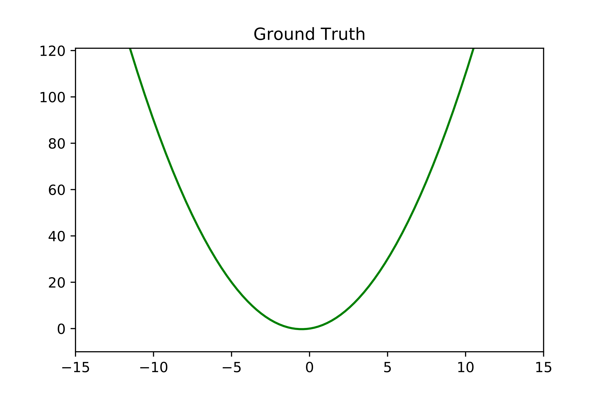
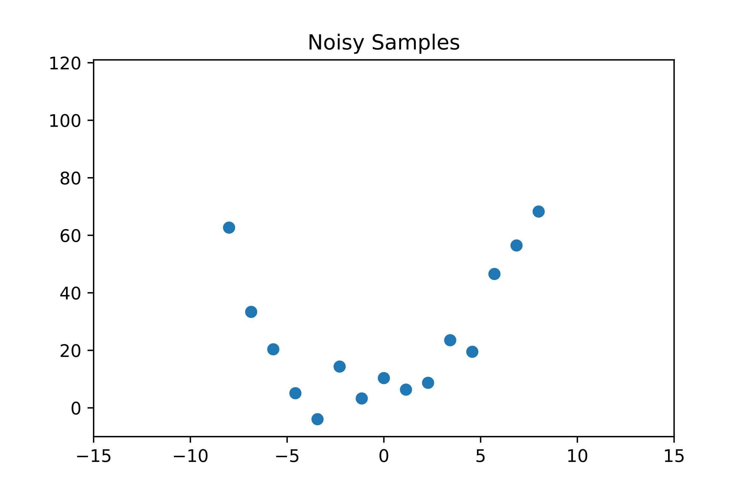
Overfitting: More Parameters, More Problems
Non-Deep Example: consider the function
Let’s take some noisy samples of the function…
Notes:
P_N(x) = \sum_{k=0}^N x^kp_k

Slide 15
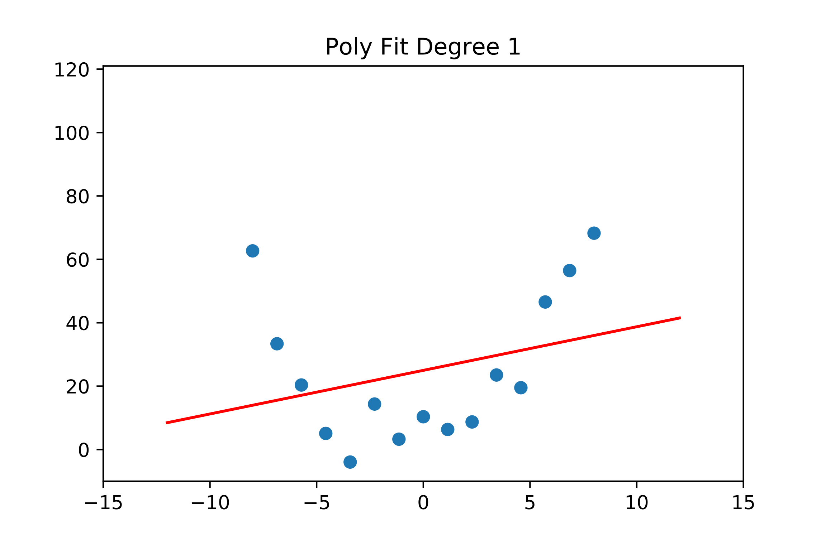
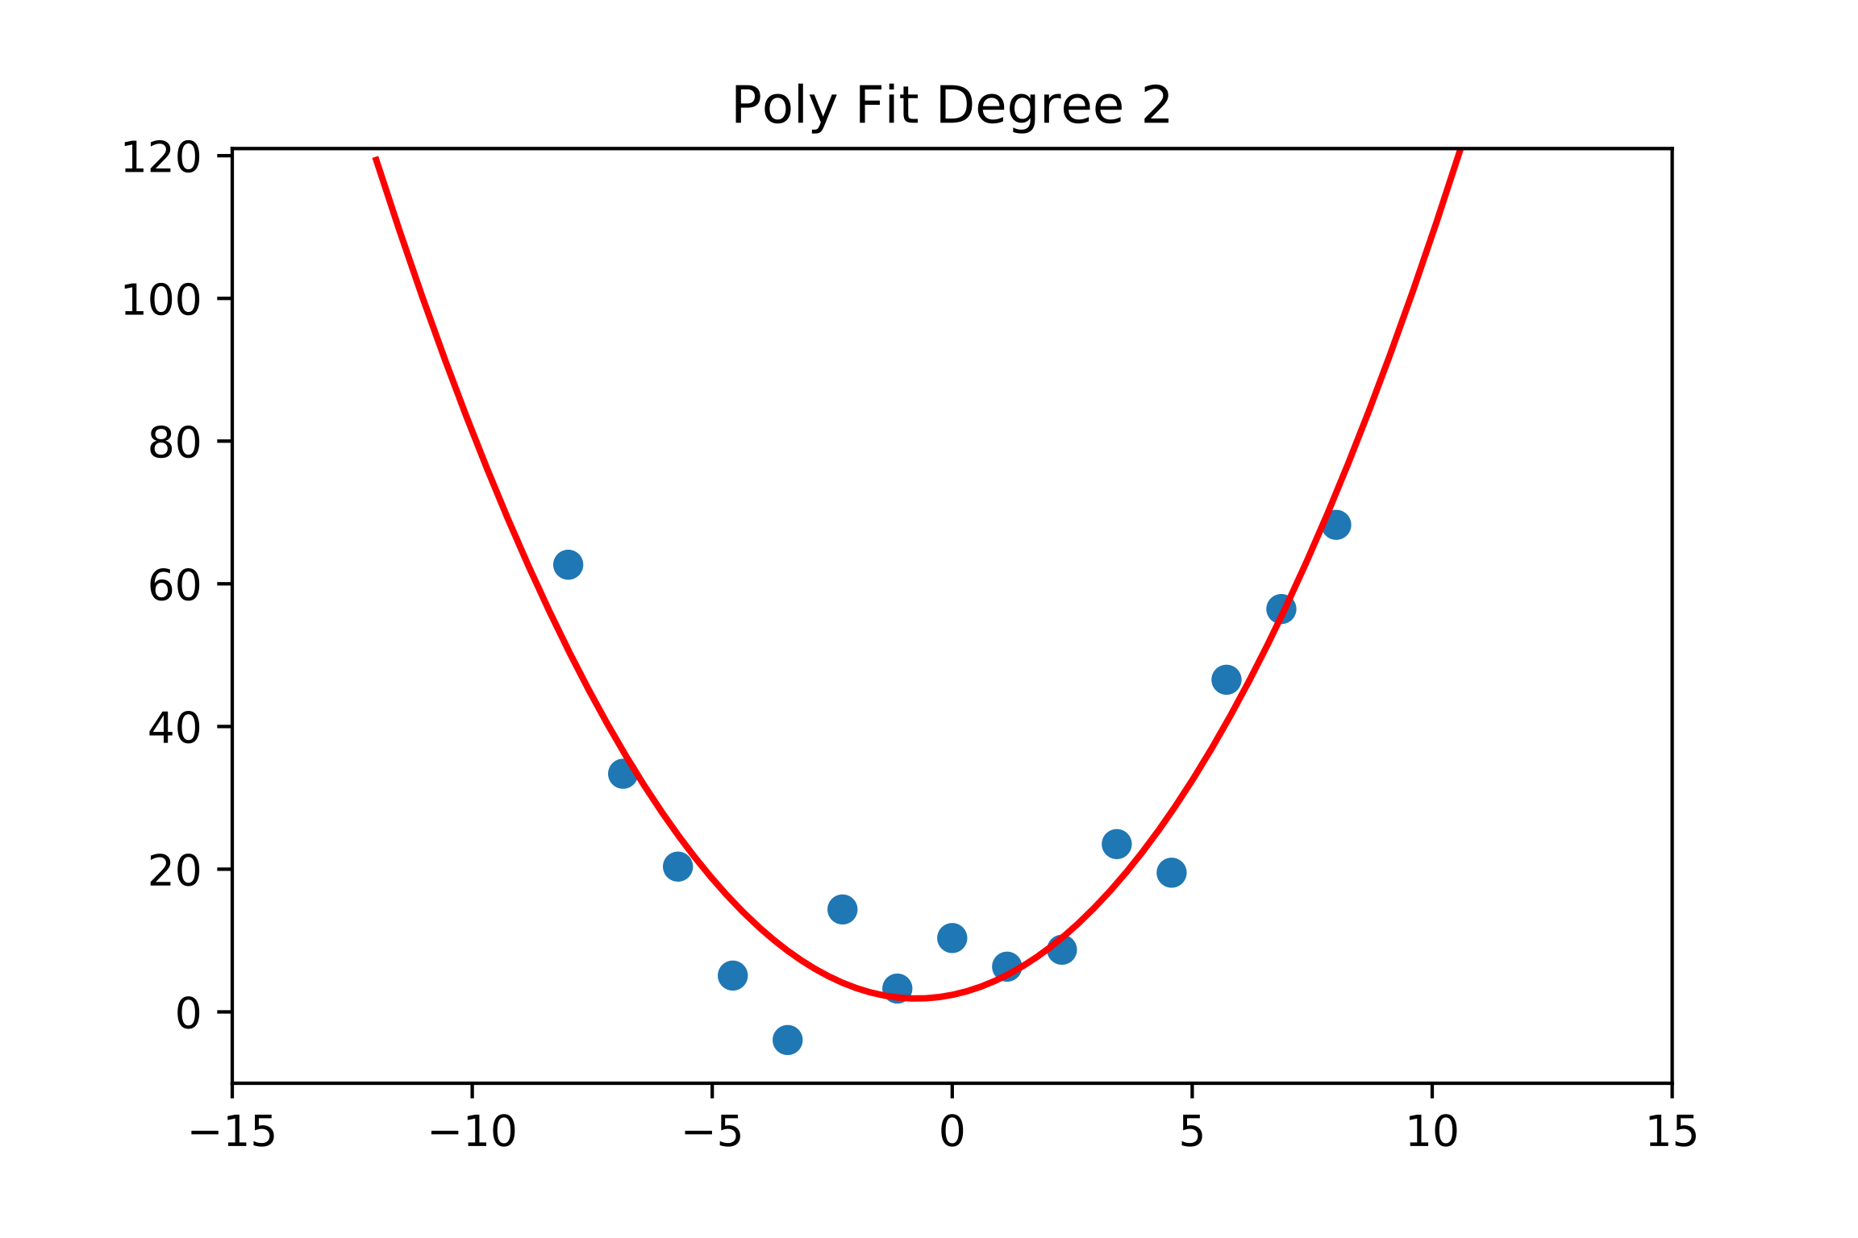
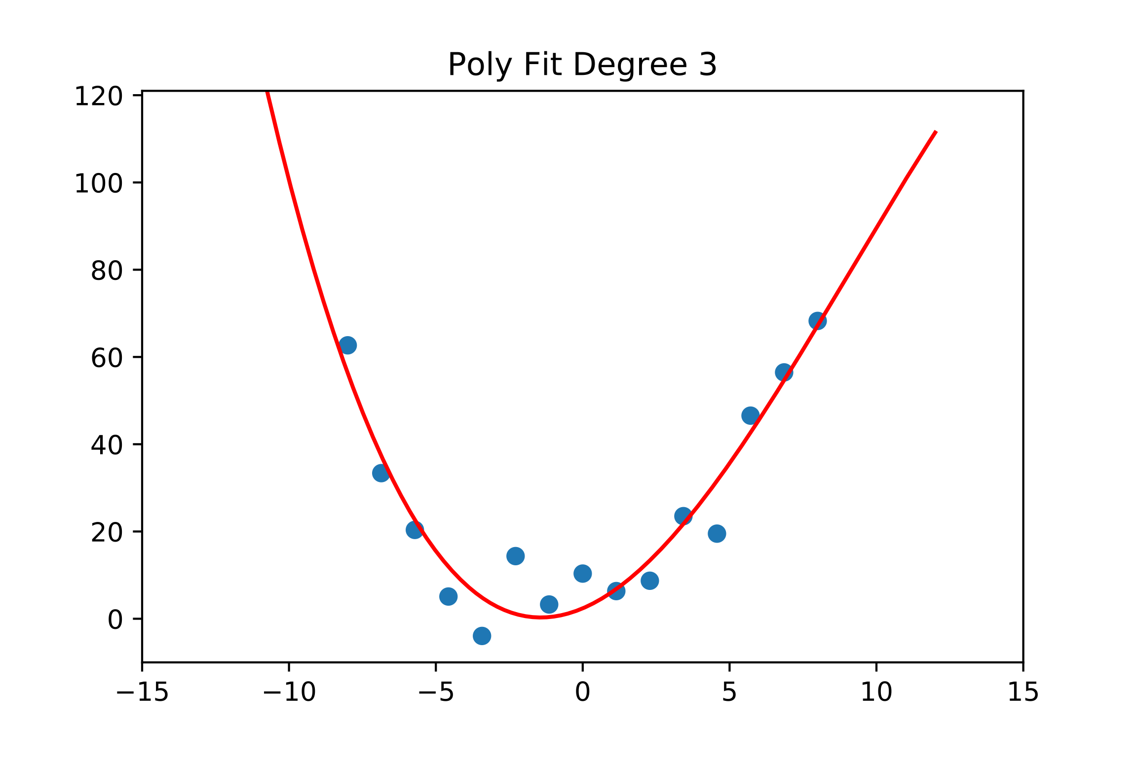
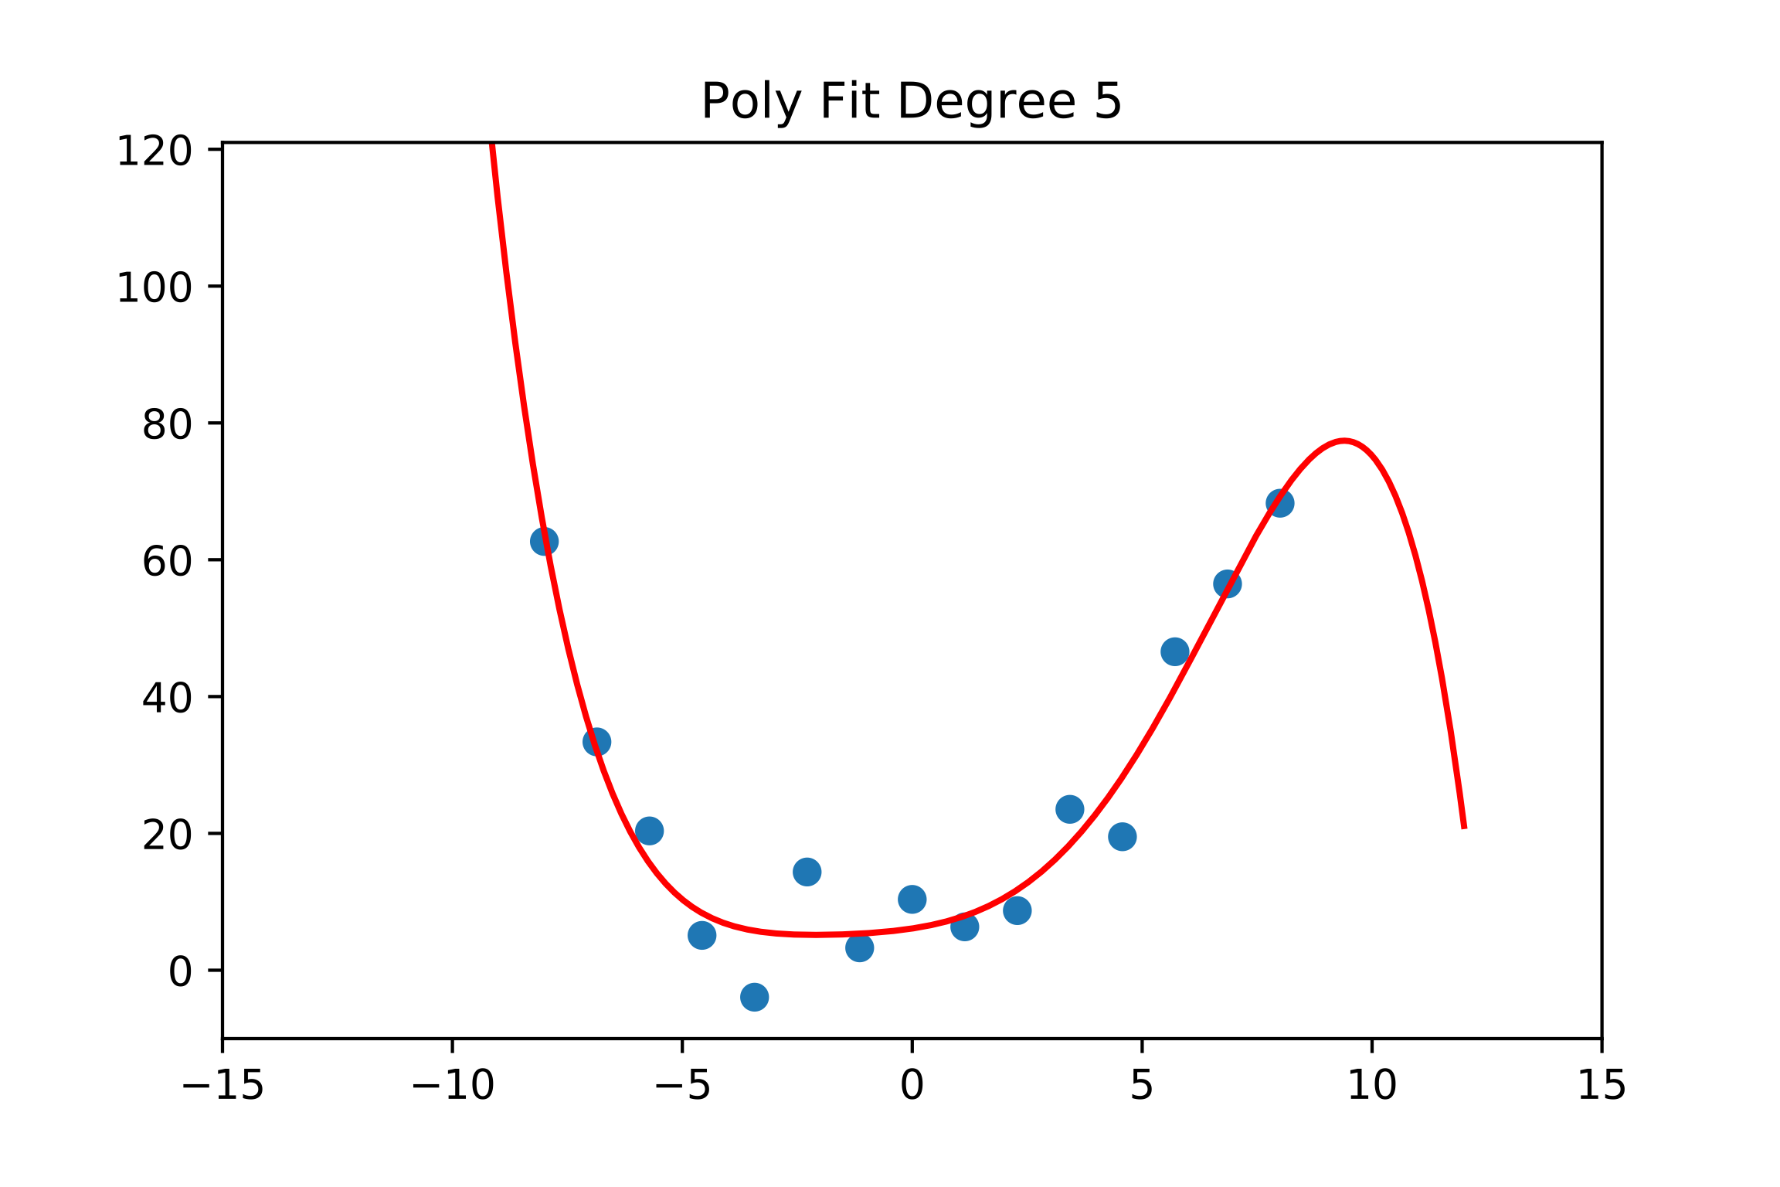
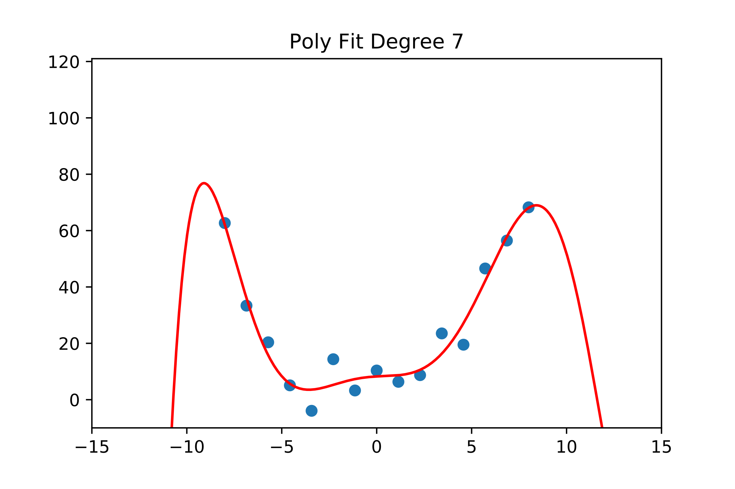
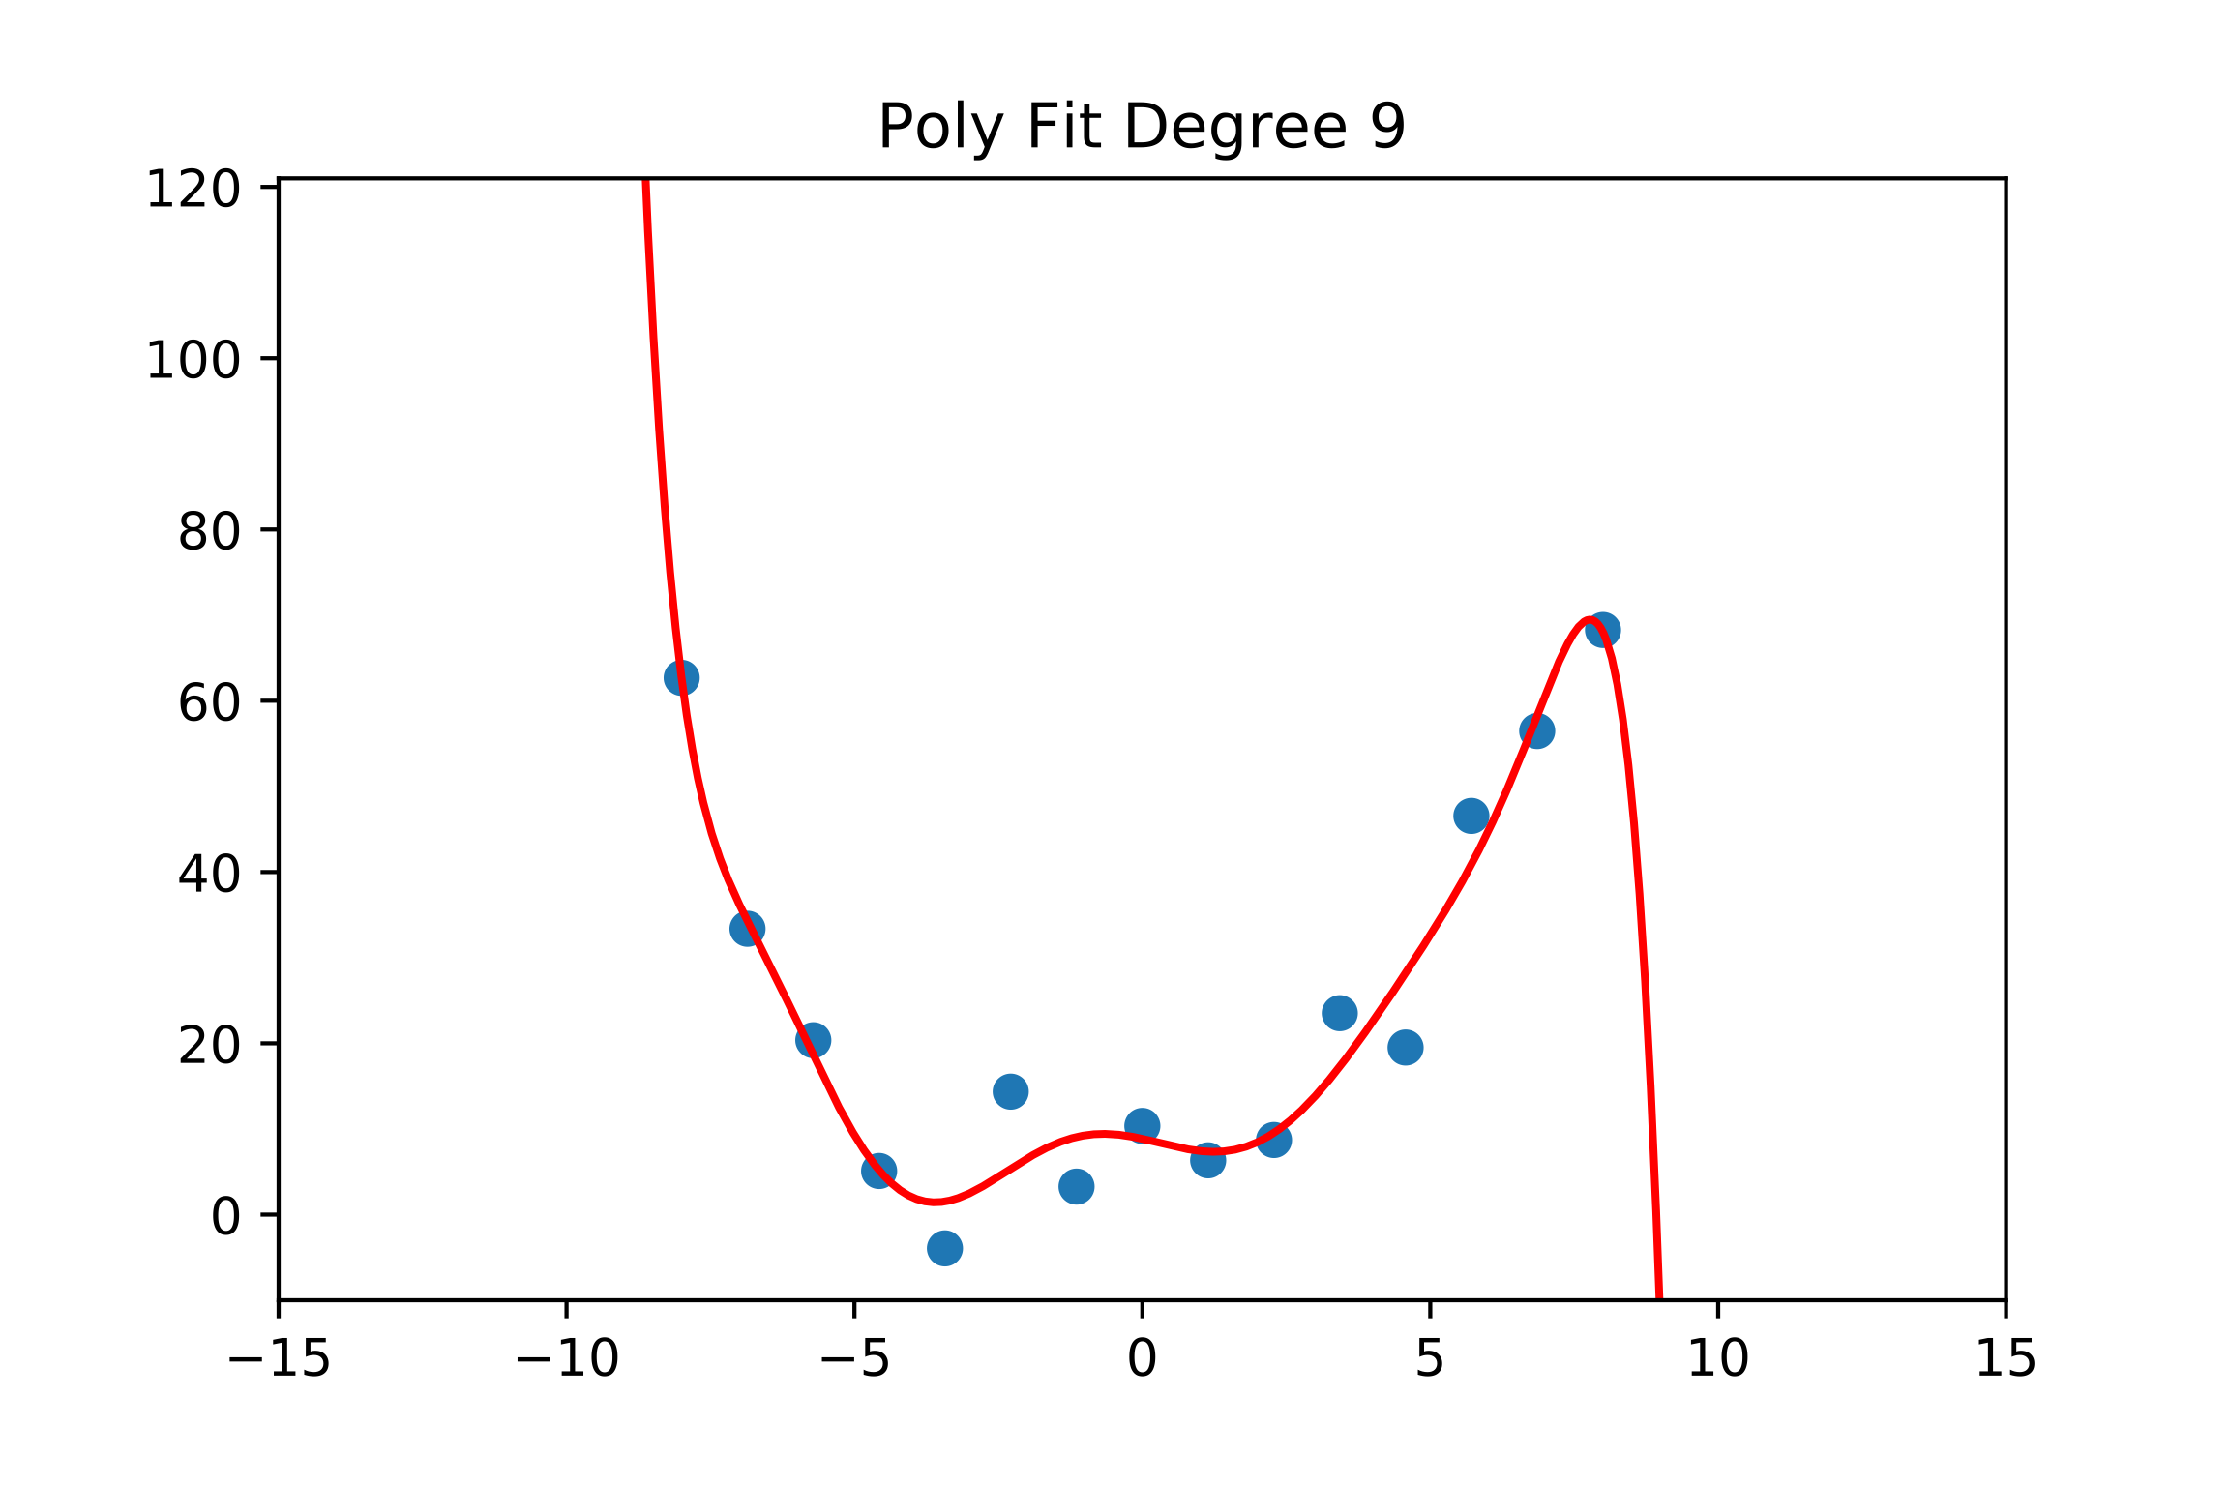
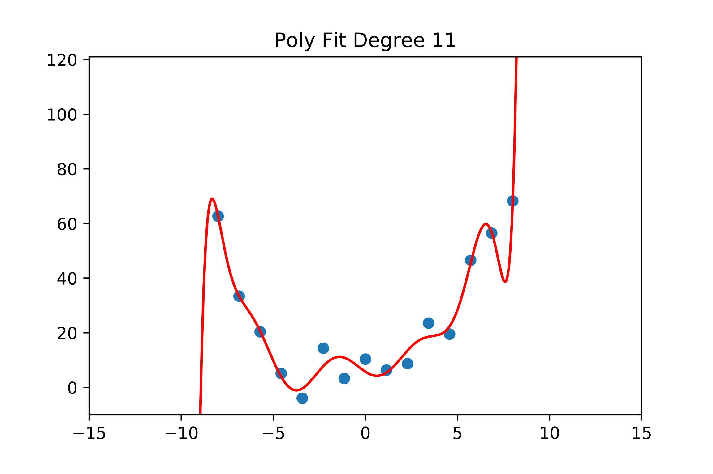
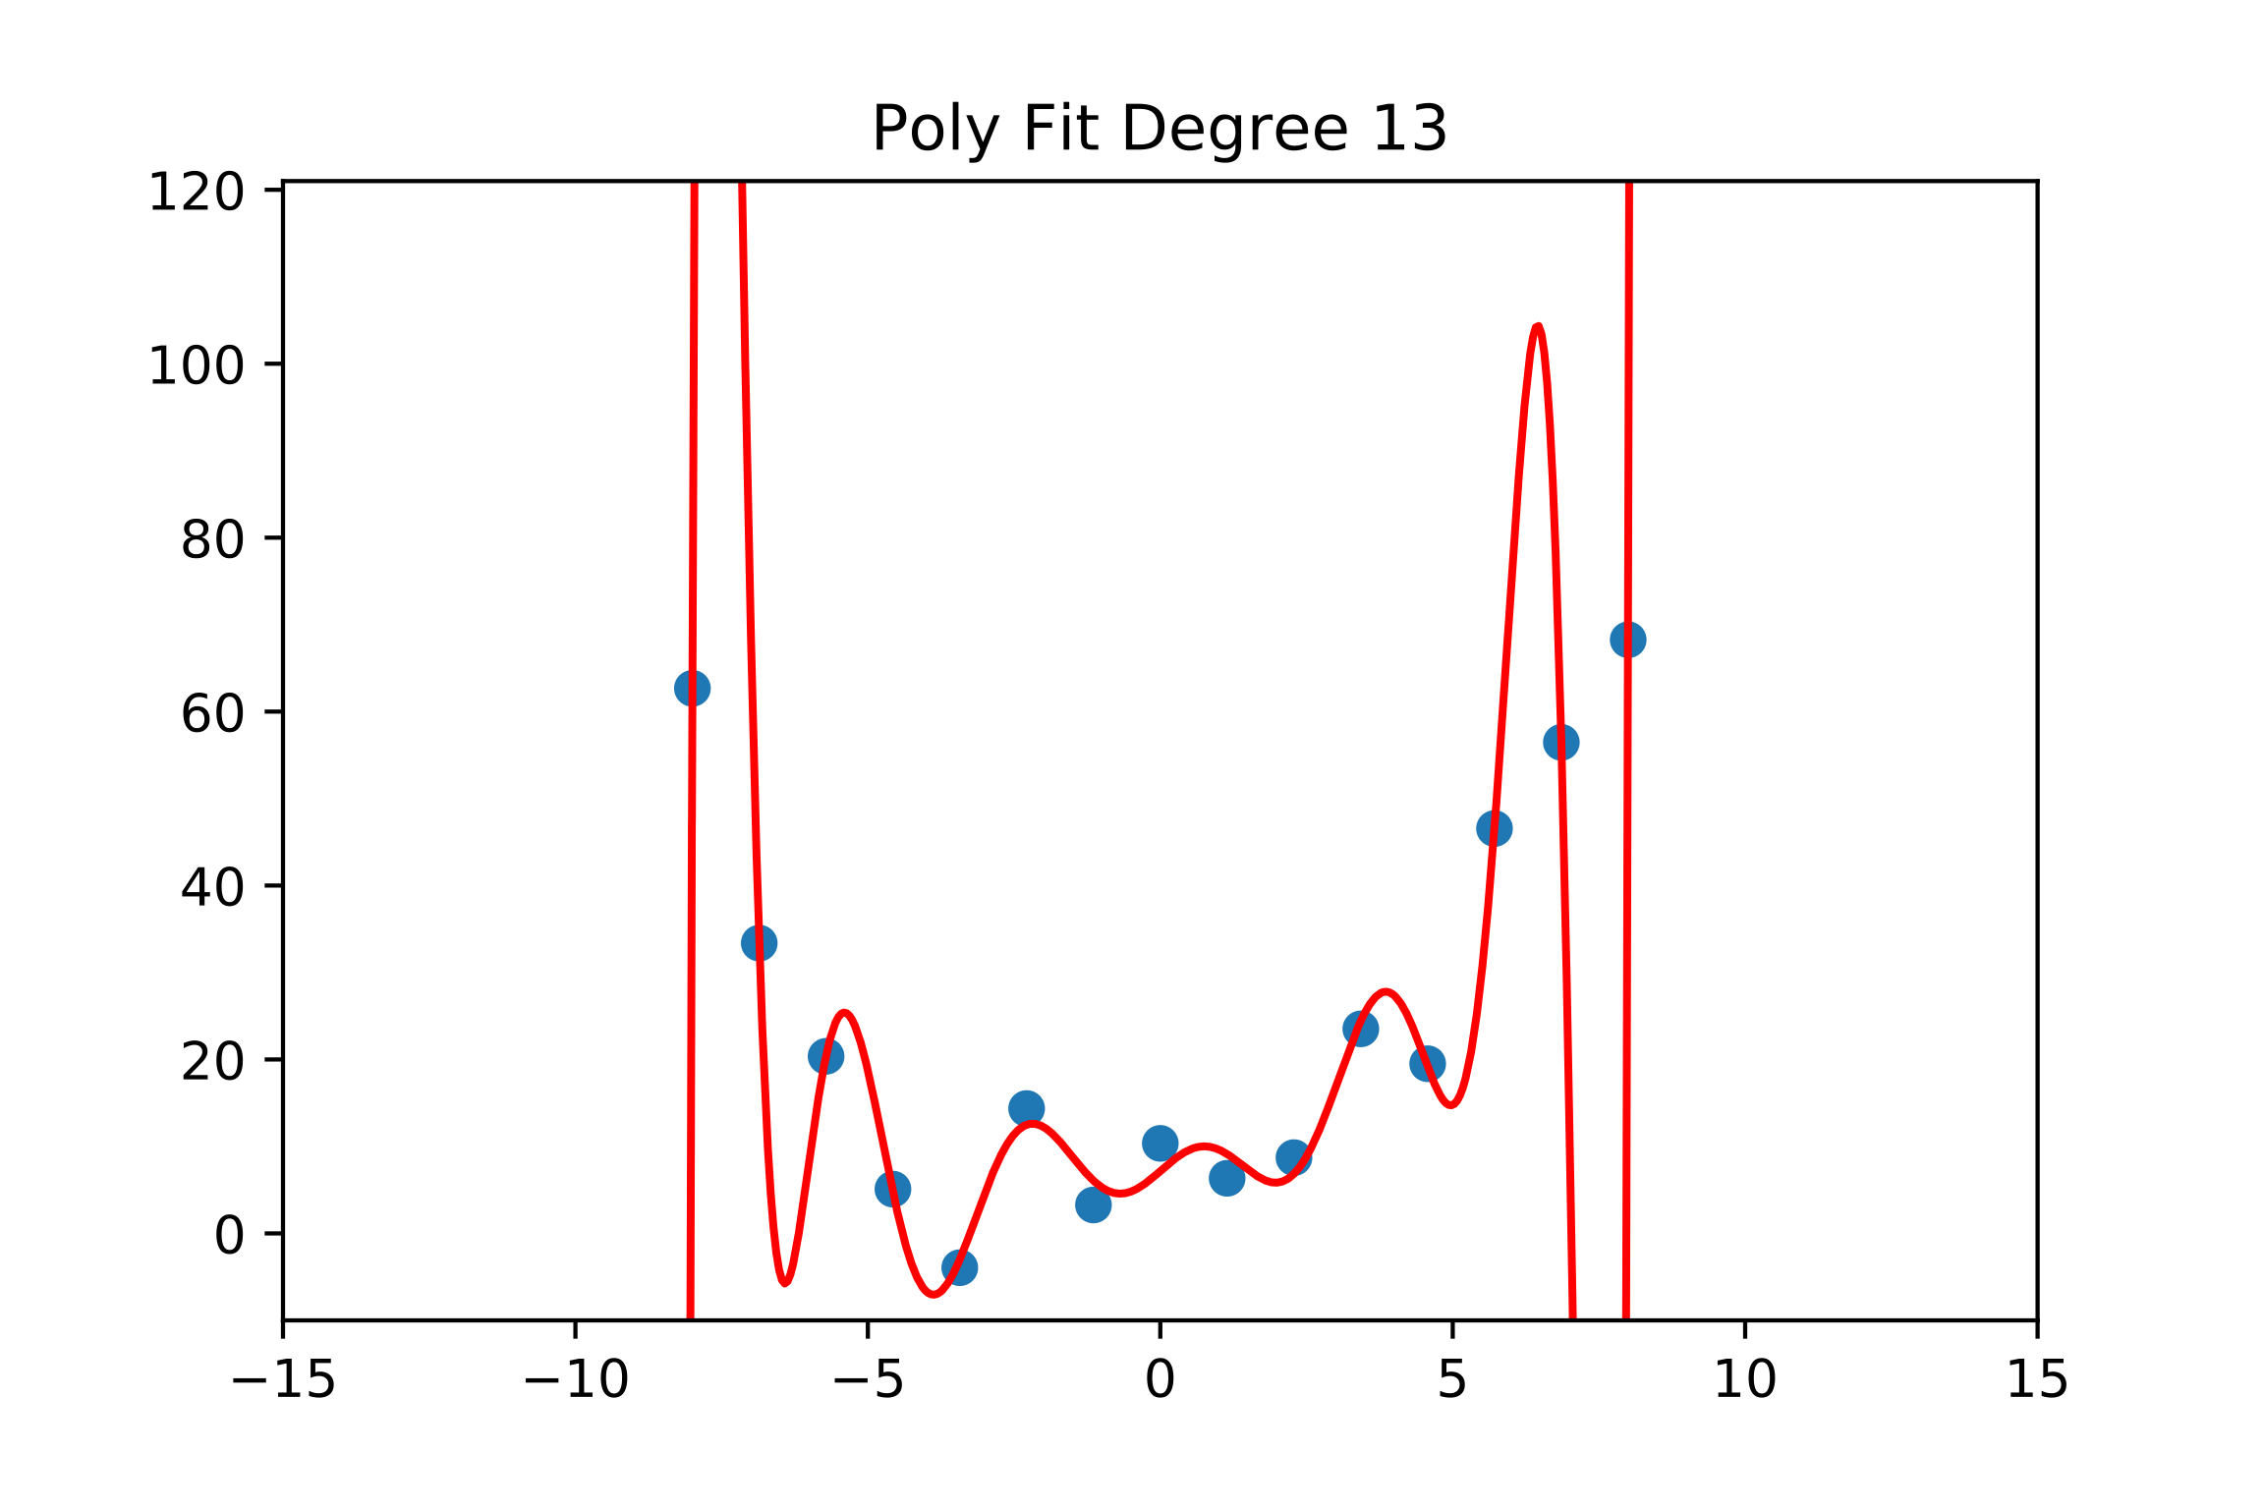
Overfitting: More Parameters, More Problems
Now lets fit a polynomial to our samples of the form
Notes:
P_N(x) = \sum_{k=0}^N x^kp_k

Slide 16
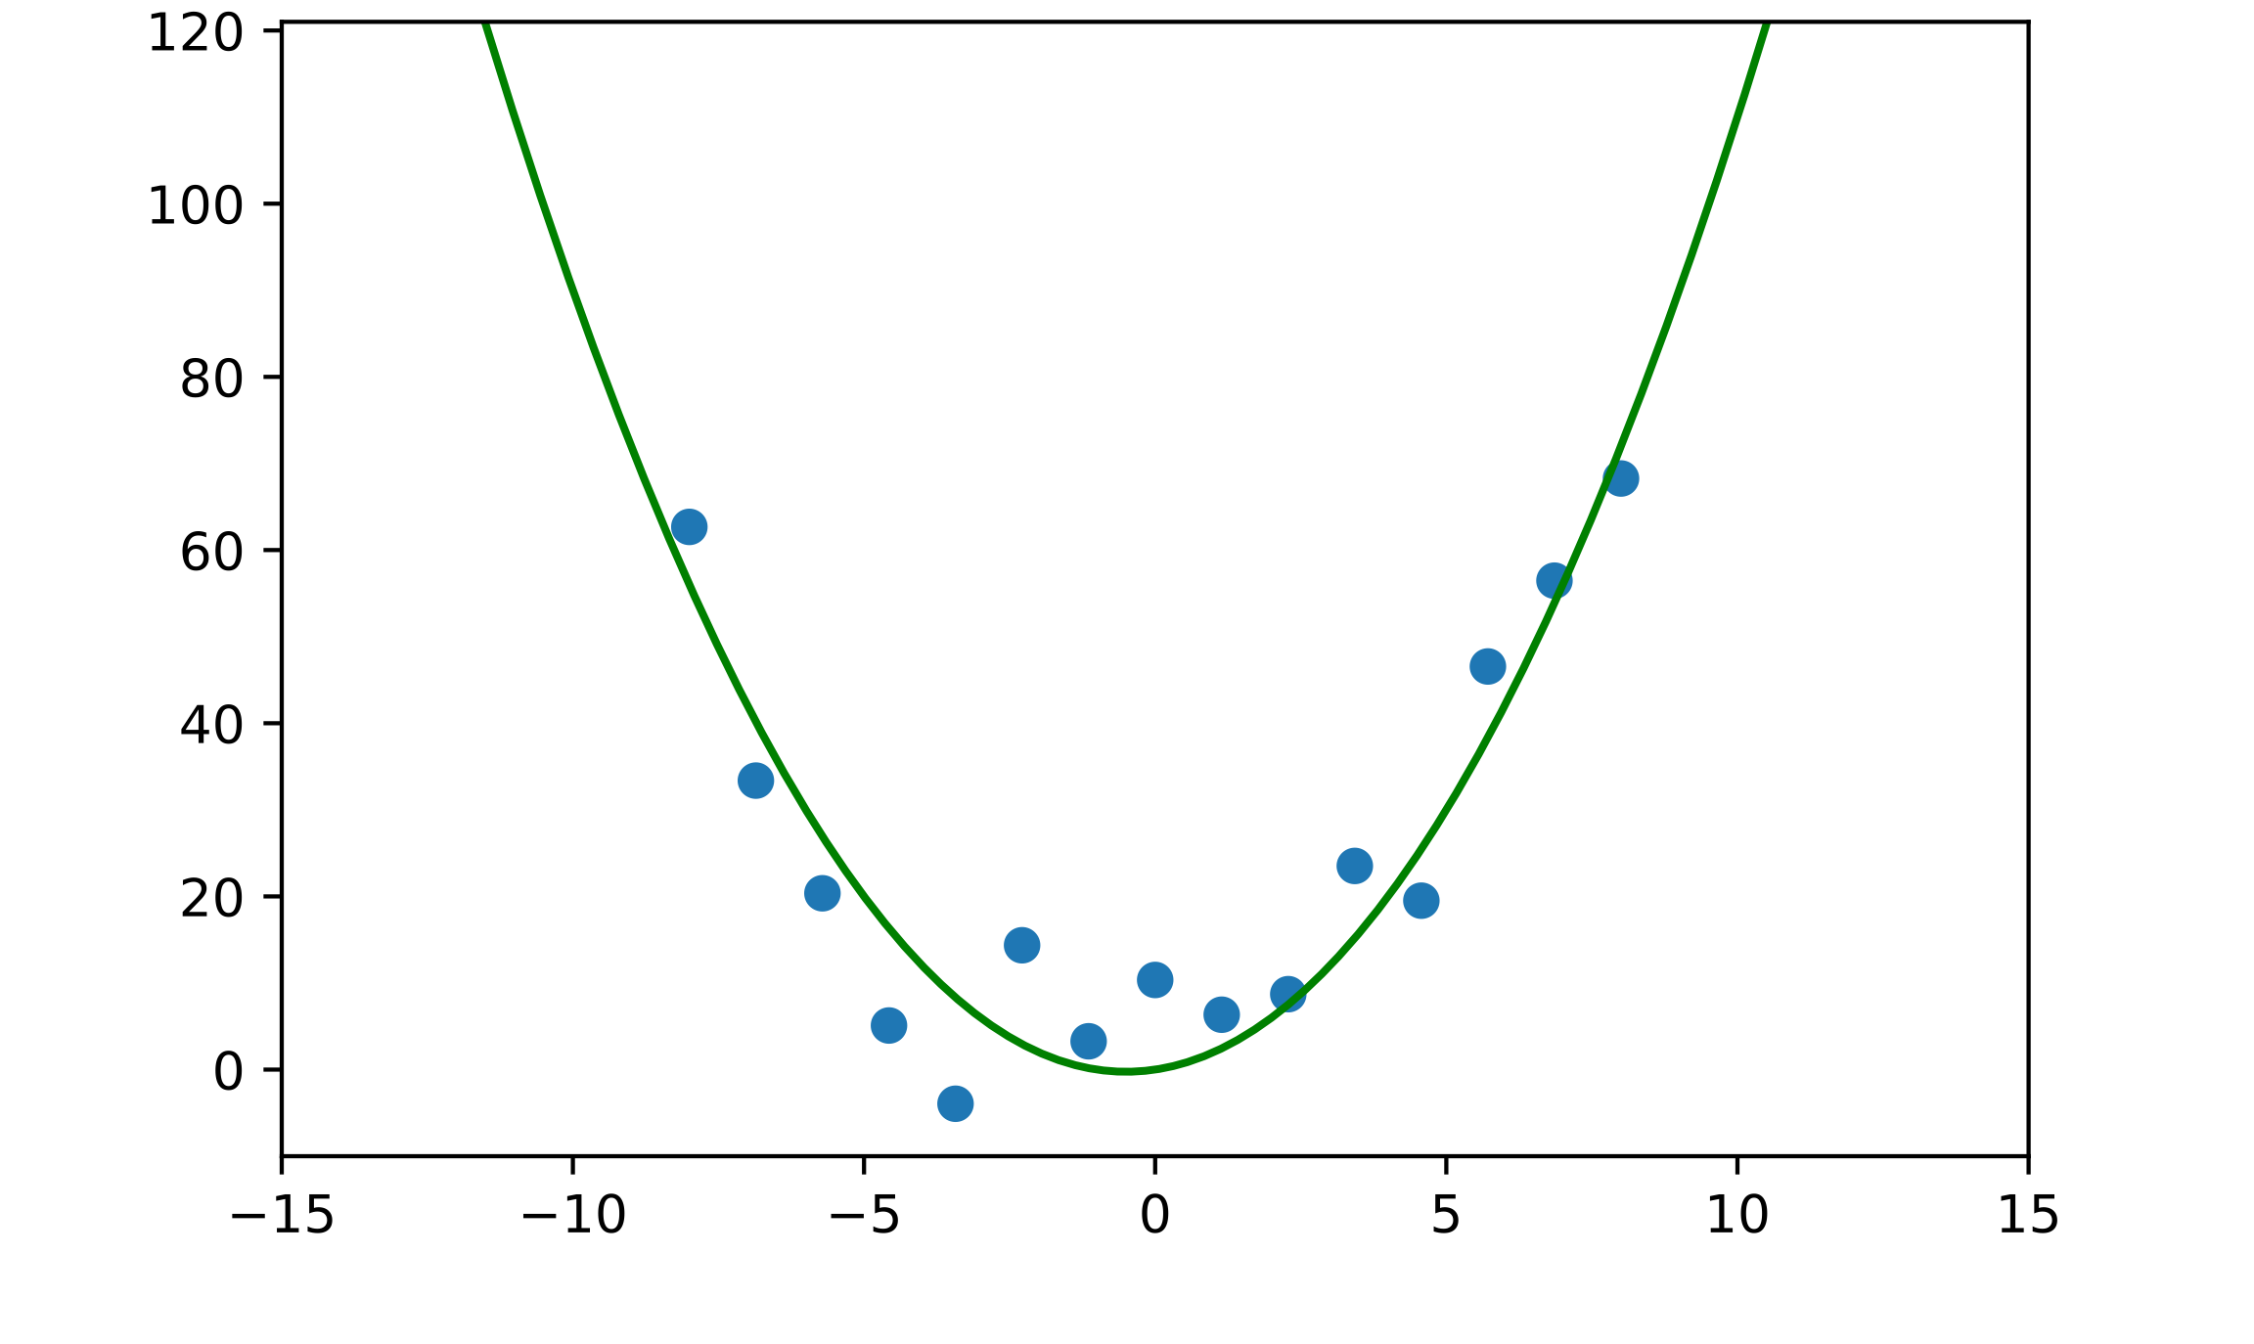
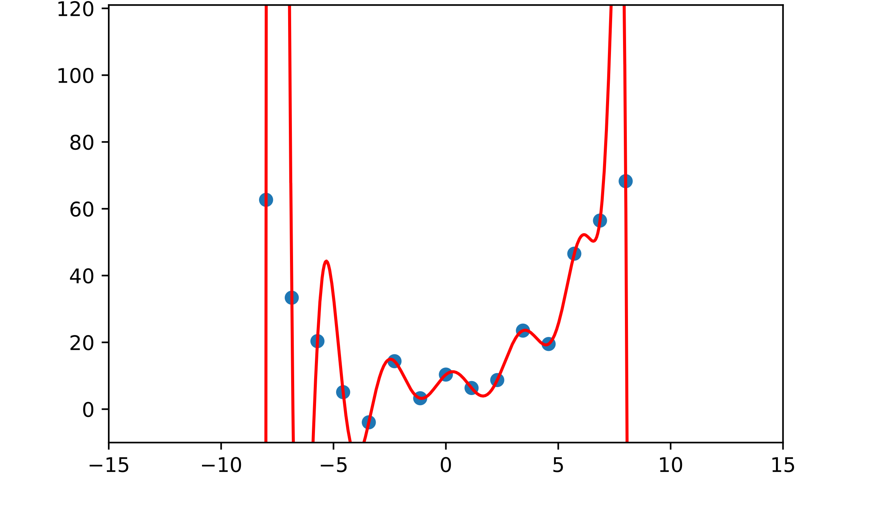
Overfitting: More Parameters, More Problems
A model with more parameters can represent more functions
E.g.,: if then
More parameters will often reduce training error but increase testing error. This is overfitting.
When overfitting happens, models do not generalize well.
Degree 2 Fit
Degree 15 Fit

Slide 17
Deep Learning: More Parameters, More Problems?
More parameters let us represent a larger space of functions
The larger that space is, the harder our optimization becomes
This means we need:
More data
More compute resources
Etc.
Convolutional Layer
Fully Connected Layer

Slide 18
Deep Learning: More Parameters, More Problems?
A convolutional layer looks for components of a function that are spatially-invariant
Convolutional Layer
Fully Connected Layer

Slide 19
How to Avoid Overfitting: Regularization
In general:
More parameters means higher risk of overfitting
More constraints/conditions on parameters can help
If a model is overfitting, we can
Collect more data to train on
Regularize: add some additional information or assumptions to better constrain learning
Regularization can be done through:
the design of architecture
the choice of loss function
the preparation of data
…

Slide 20
Regularization: Architecture Choice
“Bigger” architectures (typically, those with more parameters) tend to be more at risk of overfitting.
Convolutional Layer
Fully Connected Layer

Slide 21
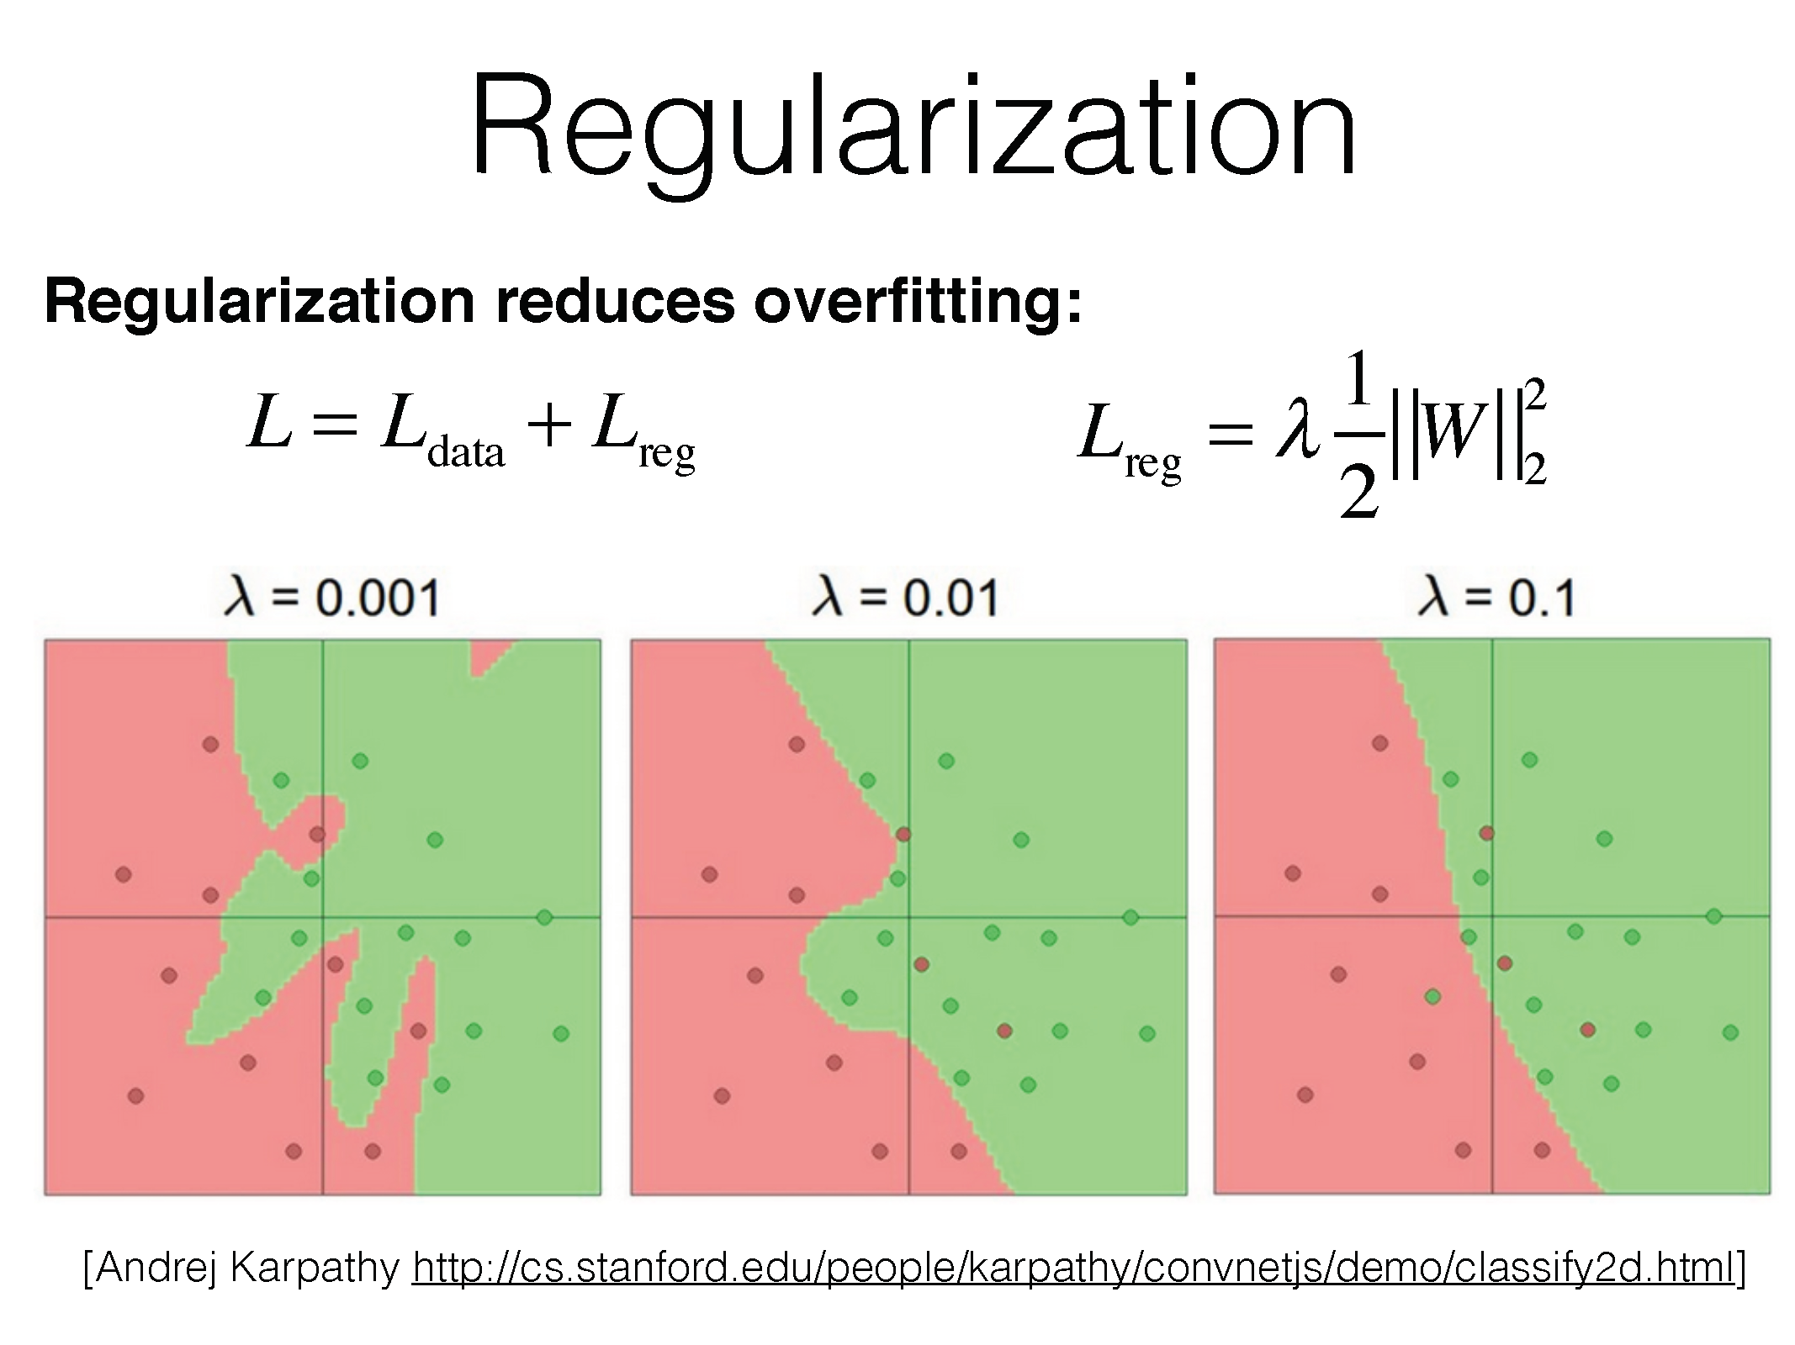

Slide 22
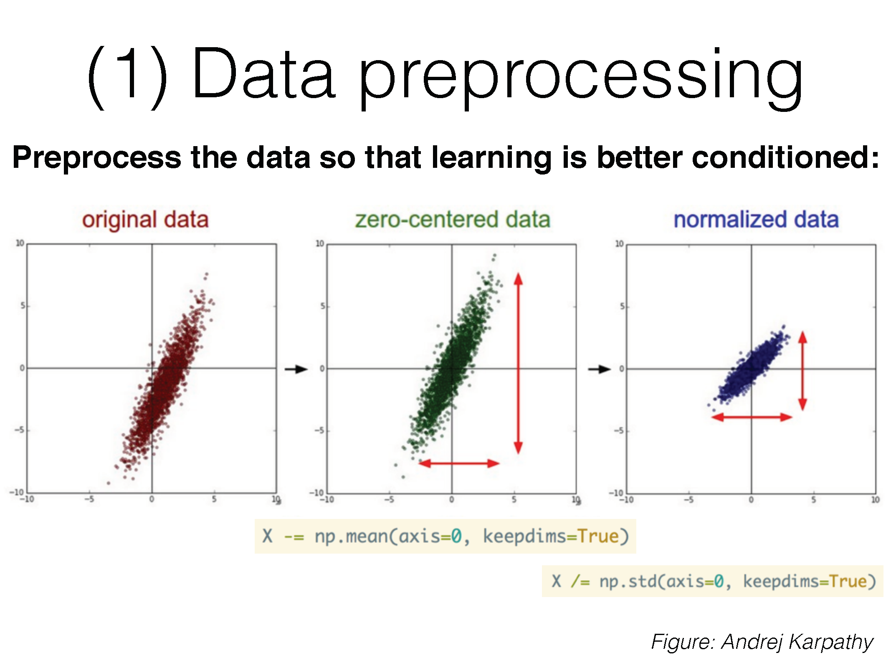

Slide 23
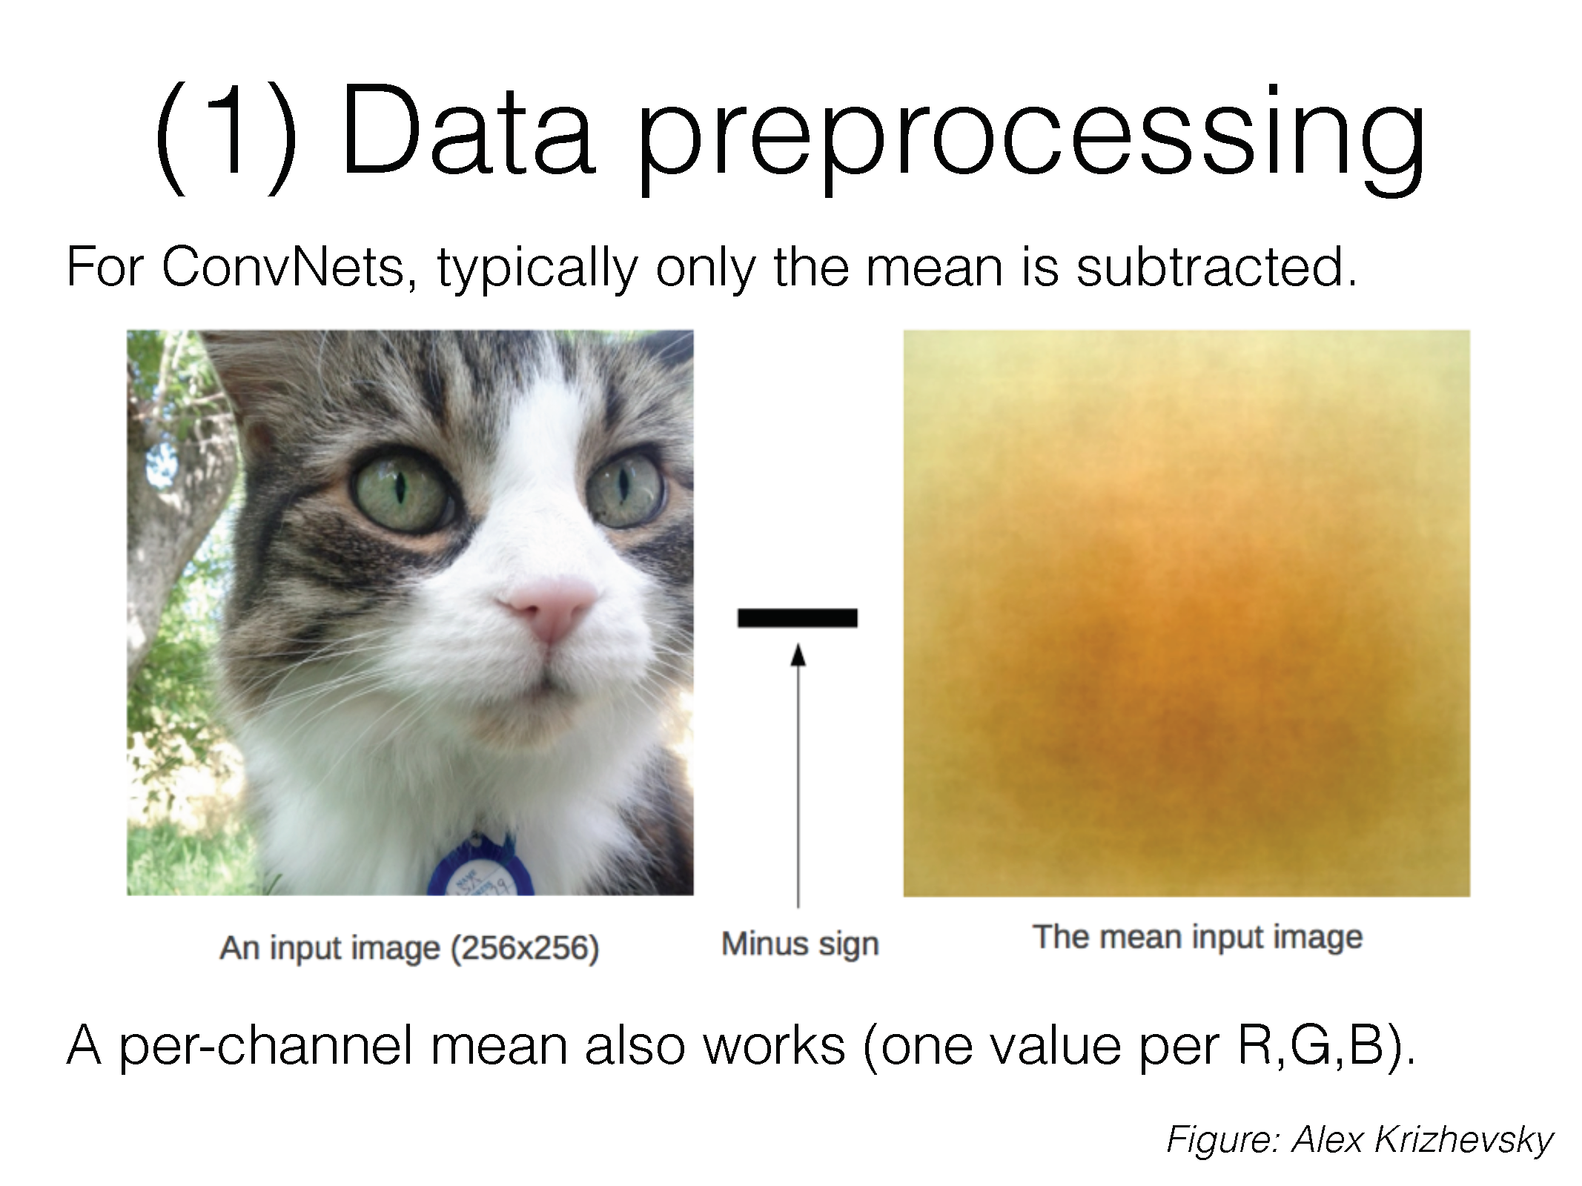

Slide 24
Batch normalization
Side note – can also perform normalization after each layer of the network to stabilize network training (“batch normalization”)

Slide 25
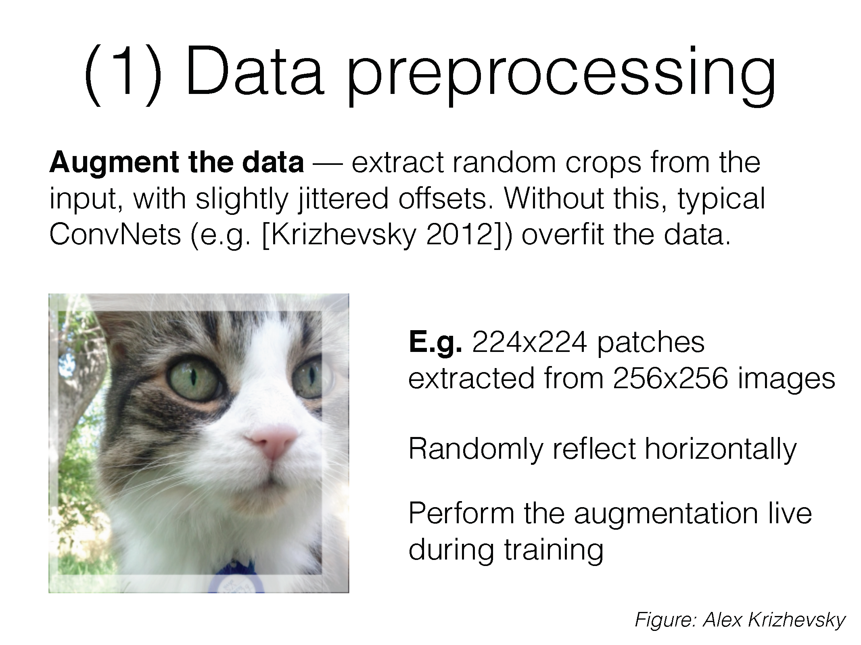

Slide 26
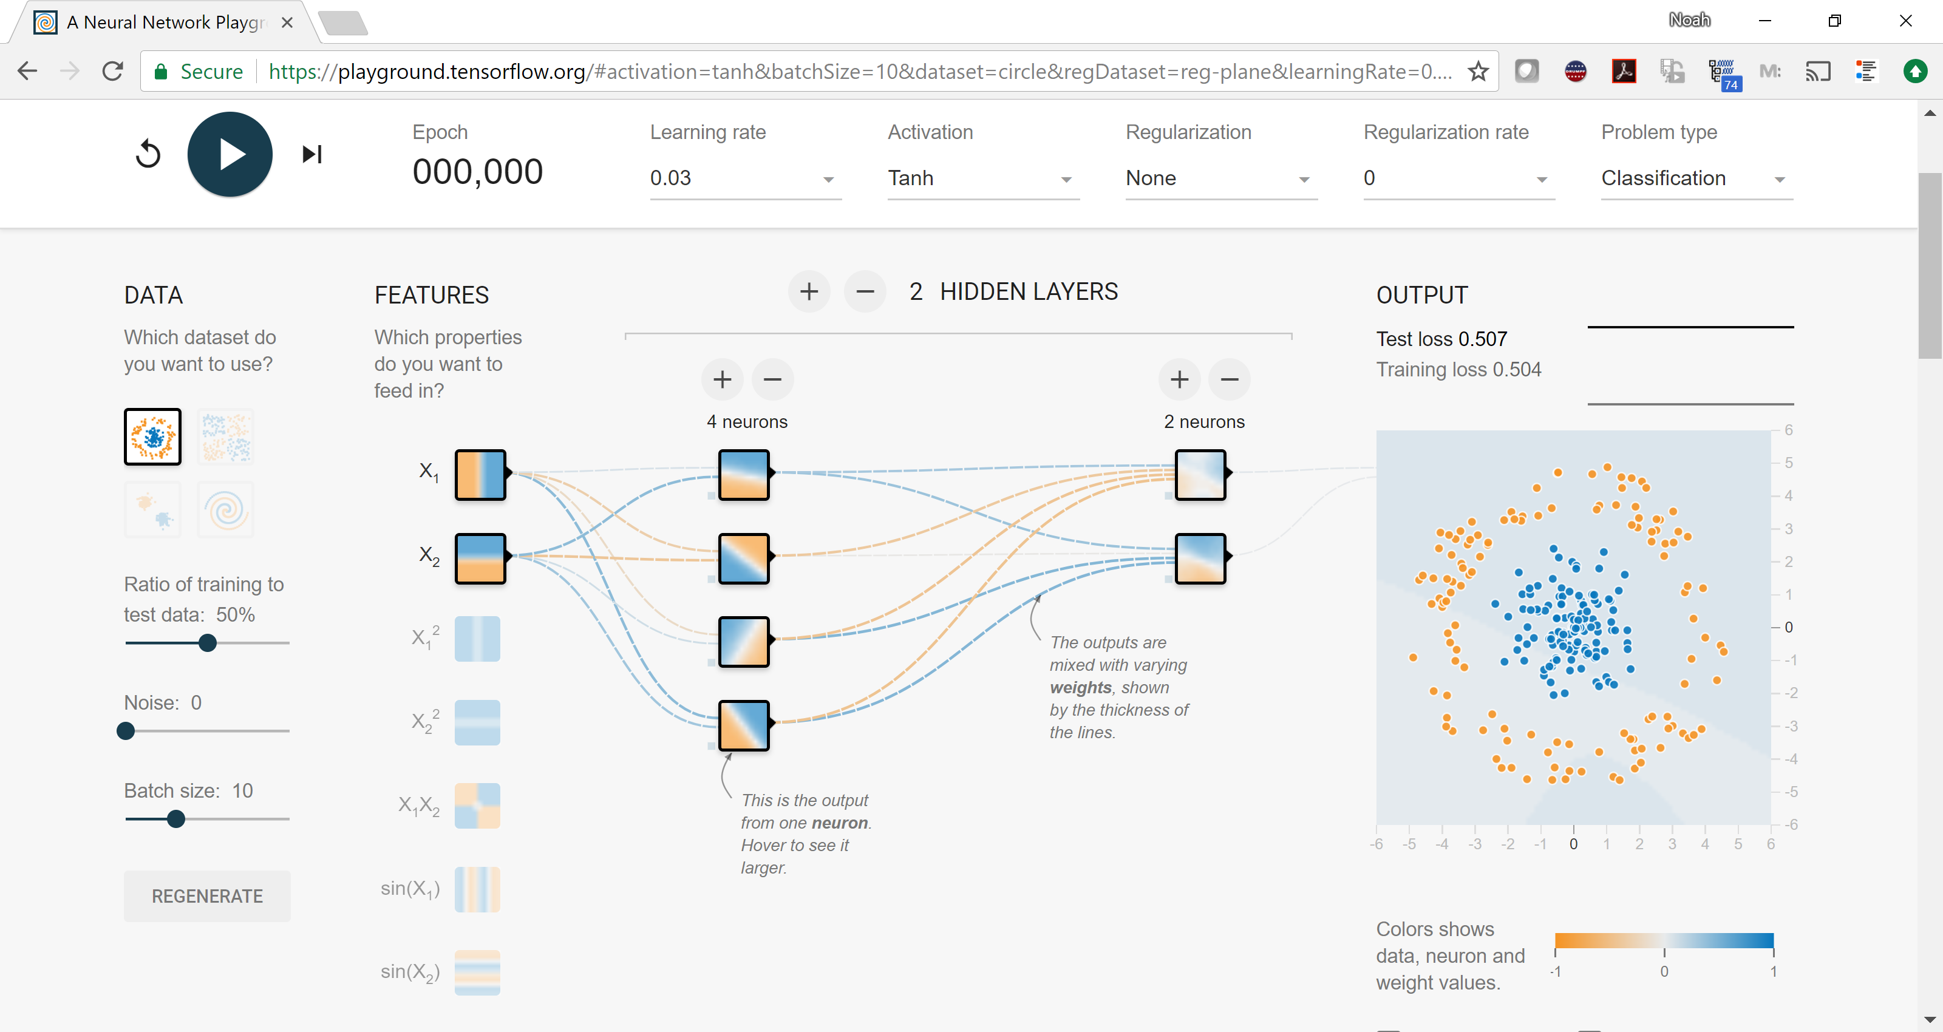
(2) Choose your architecture
https://playground.tensorflow.org/

Slide 27
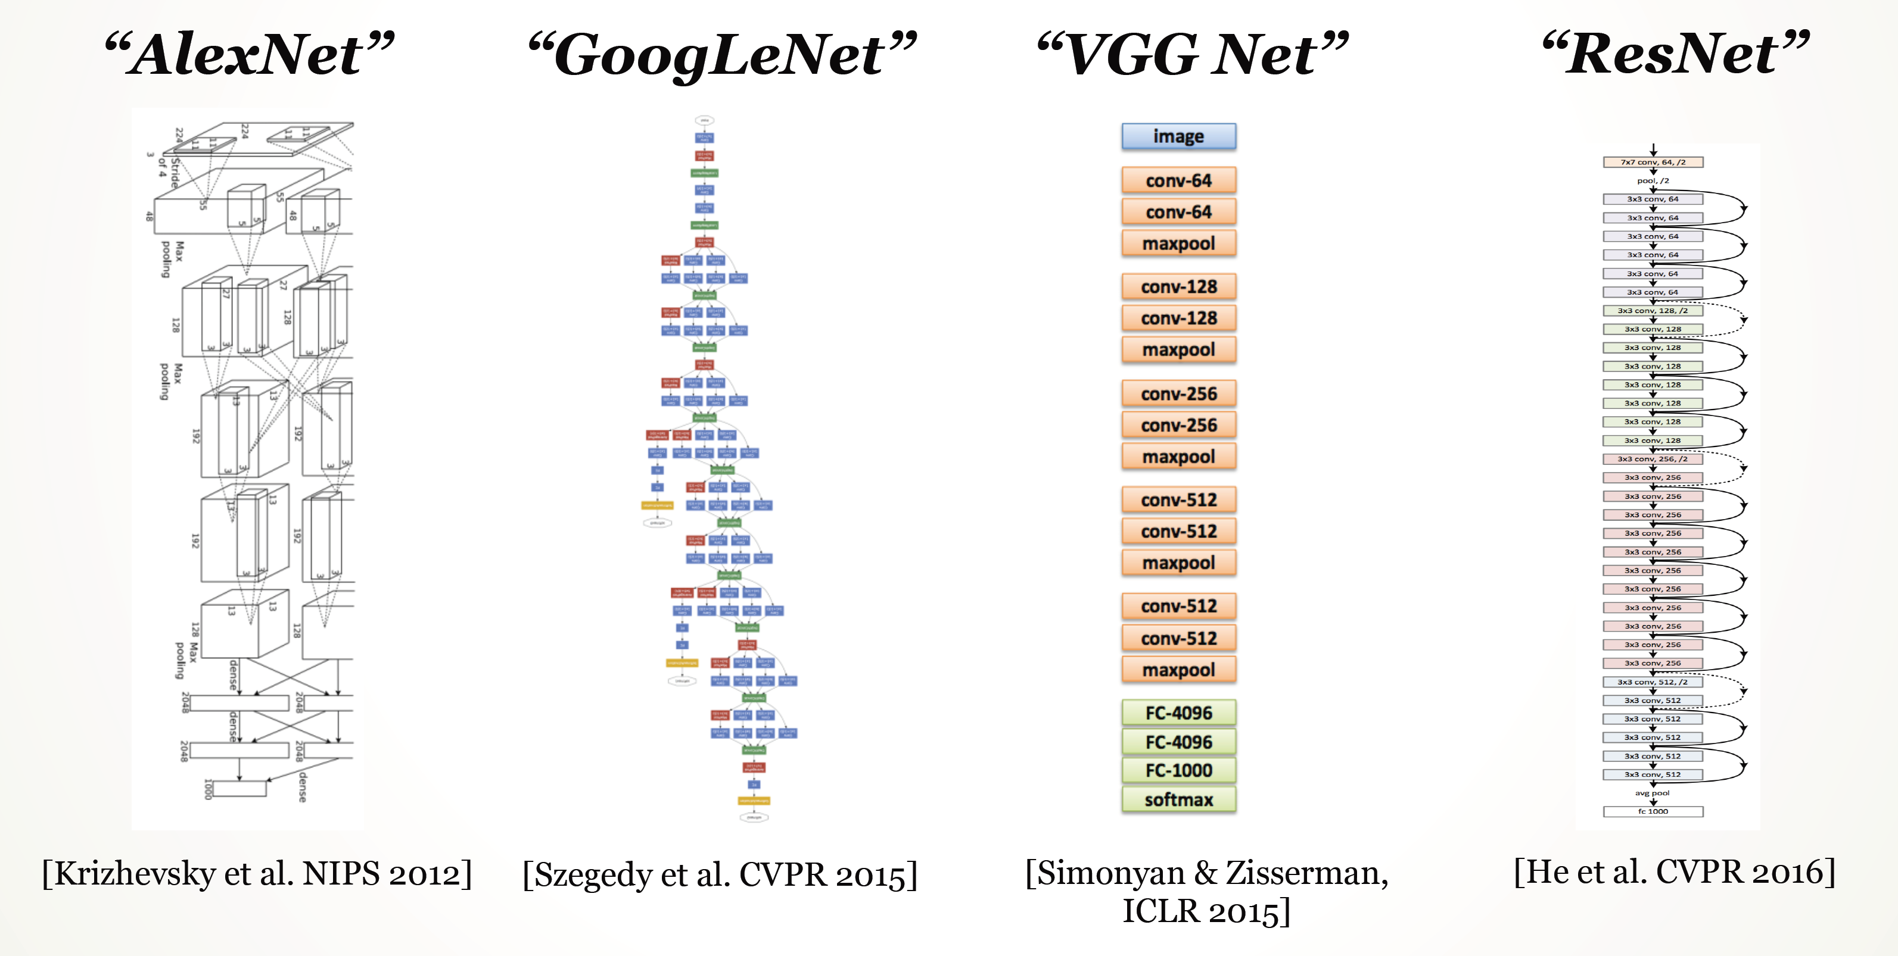
(2) Choose your architecture
Very common modern choice

Slide 28
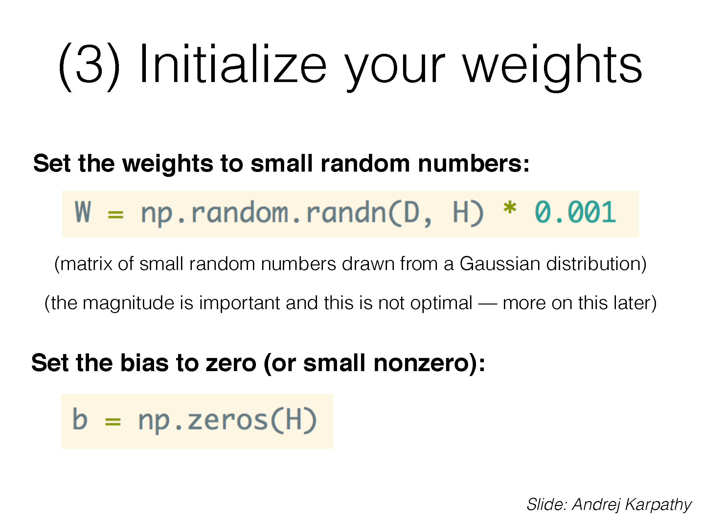
(if you use ReLU activations, folks tend to initialize bias to small positive number)

Slide 29
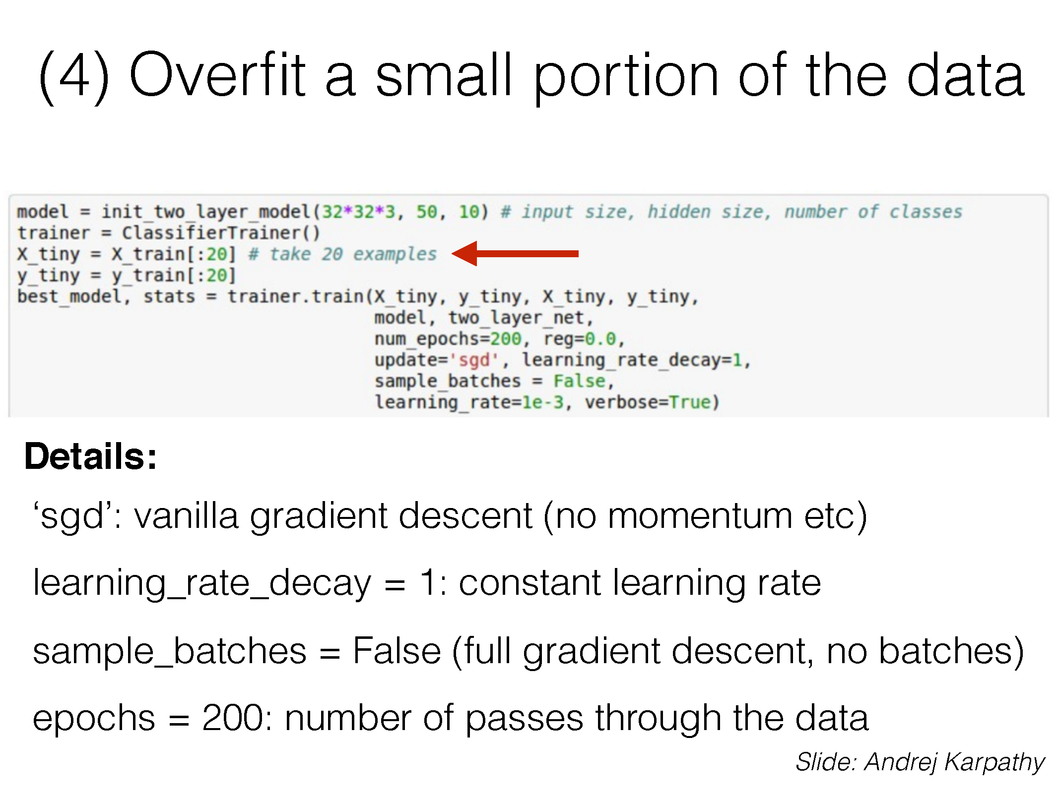
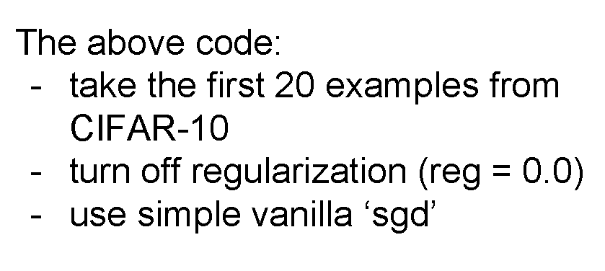

Slide 31
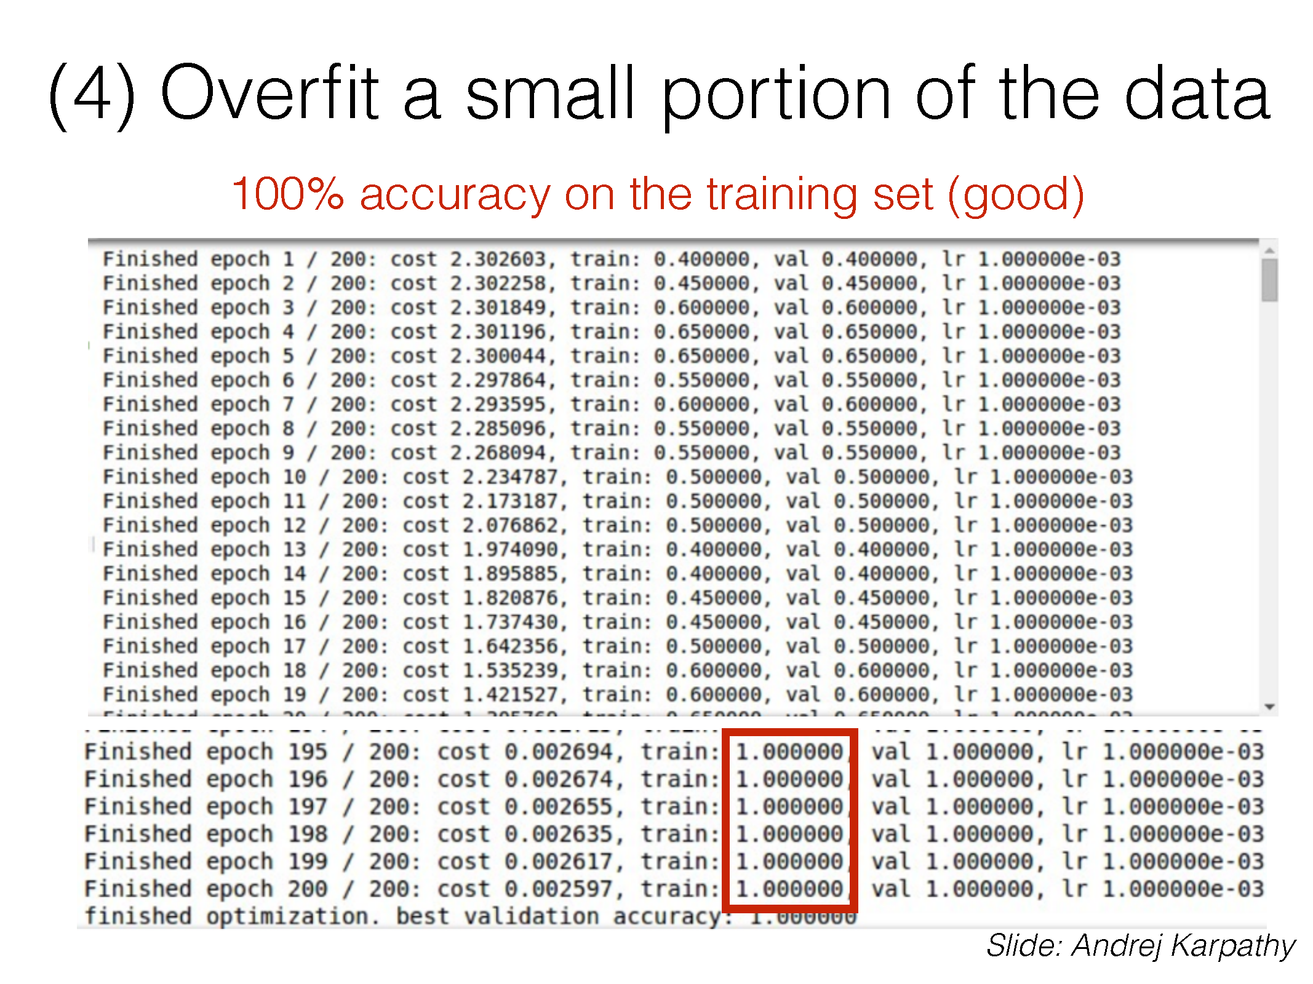

Slide 32
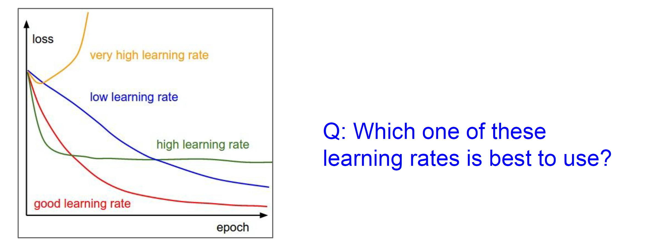
(4) Find a learning rate

Slide 33
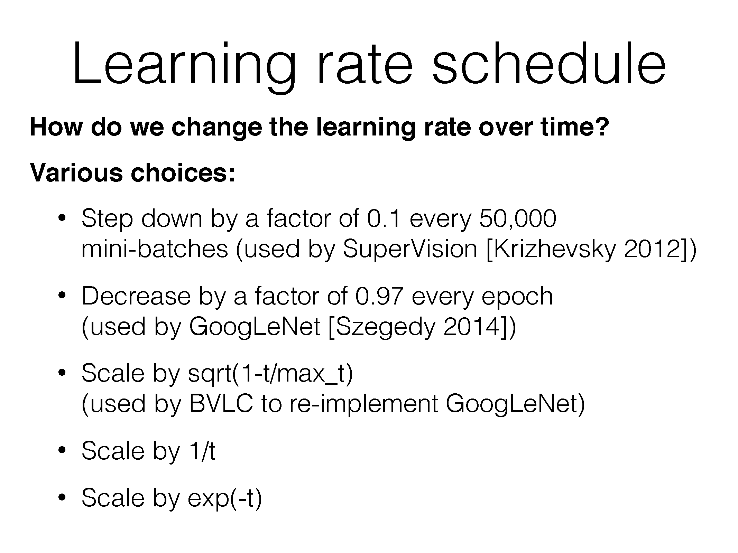

Slide 34
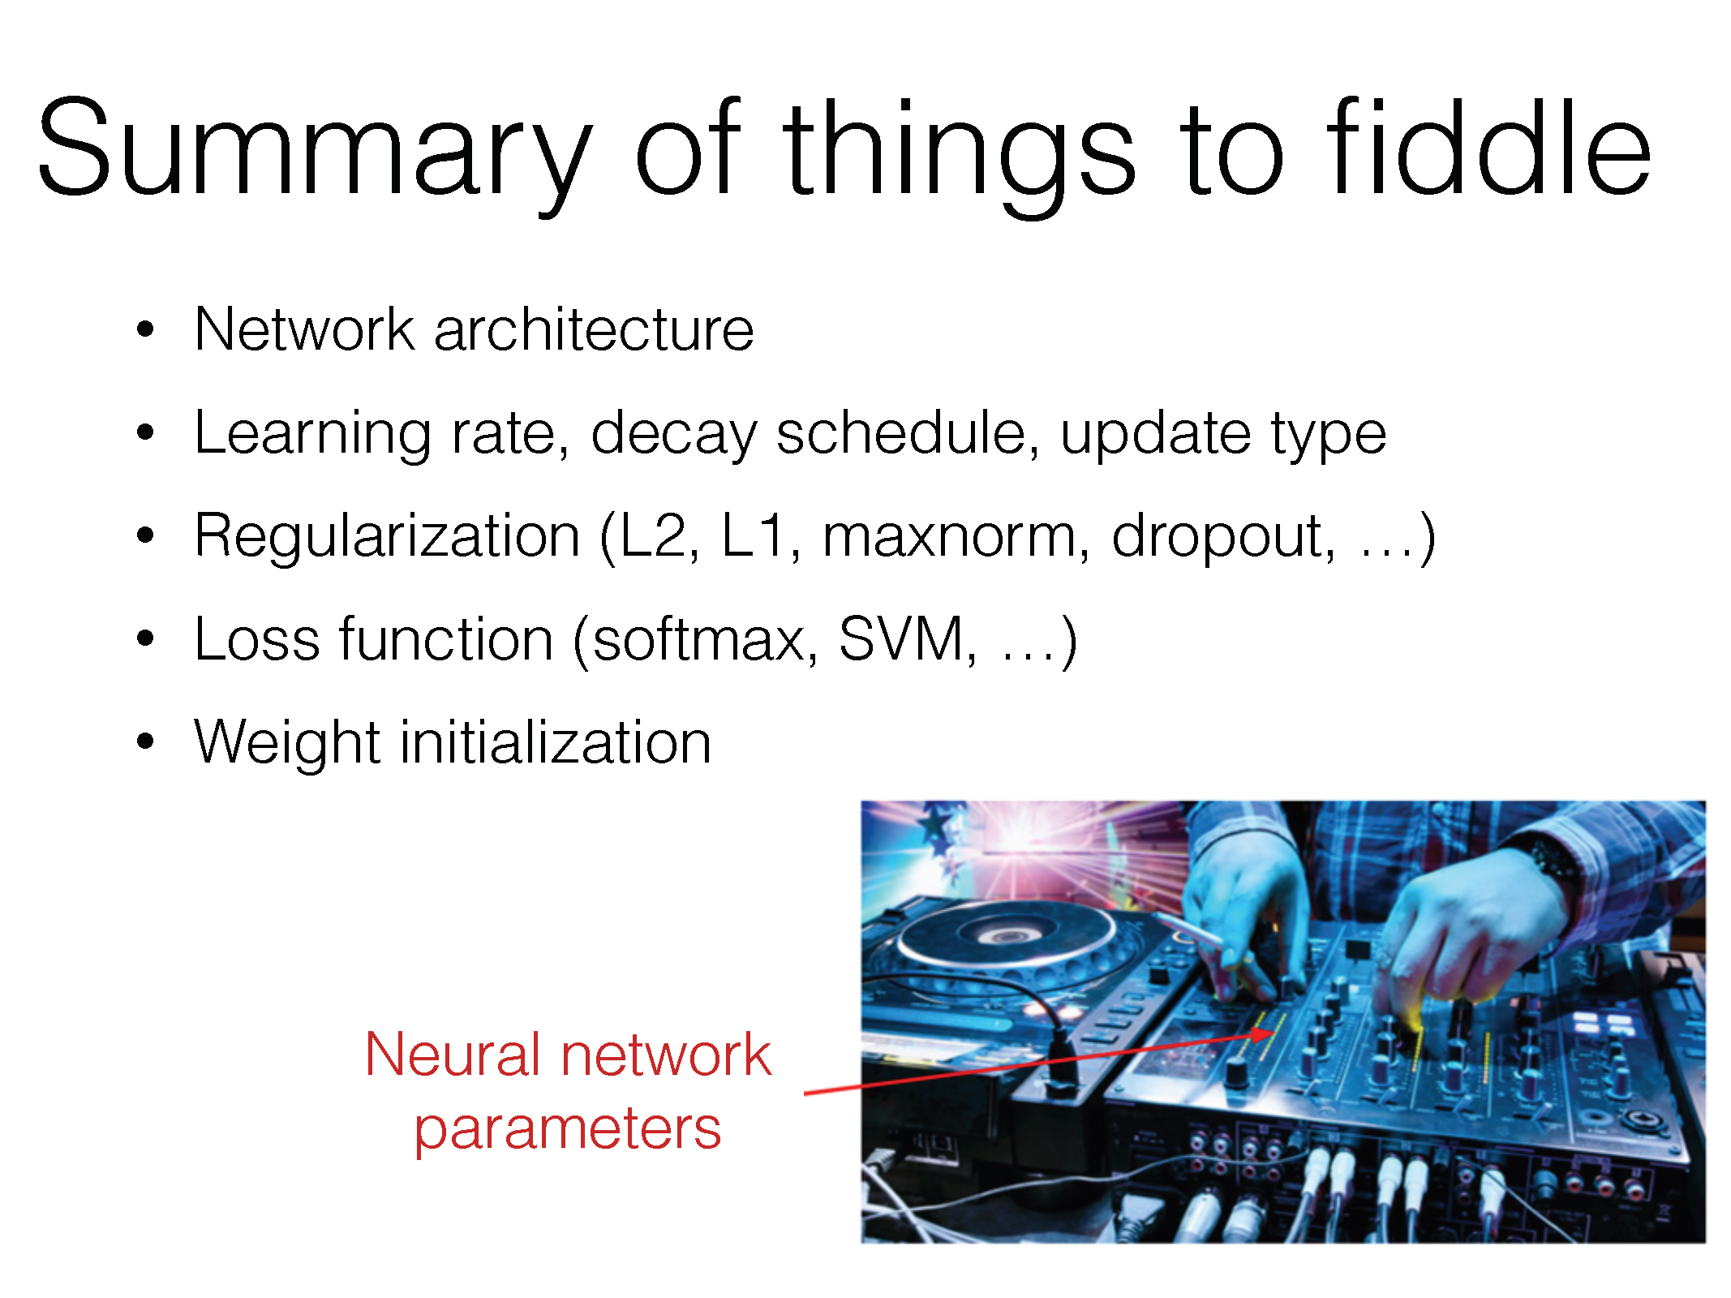

Slide 35
(+batch size)

Slide 36
Questions?

Slide 37
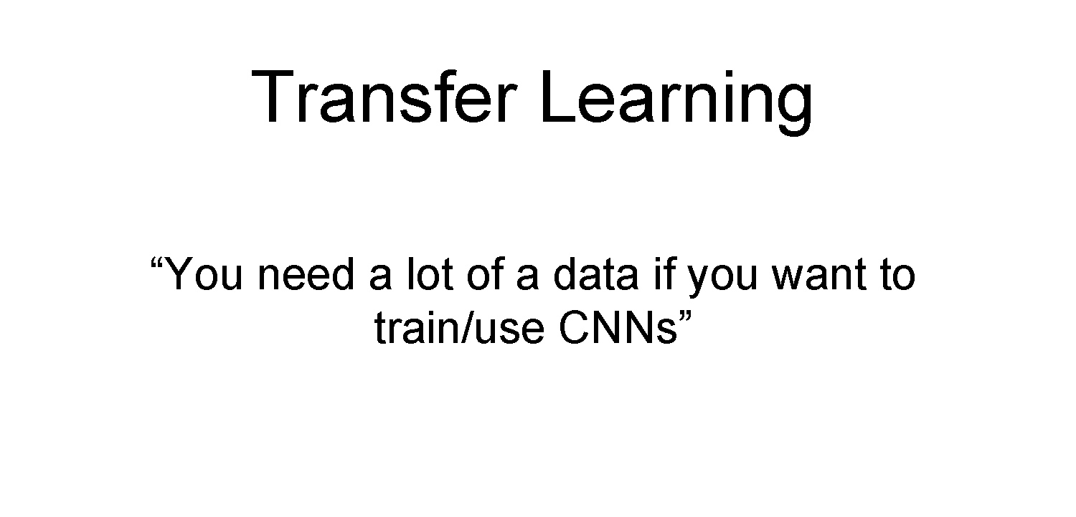

Slide 38
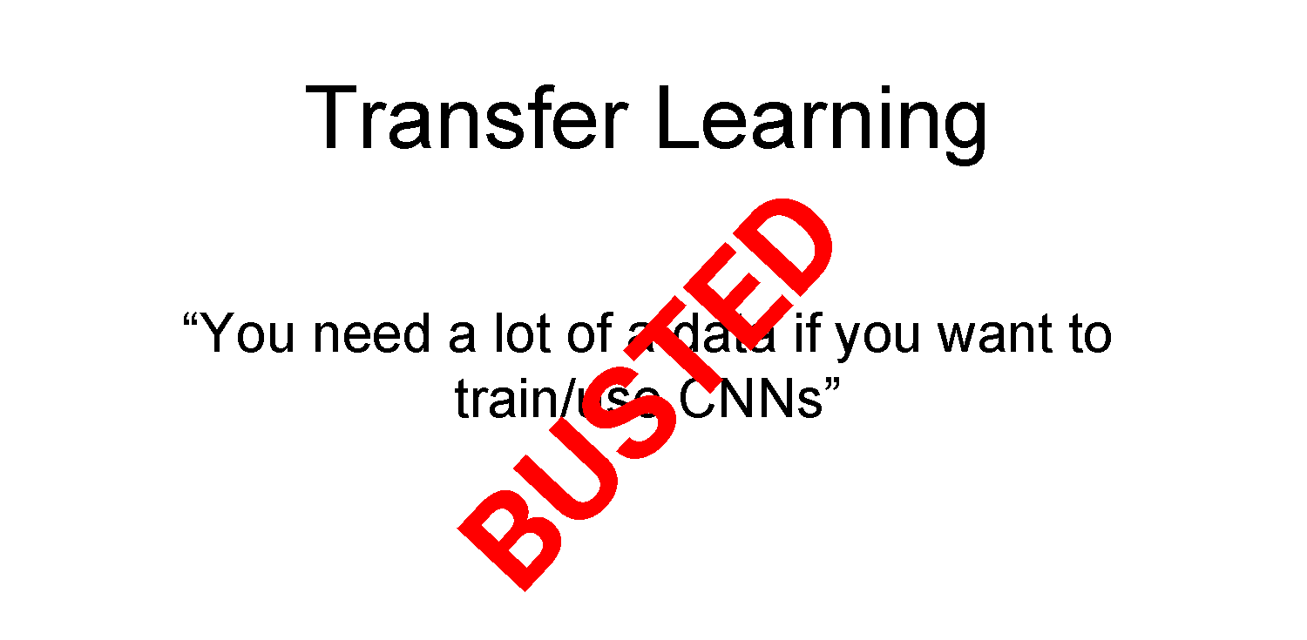

Slide 39
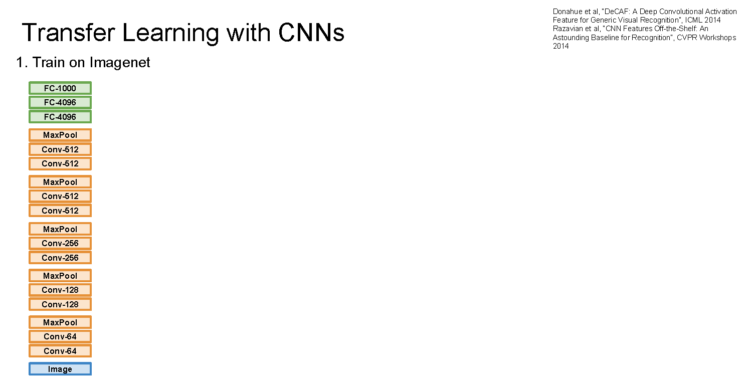

Slide 40
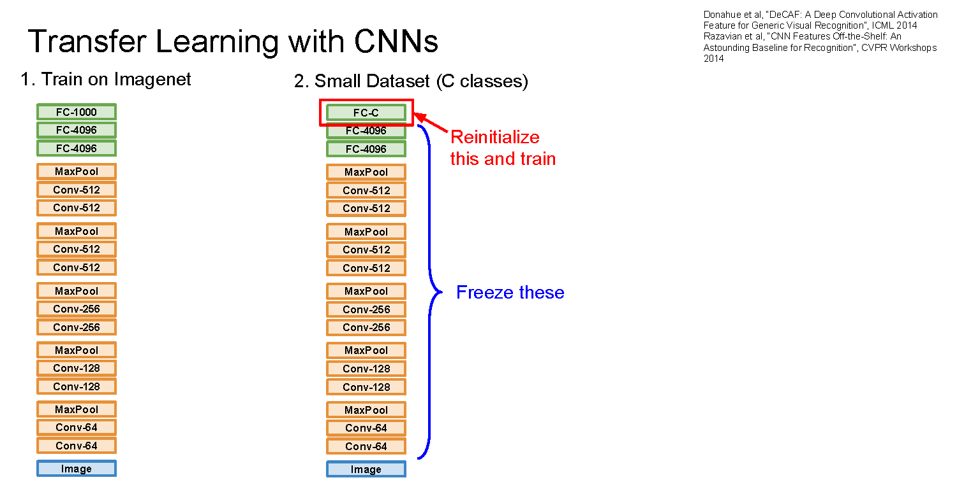

Slide 41
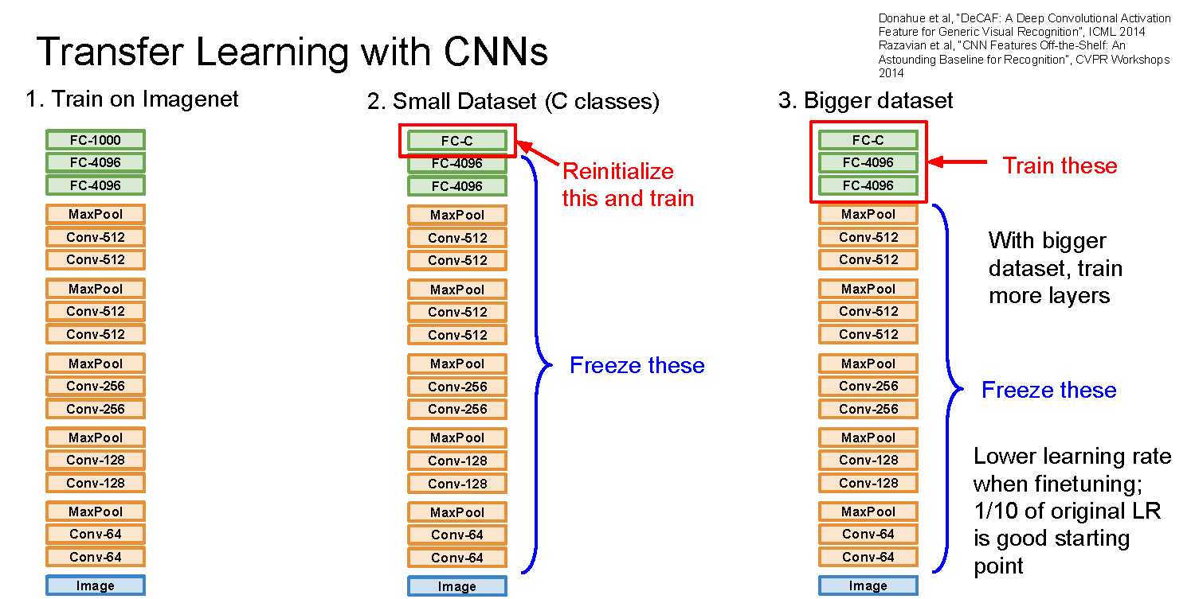

Slide 42
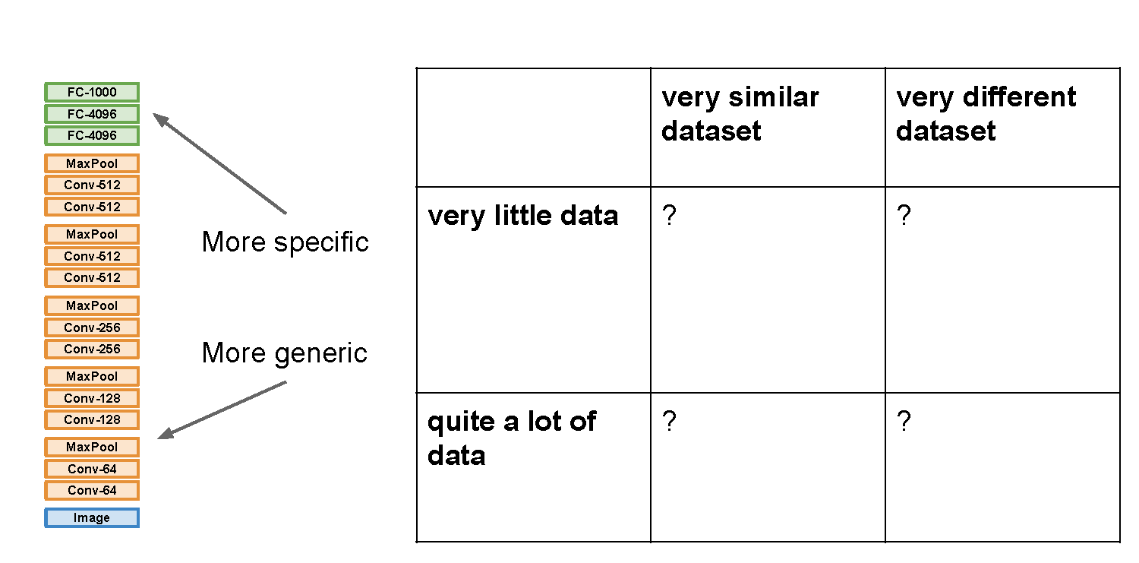

Slide 43
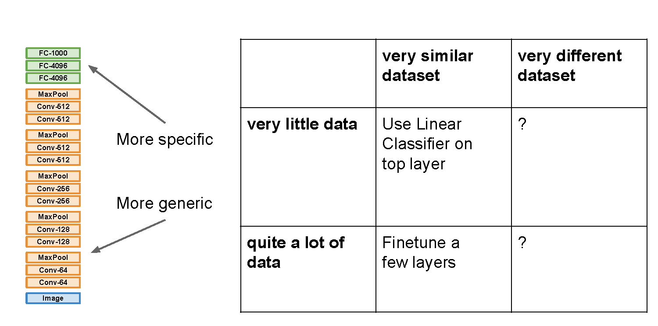

Slide 44
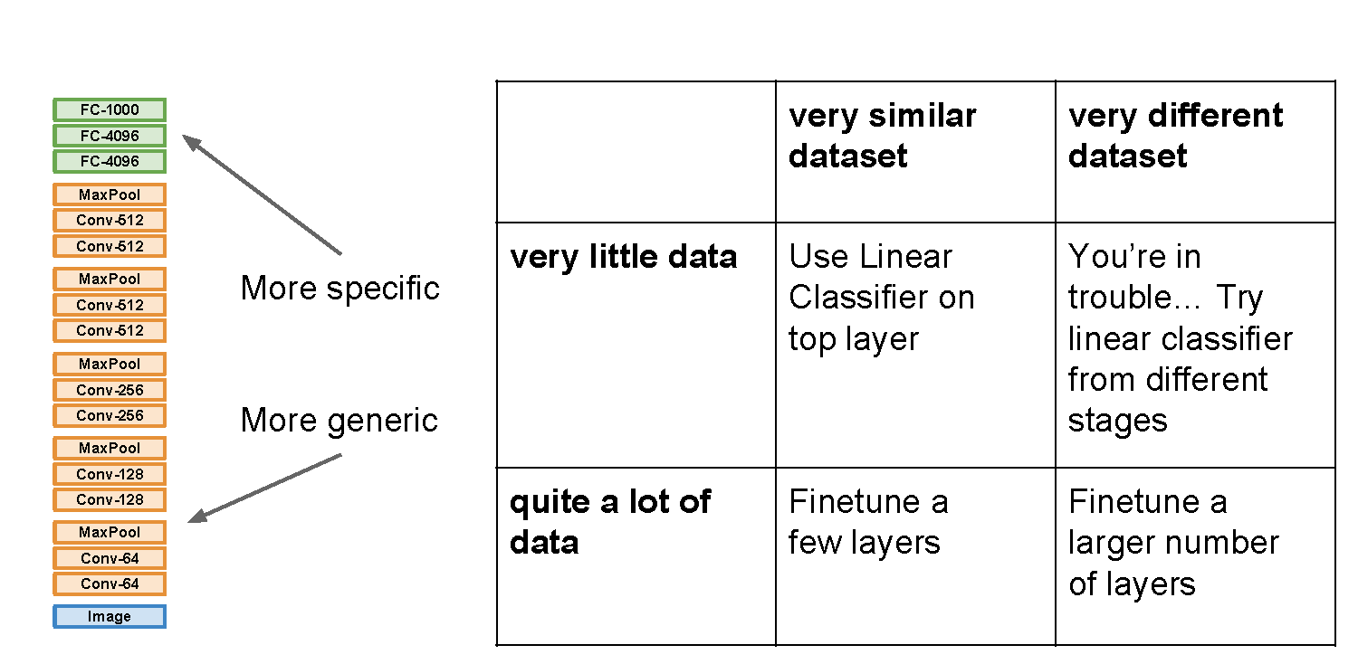

Slide 45
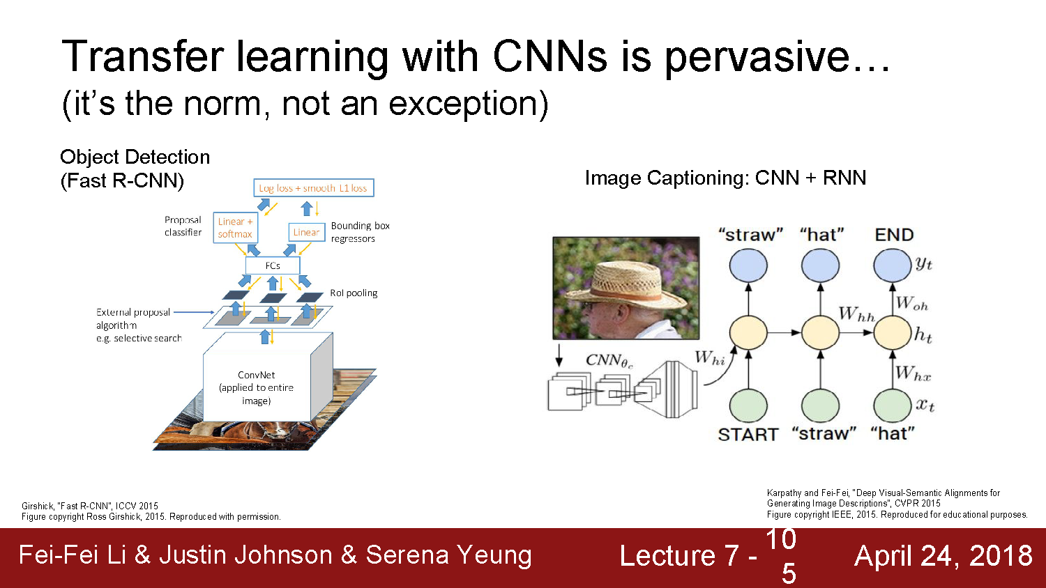

Slide 46
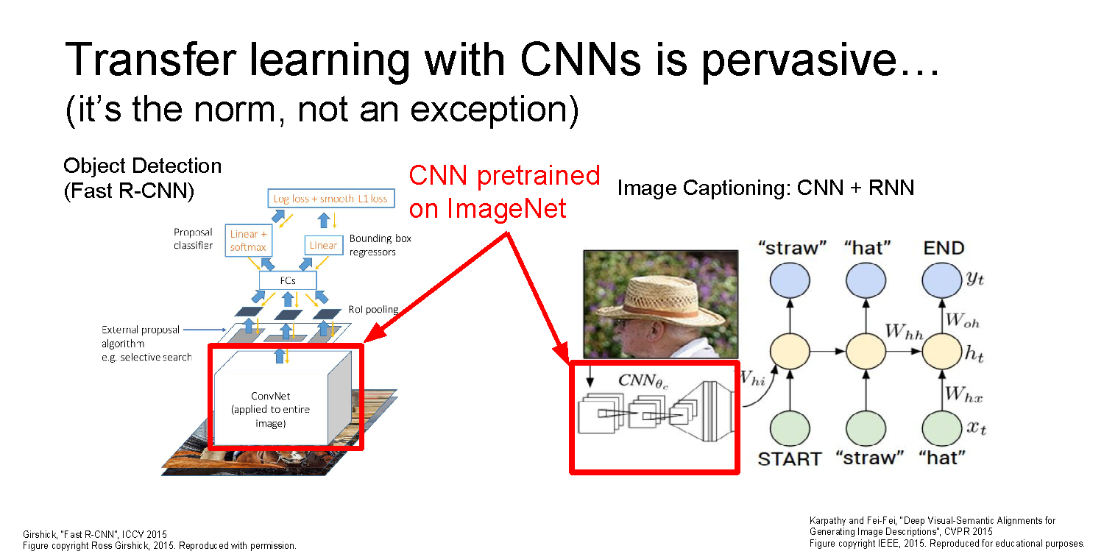

Slide 47
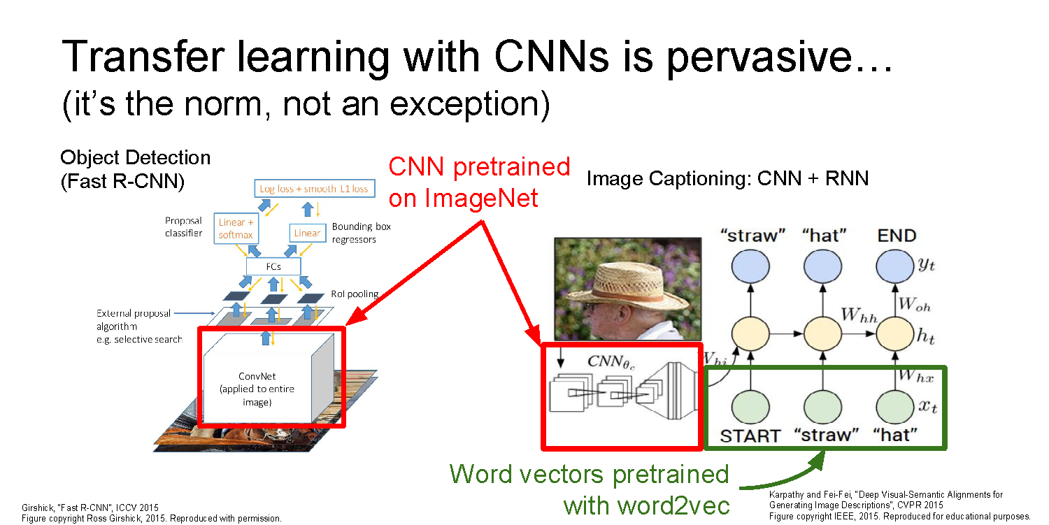

Slide 48
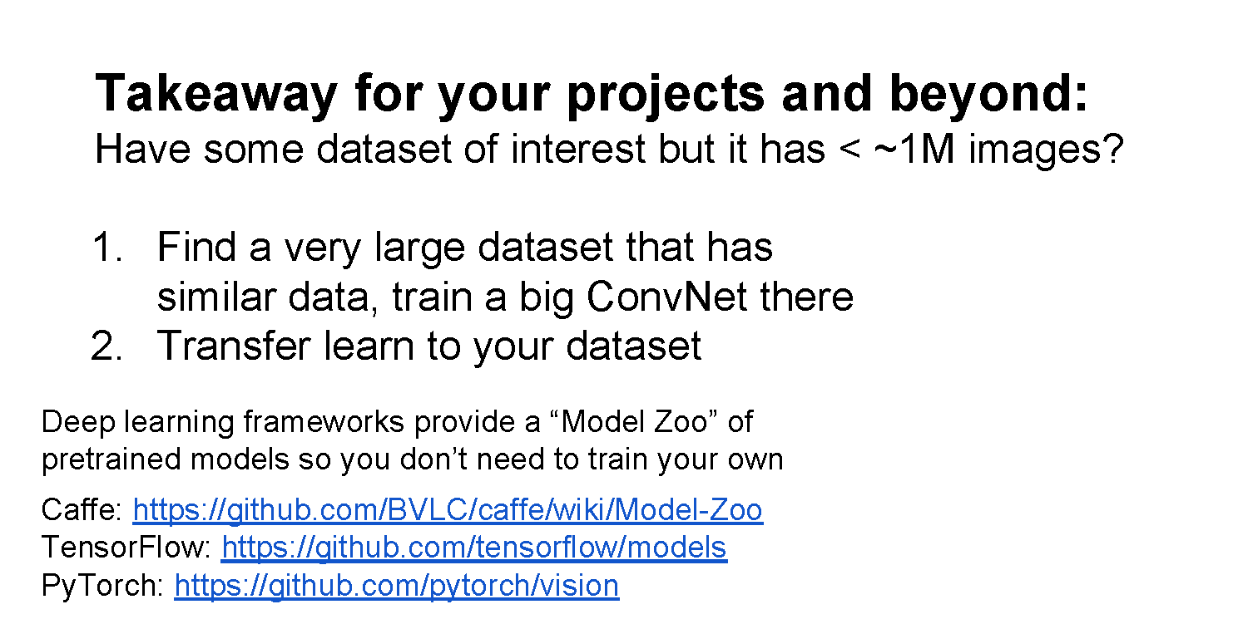
Common modern approach: start with a ResNet architecture pre-trained on ImageNet, and fine-tune on your (smaller) dataset

Slide 49
Questions?

