Slide 1
Convolutional neural networks
CS5670: Computer Vision
Slides from Fei-Fei Li, Justin Johnson, Serena Yeung
http://vision.stanford.edu/teaching/cs231n/

Slide 2
Announcements
Project 5 (NeRF): To be assigned Monday, April 25, due Wednesday, May 4
In-class final exam planned for the last day of class: Tuesday, May 10
Sample final exam to be released soon

Slide 3
Readings
Neural networks
http://cs231n.github.io/neural-networks-1/
http://cs231n.github.io/neural-networks-2/
http://cs231n.github.io/neural-networks-3/
http://cs231n.github.io/neural-networks-case-study/
Convolutional neural networks
http://cs231n.github.io/convolutional-networks/

Slide 4
Image Classification: a core task in computer vision
Assume given set of discrete labels, e.g.
{cat, dog, cow, apple, tomato, truck, … }

Slide 5
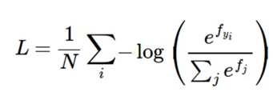
Recap: linear classification
Have score function and loss function
Score function maps an input data instance (e.g., an image) to a vector of scores, one for each category
Last time, our score function is based on linear classifier
Find W and b to minimize a loss, e.g. cross-entropy loss
f: score function
x: input instance
W, b: parameters of a linear (actually affine) function

Slide 6
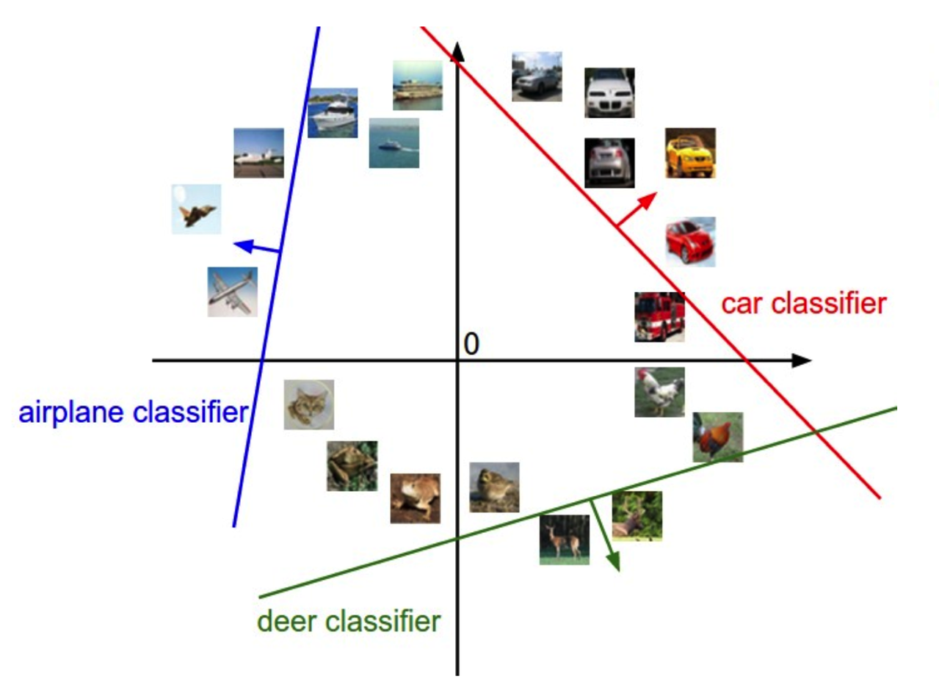
Linear classifiers separate features space into half-spaces

Slide 7
Neural networks

Slide 8
Neural networks

Slide 9
Neural networks
(10 x 100 matrix)
(100 x 3072 matrix)
100D intermediate vector

Slide 10
Neural networks
Total number of weights to learn:
3,072 x 100 + 100 x 10 = 308,200

Slide 11
Neural networks
also called “Multi-Layer Perceptrons” (MLPs)

Slide 12
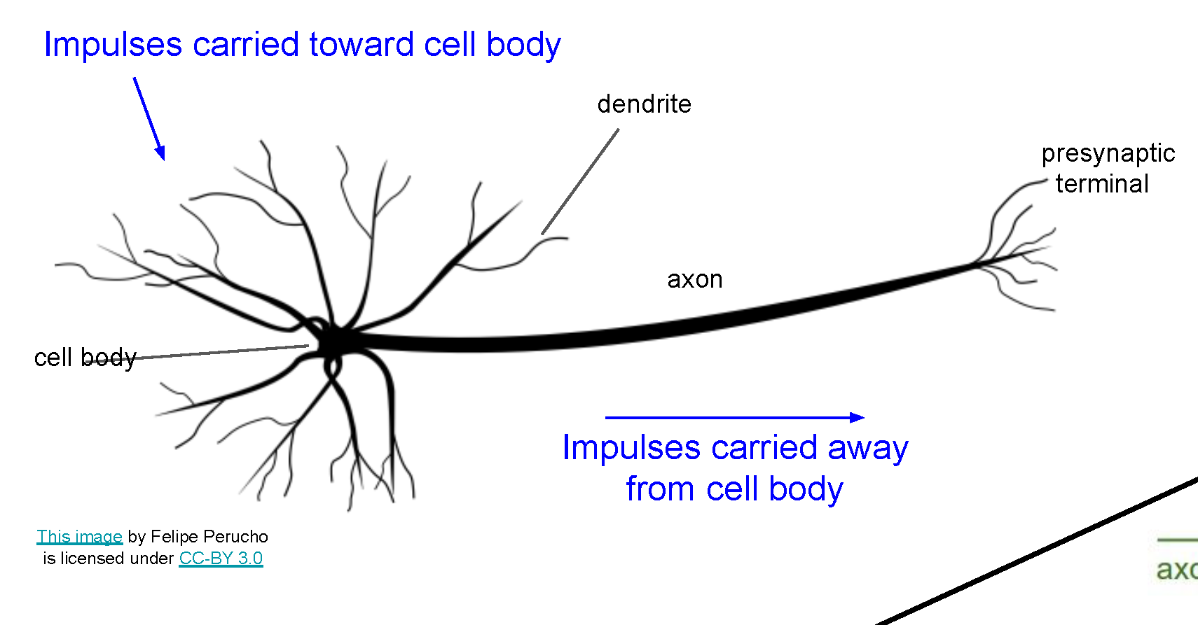
Neural networks
Very coarse generalization of neural networks:
Linear functions chained together and separated by non-linearities (activation functions), e.g. “max”
Why separate linear functions with non-linear functions?
Very roughly inspired by real neurons

Slide 14
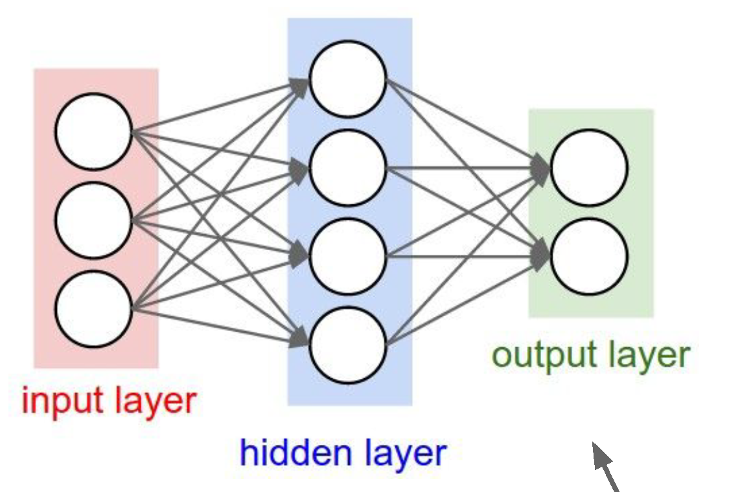
Neural network architecture
Computation graph for a 2-layer neural network
Neuron or unit

Slide 15
Deep networks typically have many layers and potentially millions of parameters

Slide 16
Deep neural network
Inception network (Szegedy et al, 2015)
22 layers

Slide 17
Just like a linear classifer – but in this case, just one layer of a larger network

Slide 20
Optimizing parameters with gradient descent
How do we find the best W and b parameters?
In general: gradient descent
Start with a guess of a good W and b (or randomly initialize them)
Compute the loss function for this initial guess and the gradient of the loss function
Step some distance in the negative gradient direction (direction of steepest descent)
Repeat steps 2 & 3
Note: efficiently performing step 2 for deep networks is called backpropagation

Slide 21
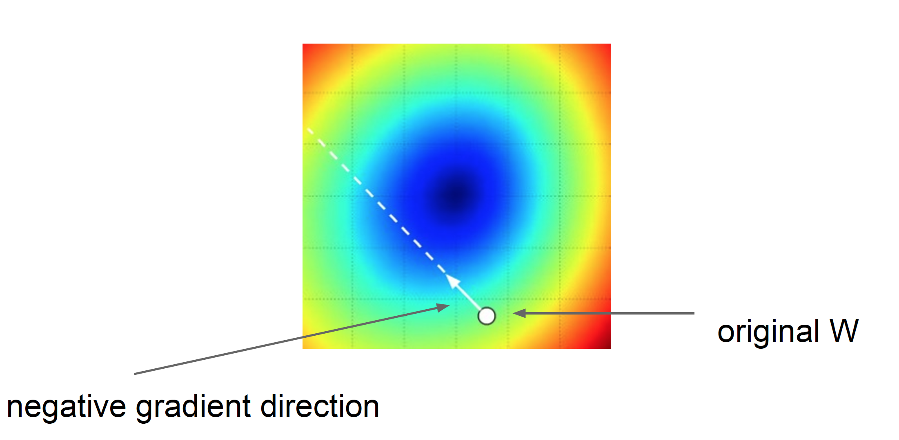
Gradient descent: walk in the direction opposite gradient
Q: How far?
A: Step size: learning rate
Too big: will miss the minimum
Too small: slow convergence

Slide 22
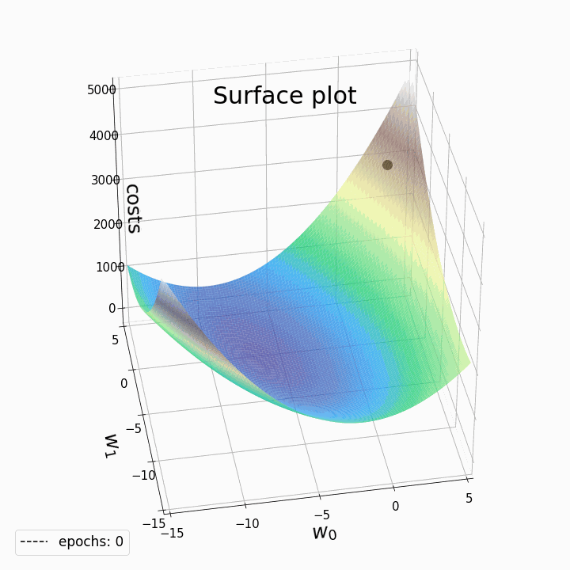
2D example of gradient descent
In reality, in deep learning we are optimizing a highly complex loss function with millions of variables (or more)
More on this later…
https://laptrinhx.com/gradient-descent-animation-2-multiple-linear-regression-3070246823/

Slide 23
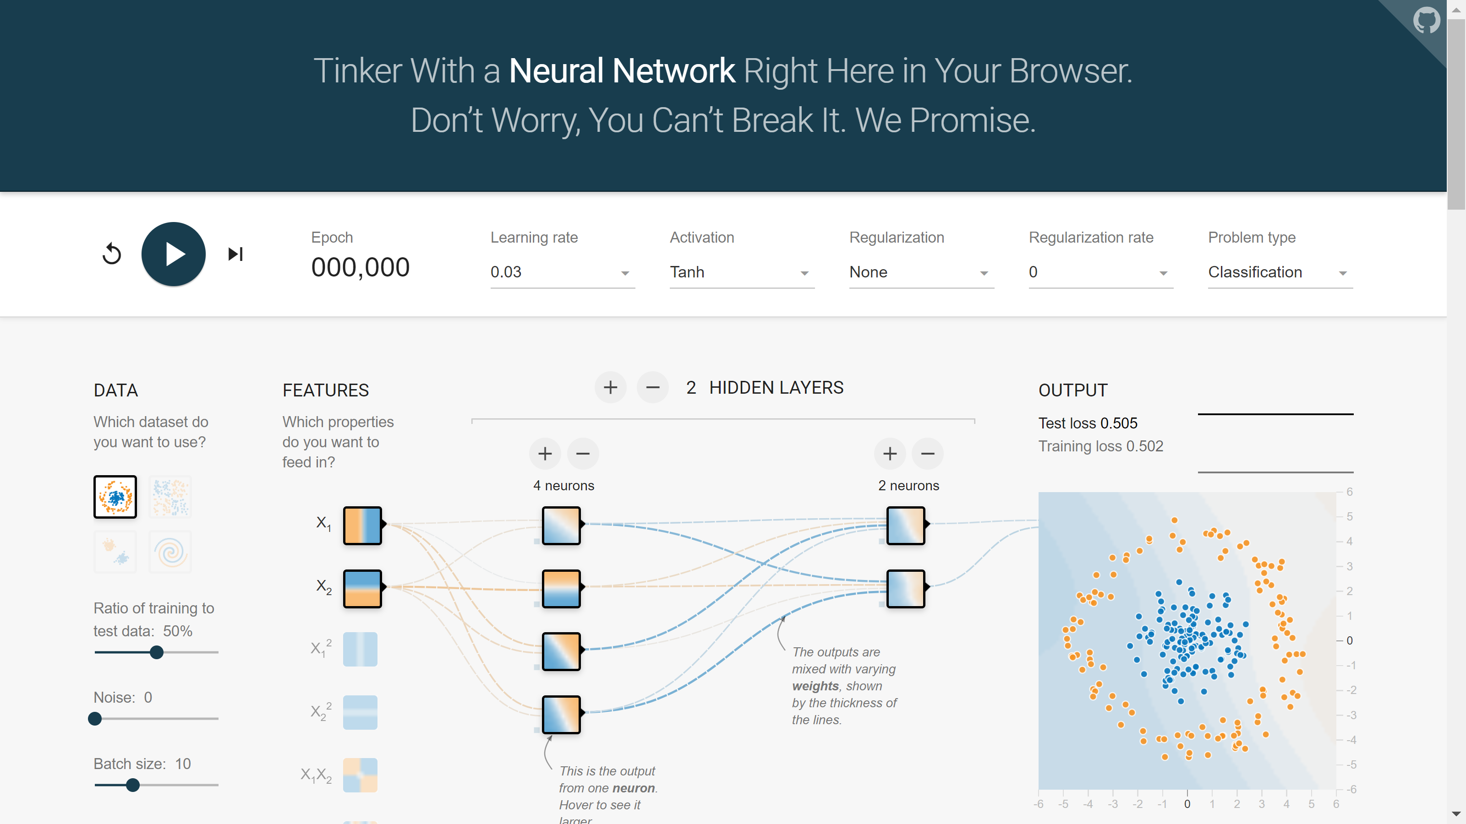
2D example: TensorFlow Playground
https://playground.tensorflow.org

Slide 24
Questions?

Slide 25
Convolutional neural networks

Slide 28
Hinton and Salakhutdinov. Reducing the Dimensionality of Data with Neural Networks. Science, 2016.

Slide 34
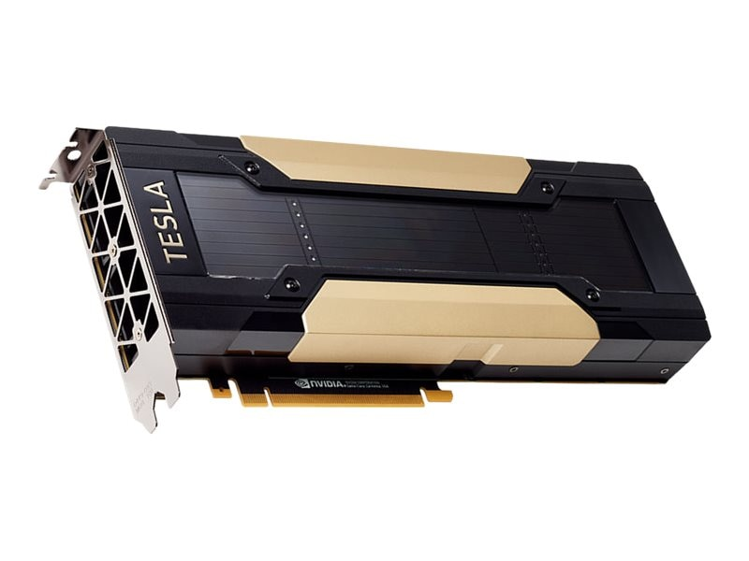
Fast-forward to today: ConvNets are everywhere
NVIDIA Tesla V100 GPU
Self-driving cars (video courtesy Tesla)
https://www.tesla.com/AI
https://cloud.google.com/tpu/

Slide 38
Caption-to-image
DALL·E: Creating Images from Text, OpenAI
https://openai.com/blog/dall-e/

Slide 39
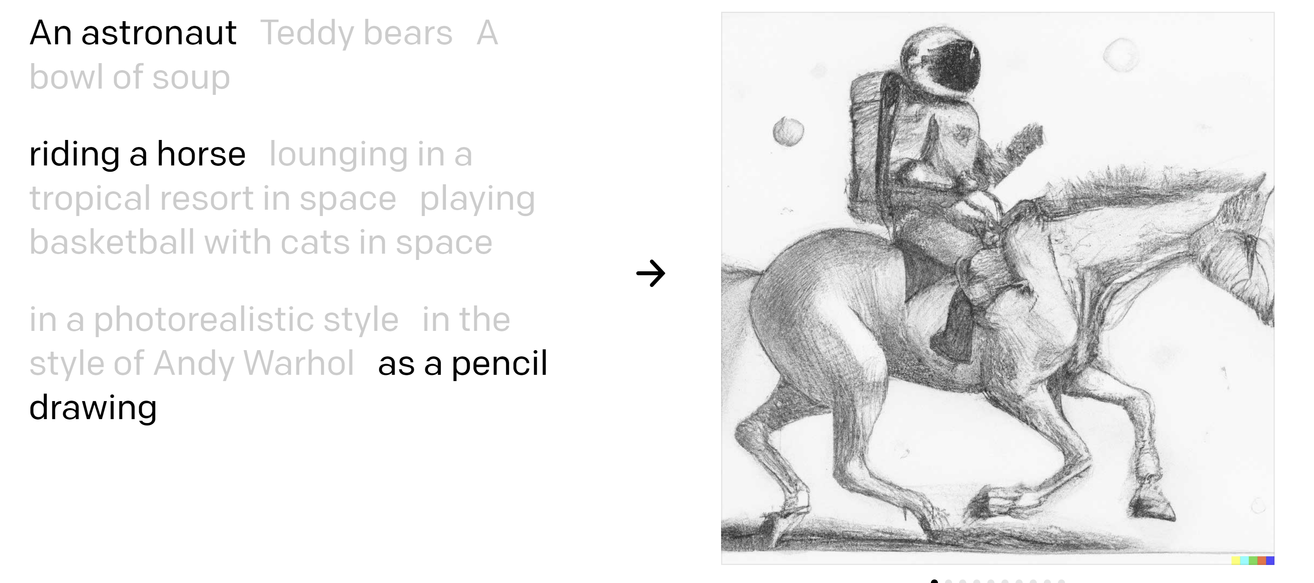
Caption-to-image
https://openai.com/dall-e-2/

Slide 41
Convolutional neural networks
Version of deep neural networks designed for signals
1D signals (e.g., speech waveforms)
2D signals (e.g., images)

Slide 42
Motivation – Feature Learning

Slide 43
Life Before Deep Learning
SVM
Ans
Input Pixels
Extract Hand-Crafted Features
Concatenate into a vector x
Linear Classifier
Figure: Karpathy 2016

Slide 44
Why use features? Why not pixels?
Q: What would be a
very hard set of classes for a linear classifier to distinguish?
(assuming x = pixels)
Slide from Karpathy 2016

Slide 45
Linearly separable classes

Slide 53
Last layer of most CNNs is a linear classifier
This piece is just a linear classifier
Ans
(GoogLeNet)
Input Pixels
Perform everything with a big neural network, trained end-to-end
Key: perform enough processing so that by the time you get to the end of the network, the classes are linearly separable

Slide 54
Visualizing AlexNet in 2D with t-SNE
Linear Classifier
(2D visualization using t-SNE)
[Donahue, “DeCAF: DeCAF: A Deep Convolutional …”, arXiv 2013]

Slide 55
Convolutional neural networks
Layer types:
Fully-connected layer
Convolutional layer
Pooling layer

Slide 57
Same as a linear classifer!

Slide 61
Number of weights: 5 x 5 x 3 + 1 = 76
(vs. 3072 for a fully-connected layer)
(+1 for bias)

Slide 65
(total number of parameters: 6 x (75 + 1) = 456)

Slide 68
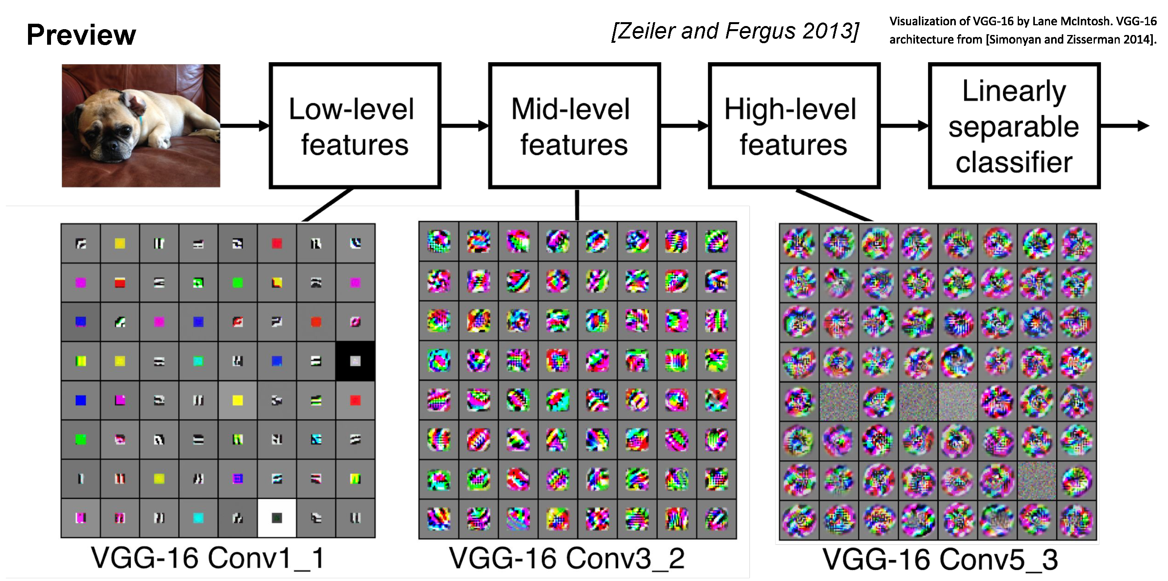

Slide 91
Convolutional layer—properties
Small number of parameters to learn compared to a fully connected layer
Preserves spatial structure—output of a convolutional layer is shaped like an image
Translation equivariant: passing a translated image through a convolutional layer is (almost) equivalent to translating the convolution output (but be careful of image boundaries)

Slide 95
https://cs.stanford.edu/people/karpathy/convnetjs/demo/cifar10.html

Slide 96
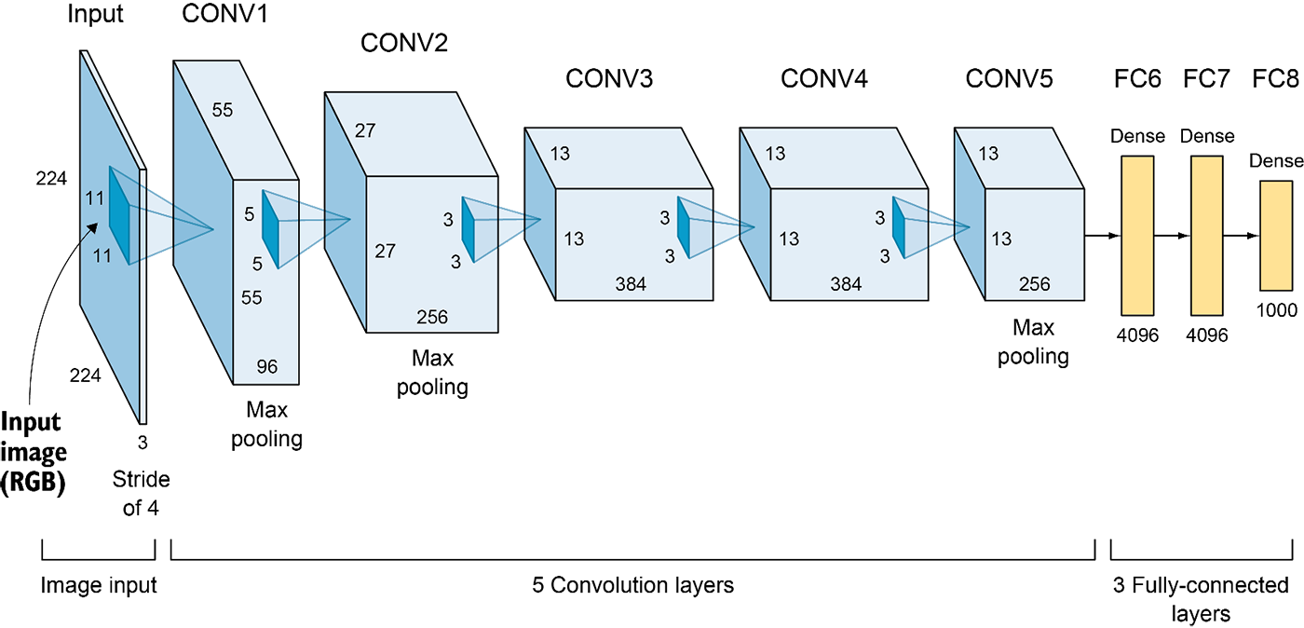
AlexNet (2012)
6M parameters in total
Output: 1,000-D vector (probabilities over 1,000 ImageNet categories)
Elgendy, Deep Learning for Vision Systems, https://livebook.manning.com/book/grokking-deep-learning-for-computer-vision/chapter-5/v-3/

Slide 97
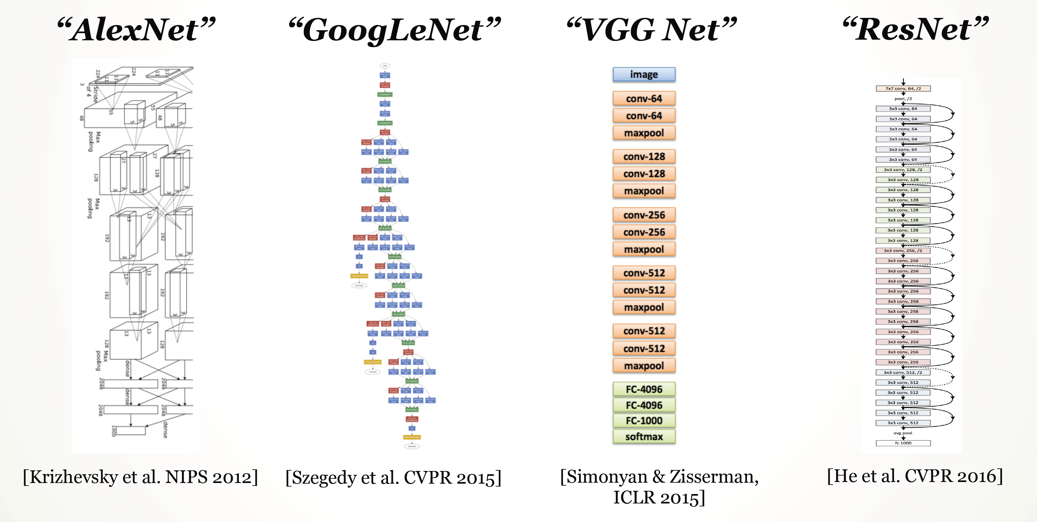

Slide 98
Big picture
A convolutional neural network can be thought of as a function from images to class scores
With millions of adjustable weights…
… leading to a very non-linear mapping from images to features / class scores.
We will set these weights based on classification accuracy on training data…
… and hopefully our network will generalize to new images at test time

Slide 99
Data is key—enter ImageNet
ImageNet (and the ImageNet Large-Scale Visual Recognition Challege, aka ILSVRC) has been key to training deep learning methods
J. Deng, W. Dong, R. Socher, L.-J. Li, K. Li and L. Fei-Fei, ImageNet: A Large-Scale Hierarchical Image Database. CVPR, 2009.
ILSVRC: 1,000 object categories, each with ~700-1300 training images. Test set has 100 images per categories (100,000 total).
Standard ILSVRC error metric: top-5 error
if the correct answer for a given test image is in the top 5 categories, your answer is judged to be correct

Slide 100
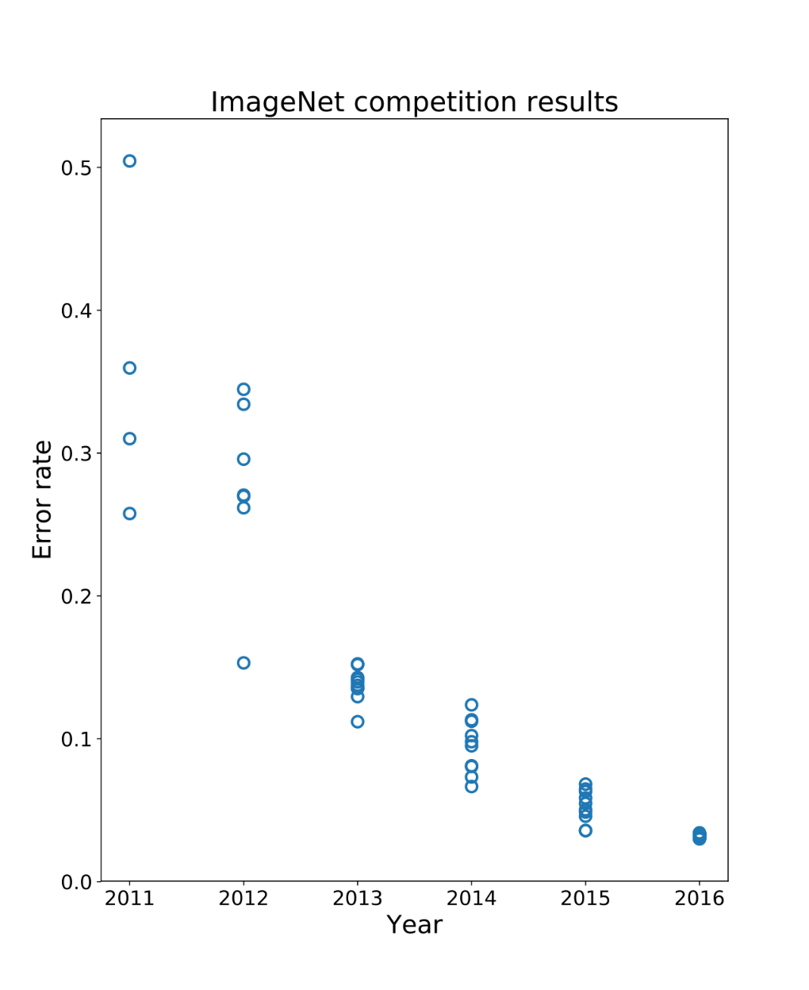
Performance improvements on ILSVRC
ImageNet Large-Scale Visual Recognition Challenge
Held from 2011-2017
1000 categories, 1000 training images per category
Test performance on held-out test set of images
Pre-deep learning era
{
Deep learning era
AlexNet

Slide 101
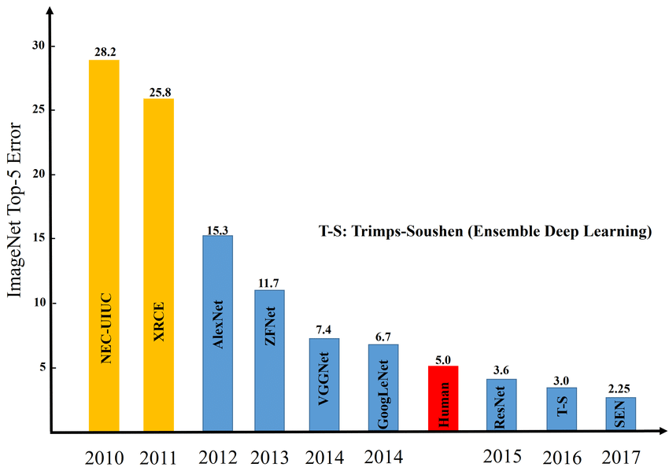
Image credit: Zaid Alyafeai, Lahouari Ghouti

Slide 102
Questions?

