Slide 1

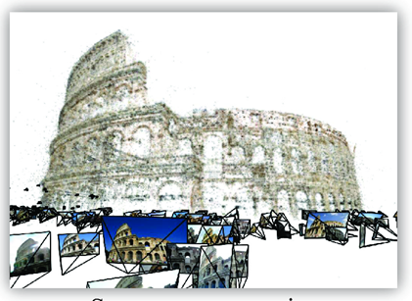
Structure from motion
CS5670: Computer Vision

Slide 2
Readings
Szeliski (2nd Edition), Chapter 11

Slide 3
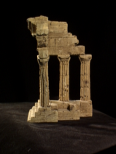
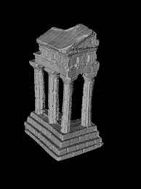
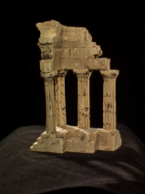
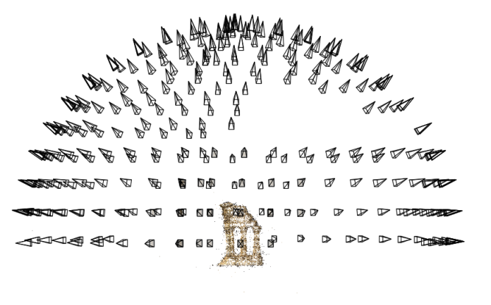
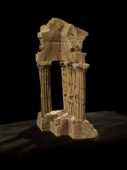
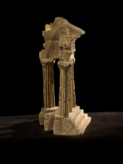
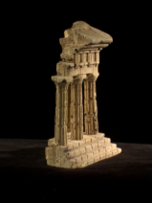
Reminder: multi-view stereo
Problem formulation: given several images of the same object or scene, compute a representation of its 3D shape

Slide 4
Structure from motion
Multi-view stereo assumes that cameras are calibrated
  Extrinsics and intrinsics are known for all views
How do we compute calibration if we don’t know it? In general, this is called structure from motion

Slide 5
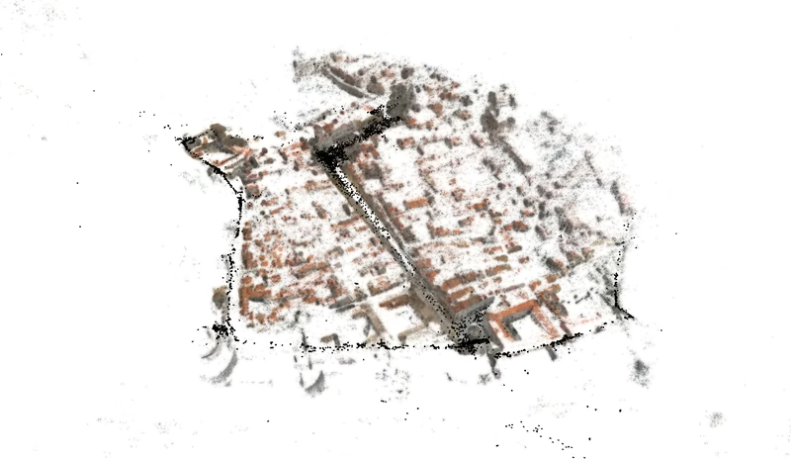
Large-scale structure from motion
Dubrovnik, Croatia. 4,619 images (out of an initial 57,845).
Total reconstruction time: 23 hours
Number of cores: 352

Slide 6


Two views
Solve for Fundamental matrix / Essential matrix
Factorize into intrinsics, rotation, and translation

Slide 7
What about more than two views?
The geometry of three views is described by a 3 x 3 x 3 tensor called the trifocal tensor
The geometry of four views is described by a 3 x 3 x 3 x 3 tensor called the quadrifocal tensor
After this it starts to get complicated…
  Instead, we explicitly solve for camera poses and scene geometry

Slide 8
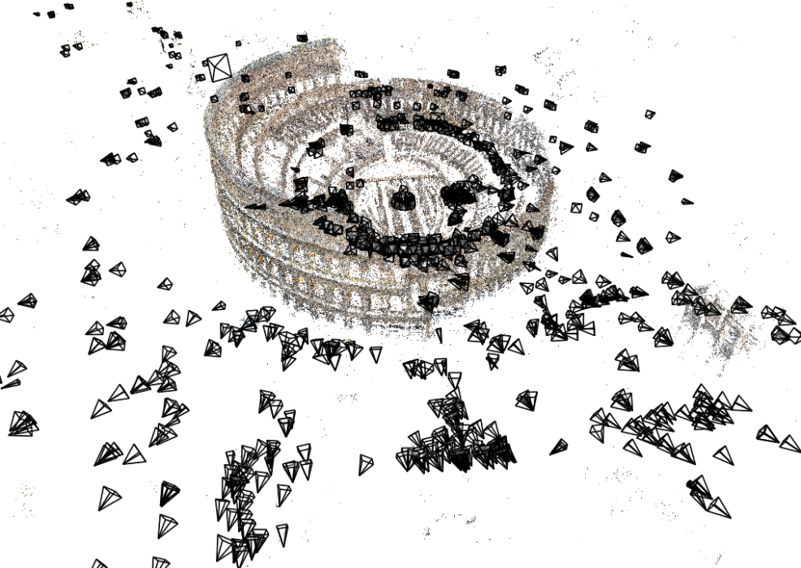
Structure from motion
Given many images, how can we
  a) figure out where they were all taken from?
  b) build a 3D model of the scene?
  This is the structure from motion (SfM) problem

Slide 9
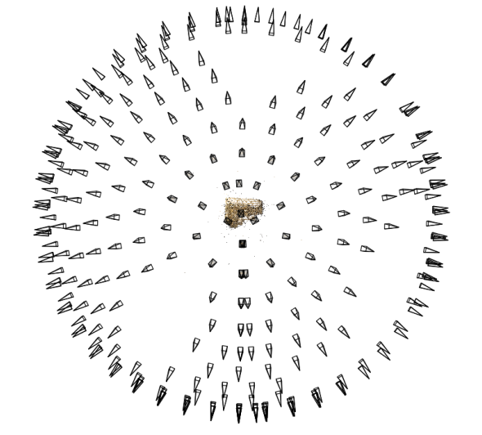
Structure from motion
Reconstruction (side)
(top)
Input: images with 2D points in correspondence p_{i,j} = (u_{i,j},v_{i,j})
Output
  structure: 3D location x_{i} for each point p_{i}
  motion: camera parameters R_{j} , t_{j} & possibly K_{j}
Objective function: minimize reprojection error

Slide 10
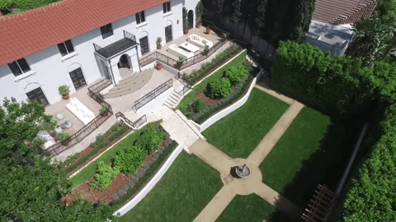
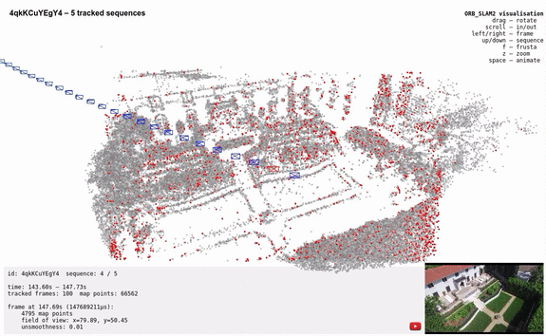
Can also compute camera poses from video (often called Visual SLAM)

Slide 11
What we’ve seen so far…
2D transformations between images
  Translations, affine transformations, homographies…
Fundamental matrices
  Represent relationships between 2D images in the form of corresponding 2D lines
What’s new: Explicitly representing 3D geometry of cameras and points

Slide 12
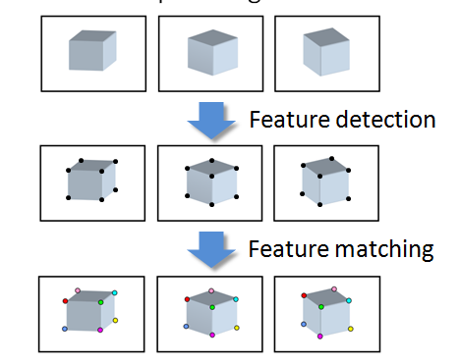
Input

Slide 13
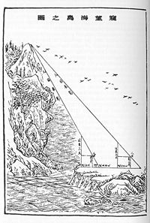
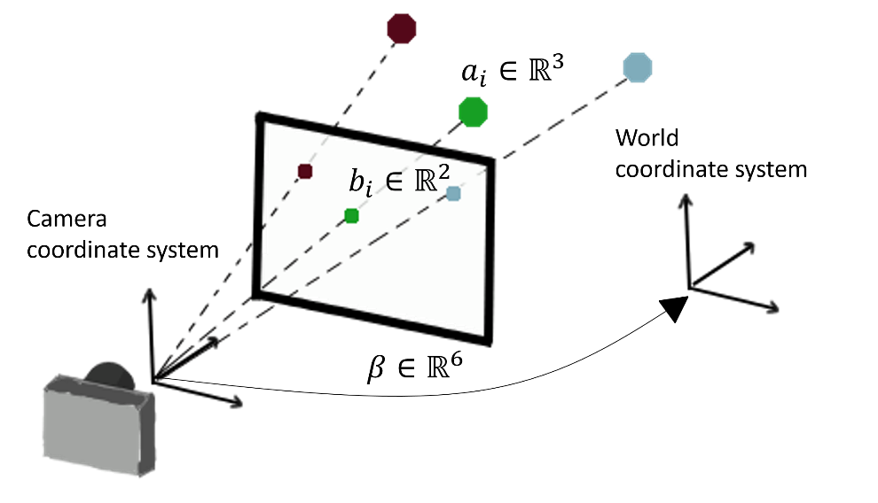
Triangulation & camera calibration
Suppose we have known camera parameters, each of which observes a point
  How can we compute the 3D location of that point?
  This is called triangulation (known since ancient times)
On the other hand: Suppose we have known 3D points
  And have matches between these points and an image
  How can we compute the camera parameters?
  This is called camera calibration (or camera resectioning)
Liu Hui (c. 263), How to measure the height of a sea island.
https://arxiv.org/abs/2003.04626

Slide 14
Structure from motion
What if we don’t know 3D points or camera parameters?
SfM solves both of these problems at once
A kind of chicken-and-egg problem
  (but solvable)

Slide 15
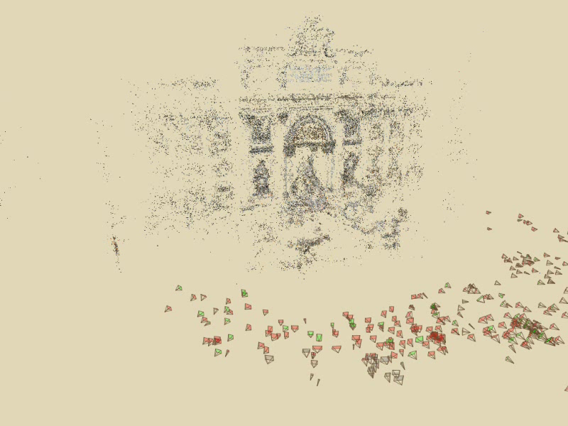
Photo Tourism
Notes:
Here’s how the same set of photos appear in our photo explorer. Our system takes the set of photos and automatically determines the relative positions and orientations from which each photo was taken. We can then load the photos into our immersive 3D browser where the user can visualize and explore the photos using spatial relationships.

Slide 16
First step: how to get correspondence?
Feature detection and matching

Slide 17
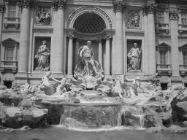
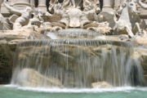
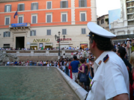
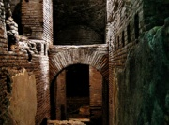

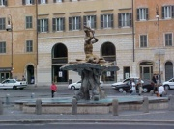
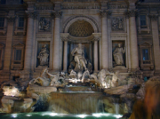
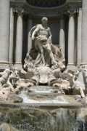

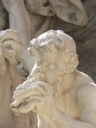
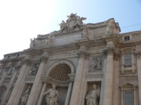
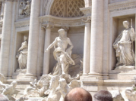


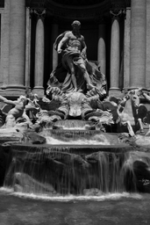

Feature detection
Detect features using SIFT [Lowe, IJCV 2004]
Notes:
So, we begin by detecting SIFT features in each photo.
[We detect SIFT features in each photo, resulting in a set of feature locations and 128-byte feature descriptors…]

Slide 18





Feature detection
Detect features using SIFT [Lowe, IJCV 2004]

Slide 19




Feature matching
Match features between each pair of images
Notes:
Next, we match features across each pair of photos using approximate nearest neighbor matching.

Slide 20


Feature matching
Refine matching using RANSAC to estimate fundamental matrix between each pair
Notes:
The matches are refined by using RANSAC, which is a robust model-fitting technique, to estimate a fundamental matrix between each pair of matching images and keeping only matches consistent with that fundamental matrix.
We then link connected components of pairwise feature matches together to form correspondences across multiple images.
Once we have correspondences, we run structure from motion to recover the camera and scene geometry. Structure from motion solves the following problem:

Slide 21
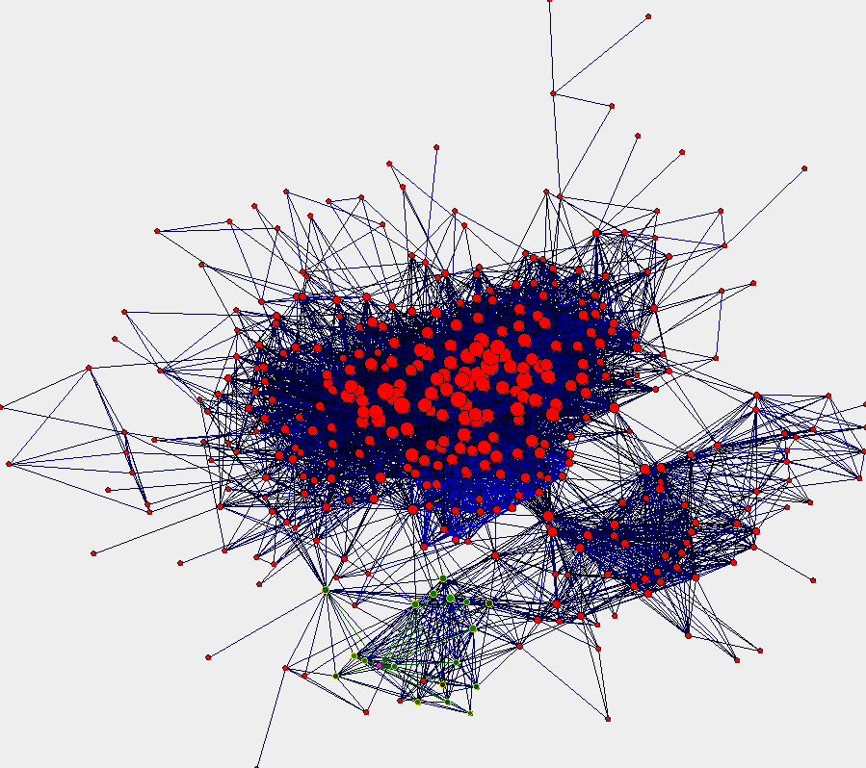
Image connectivity graph
(graph layout produced using the Graphviz toolkit: http://www.graphviz.org/)

Slide 22
Demo

Slide 23
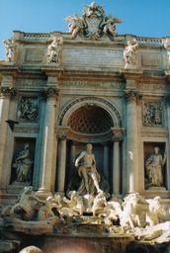
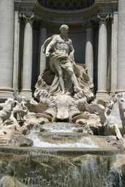
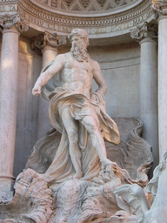
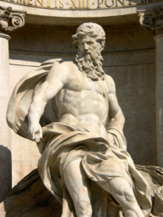
Correspondence estimation
Link up pairwise matches to form connected components of matches across several images
Image 1
Image 2
Image 3
Image 4
Notes:
The next step of our reconstruction algorithm is to link up matches between pairs of images into correspondences between multiple images, by finding connected components of matches. Suppose among these images, these features are matched only between consecutive pairs of images, perhaps because the scales of the images are so different. During correspondence estimation we link these matches and consider them to be 2D projections of a single 3D point in the scene.

Slide 24
Input to Structure from Motion

Slide 25
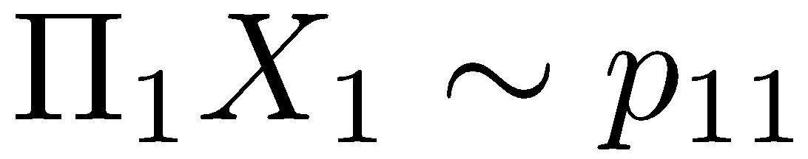
Structure from motion
X₄
X₁
X₃
minimize
X₂
g(R, T, X)
X₅
non-linear least squares
X₇
X₆
p_{1,1}
p_{1,3}
p_{1,2}
Camera 1
Camera 3
R₁,t₁
R₃,t₃
Camera 2
R₂,t₂
Notes:
Structure from motion solves the following problem:
Given a set of images of a static scene with 2D points in correspondence, shown here as color-coded points, find…
a set of 3D points P and
a rotation R and position t of the cameras that explain the observed correspondences. In other words, when we project a point into any of the cameras, the reprojection error between the projected and observed 2D points is low.
This problem can be formulated as an optimization problem where we want to find the rotations R, positions t, and 3D point locations P that minimize sum of squared reprojection errors f. This is a non-linear least squares problem and can be solved with algorithms such as Levenberg-Marquart. However, because the problem is non-linear, it can be susceptible to local minima. Therefore, it’s important to initialize the parameters of the system carefully. In addition, we need to be able to deal with erroneous correspondences.

Slide 26
Problem size
What are the variables?
  Cameras and points
How many variables per camera?
  6 (if calibrated), more if uncalibrated
How many variables per point?
  3
Trevi Fountain collection
  466 input photos
  + > 100,000 3D points
  = very large optimization problem

Slide 27
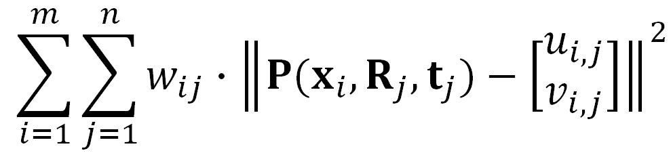

Structure from motion
Minimize sum of squared reprojection errors:
Minimizing this function is called bundle adjustment
  Optimized using non-linear least squares, e.g. Levenberg-Marquardt algorithm
predicted
image location
observed
image location
indicator variable:
is point i visible in image j ?

Slide 28
Is SfM always uniquely solvable?

Slide 29
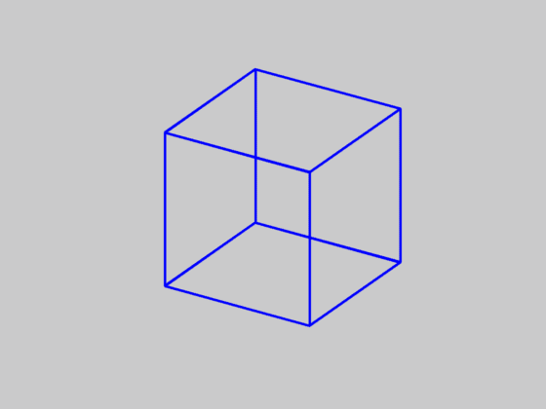
Is SfM always uniquely solvable?
No…

Slide 30





Incremental structure from motion
Notes:
To help get good initializations for all of the parameters of the system, we reconstruct the scene incrementally, starting from two photographs and the points they observe.

Slide 31
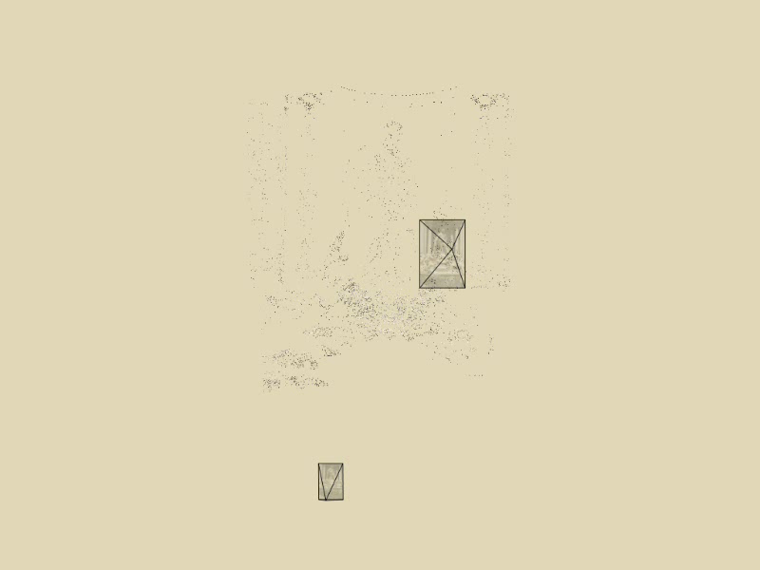
Incremental structure from motion
Notes:
To help get good initializations for all of the parameters of the system, we reconstruct the scene incrementally, starting from two photographs and the points they observe.

Slide 32
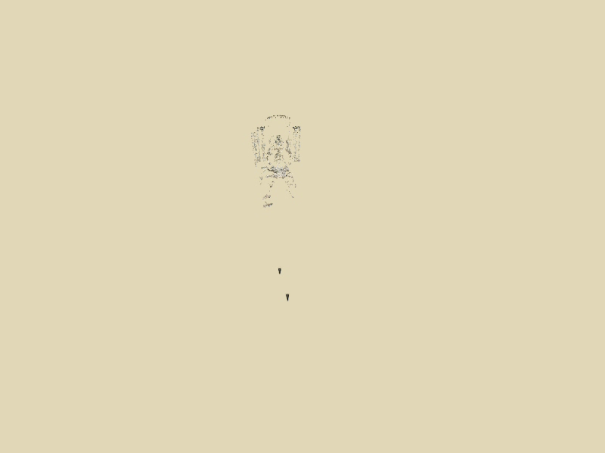
Incremental structure from motion
Notes:
We then add several photos at a time to the reconstruction, refine the model, and repeat until no more photos match any points in the scene.

Slide 33

Incremental structure from motion
Time-lapse reconstruction of Dubrovnik, Croatia, viewed from above

Slide 34
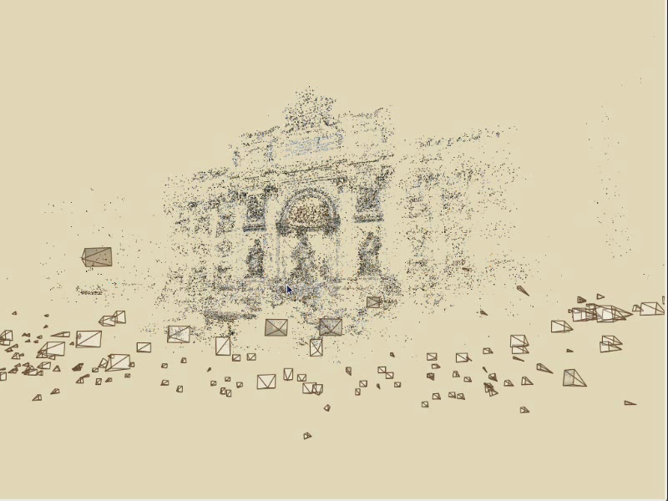
Photo Tourism

Slide 35
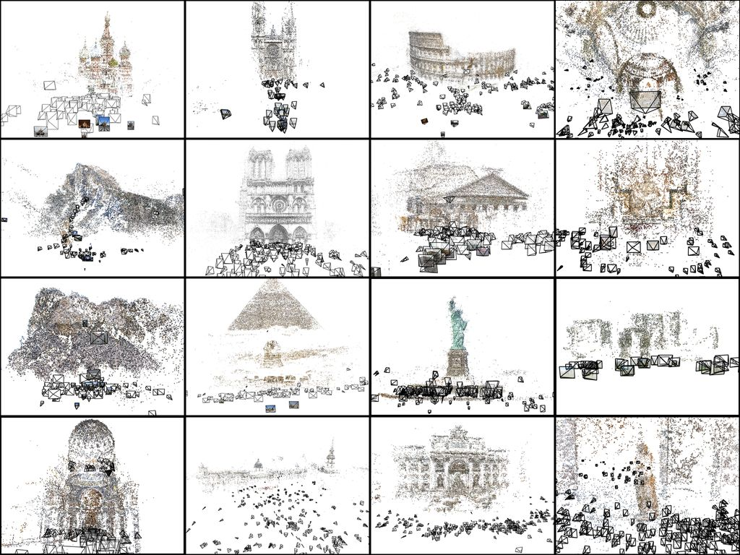

Slide 36
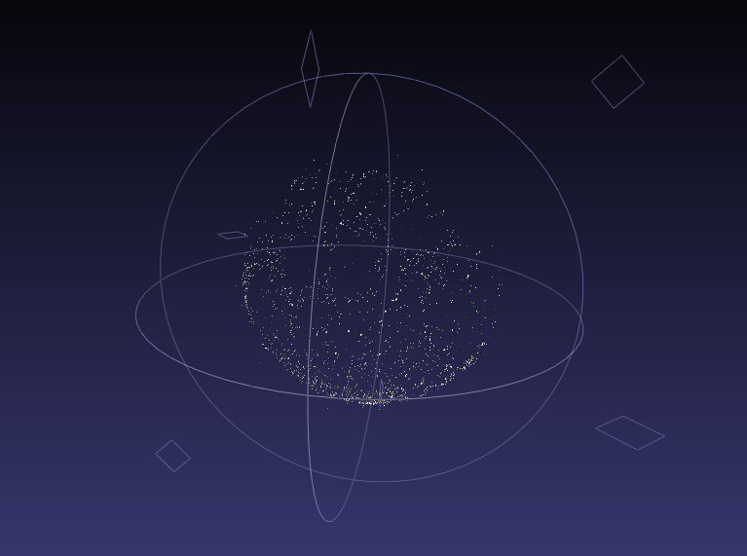

Slide 37
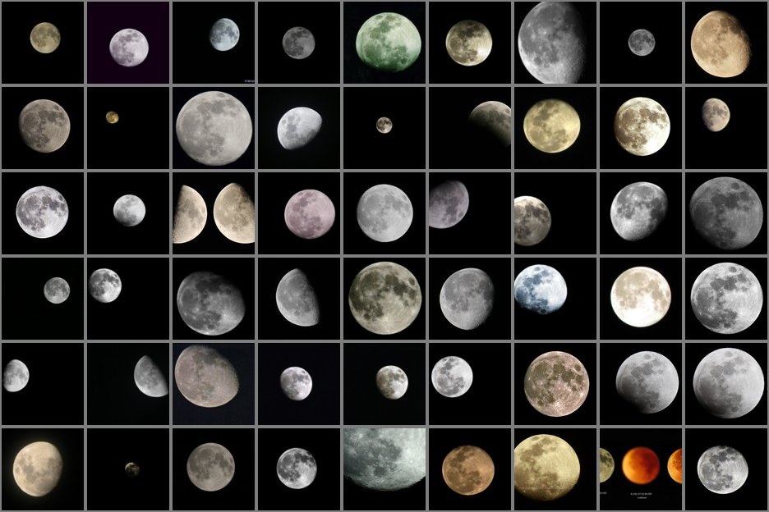

Slide 38
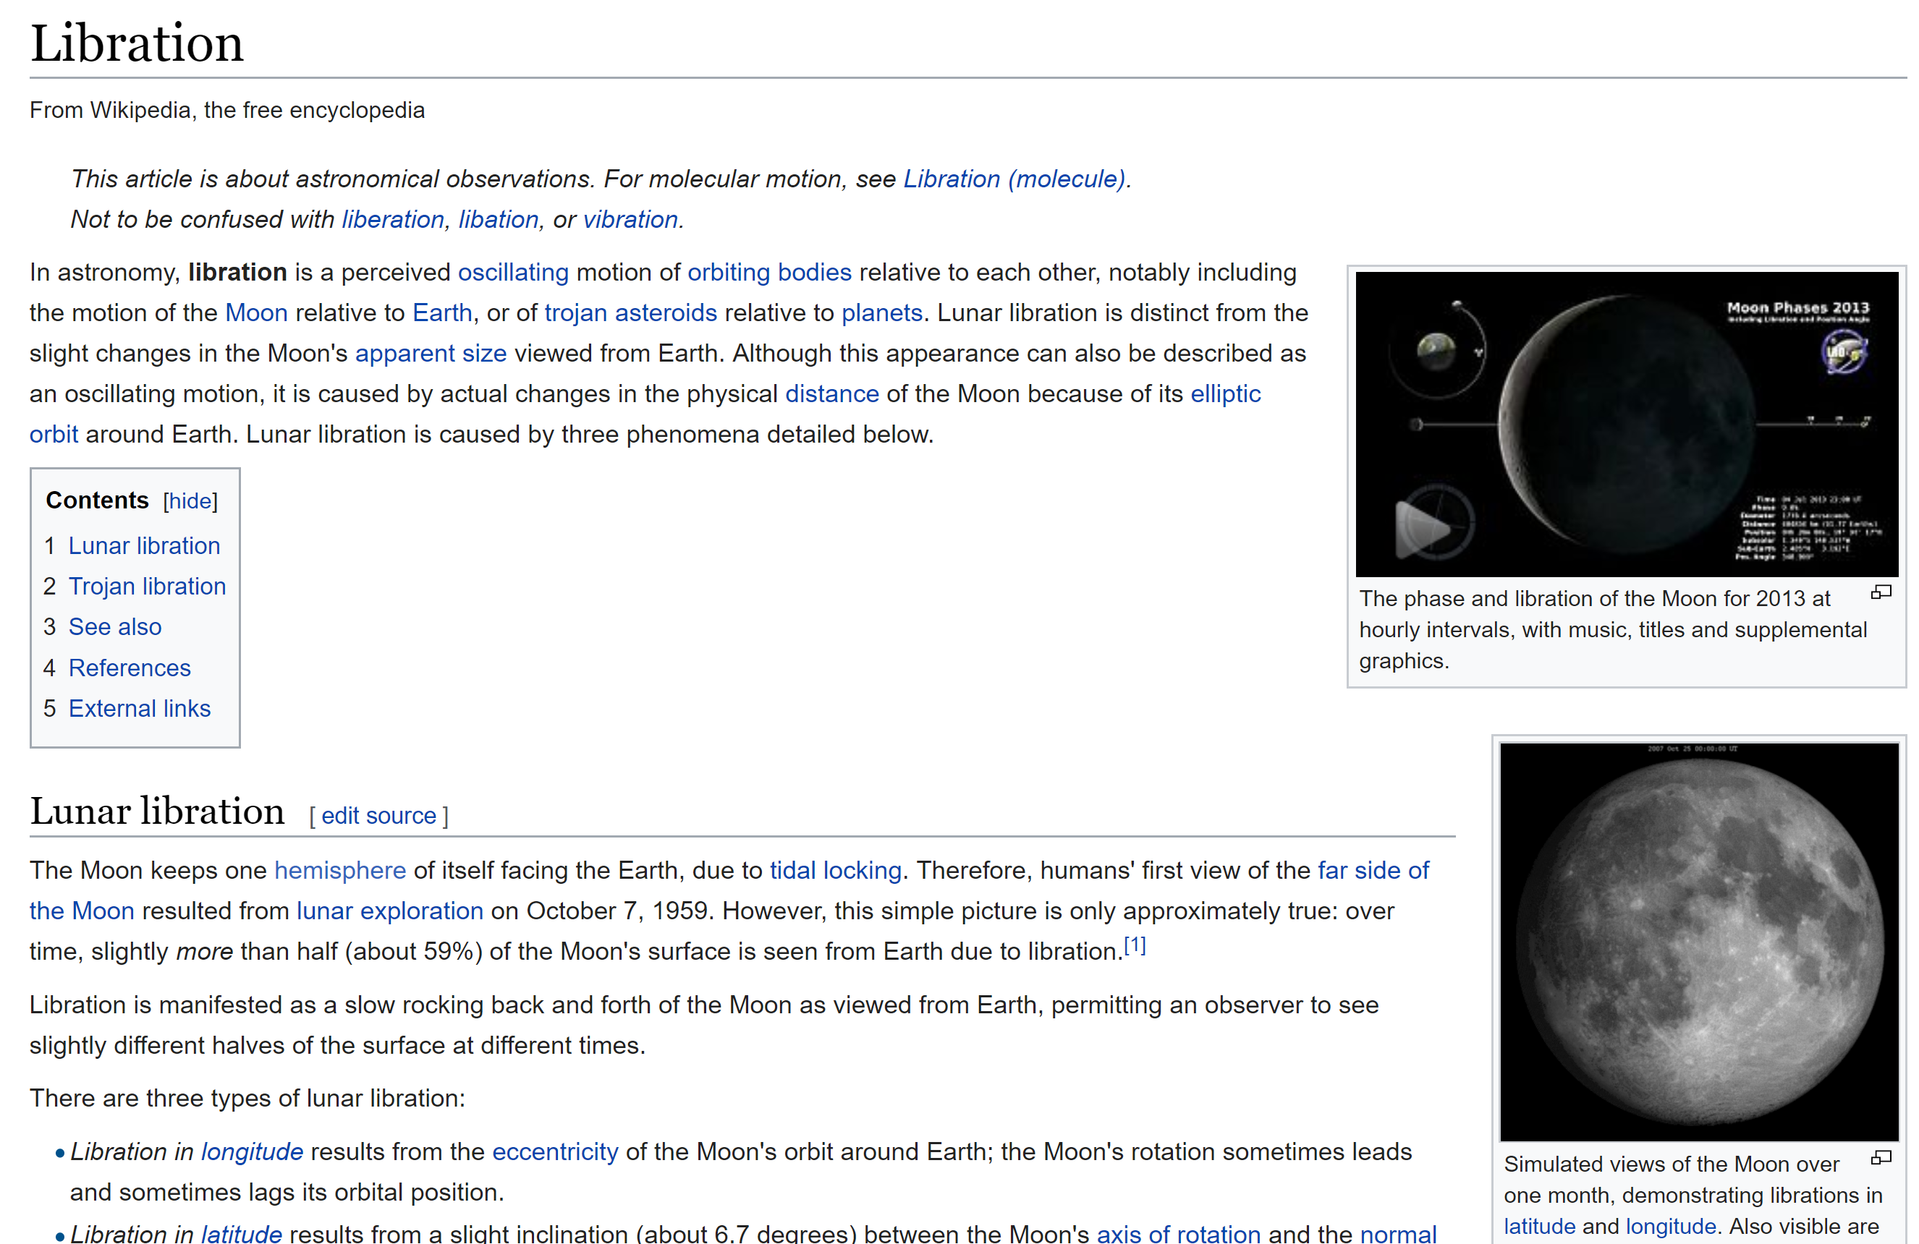
https://en.wikipedia.org/wiki/Libration

Slide 39
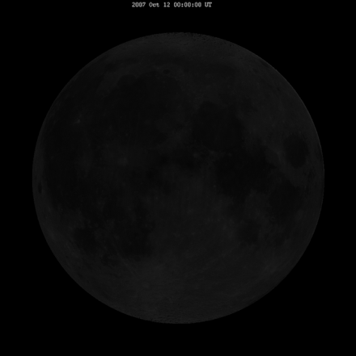
Libration

Slide 40
Questions?

Slide 41
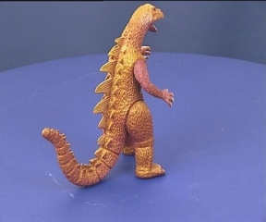
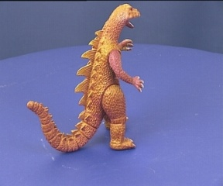
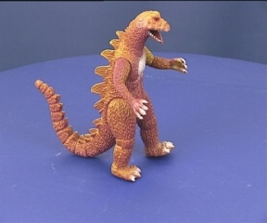
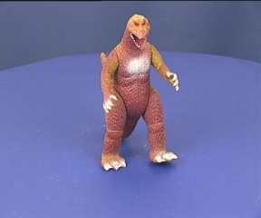
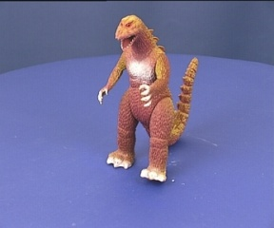
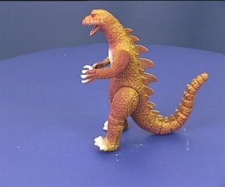



SfM – Failure cases
Necker reversal
Notes:
Necker reversal ambiguity:
This arises because an object rotating by ρ and its mirror image rotating by −ρ generate the same image under parallel projection, see figure 14.9(a). Thus, structure is only recovered up to a reflection about the frontal plane. This ambiguity is absent in the perspective case because the points have different depths in the two interpretations and so do not project to coincident image points.

Slide 42




Structure from Motion – Failure cases
Repetitive structures: Symmetries in man-made scenes

Slide 43
SfM applications
3D modeling
Surveying
Robot navigation and mapmaking
Virtual and augmented reality
Visual effects (“Match moving”)
  https://www.youtube.com/watch?v=RdYWp70P_kY

Slide 44

Applications – Hyperlapse
https://www.youtube.com/watch?v=SOpwHaQnRSY
https://www.youtube.com/watch?v=sA4Za3Hv6ng

Slide 45


Applications: Visual Reality & Augmented Reality
Oculus
Hololens
https://www.youtube.com/watch?v=KOG7yTz1iTA
https://www.youtube.com/watch?v=FMtvrTGnP04

Slide 46

Applications: Visual Reality & Augmented Reality
Scape: Building the ‘AR Cloud’: Part Three —3D Maps, the Digital Scaffolding of the 21st Century
https://medium.com/scape-technologies/building-the-ar-cloud-part-three-3d-maps-the-digital-scaffolding-of-the-21st-century-465fa55782dd

Slide 47


Application: AR walking directions
https://www.theverge.com/2019/8/8/20776247/google-maps-live-view-ar-walking-directions-ios-android-feature

Slide 48
Questions?

