Slide 1
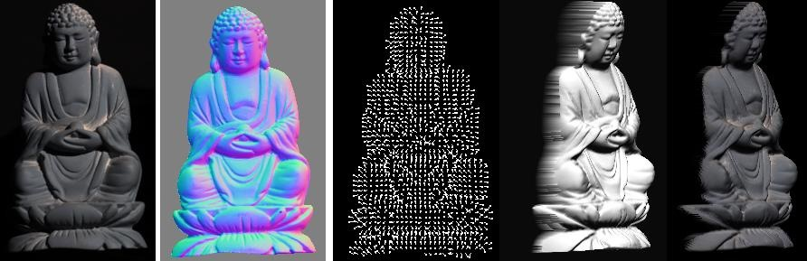
Photometric stereo
CS5670 : Computer Vision

Slide 2
Announcements
Project 4 (stereo) released today, due Friday, April 1, at 8pm
To be done in groups of 2

Slide 3
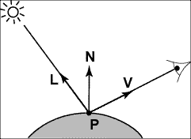
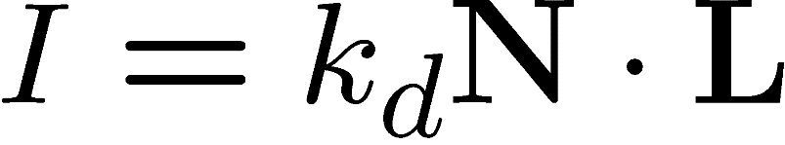
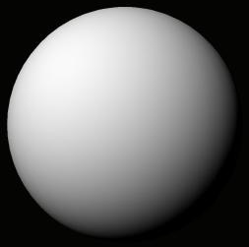
Recap: Lambertian (Diffuse) Reflectance
I : observed image intensity
k_{d} : object albedo
N : surface normal
L : light source direction
Lambertian sphere with constant albedo lit by a directional light source

Slide 4
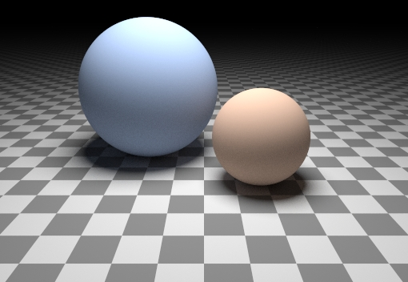
Can we determine shape from lighting?
Are these spheres?
Or just flat discs painted with varying albedo?

Slide 5

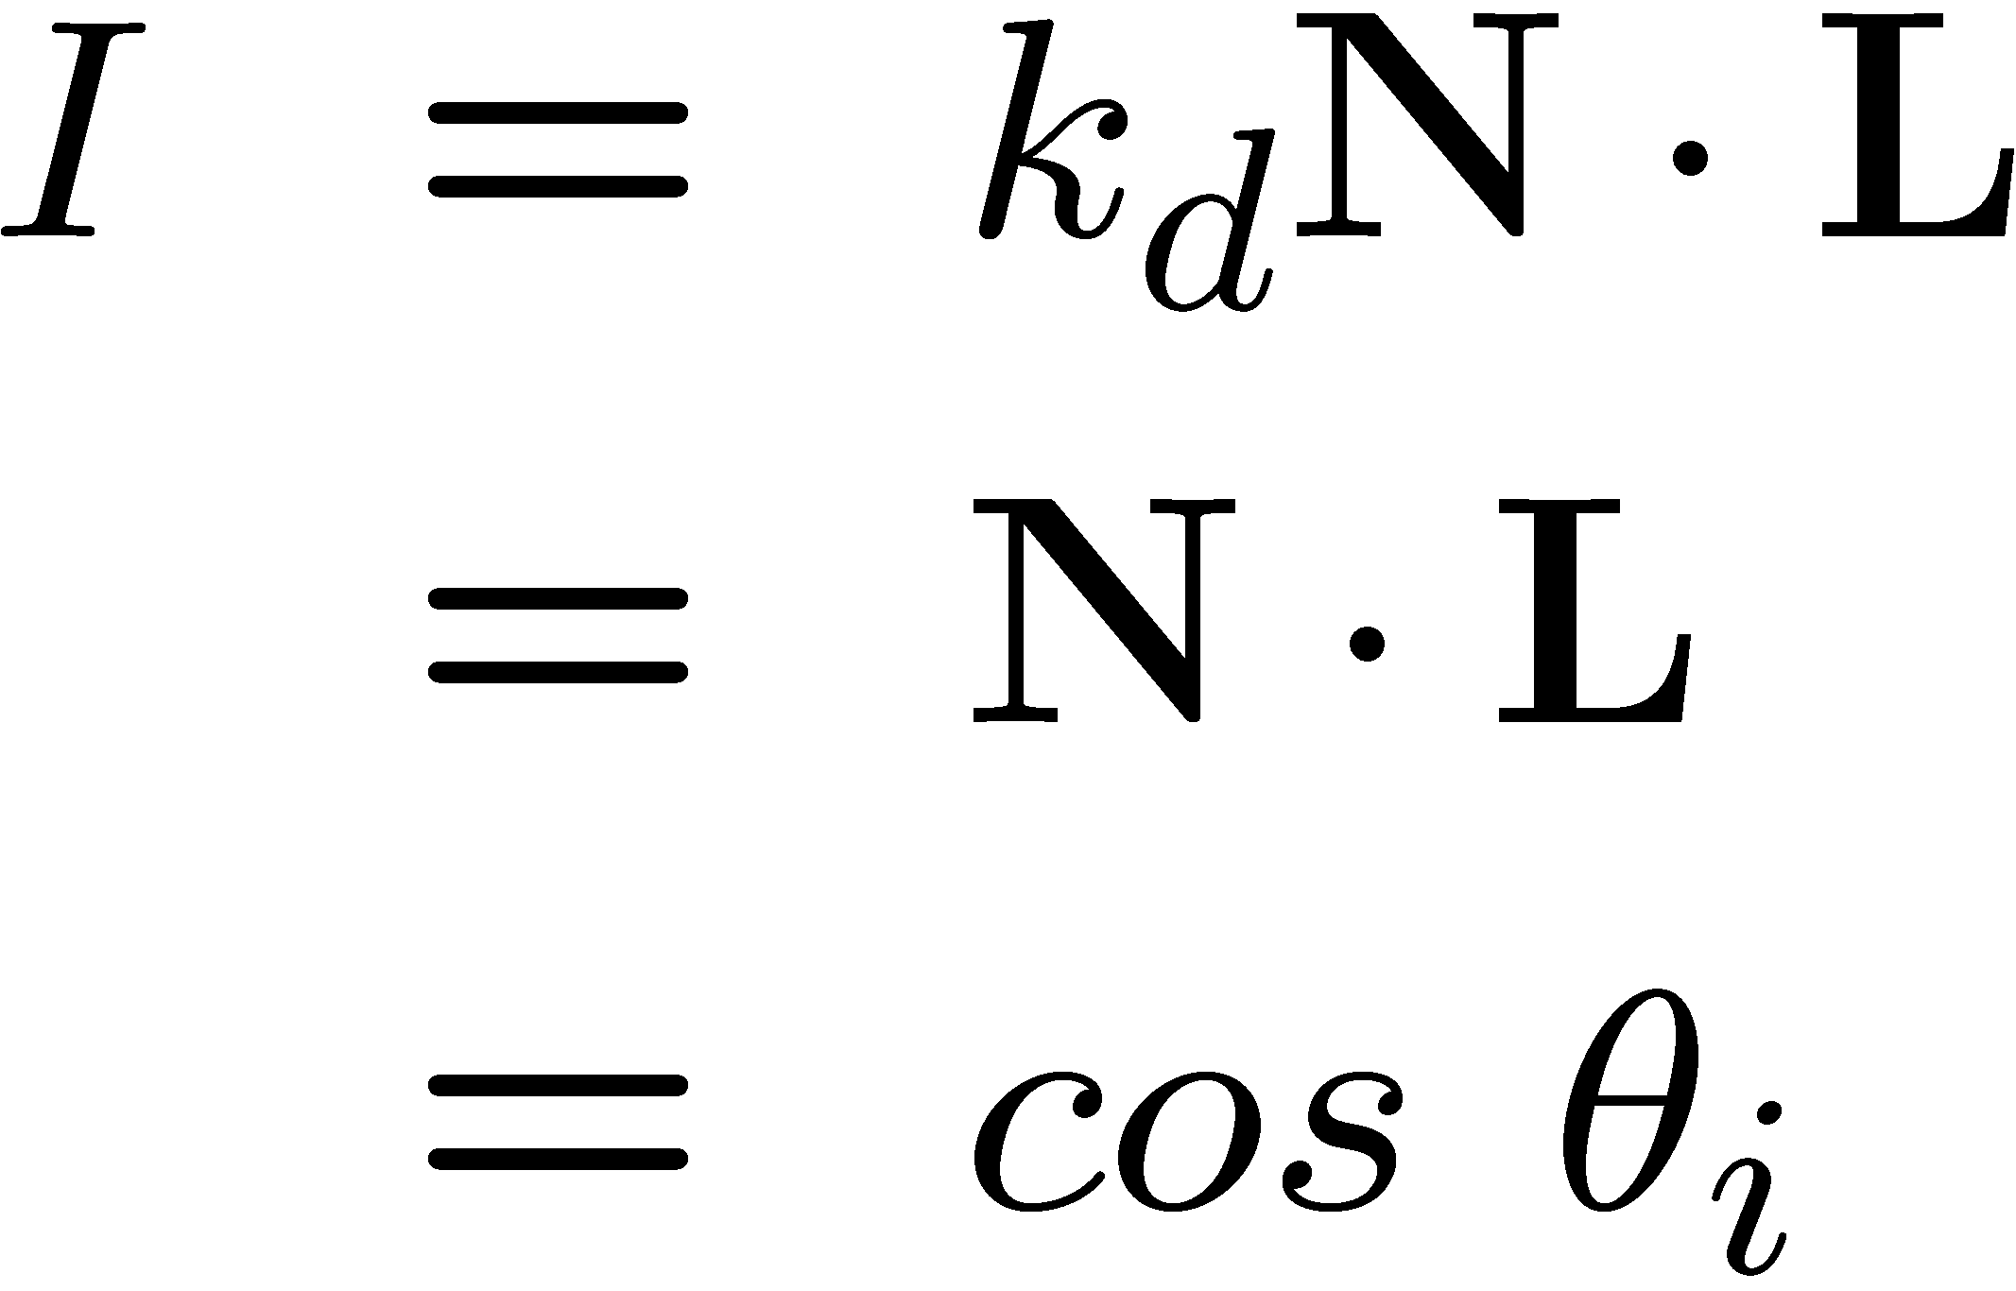

A Single Image: Shape from shading
Suppose (for now)
You can directly measure angle between normal and light source
Not quite enough information to compute surface shape
But can be if you add some additional info, for example
assume a few of the normals are known (e.g., along silhouette)
constraints on neighboring normals—“integrability”
smoothness
Hard to get it to work well in practice
plus, how many real objects have constant albedo?
But, deep learning can help

Slide 6
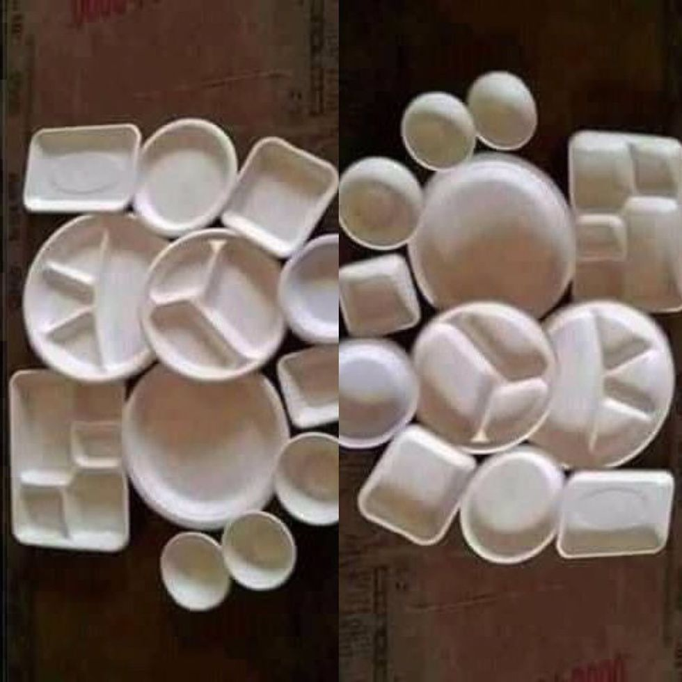
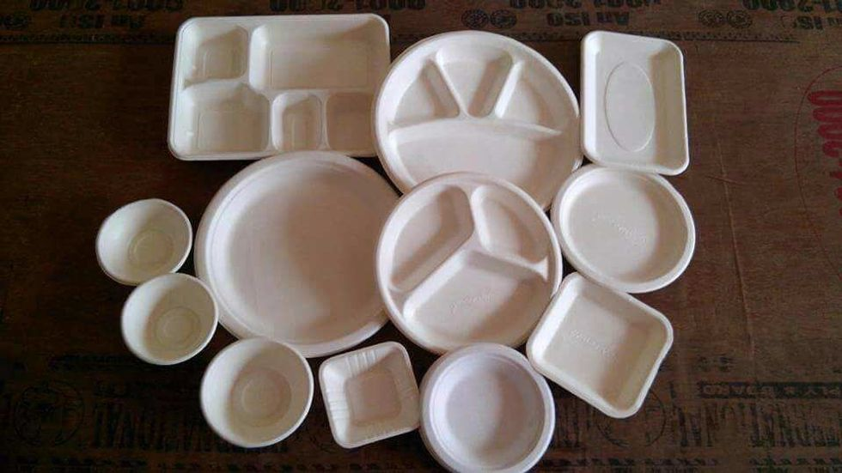
https://www.good.is/optical-illusion-plates-and-bowls-upside-down-or-not

Slide 7
Let’s take more than one photo!

Slide 8






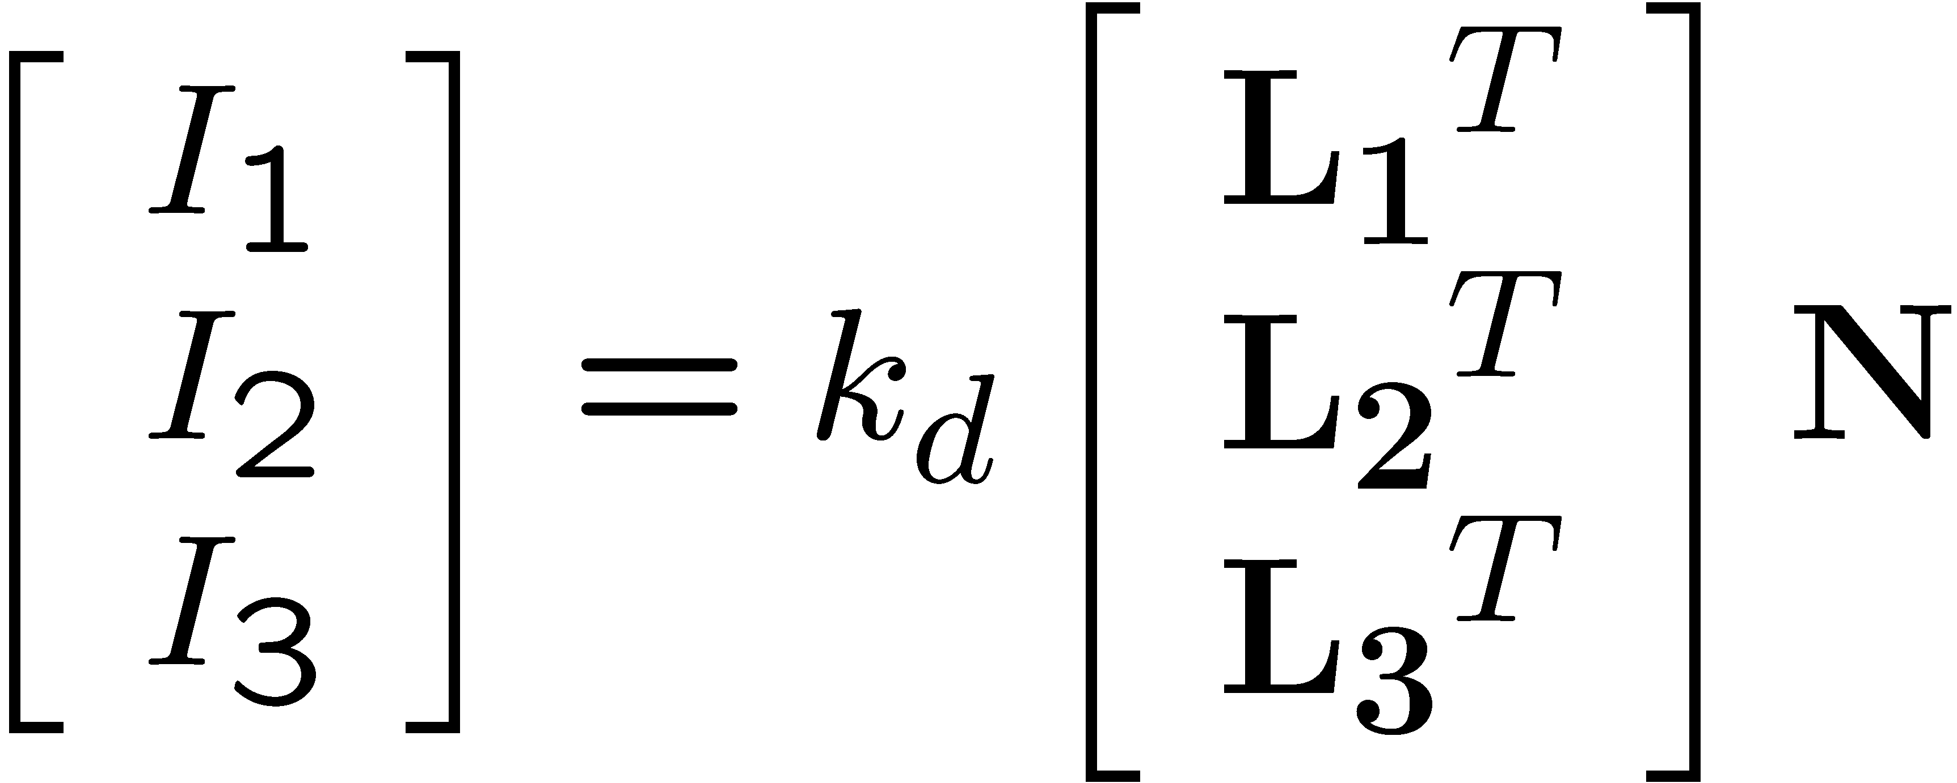
Photometric stereo
N
L₃
L₂
L₁
V
Can write this as a matrix equation:

Slide 9
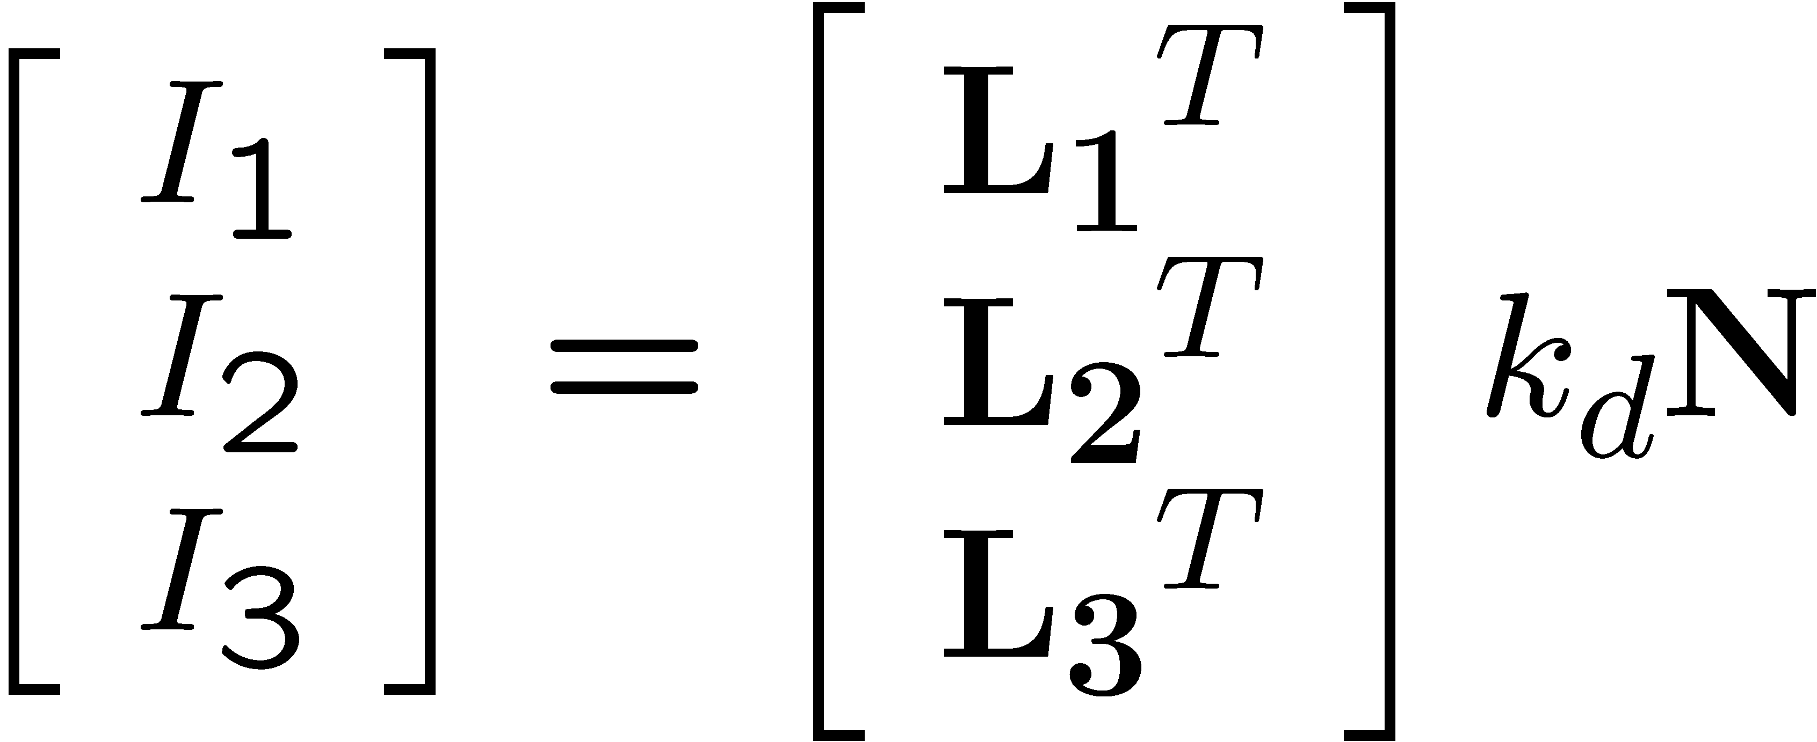


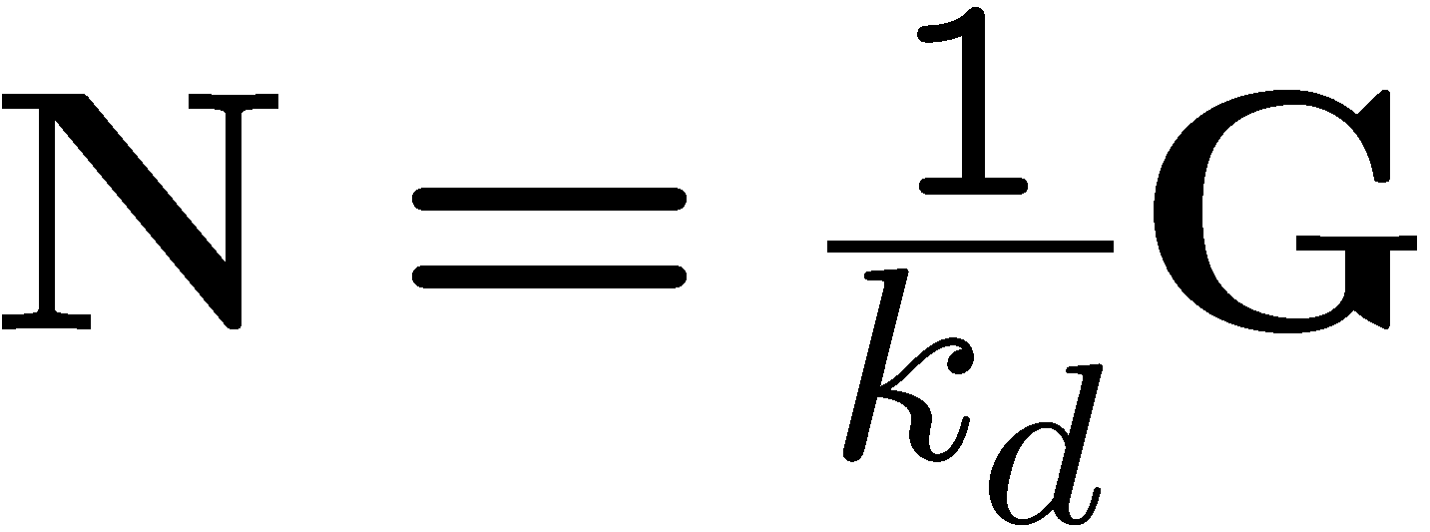





Solving the equations
Solve one such linear system per pixel to solve for that pixel’s surface normal

Slide 10
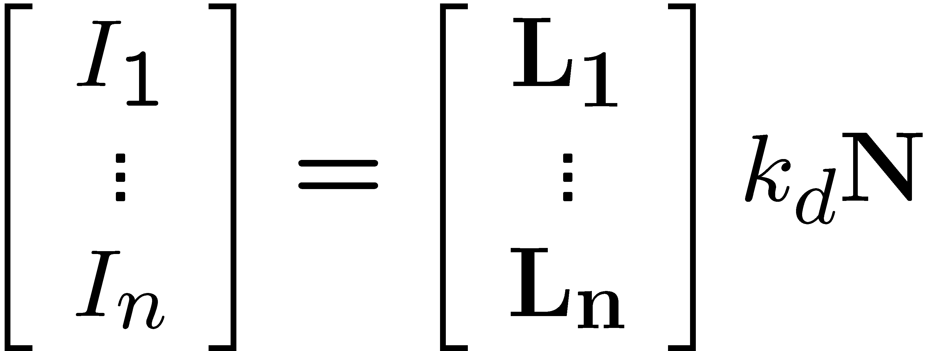
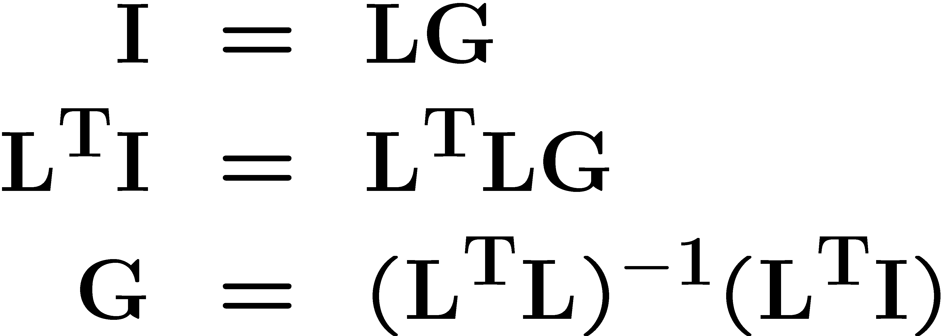
More than three lights
Can get better results by using more than 3 lights
Least squares solution:
Solve for N, k_{d} as before
What’s the size of L^{T}L?

Slide 11

Computing light source directions
Trick: place a chrome sphere in the scene
the location of the highlight tells you where the light source is

Slide 12

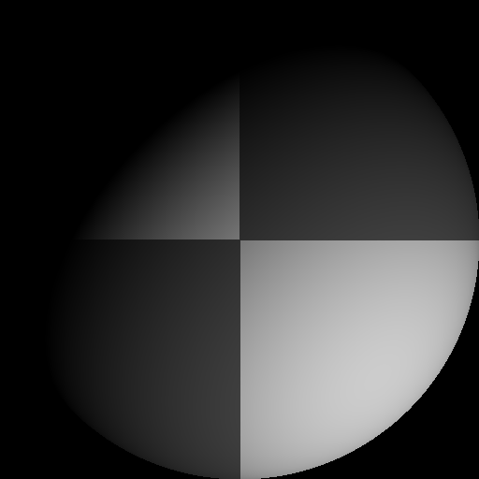
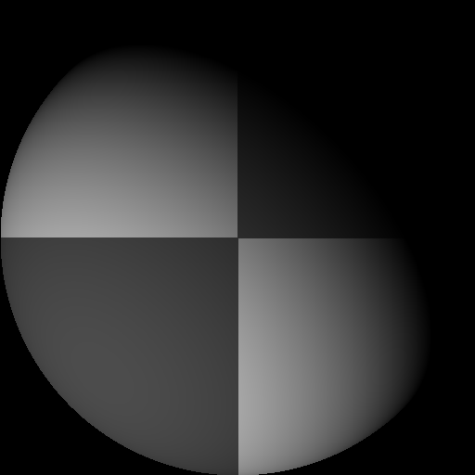
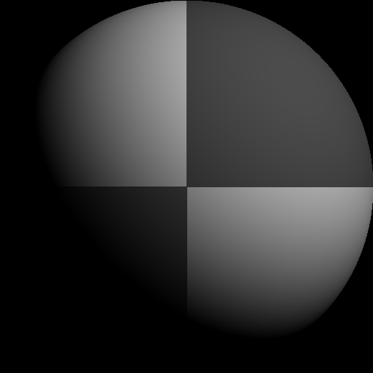
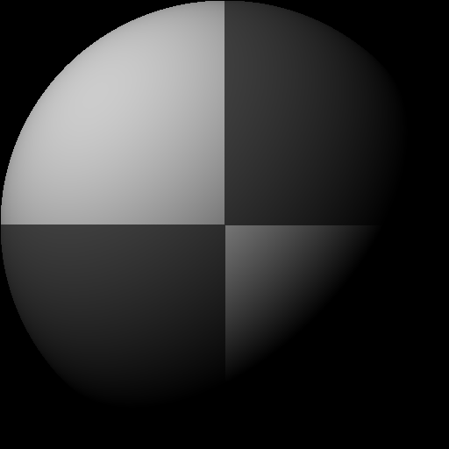
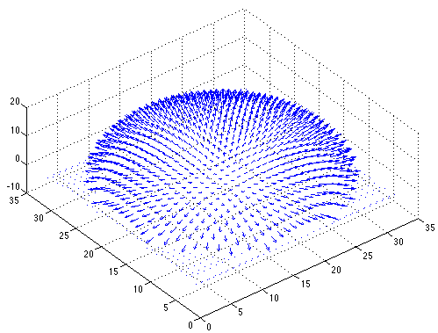

Example
Input views
Recovered albedo
Recovered normal field
Forsyth & Ponce, Sec. 5.4

Slide 13

Depth from normals
Solving the linear system per-pixel gives us an estimated surface normal for each pixel
How can we compute depth from normals?
Normals are like the “derivative” of the true depth
Input photo
Estimated normals
Estimated normals (needle diagram)

Slide 14
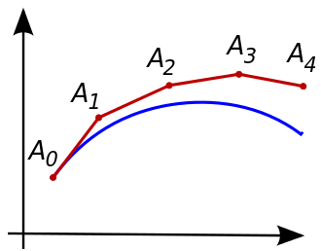
Normal Integration
Integrating a set of derivatives is easy in 1D
(similar to Euler’s method from diff. eq. class)
Could integrate normals in each column / row separately
Wouldn’t give a good surface
Instead, we formulate as a linear system and solve for depths that best agree with the surface normals

Slide 15

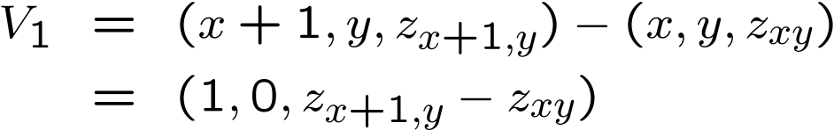


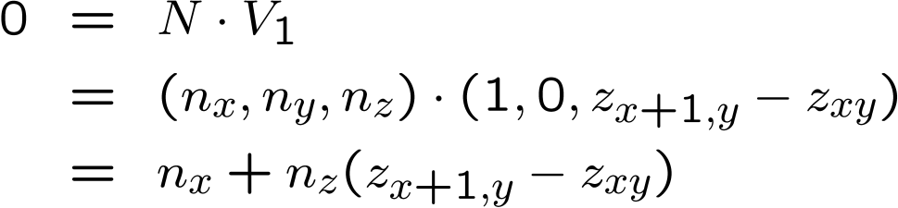

Depth from normals
V₂
V₁
N
Get a similar equation for V₂
Each normal gives us two linear constraints on z
compute z values by solving a matrix equation

Slide 16
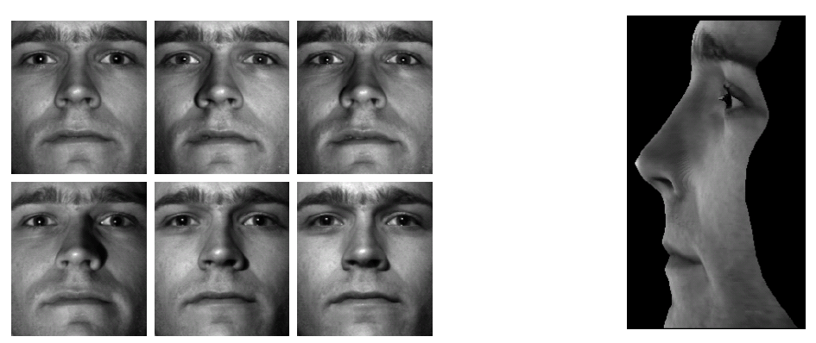
Results
from Athos Georghiades

Slide 17
Results

Slide 18
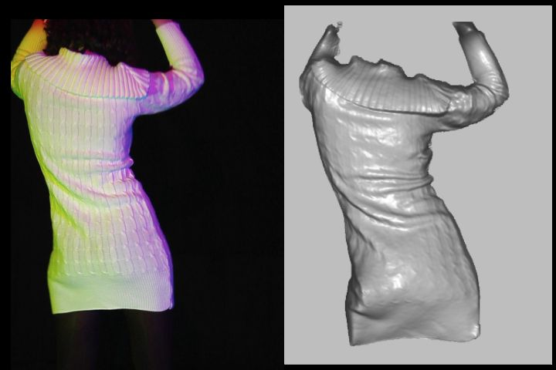
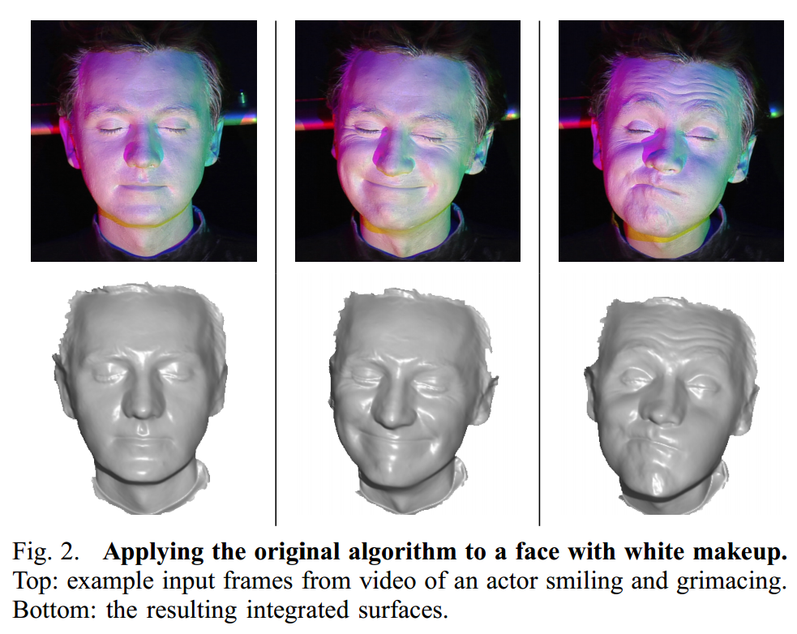
Extension
Photometric Stereo from Colored Lighting
Video Normals from Colored Lights
Gabriel J. Brostow, Carlos Hernández, George Vogiatzis, Björn Stenger, Roberto Cipolla
IEEE TPAMI, Vol. 33, No. 10, pages 2104-2114, October 2011.

Slide 19
Questions?

Slide 20
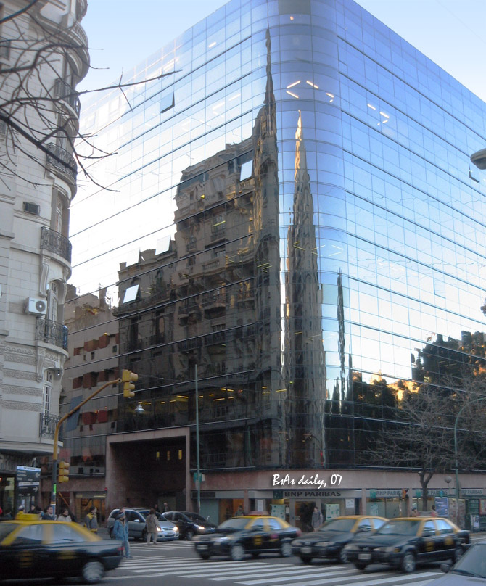
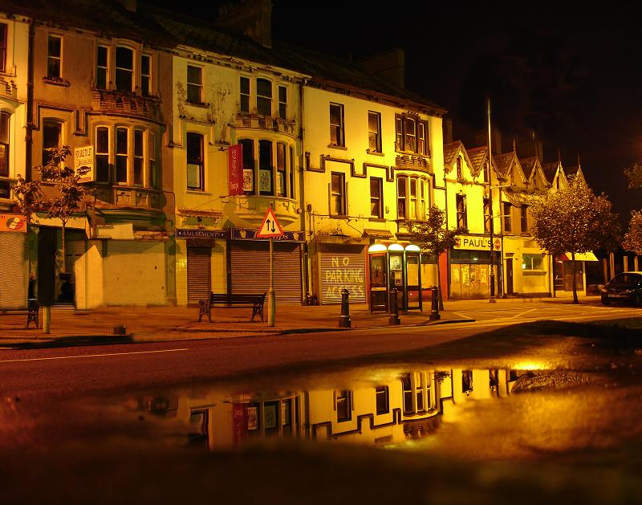
For now, ignore specular reflection
Slides from Photometric Methods for 3D Modeling, Matsushita, Wilburn, Ben-Ezra
Notes:
reflection

Slide 21
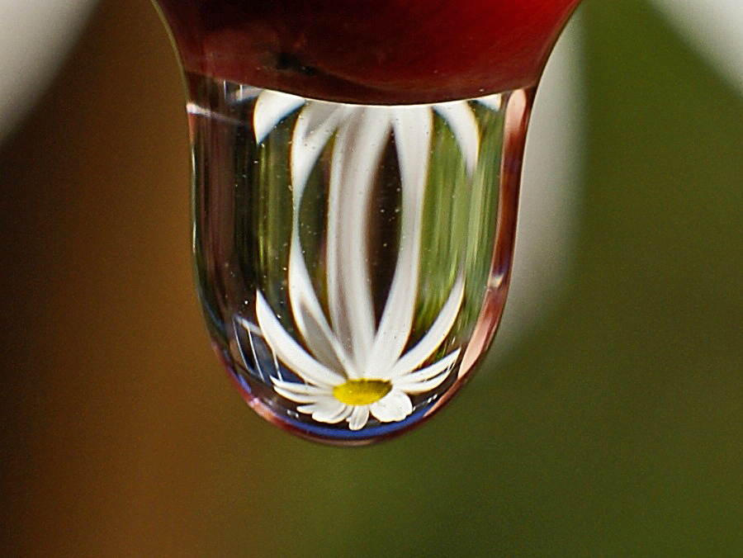
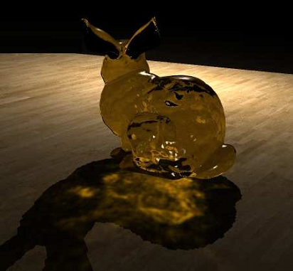
And Refraction…
Slides from Photometric Methods for 3D Modeling, Matsushita, Wilburn, Ben-Ezra

Slide 22
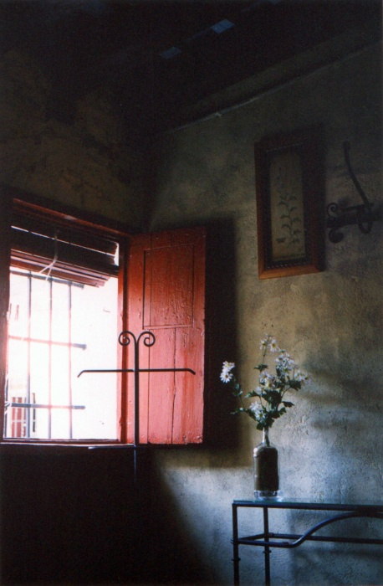
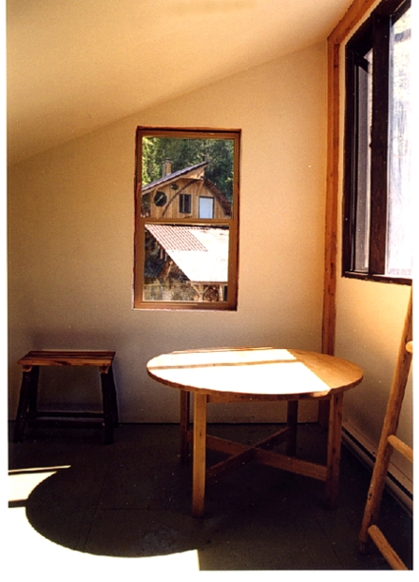
And Interreflections…
Slides from Photometric Methods for 3D Modeling, Matsushita, Wilburn, Ben-Ezra

Slide 23
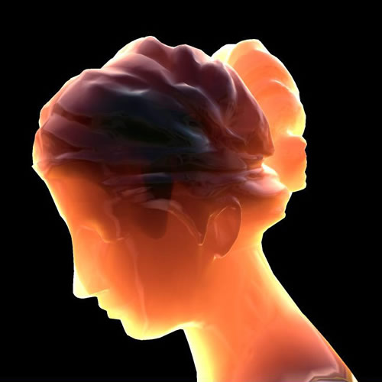
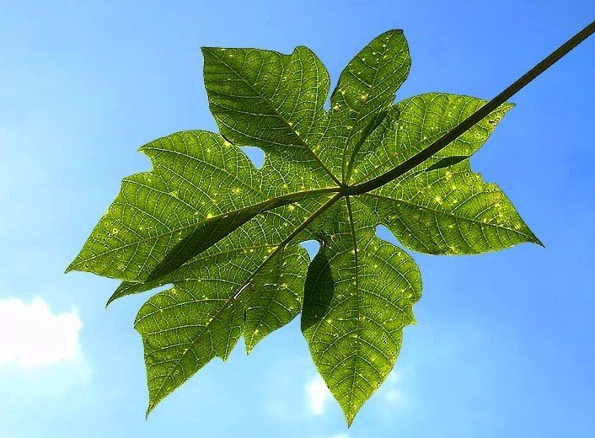
And Subsurface Scattering…
Slides from Photometric Methods for 3D Modeling, Matsushita, Wilburn, Ben-Ezra

Slide 24
Limitations
Bigger problems
doesn’t work for shiny things, semi-translucent things
shadows, inter-reflections
Smaller problems
camera and lights have to be distant
calibration requirements
measure light source directions, intensities
camera response function
Newer work addresses some of these issues
Some pointers for further reading:
Zickler, Belhumeur, and Kriegman, "Helmholtz Stereopsis: Exploiting Reciprocity for Surface Reconstruction." IJCV, Vol. 49 No. 2/3, pp 215-227.
Hertzmann & Seitz, “Example-Based Photometric Stereo: Shape Reconstruction with General, Varying BRDFs.” IEEE Trans. PAMI 2005

Slide 25

Johnson and Adelson, 2009

Slide 26
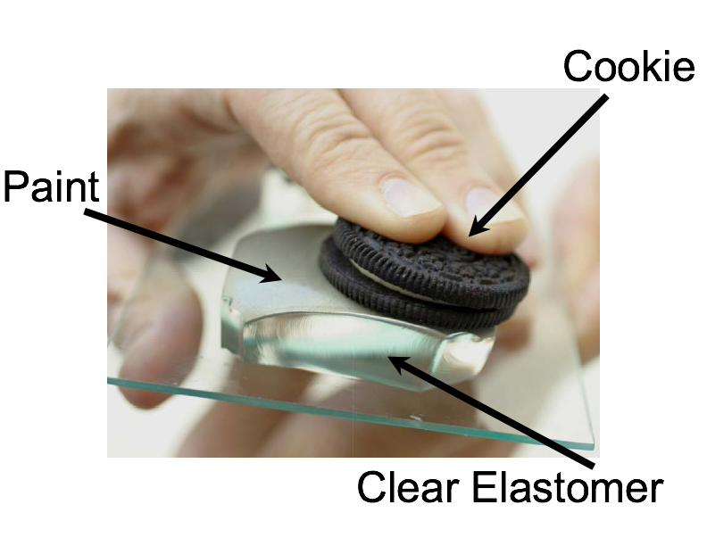
Johnson and Adelson, 2009

Slide 27
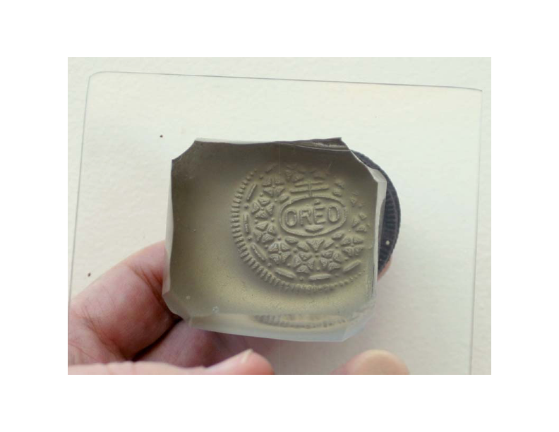

Slide 28
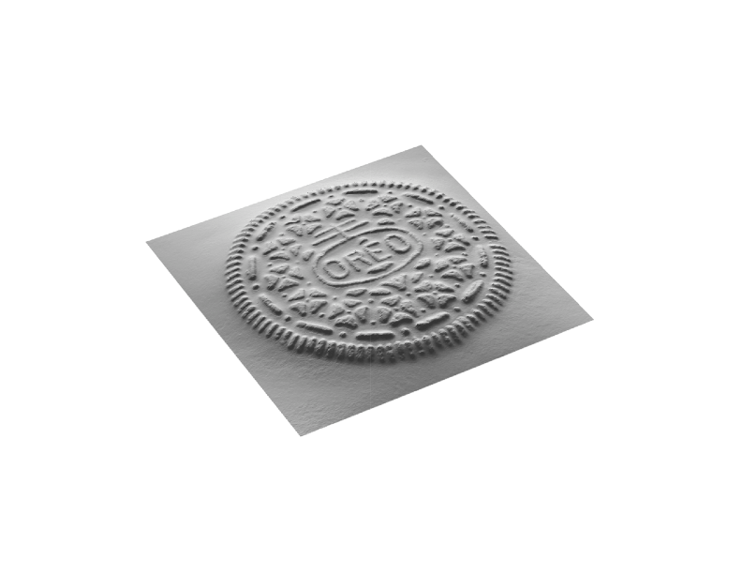

Slide 29
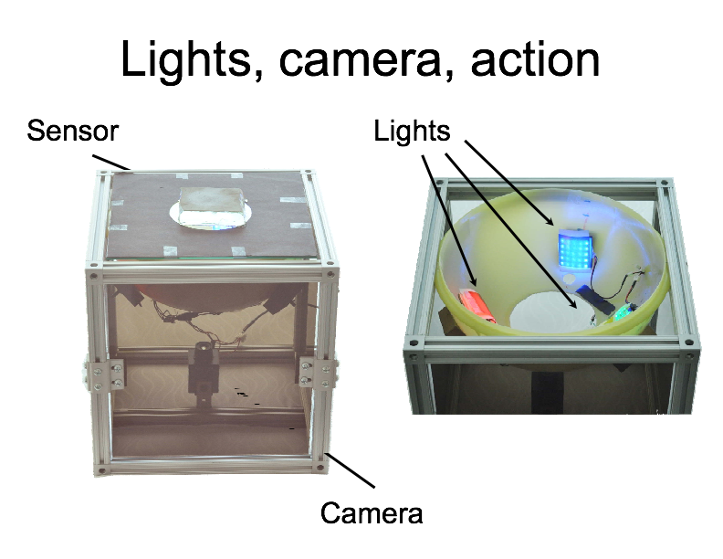

Slide 30
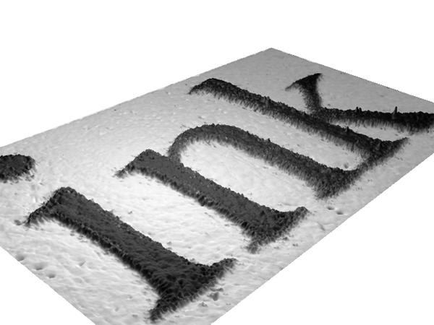

Slide 31
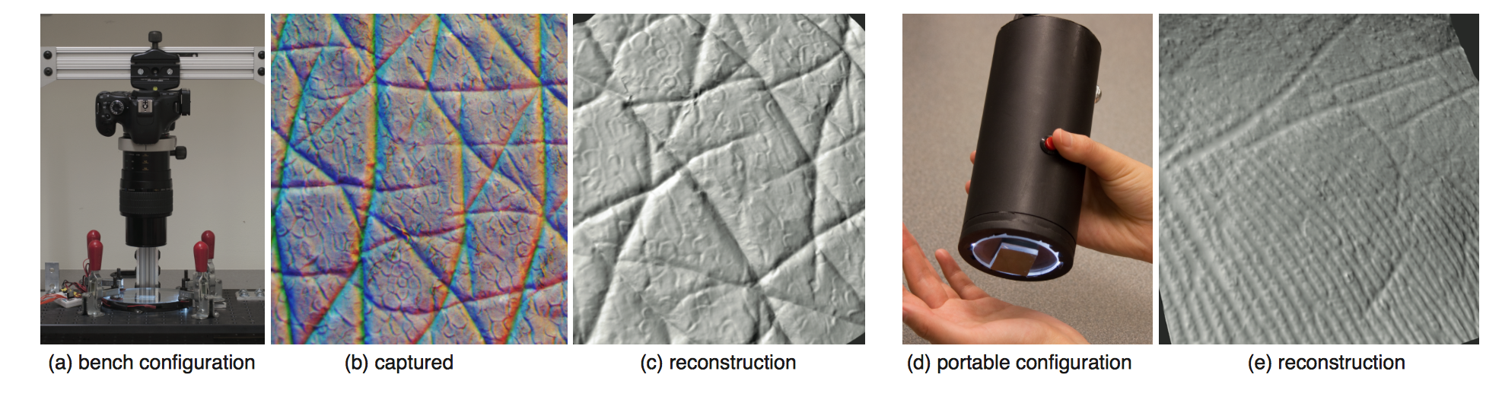
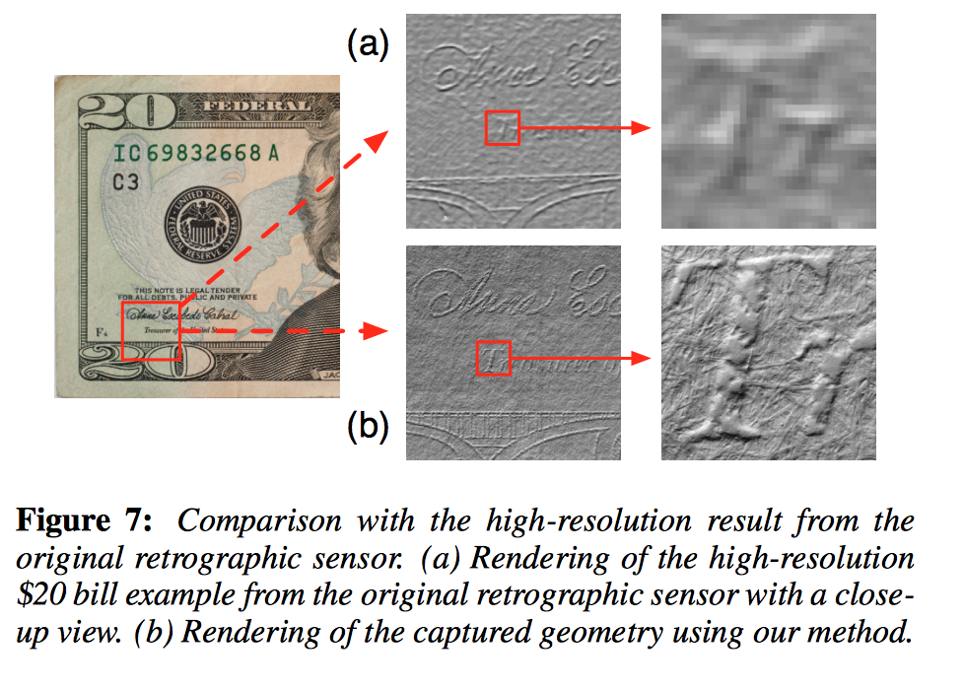

Slide 32
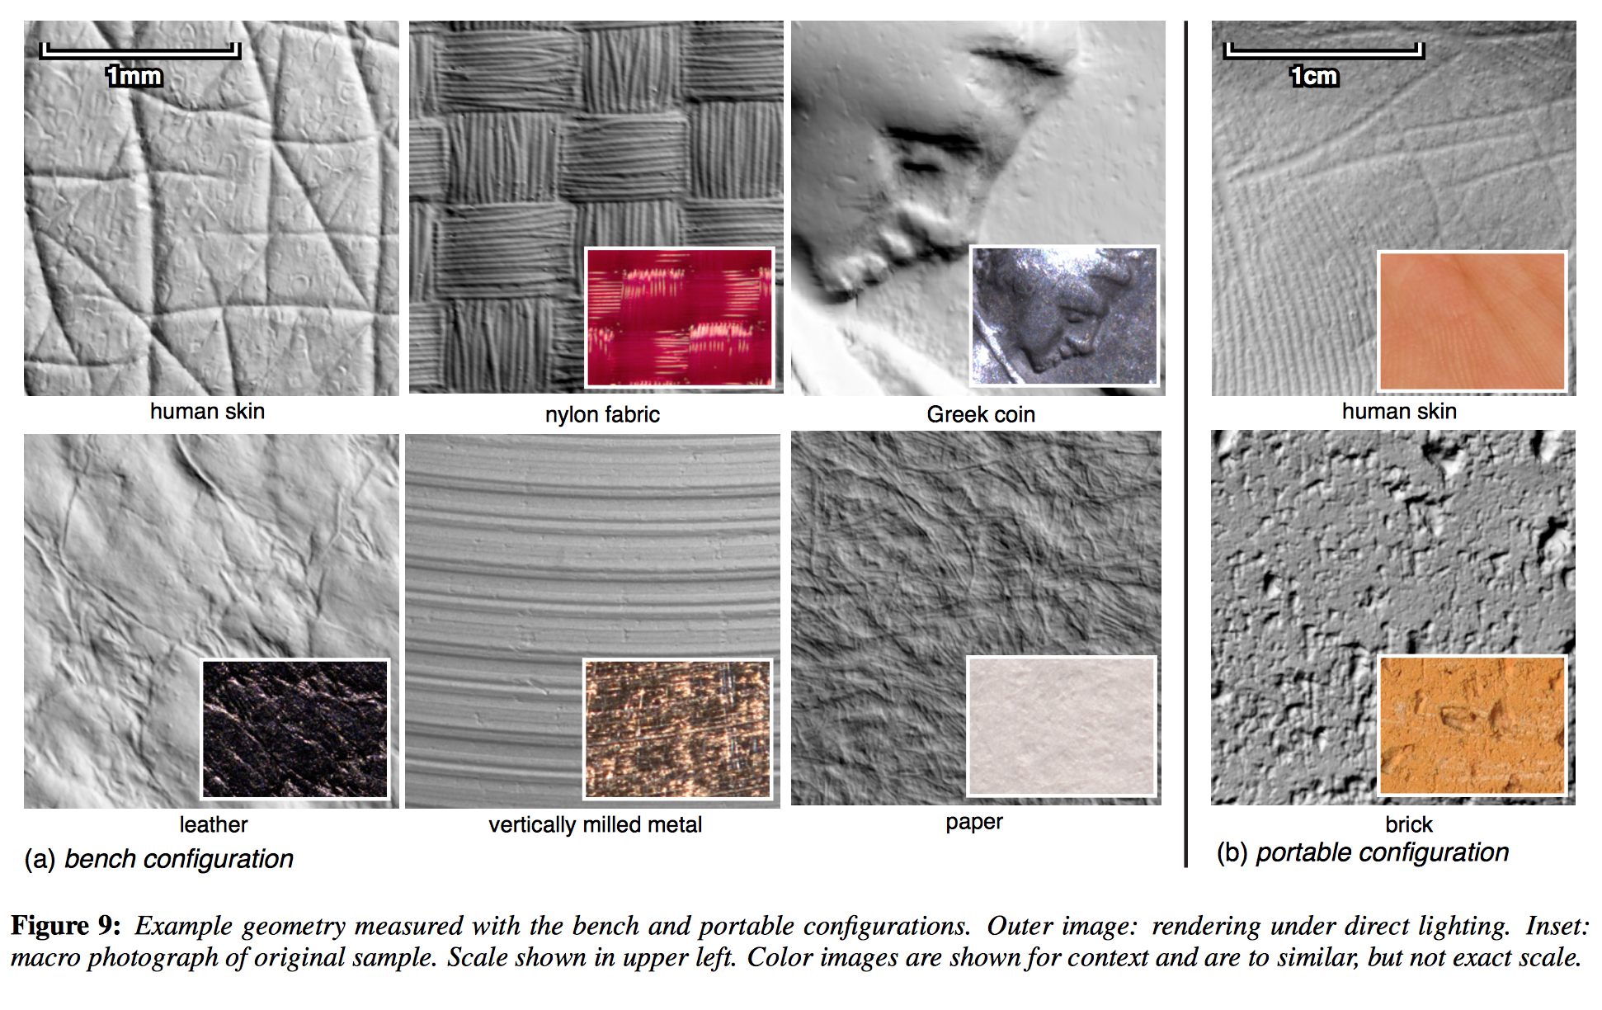

Slide 33
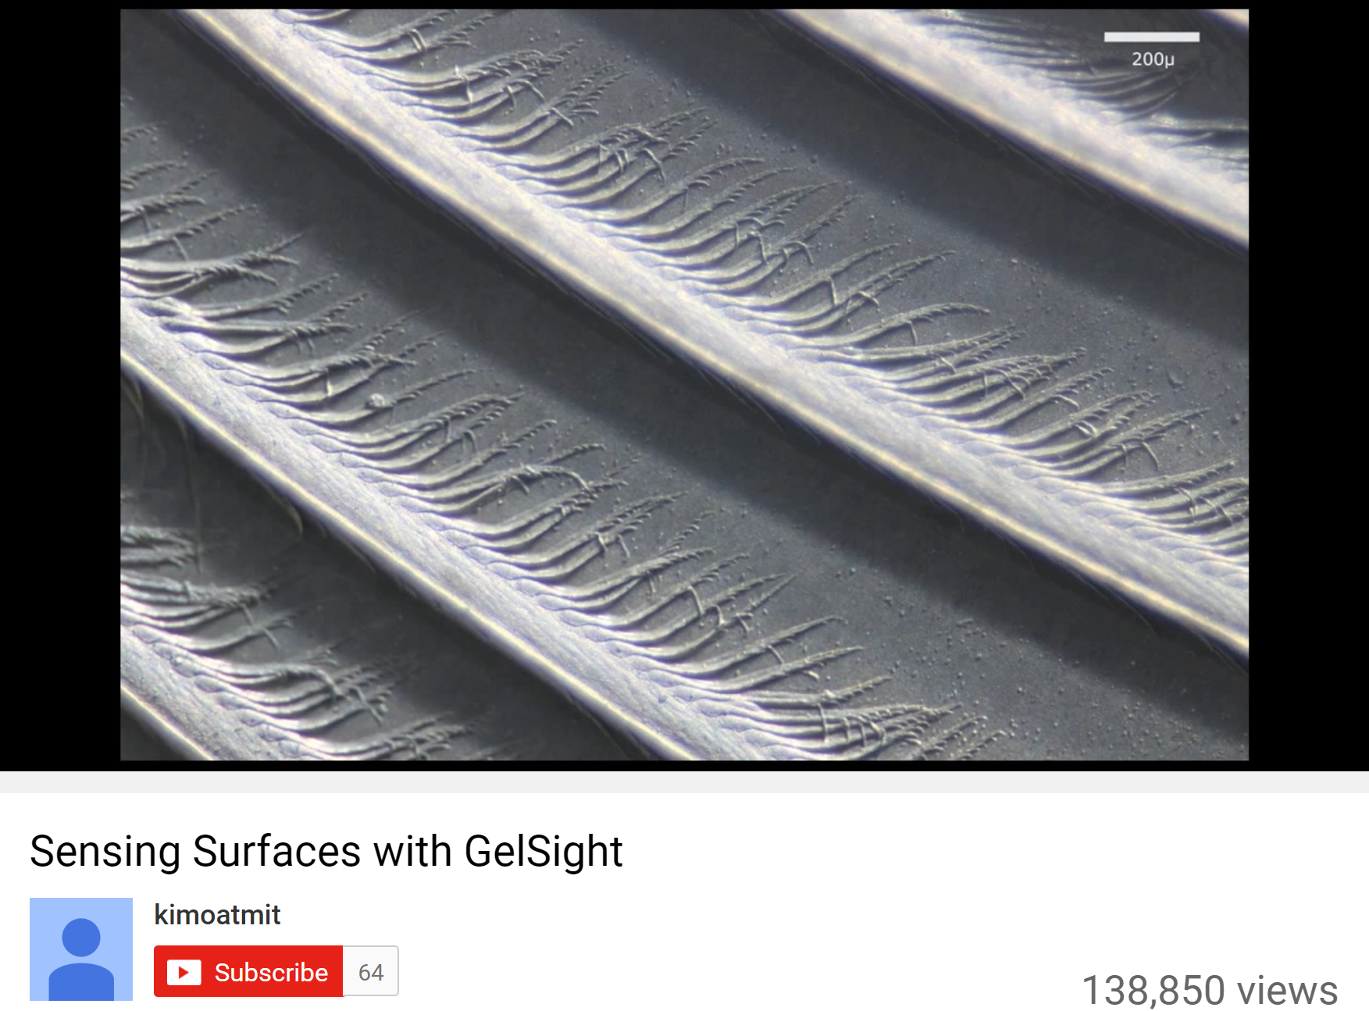
https://www.youtube.com/watch?v=S7gXih4XS7A

Slide 34
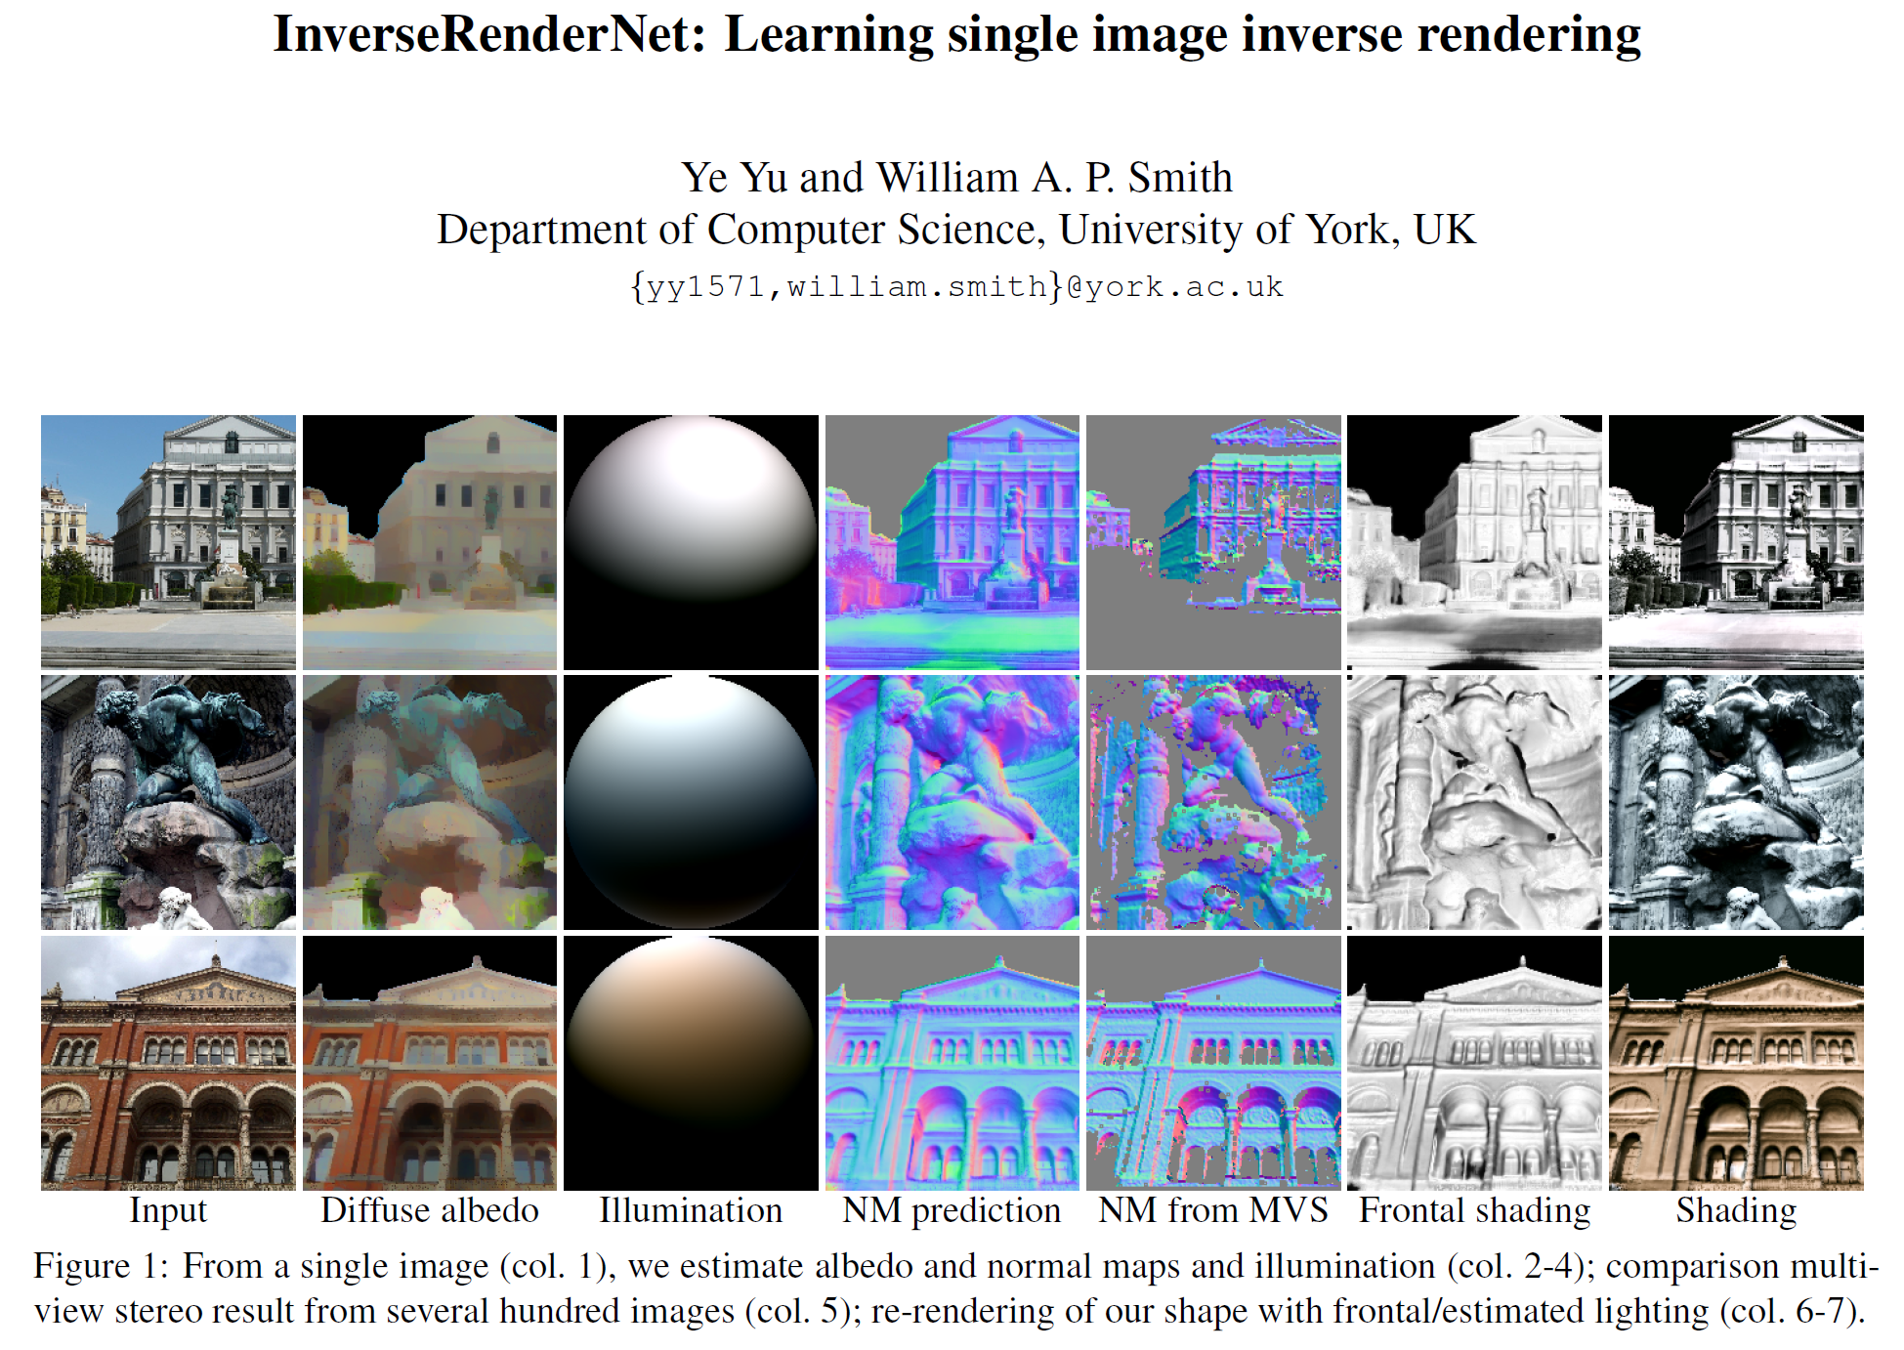

Slide 35
Questions?

