Slide 1
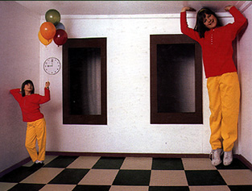
Single-View Modeling
CS5670: Computer Vision

Slide 2
Single-View Modeling
Ames Room
Readings
Mundy and Zisserman. Geometric Invariance in Computer Vision, Appendix: Projective Geometry for Machine Vision, MIT Press, 1992, (read 23.1-23.5, 23.10)
available online: http://www.cs.cmu.edu/~ph/869/papers/zisser-mundy.pdf

Slide 3
Announcements
Project 3: Autostitch (Panorama Stitching)
Due on Friday, March 18, by 7pm
To be done in groups of 2
If you need help finding a team member, let us know

Slide 4
Roadmap ahead
The next few lectures will finish up geometry
Next up is recognition / learning
We already know about camera geometry & panoramas
Coming up
Single-view modeling (today)
Two-view geometry
Multi-view geometry

Slide 5
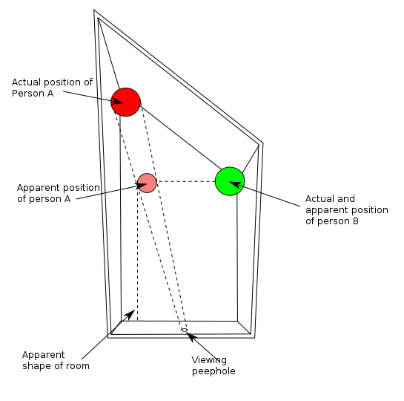
Ames Room

Slide 6
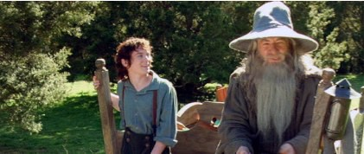
Forced perspective in film
How Lord of the Rings used forced perspective shots with a moving camera
https://www.youtube.com/watch?v=QWMFpxkGO_s

Slide 7
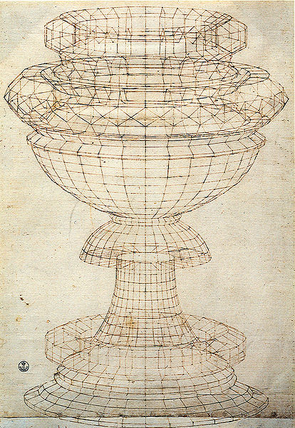
Projective geometry—what’s it good for?
Uses of projective geometry
Drawing
Measurements
Mathematics for projection
Undistorting images
Camera pose estimation
Object recognition
Paolo Uccello

Slide 8
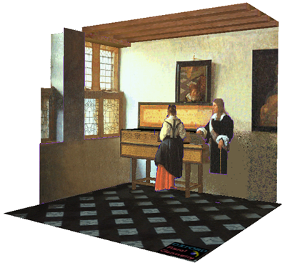
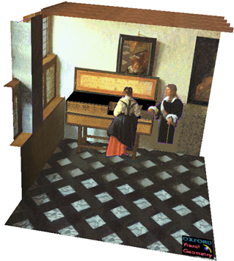

Applications of projective geometry
Vermeer’s Music Lesson
Reconstructions by Criminisi et al.

Slide 9

Making measurements in images

Slide 10
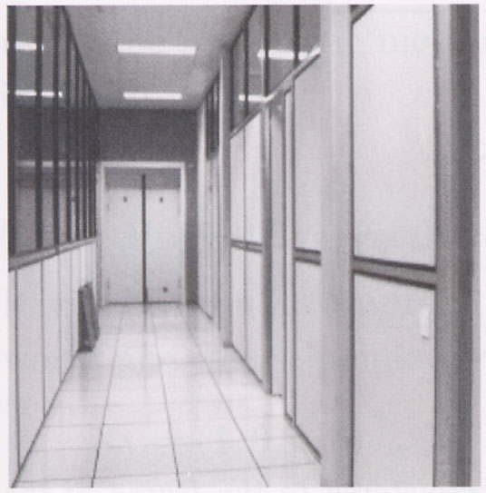
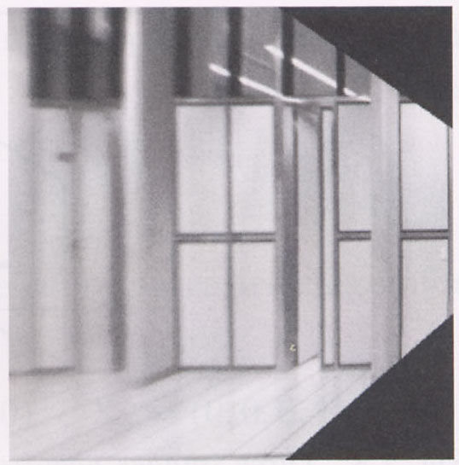
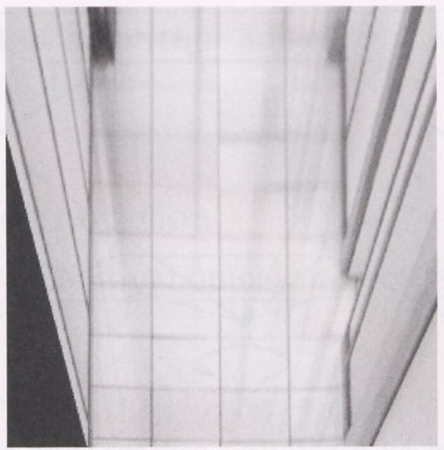
Measurements on planes
4
3
2
1
1
2
3
4
Approach: unwarp then measure
Notes:
homography!

Slide 11
Homogeneous coordinates and lines
(X,Y,W) same as (SX,SY,SW)
Line in projective plane
ax + by + c = 0
aX + bY + cW = 0
u^{T}p = p^{T}u =0
u = [a,b,c] ^{T} and p = [X,Y,W] ^{T}
(x,y) Euclidean = (X/W,Y/W)
W = 0? Ideal points, points at infinity (X,Y,0)

Slide 12
Point and line duality
A line l is a homogeneous 3-vector
It is ⊥ to every point (ray) p on the line: l.p=0
p₁
p₂
l₁
p
l
l₂
COP
COP
What is the line l spanned by points p₁ and p₂ ?
l is ⊥ to p₁ and p₂ ⇒ l = p₁ × p₂
l can be interpreted as a plane normal
What is the intersection of two lines l₁ and l₂ ?
p is ⊥ to l₁ and l₂ ⇒ p = l₁ × l₂
Points and lines are dual in projective space

Slide 13
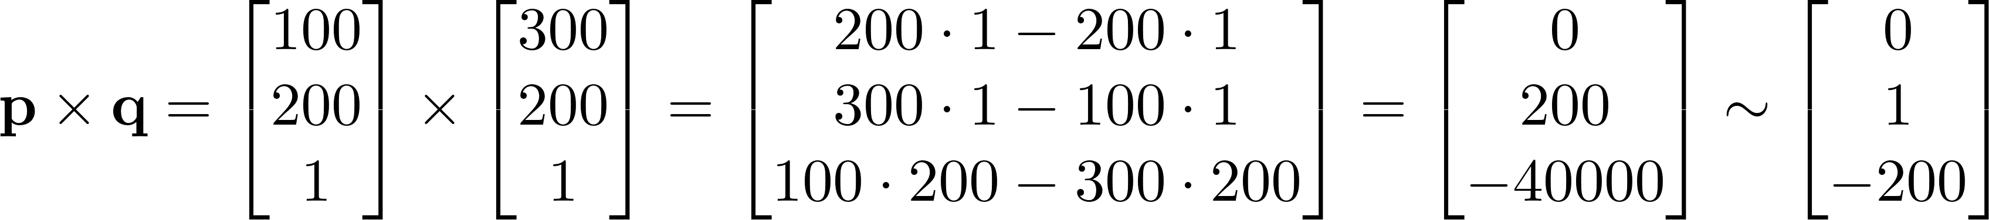
Example
r = (150, 150)
s = (250, 150)
p =(100, 200)
q = (300, 200)
What is the line passing through points p and q?
Notes:
$$
\mathbf{p} \times \mathbf{q} =
\begin{bmatrix} 100 \\ 200 \\ 1 \end{bmatrix}
\times
\begin{bmatrix} 300 \\ 200 \\ 1 \end{bmatrix} =
\begin{bmatrix}
200 \cdot 1 - 200 \cdot 1 \\
300 \cdot 1 - 100 \cdot 1 \\
100 \cdot 200 - 300 \cdot 200 \end{bmatrix} =
\begin{bmatrix} 0 \\ 200 \\ -40000 \end{bmatrix} \sim
\begin{bmatrix} 0 \\ 1 \\ -200 \end{bmatrix}
$$

Slide 14
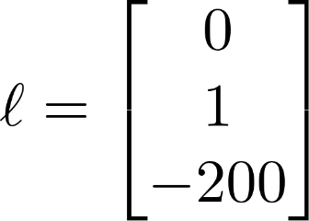
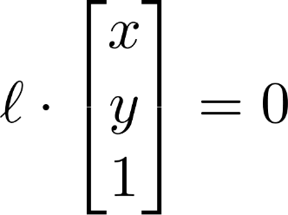

Example
r = (150, 150)
s = (250, 150)
p =(100, 200)
q = (300, 200)
How do we interpret the line ?
Answer: the set of points (x, y) such that , i.e.,
Notes:
$$
\mathbf{\ell} = \begin{bmatrix} 0 \\ 1 \\ -200 \end{bmatrix}
$$
$$
\mathbf{\ell} \cdot \begin{bmatrix} x \\ y \\ 1 \end{bmatrix} = 0
$$

Slide 15
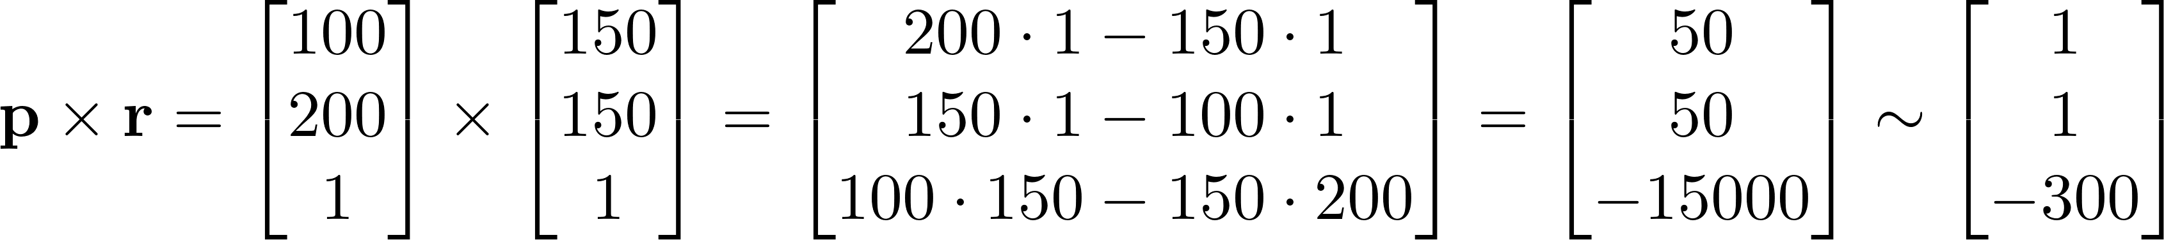

Example
r = (150, 150)
s = (250, 150)
p =(100, 200)
q = (300, 200)
What is the line passing through points p and r?
i.e., all points (x, y) such that
Notes:
$$
\mathbf{p} \times \mathbf{r} =
\begin{bmatrix} 100 \\ 200 \\ 1 \end{bmatrix}
\times
\begin{bmatrix} 150 \\ 150 \\ 1 \end{bmatrix} =
\begin{bmatrix}
200 \cdot 1 - 150 \cdot 1 \\
150 \cdot 1 - 100 \cdot 1 \\
100 \cdot 150 - 150 \cdot 200 \end{bmatrix} =
\begin{bmatrix} 50 \\ 50 \\ -15000 \end{bmatrix} \sim
\begin{bmatrix} 1 \\ 1 \\ -300 \end{bmatrix}
$$

Slide 16
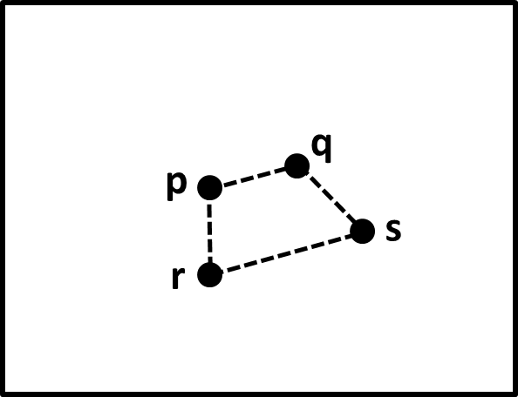
Question time
Consider the above image, with four points p, q, r, s, labeled (assume these are 2D homogeneous points).
What is a simple expression for the point of intersection between the line through p and r and the line through q and s?

Slide 17


Consider the following image, with four points p, q, r, s, labeled (assume these are 2D homogeneous points). What is a simple expression for the point of intersection between the line through p and r and the line through q and s?
ⓘ Start presenting to display the poll results on this slide.

Slide 18
Question time
Consider the above image, with four points p, q, r, s, labeled (assume these are 2D homogeneous points).
What is a simple expression for the point of intersection between the line through p and r and the line through q and s?
Answer: (p x r) x (q x s)

Slide 19
Ideal points and lines
(a,b,0)
-y
(sx,sy,0)
-y
-w
x
image plane
-w
x
image plane
Ideal point (“point at infinity”)
p ≅ (x, y, 0) – parallel to image plane
It has infinite image coordinates
Ideal line
l ≅ (a, b, 0) – parallel to image plane
Corresponds to a line in the image (finite coordinates)
goes through image origin (principal point)

Slide 20
3D projective geometry
These concepts generalize naturally to 3D
Homogeneous coordinates
Projective 3D points have four coords: P = (X,Y,Z,W)
Duality
A plane N is also represented by a 4-vector
Points and planes are dual in 3D: N P=0
Three points define a plane, three planes define a point

Slide 21
3D to 2D: perspective projection
Projection:
Notes:
Preserved: lines, incidence
Not preserved: lengths, angles, parallelism

Slide 22
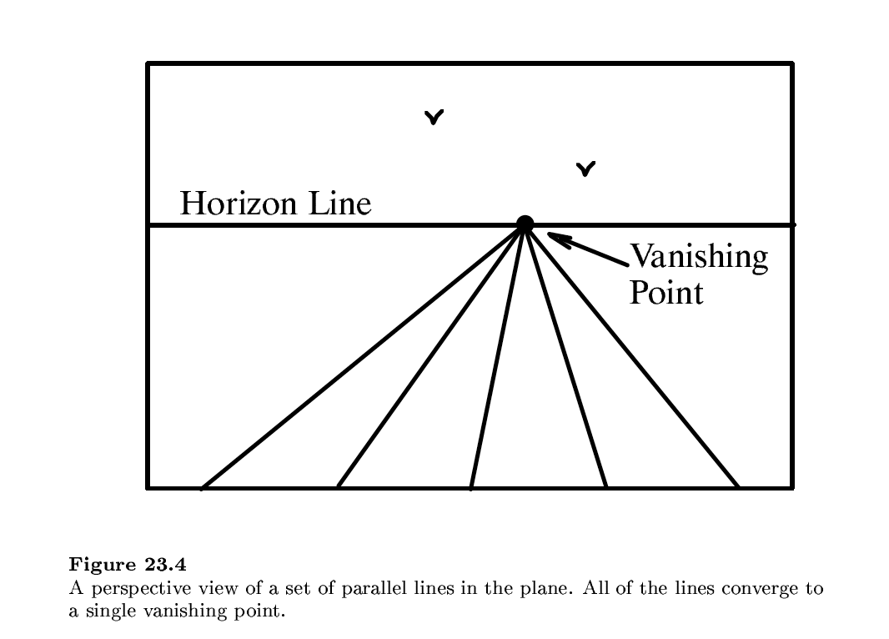

Slide 23
Vanishing points (1D)
image plane
vanishing point
camera
center
ground plane
Vanishing point
projection of a point at infinity
can often (but not always) project to a finite point in the image
camera
center
image plane
ground plane

Slide 24
Vanishing points (2D)
image plane
vanishing point
camera
center
line on ground plane

Slide 25
Vanishing points
image plane
vanishing point V
camera
center
C
line on ground plane
line on ground plane
Properties
Any two parallel lines (in 3D) have the same vanishing point v
The ray from C through v is parallel to the lines
An image may have more than one vanishing point
in fact, every image point is a potential vanishing point
Notes:
How to determine which lines in the scene vanish at a given pixel?

Slide 26
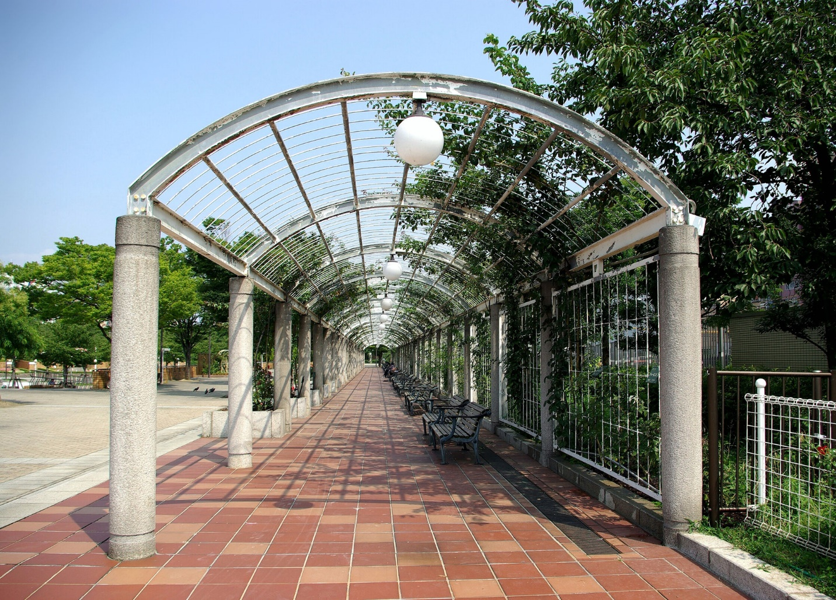
One-point perspective

Slide 27
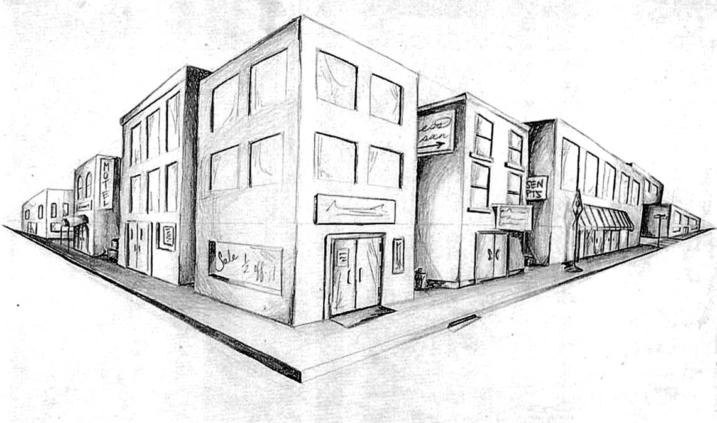
Two-point perspective
v_{y}
v_{x}

Slide 28
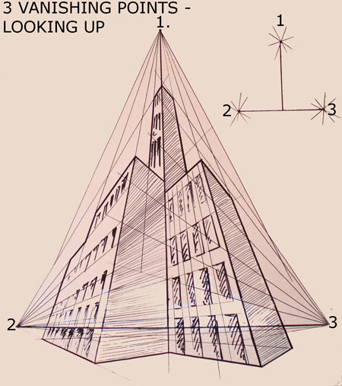
Three-point perspective

Slide 29
Questions?

Slide 30
Vanishing lines
v₁
v₂
Multiple Vanishing Points
Any set of parallel lines on the plane define a vanishing point
The union of all of these vanishing points is the horizon line
also called vanishing line
Note that different planes (can) define different vanishing lines

Slide 31
Vanishing lines
Multiple Vanishing Points
Any set of parallel lines on the plane define a vanishing point
The union of all of these vanishing points is the horizon line
also called vanishing line
Note that different planes (can) define different vanishing lines

Slide 32
Computing vanishing points
V
P₀
D

Slide 33
Computing vanishing points
V
P₀
D
Properties
P∞ is a point at infinity, v is its projection
Depends only on line direction
Parallel lines P₀ + tD, P₁ + tD intersect at P∞

Slide 34
Computing vanishing lines
v₁
l
v₂
C
l
ground plane
Properties
l is intersection of horizontal plane through C with image plane
Compute l from two sets of parallel lines on ground plane
All points at same height as C project to l
points higher than C project above l
Provides way of comparing height of objects in the scene

Slide 35

Notes:
Is this parachuter higher or lower than the person taking this picture?
Lower—he is below the horizon

Slide 36
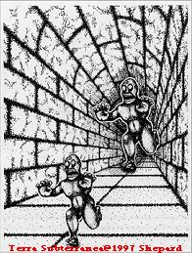
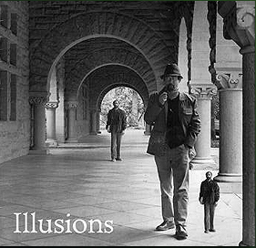
Fun with vanishing points

Slide 37
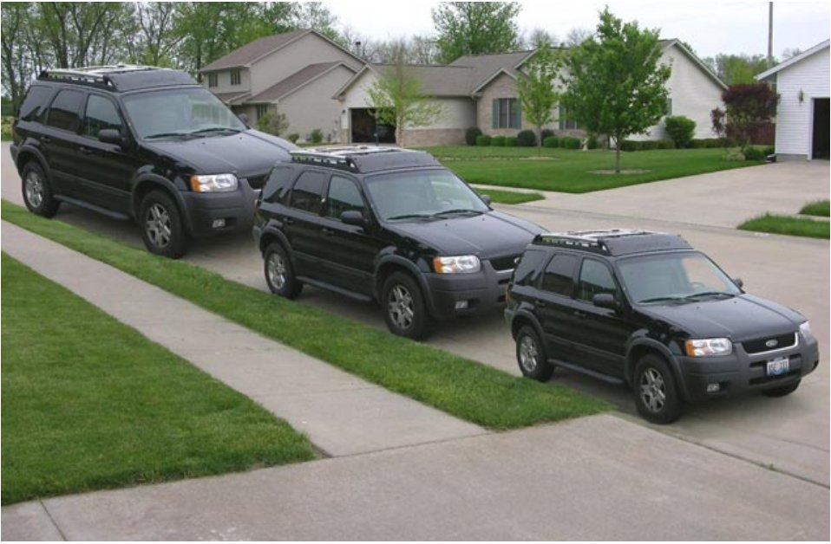
Lots of fun with vanishing points

Slide 38
Perspective cues

Slide 39
Perspective cues

Slide 40
Perspective cues

Slide 41
Comparing heights
Vanishing
Point

Slide 42
Measuring height
5.4
5
How high is the camera?
Camera height
4
3.3
3
2.8
2
1

Slide 43
Computing vanishing points (from lines)
v
q₂
q₁
p₂
p₁
Intersect p₁q₁ with p₂q₂
Least squares version
Better to use more than two lines and compute the “closest” point of intersection
See notes by Bob Collins for one good way of doing this:
http://www-2.cs.cmu.edu/~ph/869/www/notes/vanishing.txt

Slide 44


Measuring height without a ruler
H
R

Slide 45
Measuring height without a ruler
C
Z
ground plane
Compute Z from image measurements
Need more than vanishing points to do this

Slide 46
The cross ratio
A Projective Invariant
Something that does not change under projective transformations (including perspective projection)
The cross-ratio of 4 collinear points
P₄
P₃
P₂
P₁
Can permute the point ordering
4! = 24 different orders (but only 6 distinct values)
This is the fundamental invariant of projective geometry

Slide 47
Measuring height
∞
scene cross ratio
T (top of object)
t
r
R (reference point)
C
H
b
R
image cross ratio
v_{Z}
B (bottom of object)
ground plane
scene points represented as
image points as

Slide 48
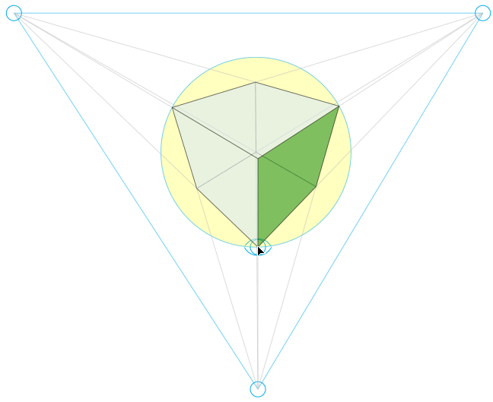
Finding the vertical (z) vanishing point
Find intersection of projections of vertical lines

Slide 49

Measuring height
v_{z}
r
vanishing line (horizon)
t₀
t
v_{x}
v
v_{y}
H
R
H
b₀
b
image cross ratio

Slide 50
Measuring height
v_{z}
r
t₀
vanishing line (horizon)
v_{x}
v
v_{y}
m₀
t₁
b₀
b₁
b
What if the point on the ground plane b₀ is not known?
Here the person is standing on the box, height of box is known
Use one side of the box to help find b₀ as shown above

Slide 51

3D modeling from a photograph
St. Jerome in his Study, H. Steenwick
Bringing Pictorial Space to Life: Computer Techniques for the Analysis of Paintings. Antonio Criminisi, Martin Kemp, Andrew Zisserman. 2002.

Slide 52
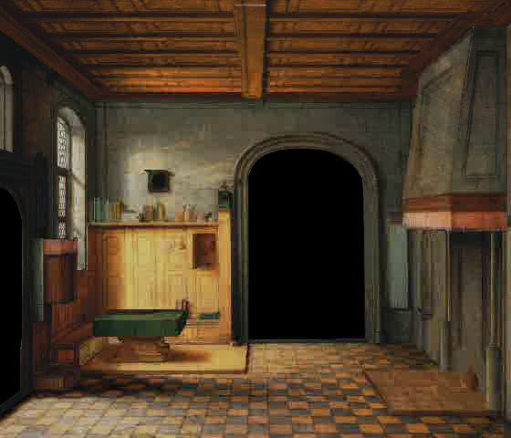
3D modeling from a photograph

Slide 53
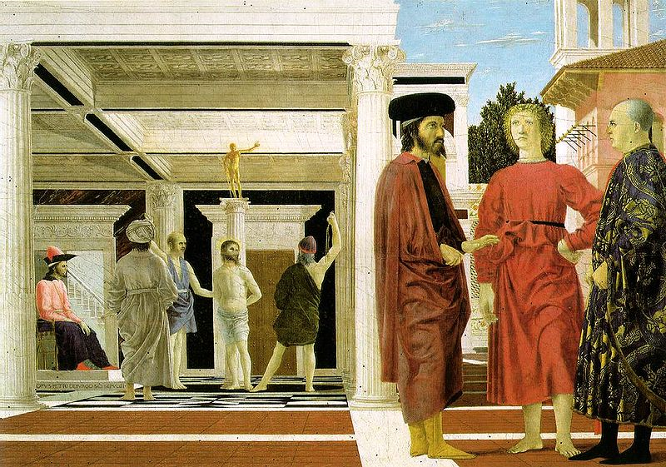
3D modeling from a photograph
Flagellation, Piero della Francesca

Slide 54
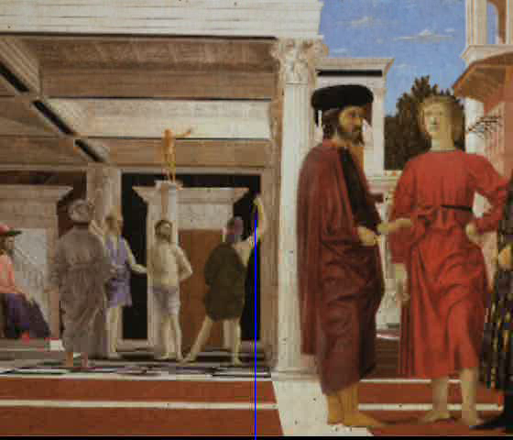
3D modeling from a photograph
video by Antonio Criminisi

Slide 55
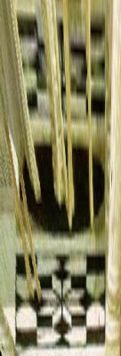
3D modeling from a photograph
Flagellation. Piero della Francesca. c1453.

Slide 56
Related problem: camera calibration
Goal: estimate the camera parameters
Version 1: solve for 3x4 projection matrix
Version 2: solve for camera parameters separately
intrinsics (focal length, principal point, pixel size)
extrinsics (rotation angles, translation)
radial distortion

Slide 57
Vanishing points and projection matrix
= v_{x} (X vanishing point)
similarly,
π
=
v
,
π
=
v
2
Y
3
Z
Not So Fast! We only know v’s up to a scale factor
Can fully specify by providing 3 reference points with known coordinates

Slide 58
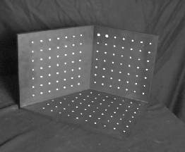
Calibration using a reference object
Place a known object in the scene
identify correspondence between image and scene
compute mapping from scene to image
Issues
must know geometry very accurately
must know 3D -> 2D correspondence

Slide 59
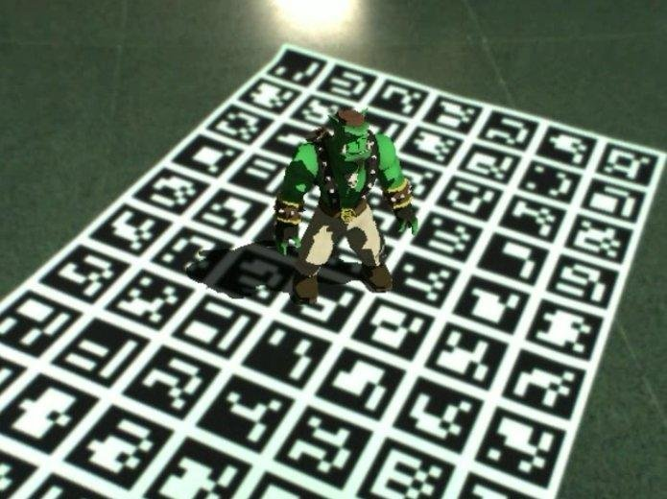
AR codes
ArUco

Slide 60
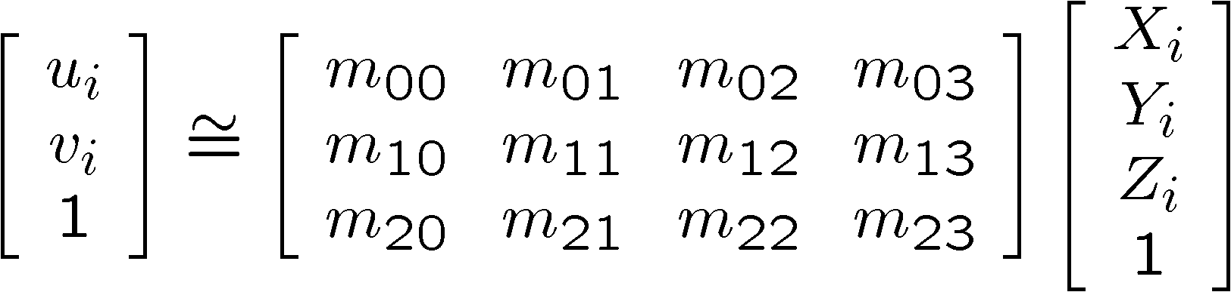
Estimating the projection matrix
Place a known object in the scene
identify correspondence between image and scene
compute mapping from scene to image

Slide 61
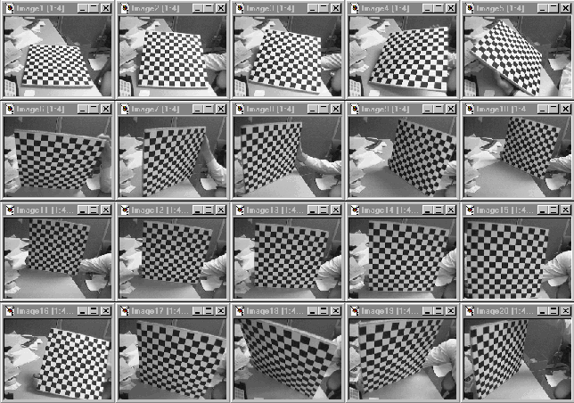
Alternative: multi-plane calibration
Images courtesy Jean-Yves Bouguet
Advantage
Only requires a plane
Don’t have to know positions/orientations
Good code available online! (including in OpenCV)
Matlab version by Jean-Yves Bouget: http://www.vision.caltech.edu/bouguetj/calib_doc/index.html
Amy Tabb’s camera calibration software: https://github.com/amy-tabb/basic-camera-calibration

Slide 62
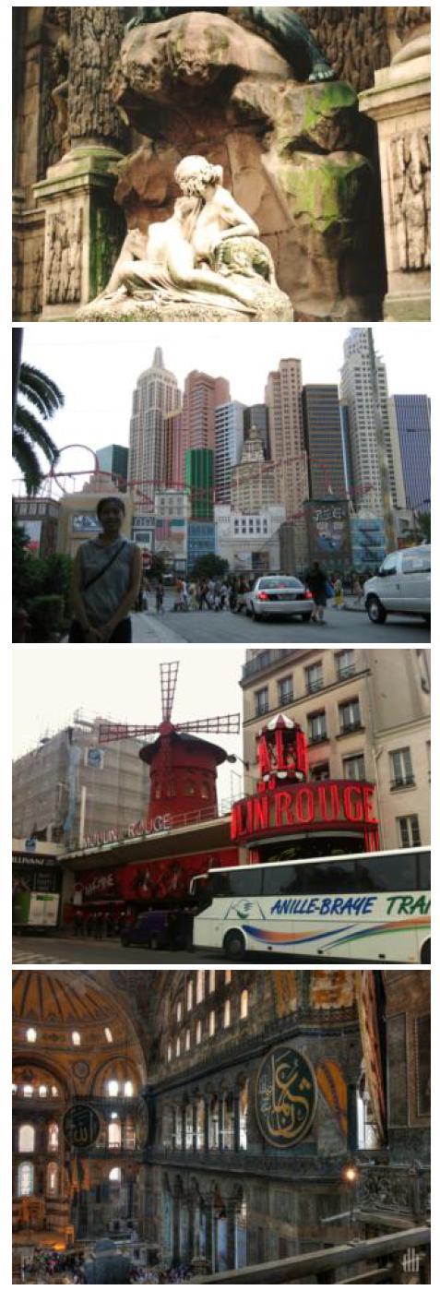
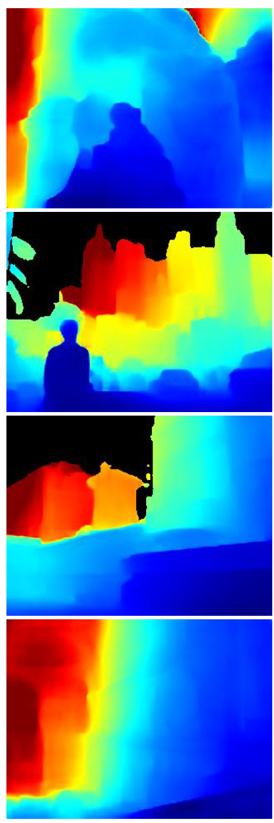
Single-image depth prediction using deep learning
Deep learning
Li and Snavely. Megadepth: Learning single-view depth prediction from internet photos. CVPR 2018.
Image
Depth map

Slide 63

MiDaS depth prediction
Ranftl et al. Towards Robust Monocular Depth Estimation: Mixing Datasets for Zero-shot Cross-dataset Transfer.
https://gradio.app/g/AK391/MiDaS
https://github.com/intel-isl/MiDaS

Slide 64

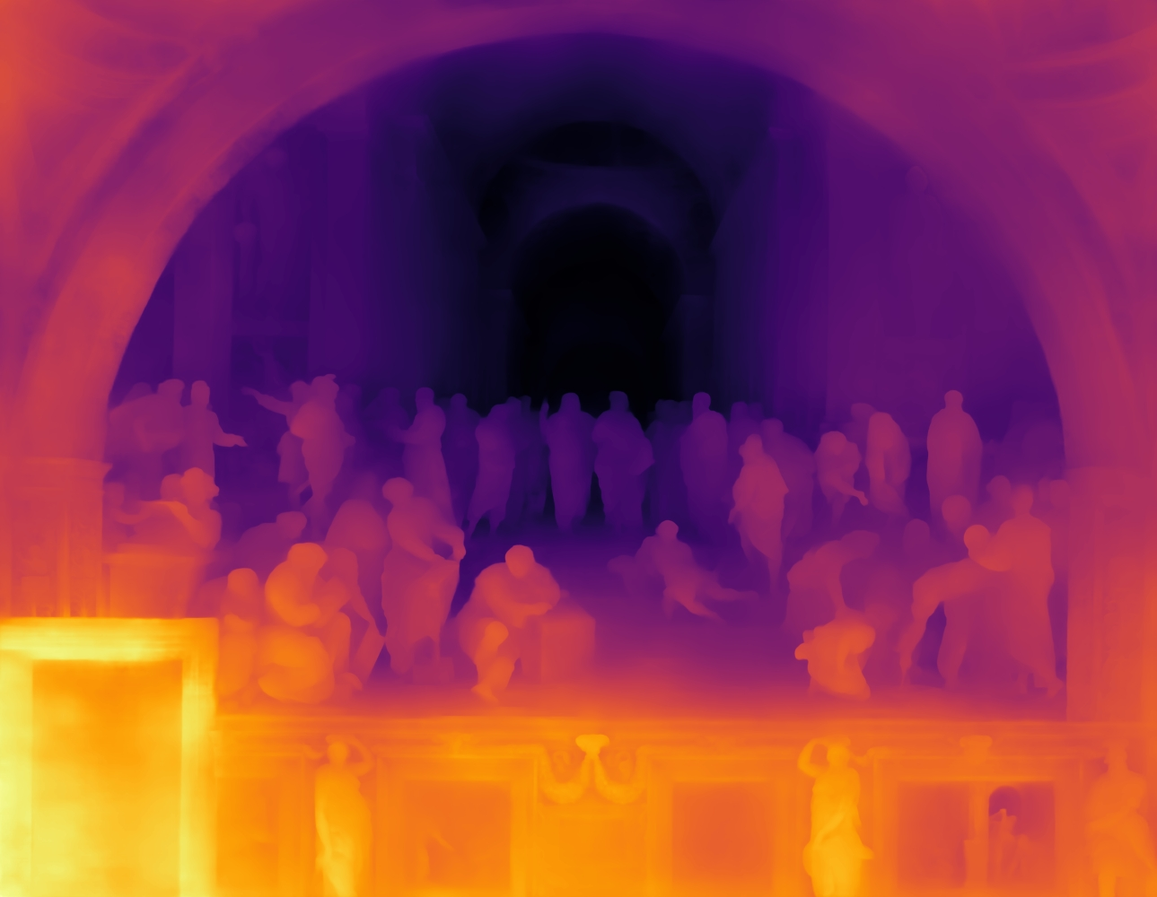

Single-image depth prediction
Picture credit: Magritte, The Treachery of Images, and the Berkeley Computer Vision Group
Miangoleh*, Dille*, Mai, Paris, and Aksoy.
Boosting Monocular Depth Estimation Models to High-Resolution via Content-Adaptive Multi-Resolution Merging.
CVPR 2021.
Notes:
So where to go from here? I think there are a lot of very interesting open directions. Of all of these Im2Scene tasks, single-view depth prediction is one of the most mature.
Beautiful ambiguity of perception.
Yağız Aksoy, SFU

Slide 65
Deep geometry prediction
More on this topic later!

Slide 66
Questions?

