Slide 1
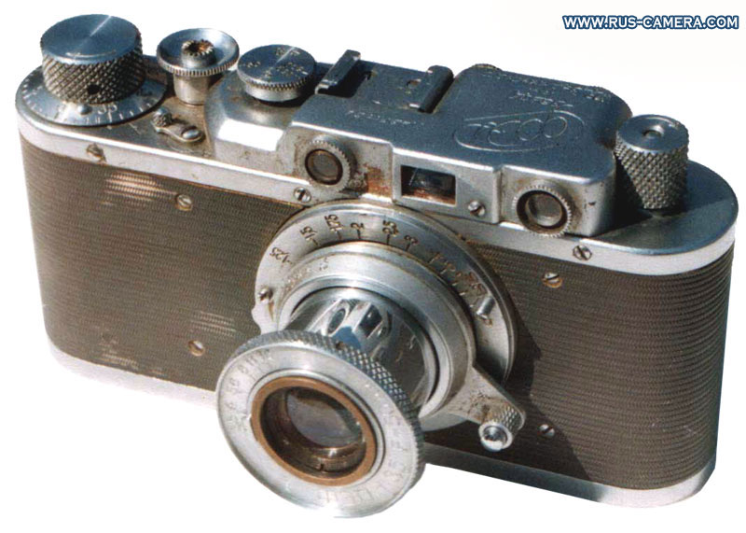
Cameras
CS5670: Computer Vision
Source: S. Lazebnik

Slide 2
Announcements
Take-home midterm handed out at the end of class
Due Tuesday, March 8, by 1pm (beginning of class)
Project 2 due tonight by 8pm
Report due Monday by 11:59pm
Project 3: Panorama Stitching
To be released next Tuesday, March 8
Tentative due date on Friday, April 2

Slide 3
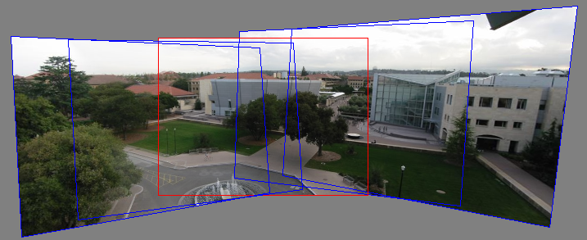
Can we use homographies to create a 360 panorama?
In order to figure this out, we need to learn what a camera is

Slide 4
Image formation
Let’s design a camera
Idea 1: put a piece of film in front of an object
Do we get a reasonable image?
No. This is a bad camera.

Slide 5
Pinhole camera
Add a barrier to block off most of the rays
This reduces blurring
The opening known as the aperture
How does this transform the image?
Notes:
It gets inverted

Slide 6
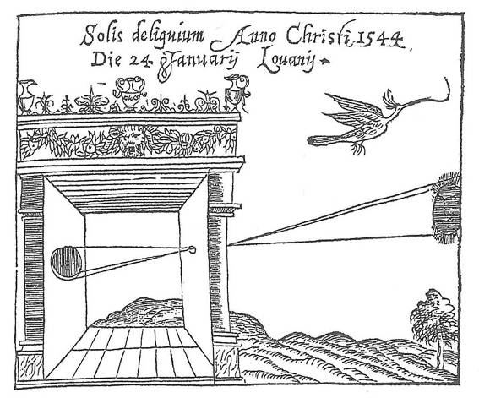
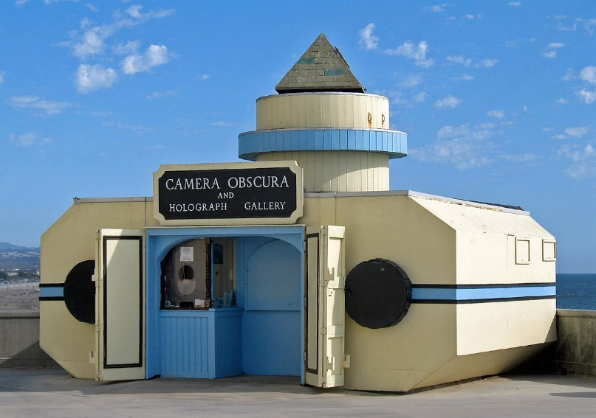
Camera Obscura
Basic principle known to Mozi (470-390 BC), Aristotle (384-322 BC)
Drawing aid for artists: described by Leonardo da Vinci (1452-1519)
Gemma Frisius, 1558
Source: A. Efros

Slide 7
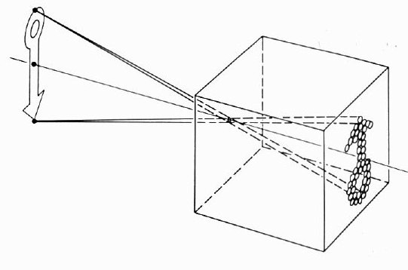
Camera Obscura

Slide 8
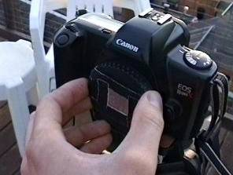
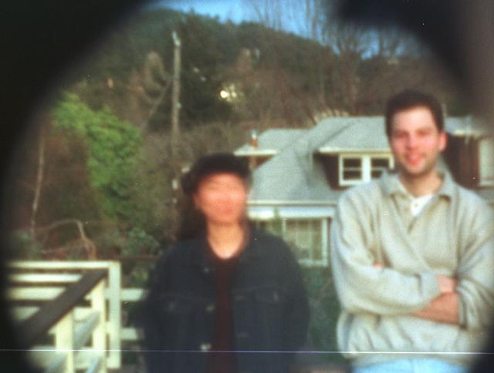
Home-made pinhole camera
Why so blurry?
Slide by A. Efros
http://www.debevec.org/Pinhole/

Slide 9
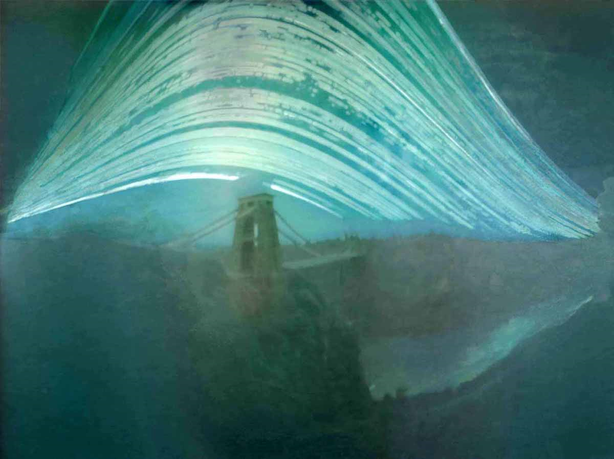
Pinhole photography
Justin Quinnell, The Clifton Suspension Bridge. December 17th 2007 - June 21st 2008 6-month exposure

Slide 10
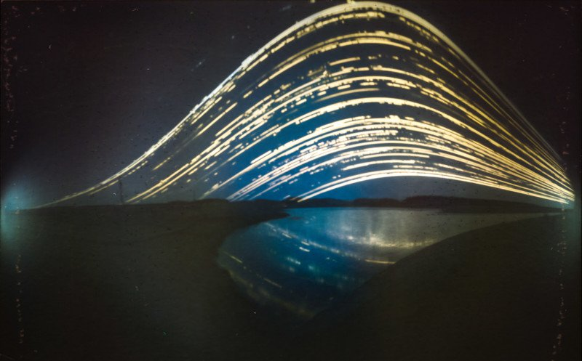
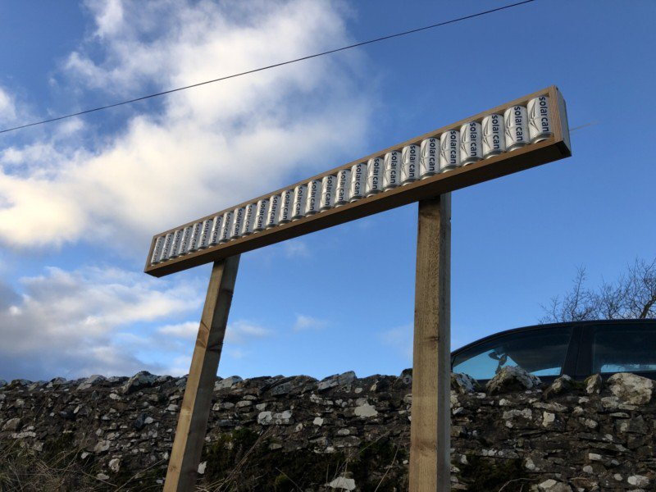
https://petapixel.com/2019/07/17/this-is-the-worlds-first-solargraphy-timelapse/

Slide 11
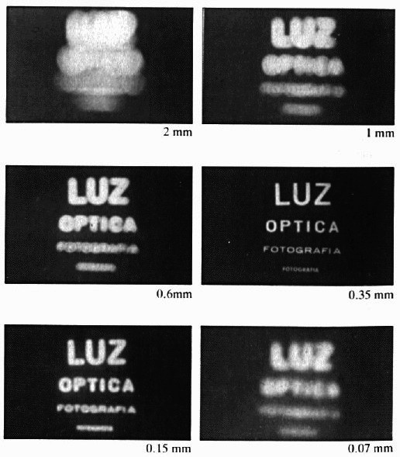
Shrinking the aperture
Why not make the aperture as small as possible?
Less light gets through
Diffraction effects...

Slide 12
Shrinking the aperture

Slide 13
Adding a lens
“circle of
confusion”
A lens focuses light onto the film
There is a specific distance at which objects are “in focus”
other points project to a “circle of confusion” in the image
Changing the shape of the lens changes this distance

Slide 14
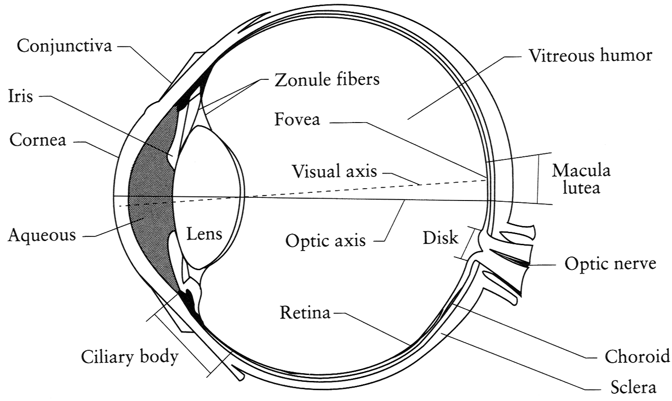
The eye
The human eye is a camera
Iris - colored annulus with radial muscles
Pupil - the hole (aperture) whose size is controlled by the iris
What’s the “film”?
photoreceptor cells (rods and cones) in the retina
Notes:
Note that the retina is curved

Slide 15
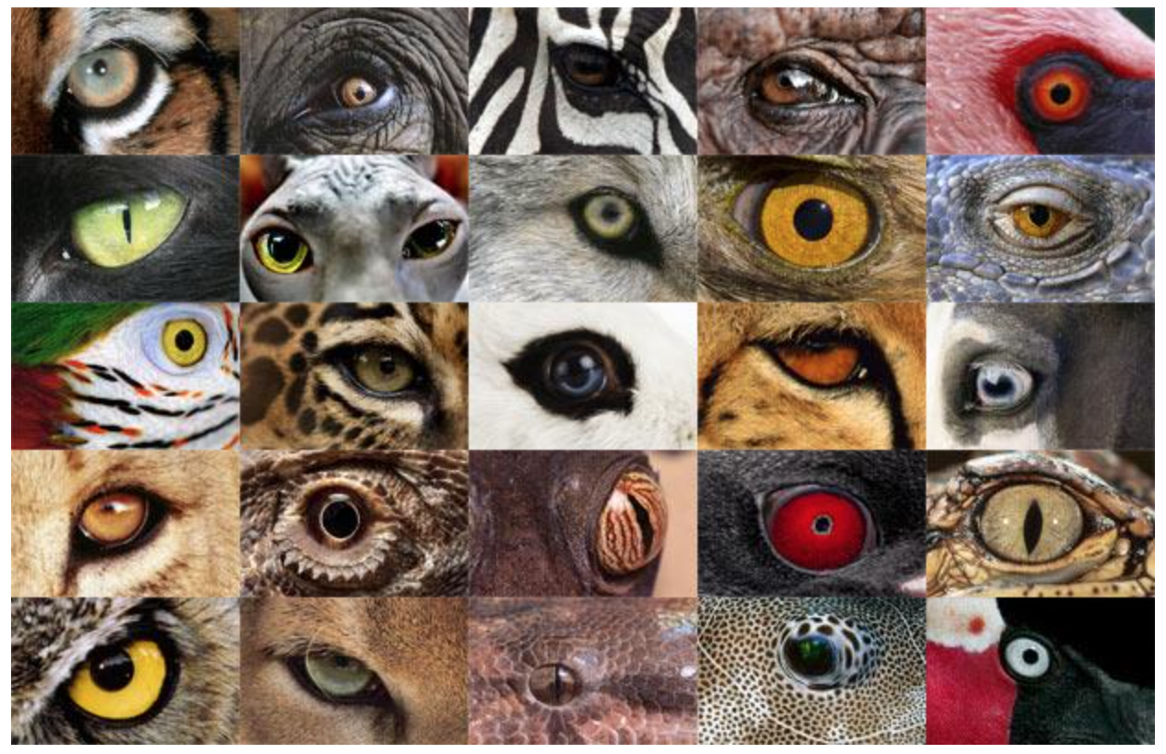
http://www.telegraph.co.uk/news/earth/earthpicturegalleries/7598120/Animal-eyes-quiz-Can-you-work-out-which-creatures-these-are-from-their-eyes.html?image=25

Slide 16
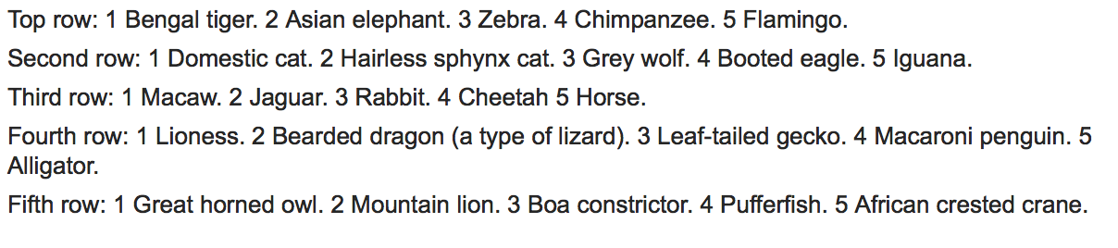
http://www.telegraph.co.uk/news/earth/earthpicturegalleries/7598120/Animal-eyes-quiz-Can-you-work-out-which-creatures-these-are-from-their-eyes.html?image=25

Slide 17

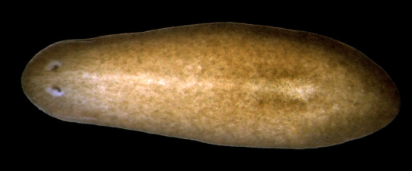
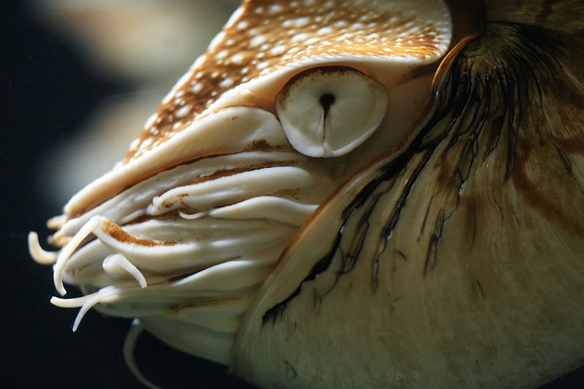
Eyes in nature: eyespots to pinhole camera
http://upload.wikimedia.org/wikipedia/commons/6/6d/Mantis_shrimp.jpg

Slide 18
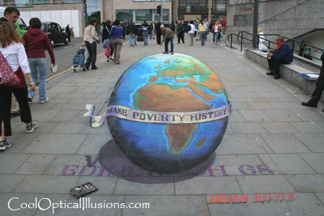
Projection

Slide 19
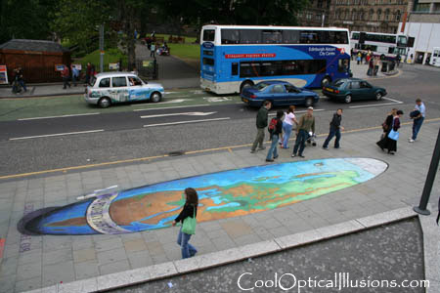
Projection

Slide 20
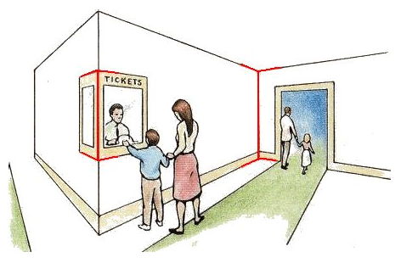
Müller-Lyer Illusion
https://en.wikipedia.org/wiki/Müller-Lyer_illusion

Slide 21
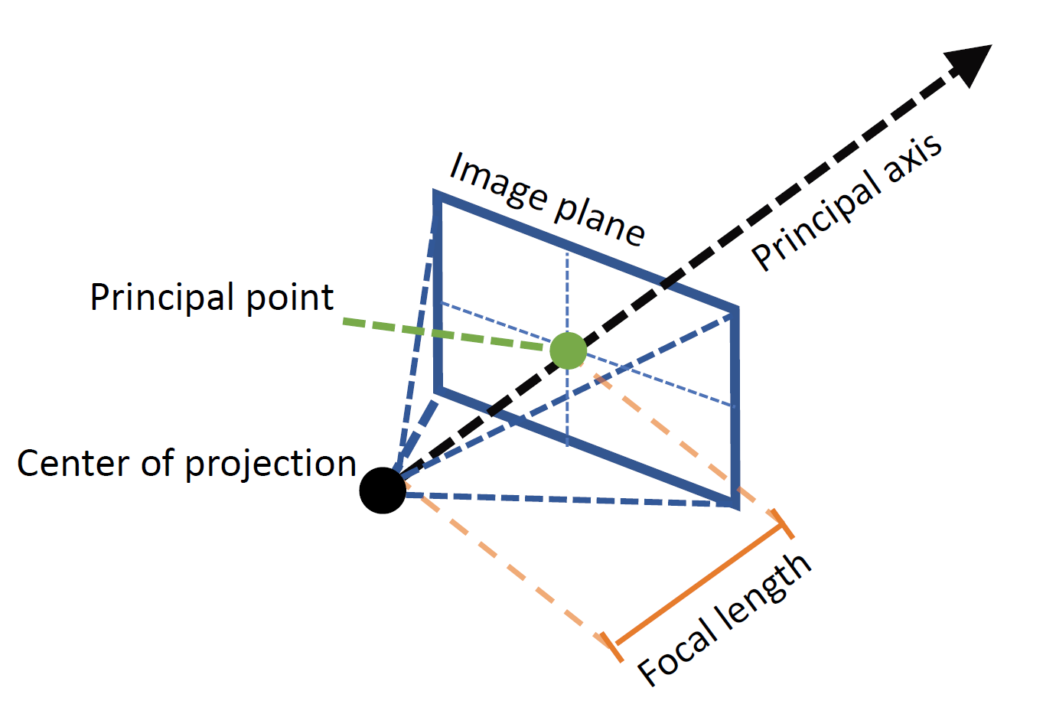
Geometric Model: A Pinhole Camera
Figure credit: Peter Hedman

Slide 22
Modeling projection
Center of Projection (COP)
(x’, y’, f)
The coordinate system
We use the pinhole model as an approximation
Put the optical center (aka Center of Projection, or COP) at the origin
Put the Image Plane (aka Projection Plane) in front of the COP (Why)?
The camera looks down the positive z-axis, and the y-axis points down
we like this if we want right-handed-coordinates
other versions are possible (e.g., OpenGL)
(x, y, z)
z
f
x
Image Plane
y
Notes:
This way the image is right-side-up

Slide 23
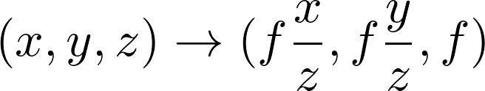
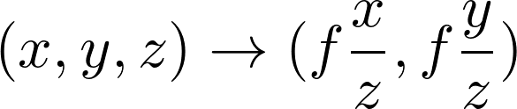




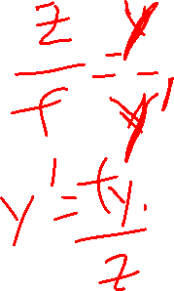
Modeling projection
Center of Projection (COP)
(x’, y’, f)
Projection equations
Compute intersection with PP of ray from (x,y,z) to COP
Derived using similar triangles
We get the projection by throwing out the last coordinate:
(x, y, z)
z
f
x
Image Plane
y
Notes:
This way the image is right-side-up

Slide 24
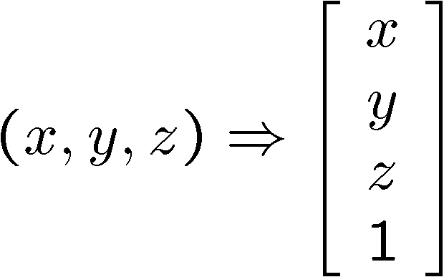
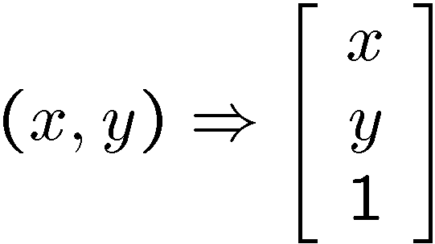
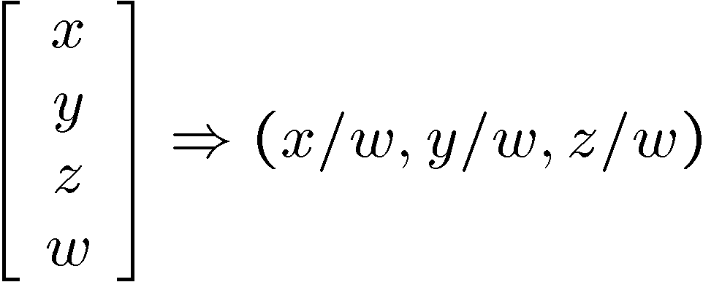
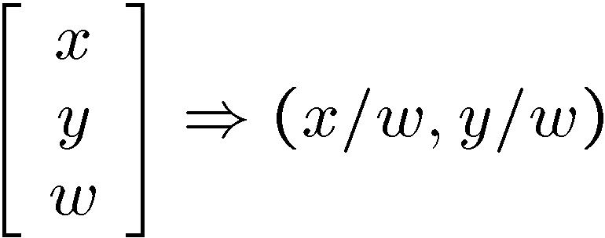
Modeling projection
Is this a linear transformation?
no—division by z is nonlinear
Homogeneous coordinates to the rescue—again!
homogeneous image
coordinates
homogeneous scene
coordinates
Converting from homogeneous coordinates

Slide 25
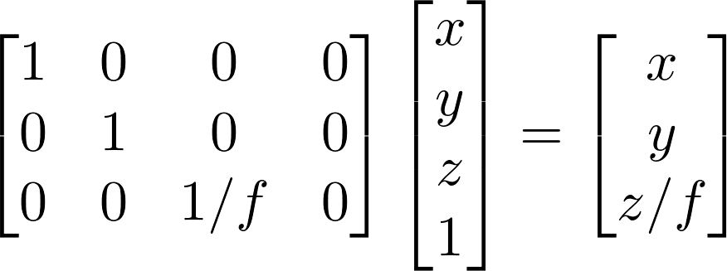
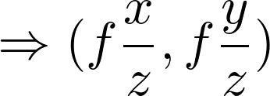
Perspective Projection
Projection is a matrix multiply using homogeneous coordinates:
divide by third coordinate
This is known as perspective projection
The matrix is the projection matrix
(Can also represent as a 4x4 matrix – OpenGL does something like this)
Notes:
$$
\begin{bmatrix}
1 & 0 & 0 & 0 \\
0 & 1 & 0 & 0 \\
0 & 0 & 1/f & 0
\end{bmatrix}
\begin{bmatrix}
x \\
y \\
z \\
1
\end{bmatrix}
=
\begin{bmatrix}
x \\
y \\
z / f
\end{bmatrix}
$$

Slide 26
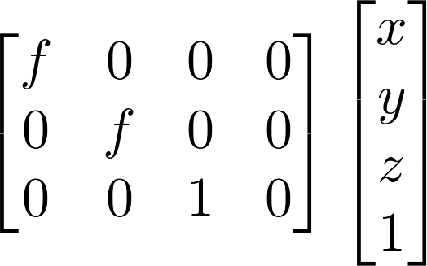
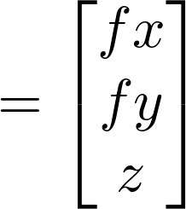
Perspective Projection
How does scaling the projection matrix change the transformation?
Scale by f:
Scaling a projection matrix produces an equivalent projection matrix!

Slide 27
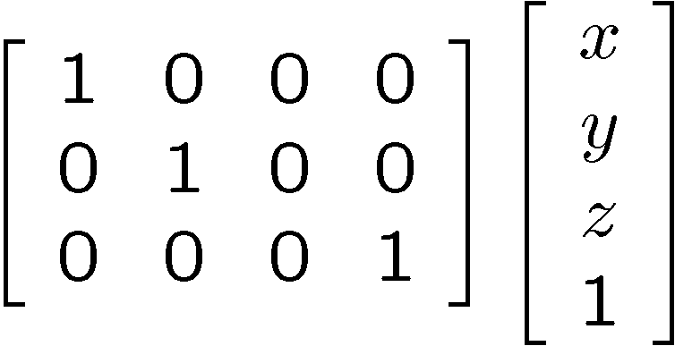
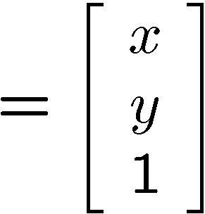

Orthographic projection
Special case of perspective projection
Distance from the COP to the PP is infinite
Good approximation for telephoto optics
Also called “parallel projection”: (x, y, z) → (x, y)
What’s the projection matrix?
Image
World

Slide 28
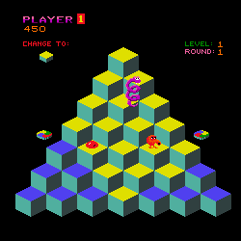
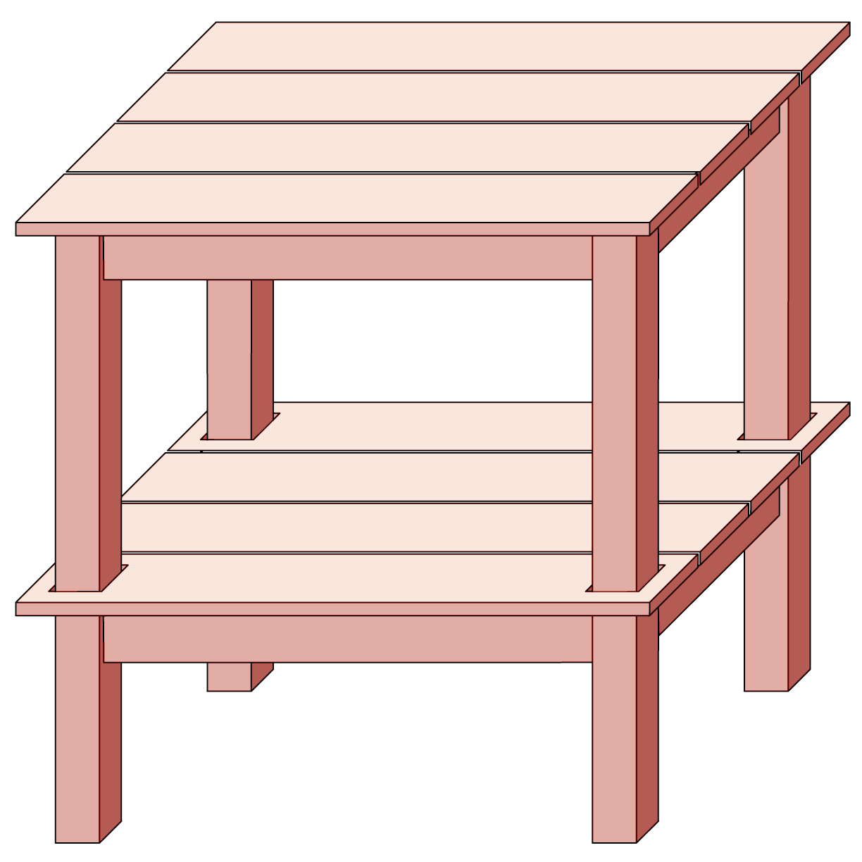
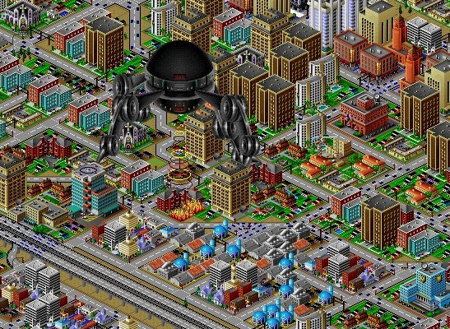
Orthographic projection

Slide 29
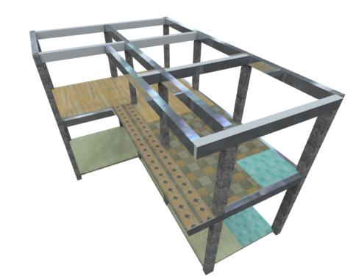
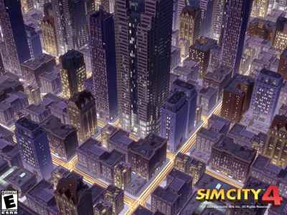
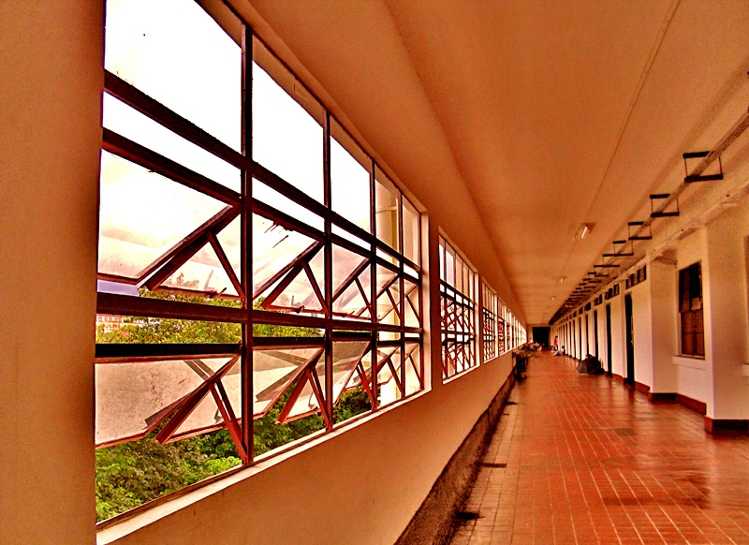
Perspective projection

Slide 30
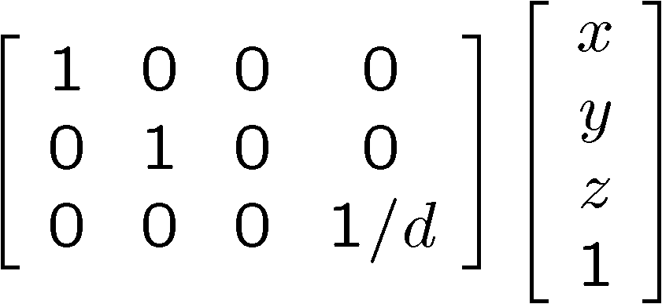
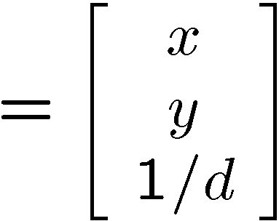

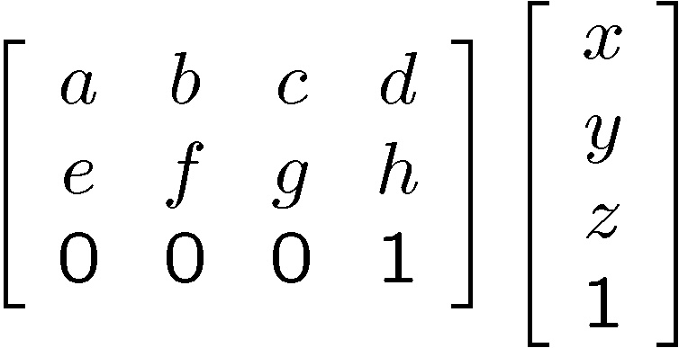
Variants of orthographic projection
Scaled orthographic
Also called “weak perspective”
Affine projection
Also called “paraperspective”

Slide 31
Dimensionality Reduction Machine (3D to 2D)
3D world
2D image
What have we lost?
Angles
Distances (lengths)
Slide by A. Efros
Figures © Stephen E. Palmer, 2002

Slide 32
Projection properties
Many-to-one: any points along same ray map to same point in image
Points → points
Lines → lines (collinearity is preserved)
But line through focal point projects to a point
Planes → planes (or half-planes)
But plane through focal point projects to line

Slide 33
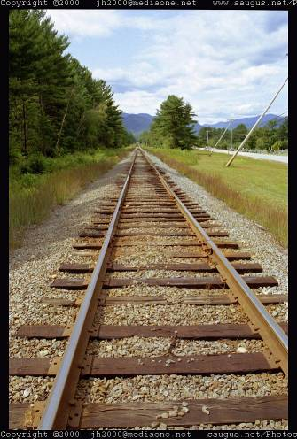
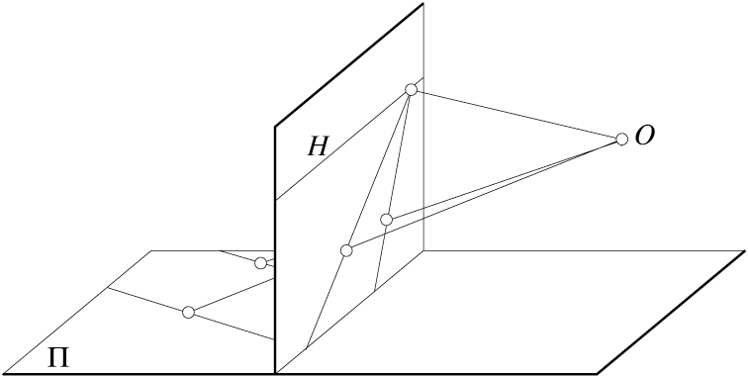
Projection properties
Parallel lines converge at a vanishing point
Each direction in space has its own vanishing point
But parallel lines parallel to the image plane remain parallel

Slide 34
Questions?

Slide 35

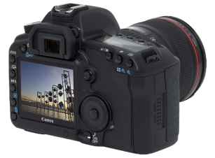
Camera parameters
How can we model the geometry of a camera?
Camera
w
y
(x, y, z)
COP
u
v
Three important coordinate systems:
World coordinates
Camera coordinates
Image coordinates
o
x
z
“The World”
How do we project a given world point (x, y, z) to an image point?

Slide 36
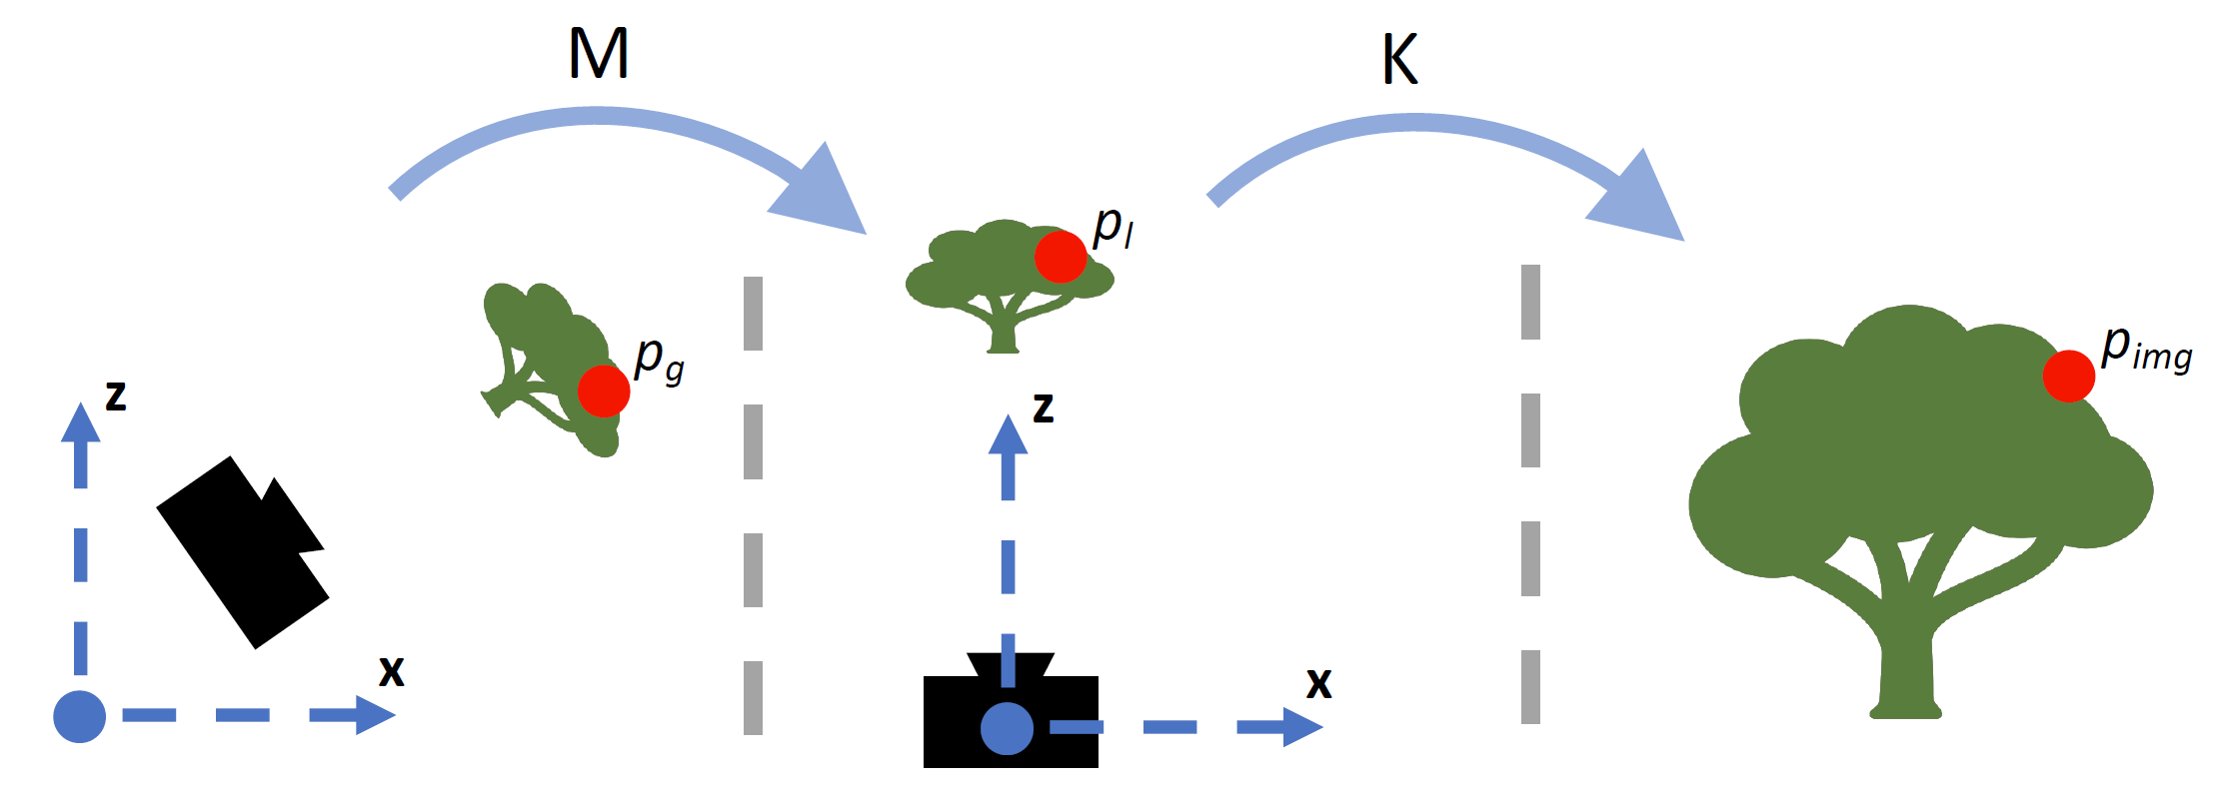
Coordinate frames
World coordinates
Camera coordinates
Image coordinates
Figure credit: Peter Hedman

Slide 37
Camera parameters
To project a point (x, y, z) in world coordinates into a camera
First transform (x, y, z) into camera coordinates
Need to know
Camera position (in world coordinates)
Camera orientation (in world coordinates)
Then project into the image plane to get image (pixel) coordinates
Need to know camera intrinsics

Slide 38

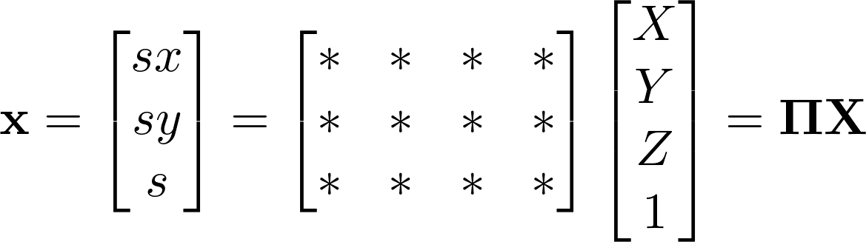


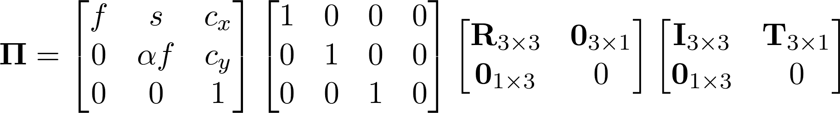
Camera parameters
A camera is described by several parameters
Translation T of the optical center from the origin of world coords
Rotation R of the image plane
focal length f, principal point (c_{x}, c_{y}), pixel aspect size α
blue parameters are called “extrinsics,” red are “intrinsics”
Projection equation
The projection matrix models the cumulative effect of all parameters
Useful to decompose into a series of operations
identity matrix
intrinsics
projection
rotation
translation
The definitions of these parameters are not completely standardized
especially intrinsics—varies from one book to another

Slide 39










Projection matrix
=
0
(in homogeneous image coordinates)

Slide 40
Extrinsics
How do we get the camera to “canonical form”?
Canonical form: Center of projection at the origin, x-axis points right, y-axis points down, z-axis points forwards
Step 1: Translate by -c
0

Slide 41
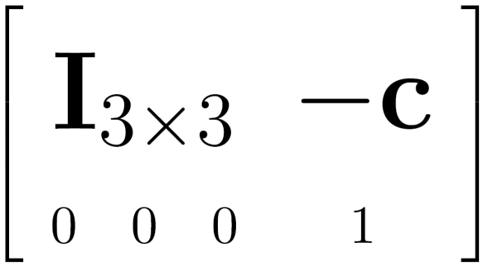

Extrinsics
How do we get the camera to “canonical form”?
Canonical form: Center of projection at the origin, x-axis points right, y-axis points down, z-axis points forwards
Step 1: Translate by -c
How do we represent translation as a matrix multiplication?
0

Slide 42
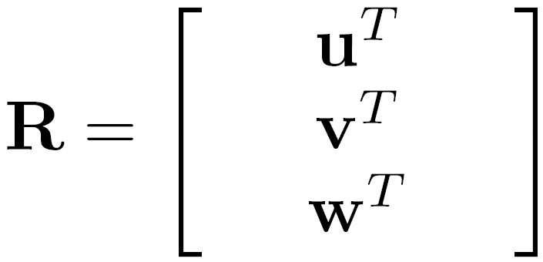
Extrinsics
How do we get the camera to “canonical form”?
Canonical form: Center of projection at the origin, x-axis points right, y-axis points down, z-axis points forwards
Step 1: Translate by -c
Step 2: Rotate by R
0
3x3 rotation matrix

Slide 43
Extrinsics
How do we get the camera to “canonical form”?
Canonical form: Center of projection at the origin, x-axis points right, y-axis points down, z-axis points forwards
Step 1: Translate by -c
Step 2: Rotate by R
0
(with extra row/column of [0 0 0 1])

Slide 44






Perspective projection
(converts from 3D rays in camera coordinate system to pixel coordinates)
(intrinsics)
in general,
(upper triangular matrix)
: aspect ratio (1 unless pixels are not square)
: skew (0 unless pixels are shaped like rhombi/parallelograms)
: principal point ((w/2,h/2) unless optical axis doesn’t intersect projection plane at image center)

Slide 45

Typical intrinsics matrix
2D affine transform corresponding to a scale by f (focal length) and a translation by (c_{x}, c_{y}) (principal point)
Maps 3D rays to 2D pixels

Slide 46






Focal length
Can think of as “zoom”
Also related to field of view
24mm
50mm
200mm
800mm

Slide 47


Field of view

Slide 48


Slide 49


Slide 50


Slide 51


Slide 52

Notes:
http://www.stsite.com/camera/telephoto-wideangle.php
Wide angle deepens
Telephoto magnifies and pulls it in

Slide 53

http://petapixel.com/2013/01/11/how-focal-length-affects-your-subjects-apparent-weight-as-seen-with-a-cat/

Slide 54


Projection matrix
intrinsics
projection
rotation
translation
This part converts 3D points in world coordinates to 3D rays in the camera’s coordinate system. There are 6 parameters represented (3 for position/translation, 3 for rotation).
The K matrix converts 3D rays in the camera’s coordinate system to 2D image points in image (pixel) coordinates.

Slide 55


Projection matrix
intrinsics
projection
rotation
translation
(t in book’s notation)

Slide 56
Projection matrix
=
0
(in homogeneous image coordinates)

Slide 57
Questions?

Slide 58

Perspective distortion
Problem for architectural photography: converging verticals
Source: F. Durand

Slide 59


Perspective distortion
Problem for architectural photography: converging verticals
Solution: view camera (lens shifted w.r.t. film)
Tilting the camera upwards results in converging verticals
Keeping the camera level, with an ordinary lens, captures only the bottom portion of the building
Shifting the lens upwards results in a picture of the entire subject
http://en.wikipedia.org/wiki/Perspective_correction_lens
Source: F. Durand

Slide 60
Perspective distortion
Problem for architectural photography: converging verticals
Result:
Source: F. Durand

Slide 61
Perspective distortion
What does a sphere project to?
Image source: F. Durand

Slide 62


Perspective distortion
The exterior columns appear bigger
The distortion is not due to lens flaws
Problem pointed out by Da Vinci
Slide by F. Durand

Slide 63

https://aaronhertzmann.com/2022/02/28/how-does-perspective-work.html

Slide 64

Perspective distortion: People

Slide 65

Distortion-Free Wide-Angle Portraits on Camera Phones
YiChang Shih, Wei-Sheng Lai, and Chia-Kai Liang, Distortion-Free Wide-Angle Portraits on Camera Phones, SIGGRAPH 2019
https://people.csail.mit.edu/yichangshih/wide_angle_portrait/

Slide 66

Distortion
No distortion
Pin cushion
Barrel
Radial distortion of the image
Caused by imperfect lenses
Deviations are most noticeable for rays that pass through the edge of the lens

Slide 67



Slide 68

Radial distortion
Arrows show motion of projected points relative to an ideal (distortion-free lens)
[Image credit: J. Bouguet http://www.vision.caltech.edu/bouguetj/calib_doc/htmls/example.html]

Slide 69


Correcting radial distortion
from Helmut Dersch

Slide 70



Distortion

Slide 71




Modeling distortion
Project to “normalized” image coordinates
Apply radial distortion
Apply focal length translate image center
To model lens distortion
Use above projection operation instead of standard projection matrix multiplication

Slide 72
Other types of projection
Lots of intriguing variants…
(I’ll just mention a few fun ones)

Slide 73

360 degree field of view…
Basic approach
Take a photo of a parabolic mirror with an orthographic lens (Nayar)
Or buy one a lens from a variety of omnicam manufacturers…
See http://www.cis.upenn.edu/~kostas/omni.html

Slide 74



Tilt-shift
http://www.northlight-images.co.uk/article_pages/tilt_and_shift_ts-e.html
Tilt-shift images from Olivo Barbieri and Photoshop imitations

Slide 75


Rotating sensor (or object)
Rollout Photographs © Justin Kerr
http://research.famsi.org/kerrmaya.html
Also known as “cyclographs”, “peripheral images”

Slide 76
Questions?

