Slide 1
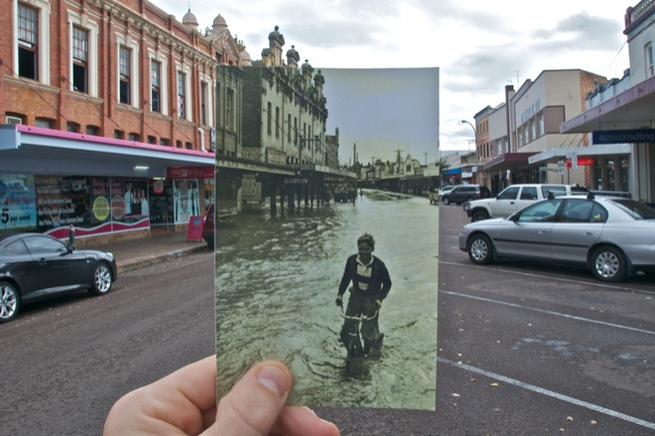
RANSAC
CS5760: Computer Vision
http://www.wired.com/gadgetlab/2010/07/camera-software-lets-you-see-into-the-past/

Slide 2
Reading
Szeliski (2nd edition): Chapter 8.1

Slide 3
Announcements
Project 2 due Thursday, March 3 by 8pm
Please get started now if you haven’t already!
Report due next Monday, March 7 by 11:59pm on CMSX
Take-home midterm to be released after February Break
To be released at 2:15pm Thursday, March 3
Due Tuesday, March 8 by 1pm
Open book, open note (but no Google)
To be done on your own

Slide 4
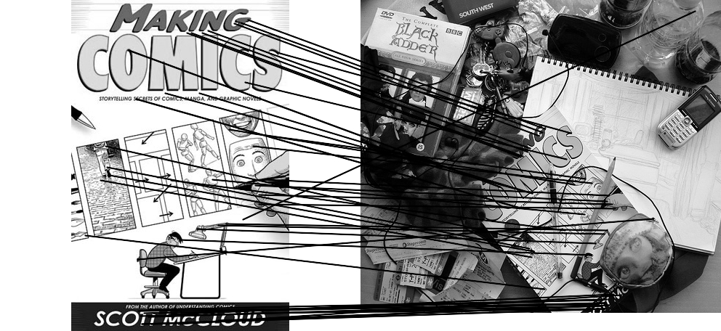
Outliers
outliers
inliers

Slide 5
Robustness
Let’s consider the problem of linear regression
How can we fix this?
Problem: Fit a line to these datapoints
Least squares fit

Slide 6
We need a better cost function…
Suggestions?

Slide 7
Idea
Given a hypothesized line
Count the number of points that “agree” with the line
“Agree” = within a small distance of the line
I.e., the inliers to that line
For all possible lines, select the one with the largest number of inliers

Slide 8
Counting inliers

Slide 9
Counting inliers
Inliers: 3

Slide 10
Counting inliers
Inliers: 20

Slide 11
How do we find the best line?
Unlike least-squares, no simple closed-form solution
Hypothesize-and-test
Try out many lines, keep the best one
Which lines?

Slide 12
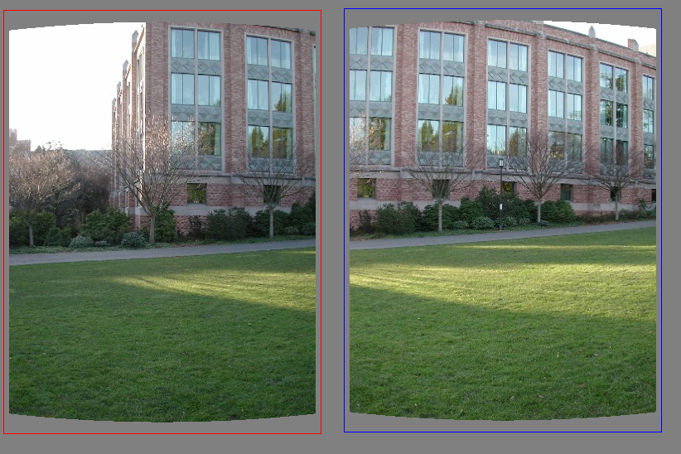
Translations

Slide 13
RAndom SAmple Consensus
Select one match at random, count inliers

Slide 14
RAndom SAmple Consensus
Select another match at random, count inliers

Slide 15
RAndom SAmple Consensus
Output the translation with the highest number of inliers

Slide 16
RANSAC
Idea:
All the inliers will agree with each other on the translation vector; the (hopefully small) number of outliers will (hopefully) disagree with each other
RANSAC only has guarantees if there are < 50% outliers
“All good matches are alike; every bad match is bad in its own way.”
– Tolstoy via Alyosha Efros

Slide 17
RANSAC
Inlier threshold related to the amount of noise we expect in inliers
Often model noise as Gaussian w/ some standard deviation (e.g. 3 pixels)
Number of rounds related to the percentage of outliers we expect, and the probability of success we’d like to guarantee
Suppose there are 20% outliers, and we want to find the correct answer with at least 99% probability
How many rounds do we need?

Slide 18
Scratch space

Slide 19
RANSAC: Another view
y translation
set threshold so that, e.g., 95% of the Gaussian
lies inside that radius
x translation

Slide 20
RANSAC
Back to linear regression
How do we generate a hypothesis?
y
x

Slide 21
RANSAC
Back to linear regression
How do we generate a hypothesis?
y
x

Slide 22
RANSAC
General version:
Randomly choose s samples
Typically s = minimum sample size that lets you fit a model
Fit a model (e.g., line) to those samples
Count the number of inliers that approximately fit the model
Repeat N times
Choose the model that has the largest set of inliers

Slide 23
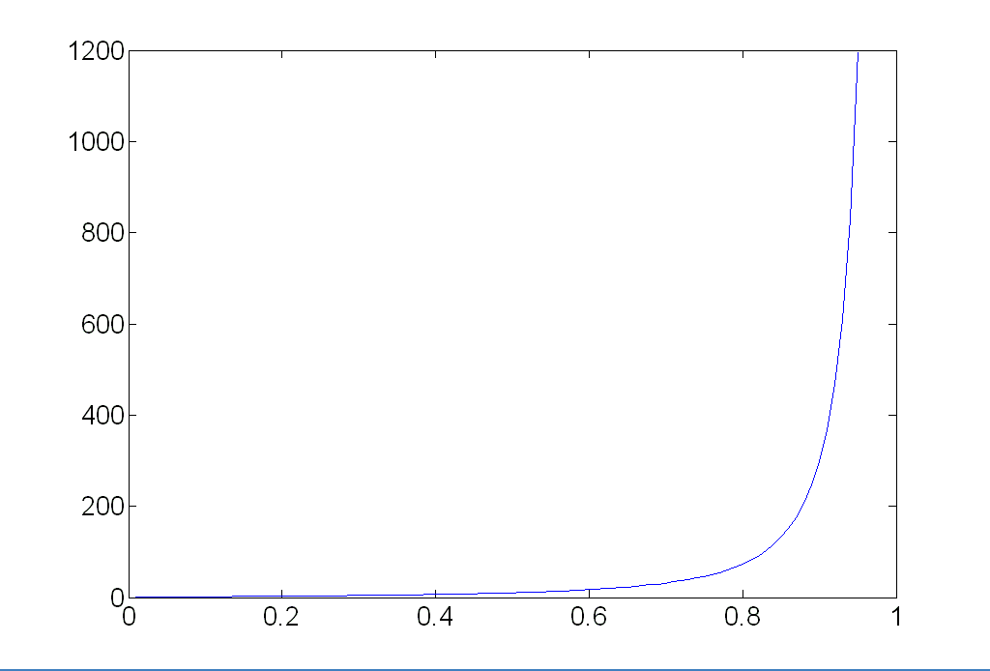
How many rounds?
If we have to choose s samples each time
with an outlier ratio e
and we want the right answer with probability p
 | proportion of outliers e
s | 5% | 10% | 20% | 25% | 30% | 40% | 50%
2 | 2 | 3 | 5 | 6 | 7 | 11 | 17
3 | 3 | 4 | 7 | 9 | 11 | 19 | 35
4 | 3 | 5 | 9 | 13 | 17 | 34 | 72
5 | 4 | 6 | 12 | 17 | 26 | 57 | 146
6 | 4 | 7 | 16 | 24 | 37 | 97 | 293
7 | 4 | 8 | 20 | 33 | 54 | 163 | 588
8 | 5 | 9 | 26 | 44 | 78 | 272 | 1177
p = 0.99
Source: M. Pollefeys

Slide 24
How big is s?
For alignment, depends on the motion model
Here, each sample is a correspondence (pair of matching points)

Slide 25
RANSAC pros and cons
Pros
Simple and general
Applicable to many different problems
Often works well in practice
Cons
Parameters to tune
Sometimes too many iterations are required
Can fail for extremely low inlier ratios
We can often do better than brute-force sampling

Slide 26
Final step: least squares fit
Find average translation vector over all inliers

Slide 27
RANSAC
An example of a “voting”-based fitting scheme
Each hypothesis gets voted on by each data point, best hypothesis wins
There are many other types of voting schemes
E.g., Hough transforms…

Slide 28
Panoramas
Now we know how to create panoramas!
Given two images:
Step 1: Detect features
Step 2: Match features
Step 3: Compute a homography using RANSAC
Step 4: Combine the images together (somehow)
What if we have more than two images?

Slide 29
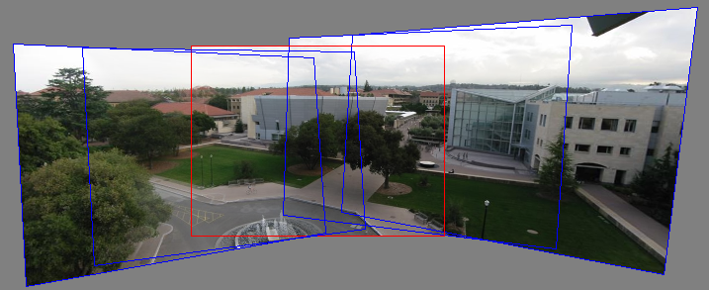
Can we use homographies to create a 360 panorama?
To figure this out, we need to know what a camera is

Slide 30
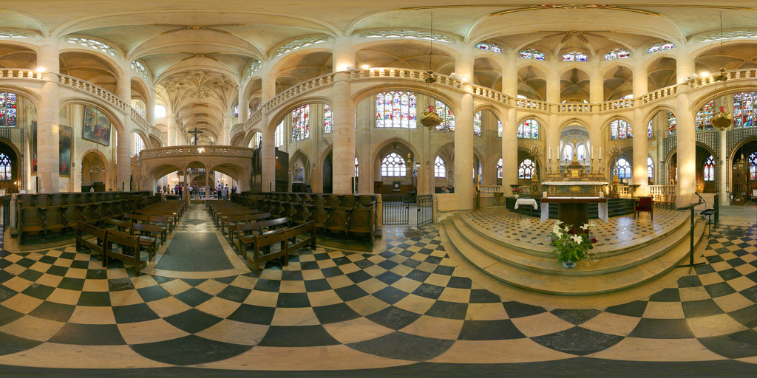
360 panorama

Slide 31
Questions?

