Slide 1
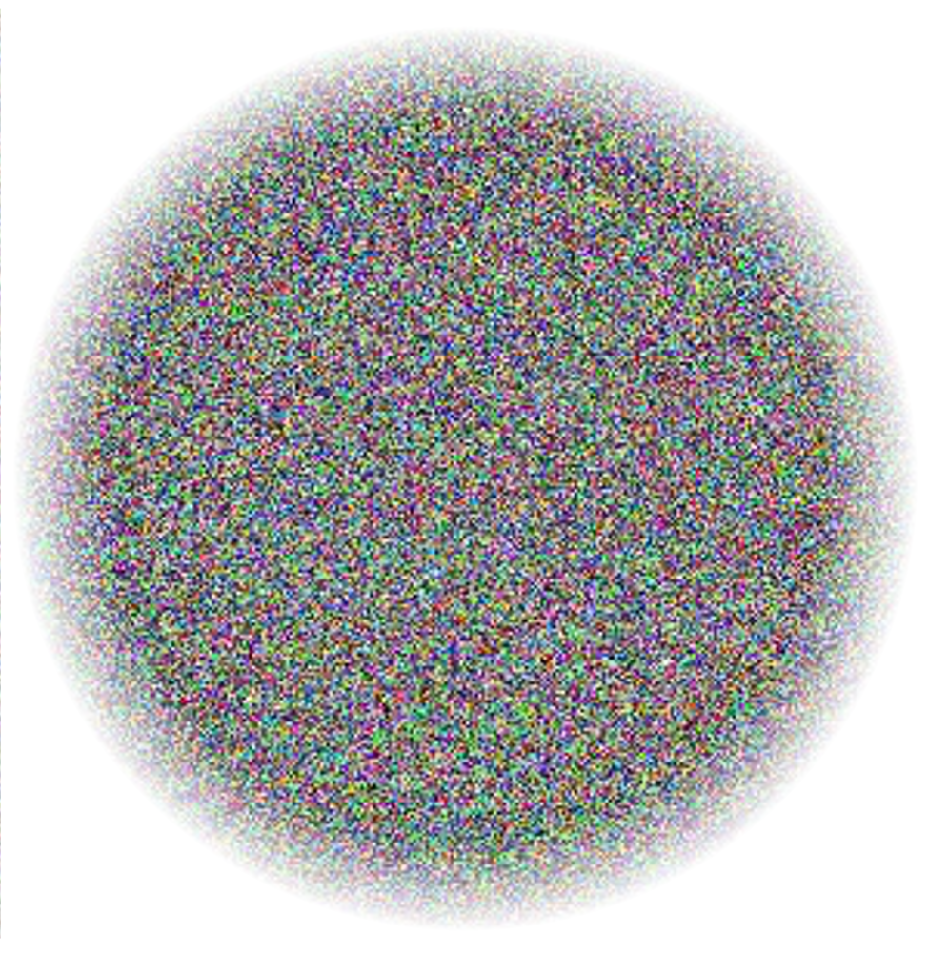
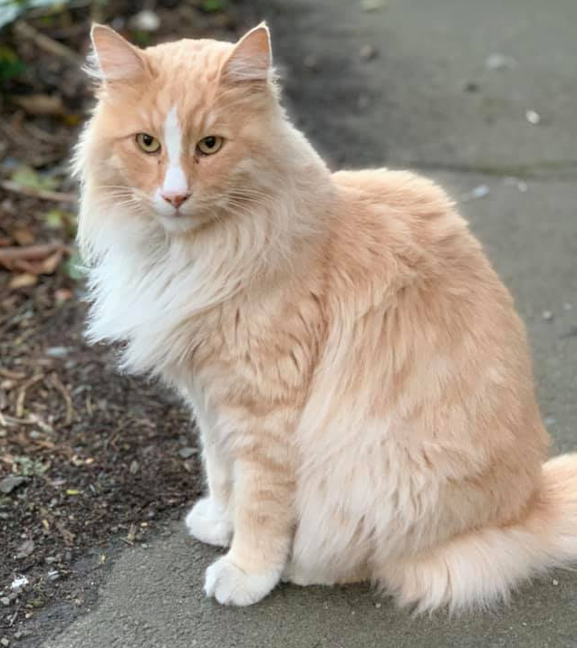
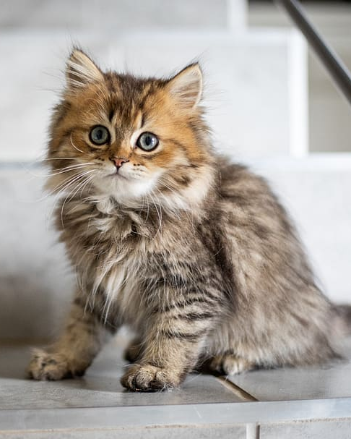
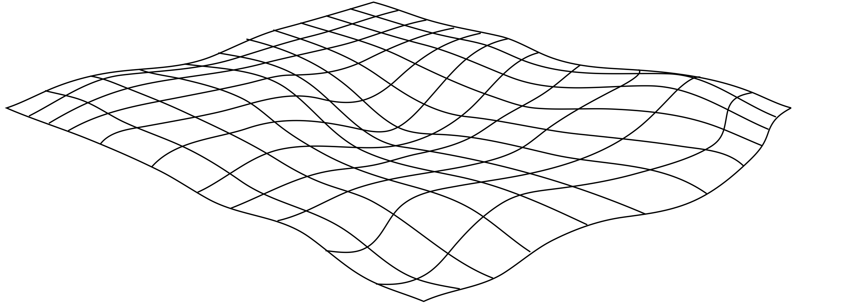
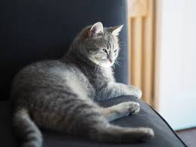
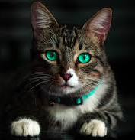
Image Manifolds & Image Synthesis (including GANS)
CS5670: Computer Vision
Most content from Abe Davis, with additional credit to Jin Sun and Phillip Isola

Slide 2
Announcements
Take-home final May 12-17
Project 5 (Convolutional Neural Networks) due Tuesday, May 11, 2021 (7:00 pm)
Course evaluations are open this Friday, May 7 to May 17
We would love your feedback!
Small amount of extra credit for filling out
What you write is still anonymous, instructors only see whether students filled it out
Link coming soon

Slide 3
Agenda
Last time:
How to train convolutional neural networks (CNNs)
This time:
One more note on training CNNs for new tasks
Dimensionality reduction
Neural networks that produce images
Generative Adversarial Networks (GANs)

Slide 4
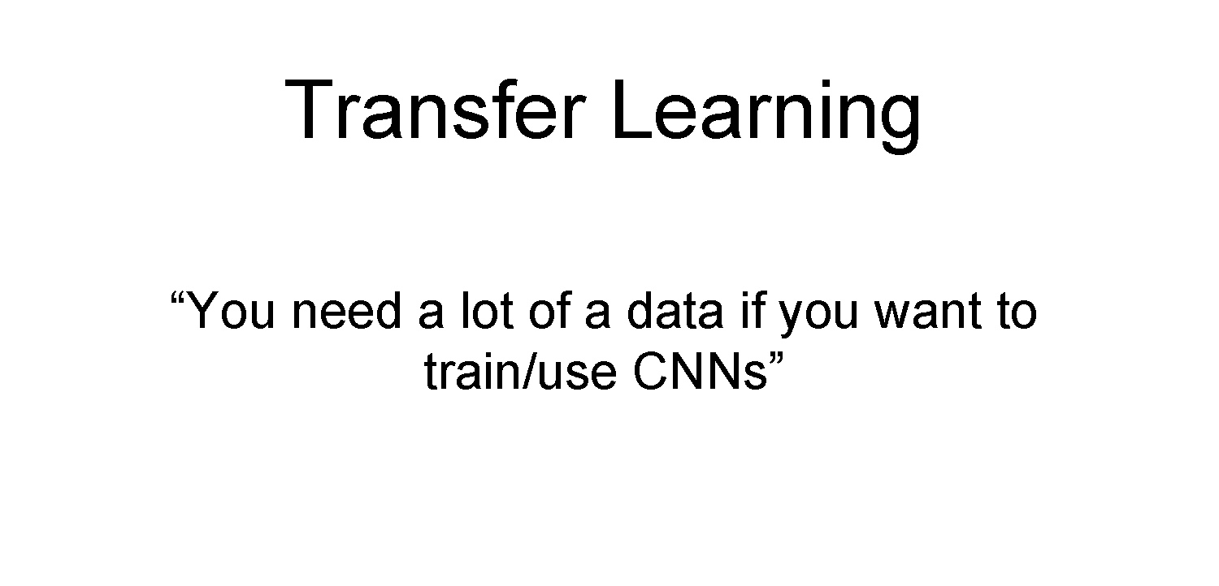

Slide 5
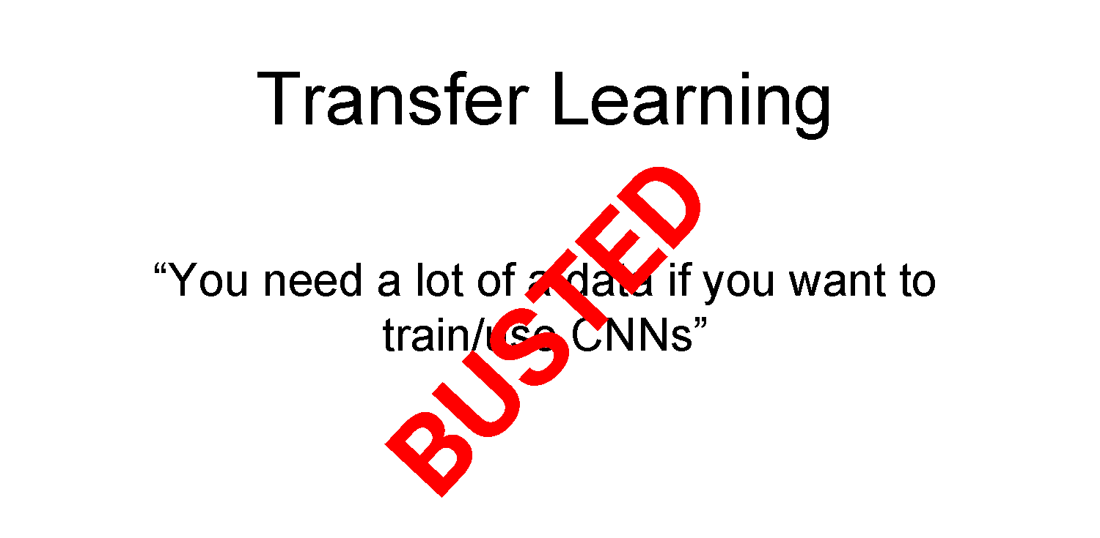

Slide 6
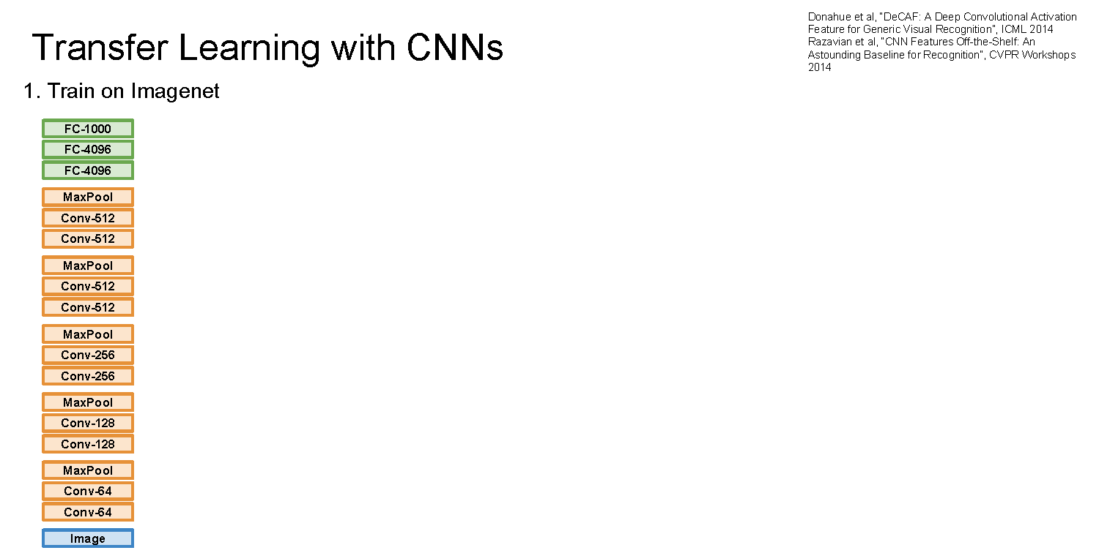

Slide 7
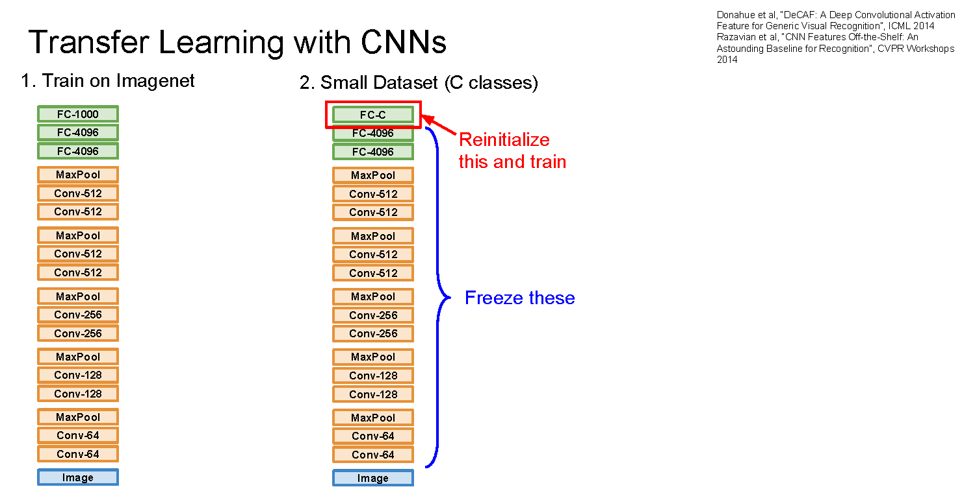

Slide 8
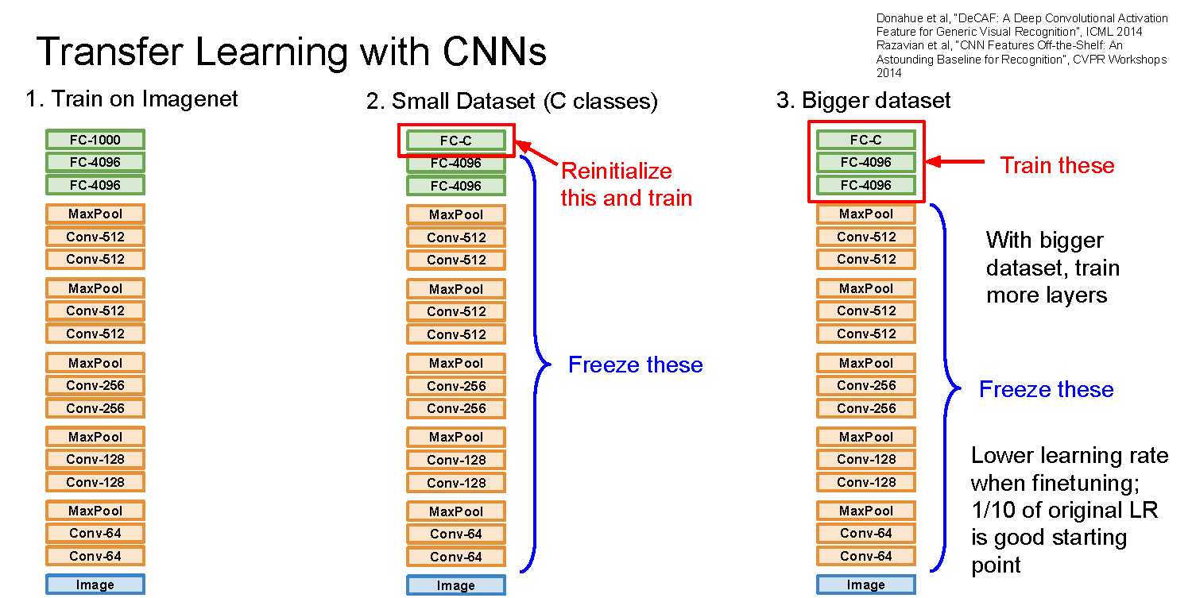

Slide 9
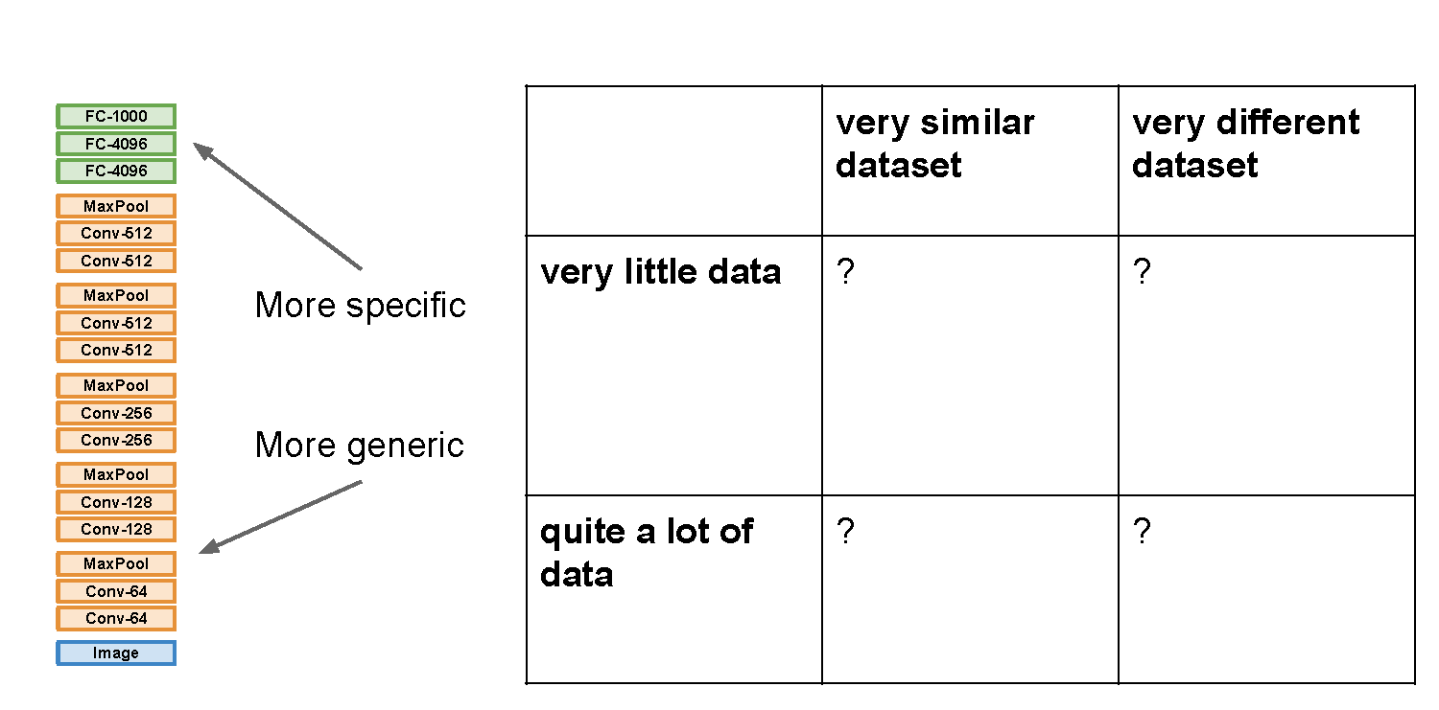

Slide 10
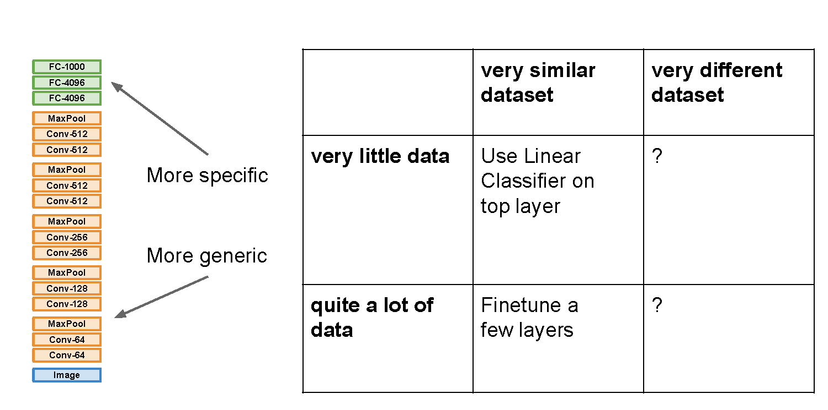

Slide 11
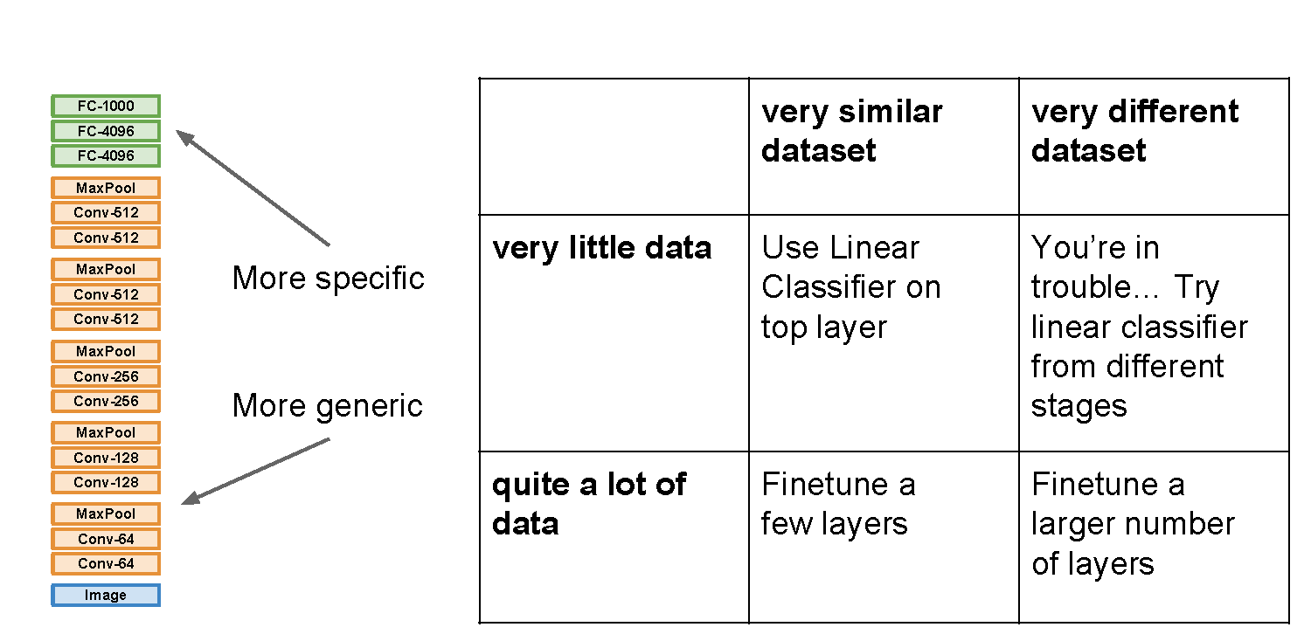

Slide 12
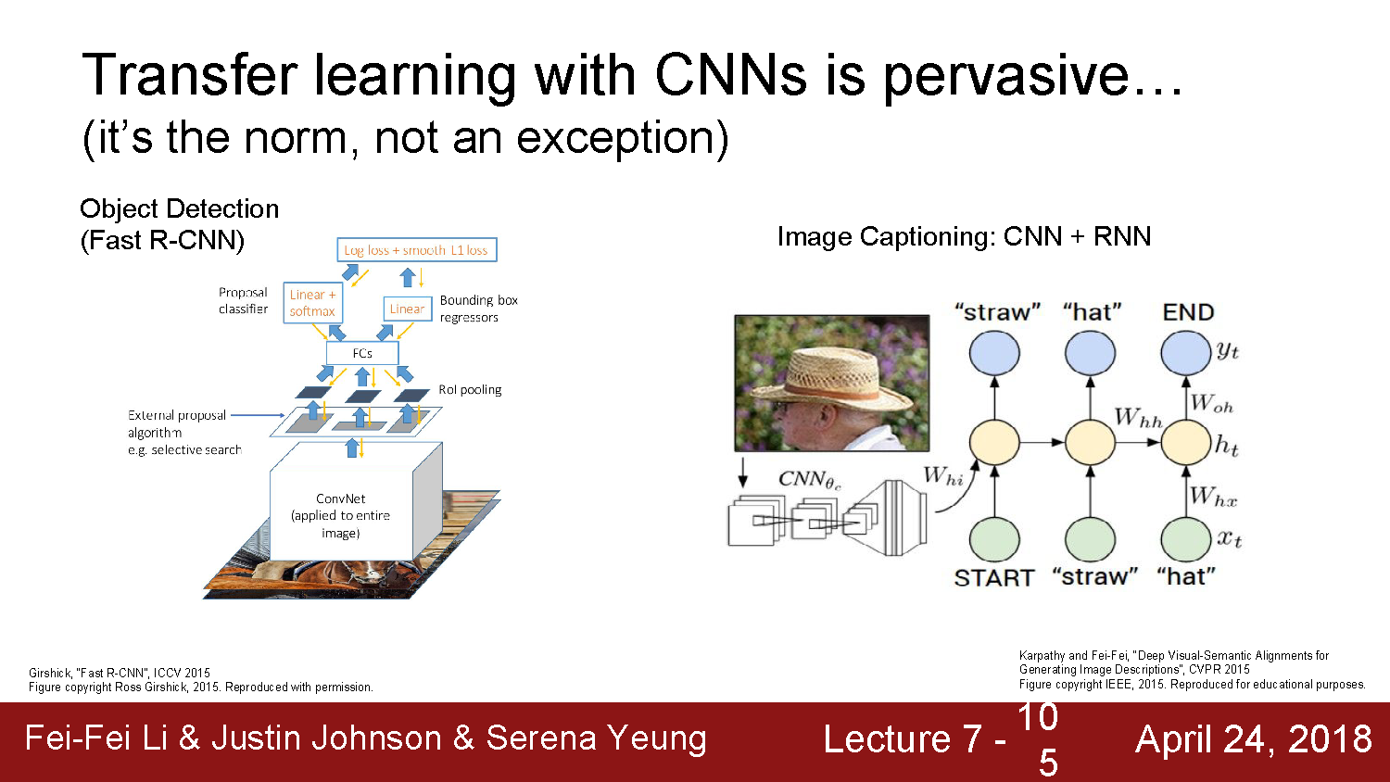

Slide 13
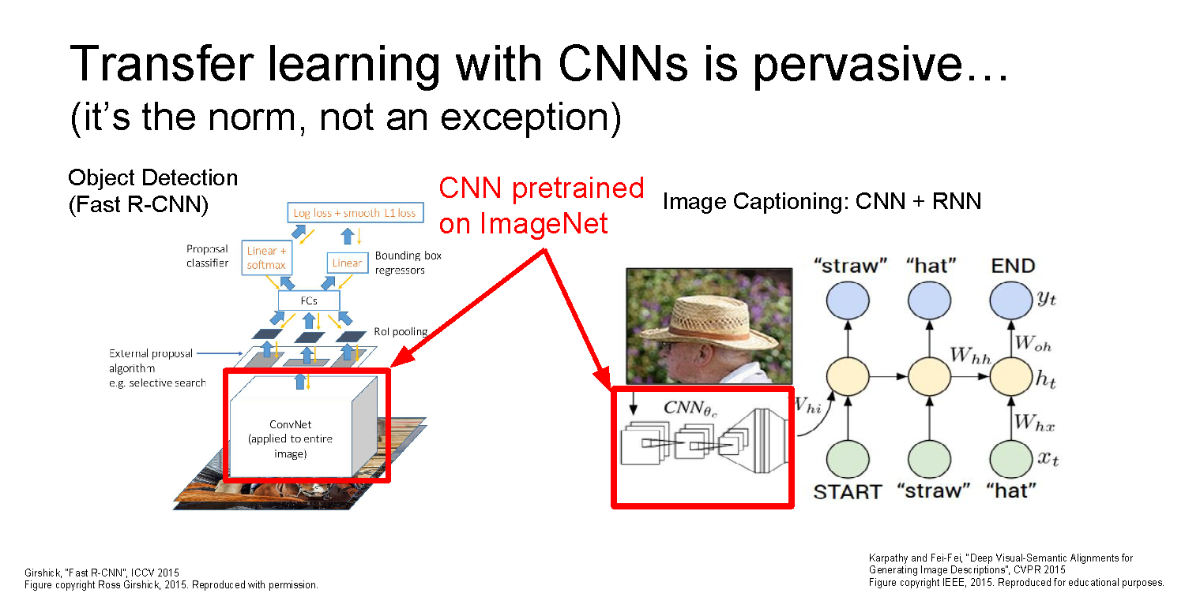

Slide 14
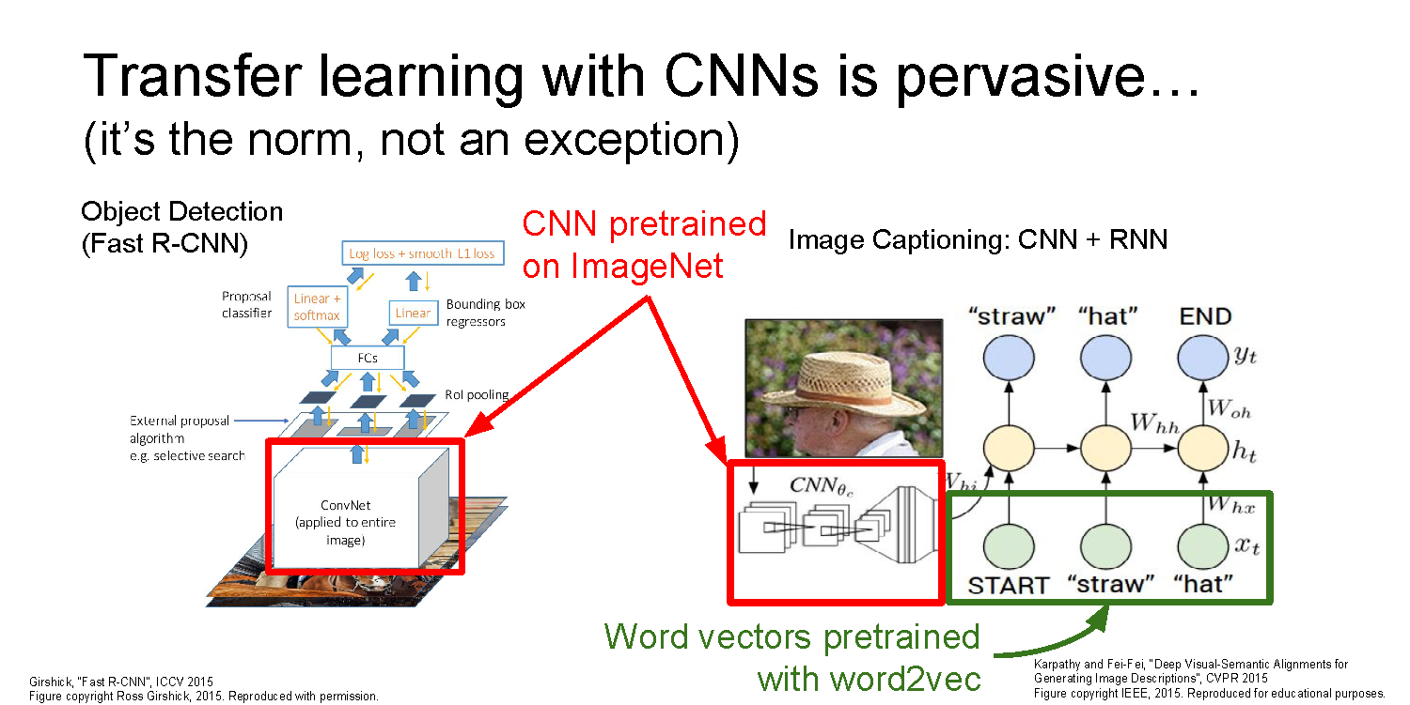

Slide 15
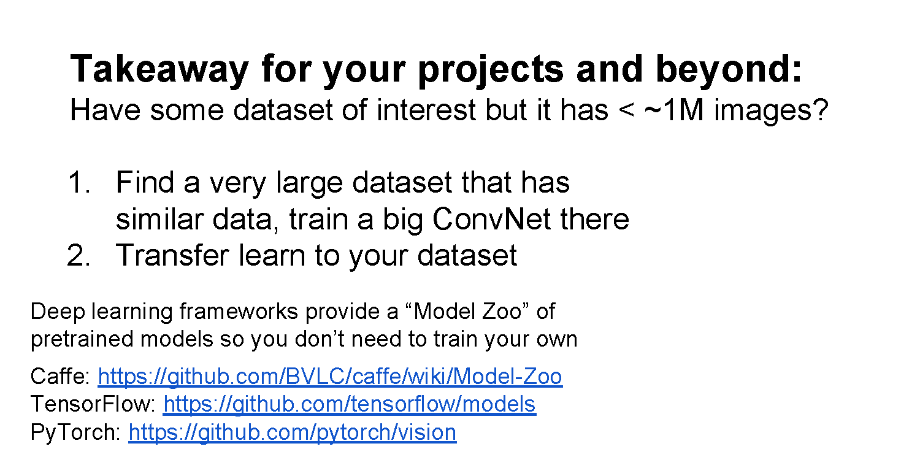
Common modern approach: start with a ResNet architecture pre-trained on ImageNet, and fine-tune on your (smaller) dataset

Slide 16
Dimensionality Reduction
By Abe Davis

Slide 17
Linear Dimensionality Reduction: 2D->1D
Consider a bunch of data points in 2D
Let’s say these points only differ along one line
If so, we can translate and rotate our data so that it is 1D

Slide 18
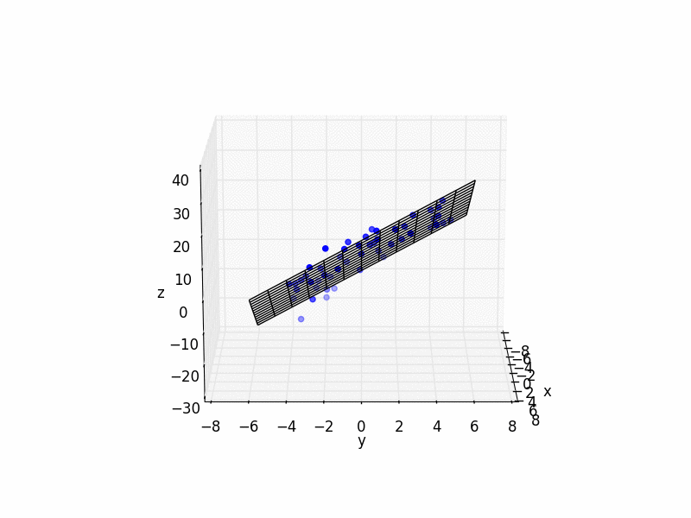

Linear Dimensionality Reduction: 3D->2D
Similar to 1D case, we can fit a plane to the data, and transform our coordinate system so that plane becomes the x-y plane
“Plane fitting”
More generally: look for the 2D subspace that best fits the data, and ignore the remaining dimensions
Think of this as data that sits on a flat sheet of paper, suspended in 3D space. We will come back to this analogy in a couple slides…
Notes:
https://math.stackexchange.com/questions/99299/best-fitting-plane-given-a-set-of-points

Slide 19
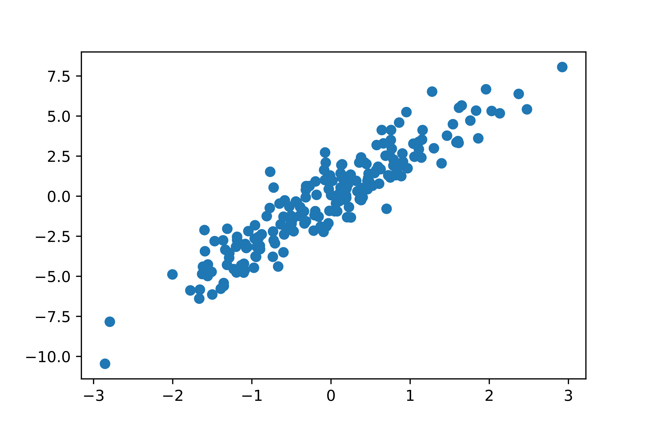
Generalizing Linear Dimensionality Reduction
Principal Components Analysis (PCA): find and order orthogonal axes by how much the data varies along each axis.
The axes we find (ordered by variance of our data) are called principal components.
Dimensionality reduction can be done by using only the first k principal components
Side Note: principal components are closely related to the eigenvectors of the covariance matrix for our data

Slide 20
Manifolds
Think of a piece of paper as a 2D subspace
If we bend & fold it, it’s still locally a 2D subspace…
A “manifold” is the generalization of this concept to higher dimensions…

Slide 21
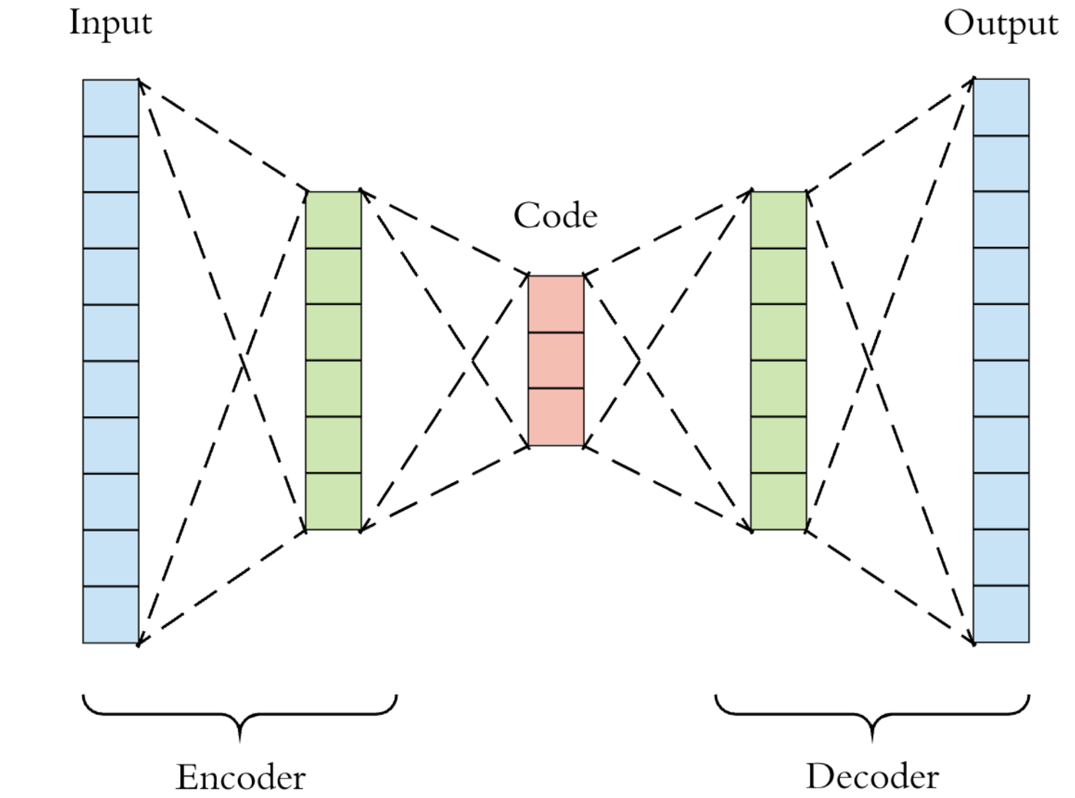
Autoencoders: Dimensionality Reduction for Manifolds
Feature space at bottleneck is often called “latent space”
Learn a non-linear transformation into some lower-dimensional space (encoder)
Learn a transformation from lower-dimensional space back to original content (decoder)
Loss function measures difference between input & output
Unsupervised
No labels required!

Slide 22
Autoencoders: Dimensionality Reduction for Manifolds
Transformations that reduce dimensionality cannot be invertible in general
An autoencoder tries to learn a transformation that is invertible for points on some manifold.

Slide 23
Image Manifolds
By Abe Davis

Slide 24

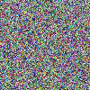
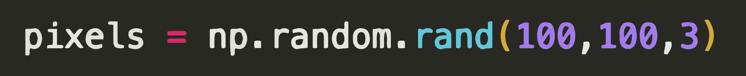
The Space of All Images
Lets consider the space of all 100x100 images
Now lets randomly sample that space…
Conclusion: Most images are noise
Question:
What do we expect a random uniform sample of all images to look like?

Slide 25
Natural Image Manifolds
Most images are “noise”
“Meaningful” images tend to form some manifold within the space of all images
Images of a particular class fall on manifolds within that manifold…
The Space of All Images

Slide 26
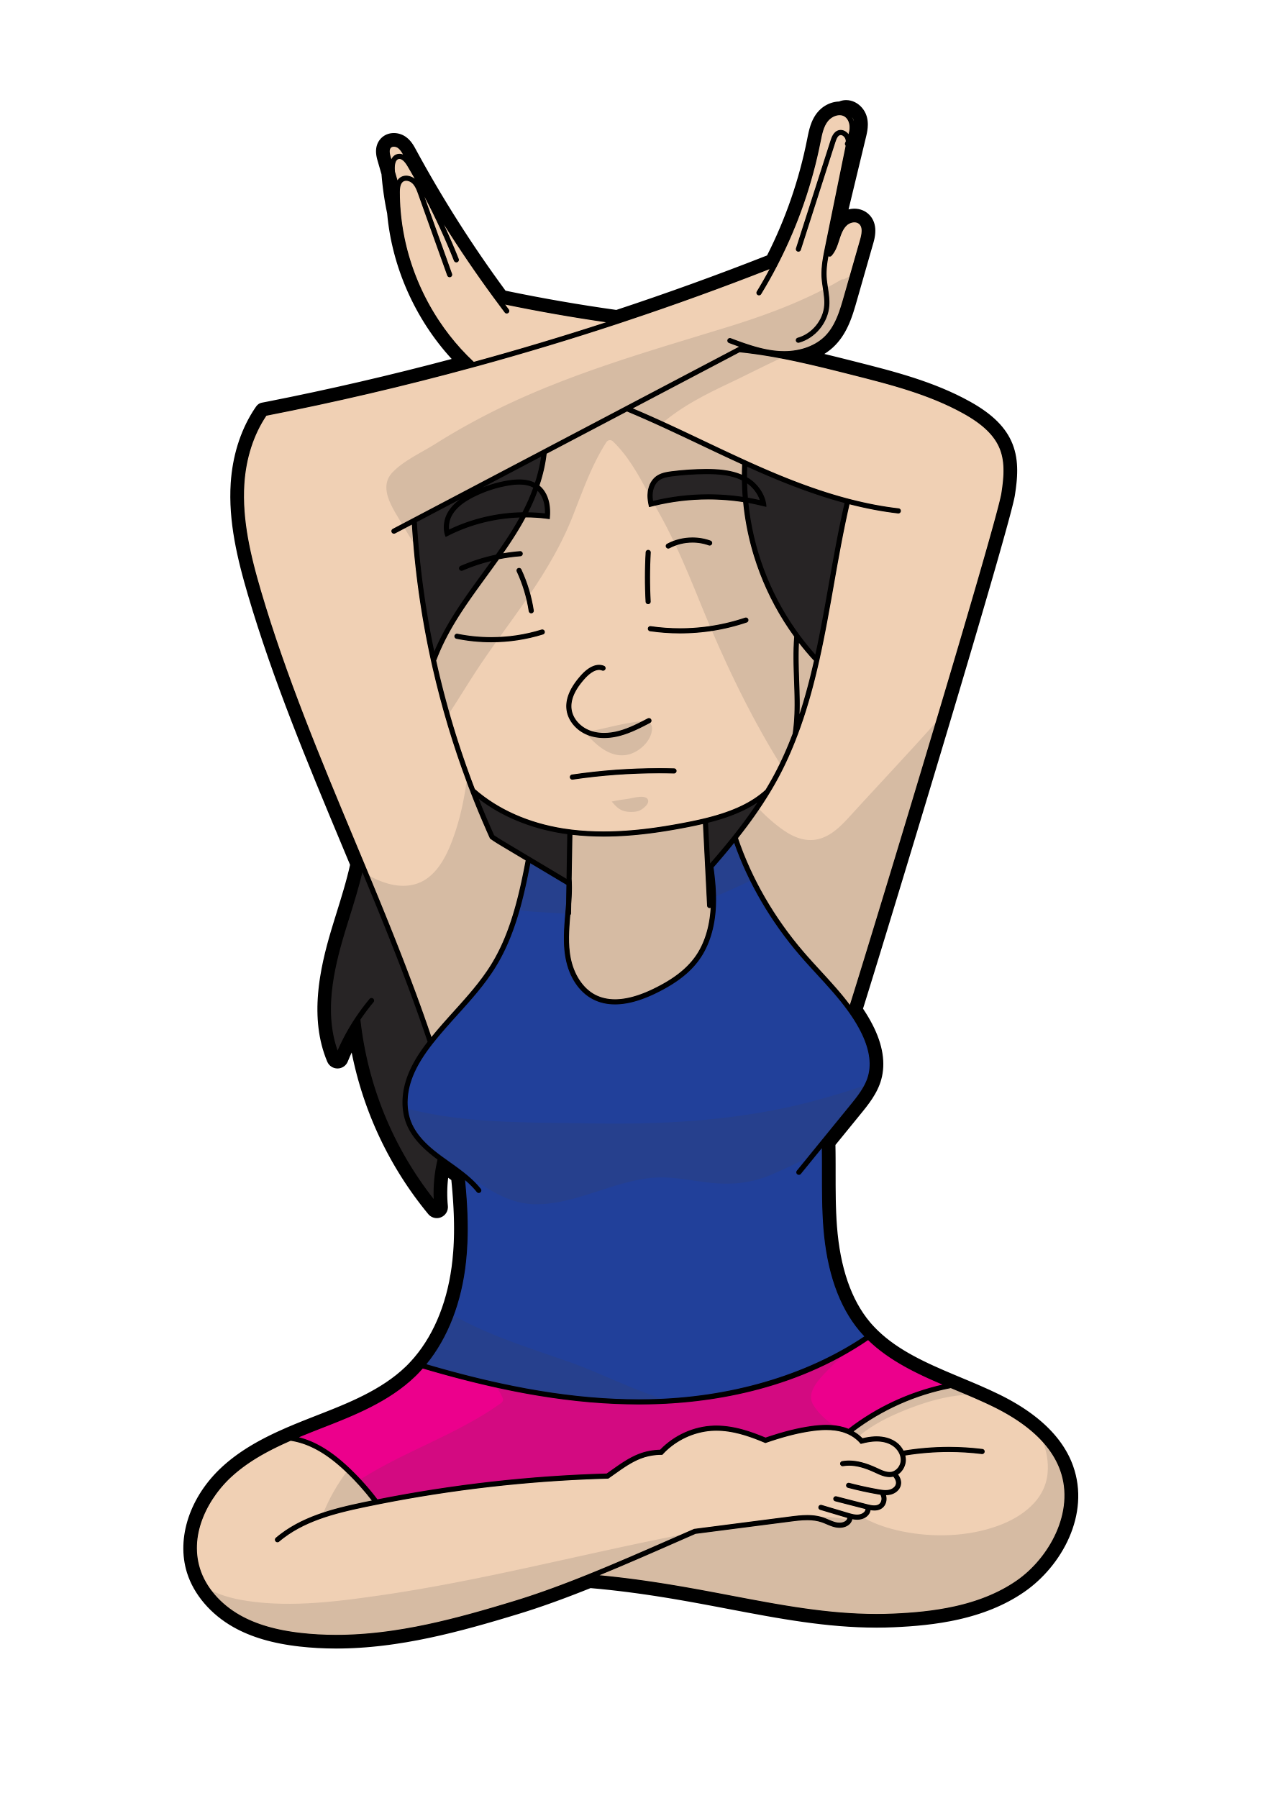

Natural Image Manifolds
Notes:
I want you to just take a moment to meditate on this concept of a manifold of natural images

Slide 27
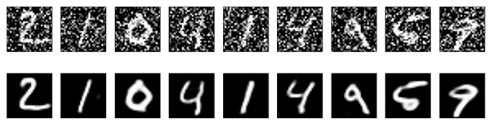
Denoising & the “Nullspace” of Autoencoders
The autoencoder tries to learn a dimensionality reduction that is invertible for our data (data on some manifold)
Most noise will be in the non-invertible part of image space (off the manifold)
If we feed noisy data in, we will often get denoised data out
Input
Output
Noisy Input
Output
Examples from: https://blog.keras.io/building-autoencoders-in-keras.html
Notes:
https://blog.keras.io/building-autoencoders-in-keras.html
Examples from:

Slide 28
Problem
Autoencoders can compress because data sits on a manifold
This doesn’t mean that every point in the latent space will be on the manifold…
GANs (later this lecture) will learn a loss function that helps with this…
Interpolation
(simple Interpolation)

Slide 29
Image-to-Image Applications
Abe Davis, with slides from Jin Sun, Phillip Isola, and Richard Zhang

Slide 30
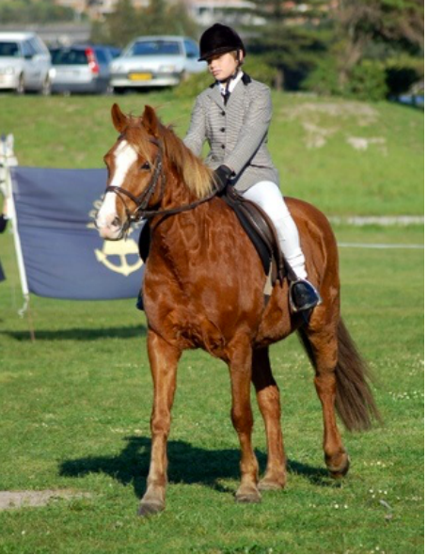
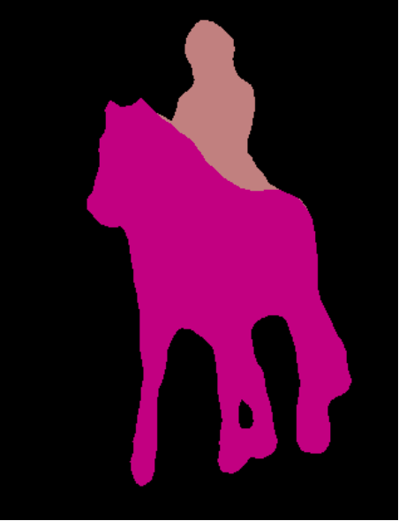
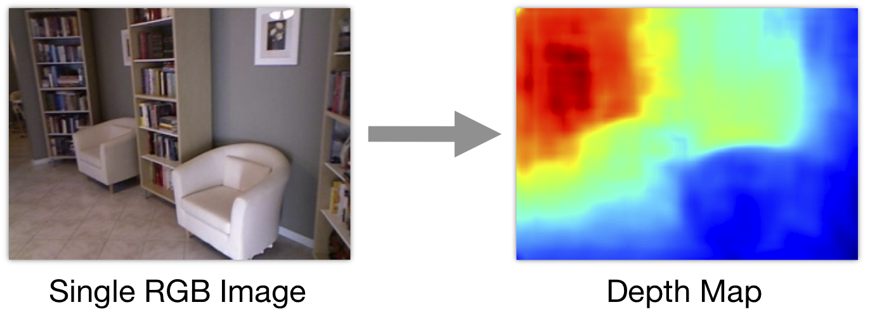
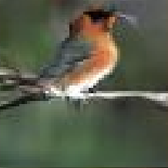
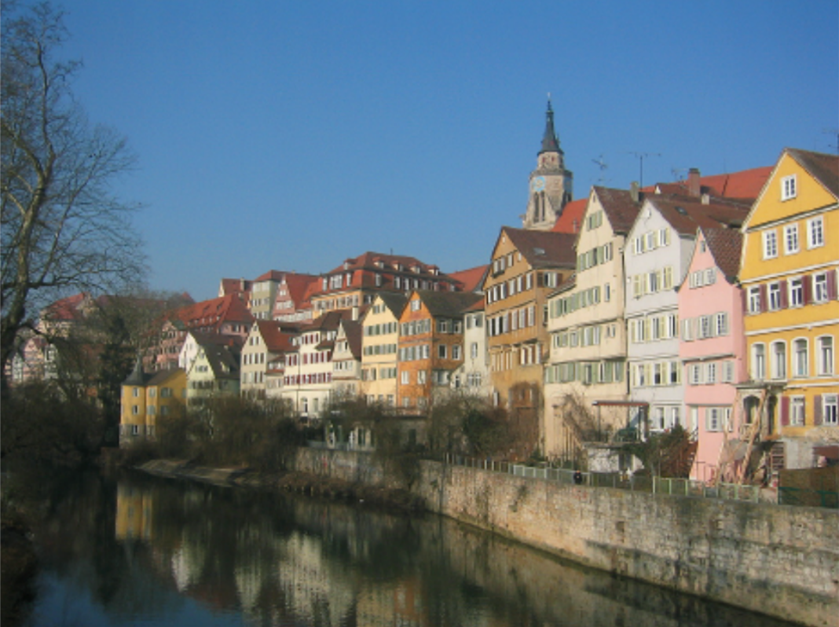
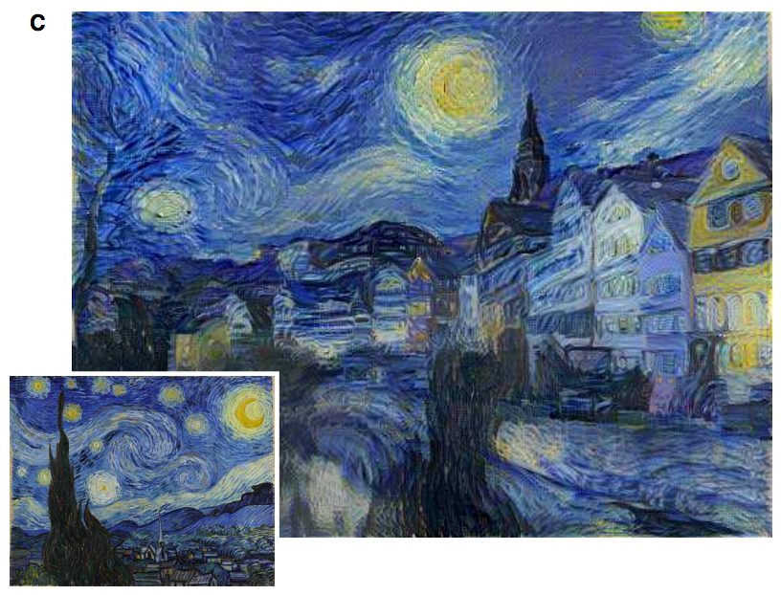
Image prediction (“structured prediction”)
Object labeling
Depth prediction
[Long et al. 2015, …]
[Eigen et al. 2014, …]
Text-to-photo
Style transfer
“this small bird has a pink breast and crown…”
[Reed et al. 2016, …]
[Gatys et al. 2016, …]

Slide 31
Image classification vs. image translation
For image classification, we map an image to a label (e.g., “cat”)
For image prediction/translation tasks, we map an image to another image-shaped thing (e.g., a depth map)
What kind of convolutional neural network architecture can do this?

Slide 32
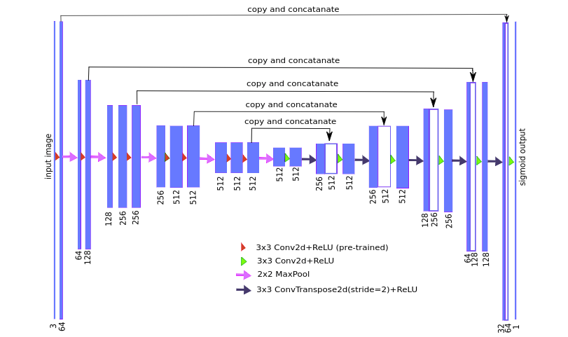
U-Net
A popular network structure to generate same-sized output
Similar to a convolutional autoencoder, but with “skip connections” that concatenate the output of earlier layers onto later layers
Great for learning transformations from one image to another

Slide 33
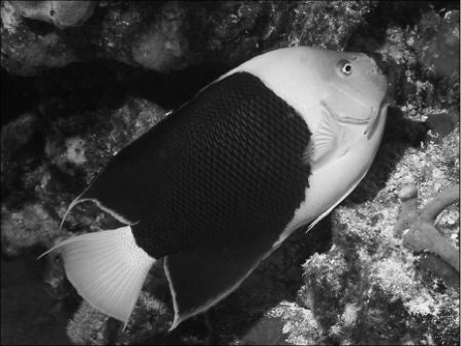
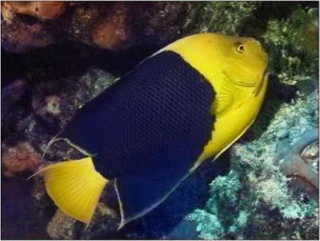

Image Colorization
from Jin Sun, Richard Zhang, Phillip Isola
Notes:
So formally, we are working in the Lab color space. The grayscale information is contained in the L, or lightness channel of the image, and is the input to our system.
The output is the ab, or color channels.
We’re looking to learn the mapping from L to ab using a CNN.
We can then take the predicted ab channels, concatenate them with the input, and hopefully get a plausible colorization of the input image. This is the graphics benefit of this problem.

Slide 34

“What should I do”
“How should I do it?”
from Jin Sun, Richard Zhang, Phillip Isola
Notes:
So formally, we are working in the Lab color space. The grayscale information is contained in the L, or lightness channel of the image, and is the input to our system.
The output is the ab, or color channels.
We’re looking to learn the mapping from L to ab using a CNN.
We can then take the predicted ab channels, concatenate them with the input, and hopefully get a plausible colorization of the input image. This is the graphics benefit of this problem.

Slide 35
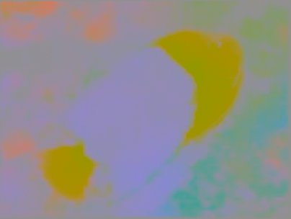

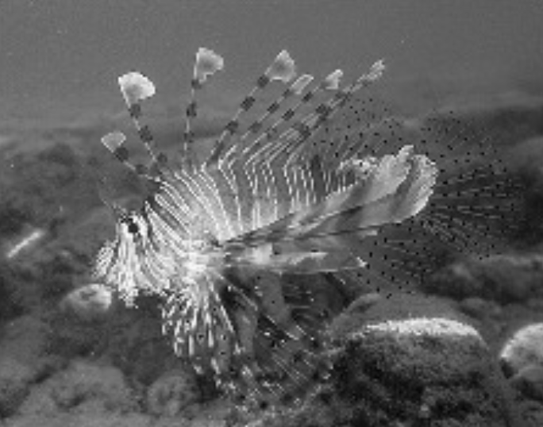
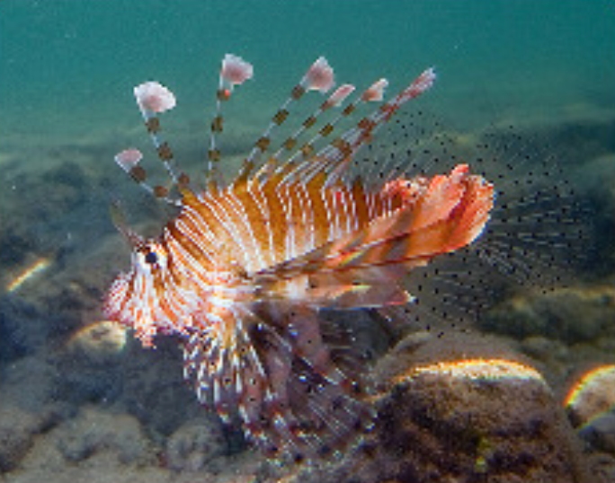
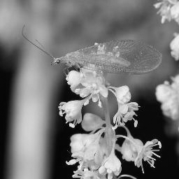
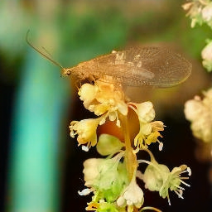
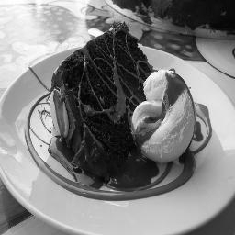
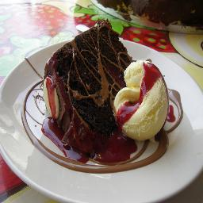
Training data
Grayscale image: L channel
Color information: ab channels
…
Objective function
(loss)
Neural Network
from Jin Sun, Richard Zhang, Phillip Isola
Notes:
So formally, we are working in the Lab color space. The grayscale information is contained in the L, or lightness channel of the image, and is the input to our system.
The output is the ab, or color channels.
We’re looking to learn the mapping from L to ab using a CNN.
We can then take the predicted ab channels, concatenate them with the input, and hopefully get a plausible colorization of the input image. This is the graphics benefit of this problem.

Slide 36
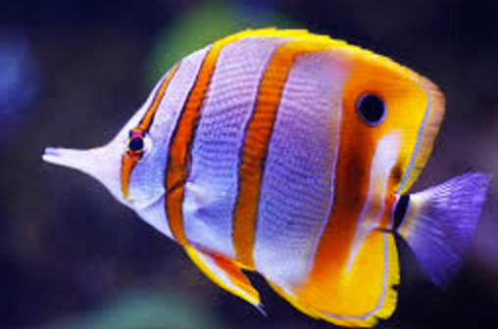
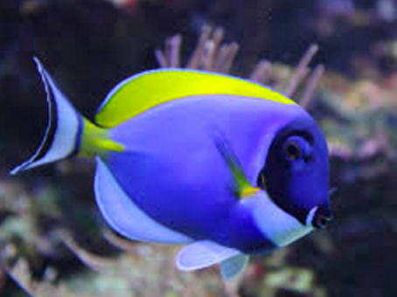
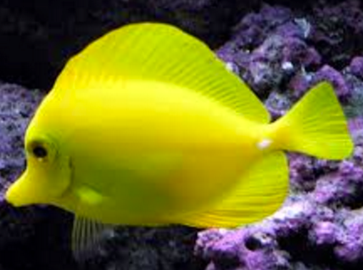
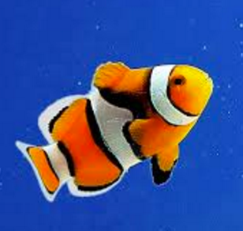
…
“yellow”
from Jin Sun, Richard Zhang, Phillip Isola

Slide 37
…
“black”
from Jin Sun, Richard Zhang, Phillip Isola

Slide 38
…
from Jin Sun, Richard Zhang, Phillip Isola

Slide 39
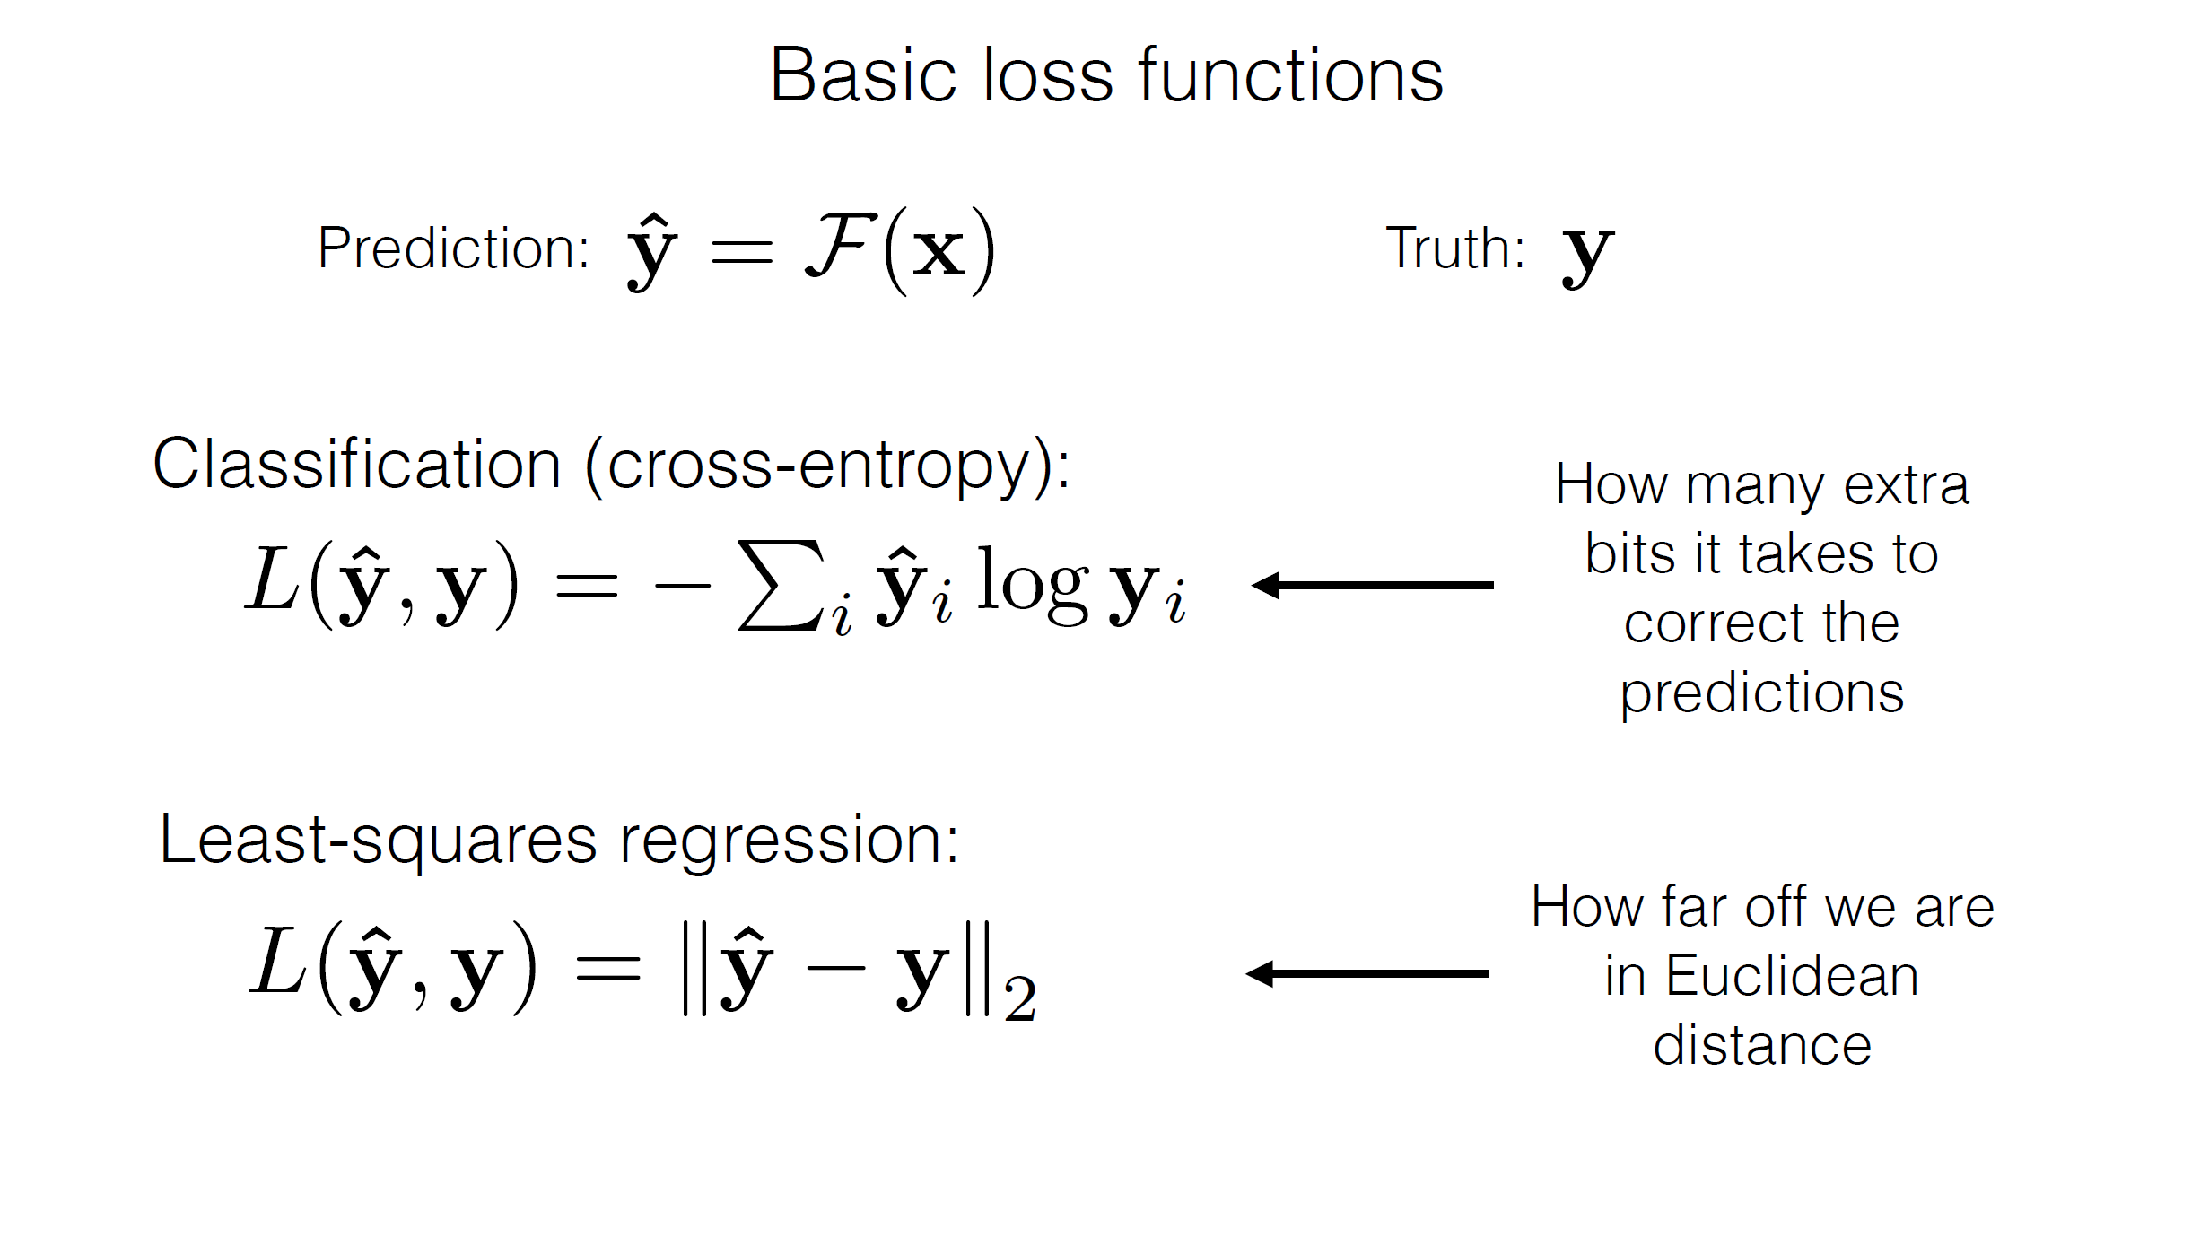
from Jin Sun, Richard Zhang, Phillip Isola

Slide 40
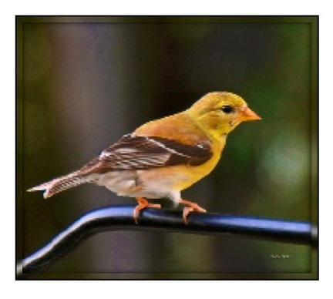
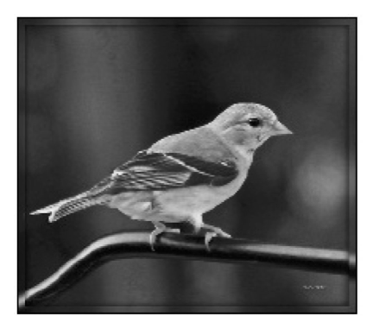
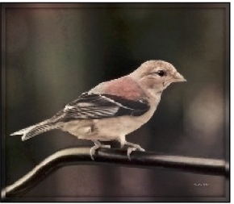

Designing loss functions
Input
Output
Ground truth
Notes:
Sounds reasonable, right?
“Minimize Euclidean distance between each predicted pixel color and its ground truth value.”

Slide 41
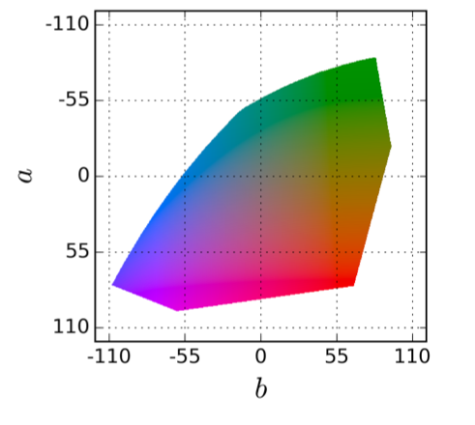


Notes:
Suppose there is an equal chance that the actual color is red or blue. Then the solution that minimizes the L2 norm is to output average of red and blue, which gives a grayish result.

Slide 42

Designing loss functions
Input
Zhang et al. 2016
Ground truth
Color distribution cross-entropy loss with colorfulness enhancing term.
[Zhang, Isola, Efros, ECCV 2016]
Notes:
Required lots of engineering. Choose a color space, discretization scheme, soft-encoding, class-rebalancing with regularization, annealed-mean, etc.
Can we just automatically learn all this?

Slide 43



Slide 44


Designing loss functions
Image colorization
L2 regression
[Zhang, Isola, Efros, ECCV 2016]
Super-resolution
L2 regression
[Johnson, Alahi, Li, ECCV 2016]
Notes:
So we can carefully engineer our loss functions

Slide 45

Designing loss functions
Image colorization
Cross entropy objective, with colorfulness term
[Zhang, Isola, Efros, ECCV 2016]
Super-resolution
Deep feature covariance matching objective
[Johnson, Alahi, Li, ECCV 2016]
Notes:
So we can carefully engineer our loss functions

Slide 46
Better Loss Function: Sticking to the Manifold
How do we design a loss function that penalizes images that aren’t on the image manifold?
Key insight: we will learn our loss function by training a network to discriminate between images that are on the manifold and images that aren’t
Interpolation
(simple Interpolation)
Notes:
All of these are just predicting pixels from pixels, so shouldn’t there be some universal loss?

Slide 47
Part 3: Generative Adversarial Networks (GANs)
Abe Davis, with slides from Jin Sun and Phillip Isola

Slide 48
Generative Adversarial Networks (GANs)
Basic idea: Learn a mapping from some latent space to images on a particular manifold
Example of a Generative Model:
We can think of classification as a way to compute some P(x) that tells us the probability that image x is a member of a class.
Rather than simply evaluating this distribution, a generative model tries to learn a way to sample from it

Slide 49
Generative Adversarial Networks (GANs)
Generator network has similar structure to the decoder of our autoencoder
Maps from some latent space to images
We train it in an adversarial manner against a discriminator network
Generator tries to create output indistinguishable from training data
Discriminator tries to distinguish between generator output and training data
Training Data
Discriminator Network

Slide 50


Example: Randomly Sampling the Space of Face Images
(Using Generative Adversarial Networks (GANs)
A
B
Which face is real?
Notes:
http://www.whichfaceisreal.com/index.php

Slide 51
Example: Randomly Sampling the Space of Face Images
(Using Generative Adversarial Networks (GANs)
A
B
Which face is real?
Notes:
http://www.whichfaceisreal.com/index.php

Slide 52

Conditional GANs
Generate samples from a conditional distribution
Example: generate high-resolution image conditioned on low resolution input
[Ledig et al 2016]

Slide 53

Generator
[Goodfellow et al., 2014]
Notes:
CONDITIONAL

Slide 54
real or fake?
Generator
Discriminator
G tries to synthesize fake images that fool D
D tries to identify the fakes
[Goodfellow et al., 2014]

Slide 55




fake (0.9)
real (0.1)
(Identify generated images as fake)
(Identify training images as real)
[Goodfellow et al., 2014]
Notes:
D wants to Maximize objective
Penalize

Slide 56

real or fake?
G tries to synthesize fake images that fool D:
[Goodfellow et al., 2014]
Notes:
G wants to minize objective

Slide 57

real or fake?
G tries to synthesize fake images that fool the best D:
[Goodfellow et al., 2014]

Slide 58
Loss Function
G’s perspective: D is a loss function.
Rather than being hand-designed, it is learned.
[Goodfellow et al., 2014]
[Isola et al., 2017]

Slide 59

real or fake?
[Goodfellow et al., 2014]
Notes:
But what if, given this input, out generator outputs this image? Is it real or is it fake?

Slide 60
real!
(“Aquarius”)
[Goodfellow et al., 2014]

Slide 61
real or fake pair ?
[Goodfellow et al., 2014]
[Isola et al., 2017]

Slide 62
real or fake pair ?
[Goodfellow et al., 2014]
[Isola et al., 2017]

Slide 63
fake pair
[Goodfellow et al., 2014]
[Isola et al., 2017]

Slide 64
real pair
[Goodfellow et al., 2014]
[Isola et al., 2017]

Slide 65
real or fake pair ?
[Goodfellow et al., 2014]
[Isola et al., 2017]

Slide 66

More Examples of Image-to-Image Translation with GANs
We have pairs of corresponding training images
Conditioned on one of the images, sample from the distribution of likely corresponding images
Edges to Image
Aerial Photo To Map
Segmentation to Street Image

Slide 67












BW → Color
Input
Output
Input
Output
Input
Output
Data from [Russakovsky et al. 2015]

Slide 68





Input
Output
Groundtruth
Data from
[maps.google.com]
Notes:
Again, pixels to pixels!
These are 512x512 but you can run it at any resolution, since it’s fully convolutional.

Slide 69



Labels → Street Views
Data from [Wang et al, 2018]

Slide 70












Day → Night
Input
Output
Input
Output
Input
Output
Data from [Laffont et al., 2014]

Slide 71












Edges → Images
Input
Output
Input
Output
Input
Output
Edges from [Xie & Tu, 2015]

Slide 72

Demo
https://affinelayer.com/pixsrv/

Slide 73


Ivy Tasi @ivymyt
Vitaly Vidmirov @vvid

Slide 74

Image Inpainting
Data from [Pathak et al., 2016]​

Slide 75

Pose-guided Generation
Data from [Ma et al., 2018]​

Slide 76

Challenges —> Solutions
Output is high-dimensional, structured object
Approach: Use a deep net, D, to analyze output!
Uncertainty in mapping; many plausible outputs
Approach: D only cares about “plausibility”, doesn’t hedge
Lack of supervised training data
Approach: ?
“this small bird has a pink breast and crown…”

Slide 77

https://junyanz.github.io/CycleGAN/

Slide 78


https://hardikbansal.github.io/CycleGANBlog/

Slide 79


Slide 80

StyleGAN
A Style-Based Generator Architecture for Generative Adversarial Networks
Tero Karras, Samuli Laine, Timo Aila
https://github.com/NVlabs/stylegan

Slide 81

StyleGAN2
Analyzing and Improving the Image Quality of StyleGAN
Tero Karras, Samuli Laine, Miika Aittala, Janne Hellsten, Jaakko Lehtinen, Timo Aila
https://github.com/NVlabs/stylegan2

Slide 82
Questions?

