Slide 1
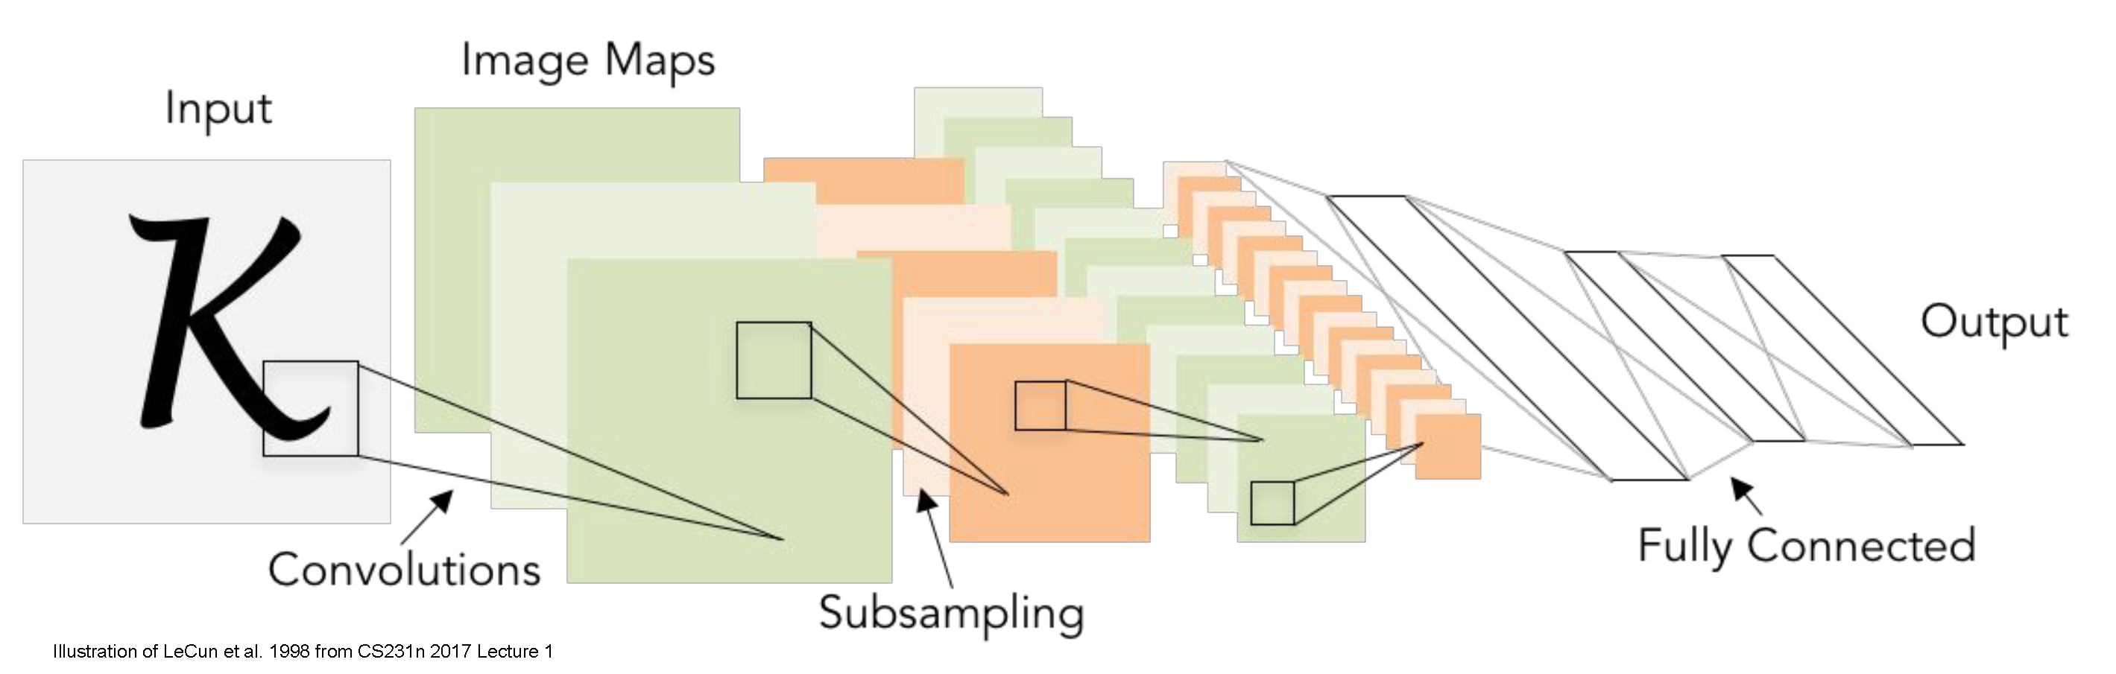
Convolutional neural networks, Part II
CS5670: Computer Vision
Slides from Fei-Fei Li, Justin Johnson, Serena Yeung
http://vision.stanford.edu/teaching/cs231n/

Slide 2
Announcements
Project 5 (Convolutional Neural Networks) released today
Due Tuesday, May 11, 2021 (7:00 pm)
Take-home final exam to be released Wednesday, May 12, 2021; due Monday, May 17, 2021
Sample final available on Ed Stem

Slide 3
Readings
Convolutional neural networks
http://cs231n.github.io/convolutional-networks/
Stochastic Gradient Descent & Backpropagation
http://cs231n.github.io/optimization-1/
http://cs231n.github.io/optimization-2/
Best practices for training CNNs
http://cs231n.github.io/neural-networks-2/
http://cs231n.github.io/neural-networks-3/

Slide 4
Project 5 Demo (Ruojin)

Slide 5
Last time
Neural networks
Convolutional neural networks

Slide 6
Today
Convolutional neural networks (continued)
Training neural networks with backpropagation
Stochastic gradient descent
Data processing and augmentation
CNN architectures
Transfer learning

Slide 7
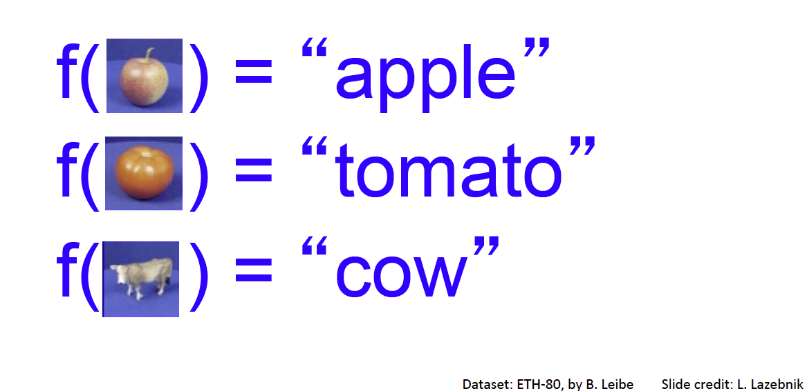
Image Classification: a core task in computer vision
Assume given set of discrete labels, e.g.
{cat, dog, cow, apple, tomato, truck, … }

Slide 8

Recap: Neural networks
Very coarse generalization:
Linear functions chained together and separated by non-linearities (activation functions), e.g. “max”

Slide 9
Convolutional neural networks
Made up of many layers of a few different types (mainly convolution layers)

Slide 10
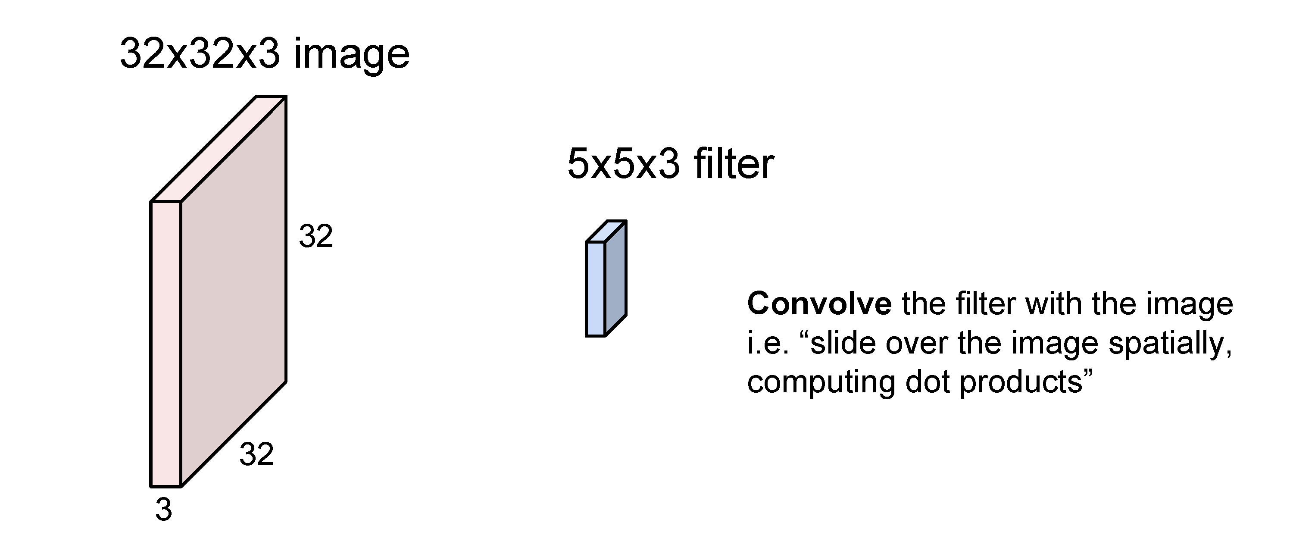
Convolutions as network layers
(weights are learned)

Slide 11
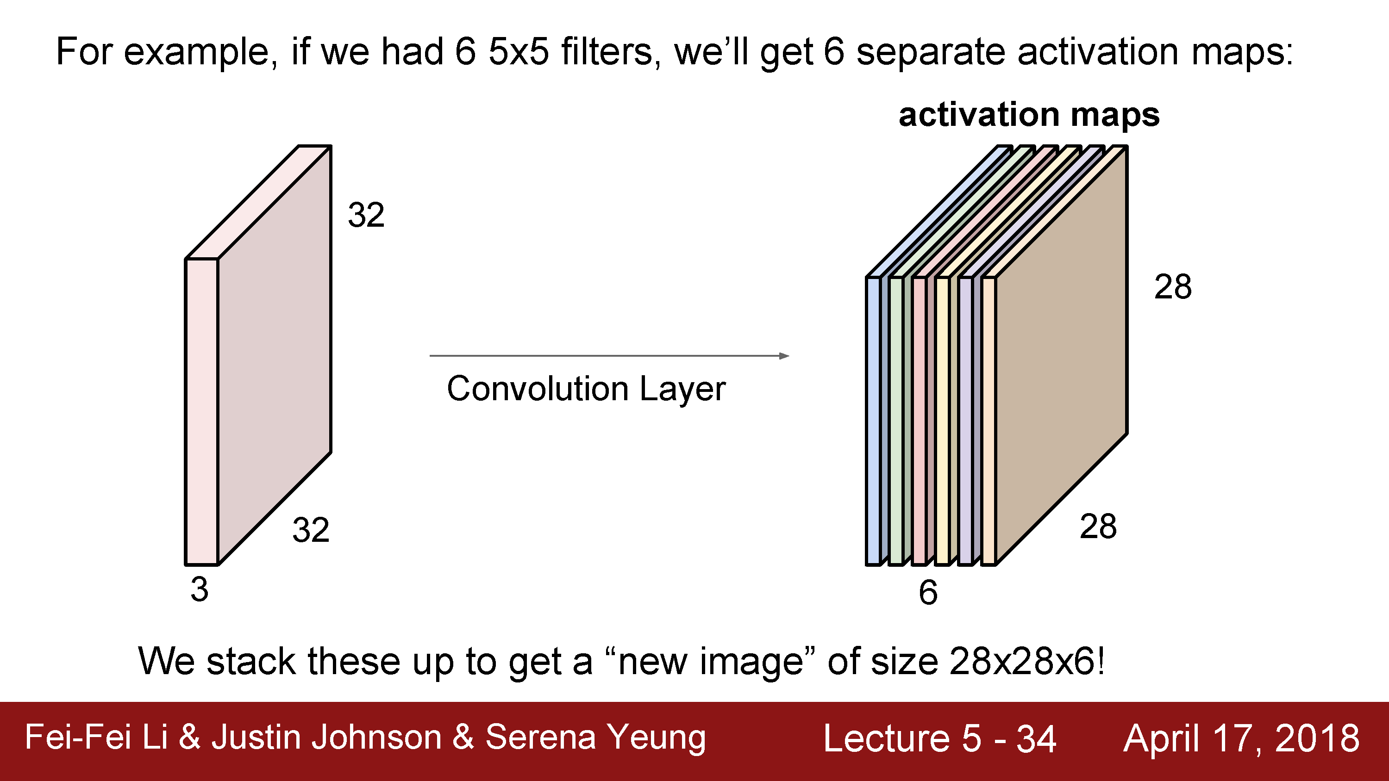
Convolutional layer
(total number of parameters: 6 x (75 + 1) = 456)

Slide 12
Convolution layer parameters
Kernel size
Number of kernels
Stride

Slide 13
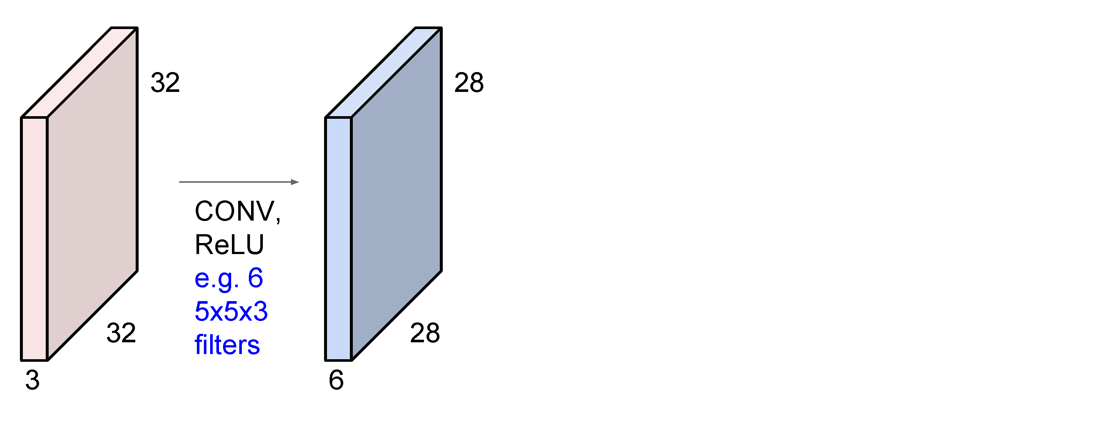

Slide 14
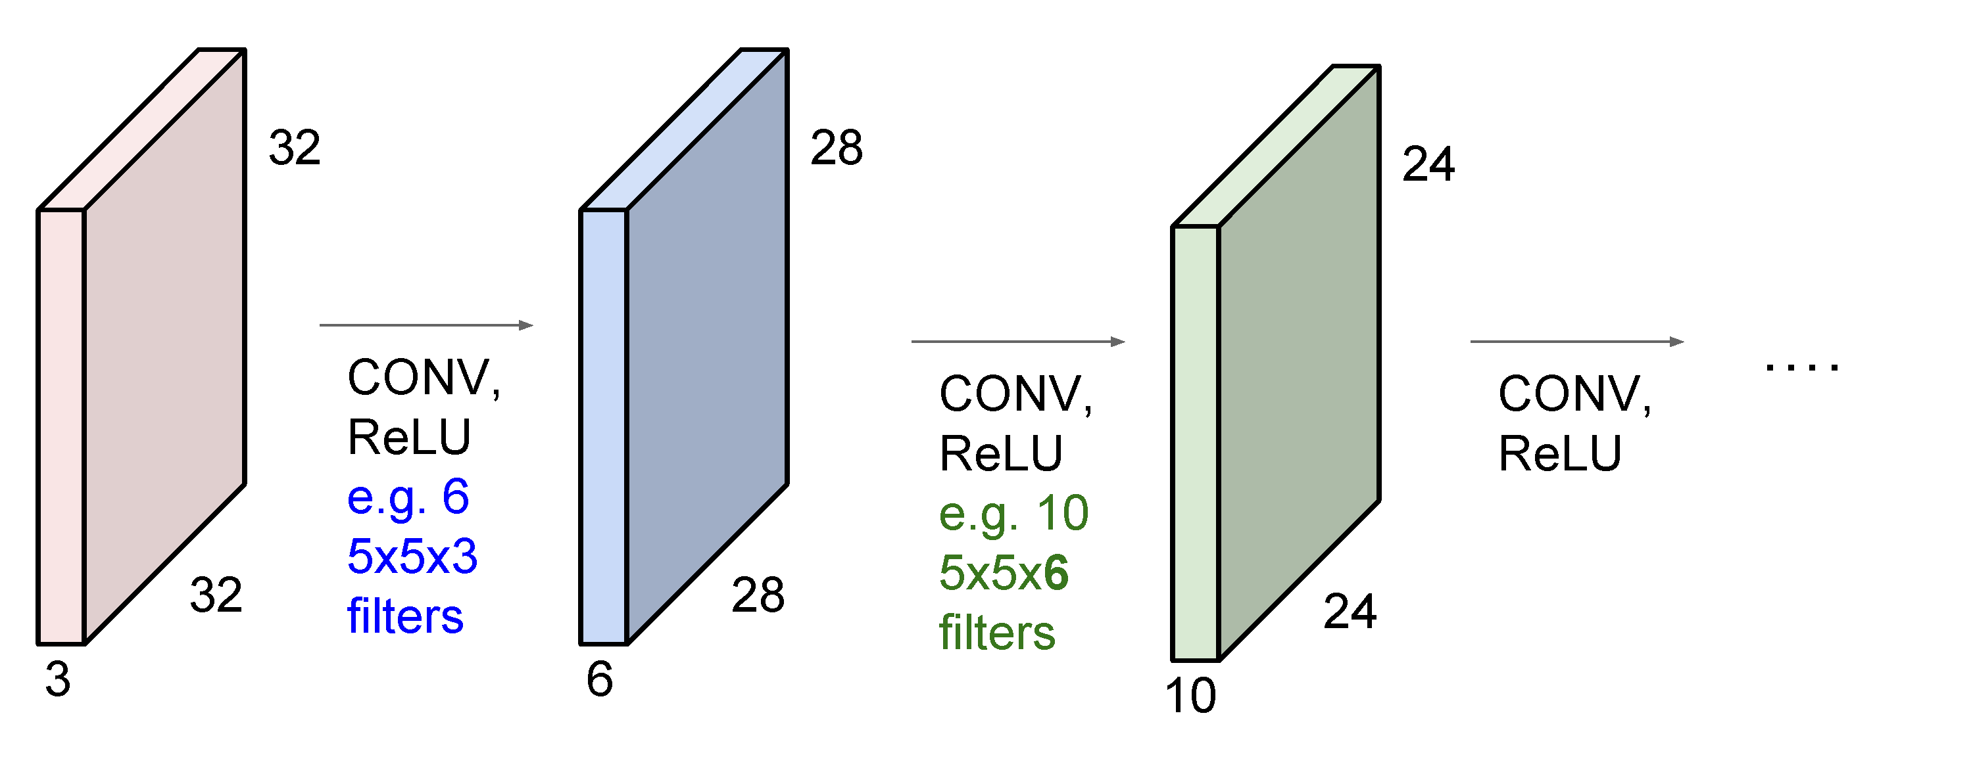

Slide 15
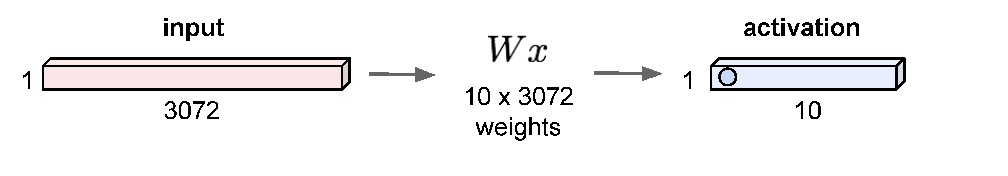
Some convolutional network layer types
Convolution layers (some parameters)
Pooling layers (no parameters)
Fully connected layers (many, many parameters)
convolution layer

Slide 16
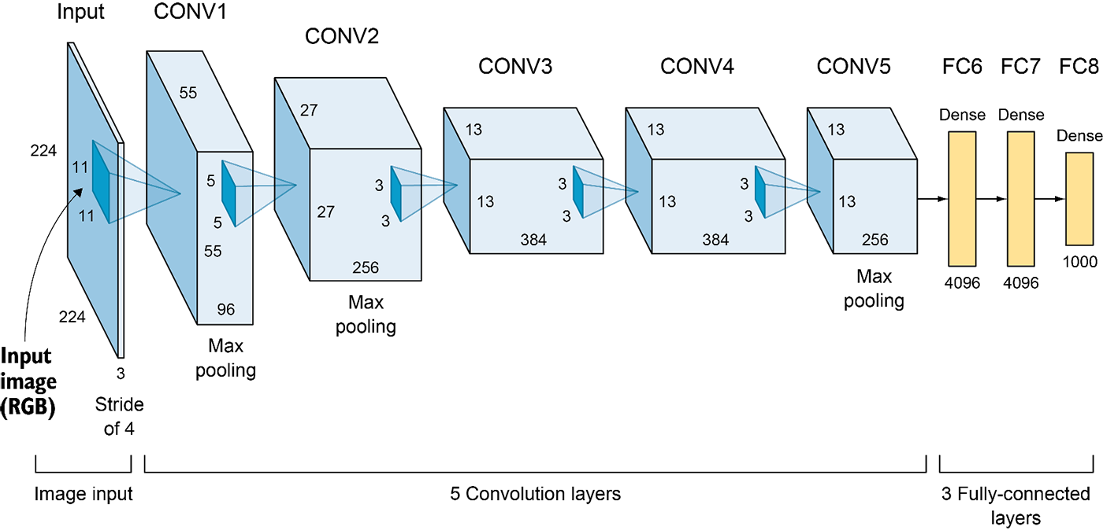
AlexNet (2012)
6M parameters in total
Output: 1,000-D vector (probabilities over 1,000 ImageNet categories)
Elgendy, Deep Learning for Vision Systems, https://livebook.manning.com/book/grokking-deep-learning-for-computer-vision/chapter-5/v-3/

Slide 17
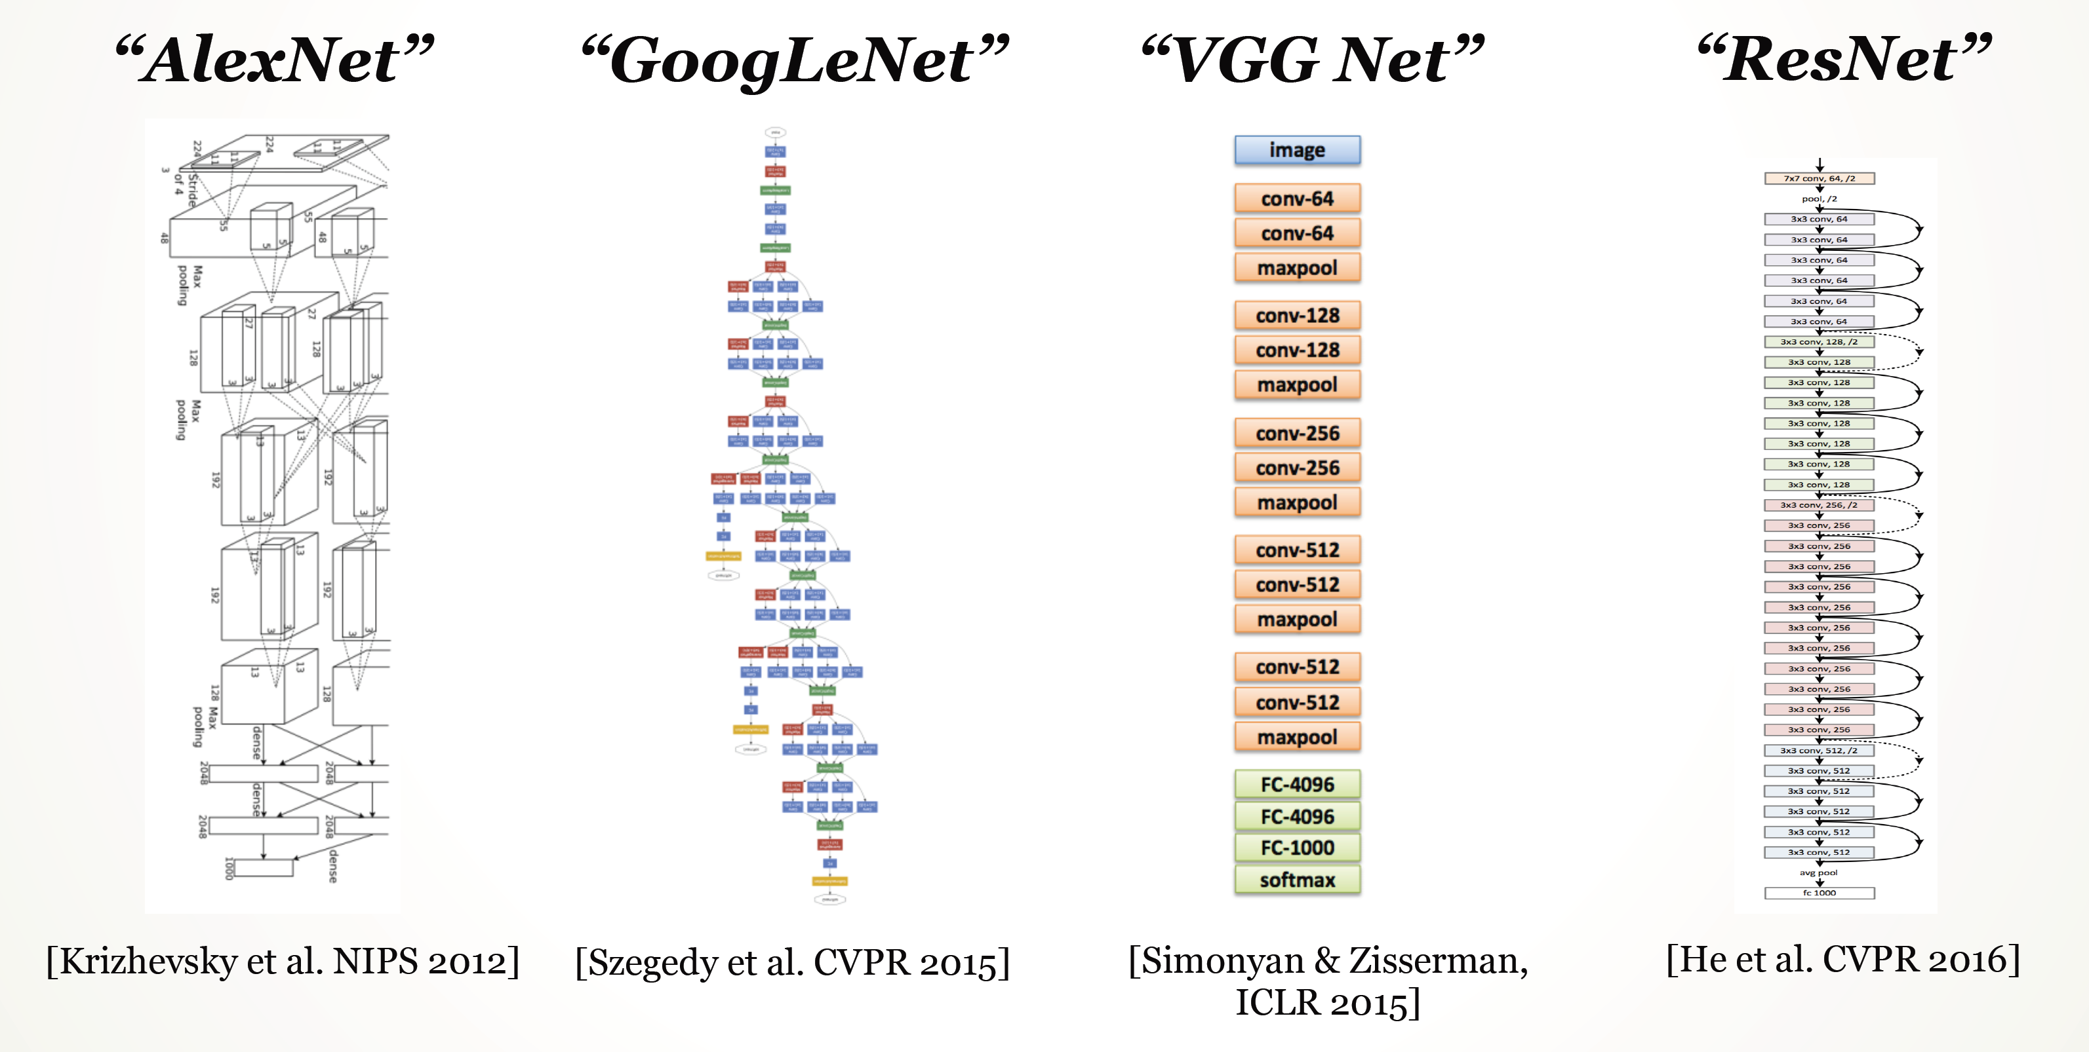

Slide 18
Big picture
A convolutional neural network can be thought of as a function from images to class scores
With millions of adjustable weights…
… leading to a very non-linear mapping from images to features / class scores.
We will set these weights based on classification accuracy on training data…
… and hopefully our network will generalize to new images at test time

Slide 19
Data is key—enter ImageNet
ImageNet (and the ImageNet Large-Scale Visual Recognition Challege, aka ILSVRC) has been key to training deep learning methods
J. Deng, W. Dong, R. Socher, L.-J. Li, K. Li and L. Fei-Fei, ImageNet: A Large-Scale Hierarchical Image Database. CVPR, 2009.
ILSVRC: 1,000 object categories, each with ~700-1300 training images. Test set has 100 images per category (100,000 total).
Standard ILSVRC error metric: top-5 error
if the correct answer for a given test image is in the top 5 categories, your answer is judged to be correct

Slide 20
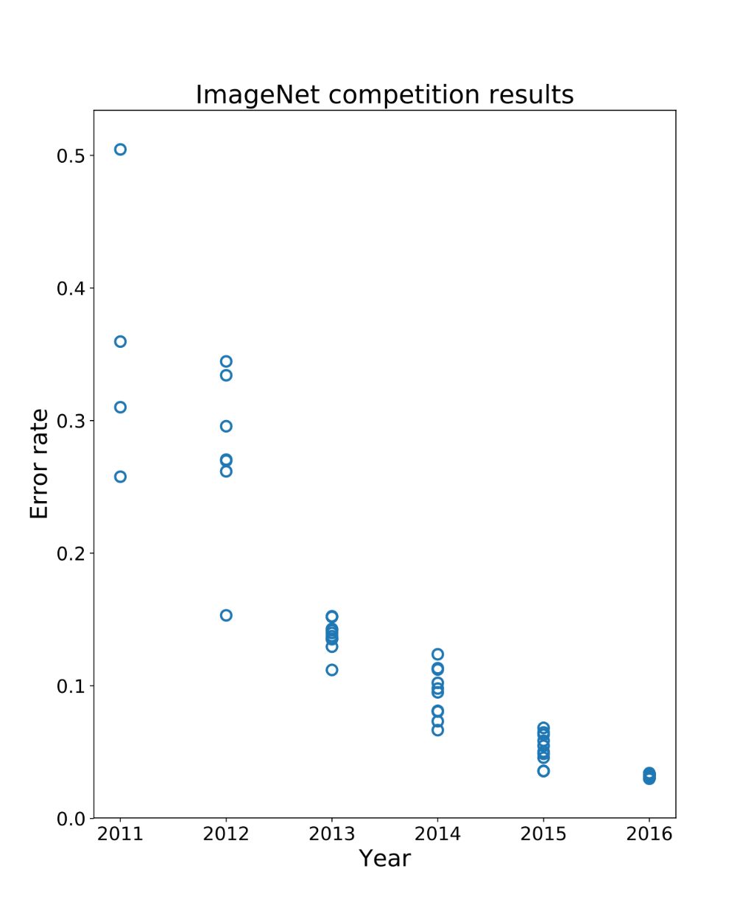
Performance improvements on ILSVRC
ImageNet Large-Scale Visual Recognition Challenge
Held from 2011-2017
1000 categories, 1000 training images per category
Test performance on held-out test set of images
Pre-deep learning era
{
Deep learning era
AlexNet

Slide 21
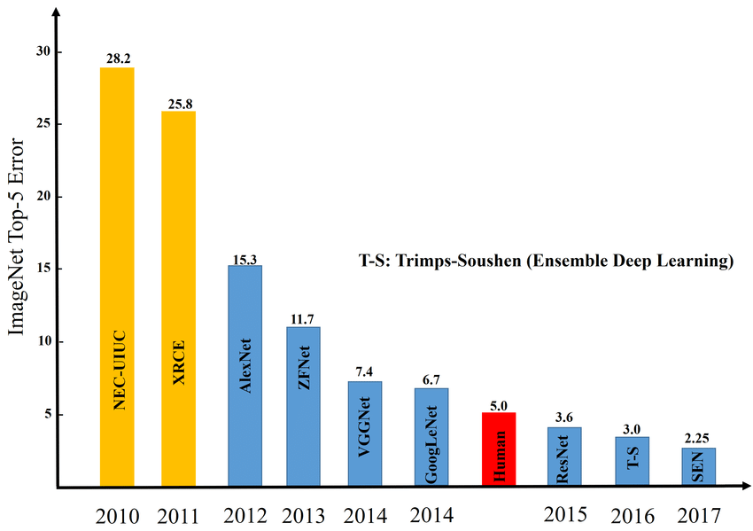
Image credit: Zaid Alyafeai, Lahouari Ghouti

Slide 22
Questions?

Slide 23
Training the network
Now we know what the structure of our function from images -> class scores is (a CNN)
How do we set the weights given training data?

Slide 24
How do we set the weights?
Need to solve an optimization problem:
Find weights W that minimize training loss L over a training set
In general this is a non-linear, non-convex problem
Closed-form solvers do not generally exist, unlike with e.g. least squares problems
Might not find the globally optimal weights
(Side note: some learning problems, such as linear SVMs, do have convex loss functions)

Slide 25
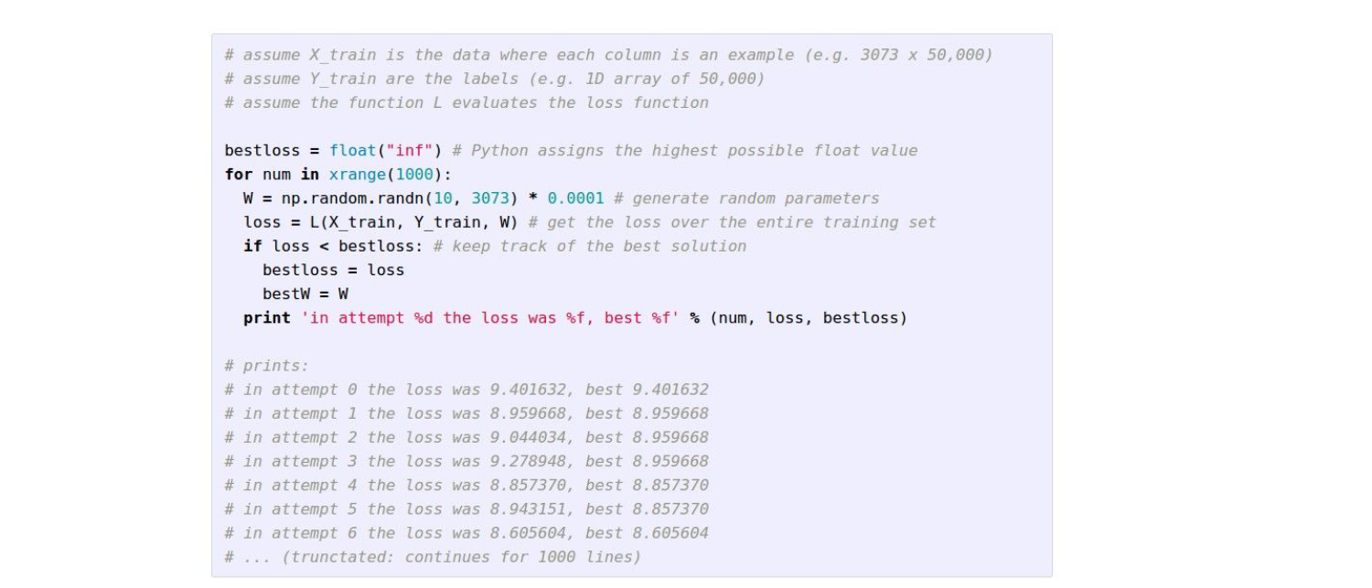
(Bad) idea #1: Random search

Slide 26
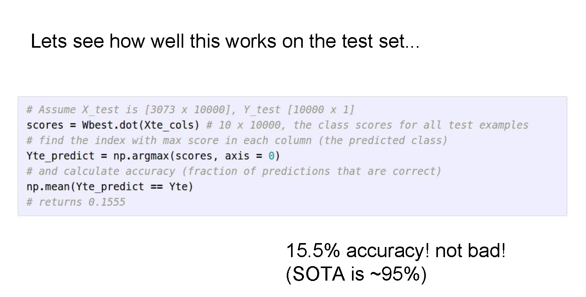

Slide 27
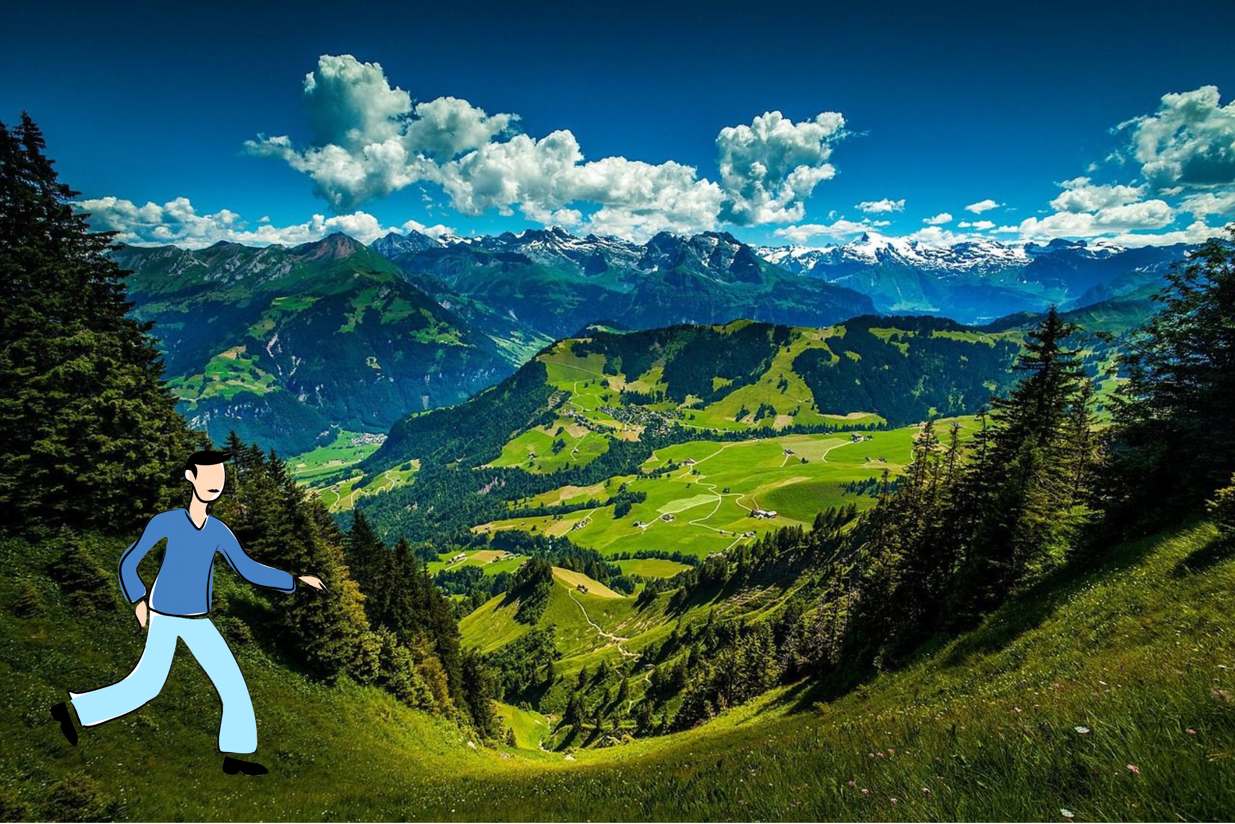
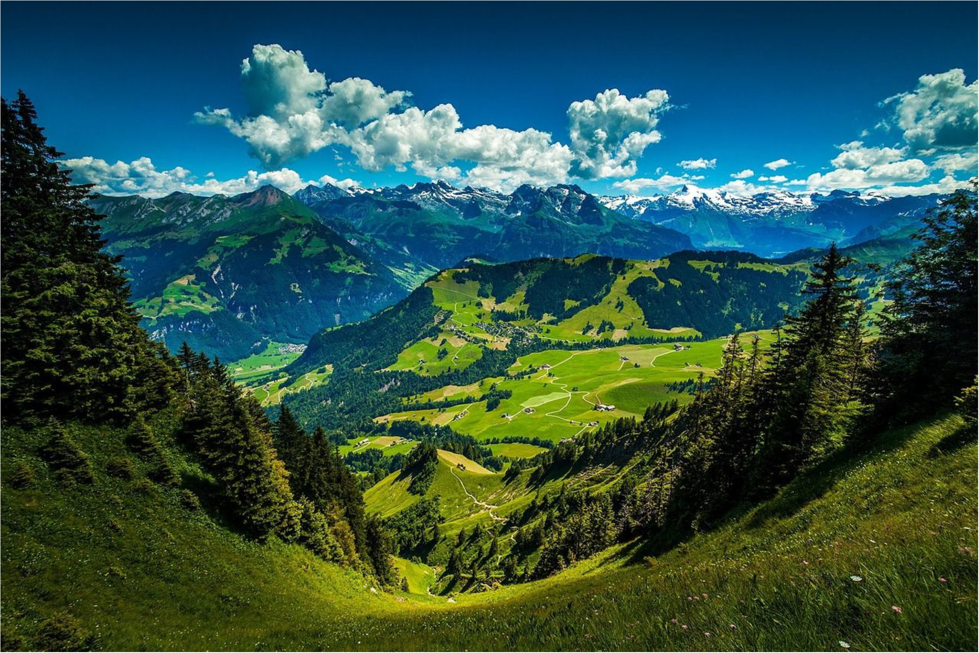
(Good) Idea #2: Gradient descent

Slide 28
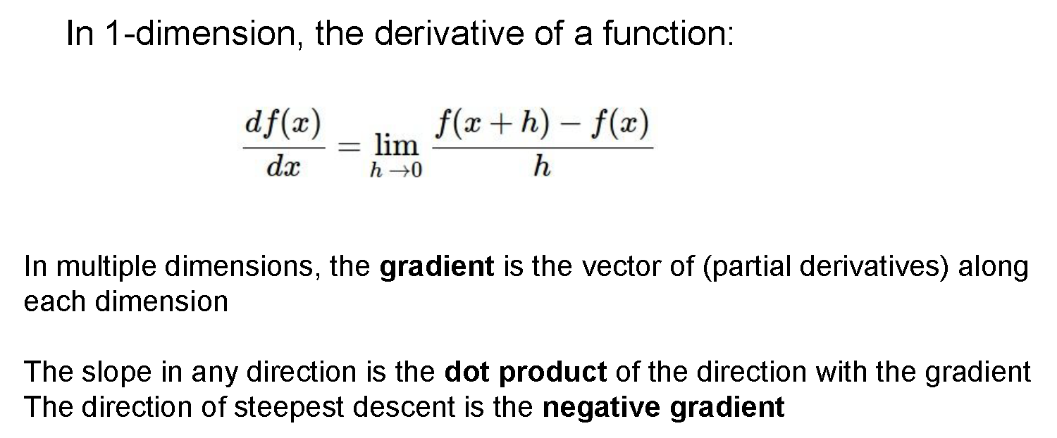
(Good) Idea #2: Gradient descent

Slide 29
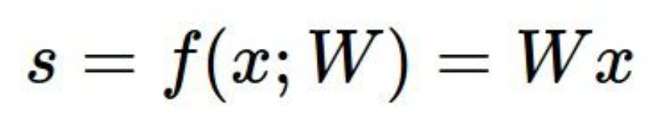
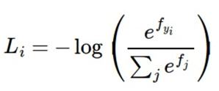
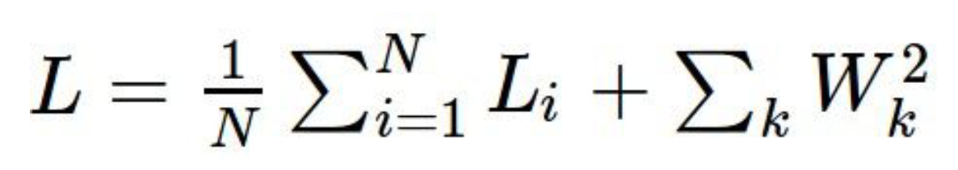
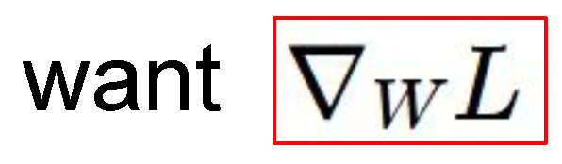
Scores, losses, and gradients
Function f maps images to class scores
Loss function maps class scores to “badness”
f is a deep CNN
Cross-entropy loss
Data loss + regularization
(gradient of L w.r.t. W, computed analytically)

Slide 30
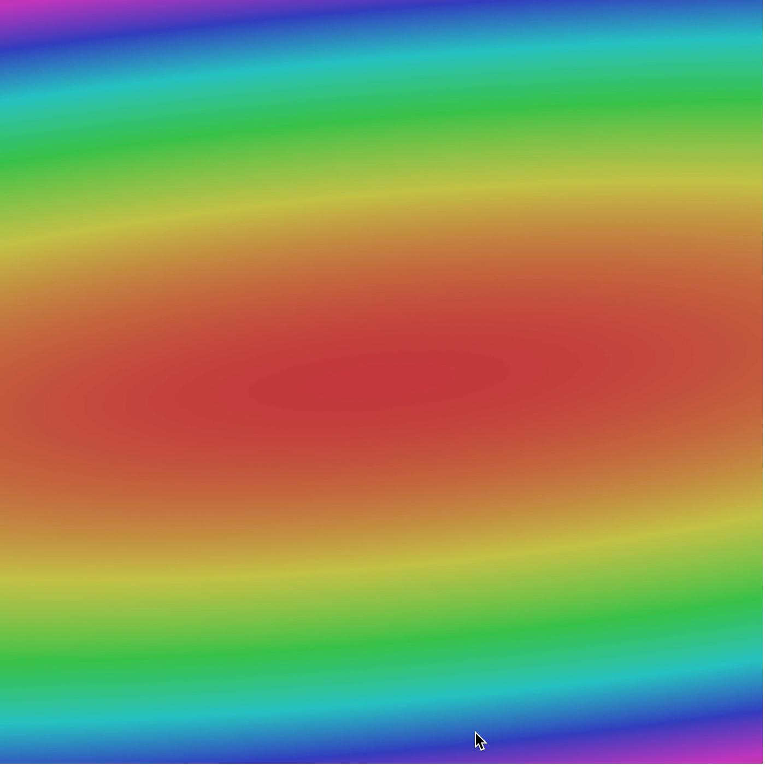
Gradient descent: iteratively follow the slope

Slide 31
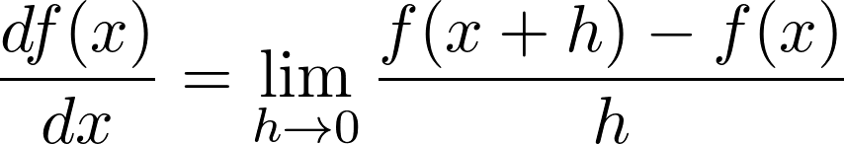
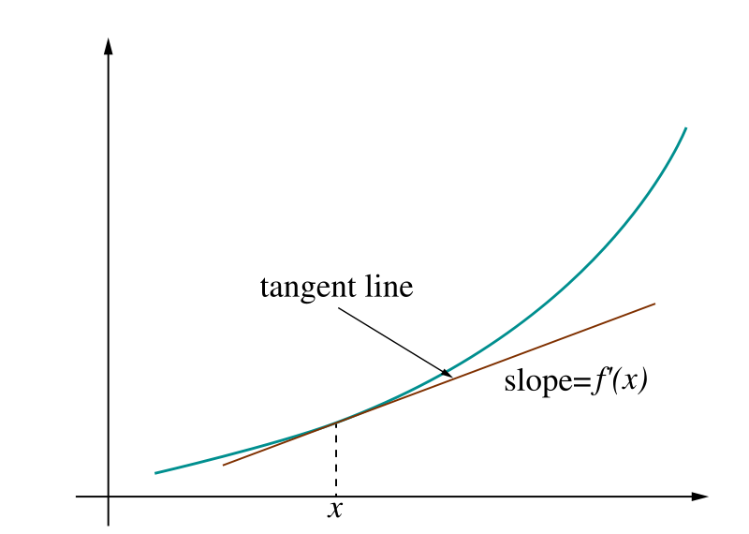
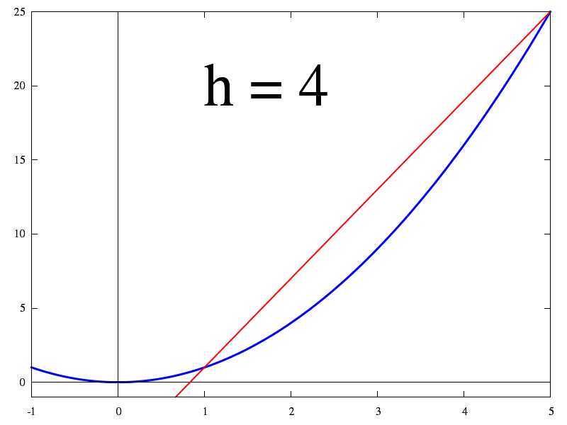
How do we compute gradients for CNNs?
Recall: a function with a single with N parameters
Our loss function involves millions of parameters
Idea 1: Numerically compute derivatives (finite differences)

Slide 32
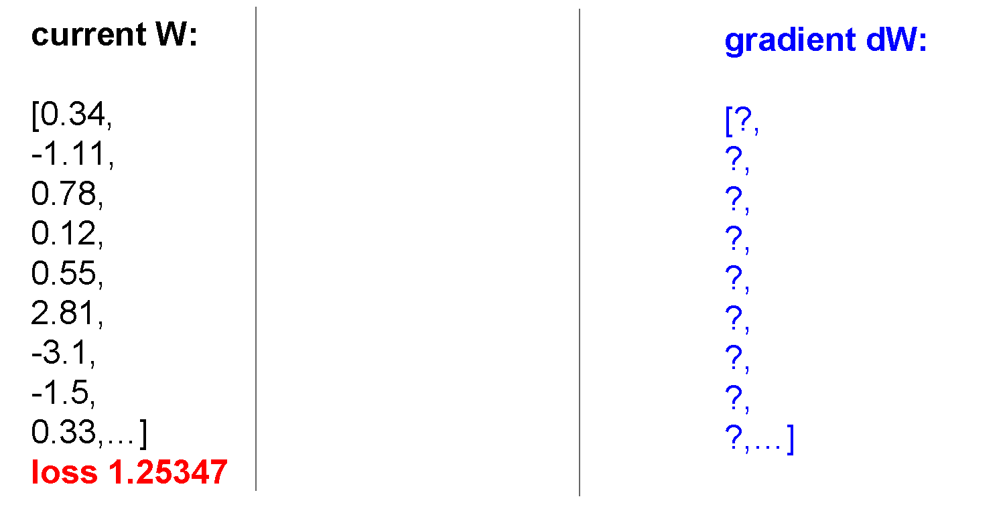

Slide 33
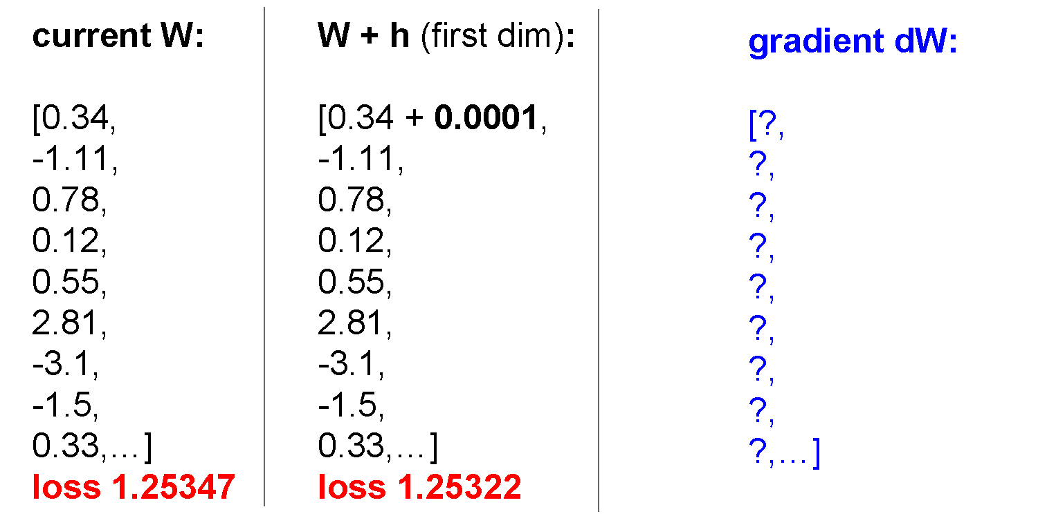

Slide 34
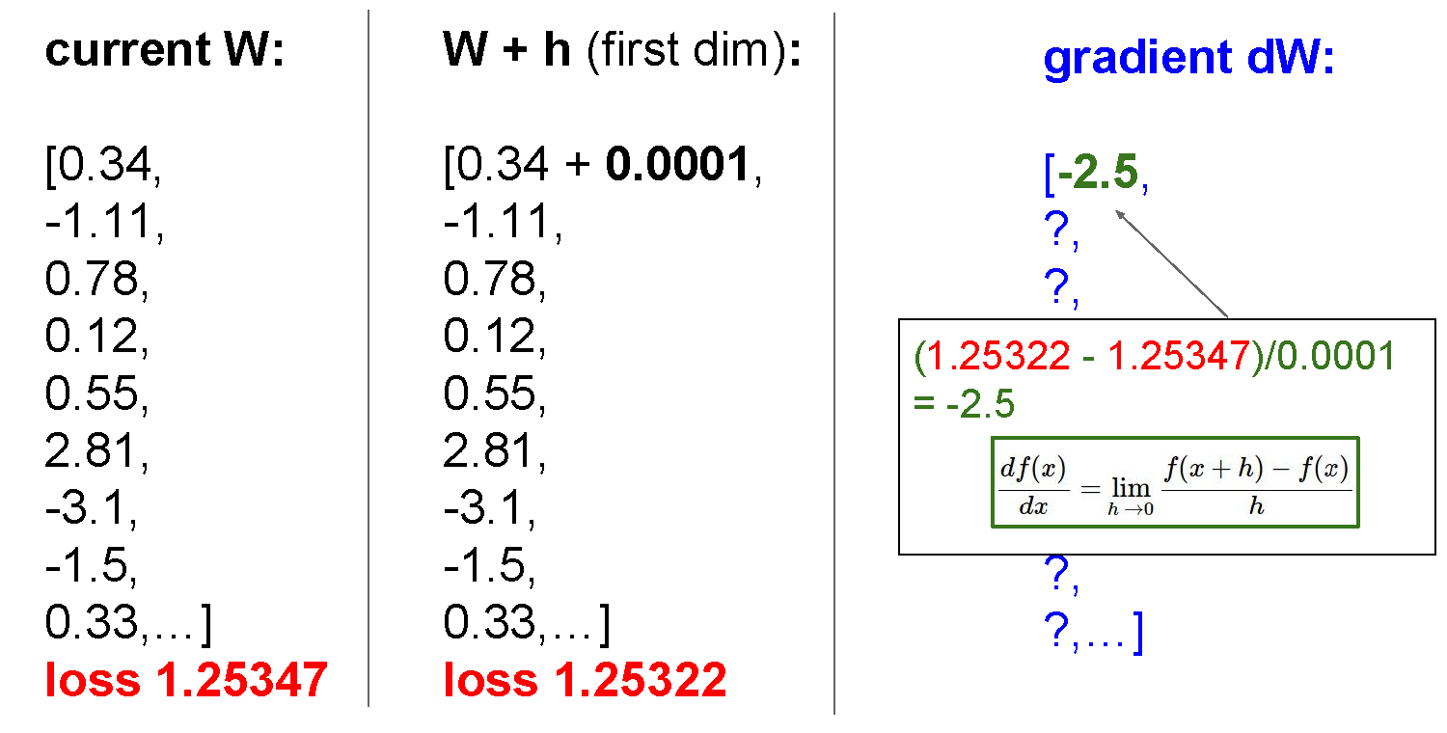

Slide 35
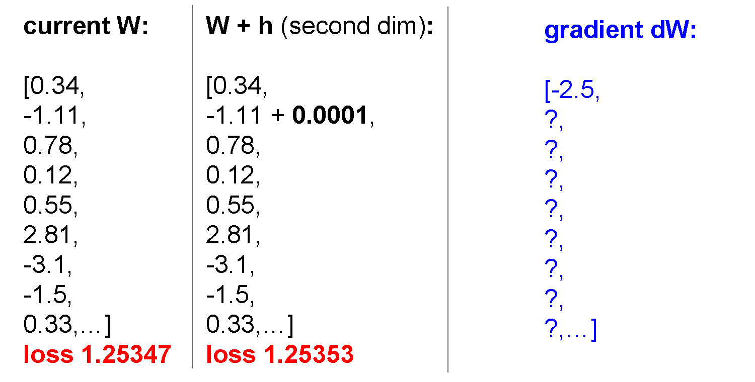

Slide 36
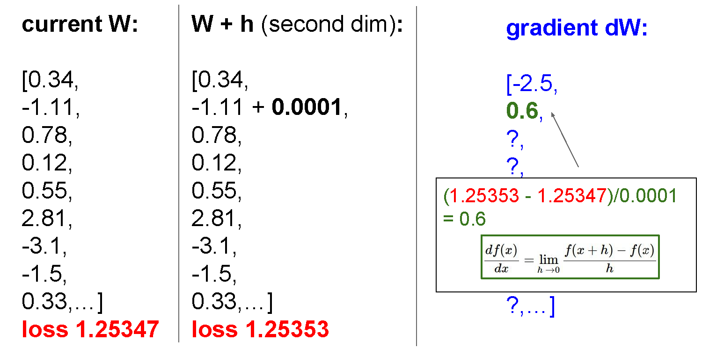

Slide 37
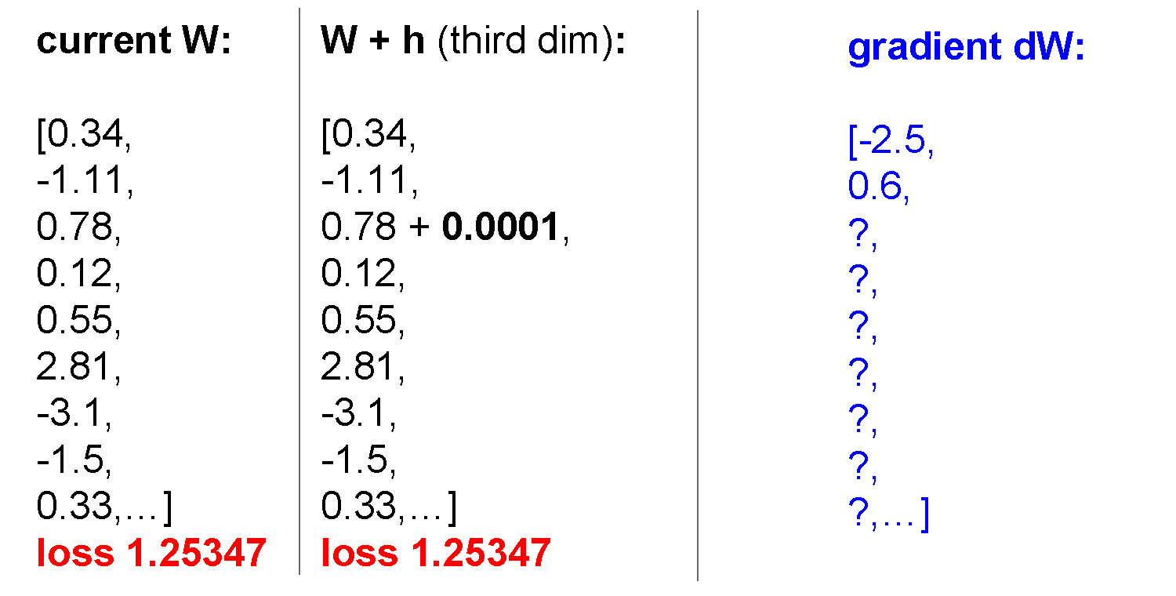

Slide 38
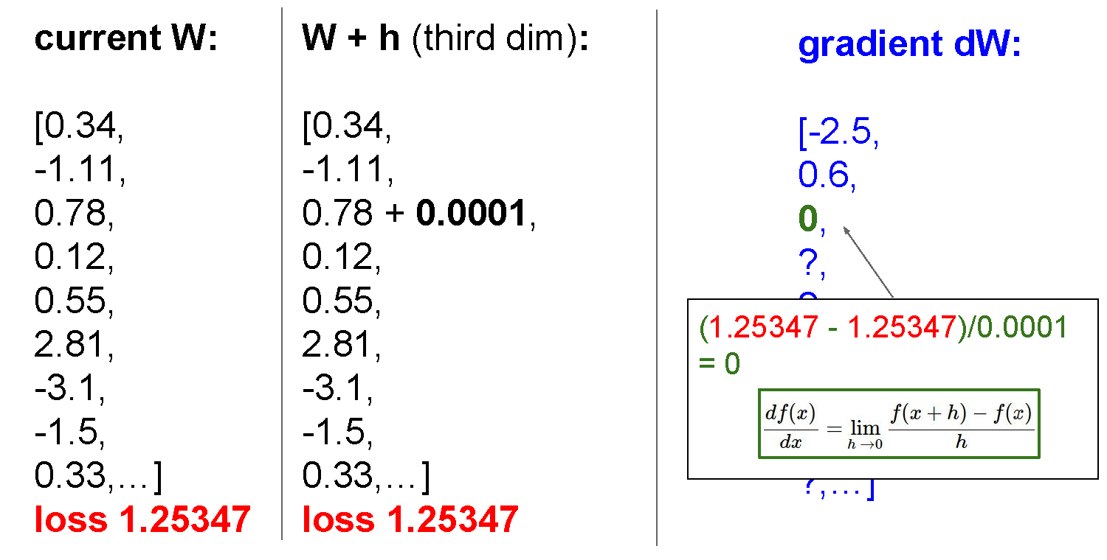

Slide 39
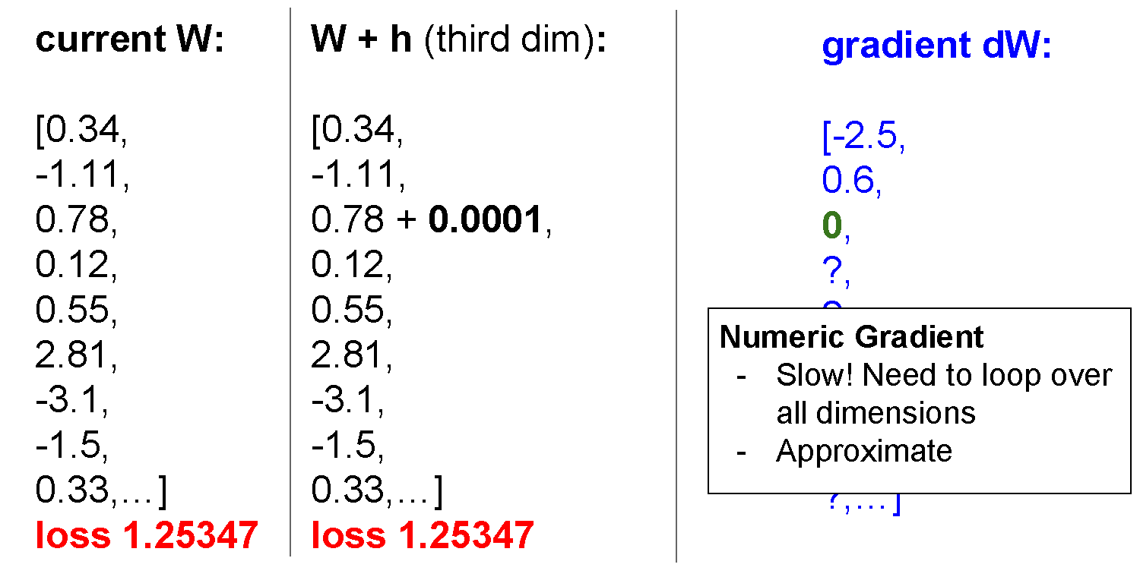

Slide 40
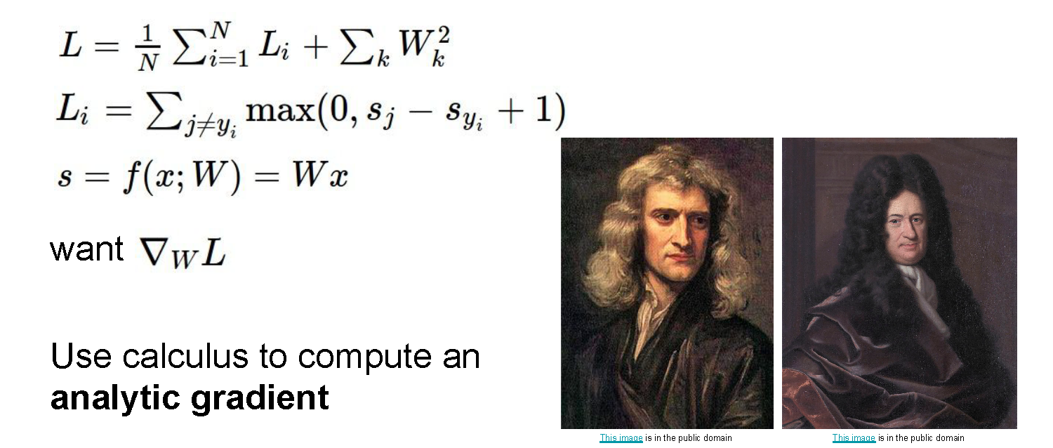
But the loss is just a function of W!

Slide 41
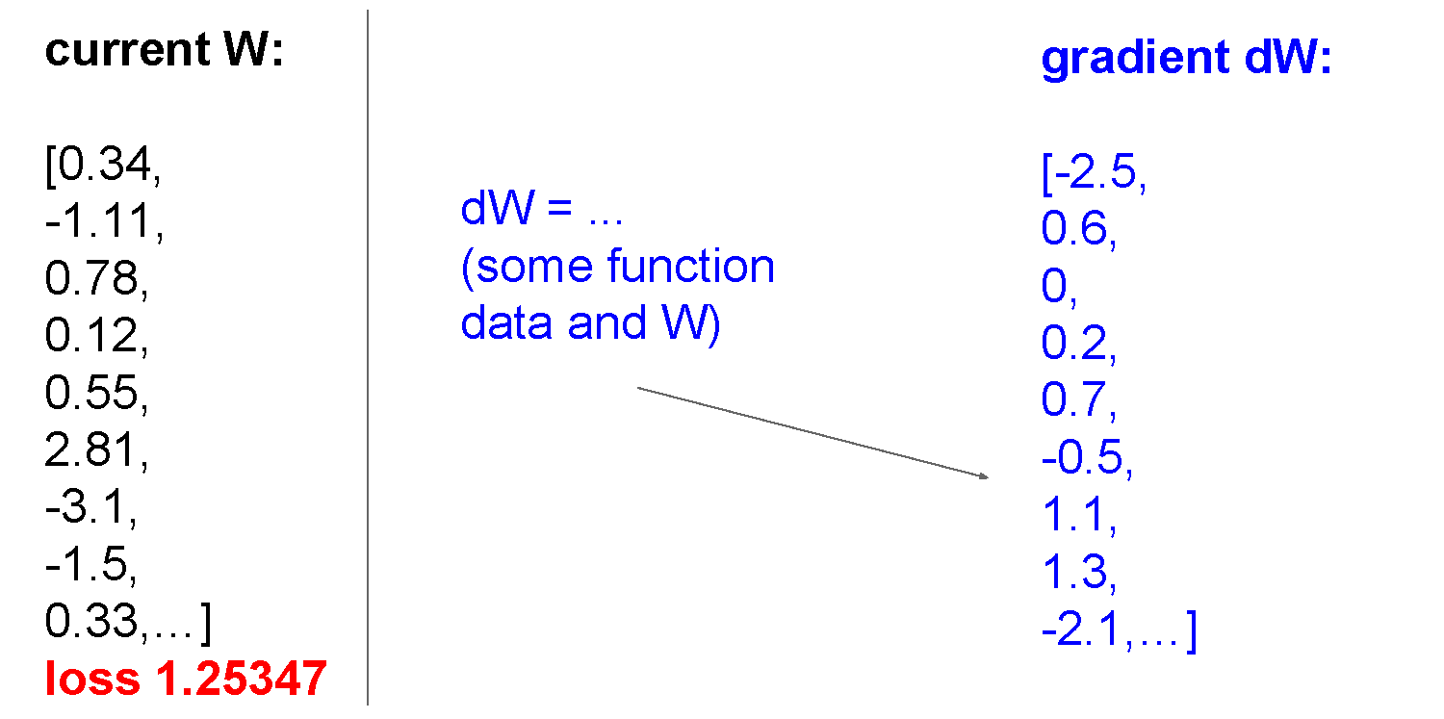

Slide 42
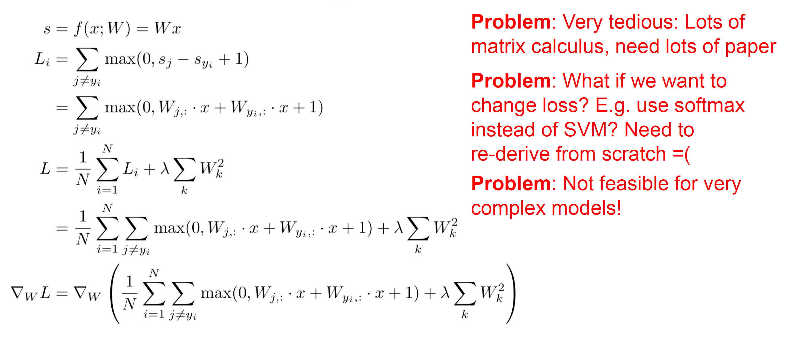
Idea #2: Calculating gradients analytically

Slide 43
Idea #2: Calculating gradients analytically

Slide 44
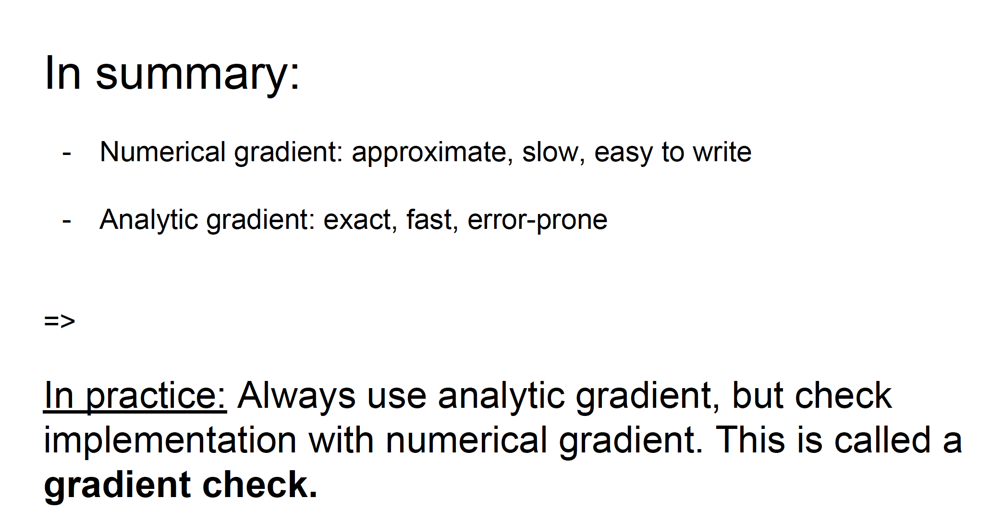

Slide 45
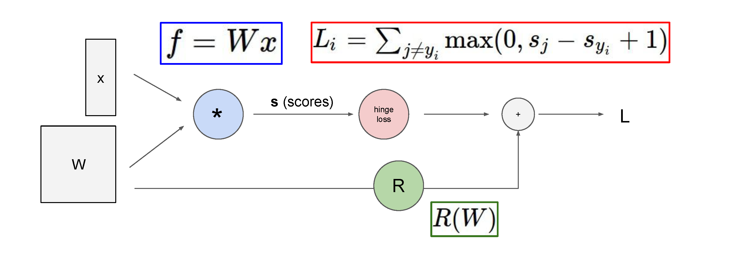
Better idea: computation graphs + backpropagation
Forward pass: compute loss using current weights
Backwards pass: compute gradients of loss w.r.t. weights, then update the weights
(backpropagation algorithm)

Slide 46
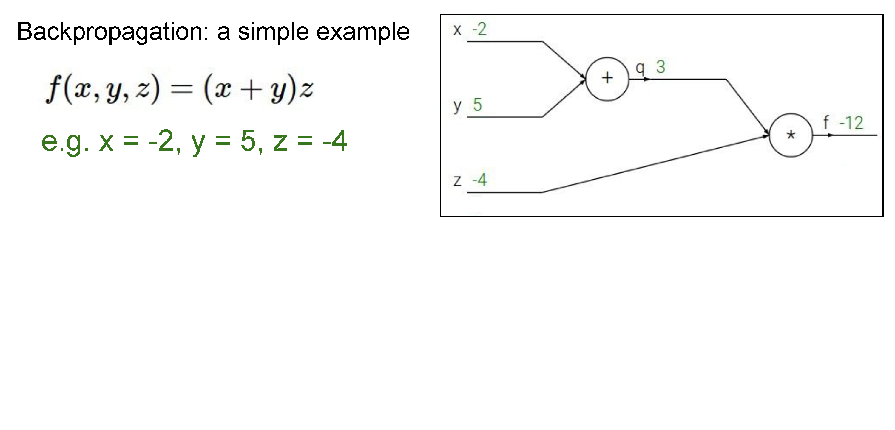

Slide 47
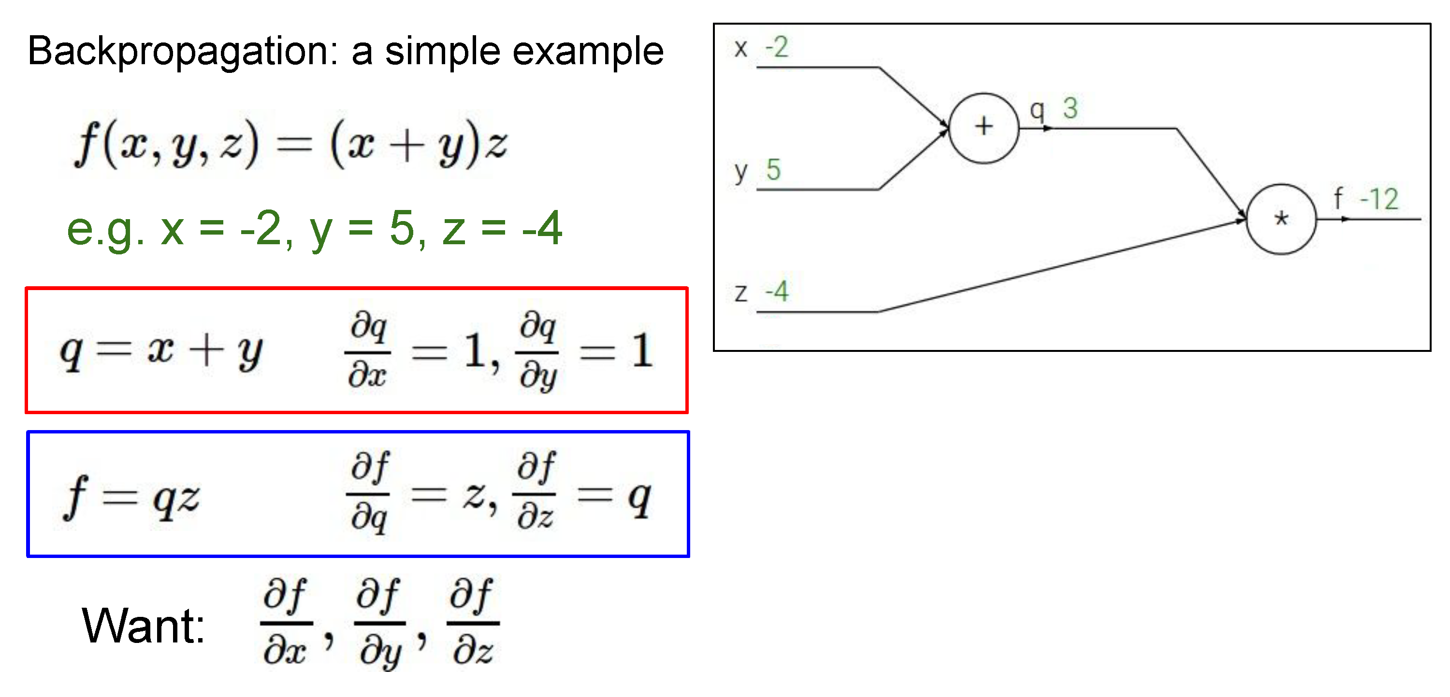

Slide 48
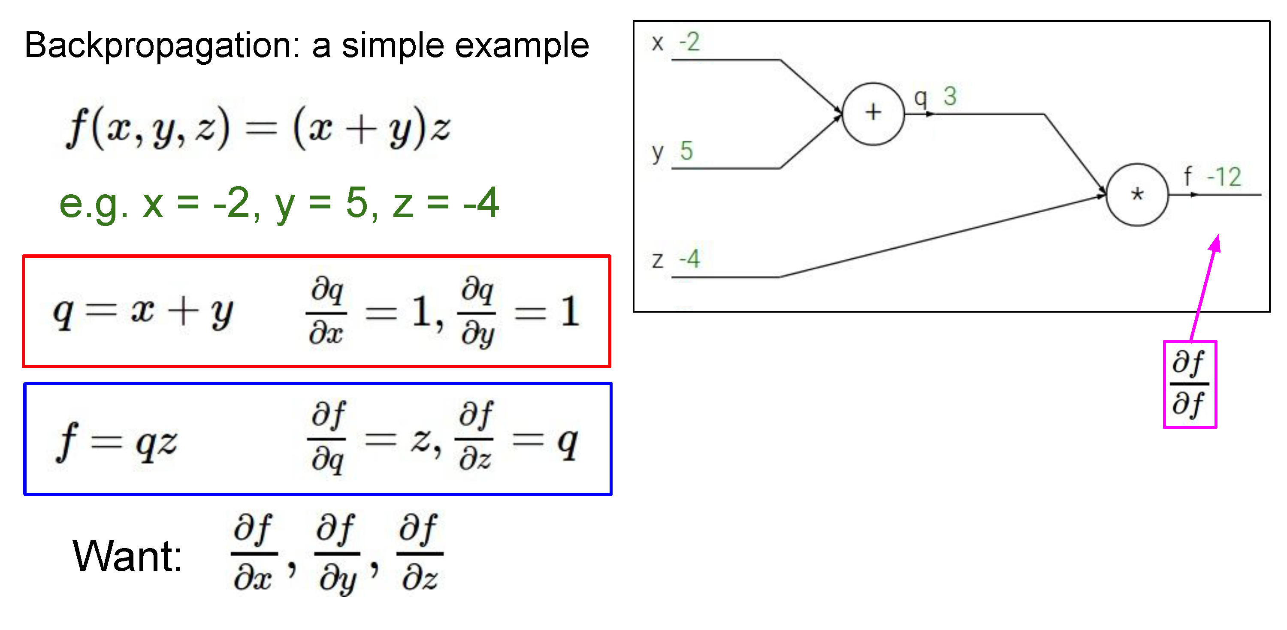

Slide 49


Slide 50
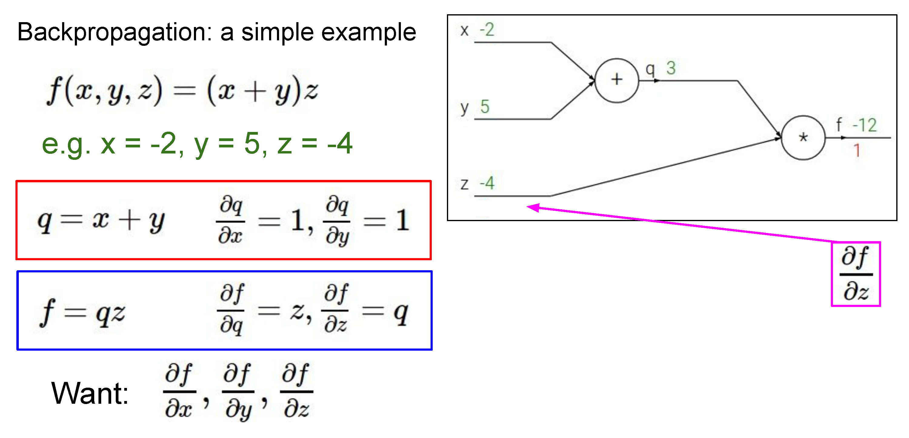

Slide 51
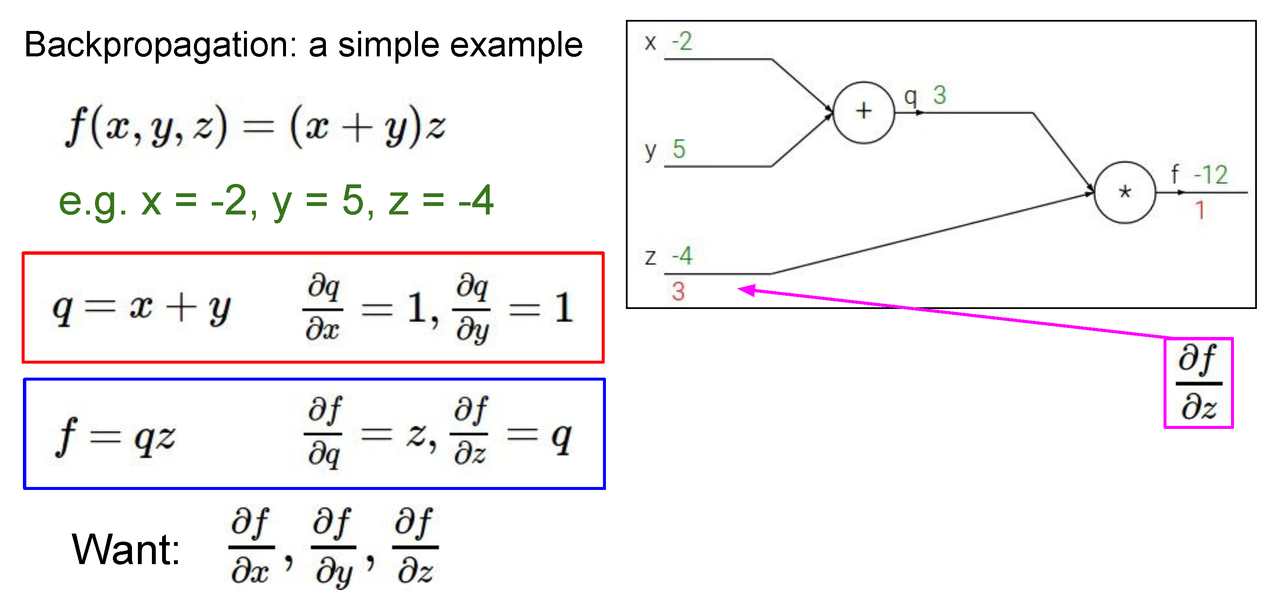

Slide 52
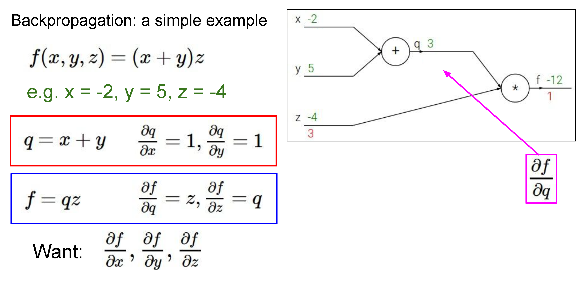

Slide 53


Slide 54
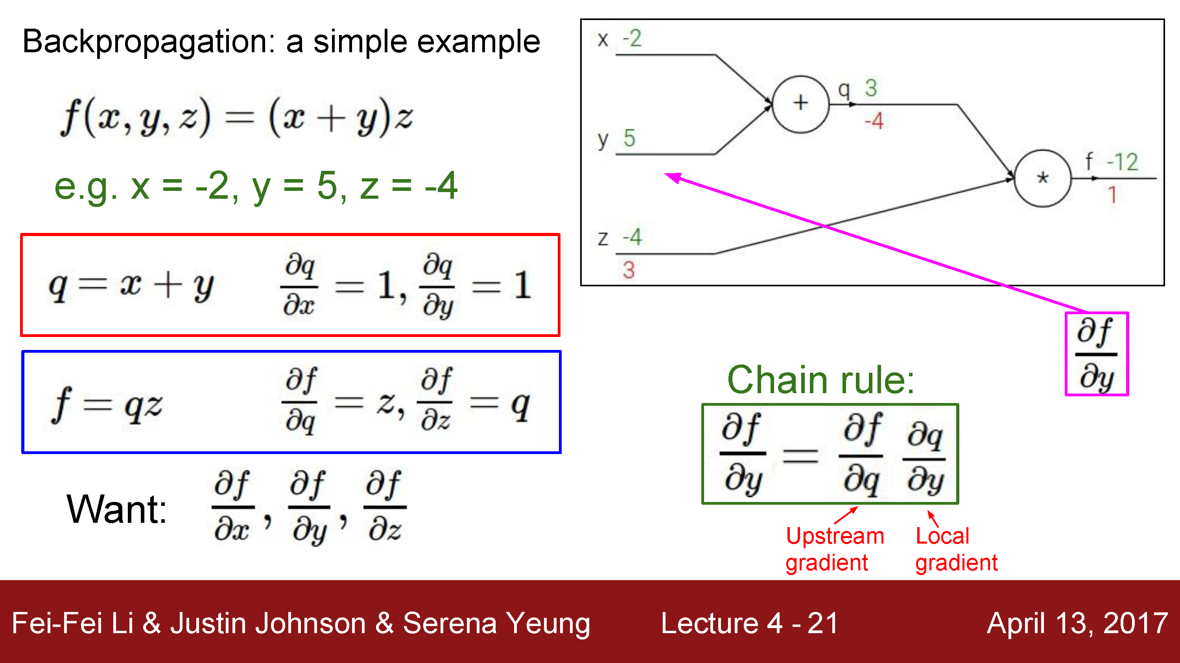

Slide 56
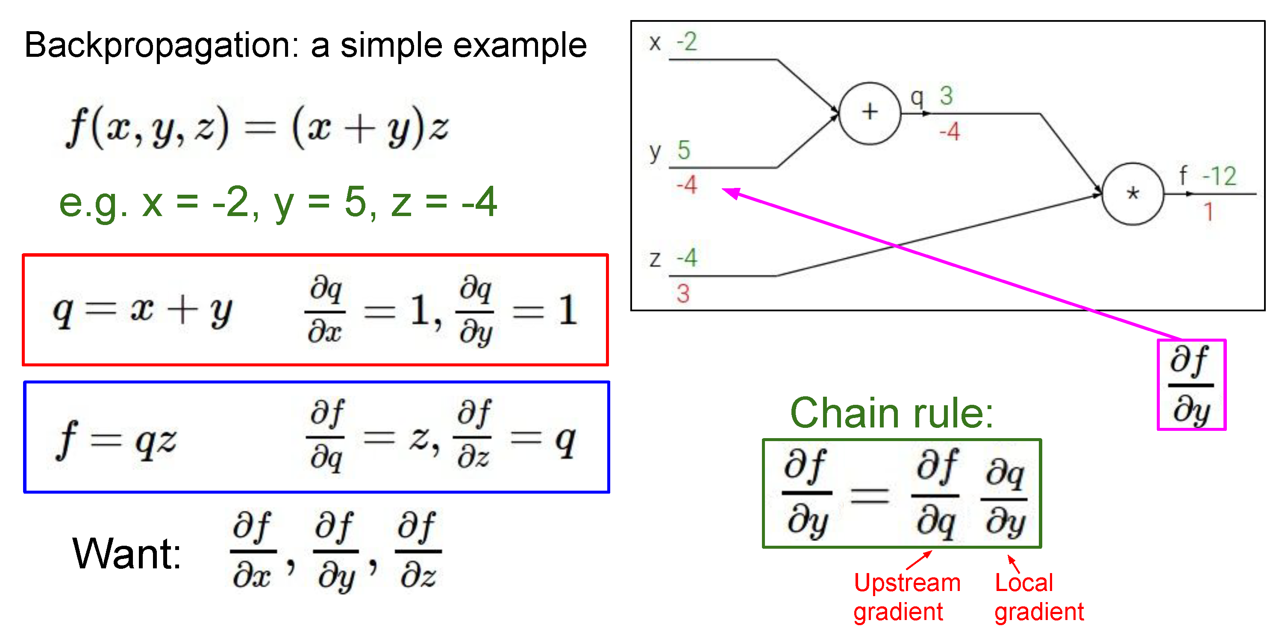

Slide 57
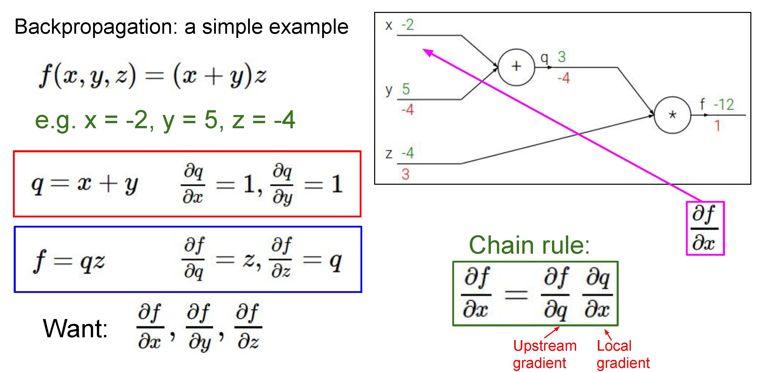

Slide 58
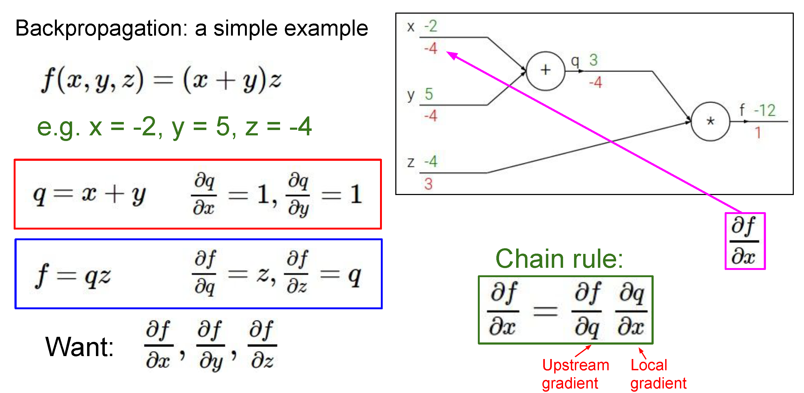

Slide 59
Backpropagation
General idea: Recursive application of the chain rule (calculus 101) backwards through a computation graph
Can reuse intermediate calculations computed during the forwards pass during the backwards pass
Natural extensions from scalar computations to vector computations
Deep learning frameworks like Pytorch / TensorFlow support efficient automated backpropagation via automatic differentiation and GPU acceleration

Slide 60
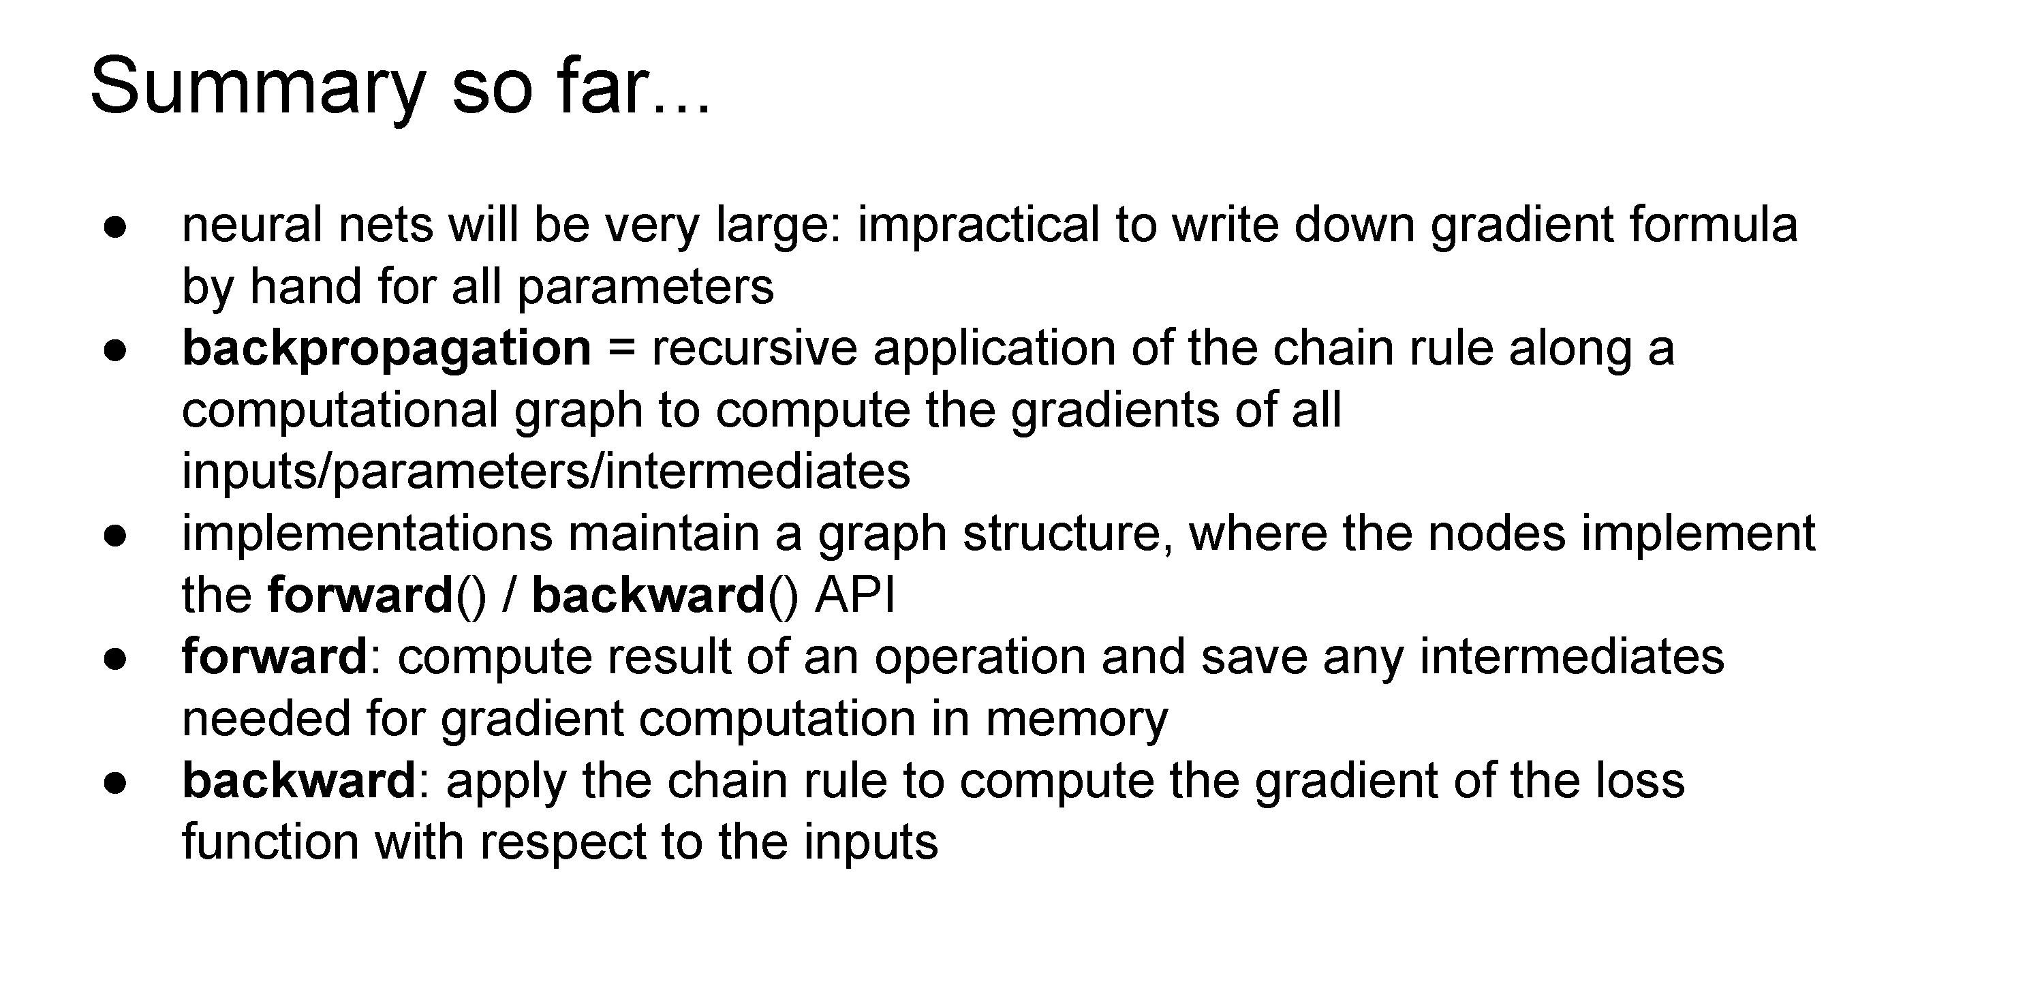

Slide 61
Questions?

Slide 62
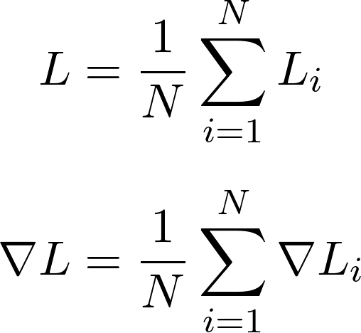
What if the training data is very large?
Recall that ImageNet has >1.2M training images
Computing the value of the loss and its gradient over the entire training set is very expensive in terms of computation
Loss function is summed over all N training images
Gradient is also summed over all N training images

Slide 63
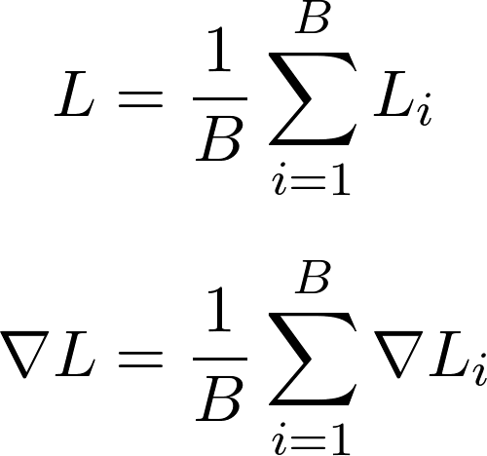
Alternative: stochastic gradient descent
Approximate the sum using a minibatch of examples
e.g., 32, 64, or 128 examples
For each step of gradient descent, choose a different batch
Where B (e.g. 32) is the minibatch size

Slide 64
Stochastic gradient descent (SGD)
A full pass through the dataset (i.e., using batches that cover the training data) is called an epoch
Usually need to train for multiple epochs, i.e., multiple full passes through the dataset to converge
Stochastic gradient descent approximates the true gradient, but works remarkably well in practice

Slide 65


Slide 66


Slide 67
Why so complicated?
Training deep networks can be finicky – lots of parameters to learn, complex, non-linear optimization function

Slide 68


Visualizing Linear Classification (slides from Abe Davis)
Classification Problem:
Separate Red & Blue
Linear Solution
Based on http://colah.github.io/posts/2014-03-NN-Manifolds-Topology/
Notes:
http://colah.github.io/posts/2014-03-NN-Manifolds-Topology/
layer_defs = [];
layer_defs.push({type:'input', out_sx:1, out_sy:1, out_depth:2});
layer_defs.push({type:'fc', num_neurons:3, activation: 'tanh'});
layer_defs.push({type:'softmax', num_classes:2});
net = new convnetjs.Net();
net.makeLayers(layer_defs);
trainer = new convnetjs.SGDTrainer(net, {learning_rate:0.01, momentum:0.1, batch_size:10, l2_decay:0.001});

Slide 69



Visualizing Classification With a Neural Network
Hidden Layer
input
Output
Output y of Neuron from Hidden Layer
Example Network
Output x of Neuron from Hidden Layer
Classification Results for Every Point in Original Space
Classification Results for Every Point in Transformed Feature Space
Based on http://colah.github.io/posts/2014-03-NN-Manifolds-Topology/
Notes:
http://colah.github.io/posts/2014-03-NN-Manifolds-Topology/
Based on http://colah.github.io/posts/2014-03-NN-Manifolds-Topology/
layer_defs = [];
layer_defs.push({type:'input', out_sx:1, out_sy:1, out_depth:2});
layer_defs.push({type:'fc', num_neurons:3, activation: 'tanh'});
layer_defs.push({type:'softmax', num_classes:2});
net = new convnetjs.Net();
net.makeLayers(layer_defs);
trainer = new convnetjs.SGDTrainer(net, {learning_rate:0.01, momentum:0.1, batch_size:10, l2_decay:0.001});

Slide 70
Demo
https://cs.stanford.edu/people/karpathy/convnetjs/demo/classify2d.html

Slide 71

What Makes Training Deep Nets Hard?
It’s easy to get high training accuracy:
Use a huge, fully connected network with tons of layers
Let it memorize your training data
Its hard to get high test accuracy
…
…
This would be an example of overfitting

Slide 72

Related Question: Why Convolutional Layers?
A fully connected layer can generally represent the same functions as a convolutional one
Think of the convolutional layer as a version of the FC layer with constraints on parameters
What is the advantage of CNNs?
Convolutional Layer
Fully Connected Layer

Slide 73


Overfitting: More Parameters, More Problems
Non-Deep Example: consider the function
Let’s take some noisy samples of the function…
Notes:
P_N(x) = \sum_{k=0}^N x^kp_k

Slide 74








Overfitting: More Parameters, More Problems
Now lets fit a polynomial to our samples of the form
Notes:
P_N(x) = \sum_{k=0}^N x^kp_k

Slide 75


Overfitting: More Parameters, More Problems
A model with more parameters can represent more functions
E.g.,: if then
More parameters will often reduce training error but increase testing error. This is overfitting.
When overfitting happens, models do not generalize well.
Degree 2 Fit
Degree 15 Fit

Slide 76
Deep Learning: More Parameters, More Problems?
More parameters let us represent a larger space of functions
The larger that space is, the harder our optimization becomes
This means we need:
More data
More compute resources
Etc.
Convolutional Layer
Fully Connected Layer

Slide 77
Deep Learning: More Parameters, More Problems?
A convolutional layer looks for components of a function that are spatially-invariant
Convolutional Layer
Fully Connected Layer

Slide 78
How to Avoid Overfitting: Regularization
In general:
More parameters means higher risk of overfitting
More constraints/conditions on parameters can help
If a model is overfitting, we can
Collect more data to train on
Regularize: add some additional information or assumptions to better constrain learning
Regularization can be done through:
the design of architecture
the choice of loss function
the preparation of data
…

Slide 79
Regularization: Architecture Choice
“Bigger” architectures (typically, those with more parameters) tend to be more at risk of overfitting.
Convolutional Layer
Fully Connected Layer

Slide 80


Slide 81


Slide 82


Slide 83
Batch normalization
Side note – can also perform normalization after each layer of the network to stabilize network training (“batch normalization”)

Slide 84


Slide 85

(2) Choose your architecture
https://playground.tensorflow.org/

Slide 86
(2) Choose your architecture
Very common modern choice

Slide 87

(if you use ReLU activations, folks tend to initialize bias to small positive number)

Slide 88



Slide 90


Slide 91

(4) Find a learning rate

Slide 92


Slide 93


Slide 94
(+batch size)

Slide 95
Questions?

Slide 96


Slide 97


Slide 98


Slide 99


Slide 100


Slide 101


Slide 102


Slide 103


Slide 104


Slide 105


Slide 106


Slide 107

Common modern approach: start with a ResNet architecture pre-trained on ImageNet, and fine-tune on your (smaller) dataset

Slide 108
Questions?

