Slide 1
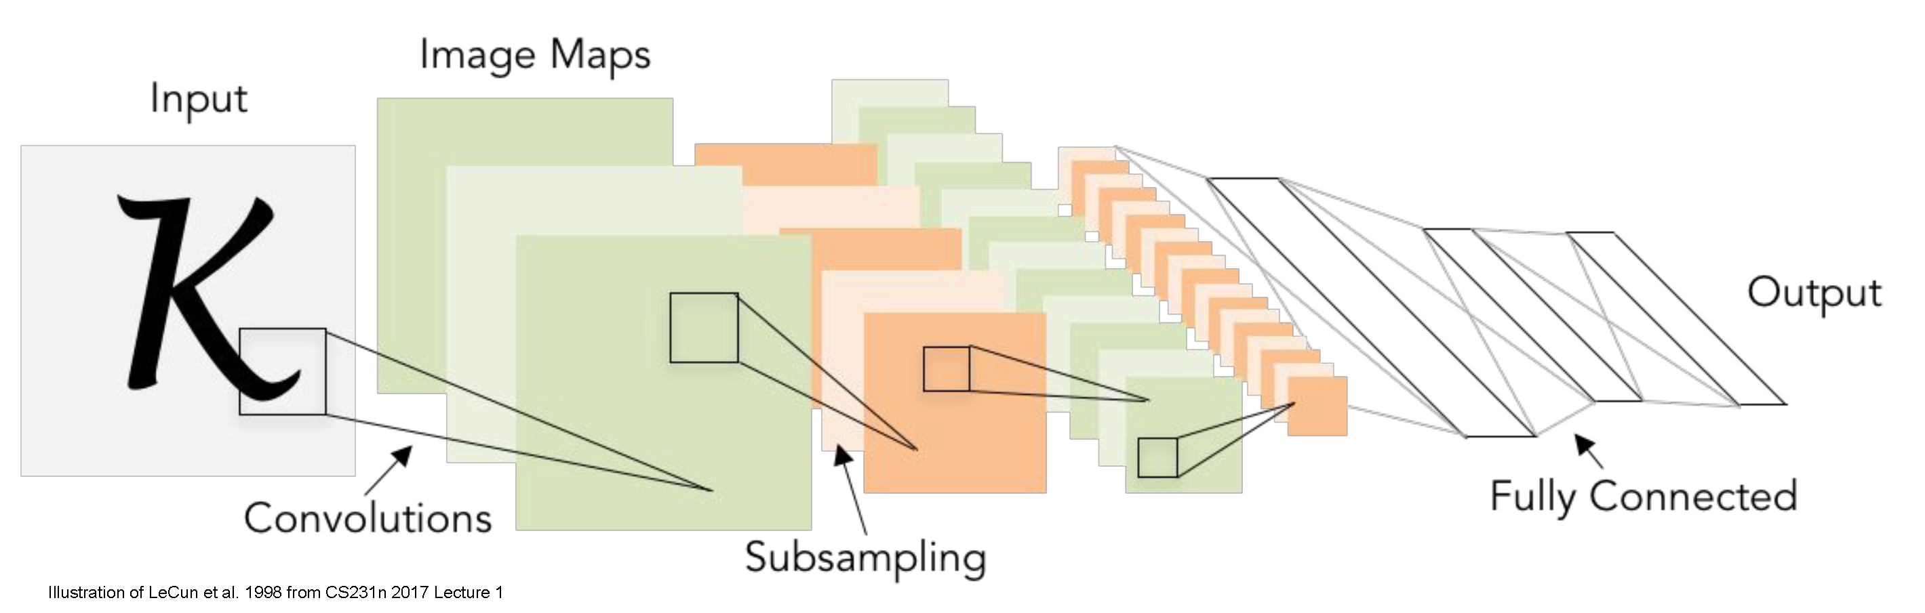
Convolutional neural networks
CS5670: Computer Vision
Slides from Fei-Fei Li, Justin Johnson, Serena Yeung
http://vision.stanford.edu/teaching/cs231n/

Slide 2
Announcements
Monday is a Wellness Day
Project 5: *New* To be assigned Wednesday, April 28, due Tuesday, May 11
By a large majority, respondents preferred original final exam time: assigned Wednesday, May 12, 2021; due Monday, May 17, 2021
Sample final exam to be released soon

Slide 3
Readings
Neural networks
  http://cs231n.github.io/neural-networks-1/
  http://cs231n.github.io/neural-networks-2/
  http://cs231n.github.io/neural-networks-3/
  http://cs231n.github.io/neural-networks-case-study/
Convolutional neural networks
  http://cs231n.github.io/convolutional-networks/

Slide 4
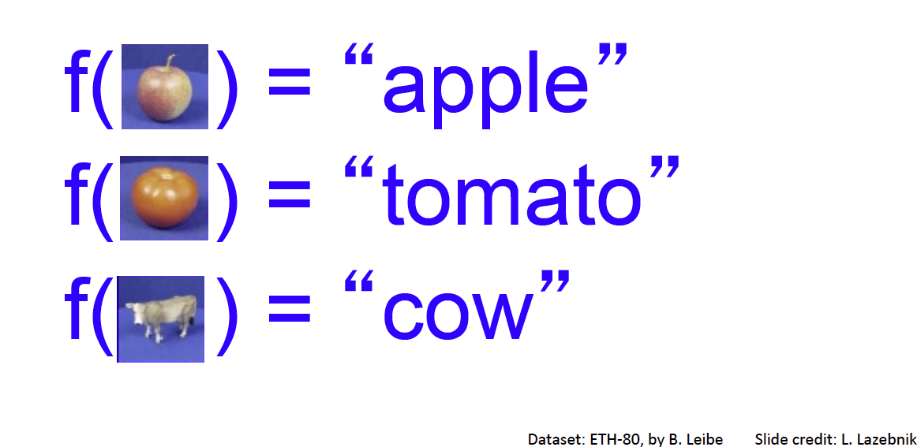
Image Classification: a core task in computer vision
Assume given set of discrete labels, e.g.
{cat, dog, cow, apple, tomato, truck, … }

Slide 5

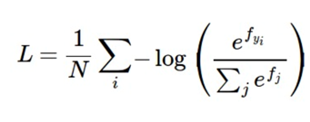
Recap: linear classification
Have score function and loss function
  Score function maps an input data instance (e.g., an image) to a vector of scores, one for each category
  Last time, our score function is based on linear classifier
Find W and b to minimize a loss, e.g. cross-entropy loss
f: score function
x: input instance
W, b: parameters of a linear (actually affine) function

Slide 6
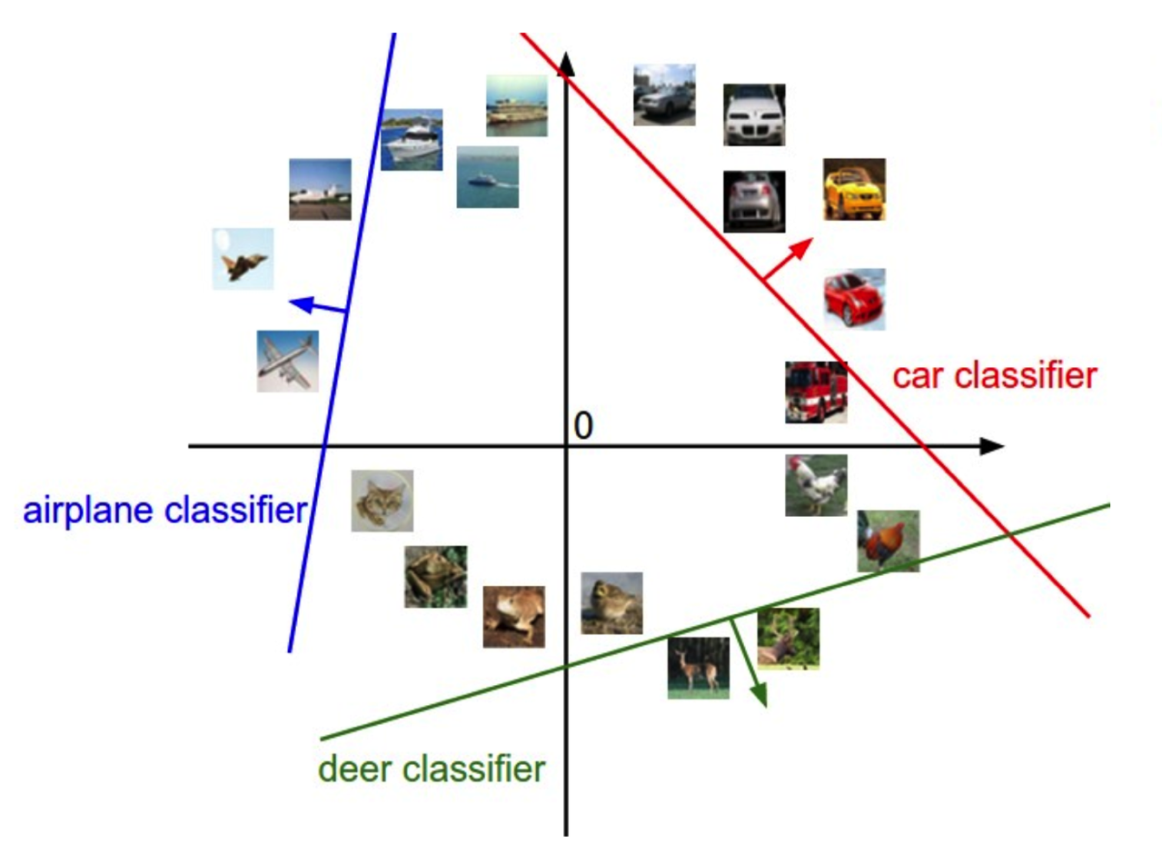
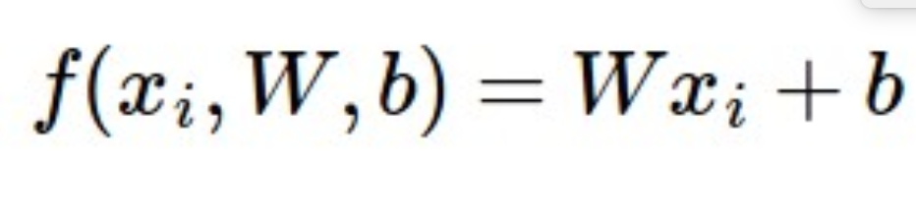
Linear classifiers separate features space into half-spaces

Slide 7
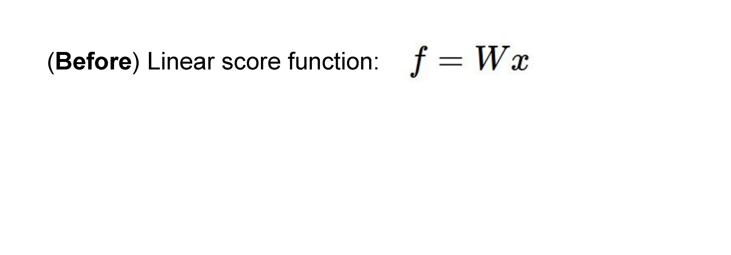
Neural networks

Slide 8
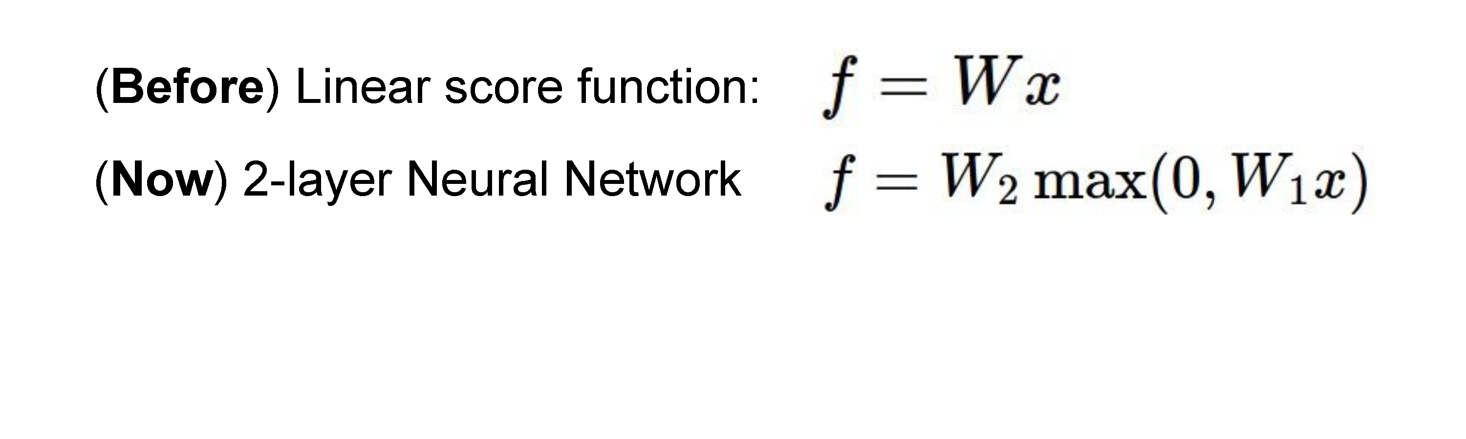
Neural networks

Slide 9
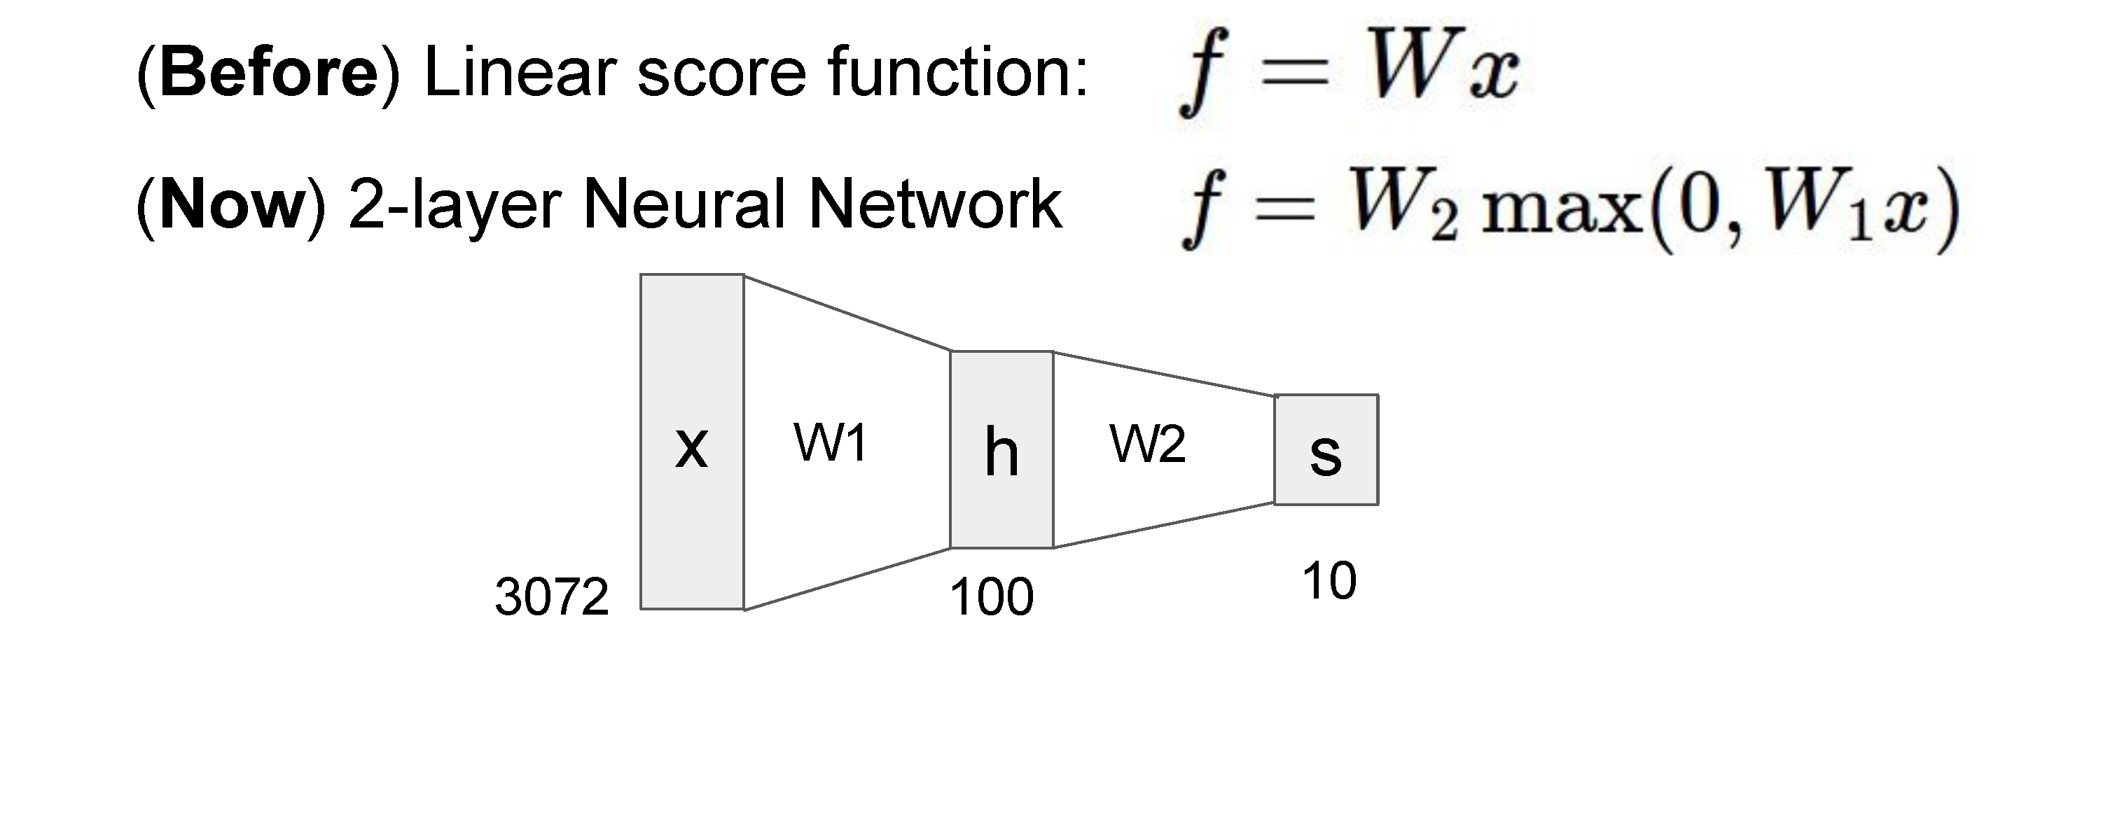

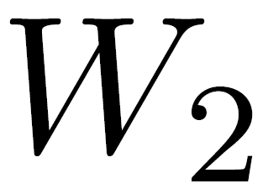
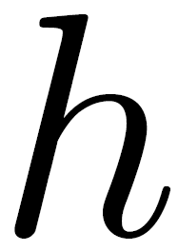
Neural networks
(10 x 100 matrix)
(100 x 3072 matrix)
100D intermediate vector

Slide 10
Neural networks
Total number of weights to learn:
3,072 x 100 + 100 x 10 = 308,200

Slide 11
Recap: linear classification
Have score function and loss function
  Score function maps an input data instance (e.g., an image) to a vector of scores, one for each category
  Last time, our score function is based on linear classifier
Find W and b to minimize a loss, e.g. cross-entropy loss
f: score function
x: input instance
W, b: parameters of a linear (actually affine) function

Slide 12
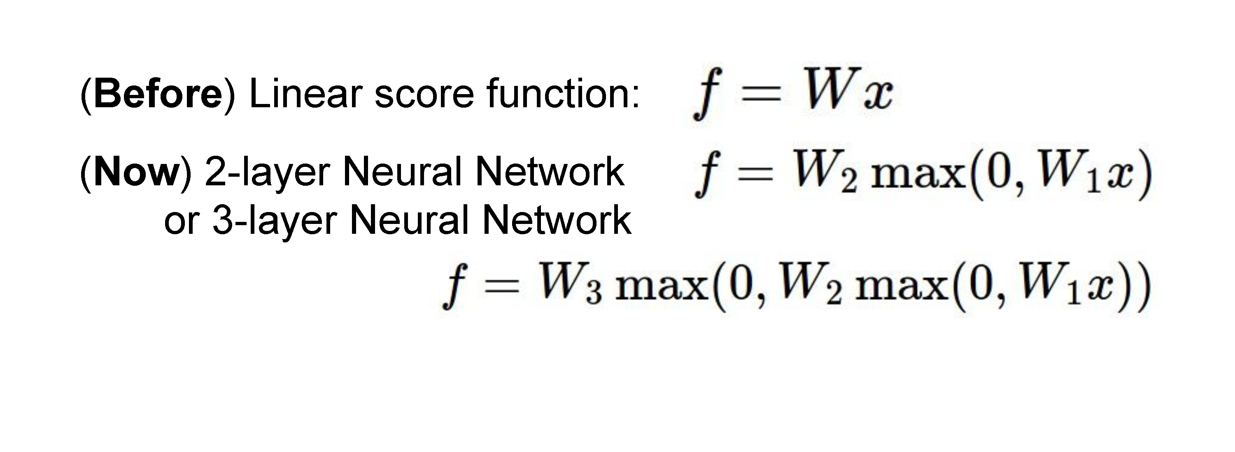
Neural networks
also called “Multi-Layer Perceptrons” (MLPs)

Slide 13

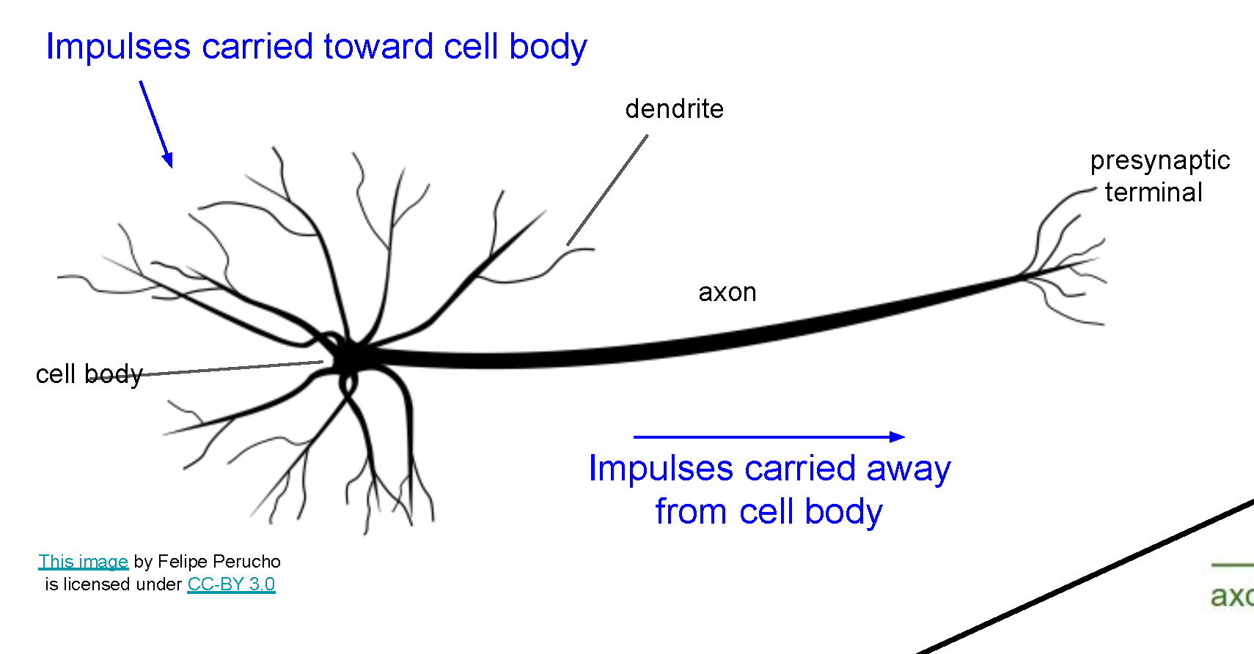
Neural networks
Very coarse generalization of neural networks:
  Linear functions chained together and separated by non-linearities (activation functions), e.g. “max”
  Why separate linear functions with non-linear functions?
  Very roughly inspired by real neurons

Slide 14
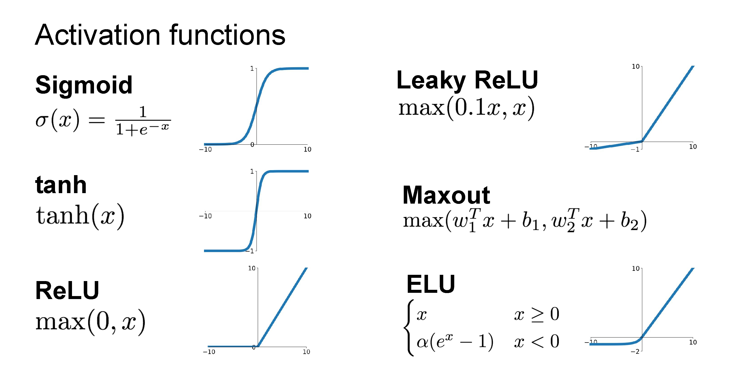

Slide 15
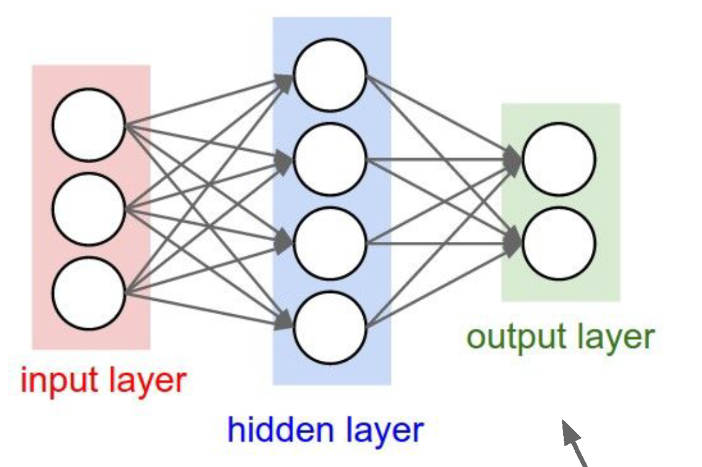
Neural network architecture
Computation graph for a 2-layer neural network
Neuron or unit

Slide 16
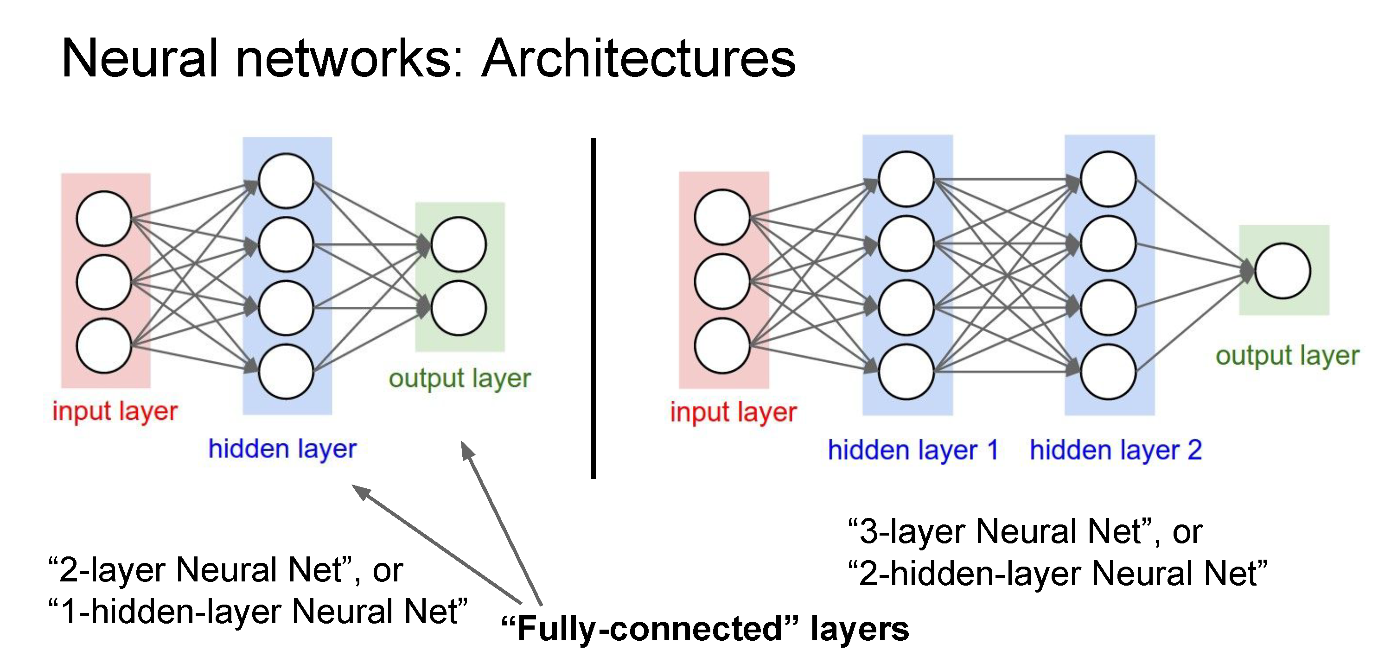
Deep networks typically have many layers and potentially millions of parameters

Slide 17
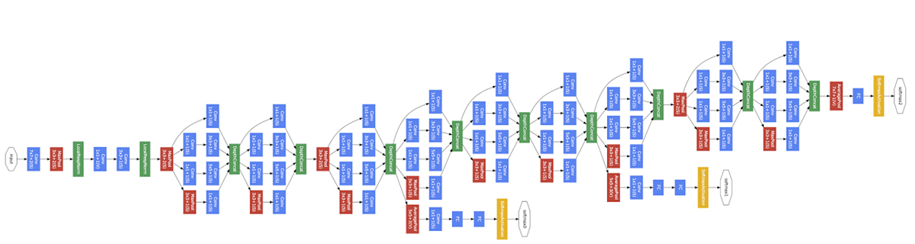
Deep neural network
Inception network (Szegedy et al, 2015)
22 layers

Slide 18
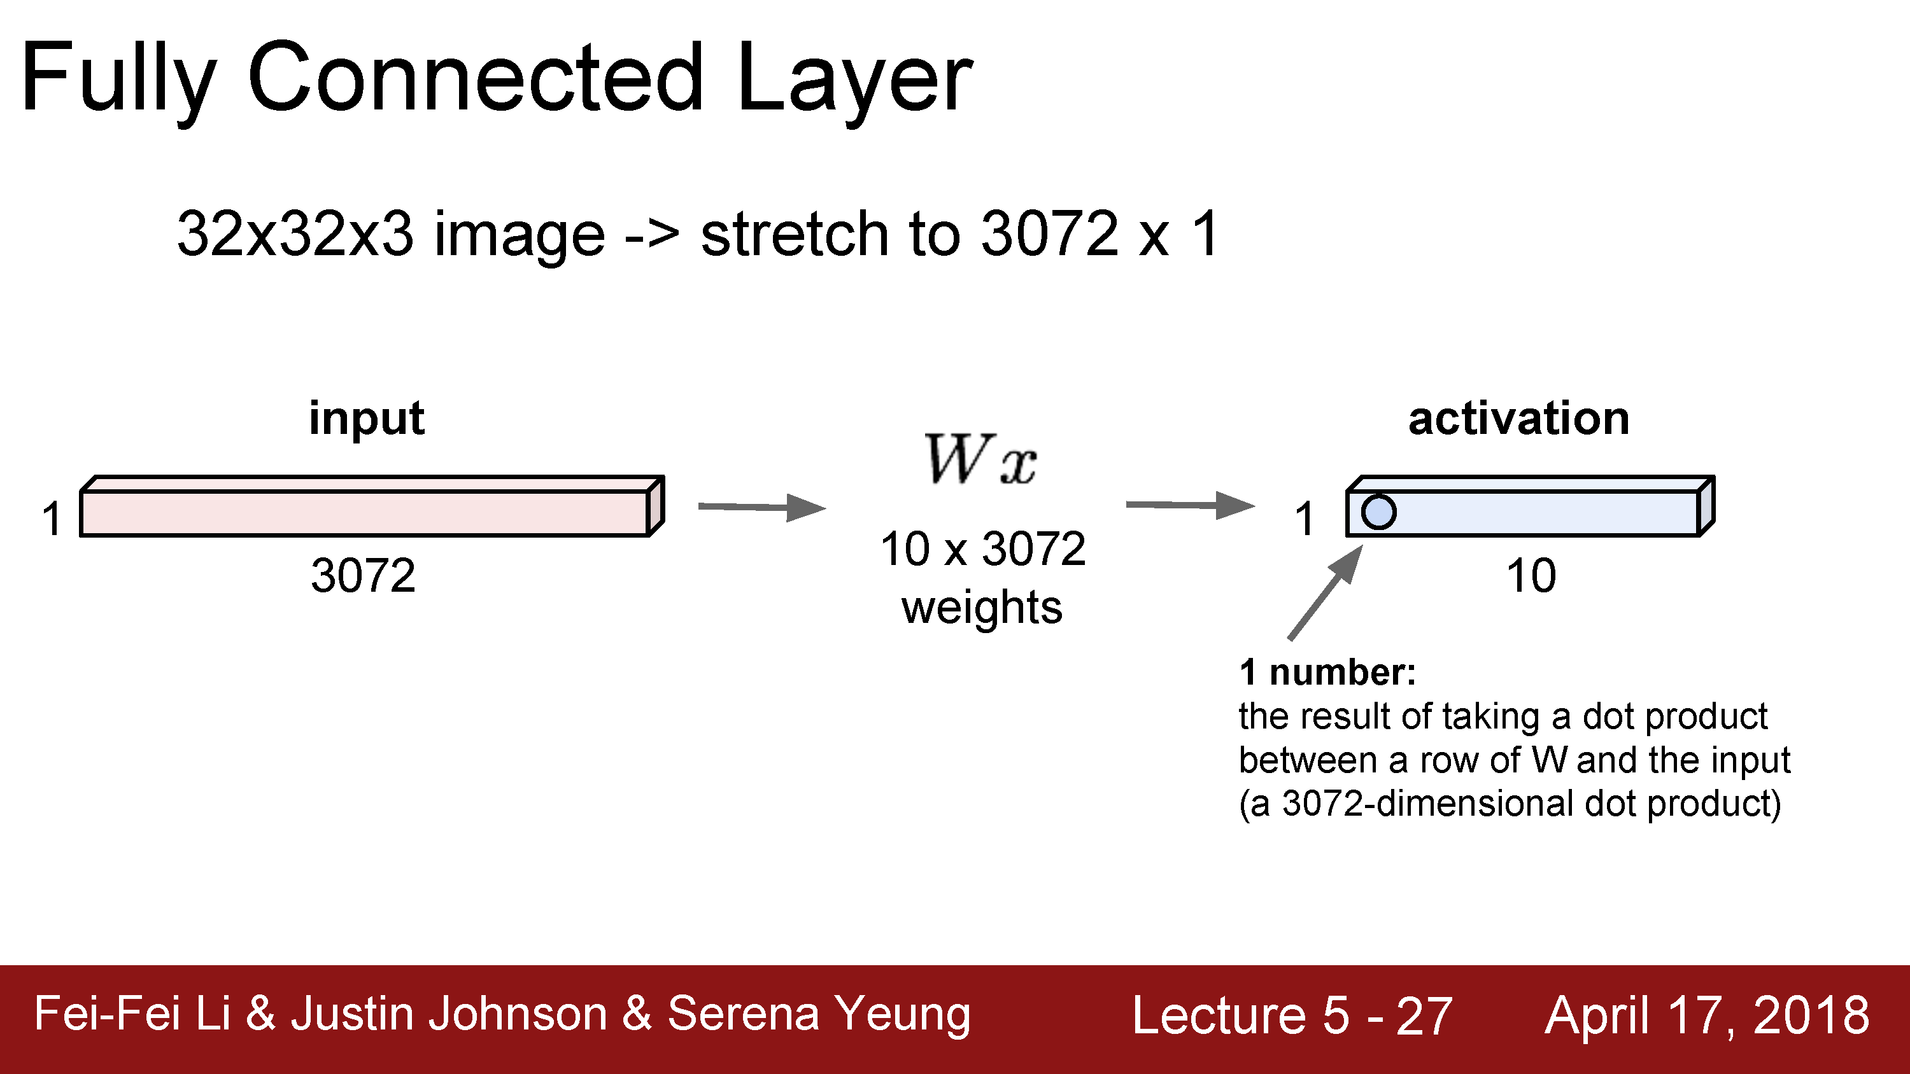
Just like a linear classifer – but in this case, just one layer of a larger network

Slide 19
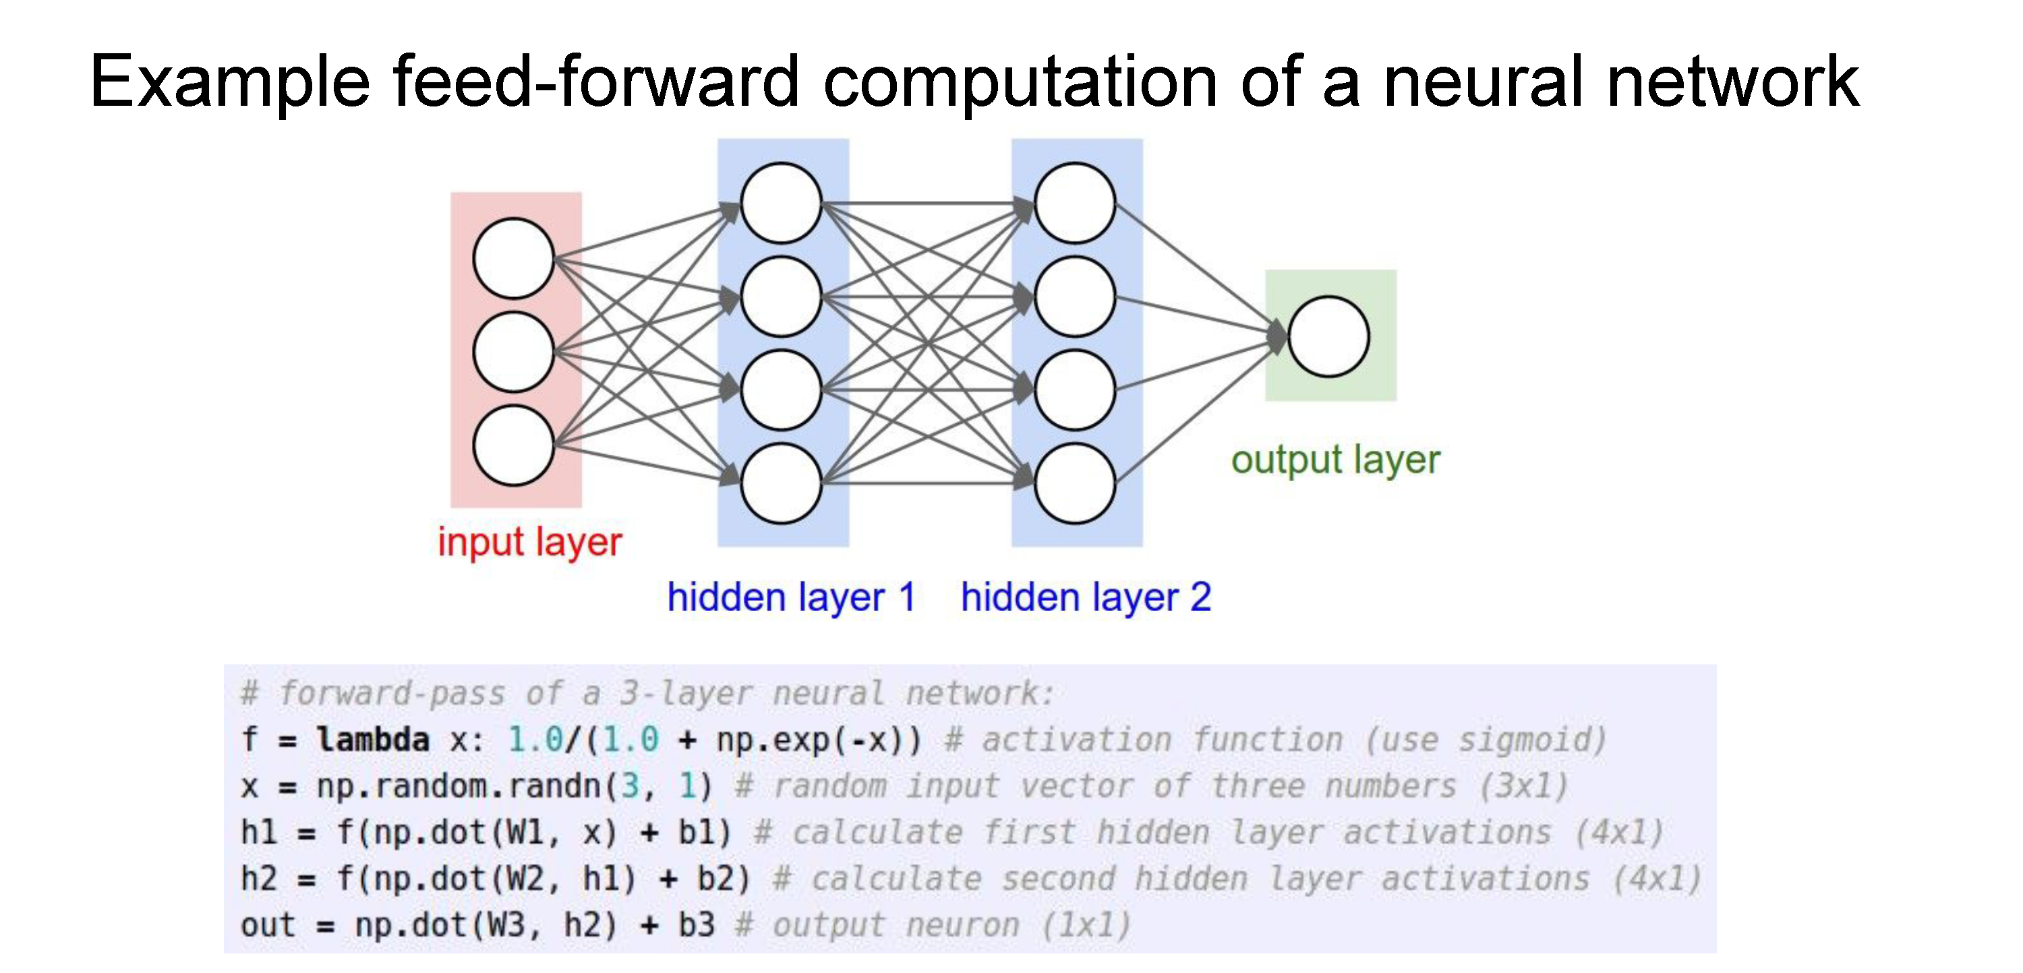

Slide 20
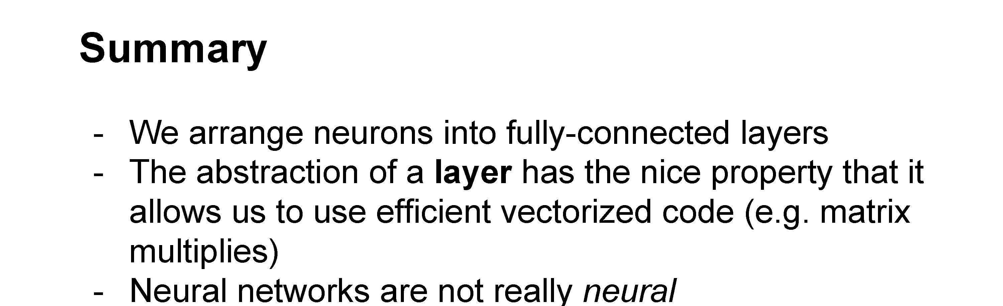

Slide 21
Optimizing parameters with gradient descent
How do we find the best W and b parameters?
In general: gradient descent
  Start with a guess of a good W and b (or randomly initialize them)
  Compute the loss function for this initial guess and the gradient of the loss function
  Step some distance in the negative gradient direction (direction of steepest descent)
  Repeat steps 2 & 3
Note: efficiently performing step 2 for deep networks is called backpropagation

Slide 22
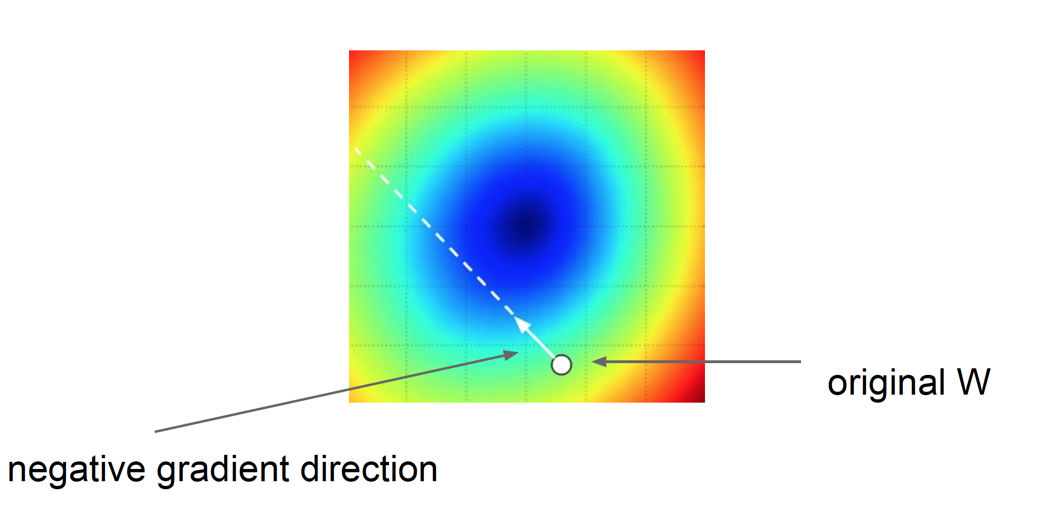
Gradient descent: walk in the direction opposite gradient
Q: How far?
A: Step size: learning rate
Too big: will miss the minimum
Too small: slow convergence

Slide 23
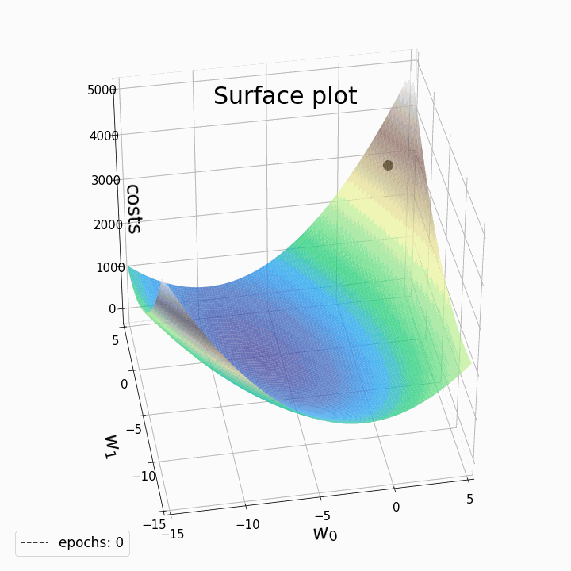
2D example of gradient descent
In reality, in deep learning we are optimizing a highly complex loss function with millions of variables (or more)
More on this later…
https://laptrinhx.com/gradient-descent-animation-2-multiple-linear-regression-3070246823/

Slide 24
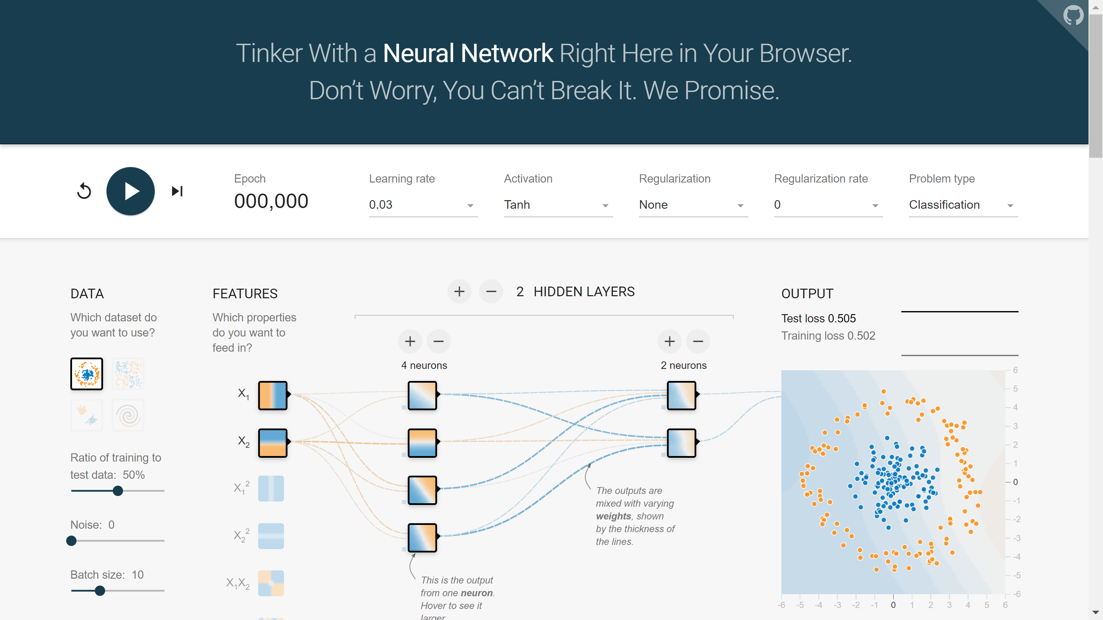
2D example: TensorFlow Playground
https://playground.tensorflow.org

Slide 25
Questions?

Slide 26
Convolutional neural networks

Slide 27
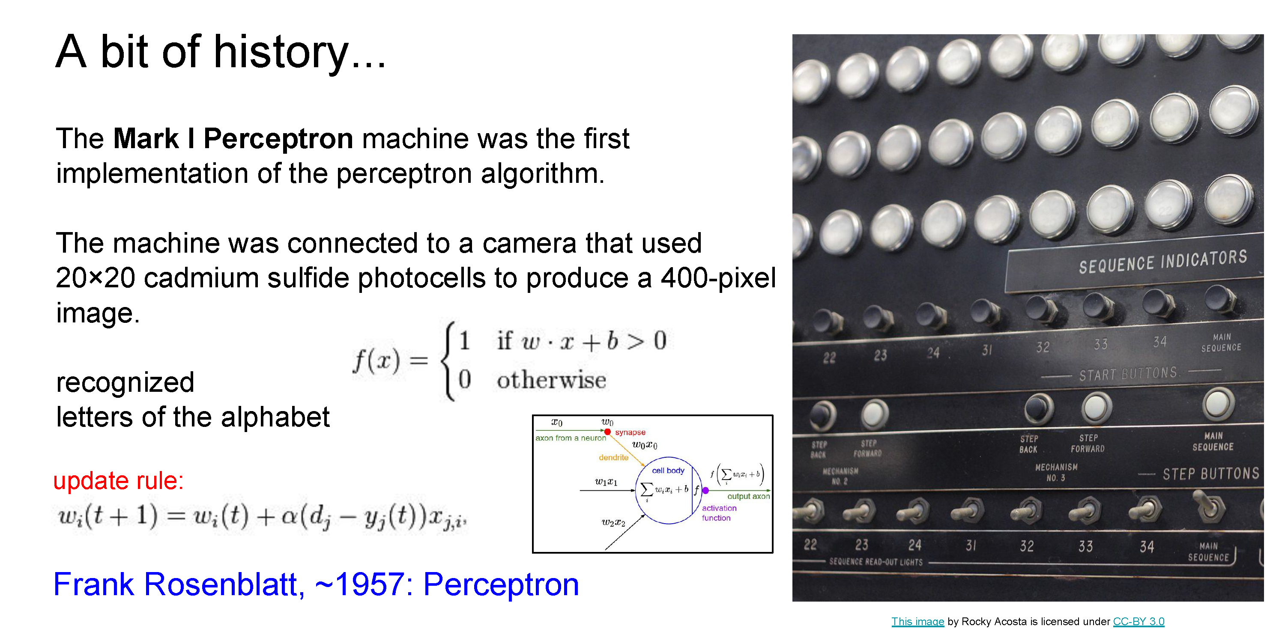

Slide 28
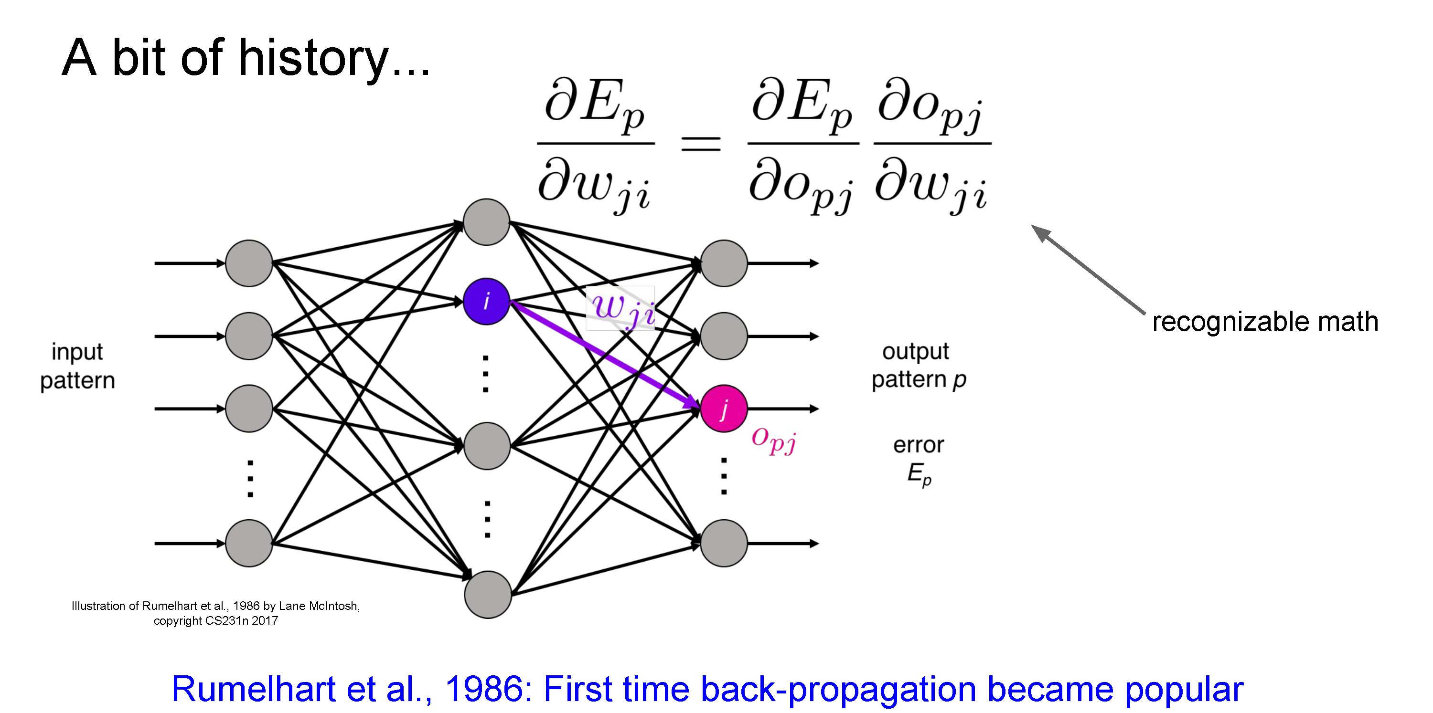

Slide 29
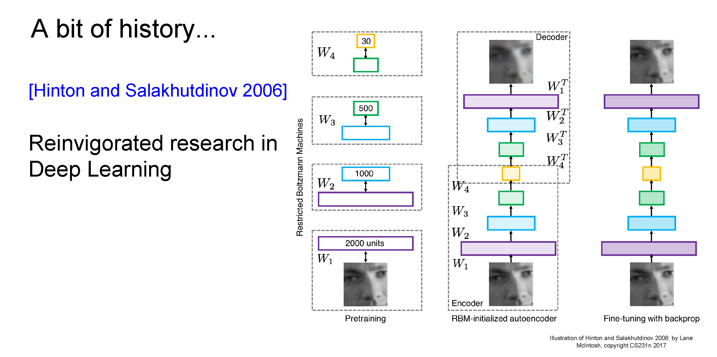
Hinton and Salakhutdinov. Reducing the Dimensionality of Data with Neural Networks. Science, 2016.

Slide 30
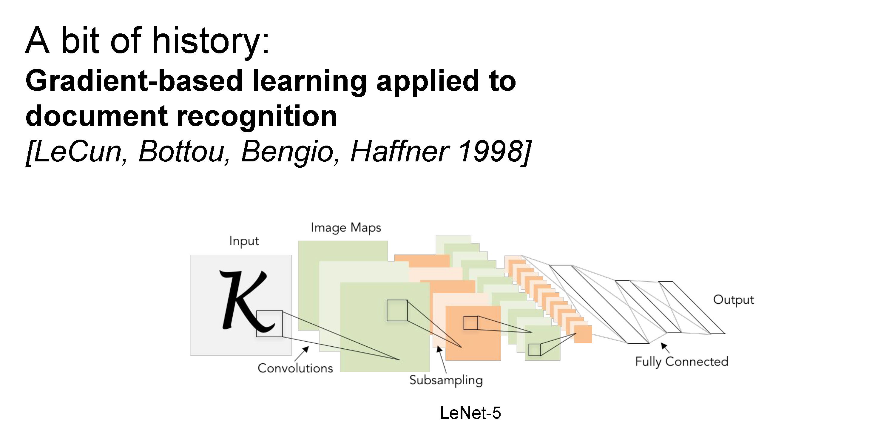

Slide 31
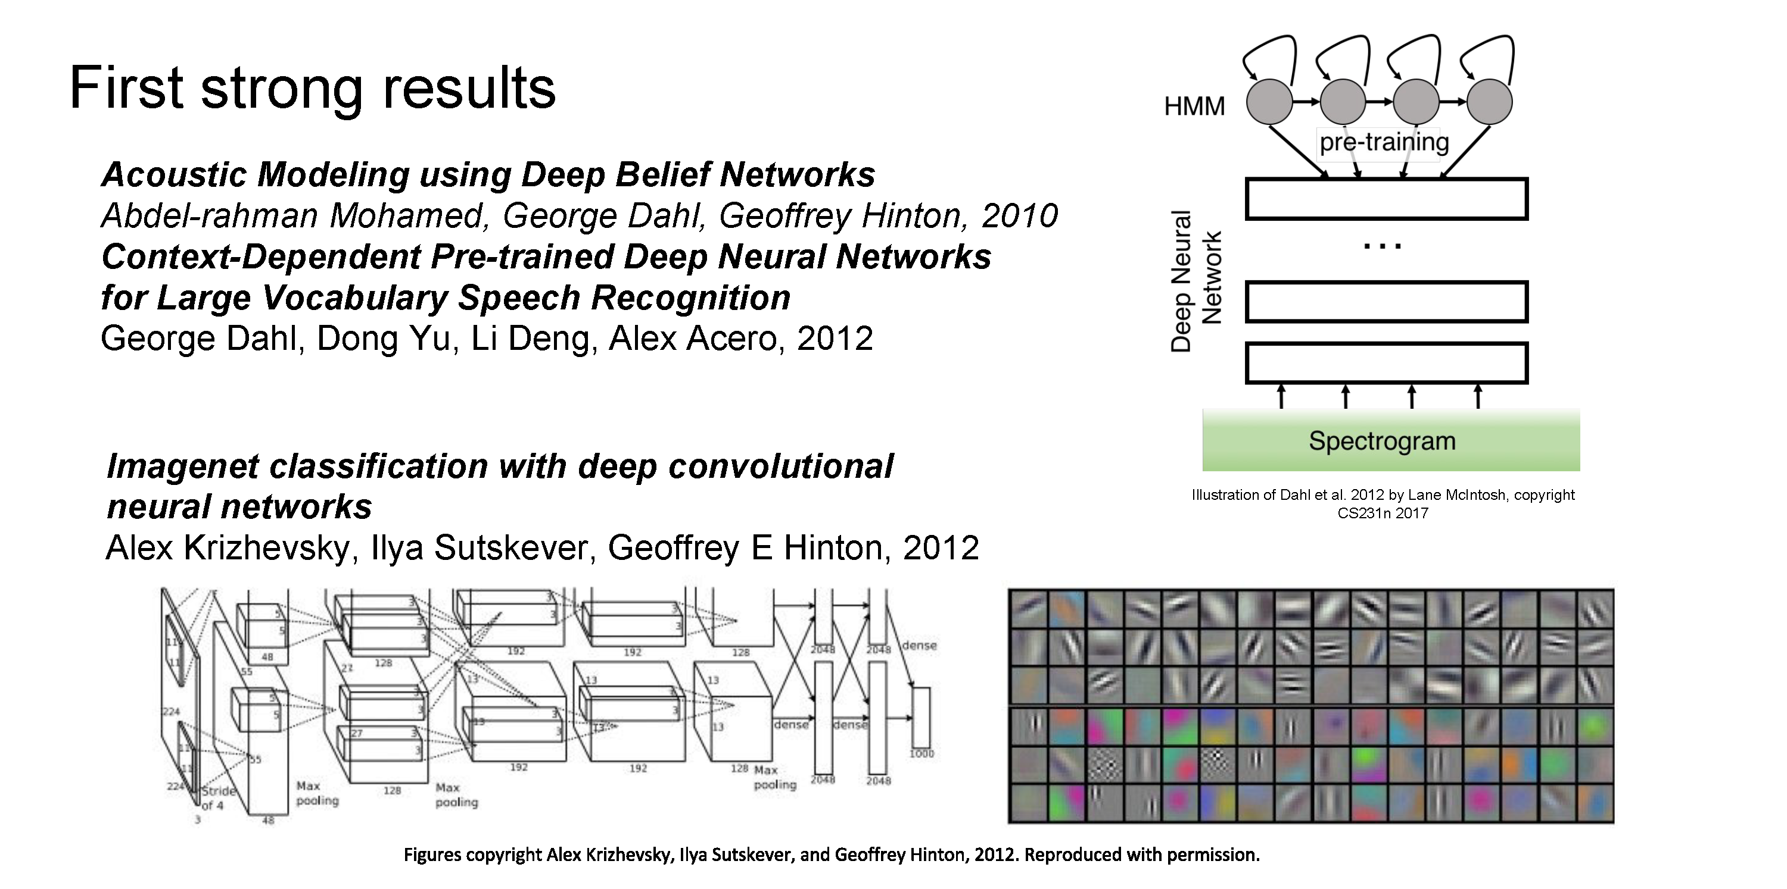

Slide 32
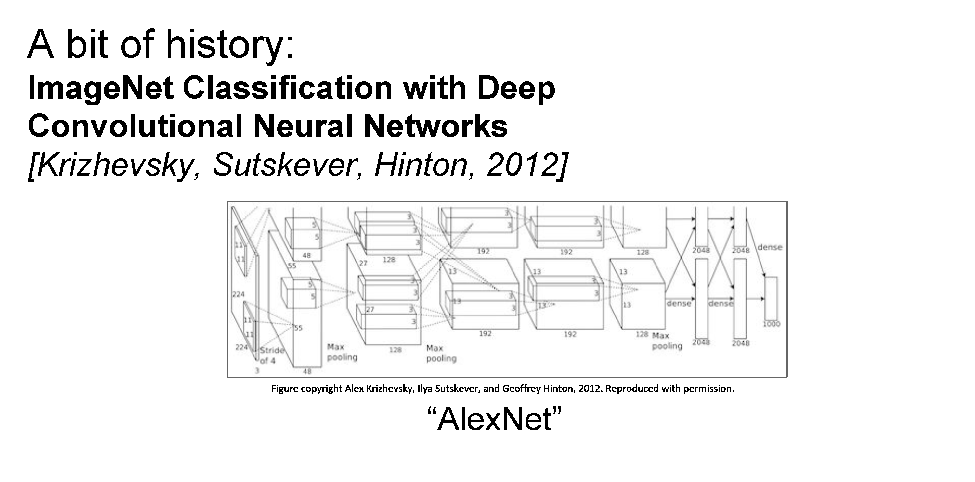

Slide 33
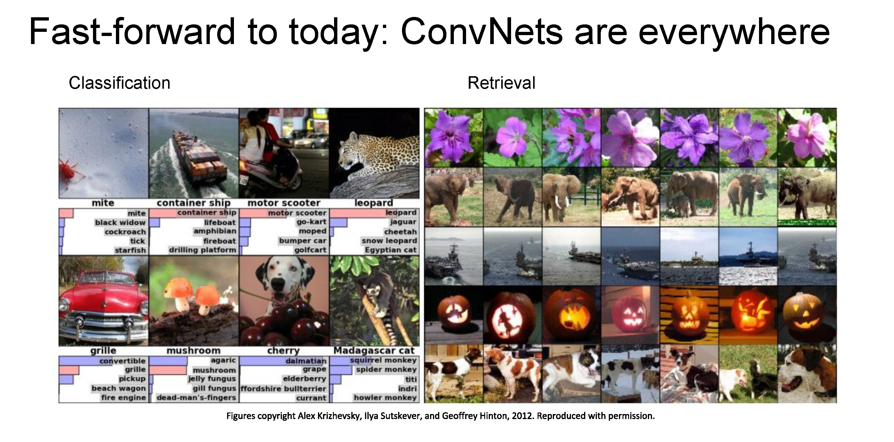

Slide 34
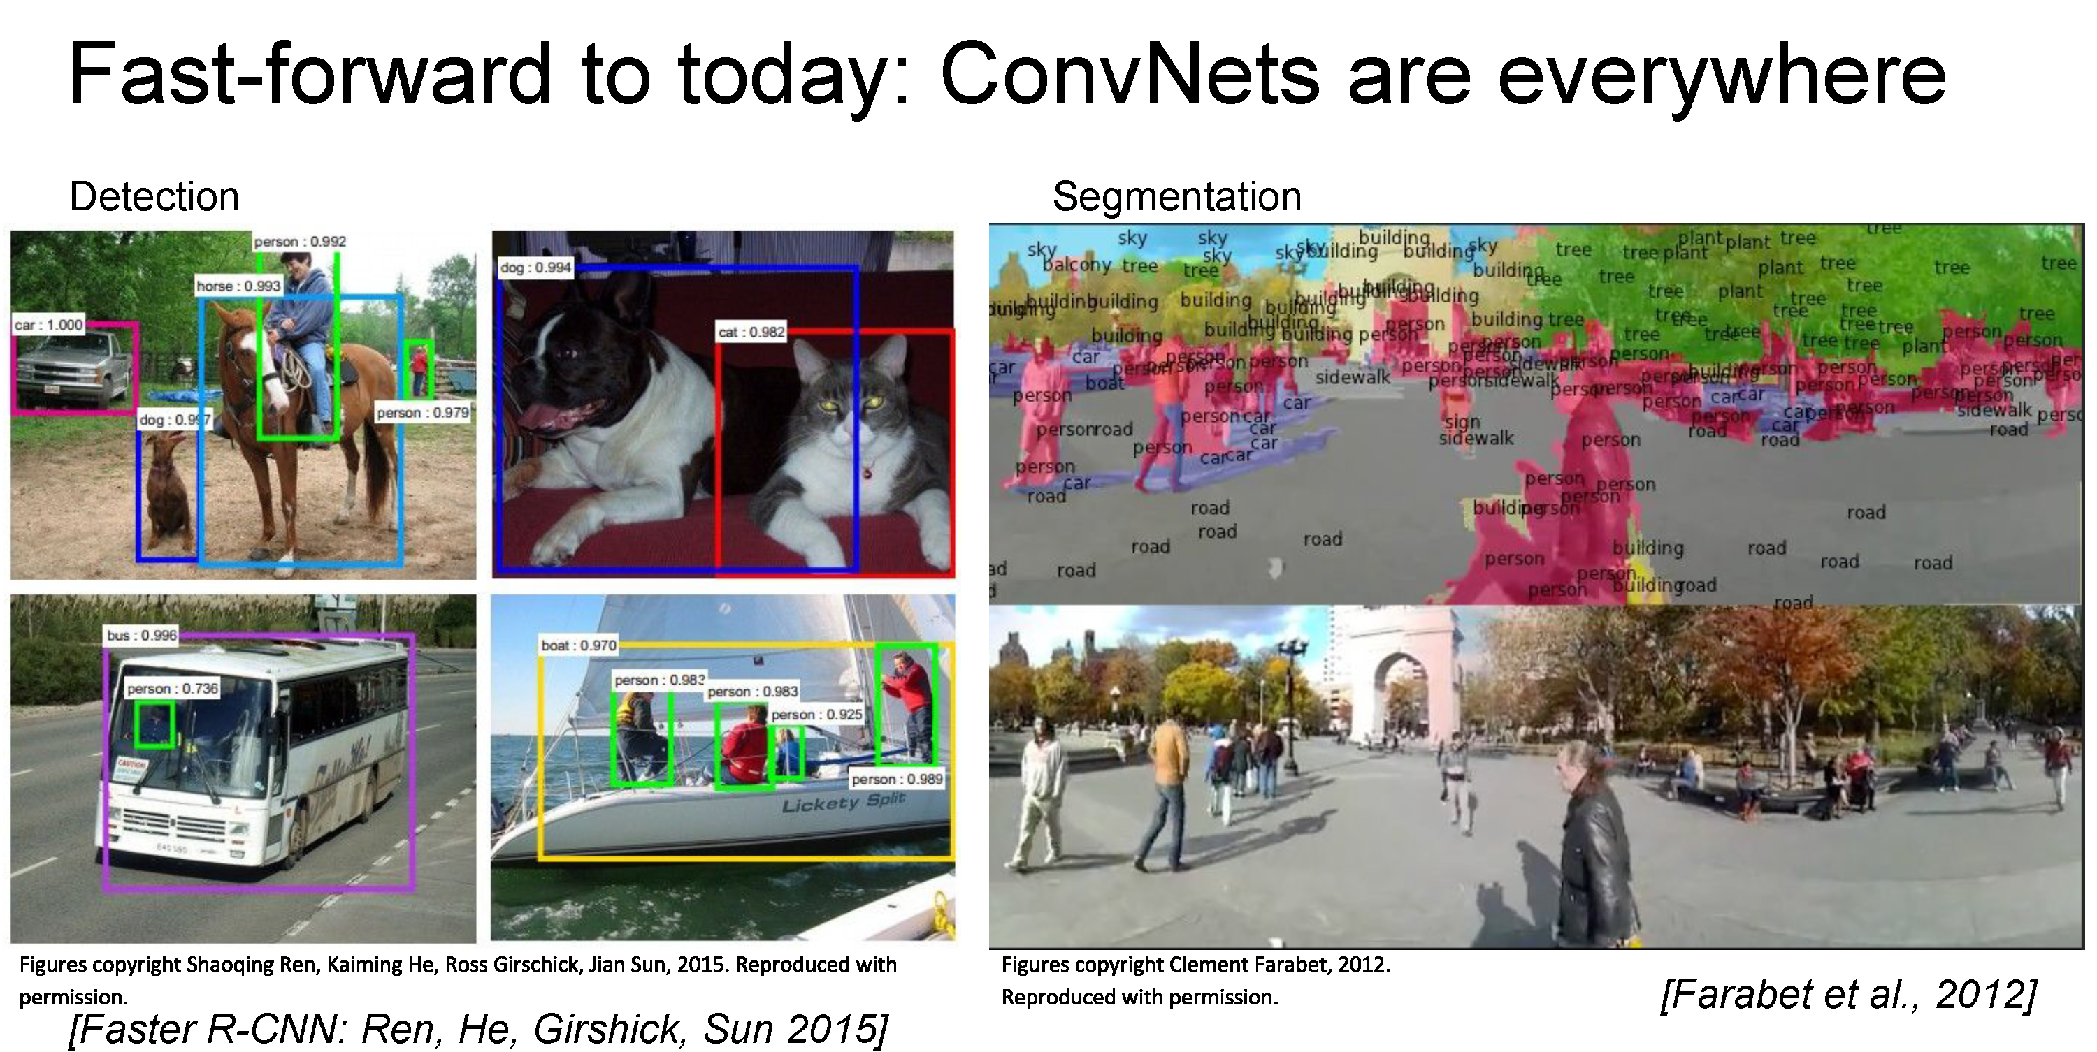

Slide 35
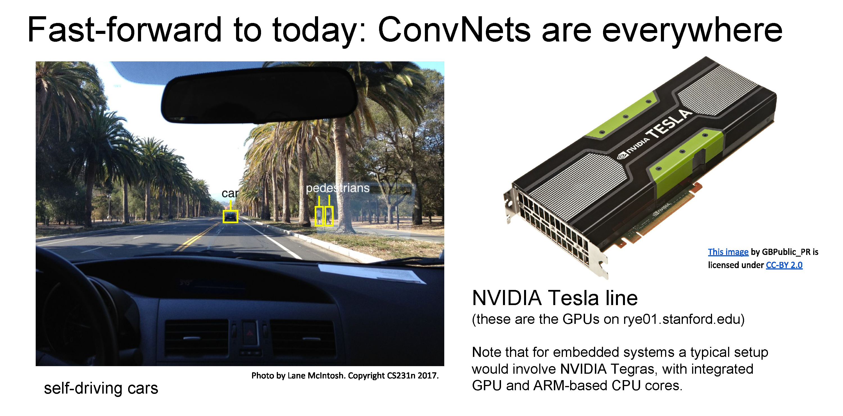

Slide 36
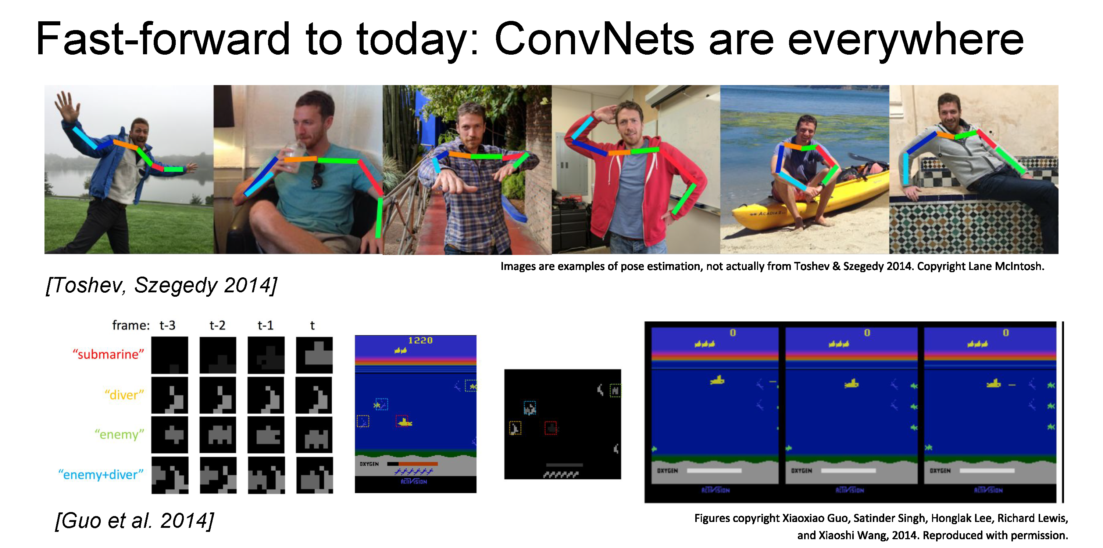

Slide 37
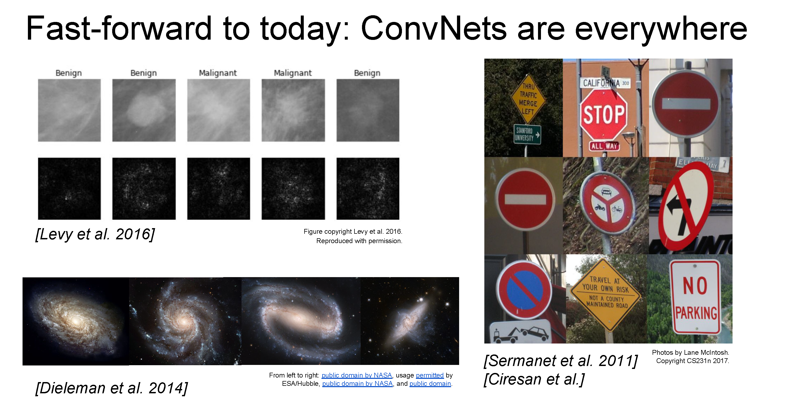

Slide 38
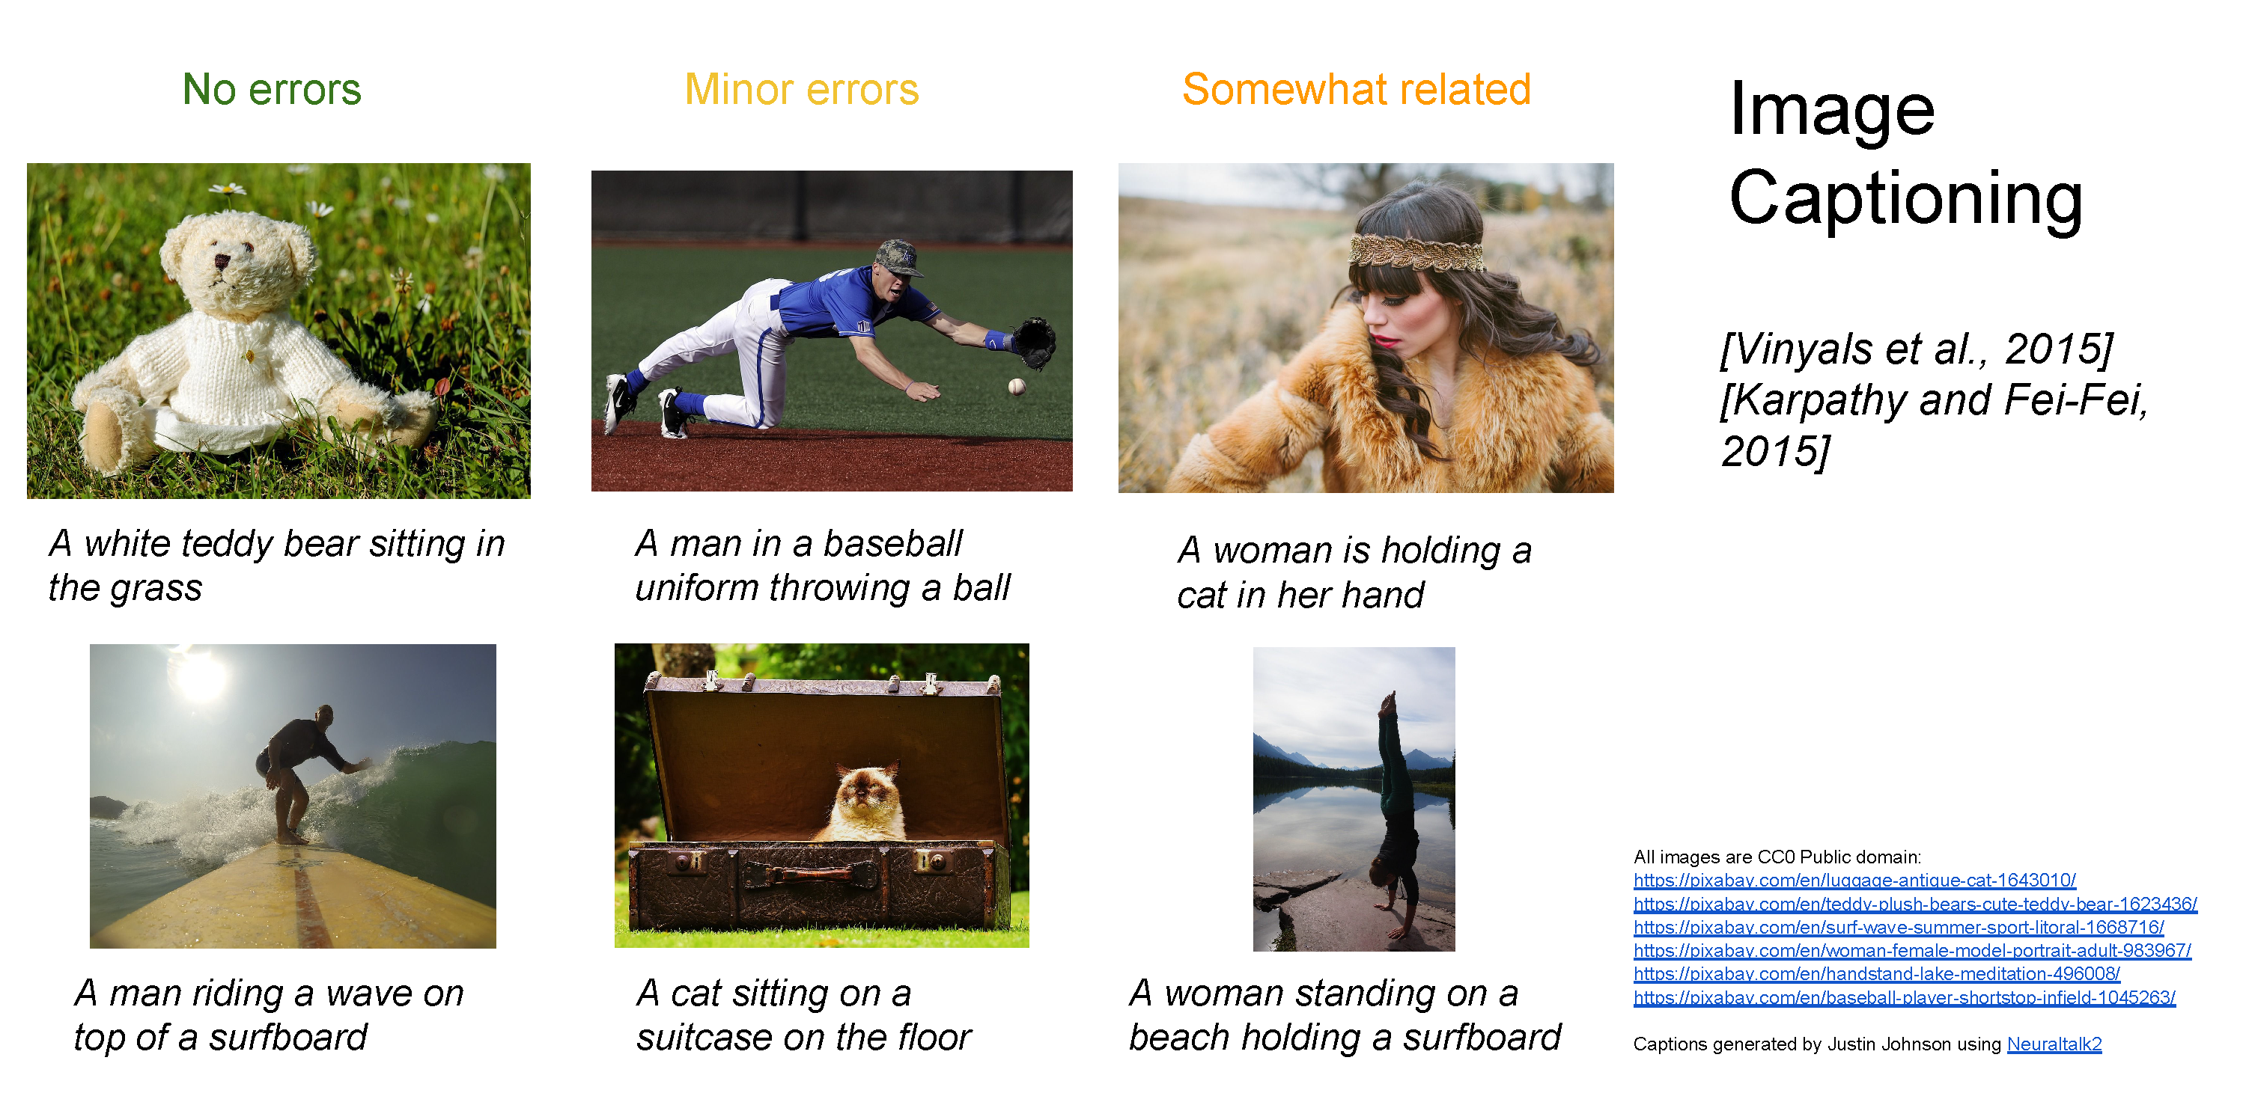

Slide 39

Caption-to-text
DALL·E: Creating Images from Text, OpenAI
https://openai.com/blog/dall-e/

Slide 40


Slide 41
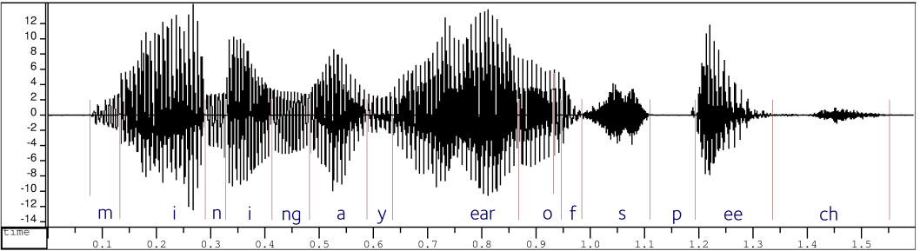

Convolutional neural networks
Version of deep neural networks designed for signals
  1D signals (e.g., speech waveforms)
  2D signals (e.g., images)

Slide 42
Motivation – Feature Learning

Slide 43
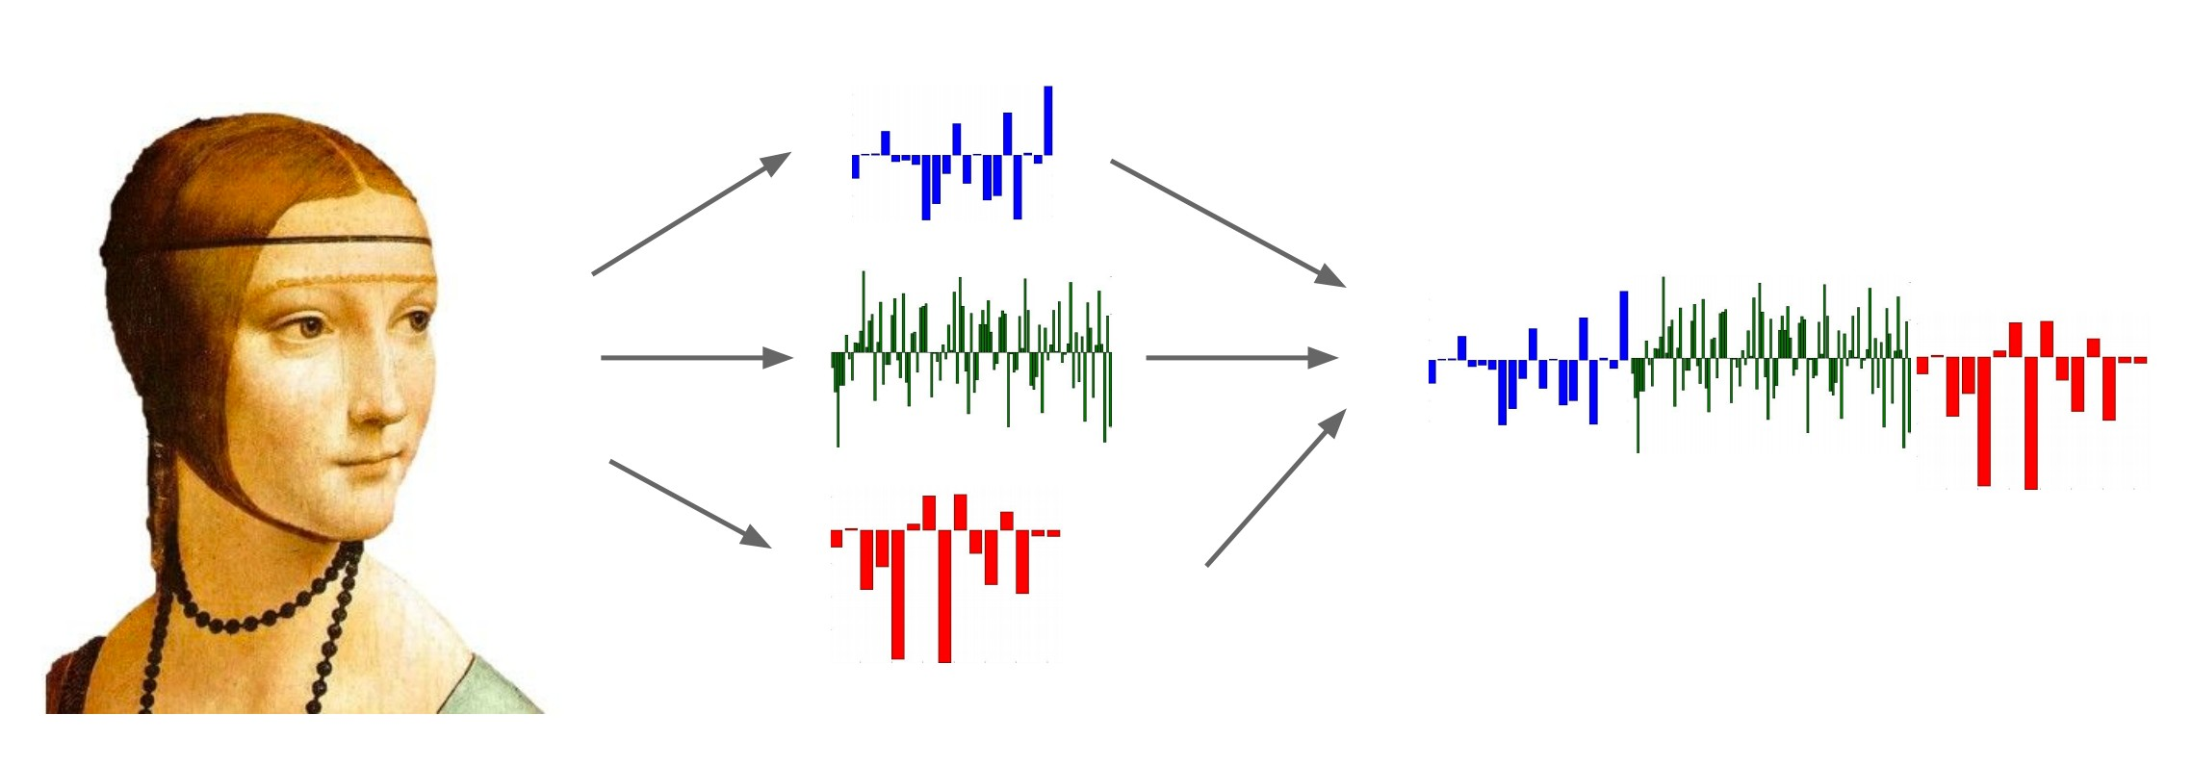
Life Before Deep Learning
SVM
Ans
Input Pixels
Extract Hand-Crafted Features
Concatenate into a vector x
Linear Classifier
Figure: Karpathy 2016

Slide 44
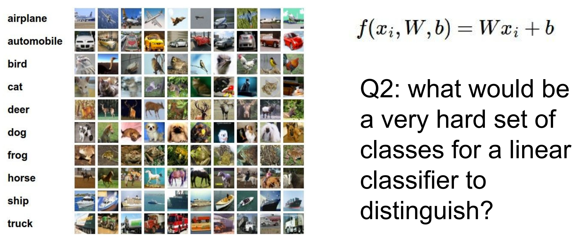
Why use features? Why not pixels?
Q: What would be a
very hard set of classes for a linear classifier to distinguish?
(assuming x = pixels)
Slide from Karpathy 2016

Slide 45
Linearly separable classes

Slide 46
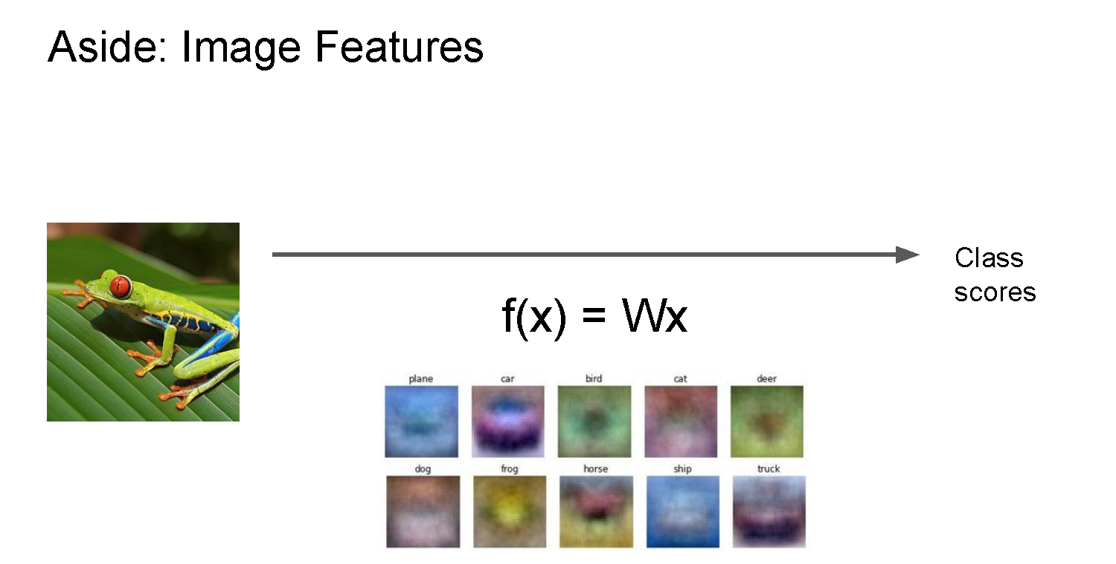

Slide 47
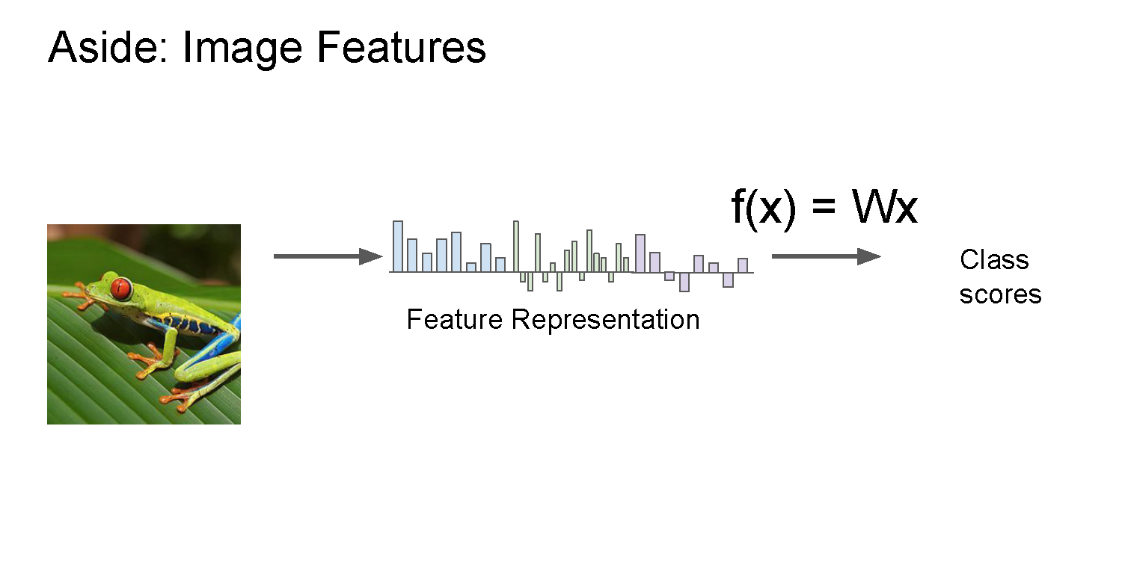

Slide 48
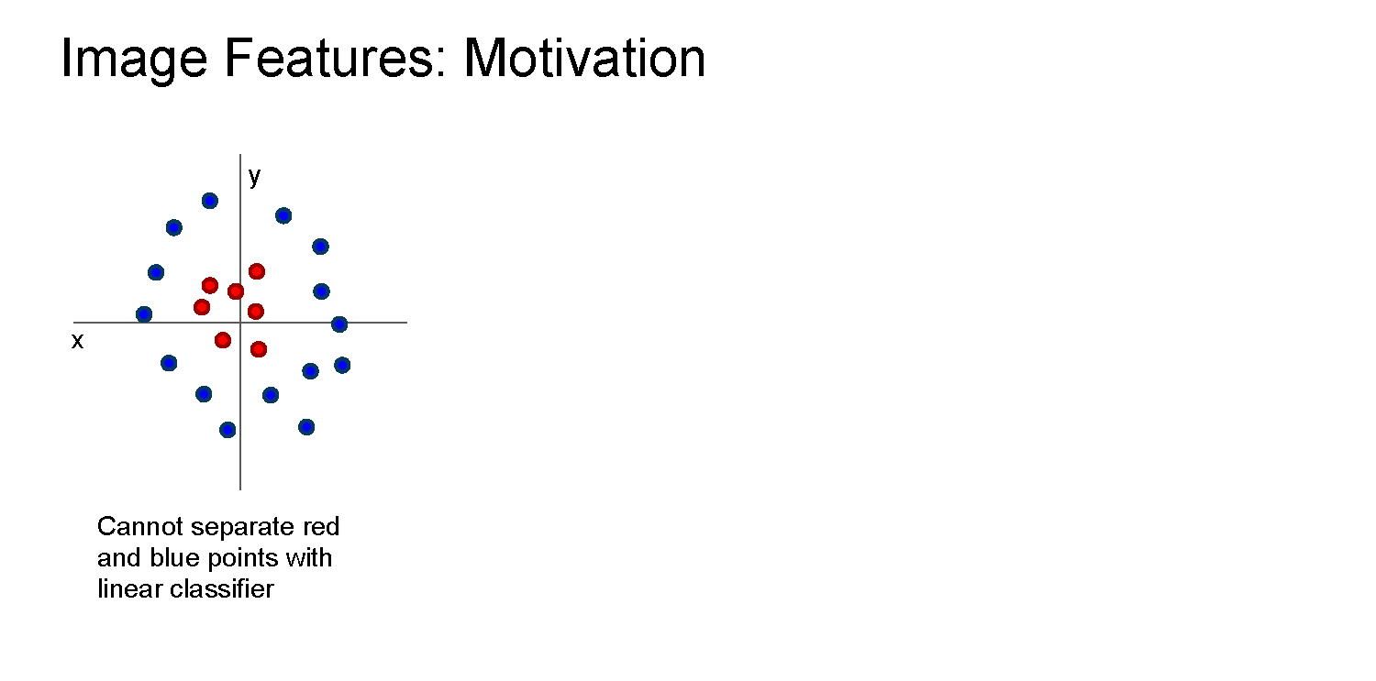

Slide 49
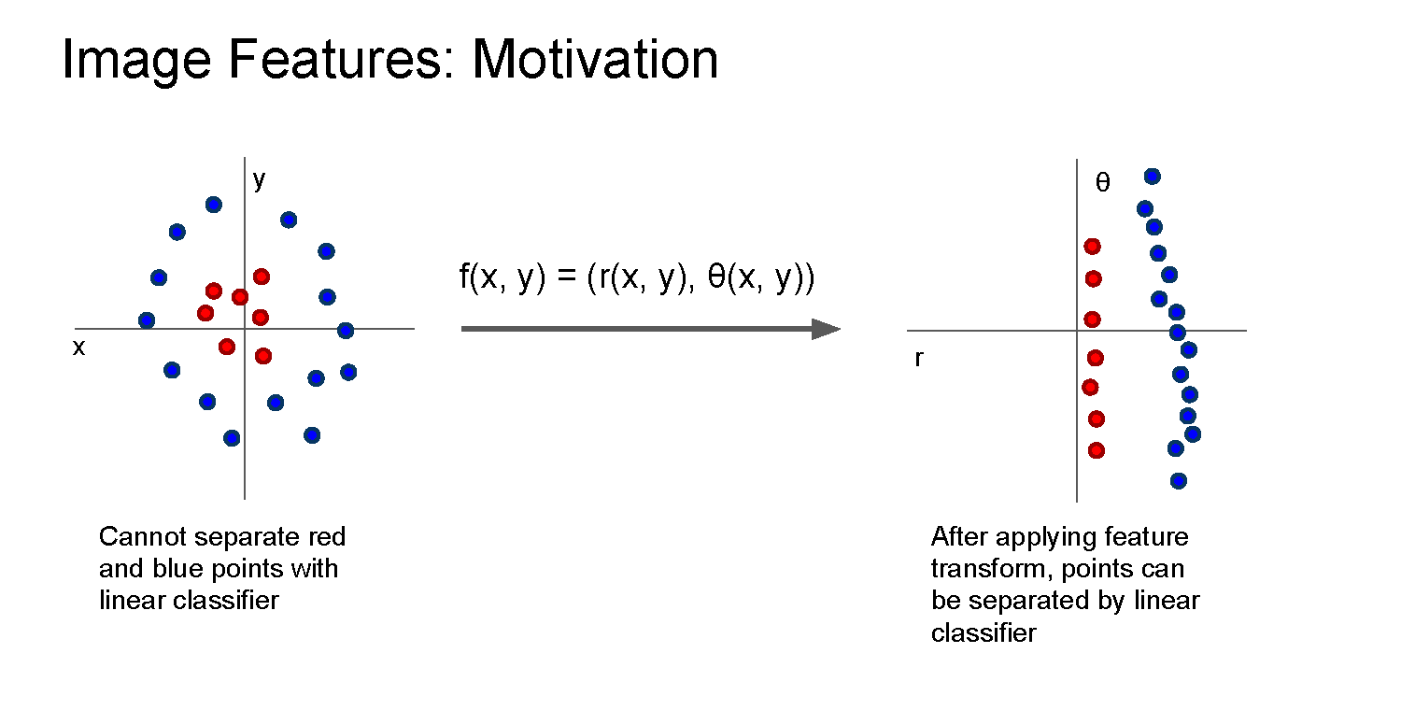

Slide 50
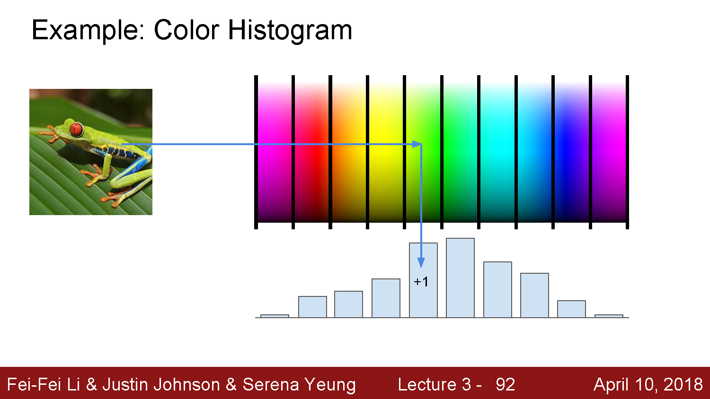

Slide 51
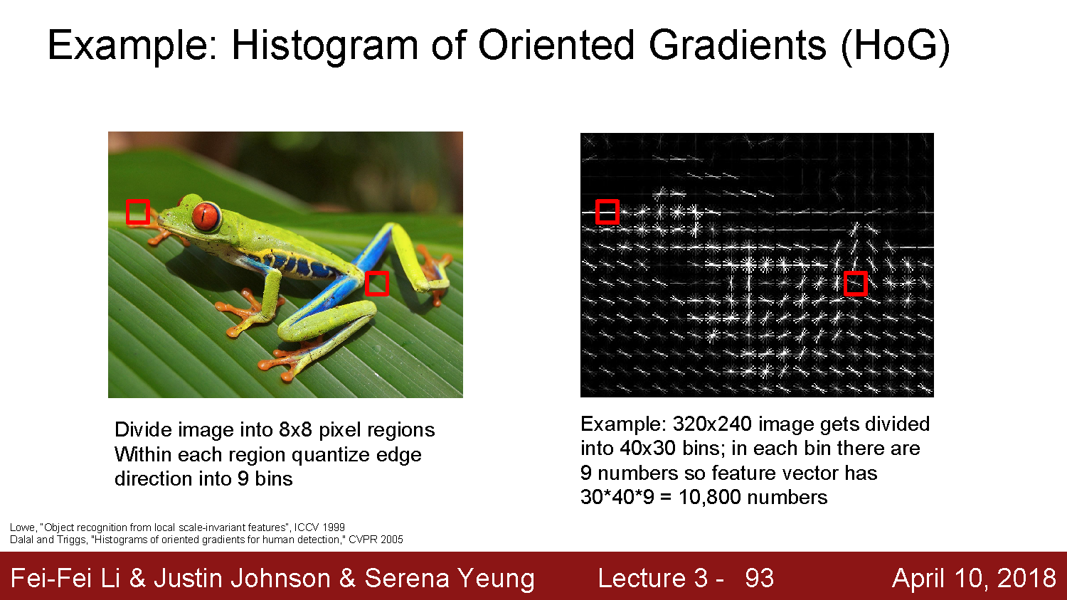

Slide 52
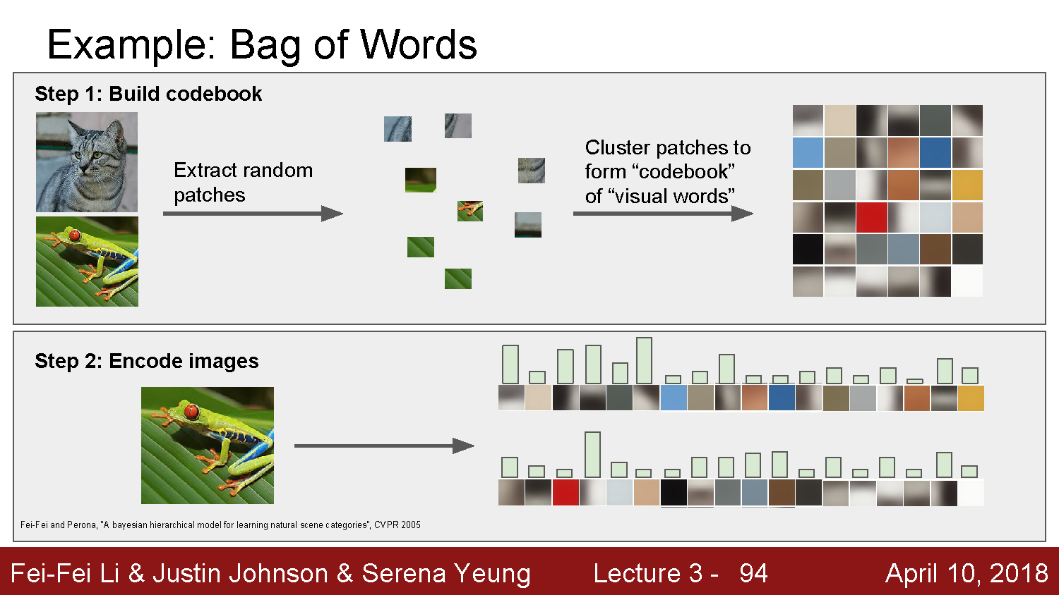

Slide 53
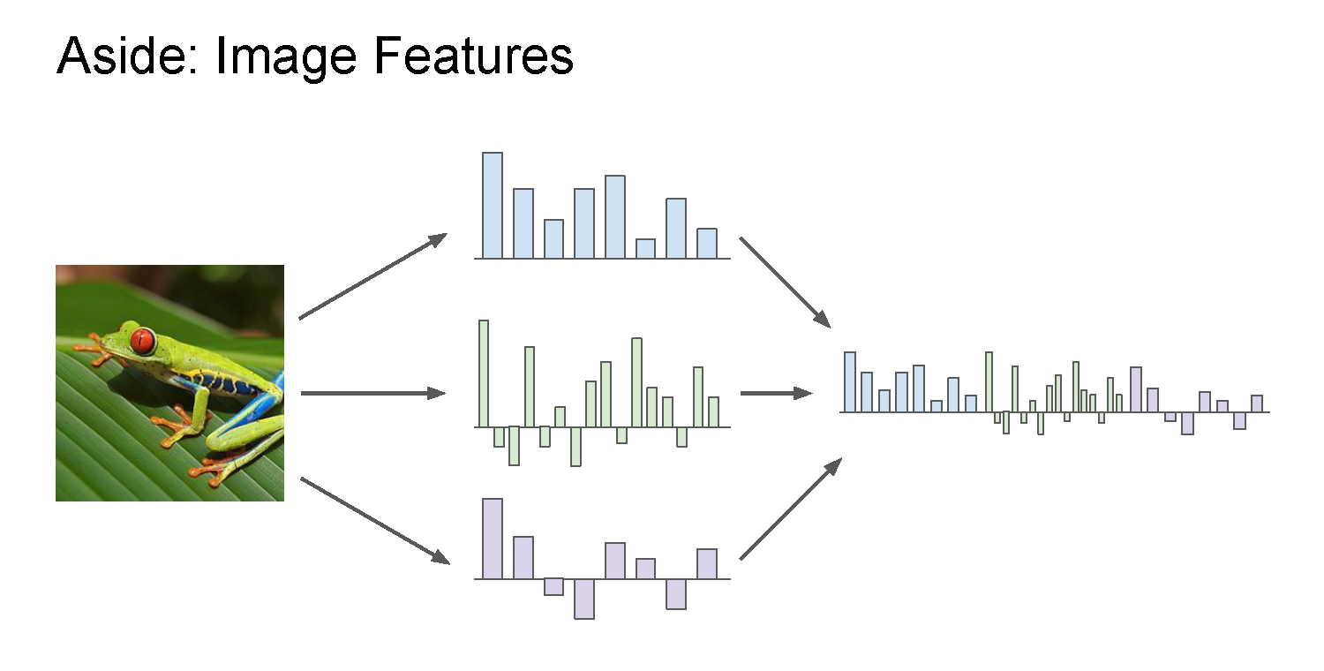

Slide 54
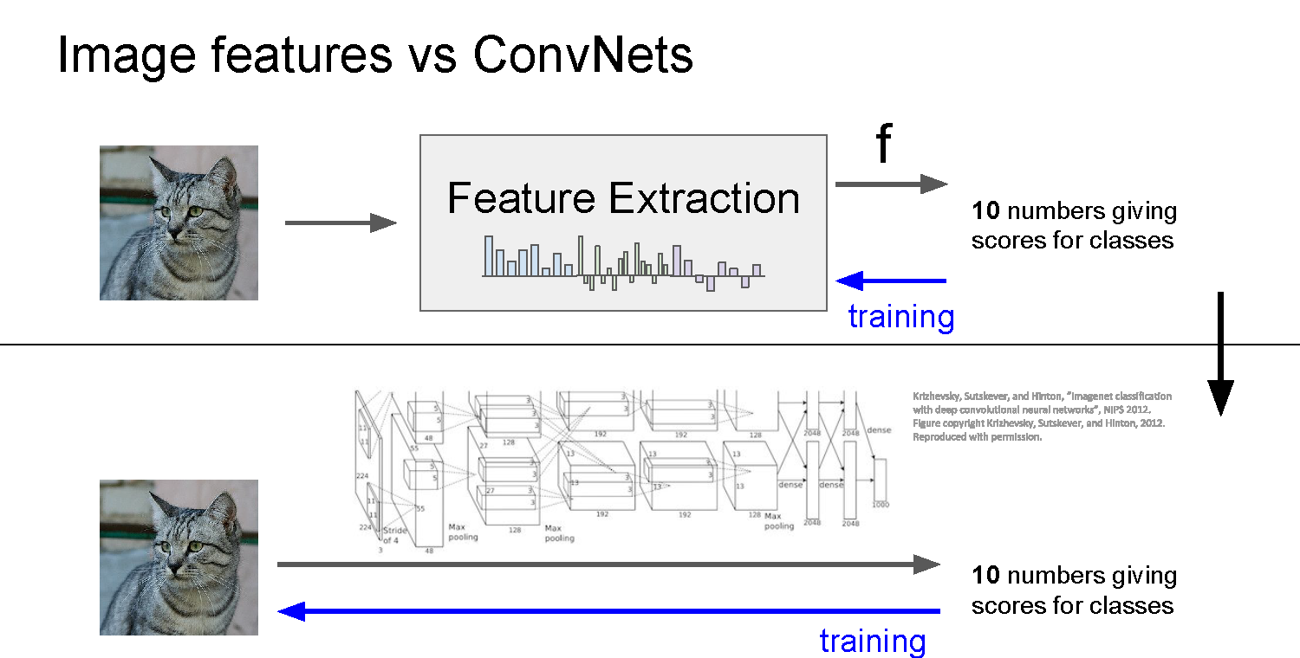

Slide 55
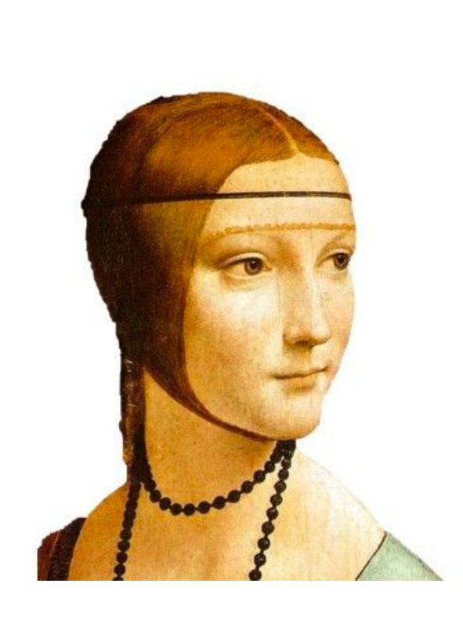
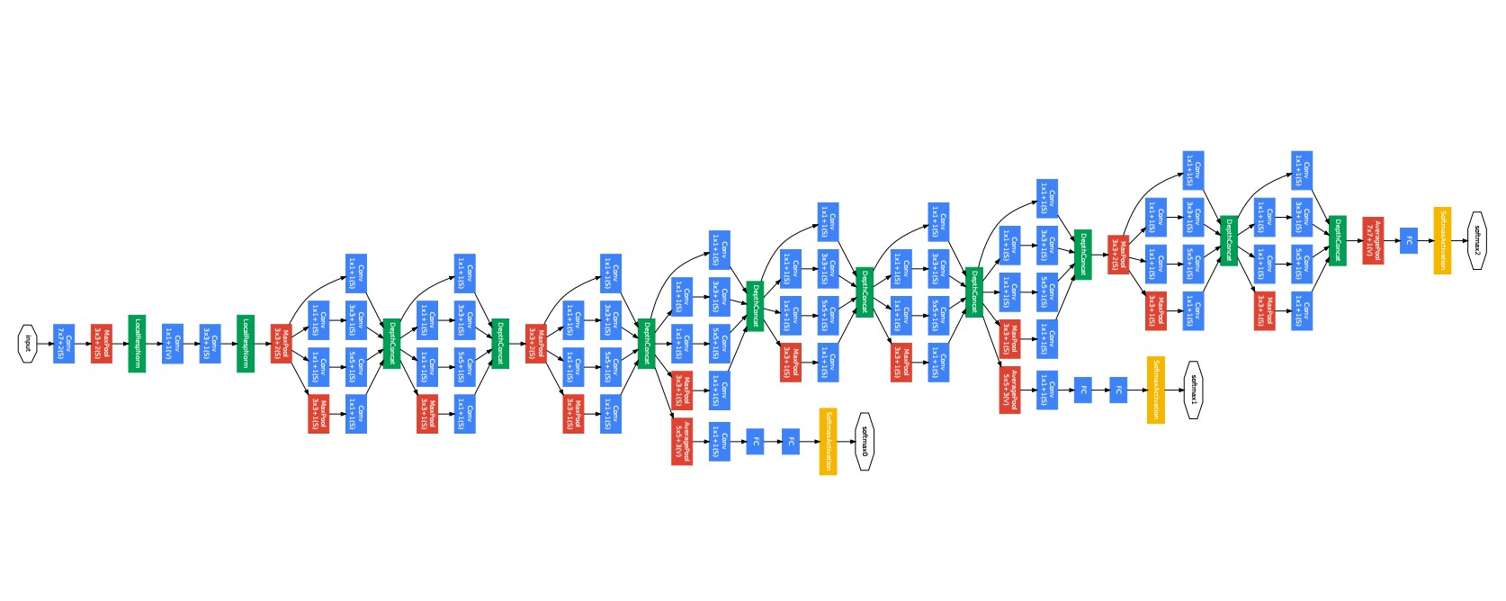
Last layer of most CNNs is a linear classifier
This piece is just a linear classifier
Ans
(GoogLeNet)
Input Pixels
Perform everything with a big neural network, trained end-to-end
Key: perform enough processing so that by the time you get to the end of the network, the classes are linearly separable

Slide 56
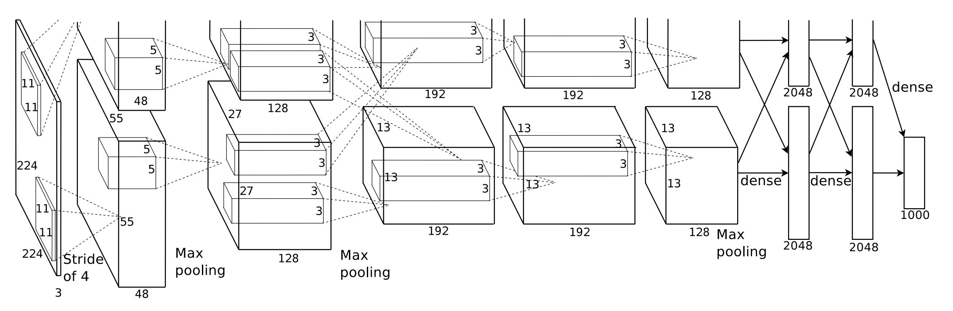
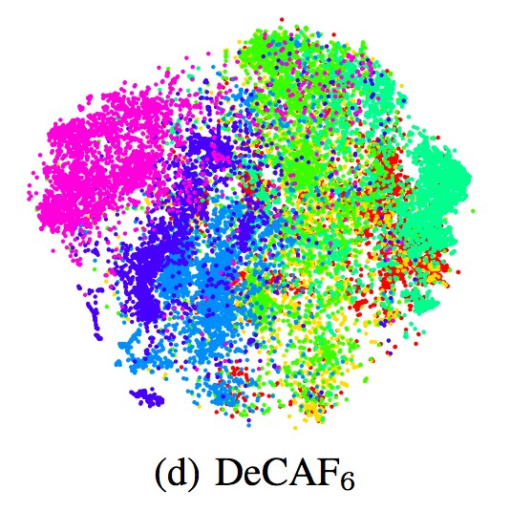


Visualizing AlexNet in 2D with t-SNE
Linear Classifier
(2D visualization using t-SNE)
[Donahue, “DeCAF: DeCAF: A Deep Convolutional …”, arXiv 2013]

Slide 57
Convolutional neural networks
Layer types:
  Fully-connected layer
  Convolutional layer
  Pooling layer

Slide 58


Slide 59
Same as a linear classifer!

Slide 60


Slide 61


Slide 62


Slide 63
Number of weights: 5 x 5 x 3 + 1 = 76
(vs. 3072 for a fully-connected layer)
(+1 for bias)

Slide 64


Slide 65


Slide 66


Slide 67

(total number of parameters: 6 x (75 + 1) = 456)

Slide 68


Slide 69


Slide 70


Slide 71


Slide 72


Slide 73


Slide 74


Slide 75


Slide 76


Slide 77


Slide 78


Slide 79


Slide 80


Slide 81


Slide 82


Slide 83


Slide 84


Slide 85


Slide 86


Slide 87


Slide 88


Slide 89


Slide 90


Slide 91


Slide 92


Slide 93


Slide 94


Slide 95
Convolutional layer—properties
Small number of parameters to learn compared to a fully connected layer
Preserves spatial structure—output of a convolutional layer is shaped like an image
Translation equivariant: passing a translated image through a convolutional layer is (almost) equivalent to translating the convolution output (but be careful of image boundaries)

Slide 96


Slide 97


Slide 98


Slide 99

https://cs.stanford.edu/people/karpathy/convnetjs/demo/cifar10.html

Slide 100


Slide 101

Next time: Backpropagation
This is the backwards pass. We compute it with backpropagation

Slide 102
AlexNet

Slide 103


Slide 104
Big picture
A convolutional neural network can be thought of as a function from images to class scores
  With millions of adjustable weights…
  … leading to a very non-linear mapping from images to features / class scores.
  We will set these weights based on classification accuracy on training data…
  … and hopefully our network will generalize to new images at test time

Slide 105
Data is key—enter ImageNet
ImageNet (and the ImageNet Large-Scale Visual Recognition Challege, aka ILSVRC) has been key to training deep learning methods
  J. Deng, W. Dong, R. Socher, L.-J. Li, K. Li and L. Fei-Fei, ImageNet: A Large-Scale Hierarchical Image Database. CVPR, 2009.
ILSVRC: 1,000 object categories, each with ~700-1300 training images. Test set has 100 images per categories (100,000 total).
Standard ILSVRC error metric: top-5 error
  if the correct answer for a given test image is in the top 5 categories, your answer is judged to be correct

Slide 106

Performance improvements on ILSVRC
ImageNet Large-Scale Visual Recognition Challenge
Held from 2011-2017
1000 categories, 1000 training images per category
Test performance on held-out test set of images
Pre-deep learning era
{
Deep learning era
AlexNet

Slide 107

Image credit: Zaid Alyafeai, Lahouari Ghouti

Slide 108
Questions?

