Slide 1
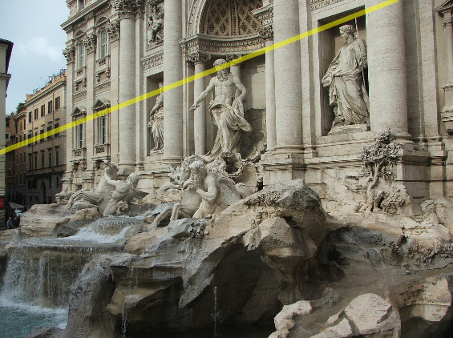
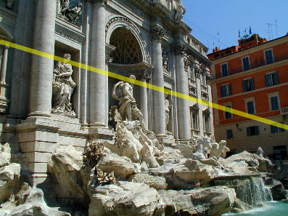
Two-view geometry
CS5670: Computer Vision

Slide 2
Reading
Reading: Szeliski 1st Edition, Ch. 7.2

Slide 3
Fundamental matrix song
http://danielwedge.com/fmatrix/

Slide 4
Announcements
Project 4 (Stereo) released today, due 4/20 by 7pm
  To be done in groups of 2
Two more topics on geometry, then on to recognition and deep learning
Please enter any midterm regrade requests by this Wednesday
Questions? sli.do, enter code #cs5670

Slide 5
Project 4 Demo

Slide 6
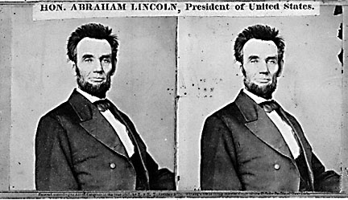
Back to stereo
Where do epipolar lines come from?

Slide 7




Two-view geometry
Where do epipolar lines come from?
3D point lies somewhere along r
epipolar line
epipolar line
(projection of r)
epipolar plane
0
Image 1
Image 2

Slide 8

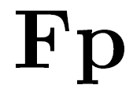
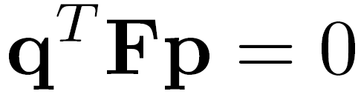
Fundamental matrix
epipolar line
epipolar line
(projection of ray)
epipolar plane
0
Image 1
Image 2
This epipolar geometry of two views is described by a Very Special 3x3 matrix , called the fundamental matrix
maps (homogeneous) points in image 1 to lines in image 2!
The epipolar line (in image 2) of point p is:
Epipolar constraint on corresponding points:

Slide 9


Fundamental matrix
epipolar line
epipolar line
(projection of ray)
epipolar plane
0
Two Special points: e₁ and e₂ (the epipoles): projection of one camera into the other

Slide 10
Fundamental matrix
0
Two Special points: e₁ and e₂ (the epipoles): projection of one camera into the other
All of the epipolar lines in an image pass through the epipole
Epipoles may or may not be inside the image

Slide 11
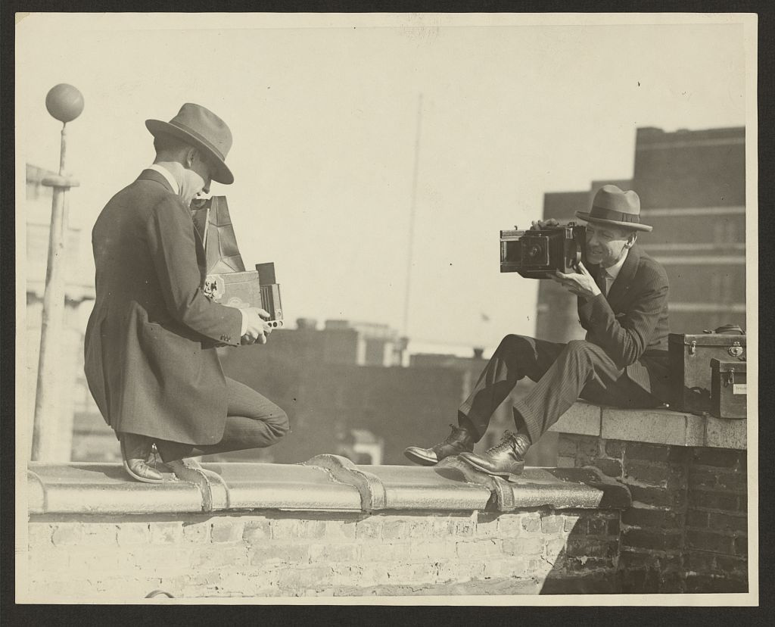
Epipoles

Slide 12

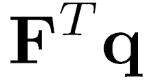
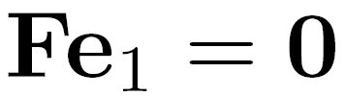
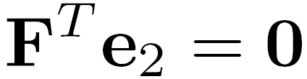
Properties of the Fundamental Matrix
is the epipolar line associated with
is the epipolar line associated with
and
is rank 2
How many parameters does have?
T

Slide 13
Example

Slide 14
Demo

Slide 15
Fundamental matrix
0
Why does F exist?
Let’s derive it…

Slide 16

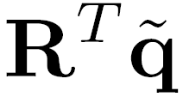

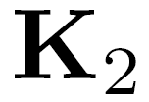

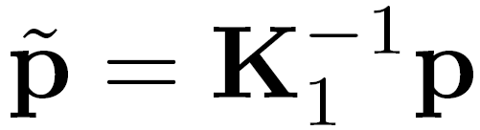
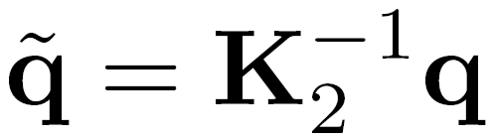
Fundamental matrix – calibrated case
0
: intrinsics of camera 1
: intrinsics of camera 2
: rotation of image 2 w.r.t. camera 1
: ray through p in camera 1’s (and world) coordinate system
: ray through q in camera 2’s coordinate system

Slide 17

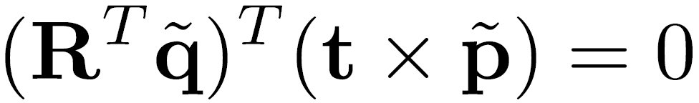
Fundamental matrix – calibrated case
0
, , and are coplanar
epipolar plane can be represented as with its normal

Slide 18
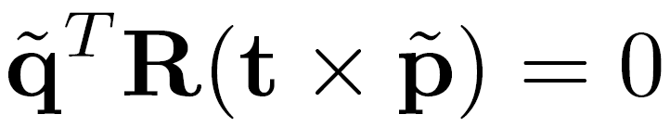
Fundamental matrix – calibrated case
0

Slide 19
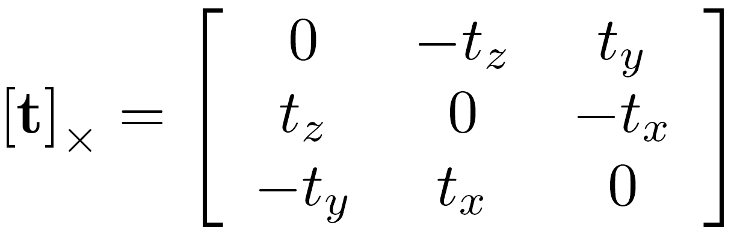
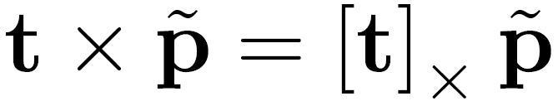
Fundamental matrix – calibrated case
0
One more substitution:
  Cross product with t (on left) can be represented as a 3x3 matrix

Slide 20
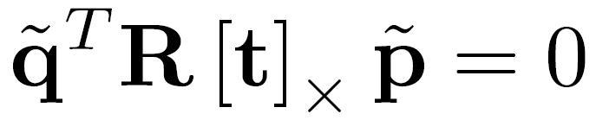
Fundamental matrix – calibrated case
0

Slide 21
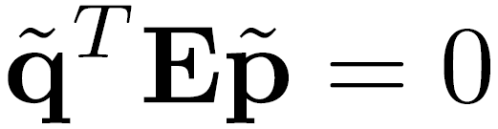

Fundamental matrix – calibrated case
0
: ray through p in camera 1’s (and world) coordinate system
: ray through q in camera 2’s coordinate system
{
the Essential matrix

Slide 22
Cross-product as linear operator
  Useful fact: Cross product with a vector t can be represented as multiplication with a (skew-symmetric) 3x3 matrix

Slide 23
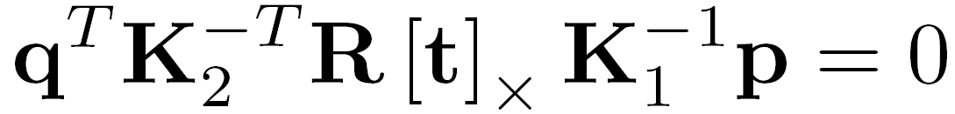

Fundamental matrix – uncalibrated case
0
: intrinsics of camera 1
: intrinsics of camera 2
: rotation of image 2 w.r.t. camera 1
the Fundamental matrix

Slide 24
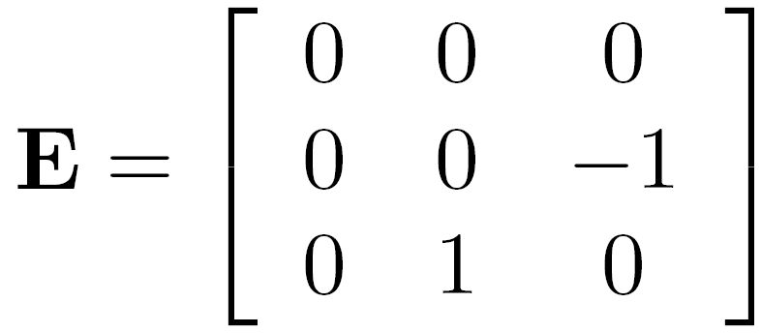
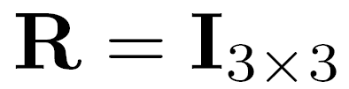
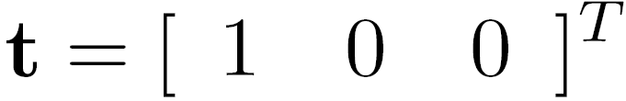
Rectified case

Slide 25
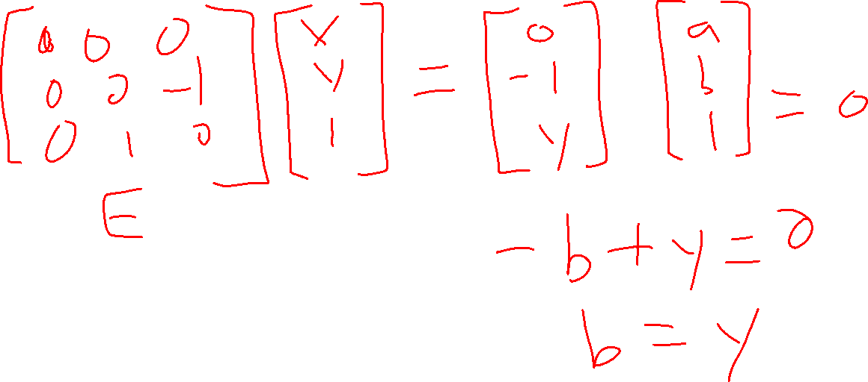

Slide 26
Stereo image rectification
reproject image planes onto a common plane
  plane parallel to the line between optical centers
pixel motion is horizontal after this transformation
two homographies, one for each input image reprojection
  C. Loop and Z. Zhang. Computing Rectifying Homographies for Stereo Vision. CVPR 1999.

Slide 27
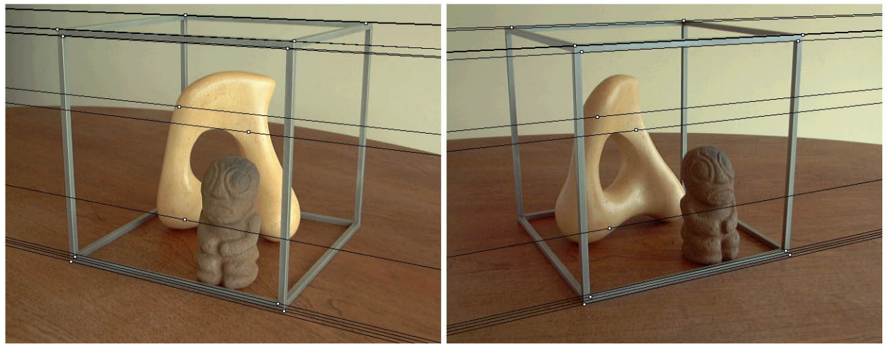
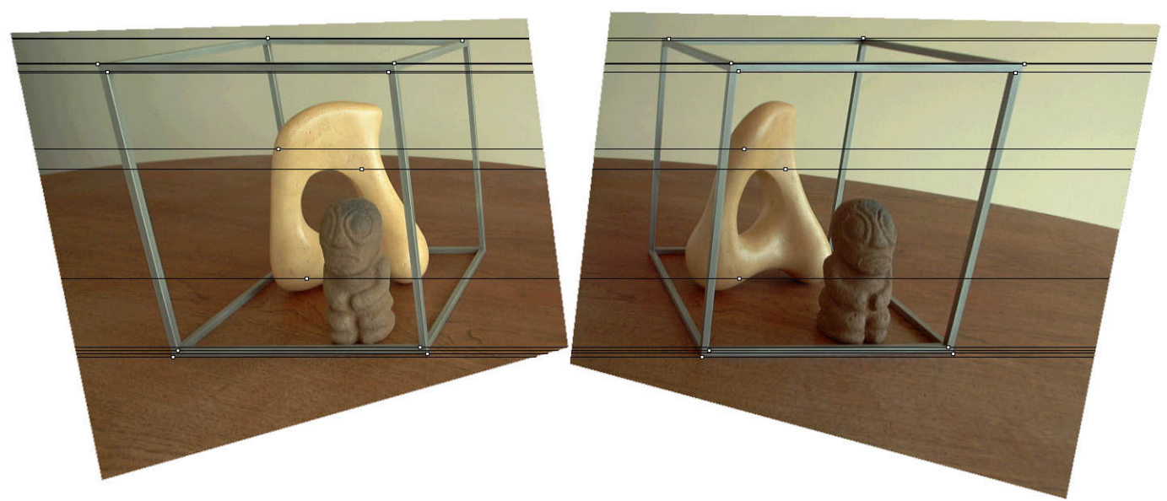
Original stereo pair
After rectification

Slide 28
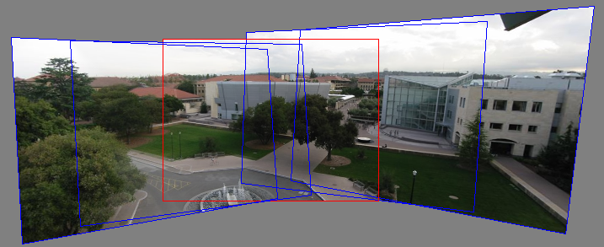


Relationship between F matrix and homography?
Images taken from the same center of projection? Use a homography!

Slide 29
Questions?

Slide 30


Estimating F
If we don’t know K₁, K₂, R, or t, can we estimate F for two images?
Yes, given enough correspondences

Slide 31
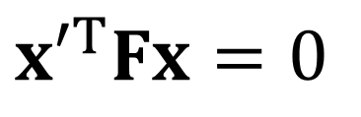

Estimating F – 8-point algorithm
The fundamental matrix F is defined by
$$x′^{Τ}Fx=0$$
for any pair of matches x and x’ in two images.
$$F=\left[\begin{matrix}f_{11} & f_{12} & f_{13} \\ f_{21} & f_{22} & f_{23} \\ f_{31} & f_{32} & f_{33}\end{matrix}\right]$$
Let x=(u,v,1)^{T} and x’=(u’,v’,1)^{T},
each match gives a linear equation
$$uu′f_{11}+vu′f_{12}+u′f_{13}+uv′f_{21}+vv′f_{22}+v′f_{23}+uf_{31}+vf_{32}+f_{33}=0$$

Slide 32
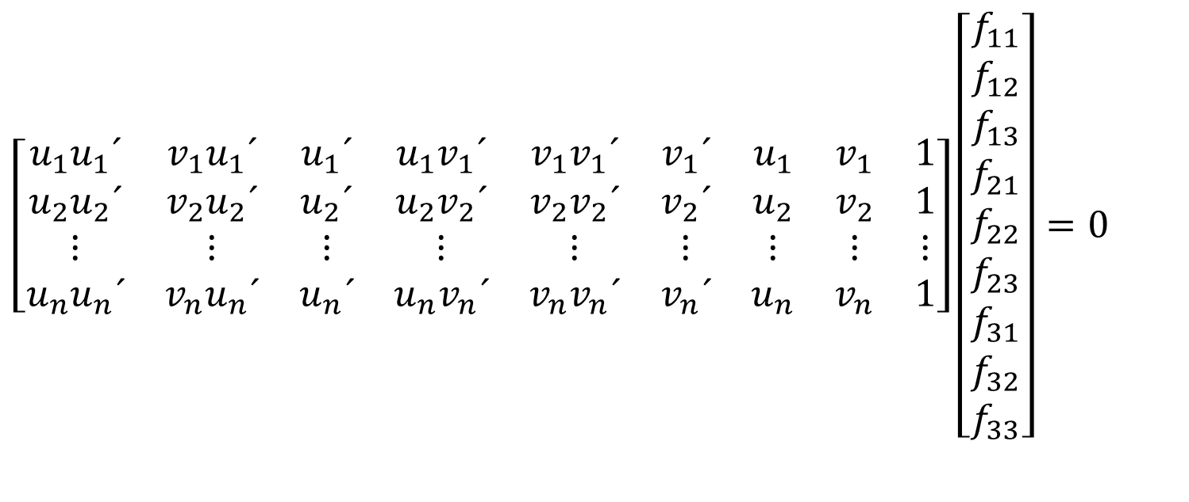



8-point algorithm
$$\left[\begin{matrix}u_{1}u_{1}´ & v_{1}u_{1}´ & u_{1}´ & u_{1}v_{1}´ & v_{1}v_{1}´ & v_{1}´ & u_{1} & v_{1} & 1 \\ u_{2}u_{2}´ & v_{2}u_{2}´ & u_{2}´ & u_{2}v_{2}´ & v_{2}v_{2}´ & v_{2}´ & u_{2} & v_{2} & 1 \\ ⋮ & ⋮ & ⋮ & ⋮ & ⋮ & ⋮ & ⋮ & ⋮ & ⋮ \\ u_{n}u_{n}´ & v_{n}u_{n}´ & u_{n}´ & u_{n}v_{n}´ & v_{n}v_{n}´ & v_{n}´ & u_{n} & v_{n} & 1\end{matrix}\right]\left[\begin{matrix}f_{11} \\ f_{12} \\ f_{13} \\ f_{21} \\ f_{22} \\ f_{23} \\ f_{31} \\ f_{32} \\ f_{33}\end{matrix}\right]=0$$
Like with homographies, instead of solving , we seek f to minimize , least eigenvector of .
$$Af=0$$
$$\left\|Af\right\|$$
$$A^{Τ}A$$

Slide 33





8-point algorithm – Problem?
F should have rank 2
To enforce that F is of rank 2, F is replaced by F’ that minimizes subject to the rank constraint.
$$\left\|F−F′\right\|$$
This is achieved by SVD. Let , where
, let
then is the solution (closest rank-2 matrix to F)
$$F=UΣV^{Τ}$$
$$Σ=\left[\begin{matrix}σ_{1} & 0 & 0 \\ 0 & σ_{2} & 0 \\ 0 & 0 & σ_{3}\end{matrix}\right]$$
$$\text{Σ}\text{′}=\left[\begin{matrix}σ_{1} & 0 & 0 \\ 0 & σ_{2} & 0 \\ 0 & 0 & 0\end{matrix}\right]$$
$$F′=U\text{Σ}\text{′}V^{Τ}$$

Slide 34
8-point algorithm
% Build the constraint matrix
A = [x2(1,:)'.*x1(1,:)' x2(1,:)'.*x1(2,:)' x2(1,:)' ...
x2(2,:)'.*x1(1,:)' x2(2,:)'.*x1(2,:)' x2(2,:)' ...
x1(1,:)' x1(2,:)' ones(npts,1) ];
[U,D,V] = svd(A);
% Extract fundamental matrix from the column of V
% corresponding to the smallest singular value.
F = reshape(V(:,9),3,3)';
% Enforce rank2 constraint
[U,D,V] = svd(F);
F = U*diag([D(1,1) D(2,2) 0])*V';

Slide 35
8-point algorithm
Pros: linear, easy to implement and fast
Cons: susceptible to noise

Slide 36

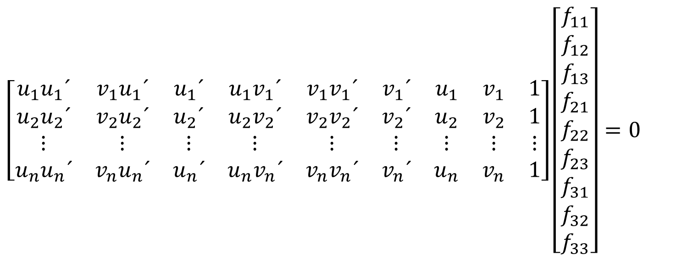
Problem with 8-point algorithm
$$\left[\begin{matrix}u_{1}u_{1}´ & v_{1}u_{1}´ & u_{1}´ & u_{1}v_{1}´ & v_{1}v_{1}´ & v_{1}´ & u_{1} & v_{1} & 1 \\ u_{2}u_{2}´ & v_{2}u_{2}´ & u_{2}´ & u_{2}v_{2}´ & v_{2}v_{2}´ & v_{2}´ & u_{2} & v_{2} & 1 \\ ⋮ & ⋮ & ⋮ & ⋮ & ⋮ & ⋮ & ⋮ & ⋮ & ⋮ \\ u_{n}u_{n}´ & v_{n}u_{n}´ & u_{n}´ & u_{n}v_{n}´ & v_{n}v_{n}´ & v_{n}´ & u_{n} & v_{n} & 1\end{matrix}\right]\left[\begin{matrix}f_{11} \\ f_{12} \\ f_{13} \\ f_{21} \\ f_{22} \\ f_{23} \\ f_{31} \\ f_{32} \\ f_{33}\end{matrix}\right]=0$$
~10000
~10000
~100
~10000
~10000
~100
~100
~100
1
Orders of magnitude difference
between column of data matrix
→ least-squares yields poor results

Slide 37

Normalized 8-point algorithm
normalized least squares yields good results
Transform image to ~[-1,1]x[-1,1]
(0,500)
(700,500)
(-1,1)
(1,1)
$$\left[\begin{matrix}\frac{2}{700} & 0 & −1 \\ & \frac{2}{500} & −1 \\ & & 1\end{matrix}\right]$$
(0,0)
(0,0)
(700,0)
(-1,-1)
(1,-1)

Slide 38
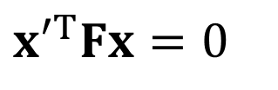






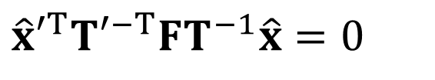
Normalized 8-point algorithm
Transform input by ,
Call 8-point on to obtain
$${\hat{x}}_{i}=Tx_{i}$$
$${\hat{x}}_{i}^{′}=Tx_{i}^{′}$$
$${\hat{x}}_{i},{\hat{x}}_{i}^{′}$$
$$\hat{F}$$
$$F=T′^{Τ}\hat{F}T$$
$$x′^{Τ}Fx=0$$
$$\hat{x}′^{Τ}T′^{−Τ}FT^{−1}\hat{x}=0$$
$$\hat{F}$$

Slide 39
Normalized 8-point algorithm
[x1, T1] = normalise2dpts(x1);
[x2, T2] = normalise2dpts(x2);
A = [x2(1,:)'.*x1(1,:)' x2(1,:)'.*x1(2,:)' x2(1,:)' ...
x2(2,:)'.*x1(1,:)' x2(2,:)'.*x1(2,:)' x2(2,:)' ...
x1(1,:)' x1(2,:)' ones(npts,1) ];
[U,D,V] = svd(A);
F = reshape(V(:,9),3,3)';
[U,D,V] = svd(F);
F = U*diag([D(1,1) D(2,2) 0])*V';
% Denormalise
F = T2'*F*T1;

Slide 40
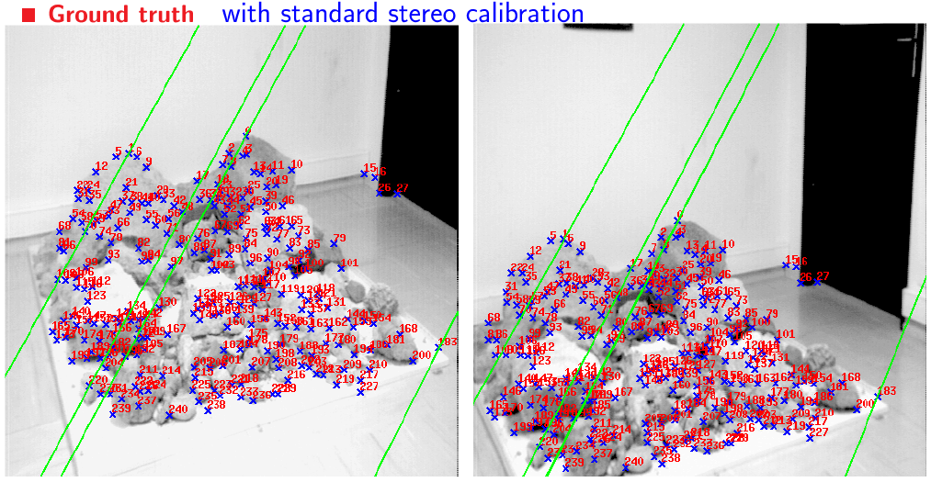
Results (ground truth)

Slide 41
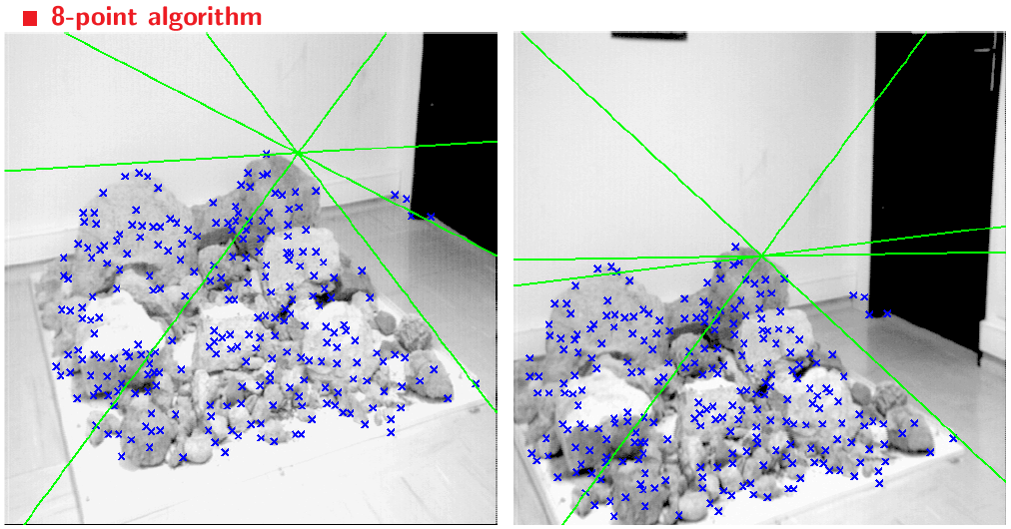
Results (ground truth)

Slide 42
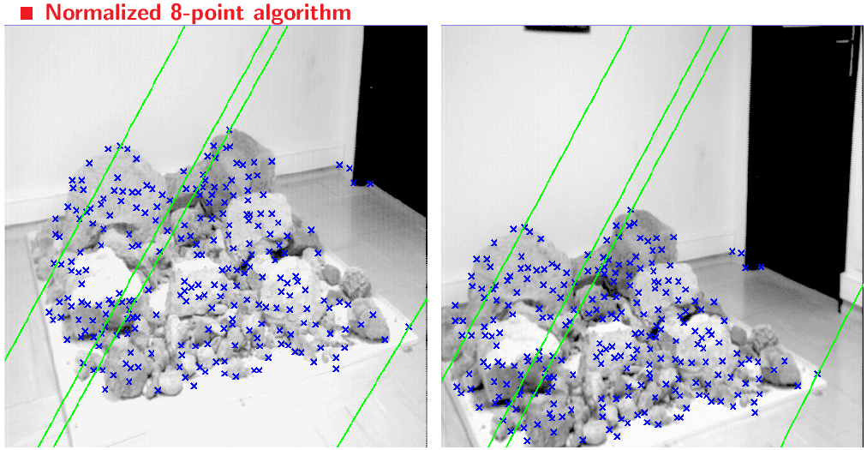
Results (normalized 8-point algorithm)

Slide 43
What about more than two views?
The geometry of three views is described by a 3 x 3 x 3 tensor called the trifocal tensor
The geometry of four views is described by a 3 x 3 x 3 x 3 tensor called the quadrifocal tensor
After this it starts to get complicated…

Slide 44
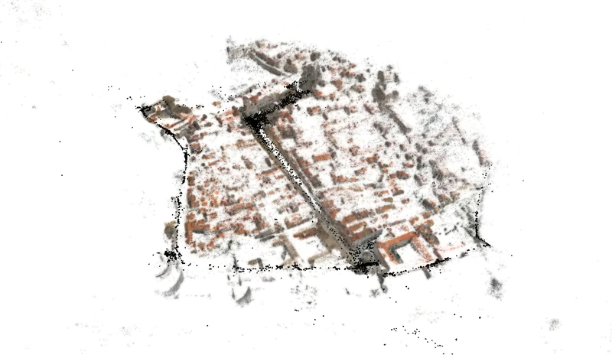
Large-scale structure from motion
Dubrovnik, Croatia. 4,619 images (out of an initial 57,845).
Total reconstruction time: 23 hours
Number of cores: 352

Slide 45
Questions?

